Slide 1
Using EEMD on EEG
Farhan Rahman

Slide 2
EEMD Method
Parameters used:
aim =8; % numbers of IMF
NR =10; % value of ensemble
Nstd = 0.3; % parameter to white noise
imf=eemd_e(y,aim,NR,Nstd);

Slide 3
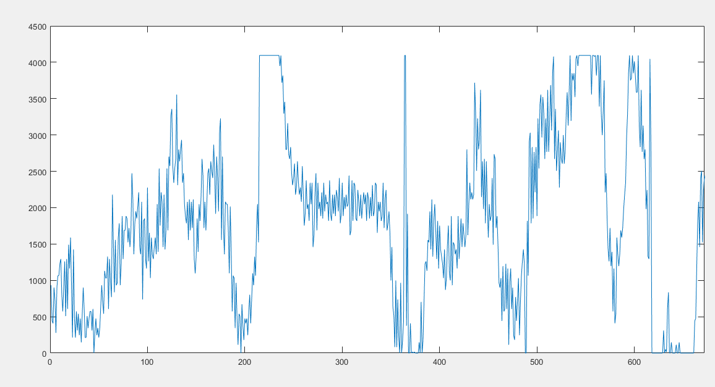
Original Signal
Plot has been obtained for 672 data points over a period of 5 seconds with the sampling frequency 128Hz.

Slide 4
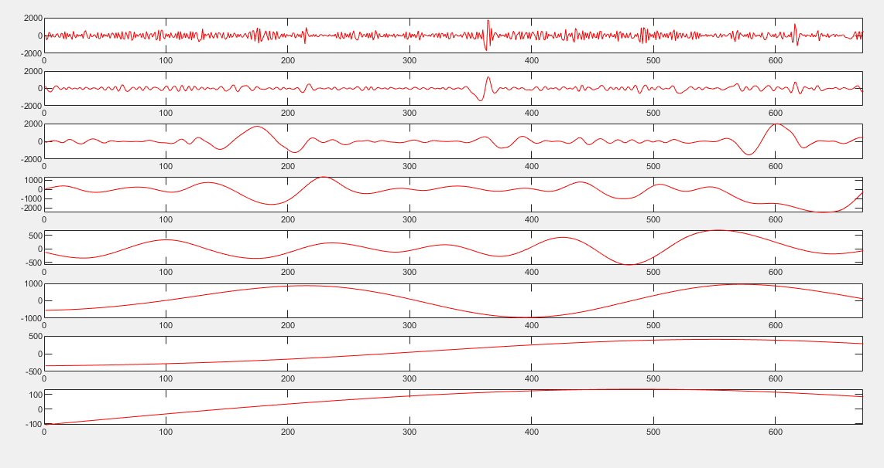
IMF plot for the original signal
Plot for 8 IMF values

Slide 5
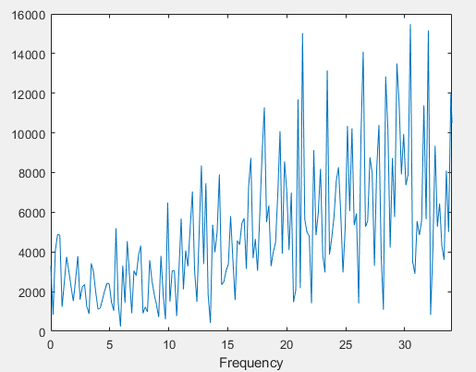
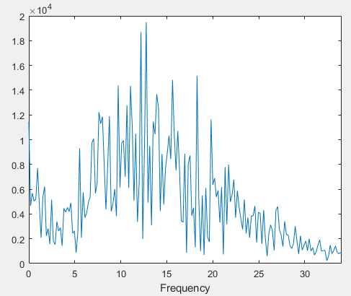
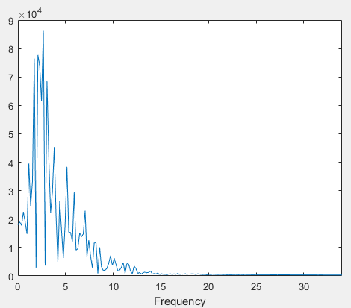
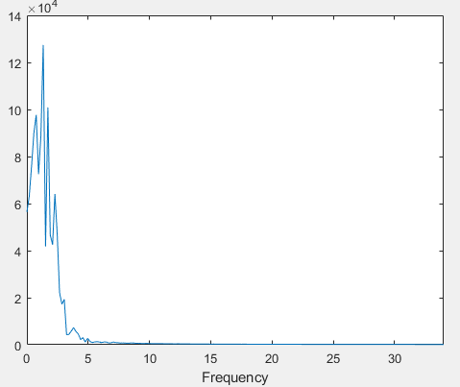
FFT for the IMF values

Slide 6
