Slide 1
CNN Model
Farhan Rahman

Slide 2
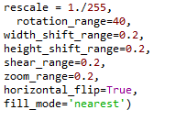
Model Summary
Size of input image : 150x150
Augmentation used :

Slide 3
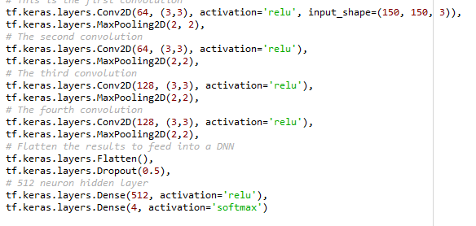
Convolution Layer

Slide 4
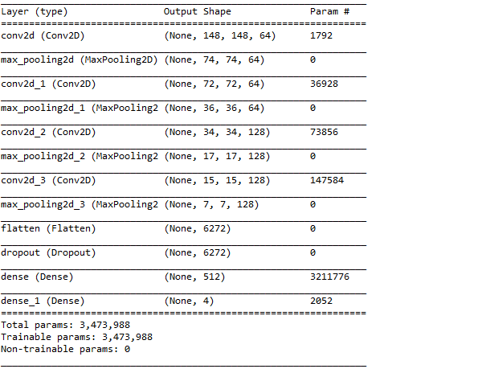
Model Summary

Slide 5
Progress
As of now the dataset consists of 4 classes each containing 200 images in each class belonging to the training dataset.
Due to the lack of dataset the model is not yet able to achieve accuracy beyond 30%.
Further data is being collected to achieve around 5000 dataset.
If the model is not efficient then pre trained CNN models can be used like Inception model and VGGNet.

Slide 6
Link to the code
The github link for the CNN model is given below for reference.

