Slide 1
Plotting EEG signal
Farhan Rahman

Slide 2
Getting data
The following EEG plot has been selected for an interval of 5 seconds from the data set provided NTUH_OR62_2014.10.15_2 .
So a data set of 673 values was obtained.

Slide 3
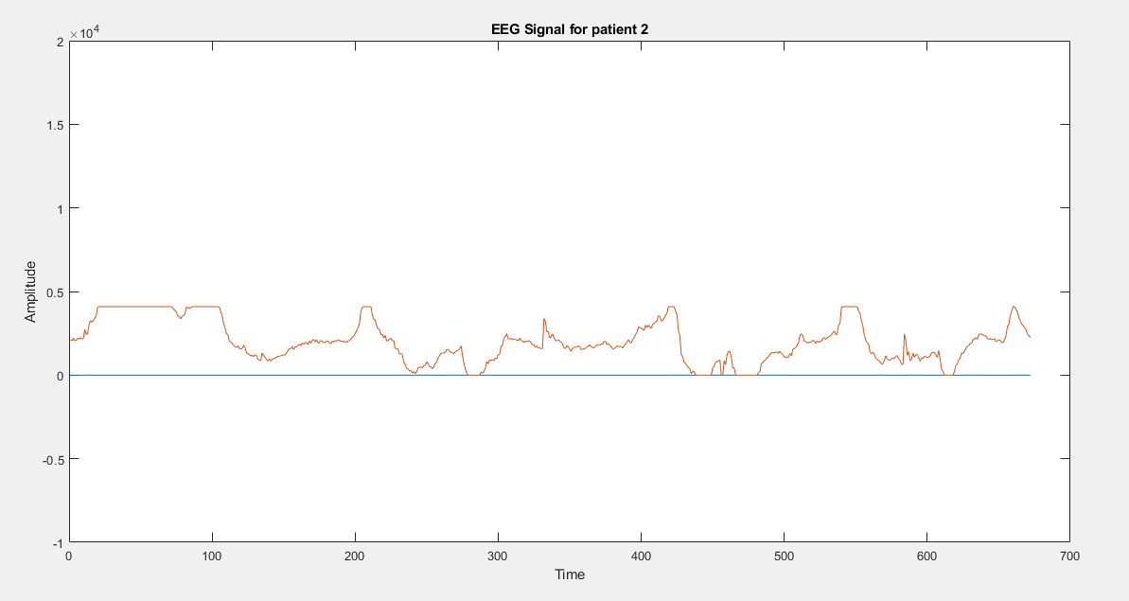
Plot

Slide 4
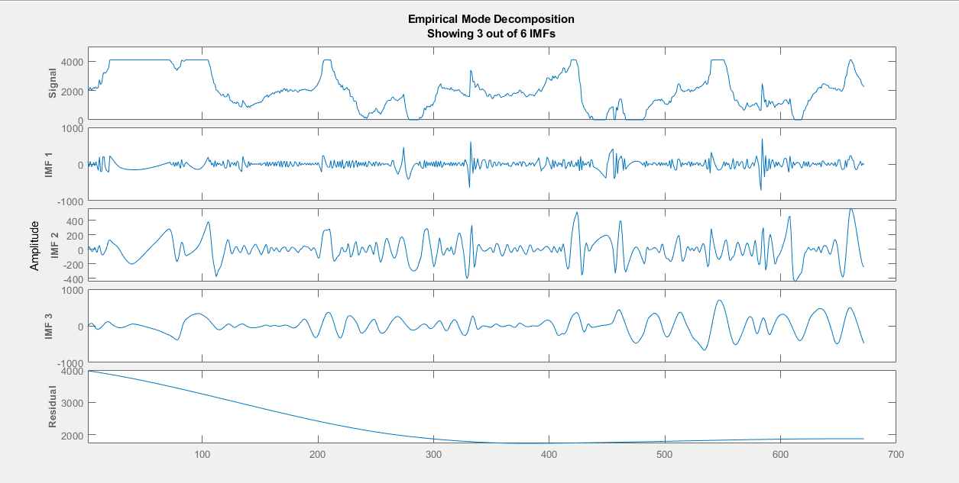
IMF plot for the EEG signal

Slide 5
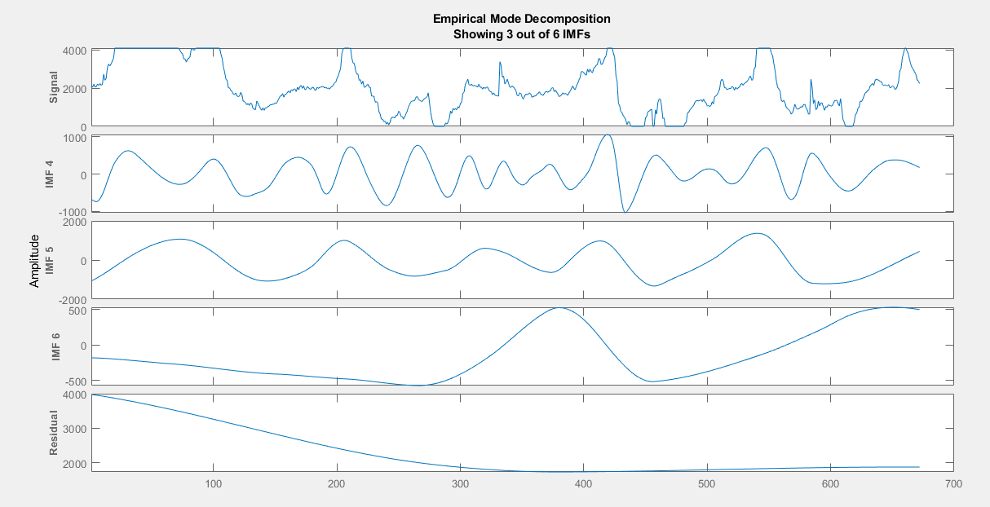
Other IMF4-6

Slide 6
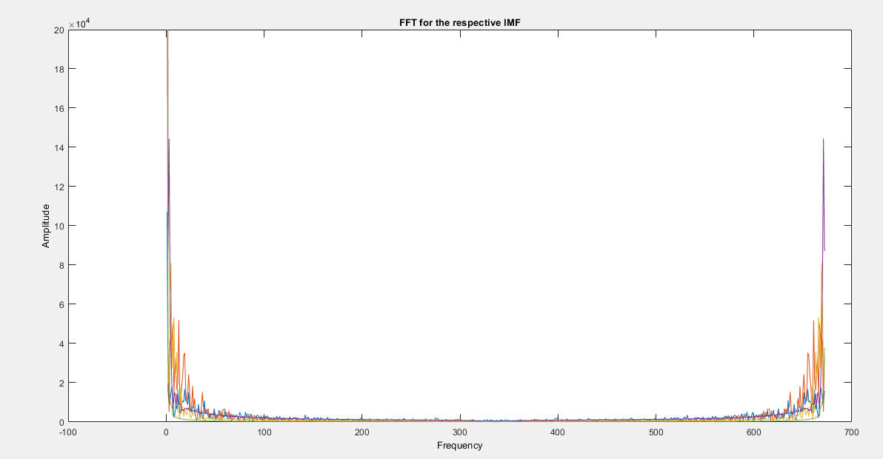
Fourier Transform

Slide 7
Frequency Transform
The x- axis has been plotted for sampling frequnecy ~ 128Hz.

Slide 8
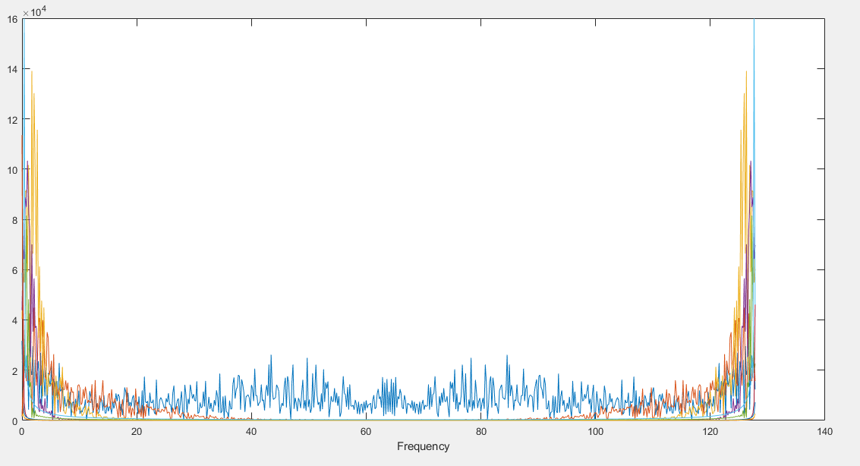
plot

Slide 9
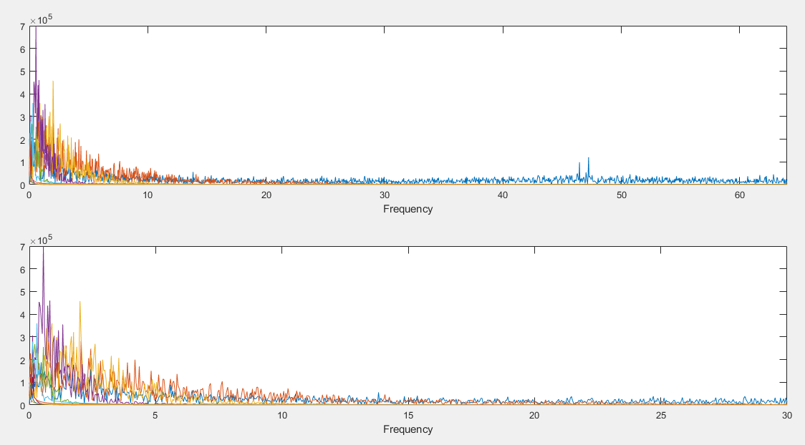
Zoom PLOT

