Slide 1
Karl Pearson and the crabs from Naples bay

Slide 2
Weldon observation ad supposition
In 1892, Weldon and his wife collected extensive data on populations of the crab, Carcinus Moenas, and observed that one trait, the forehead width to the body length ratio, in the crabs from Naples bay actually showed a highly skewed, rather than a normal, distribution.
Weldon wondered whether this distribution could be the result of the population being a mix of two different normal distributions, with the possible implication that the population consisted of two different races or ‘types’ in the same locality.

Slide 3
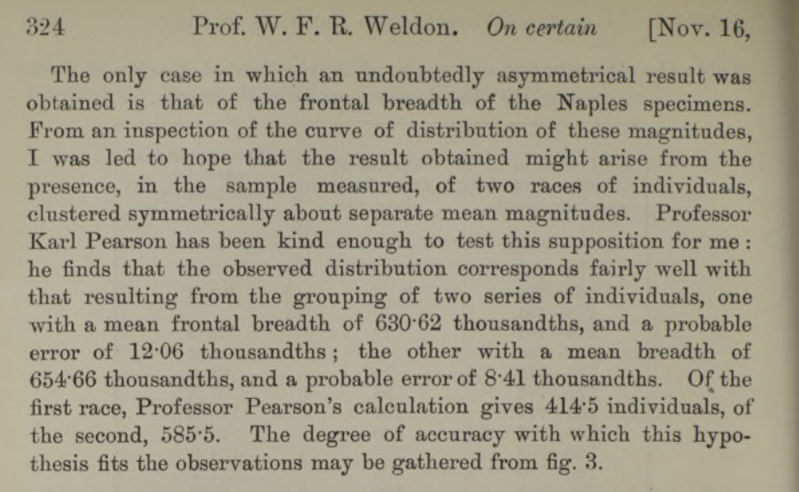
The Pearson solution
Method of moments
Pearson derived a ninth degree polynomial in the first 5 moments and located the real roots of this polynomial over a carefully chosen interval. Each root gives a candidate mixture that matches the first 5 moments; there were two valid solutions, among which Pearson selected the one whose 6-th moment was closest to the observed empirical 6-th moment.
The calculation was formidable and done without the aid of computing machinery of any kind.

Slide 4
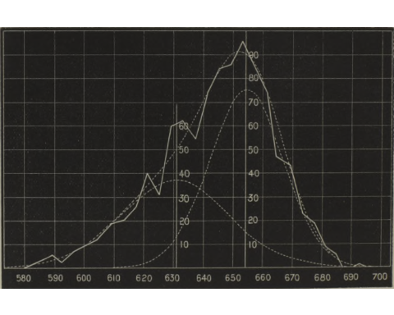
The Pearson solution
Plot of the two normal distributions
The horizontal scale represents thousandths of the carapace length, the vertical scale numbers of individuals. Each ordinate of the upperdotted curve is the sum of the corresponding ordinates of the two component curves.

Slide 5
Dataset
The data give the ratio of “forehead” breadth to body length for 1000 crabs sampled at Naples by Professor W.F.R. Weldon. The observations are grouped in intervals of 0.0040 width and for each range is reported the count. Waldon dataset contains 29 rows, with 2 columns, “ratio” and “freq” (the count).
ratio | freq
0.5835 | 1
0.5875 | 3
0.5915 | 5
0.5955 | 2
0.5995 | 7
0.6035 | 10
0.6075 | 13
0.6115 | 19
0.6155 | 20
0.6195 | 25

Slide 6
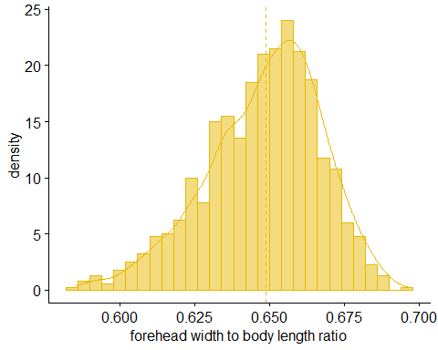
Observed densit plot

Slide 7
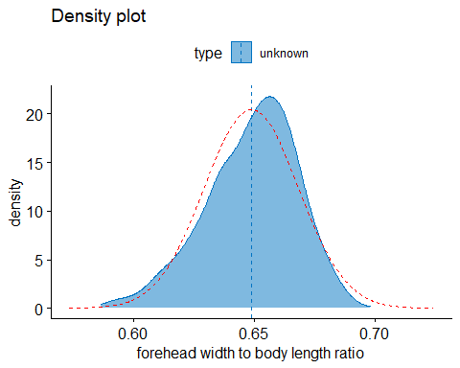
Checking Normality
Comparing the observed density and a normal distribution with the same mean and variance, highlights that the observed curve is asymmetrical. This is just one hint that underlying distribution may be not a simple Gaussian.

Slide 8
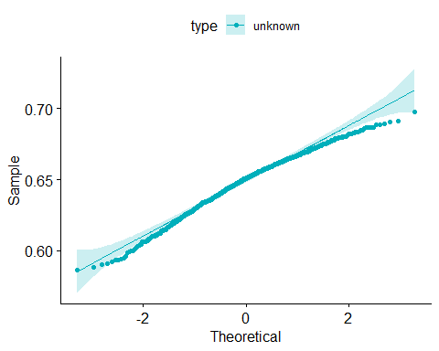
Checking Normality
Q–Q plot
A Q-Q plot, short for “quantile-quantile” plot, is used to assess whether or not a set of data potentially came from some theoretical distribution.
In most cases, this type of plot is used to determine whether or not a set of data follows a normal distribution.
If the data is normally distributed, the points in a Q-Q plot will lie on a straight diagonal line.
Conversely, the more the points in the plot deviate significantly from a straight diagonal line, the less likely the set of data follows a normal distribution.

Slide 9
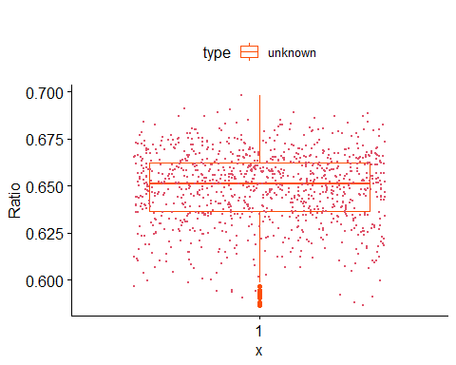
Checking Normality
Box plot
Boxplot shows the median’s asymmetry and many outliers, very unlikely in a Gaussian distribution.

Slide 10
Checking Normality
Hypothesis testing
The Shapiro-Wilk and Pearson chi-square tests give a very low p-value rejecting the null hypothesis that the distribution was normal
method | pValue
Shapiro-Wilk normality test | 9.104e-11
Pearson chi-square normality test | < 2.2e-16

Slide 11
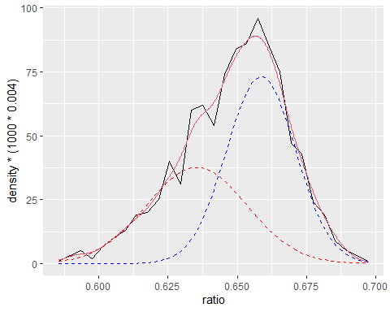
Pearson calculation in R
## Pearson’s polynomial appears to have 4 negative real roots. ## (i,alpha,mu1,mu2,sigma1,sigma2, sixth[i])= 1 0.4271507 0.6353577 0.6587044 0.01810715 0.01251076 3.150669e-11 ## (i,alpha,mu1,mu2,sigma1,sigma2, sixth[i])= 2 0.5279179 0.638945 0.6596762 0.01905285 0.01167389 4.213893e-11 ## Negative variance found, removing root. ## Negative variance found, removing root. ## Of the 2 statistically meaningful solutions, the closest to the sample’s sixth moment is (alpha,mu1,mu2,sigma1,sigma2)= ## 0.4271507 0.6353577 0.6587044 0.01810715 0.01251076

Slide 12
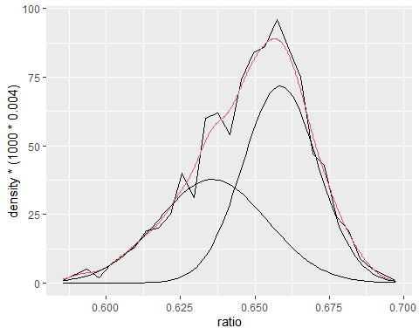
# EM Algorithm
## number of iterations= 865

Slide 13
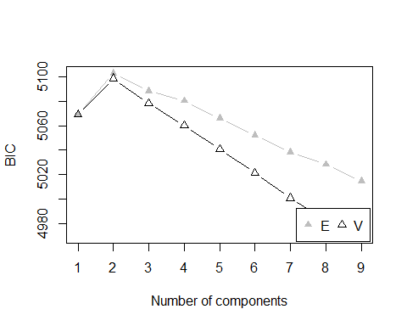
## Call: ## hc(data = crabs.df$ratioj, modelName = "V", verbose = FALSE) ## ## Model-Based Agglomerative Hierarchical Clustering ## Model name = V ## Use = VARS ## Number of objects = 1000

