Slide 1
SERVLET

Slide 2
Where are we?
JAVA
Introduction
Object-oriented design
Advanced topics
Server-side coding
4. Object
Classes
10. JDBC
1. Intro to
Java, Course
7. Inheritance
11.Streams
2. Java lang.
basics
6. Exception
Handling
13. Servlets
5. Encapsulation
14. JSP
3. Arrays
8. Polymorphism
12. Networking
9. Abstract classes
and Interfaces
Newbie
Programmers
Designers
Developers
Professionals

Slide 3
Outline
Concepts
Features
javax.servlet.Servlet
javax.servlet.http.HttpServlet
Example: get and send a page to client
Example: post
Image generating
Session tracking
  Cookie, HttpSession, URL-rewriting
Practical examples

Slide 4
Today’s buzzwords
Applets
  Java programs capable of running within a web browser
Servlets
  Java code running on server side
Session tracking
  Keeping context information during a session of browsing related web pages

Slide 5
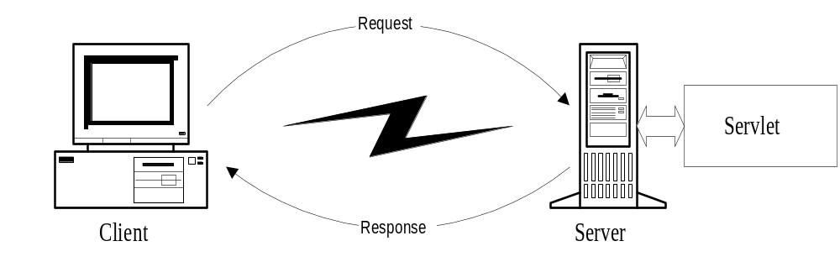
What is java servlet ?
A servlet is a small Java program that runs within a Web server. Servlets receive and respond to requests from Web clients, usually across HTTP, the HyperText Transfer Protocol. Servlet is an opposite of applet as a server-side applet. Applet is an application running on client while servlet is running on server.

Slide 6
What is Java Servlets?
Servlet
  module run inside request/response-oriented server
Browser
HTML form
Java-enabled
Web Server
Servlet
Database
  Servlets are to Servers what Applets are to Browsers
Servlet
=
Applet
Server
Browser
  Substitute for CGI scripts
    easier to write and fast to run
  Not part of the core Java Framework
Notes:
1. 서블릿의 개념
- 서버측에서 클라이언트측의 요구를 받아 그에 대한 처리를 한 후 결과를 되돌리는 모듈이다.
2. 애플릿/서블릿
애플릿은 서버측에서 작성되었지만, 코드가 클라이언트로 다운로드되어 실행되는 반면, 서블릿은 서버 측에서 직접 실행되어 그 결과만 반환된다는 점에서 오히려 CGI와 비슷하다. 하지만,CGI보다는 요구와 결과를 처리하는 방법이 더 쉽다.
3. JDK의 기본 패키지가 아니다. 서블릿을 작성하려면, JDK외에 JSDK(98년 중반 현재 2.0까지 발표)를 다운로드받아야 한다.
4. 서블릿을 동작시키려면, 서블릿 실행을 처리할 수 있는 웹 서버 또한 존재해야 한다.

Slide 7
Example use of servlet
Processing data POST over HTTPs using HTML form as purchase order or credit card data
Allowing collaborative between people such as on-line conferencing
Many servlet can chain together among Web servers to reduce load on one Web server.

Slide 8
Why Use Servlets ?
One of the reasons that Java became popular is Applets.
  but there are problems with Applets
    Browser compatibility
    Download bandwidth
Server-side Java
  the code is executed on the server side not the client side
  a dynamically loaded module that services requests from a Web server

Slide 9
Servlets (contd.)
  vs. Common Gateway Interface (CGI)
    create new process for each request
      most platform independent CGI language - Perl
        start a new instance of interpreter for every request
    CGI runs in a completely separate process from the Web server
  vs. Server-Side JavaScript
    only available on certain web servers
  vs. Active Server Pages (ASP)
    only available on certain web servers

Slide 10
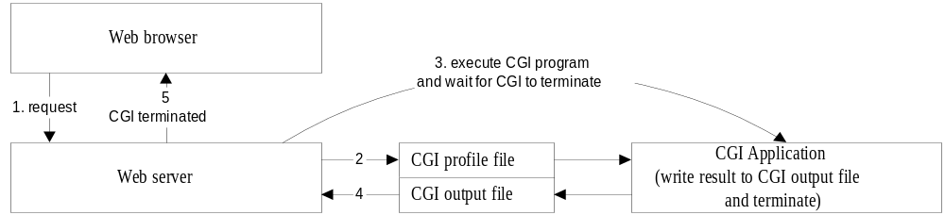
CGI Communication (traditional approach)
1. Web browser requset a response from CGI program.
2. Web server create CGI profile file that was contain information about CGI variable, server and CGI output file.
3. Web server starts CGI application and wait for its termination.
4. CGI program runs and writes the result to CGI output file and then terminates.
5. Web server reads from CGI output file and send back to Web browser.

Slide 11
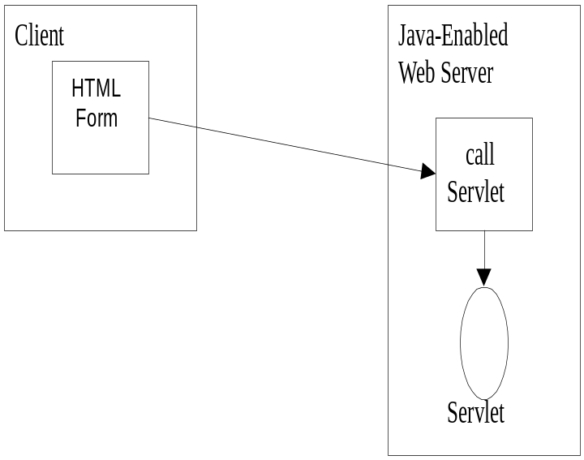
Servlet Communication
Web browser request servlet by specified URL as http://www.host.com/serlet/servletName
Web server call service() method in ServletLoader class which will dynamically load a specified servlet name from a special directory call servlet.

Slide 12
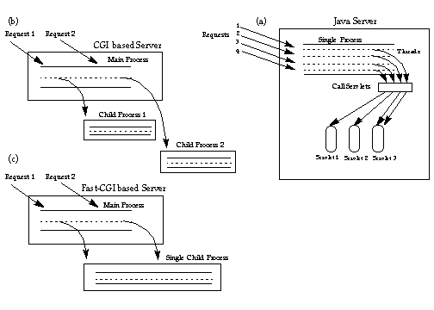
Servlet vs CGI
Servlet run as light weight thread in process.
CGI run as heavy weight process.

Slide 13
Advantage of servlet over CGI
PlatForm Independence
Servlets can run on any platform. PERL also can be moved from platform to platform while CGI such as C are not portable.
Performance
Servlets only needs be loaded once, while CGI programs needs to be load for every request so that servlet should performs faster than CGI
Security
While CGI can do many insecure things, java provided security in language level.

Slide 14
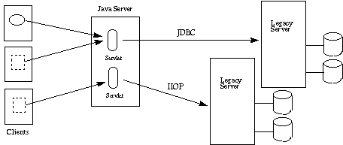
Three Tier Applications.

Slide 15
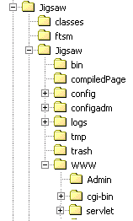
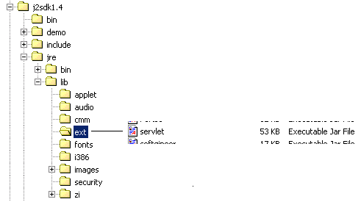
Java Servlet Development Kit installation

Slide 16
Requirement for running java servlet
Java Servlet API
A set of java classes. This is a Java Servlet Development Kit(JSDK) that can be download from http://java.sun.com
JSDK allows most standard Web server such as Netscape servers, IIS, Apache and others to load servlets
Java-enabled Web server
There are many web server that support java virtual machine such as Java Web server by SUN, WebSite Pro V2.0 by O’Reilly and the latest version of World Wide Web Consortium’s free jigsaw Web Server.

Slide 17
Servlet Lifecycle
Server loads Servlets
- run init method
No Concurrency Issue
Server runs init only once, not per request
Servlets Accept Request from
Clients and return Data back
- run service method
service must be thread-safe
- multiple service method at a time
if that is impossible, servlet must
implement SingleThreadModel interface
Server removes Servlets
- run destroy method
destroy must be thread-safe
- when server runs destroy, other threads
might be accessing shared resources
Server reloads Servlets
- run init method

Slide 18
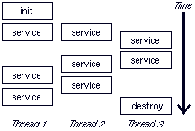
A Typical Servlet Lifecycle
    from Servlet Essential 1.3.5 by Stefan Zeiger
    http://www.novocode.com/doc/servlet-essentials/

Slide 19
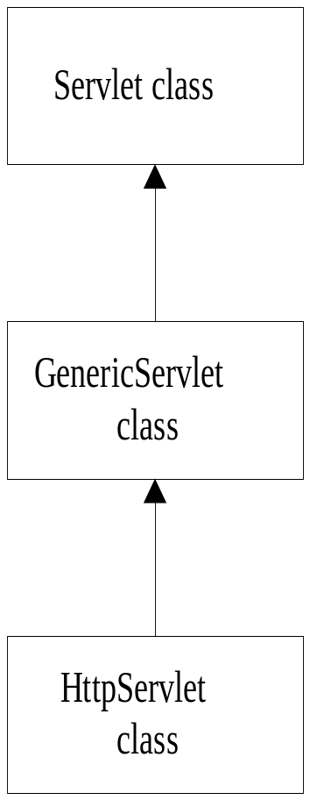
Servlet class Example
Interface Servlet
Define the standard way in which a network server will access a servlet. All servlet classes must (fundamentally) implement this interface.
GenericServlet
Defines a generic, protocol-independent servlet. For servlet that is not intended to use with Web server. To write an HTTP servlet for use on the Web, extend HttpServlet instead
HttpServlet
For Servlet that is intended to use with Web server. This class adds HTTP-specific to work with a Web server context

Slide 20

Servlet Structure
All servlet classes and interfaces that form the API are found in the javax.servlet package.
All servlets, no matter what type of server they are destined to be used with, implement the javax.servlet.Servlet interface. This interface defines the basic functionality that a servlet must possess

Slide 21

ServletConfig
When the servlet first starts up, the system can pass specific initialization information to the servlet for possible processing via the init(...) method.
Parameters are passed in using a key/value pairing, and two methods are provided to access this data: getInitParameter(...) and getInitParameterName().

Slide 22
ServletContext
allows the servlet to interrogate the server about various pieces of environmental data
Example :
  Many servers, particularly web servers, refer to files and resources as virtual files. However, this makes opening up files difficult, as the virtual file or alias needs to be mapped onto a real file. The ServletContext interface, for example, provides a method to convert an alias and real path file names.

Slide 23
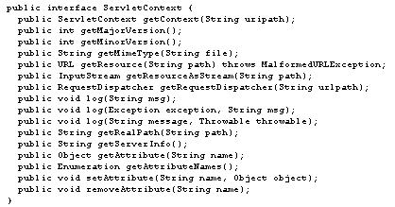
ServletContext

Slide 24
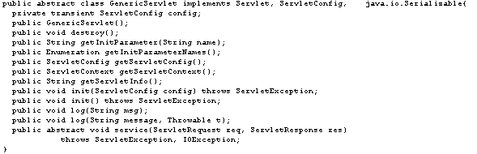
GenericServlet
The base class on which the majority of servlets are based is the GenericServlet class.

Slide 25


Interface Servlet class
void init(ServletConfig)
Initialized the servlet when it is loaded into server (system).
abstract void service(ServletRequest, ServletResponse)
This is an abstract class so that it must be implemented by a subclass of GenericServlet class. A method that the servlet processes each client request
destroy()
This method is called when the server remove a servlet from memory.

Slide 26
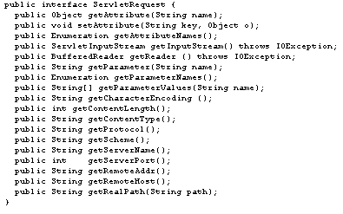
ServletRequest

Slide 27
ServletRequest
If, on the other hand, data is coming from a non-HTTP client, then the data may be coming in as a stream. The ServletInputStream can be used to read this stream. Additional information about the client that may be useful is the home network address from which it is sending. This information can be made available through the getRe-moteAddr() and getRemoteHost() methods.

Slide 28

ServletResponse
The most important method of this interface is the getOutputStream() method. This returns the ServletOutputStream, which can be used to provide any other preferred output stream class from the java.io package.

Slide 29
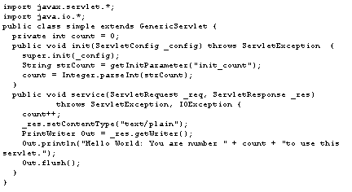
GenericServlet : Example

Slide 30
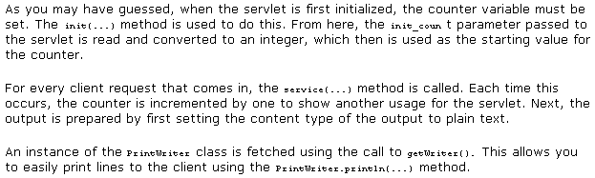
GenericServlet

Slide 31
Web-Based Servlet
The developers at Java recognized the fact that the majority of servlets would be employed in the field of the Internet, with particular emphasis on the world wide web. The servlet API offers you a direct alternative to using CGI and Microsoft's Active Server Pages (ASP) to implement server-side solutions. To make coding servlets for the web relatively easy, a special HttpServlet class was developed. This provided methods to access the more common header fields found in the HTTP protocol.

Slide 32
HttpServlet class
void doGet(HttpServletRequest, HttpServletResponse)
This method handle HTTP GET requests.
void doPost(HttpServletRequest, HttpServletResponse)
This method handle HTTP POST requests. The Form parameter are read via HttpServletRequest parameter.
void service(HttpServletRequest, HttpServletResponse)
This method can handle both GET and POST method. Normally, service() method used to overide one or both of the previous method
void service(servletRequest,ServeletResponse)
This method overides service() method of GenericServlet class

Slide 33
HttpServlet
The HttpServlet, based on the GenericServlet class.
It provides an improved interface for dealing with HTTP-specific client requests.
In addition to the service(...) method that is used to deal with all requests, seven additional methods exist for processing requests; doGet(...), doPost(...), doHead(...), doPut(...), doTrace(...), doOptions(...) , and doDelete(...).

Slide 34
Servlet Architecture Overview - HTTP servlets
parameters, protocol, remote host,
ServerInputStream(binary data etc..)
Servlet
interface
ServletRequest
doGet(ServletRequest req, ServletResponse res);
Servlet
GET
Client
ServletResponnse
ServletRequest
POST
doPost(ServletRequest req, ServletResponse res);
Servlet
IS-A
ServletResponse
mime type to reply,reply data,
ServletOutputStream

Slide 35
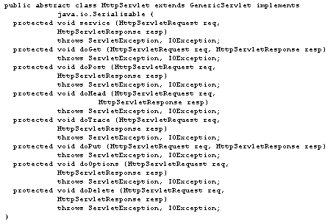
HttpServlet Interface

Slide 36
ServletRequest Interface
This interface return information about parameter sent with
the request.
int getContentLength()
String getContentType()
String getProtocol()
String getScheme()
String getServerName()
int getServerPort()
String getRemoteAddr()

Slide 37
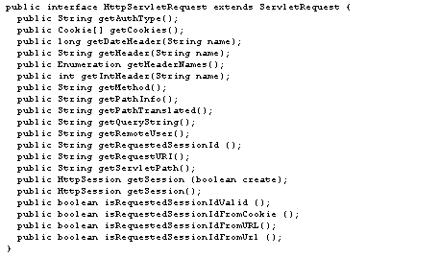
HttpServletRequest :

Slide 38
ServletRequest Interface(continued)
String getRemoteHost()
String getRealPath(String path)
ServletInputStream getInputStream()
String getParameter(String name)
String[] getParameterValues(String name)
Enumeration getParameterNames()
Object getAttribute(String name)

Slide 39
ServletResponse Interface
This interface defined method for sending information back to Web browser.
void setContentLength(int len)
void setContentType(String type)
ServletOutputStream getOutputStream()

Slide 40
HttpServletRequest Interface
The method of HttpServletRequest interface inherits the method in ServletRequest interface. GET, POST, and HEAD in HTTP are also supported.

Slide 41
Servlets (contd.)
  HttpServletRequest
    information sent from the client
      getParameter()
      getParameterValues()
      getParameterNames()
        will discuss in detail later in FormPost
  HttpServletResponse
    information sent to the client
      getWriter()
        return an instance of PrintWriter
        you can use print and println with a PrintWriter
        see SimpleServlet

Slide 42
HttpServletResponse Interface(continued)
boolean containHeader(String name)
void setStatus(int statusCode, String statusMessage)
void sendError(int statusCode, String Message)
void sendError(int statusCode)
void setDateHeader(String name, long date)
void sendRedirect(String location)

Slide 43
HttpServletResponse Interface
String getMethod()
String getServletPath()
String getPathInfo()
String getPathTranslated()
String getQueryString()
String getRemoteUser()
String getAuthType
String getHeader(String name)
String getIntHeader(String name)
long getDateHeader()
Enumeration getHeaderNames()

Slide 44
Writing the Servlet
Implement the javax.servlet.Servlet interface
  HTTP: extends javax.servlet.http.HttpServlet class
public class SurveyServlet extends HttpServlet {
/* typical servlet code, with no threading concerns
* in the service method. */
...
}

Slide 45
Interacting with Clients(1)
- HTTP servlets
methods
doGet
Get
Client
Post
doPost
Put
doPut
Delete
doDelete
HttpServletRequest - argument & HTTP header data
  String[] getParameterValues(String name) - get user parameter
  For GET method
    - String getQueryString()
  For POST, PUT, DELETE method
    - BufferedReader getReader() - text data
    - ServletInputStream getInputStream() - binary data

Slide 46
Interacting with Clients(2)
- HTTP servlets
HttpServletResponse - return the response data to the user
  PrintWriter getWriter() - text data
  ServletOutputStream getOutputStream() - binary data
  Before accessing the Writer or OutputStream, HTTP header data should be set

Slide 47
Example of an HTTP Servlet - GET/HEAD methods
public class SimpleServlet extends HttpServlet {
public void doGet(HttpServletRequest req, HttpServletResponse res)
throws ServletException, IOException {
// set header field first
res.setContentType("text/html");
// then get the writer and write the response data
PrintWriter out = res.getWriter();
out.println("<HEAD><TITLE> SimpleServlet</TITLE></HEAD> <BODY>");
out.println("<h1> SimpleServlet Output </h1>");
out.println("</BODY>");
out.close();
}
public String getServletInfo() {
return "A simple servlet";
} }

Slide 48
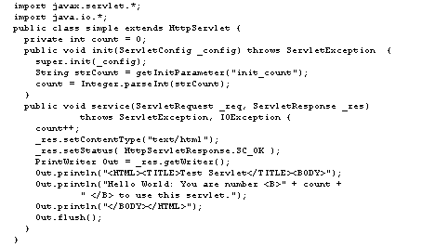
Example (2) use of HttpServlet

Slide 49
Accessing web-based servlets
Assume the servlets' class file has been placed in the server's servlets directory. The servlet can be called by including /servlet/ before the servlet name in the URL.
For example, if you set the class name of the sample servlet to TestServlet, then it could be accessed using http://<hostname>/servlet/TestServlet

