Slide 1
DBSCAN
A Density-Based Clustering Algorithm

Slide 2
What is DBSCAN?

Slide 3
DBSCAN stands for Density-Based Spatial Clustering of Applications with Noise
It is an unsupervised clustering algorithm that groups points based on density.
Key Idea:
Points in high-density regions are grouped together.
Low-density points are classified as noise or outliers.
Key Terms:
Core points: Have at least MinPts neighbors within distance ε (epsilon).
Border points: Have fewer than MinPts but are within ε of a core point.
Noise points: Are neither core nor border points.

Slide 4
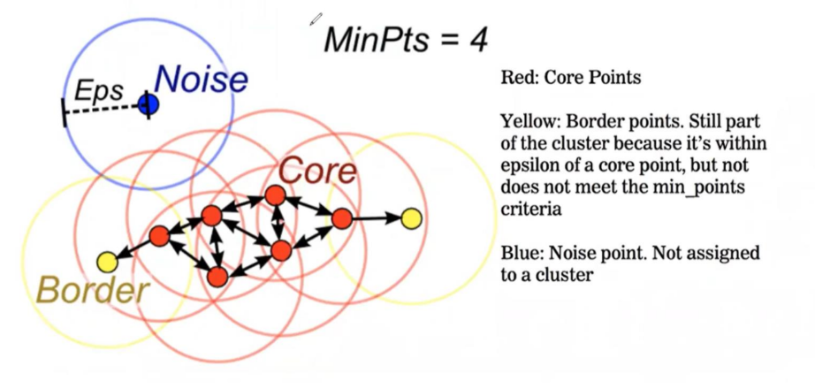

Slide 5
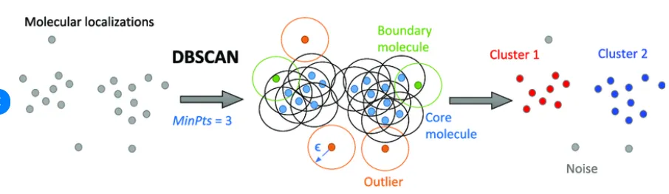

Slide 6
DBSCAN vs. K-Means: Key Differences

Slide 7
Feature | DBScan | K-Means
Approach | Density-based | Centroid-based
Shape of Clusters | Arbitrary (can be non-spherical) | Circular
Handles Noise? | Yes, can classify outliers | No, assigns every point to a cluster
Requires k (Number Of Clusters? | No | Yes

Slide 8
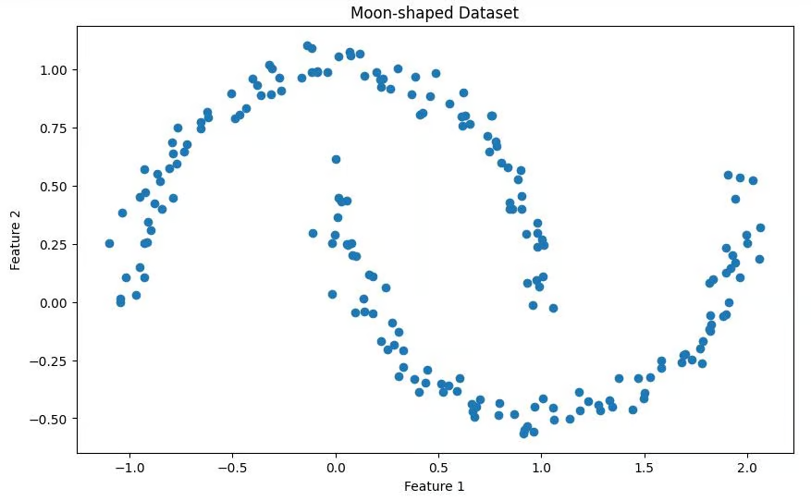

Slide 9
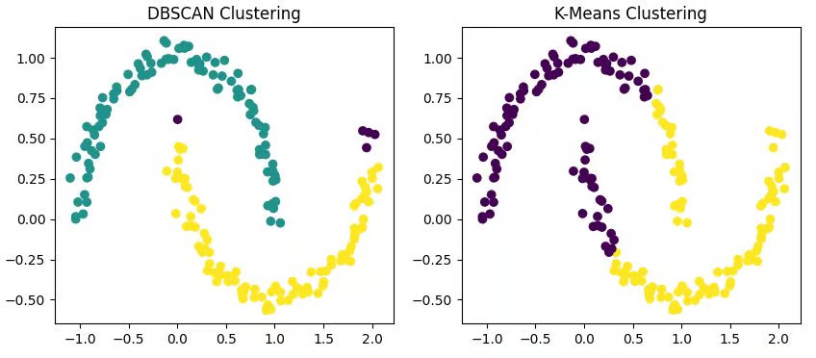

Slide 10
PROBLEM STATEMENT

Slide 11
Given a dataset, Mall_Customers.csv, which contains information about customers of a mall.
We have to perform clustering using the DBSCAN (Density-Based Spatial Clustering of Applications with Noise) algorithm.

Slide 12
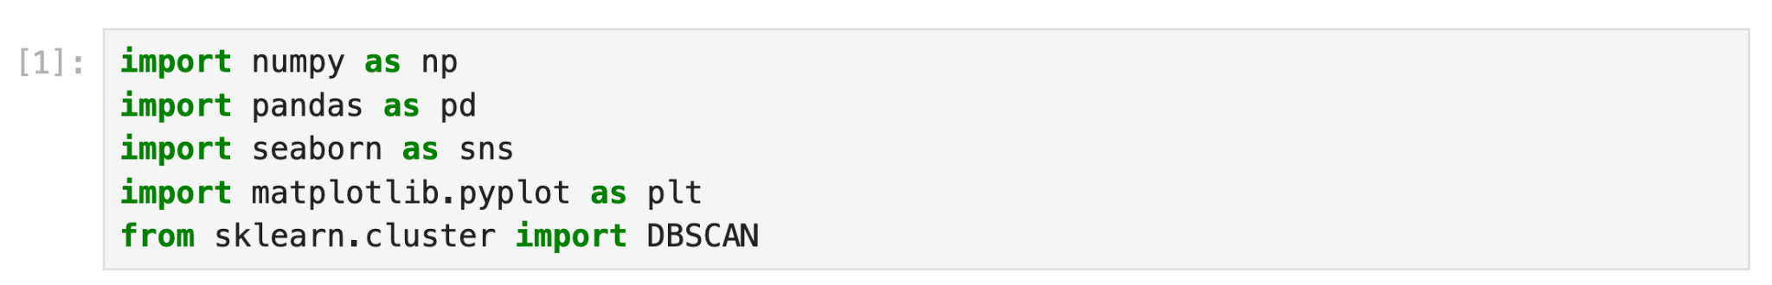
1. Importing Necessary Libraries
numpy: Used for numerical operations.
pandas: Used for handling tabular data.
seaborn & matplotlib.pyplot: Used for visualization.
DBSCAN from sklearn.cluster: Used for clustering.

Slide 13
2. Loading the Dataset
Reads the ‘Mall_Customers’ CSV file containing customer data.
Extracts three features for clustering:
Age
Annual Income (k$)
Spending Score (1-100)

Slide 14
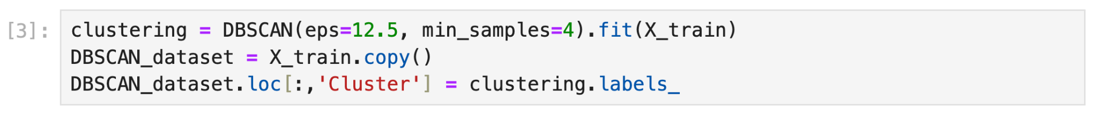
3. Applying DBSCAN Clustering & Storing the Clusters
eps=12.5: Defines the maximum distance for two points to be considered neighbors.
min_samples=4: A cluster must have at least 4 points.
fit(X_train): Performs DBSCAN clustering on the data.
Creates a copy of X_train for visualization.
clustering.labels_ assigns a cluster label to each data point.
-1 indicates an outlier (noise point).
Other numbers represent different clusters.

Slide 15
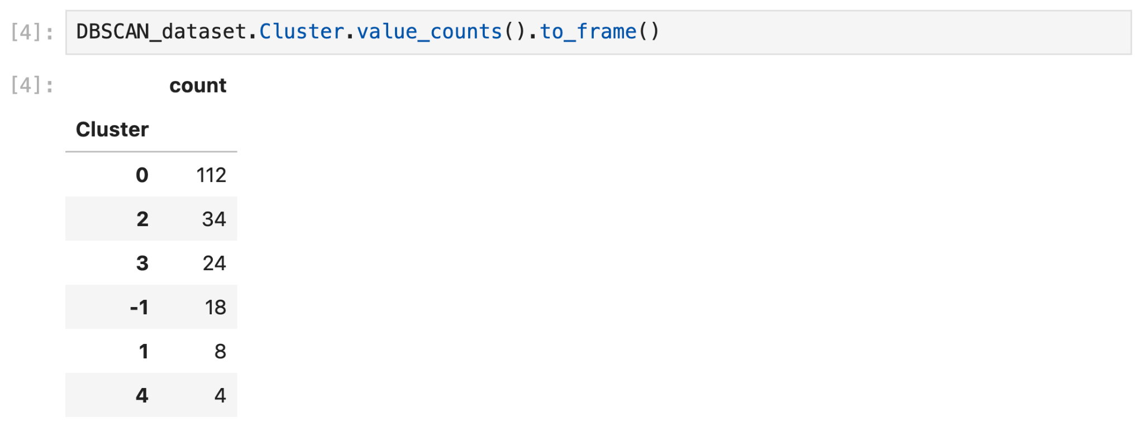
4. Analyzing Clusters
Displays the count of points in each cluster.

Slide 16
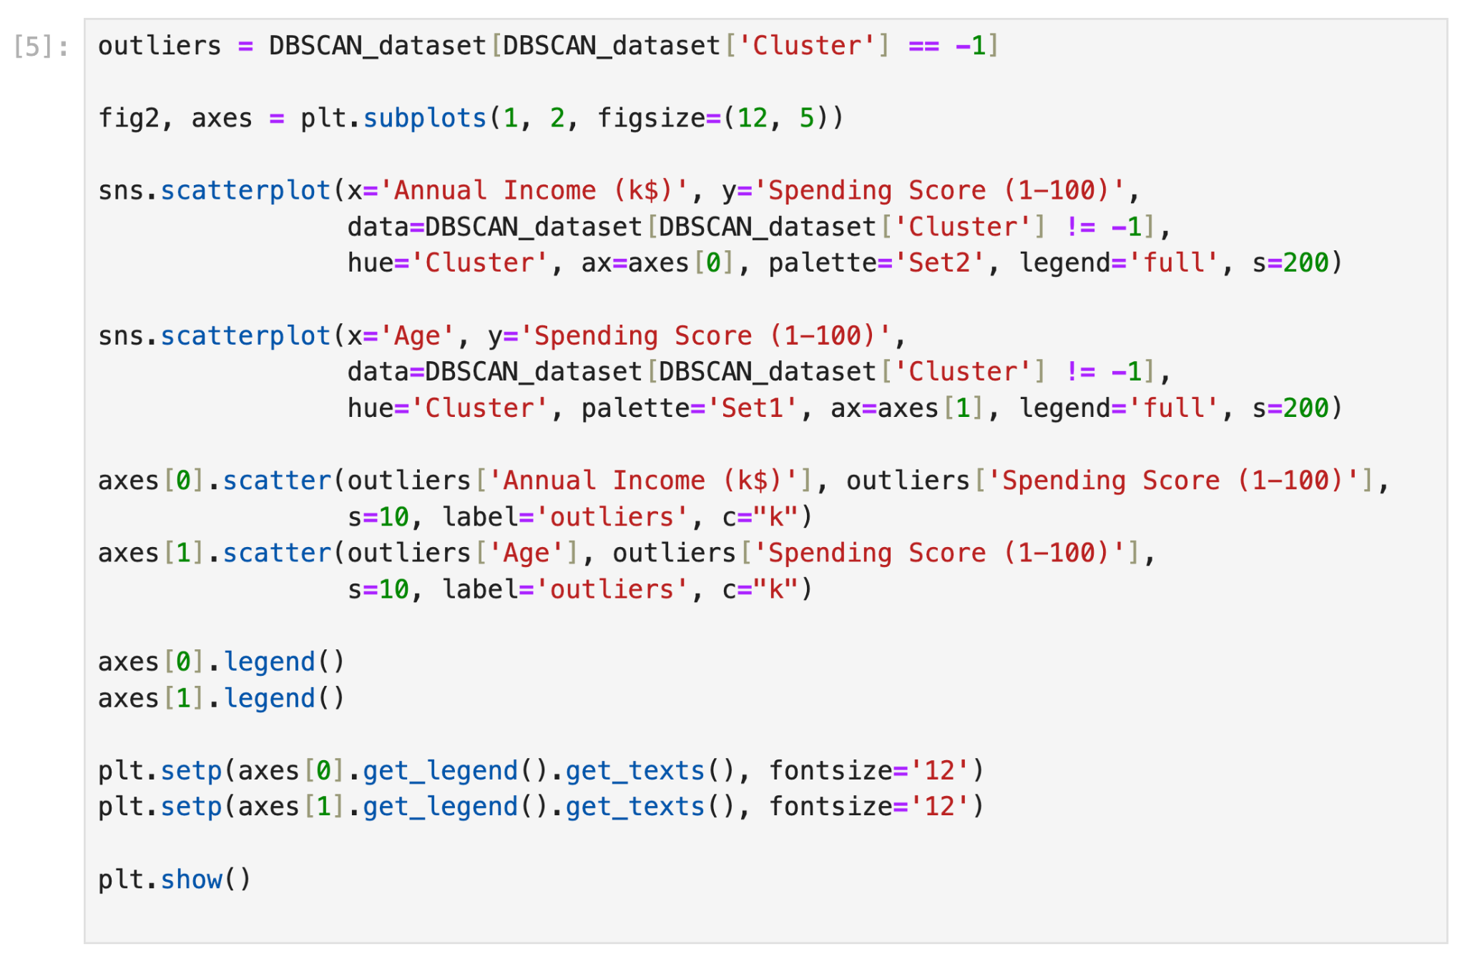
5. Analyzing Outliers
Extracts outliers (noise points), which are points labeled -1.

Slide 17
6. Plotting the Clusters
Creates a 1-row, 2-column subplot for visualizing clusters.
Plots clusters based on Annual Income vs. Spending Score.
Plots clusters based on Age vs. Spending Score.
Then we plot outliers as black (c="k") dots.
Later we add legends to both plots.
Finally, we displays the scatter plots using plt.show()

Slide 18
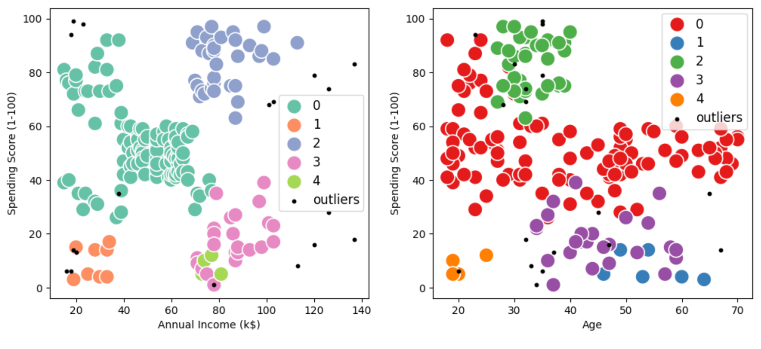

Slide 19


THANK YOU
Farhan Javed
BTECH 3rd Year
Roll No.: 12
Notes:
:DDDD

