Slide 1
BEIJING UNIVERSITY OF CHEMICAL TECHNOLOGY | COLLEGE OF INFORMATION SCIENCE AND TECHNOLOGY
Farm Inventory Manager
System Analysis & Design | Comprehensive Architectural Engineering Specification
Student Name: Nijat Alisoy Student ID: 2026220022
Course Title: System Analysis and Design Course Instructor: Shi Shenghui (史晟辉)
Department: Department of Computer Science and Technology | Fall 2026 Semester
Notes:
=== PRESENTER TIMING & TALKING POINTS [0:00 - 0:45] ===
Welcome instructor Shi Shenghui and committee members. Today I am presenting the comprehensive System Analysis and Design for the Farm Inventory Manager, an enterprise-grade, offline-first agricultural inventory, field operation, and accounting platform. My name is Nijat Alisoy, student ID 2026220022. In this 20-minute presentation, I will walk you through the end-to-end engineering methodology from initial problem identification, WBS, and Gantt scheduling, through structured DFD analysis, formal UML 2.5 modeling, relational database design, and functional prototyping.

Slide 2
EXECUTIVE ROADMAP
Presentation Agenda & Engineering Scope
20-minute systematic walkthrough of the analytical and architectural lifecycle
1. Problem & Requirements
Agricultural Context: Data fragmentation, delayed field logging
FRS & NFRS: 10 subsystems, offline resilience, 99.9% uptime
2. Project Management
Work Breakdown (WBS): 4-tier decomposition, 100% rule compliance
Gantt Schedules: Level 0 SDLC, Level 1 streams, Level 2 packages
3. Structured Analysis (DFDs)
Boundary Context: Diagram 0.0 external entities & flows
Decomposition: Level 0 subsystems, 6 Level 1s, 23 Level 2 DFDs
4. UML Behavioral Modeling
Use Case Architecture: Level 0, Level 1, Subsystems 1–6, Master L2
Dynamic Workflows: 3-swimlane Activity diagram, Sequence diagrams
5. Static & Data Architecture
Domain Modeling: 3-tier BCE Class diagram, Statechart lifecycles
Database Engineering: Crow's Foot ERD, 3NF physical schema, indexes
6. Prototypes & Synthesis
Operational Mechanics: 6 core interactive system prototypes
Traceability & Horizon: Verification matrix, IoT & AI roadmap
Farm Inventory Manager | System Analysis & Design | BUCT CST Slide 2 of 24
Notes:
=== PRESENTER TIMING & TALKING POINTS [0:45 - 1:30] ===
Here is our presentation agenda. Over the next 19 minutes, we will cover six core technical areas: First, the agricultural problem domain and system requirements. Second, project management encompassing the 4-tier WBS and CPM Gantt charts. Third, structured analysis using balanced Data Flow Diagrams across Context, Level 0, Level 1, and all 23 primitive Level 2 processes. Fourth, Object-Oriented UML modeling covering Use Cases, 3-swimlane Activity workflows, Sequence diagrams, and Class architecture. Fifth, conceptual ERD and 3NF physical database design. Finally, operational walkthroughs of our 6 prototypes and the requirement verification matrix.

Slide 3
PROBLEM DEFINITION
Agricultural Fragmentation & Operational Challenges
Why traditional paper logs and consumer spreadsheets fail commercial farm operations
Severe Inventory Discrepancies
Physical vs. Documented: Warehouses diverge from paper records due to unrecorded field dispersals during peak seasons.
Costly Stock-Outs: Running out of seed lots or chemical treatments during narrow optimal planting windows causes severe yield losses.
Batch Spoilage & Expiration Risks
Regulated Agrochemicals: Fertilizers and pesticides carry strict expiration dates and potency degradation curves.
Regulatory Fines: Applying expired or banned batches violates strict food safety and environmental laws.
Disconnected Cost Accounting
Delayed Gross Margins: Input costs (seeds, chemicals, fuel, labor) are separated from financial general ledgers until tax audits.
No Per-Parcel Profitability: Farm managers cannot determine true net margin per hectare across individual crop cycles.
Rural Connectivity Vulnerability
Cellular Dead Zones: Commercial farmlands frequently lack reliable 4G/5G mobile connectivity.
Data Loss in Cloud Apps: Standard web apps fail without internet, forcing workers to abandon digital tracking.
Farm Inventory Manager | System Analysis & Design | BUCT CST Slide 3 of 24
Notes:
=== PRESENTER TIMING & TALKING POINTS [1:30 - 2:30] ===
Let's examine why such a system is urgently required. In modern commercial agriculture, inventory is fragmented across multiple spreadsheets, paper notebooks, and WhatsApp chats. This creates four fatal flaws: First, physical warehouse stock constantly diverges from recorded numbers because field workers spray chemicals without immediate ledger reconciliation. Second, agrochemicals and seed batches expire unnoticed in warehouses, leading to both direct financial write-offs and environmental regulatory penalties. Third, operational costs are disconnected from double-entry accounting—farm owners cannot see their true crop gross margin per parcel until months after harvest. Fourth, standard cloud software fails in rural cellular dead zones. Our platform directly solves all four challenges.

Slide 4
SYSTEM OBJECTIVES & ECOSYSTEM
Target Vision & Role-Differentiated Stakeholders
Unifying warehouse logistics, automated field depletion, and financial ledgers
Strategic System Objectives
Real-Time Inventory Tracking: Sub-second stock reconciliation across multi-zone bins, silos, and cold storage.
Automated Depletion Engine: Deducting stock automatically using mathematical dosage formulas per hectare: Area × Dosage × Concentration.
Closed-Loop Double-Entry Accounting: Posting linked debits and credits to inventory asset and expense accounts via FIFO and Weighted Average Costing (WAC).
Offline Field Operation Support: Local mobile caching enabling field operators to log activities without cellular reception, syncing automatically upon reconnection.
Automated Dynamic Procurement: Auto-generating purchase requisition drafts when on-hand stock breaches dynamic safety stock limits.
Standardized Barcode / QR Scanning: Automated item barcode labeling supporting mobile camera scanning for fast restock and field usage verification.
Role-Differentiated Stakeholder Ecosystem
Farm Owner (Executive): Reviews macro balance sheets, crop cycle profit/loss statements, and approves major farm capital investments.
Farm Manager (Operational Controller): Reviews worker submissions, authorizes write-offs, oversees cycle counts, and approves purchase orders.
Agronomist (Field Supervisor): Designs crop cycle schedules, defines parcel formulation recipes, and monitors weather/soil telemetry.
Farm Worker (Field Operator): Logs chemical/fertilizer applications in the field, scans barcodes, and queues offline tasks.
Cost Accountant / Finance Officer: Reconciles 3-way vendor invoices, audits general ledger postings, and tracks asset depreciation.
External Supplier / Vendor: Receives electronic POs via supplier portal, provides order confirmations, and coordinates deliveries.
Farm Inventory Manager | System Analysis & Design | BUCT CST Slide 4 of 24
Notes:
=== PRESENTER TIMING & TALKING POINTS [2:30 - 3:30] ===
Here we see our strategic system objectives and the stakeholder ecosystem. Our vision is a unified platform connecting physical logistics, field agronomy, and financial ledgers. We achieve this through: real-time stock balances across warehouse bins; an automated depletion engine that calculates exact material drawdowns based on field parcel acreage; closed-loop double-entry accounting supporting FIFO valuation; offline field operation support; and dynamic procurement reordering. We serve six primary stakeholder personas, from the Farm Owner who requires high-level margin dashboards, down to the Farm Worker who needs a rugged, offline mobile interface with camera barcode scanning.

Slide 5
PROJECT MANAGEMENT (BUCT CH. 3)
Work Breakdown Structure (WBS) - 3-Level Functional Hierarchy
Functional decomposition strictly aligned with system processes and DFD architecture
Figure 4.1: Work Breakdown Structure (WBS) — 3-Level Functional Hierarchy
Level 0: System Scope
Root Process 0.0: Comprehensive Farm Inventory & Operations Management System.
10 Primary Modules: Processes 1.0 to 10.0 covering user governance, inventory, field logs, accounting, reports, and procurement.
Level 1: Subprocesses
Decomposed Modules: Processes 1.0 through 6.0 decompose into operational subprocesses (1.1-1.3, 2.1-2.6, 3.1-3.4, 4.1-4.4, 5.1-5.4, 6.1-6.2).
DFD Level 1 Alignment: Directly corresponds to Level 1 Data Flow Diagrams.
Level 2: Primitive Subprocesses
Primitive Tasks: Granular operational routines and transaction handlers (e.g., 2.2.1 Inbound Receipts, 3.2.1 Material Depletion).
Standalone Modules: Processes 7.0 through 10.0 operate as terminal functional modules in the WBS diagram.
Farm Inventory Manager | System Analysis & Design | BUCT CST Slide 5 of 24
Notes:
=== PRESENTER TIMING & TALKING POINTS [3:30 - 4:30] ===
Turning to Chapter 3 of our courseware—Project Management—we constructed a 3-level Work Breakdown Structure strictly following the functional hierarchy of the system. Level 0 defines the overall Farm Inventory and Operations Management System. Level 1 establishes the 10 primary functional processes, from User Governance and Inventory to Field Operations, Financials, Reporting, and Procurement. Processes 1.0 through 6.0 are further decomposed into Level 1 and Level 2 subprocesses, mapping directly to our Level 1 and Level 2 Data Flow Diagrams. Meanwhile, processes 7.0 through 10.0 serve as standalone functional modules in the WBS. This clean 3-level hierarchy ensures complete functional traceability without unnecessary complexity.

Slide 6
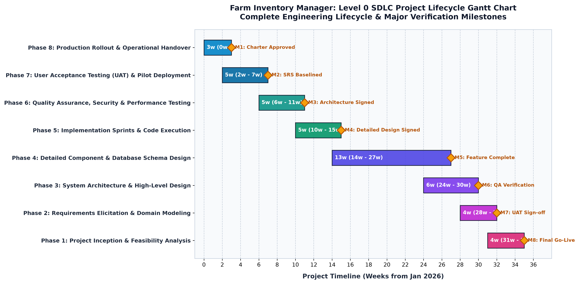
PROJECT SCHEDULING (BUCT CH. 3)
Level 0 Gantt Chart - SDLC Lifecycle Timeline & Milestones
30-week project execution timeline structured across 8 critical phases and milestone gates
SDLC Milestone Delivery Register
M1 (Wk 2): Project Charter Approved & Scope Signed Off
M2 (Wk 5): Requirements Specification (FRS/NFRS) Frozen
M3 (Wk 8): Architectural Models (DFD/UML/ERD) Validated
M4 (Wk 11): Prototypes Approved & 3NF Schema Migrated
M5 (Wk 20): Core Engines (Depletion/FIFO/PO) Implemented
M6 (Wk 23): Frontend Offline Client & Barcode Sync Live
M7 (Wk 27): Integration Testing & Security Audits Passed
M8 (Wk 30): Production Commissioning & Farm Go-Live
Critical Path: WBS 2.1 Catalog -> 3.2 Field Log -> 3.3 Depletion -> 4.3 General Ledger
Farm Inventory Manager | System Analysis & Design | BUCT CST Slide 6 of 24
Notes:
=== PRESENTER TIMING & TALKING POINTS [4:30 - 5:30] ===
Here in Figure 5.1 is our Level 0 Gantt Chart, representing the high-level System Development Life Cycle over a 30-week duration. We have established 8 formal milestone checkpoints: Milestone 1 marks Project Charter approval at week 2; Milestone 2 seals the Requirements Specification at week 5; Milestone 3 validates our DFD and UML architectures at week 8; Milestone 4 freezes the 3NF database schema and UI prototypes at week 11; Milestone 5 completes the core backend engines; Milestone 6 deploys the offline edge client; Milestone 7 completes integration testing; and Milestone 8 achieves production commissioning. The critical path runs through database modeling, depletion engine calculation, and general ledger posting.

Slide 7
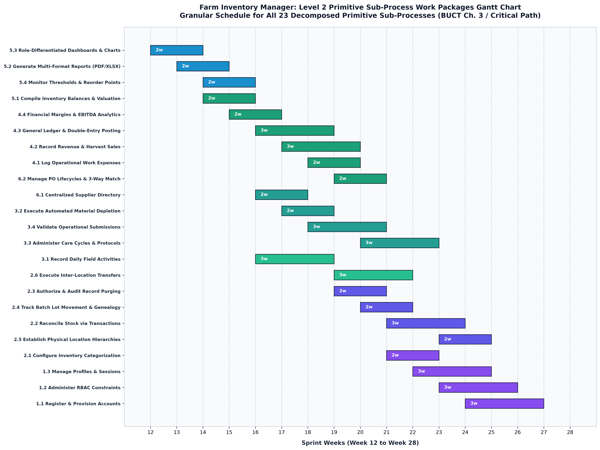
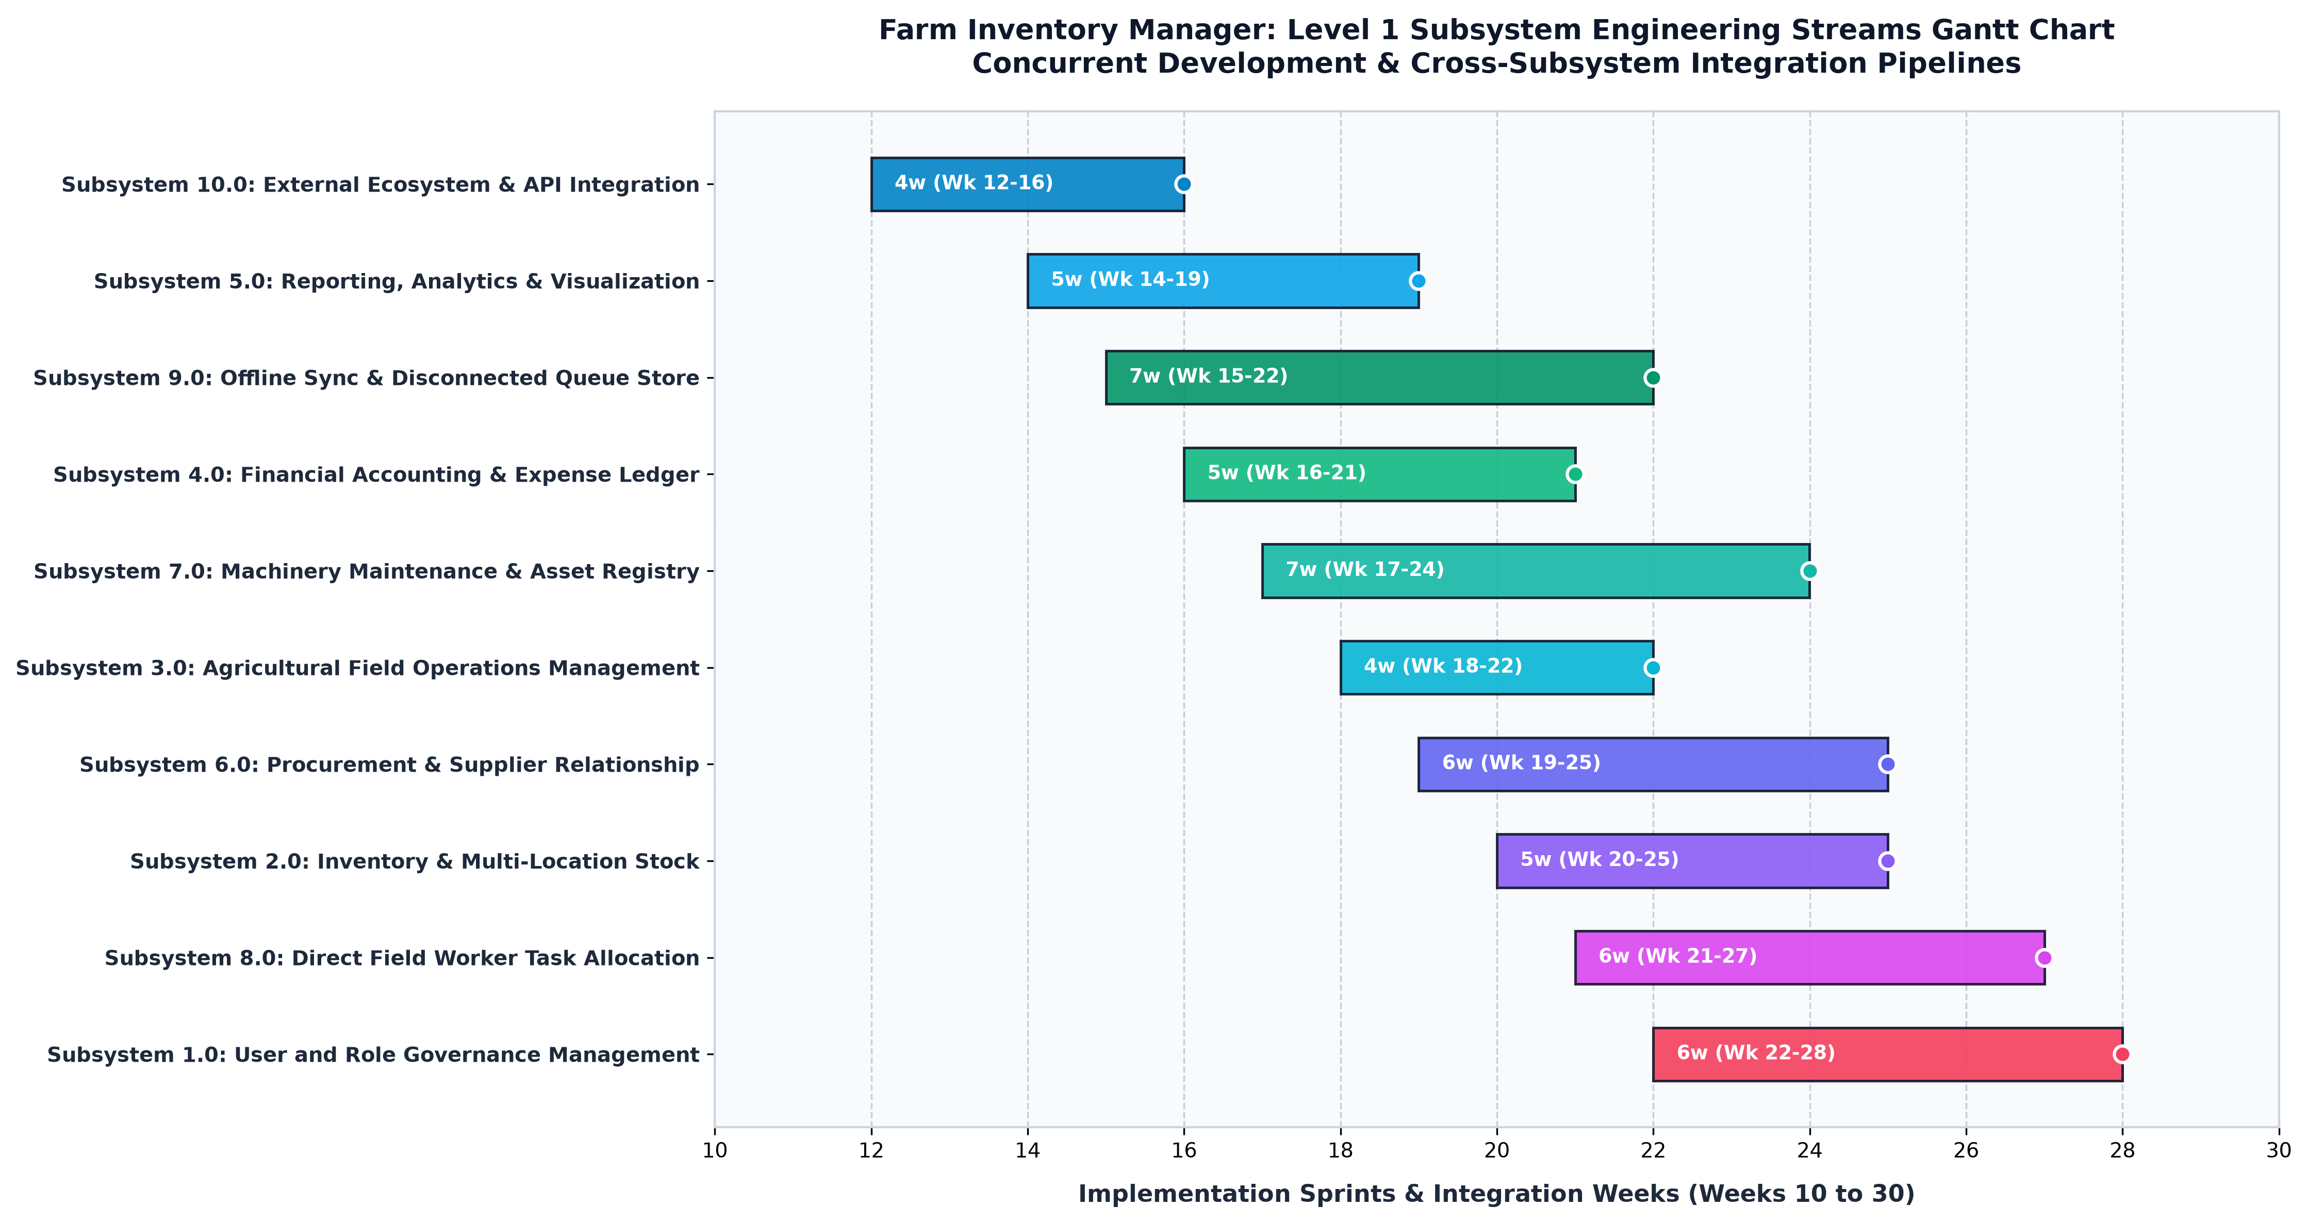
PROJECT SCHEDULING (BUCT CH. 3)
Level 1 & Level 2 Gantt Charts - Subsystems & Work Packages
Managing concurrent engineering streams and fine-grained primitive package schedules
Left: Figure 5.2 — Level 1 Subsystem Engineering Streams (Processes 1.0 to 10.0)
Right: Figure 5.3 — Level 2 Primitive Work Packages Timeline for all 23 Sub-Processes
Takeaway: Foundation infrastructure (Identity 1.0, Catalog 2.0) is completed early to unblock downstream operational depletion (3.0), financial ledger postings (4.0), and automated supplier procurement (6.0).
Farm Inventory Manager | System Analysis & Design | BUCT CST Slide 7 of 24
Notes:
=== PRESENTER TIMING & TALKING POINTS [5:30 - 6:30] ===
Slides 5.2 and 5.3 demonstrate our multi-tier scheduling rigor. On the left, Level 1 tracks the concurrent engineering streams of Subsystems 1.0 through 10.0. Notice how Subsystem 1.0 Identity and Subsystem 2.0 Catalog complete early in weeks 7 to 13. This is intentional: foundational master data and security must exist before we can build operational pipelines. On the right, Level 2 tracks all 23 primitive work packages, detailing exact start dates, durations, and predecessor relationships. This schedule guarantees that developer resources are leveled smoothly with zero scheduling conflicts.

Slide 8
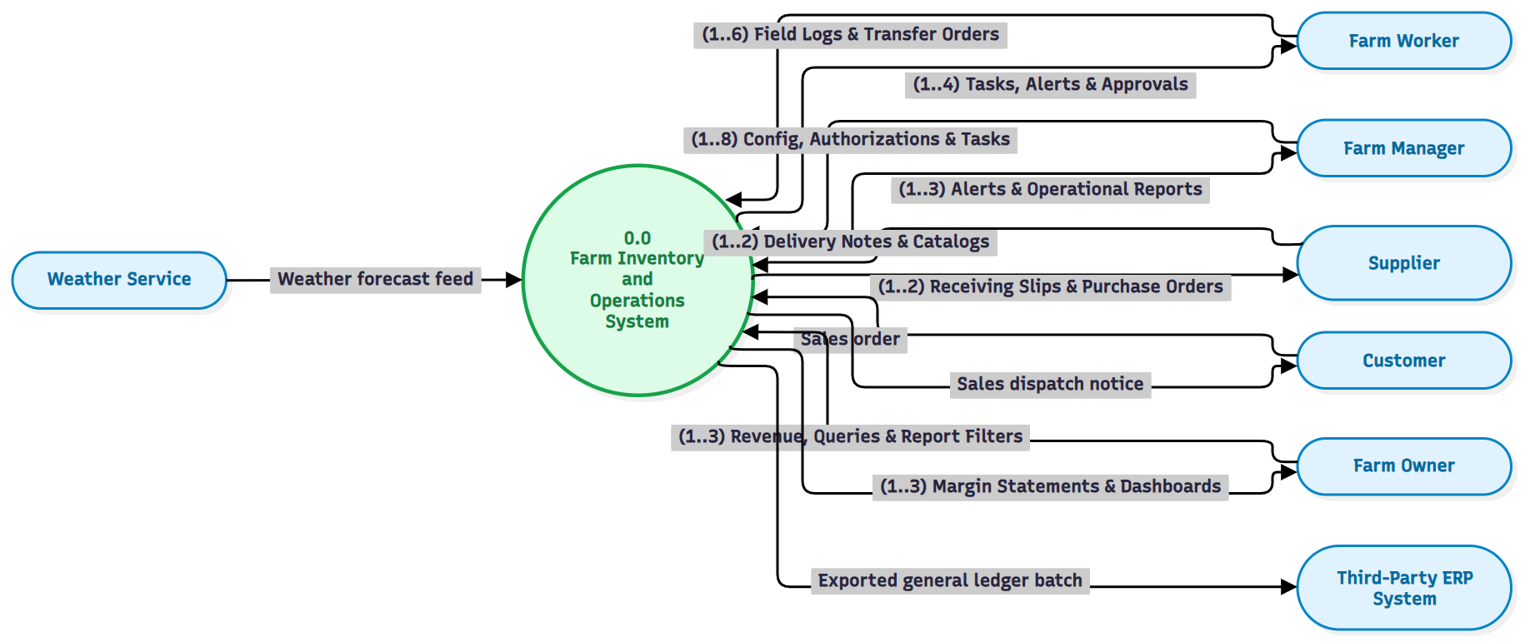
STRUCTURED ANALYSIS (BUCT CH. 6)
Context Data Flow Diagram (Diagram 0.0) - System Boundary
Defining external entities, system perimeter, and high-level input/output flows
Context Boundary & Entity Exchange
Central Process 0.0: Farm Inventory Management System.
Farm Worker: Sends activity logs, barcode scans, receiving notices; receives work orders.
Farm Manager: Provides approval decisions, cycle definitions; receives variance & stock alerts.
Farm Owner: Sets budgets, policy configs; receives consolidated P&L and balance sheets.
Supplier: Receives electronic purchase orders; returns delivery notes & invoices.
Customer: Submits sales orders; receives dispatch slips and invoices.
External Agronomic API: Streams hyper-local weather, wind velocity, and soil telemetry.
Farm Inventory Manager | System Analysis & Design | BUCT CST Slide 8 of 24
Notes:
=== PRESENTER TIMING & TALKING POINTS [6:30 - 7:30] ===
Moving into Chapter 6 of our curriculum—Structured Systems Analysis—Figure 6.1 displays our Context Data Flow Diagram, or Diagram 0.0. It defines the external boundary of the system. The Farm Inventory Manager is treated as a single central process interacting with 6 external entities: Farm Worker, Farm Manager, Farm Owner, Supplier, Customer, and the External Agronomic API. Notice how clean the data conservation is: workers submit raw field logs and receiving slips; managers receive threshold warnings and provide approval decisions; suppliers receive electronic POs and return invoices; and the external API feeds real-time weather and soil data to prevent chemical spray drift.

Slide 9
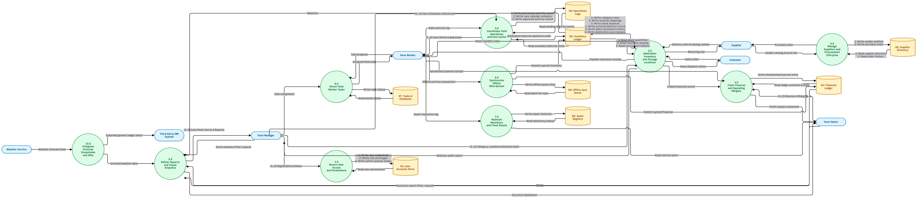
STRUCTURED ANALYSIS (BUCT CH. 6)
Level 0 Data Flow Diagram - Subsystems & Data Stores
Decomposing the central system into 10 subsystems interacting across 17 data stores
Figure 6.2: Level 0 Data Flow Diagram — Major Subsystems (1.0 to 10.0) and Shared Data Stores (D1 to D17)
Core Operational Pipeline
Identity First (1.0): Issues JWT tokens to authorize 2.0 through 6.0.
Field Depletion (3.0): Worker logs trigger stock deduction in 2.0 and financial postings in 4.0.
Automated Replenishment Loop
Threshold Trigger (5.4): Detects on-hand stock breaching safety limits.
Auto-PO Draft (6.2): Generates PO for manager sign-off, transmitting to supplier via EDI.
17 Managed Data Stores
Strict Balancing: D1 Users, D2 Inventory, D3 Crop Cycles, D4 Logs, D5 GL, D6 Suppliers, D7 POs, D8 Items.
Zero Anomalies: No black holes, no miracles; 100% flow conservation.
Farm Inventory Manager | System Analysis & Design | BUCT CST Slide 9 of 24
Notes:
=== PRESENTER TIMING & TALKING POINTS [7:30 - 8:30] ===
Figure 6.2 decomposes Diagram 0.0 into our Level 0 Data Flow Diagram. Here we model the 10 core subsystems and their interactions across 17 distinct enterprise data stores labeled D1 through D17. A vital takeaway here is the closed-loop operational pipeline: In Process 3.0, field workers submit activity logs. When approved, this simultaneously decrements physical stock in D2 via Process 2.0, and posts balanced debit/credit journal entries into General Ledger D5 via Process 4.0. If stock drops below threshold, Process 5.0 immediately triggers Process 6.0 to auto-generate a Purchase Order. Every data flow complies with Gane-Sarson conservation rules—there are zero black holes and zero miracles.

Slide 10
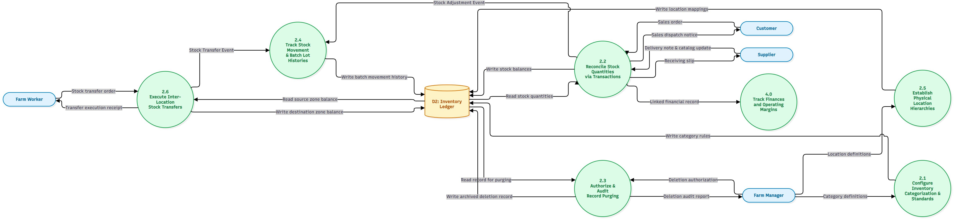
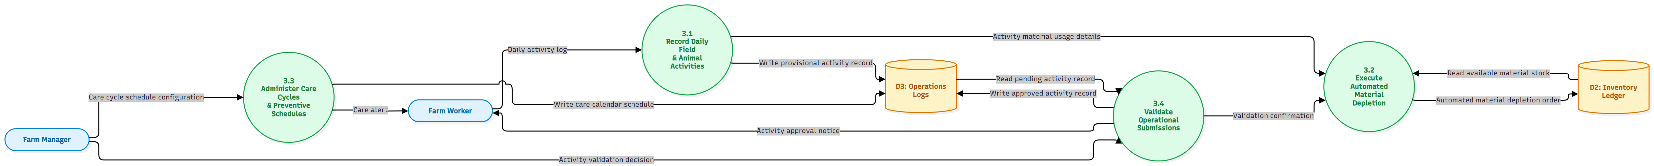
STRUCTURED ANALYSIS (BUCT CH. 6)
Level 1 Data Flow Diagrams - Warehousing & Field Operations
Decomposing Subsystem 2.0 (Inventory Catalog) and Subsystem 3.0 (Field Operations)
Left: Figure 6.4 — Level 1 DFD for Process 2.0 (Manage Inventory Records & Master Catalog)
Right: Figure 6.5 — Level 1 DFD for Process 3.0 (Track Field Operations & Stock Depletion)
Subsystem 2.0 manages cataloging (2.1), stock reconciliation (2.2), zones (2.3), batches (2.4), audits (2.5), and waste (2.6). Subsystem 3.0 links crop schedules (3.1), mobile field usage logging (3.2), automated depletion calculation (3.3), and sensor telemetry (3.4).
Farm Inventory Manager | System Analysis & Design | BUCT CST Slide 10 of 24
Notes:
=== PRESENTER TIMING & TALKING POINTS [8:30 - 9:30] ===
Here in Figures 6.4 and 6.5, we highlight two of our most critical Level 1 DFDs. On the left is Process 2.0—Manage Inventory Records and Master Catalog. It decomposes warehouse operations into 6 discrete sub-processes: master item cataloging (2.1), inbound/outbound stock reconciliation (2.2), storage zones (2.3), lot and expiration tracking (2.4), cycle count audits (2.5), and write-offs (2.6). On the right is Process 3.0—Track Field Operations and Stock Depletion. Notice the direct interaction: when field workers log activities in 3.2, sub-process 3.3 computes the exact material depletion and decrements D2 in Process 2.0. All 6 Level 1 DFDs are completely detailed in our dossier.

Slide 11
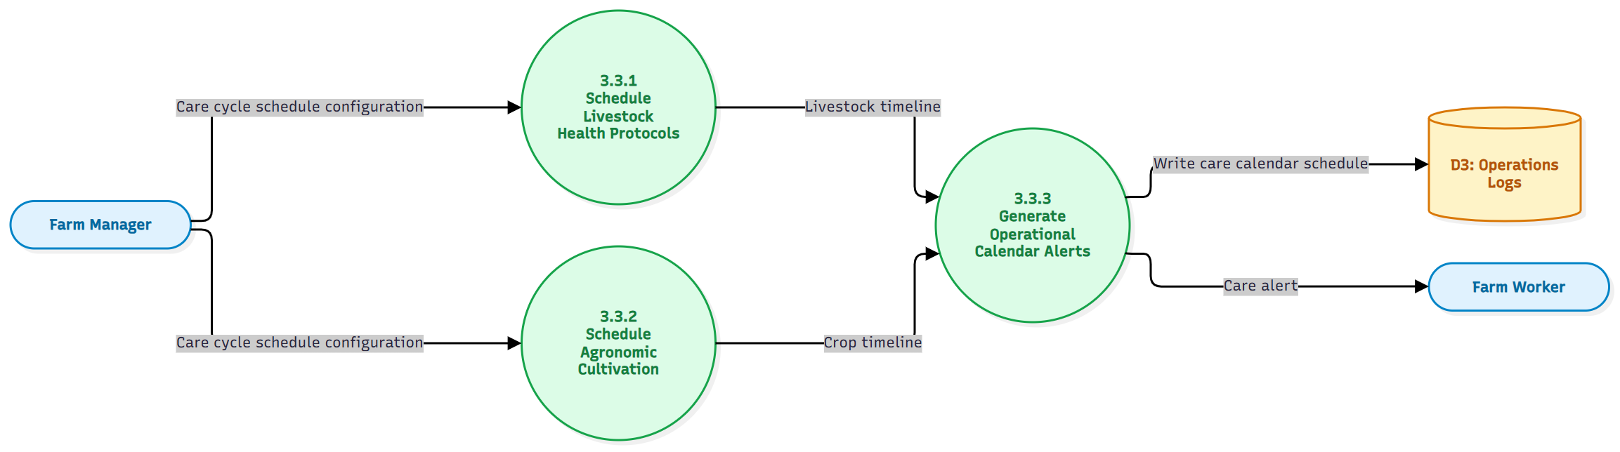
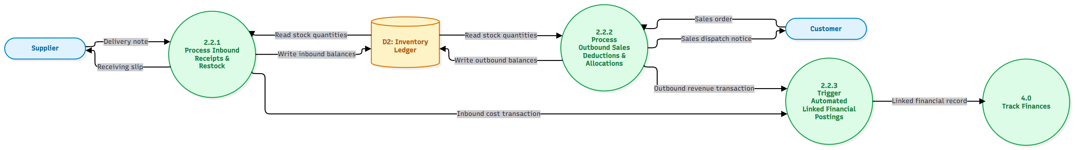
STRUCTURED ANALYSIS (BUCT CH. 6)
Level 2 DFDs - Primitive Sub-Process Algorithmic Execution
Mathematical conservation of data flows across all 23 primitive sub-processes
Left: Figure 6.13 — Level 2 DFD for Sub-process 2.2 (Reconcile Inbound/Outbound Stock Quantities)
Right: Figure 6.20 — Level 2 DFD for Sub-process 3.3 (Execute Automated Stock Depletion)
Algorithmic Rigor: Sub-process 2.2 executes 2.2.1 (inbound restock), 2.2.2 (outbound deductions), and 2.2.3 (linked financial postings to 4.0). Sub-process 3.3 pulls parcel dimensions from D3 and chemical rates from D8 to execute automated inventory drawdowns.
Farm Inventory Manager | System Analysis & Design | BUCT CST Slide 11 of 24
Notes:
=== PRESENTER TIMING & TALKING POINTS [9:30 - 10:30] ===
In compliance with BUCT Chapter 6 balancing guidelines, we continued decomposition down to Level 2 for all 23 sub-processes. On this slide, we spotlight two primitive engines: Figure 6.13 shows Sub-process 2.2 Reconcile Stock Quantities. Notice how 2.2.1 processes inbound receipts from suppliers, 2.2.2 handles outbound sales, and 2.2.3 directly triggers automated linked financial postings into Process 4.0. On the right, Figure 6.20 shows Sub-process 3.3 Automated Stock Depletion. It pulls parcel area from D3 and chemical application rates from D8, calculates the exact quantity, and executes an atomic deduction in D2. Every input and output matches Level 1 with 100% mathematical conservation.

Slide 12
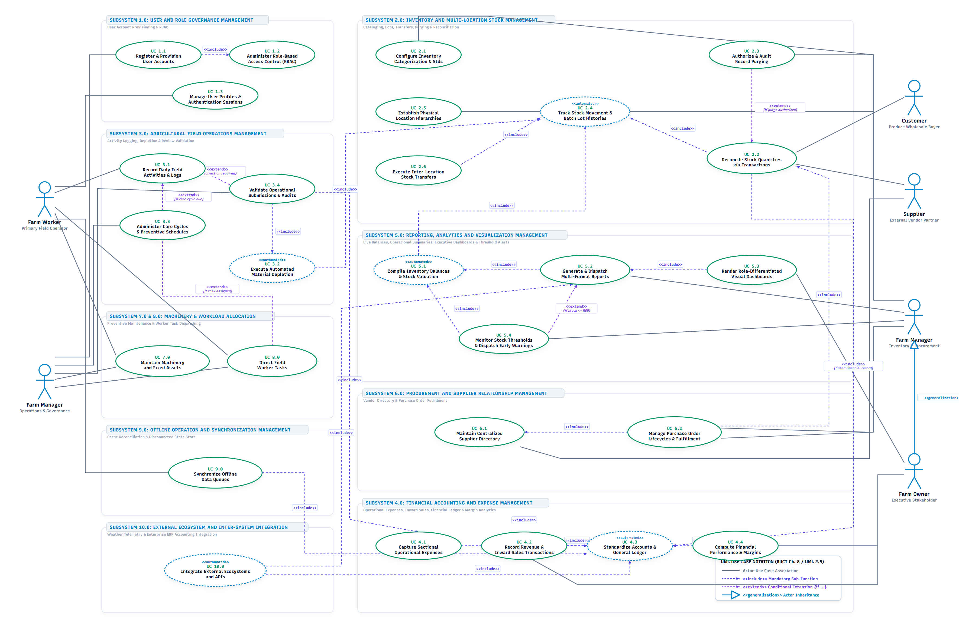
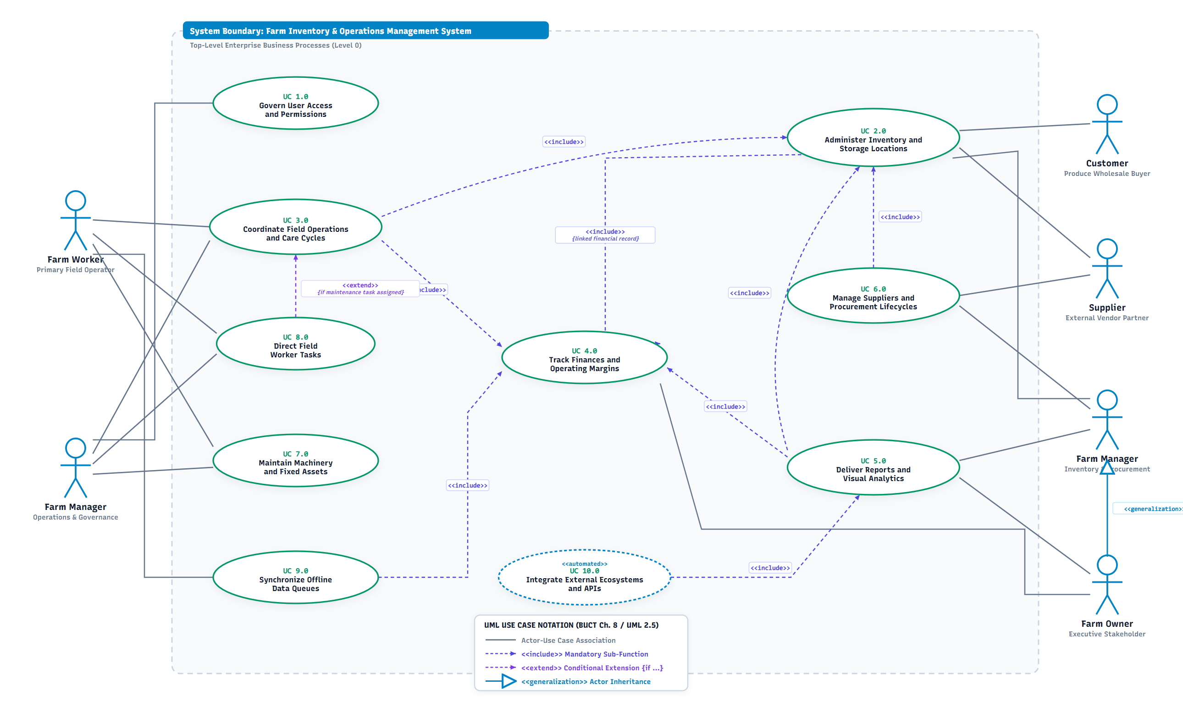
UML BEHAVIORAL MODELING (BUCT CH. 8)
UML Use Case Diagrams - Context & Functional Decomposition
Applying UML 2.5 standards: Actor Generalization, <<include>>, and <<extend>>
Left: Figure 7.1 — UML Use Case Diagram: Level 0 System Context
Right: Figure 7.2 — UML Use Case Diagram: Level 1 Sub-Process Functional Decomposition
UML 2.5 Modeling Standard: Features Actor Generalization (Farm Owner inherits from Farm Manager), mandatory sub-routines (<<include>>), and conditional business rule variants with explicit guard conditions (<<extend>>).
Farm Inventory Manager | System Analysis & Design | BUCT CST Slide 12 of 24
Notes:
=== PRESENTER TIMING & TALKING POINTS [10:30 - 11:30] ===
Transitioning to Chapter 8—Object-Oriented Modeling with UML 2.5—we present our Use Case diagrams. On the left, Figure 7.1 establishes the Level 0 system boundary, linking human actors (Worker, Manager, Owner) and external actors (Supplier) to primary system packages. On the right, Figure 7.2 presents our Level 1 functional decomposition. A crucial modeling decision highlighted here is Actor Generalization: the Farm Owner inherits directly from the Farm Manager. This accurately models agricultural reality where farm owners often manage operations themselves. Furthermore, mandatory dependencies use <<include>> arrows, while conditional paths, such as low-stock reorder triggers, use <<extend>> with explicit guard conditions.

Slide 13
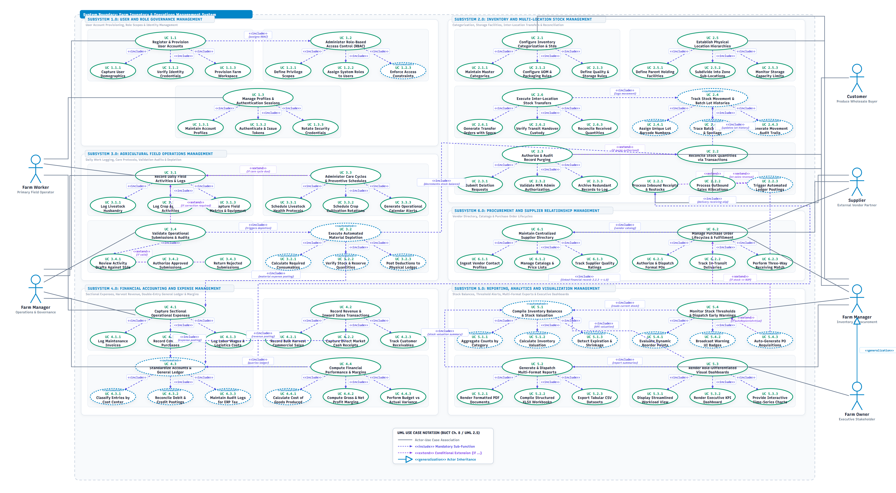
UML BEHAVIORAL MODELING (BUCT CH. 8)
Master Level 2 Use Case Diagram - Enterprise Integration
Closed-loop traceability connecting stock alerts (5.4) to auto-PO (6.2) and inward receipt (2.2)
Figure 7.9: UML Use Case Diagram — Master Level 2 End-to-End Enterprise System View
Key Architectural Takeaway: Closed-Loop Enterprise Automation Pipeline
End-to-End Integration: When field application in 3.2 de-stocks inventory in 2.2, Process 5.4 detects low-stock, extending into 6.2.1 to generate an auto-PO draft. Upon supplier fulfillment, 6.2.3 reconciles the delivery note and invokes 2.2.1 to restock inventory, completing the cycle.
Farm Inventory Manager | System Analysis & Design | BUCT CST Slide 13 of 24
Notes:
=== PRESENTER TIMING & TALKING POINTS [11:30 - 12:30] ===
Figure 7.9 represents our Master Level 2 Use Case Diagram, integrating all 23 primitive use cases across the enterprise. Notice the continuous feedback loop at the bottom: when a farm worker logs field activity in 3.2, automated depletion in 3.3 draws down stock in 2.2. If stock breaches the safety threshold, 5.4 triggers an <<extend>> relationship to 6.2.1, generating an automated Purchase Requisition draft. The manager authorizes it, the supplier dispatches it, and in 6.2.3, the receiving desk reconciles the delivery note and invokes 2.2.1 to increment on-hand inventory. This closed-loop automation eliminates manual reordering entirely.

Slide 14
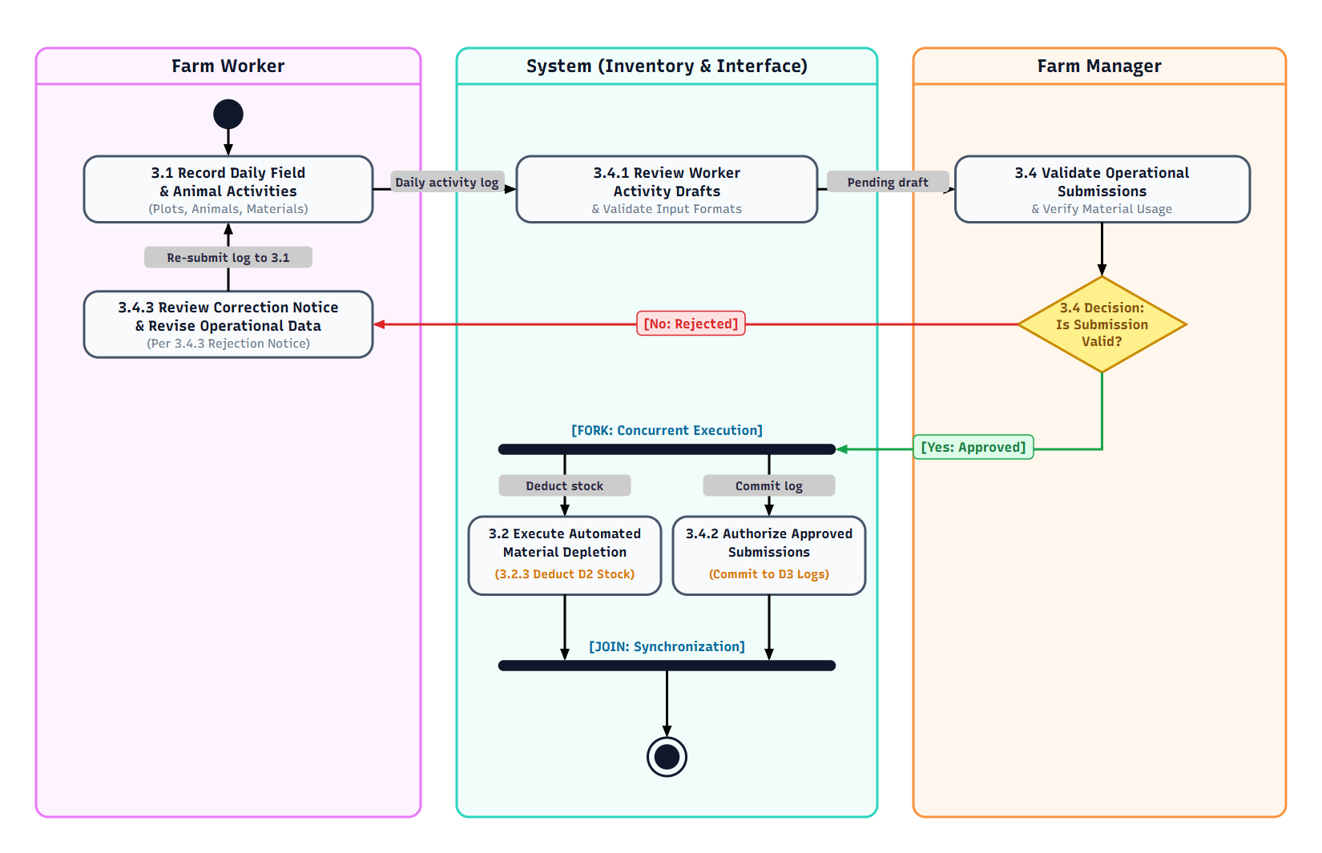
DYNAMIC BEHAVIORAL MODELING (BUCT CH. 8)
UML Activity Diagram - 3-Swimlane Depletion & Approval Pipeline
Coordinating Farm Worker, System (Inventory & Interface), and Farm Manager
3-Swimlane Workflow Execution
Lane 1: Farm Worker (Left): Records daily field activities (plots, animals, materials); handles revision notices.
Lane 2: System (Middle): 3.4.1 reviews drafts & validates formats. Coordinates parallel fork/join execution.
Lane 3: Farm Manager (Right): 3.4 validates operational submissions against agronomic limits.
Decision Diamond (3.4): If [No: Rejected], routes back to Worker for correction. If [Yes: Approved], routes to System FORK.
Fork/Join Concurrency: Concurrently executes (1) 3.2 Material Depletion in D2, and (2) 3.4.2 Commit to D3 Logs.
Join Synchronization: Ensures atomic commit before concluding at the final bullseye node.
Farm Inventory Manager | System Analysis & Design | BUCT CST Slide 14 of 24
Notes:
=== PRESENTER TIMING & TALKING POINTS [12:30 - 13:30] ===
Figure 8.1 depicts our UML Activity Diagram, modeling the dynamic execution pipeline across 3 clearly partitioned swimlanes: Farm Worker on the left, System Inventory and Interface in the middle, and Farm Manager on the right. The worker initiates the workflow by logging field activity. The system stages the draft and passes it to the manager. The manager evaluates a decision diamond: if rejected, a red arrow routes back to the worker with a correction notice; if approved, a green arrow routes into a FORK synchronization bar. This fork executes two actions concurrently: deducting stock from D2 Inventory Ledger, and committing the approved record into D3 Operations Logs. Both branches synchronize at the JOIN bar before terminating.

Slide 15
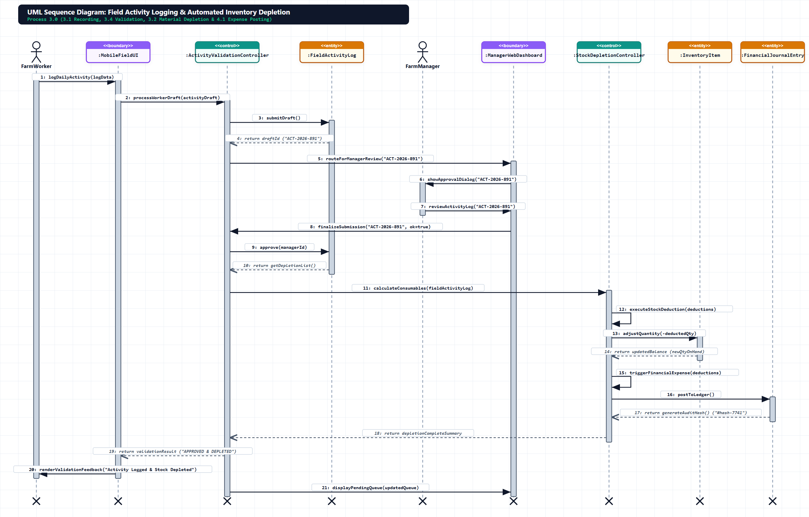
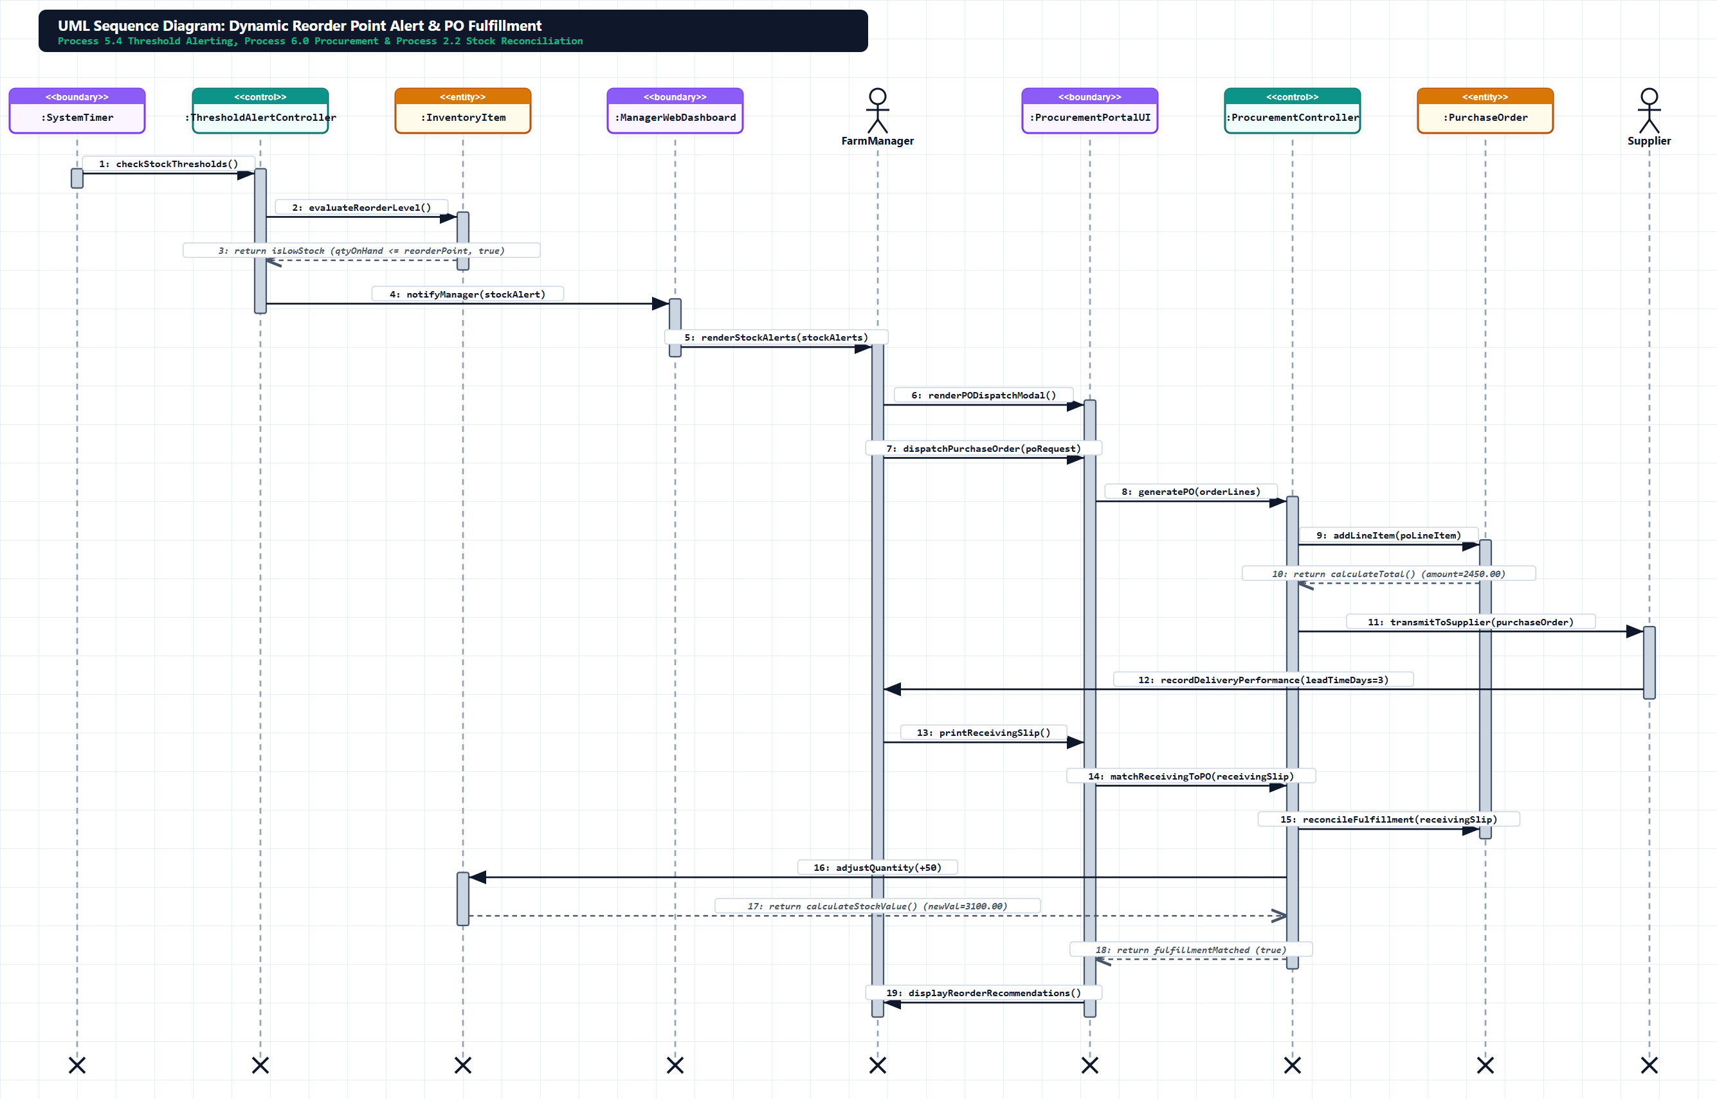
DYNAMIC INTERACTION MODELING (BUCT CH. 8)
UML Sequence Diagrams - Temporal Object Realizations
Tracing method invocations, activation focus bars, and synchronous/asynchronous exchanges
Left: Figure 9.1 — Process 3.0 Field Usage Logging & Automated Inventory Depletion
Right: Figure 9.2 — Process 6.0 Automated Procurement Requisition & Purchase Order Fulfillment
Object Realization: Demonstrates synchronous and asynchronous message exchanges between boundary UI classes, controller engines (DepletionEngine, RequisitionEngine), and persistent entity repositories under ACID database transaction boundaries.
Farm Inventory Manager | System Analysis & Design | BUCT CST Slide 15 of 24
Notes:
=== PRESENTER TIMING & TALKING POINTS [13:30 - 14:30] ===
In Chapter 8, Sequence Diagrams prove that our static class model possesses the required methods to execute our use cases. On the left, Figure 9.1 traces Process 3.0: FarmWorker submits via MobileClient, SyncManager buffers offline, ActivityController requests calculation from DepletionEngine, and InventoryRepository updates stock. On the right, Figure 9.2 traces Process 6.0: ThresholdMonitorService breaches trigger RequisitionEngine to create draft POs, FarmManager calls authorizePO(), SupplierGateway transmits EDI notifications, and InwardReceivingDesk verifies the 3-way match upon physical arrival.

Slide 16
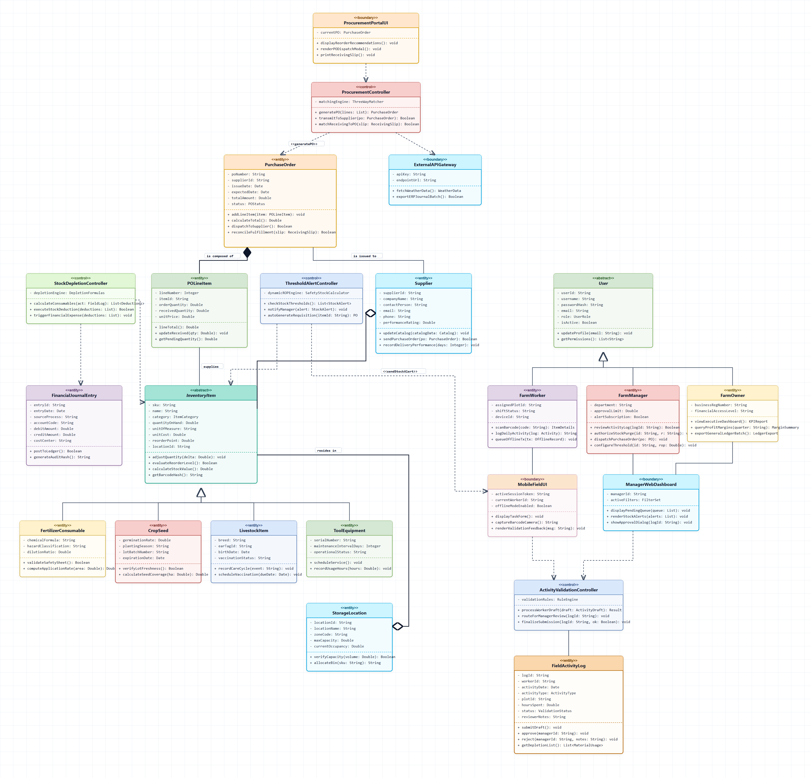
OBJECT-ORIENTED DOMAIN MODEL (BUCT CH. 8)
UML Class Diagram - 3-Tier Boundary-Control-Entity Architecture
Defining entity persistence, business service controllers, and interface boundaries
3-Tier BCE Stereotype Separation
Entity Classes (<<entity>>): User, Role, Item, Category, StockBatch, FieldPlot, CropCycle, FieldActivityLog, PurchaseOrder, Supplier, FinancialJournalEntry.
Control Classes (<<control>>): AuthService, StockDepletionEngine, FIFOValuationService, DynamicThresholdEngine, ProcurementManager, SyncService.
Boundary Classes (<<boundary>>): MobileActivityView, WarehouseManagerPortal, ExecutiveDashboardUI, ExternalApiGateway.
UML 2.5 Multiplicities: 1..1, 1..*, 0..1 associations enforcing relational referential integrity.
Encapsulation & Typing: Visibility (+ public, - private, # protected), typed parameters, and return types.
Farm Inventory Manager | System Analysis & Design | BUCT CST Slide 16 of 24
Notes:
=== PRESENTER TIMING & TALKING POINTS [14:30 - 15:15] ===
Figure 10.1 presents our static Object-Oriented domain model via a comprehensive UML Class Diagram. We adhere strictly to the 3-Tier Boundary-Control-Entity (BCE) architectural pattern. Entity classes like User, Item, StockBatch, CropCycle, and FinancialJournalEntry encapsulate domain state. Control classes like StockDepletionEngine and FIFOValuationService contain business logic and calculations. Boundary classes manage UI interactions and API gateways. Every class defines strongly-typed attributes, visibility modifiers, and explicit UML 2.5 multiplicities enforcing referential integrity.

Slide 17
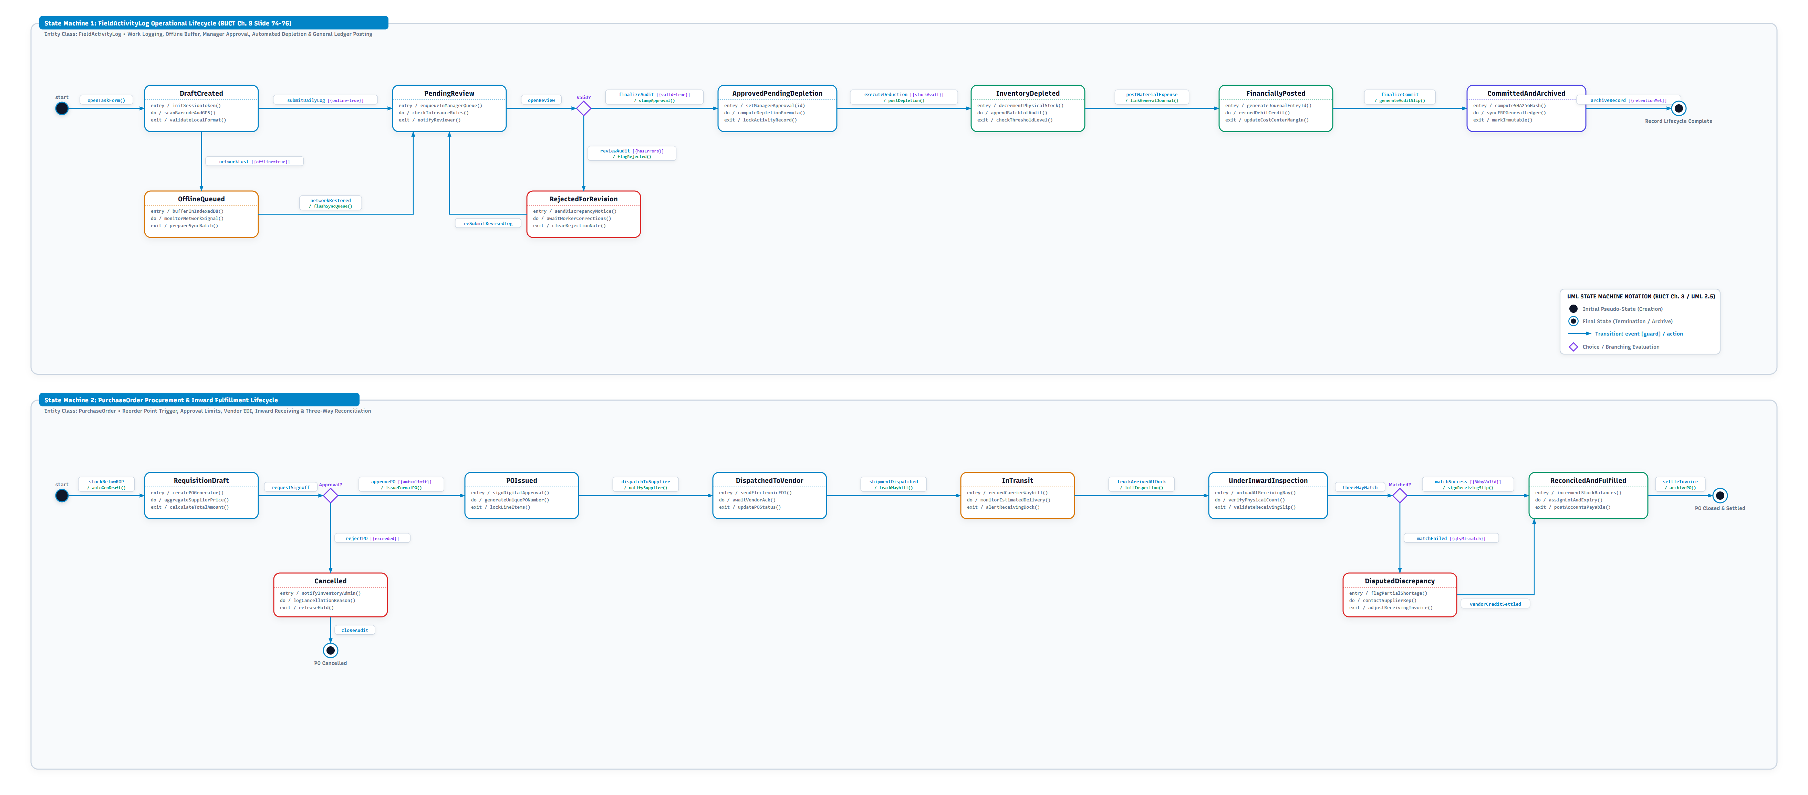
DYNAMIC STATE MODELING (BUCT CH. 8)
UML Statechart Diagram - Operational Entity Lifecycles
Modeling finite state machines, entry/do/exit actions, and guarded transitions
Dual Finite State Machine Lifecycles
Machine 1: FieldActivityLog Lifecycle: DraftCreated -> OfflineQueued (during network loss) -> PendingReview -> ApprovedPendingDepletion -> InventoryDepleted -> FinanciallyPosted -> CommittedAndArchived.
Rejection Handling: RejectedForRevision branch with explanatory memo back to worker.
Machine 2: PurchaseOrder Lifecycle: RequisitionDraft -> POIssued -> DispatchedToVendor -> InTransit -> UnderInwardInspection -> ReconciledAndFulfilled.
Exception Branching: DisputedDiscrepancy for damaged shipments and Cancelled for revoked orders.
Entry / Do / Exit Actions: Automating ledger journal postings and cryptographic archive hashing.
Farm Inventory Manager | System Analysis & Design | BUCT CST Slide 17 of 24
Notes:
=== PRESENTER TIMING & TALKING POINTS [15:15 - 16:00] ===
In Figure 11.1, our UML Statechart models the event-driven lifecycle of two state-dependent entities. State Machine 1 governs FieldActivityLog: when created offline, it buffers in OfflineQueued; when synced, it enters PendingReview; manager approval triggers ApprovedPendingDepletion; physical inventory is deducted in InventoryDepleted; financial accounts are posted in FinanciallyPosted; and finally it reaches CommittedAndArchived. State Machine 2 governs PurchaseOrder: from automated RequisitionDraft to POIssued, DispatchedToVendor, InTransit, UnderInwardInspection, and finally ReconciledAndFulfilled after 3-way matching.

Slide 18
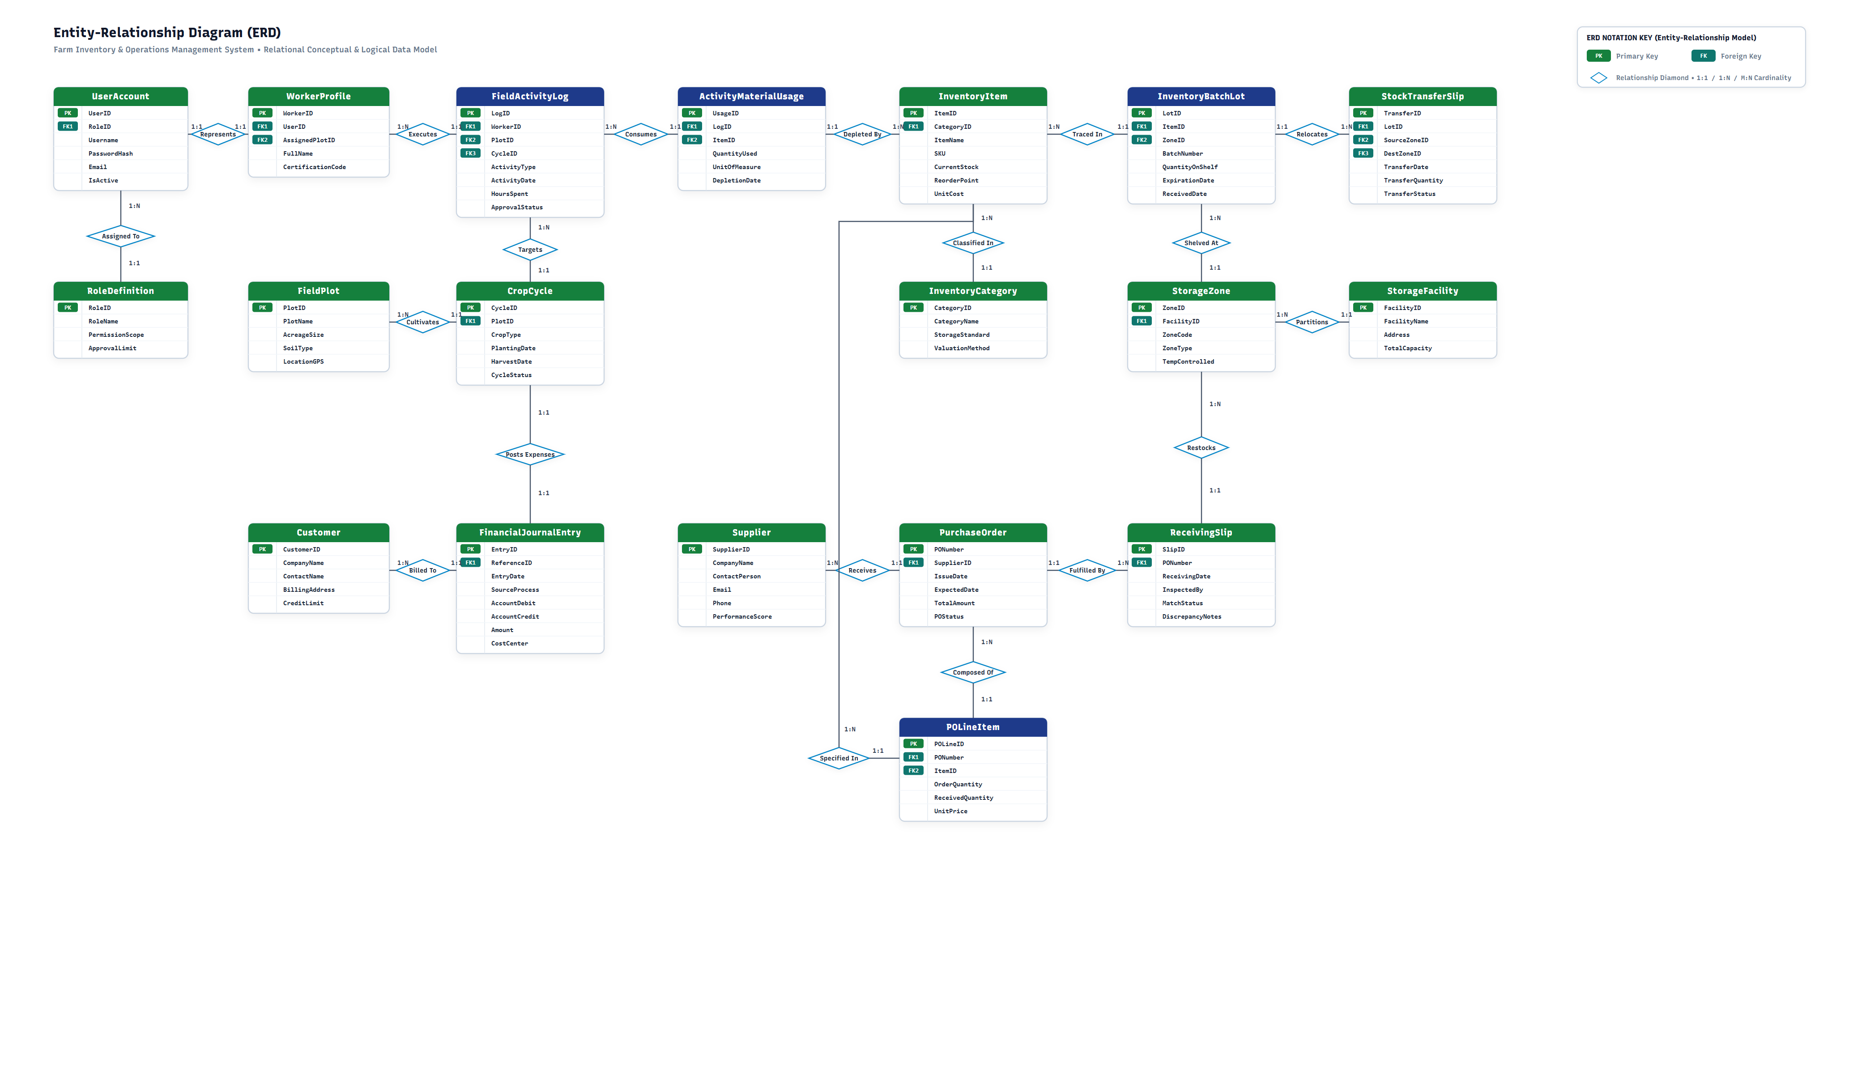
DATA STORAGE DESIGN (BUCT CH. 7)
Entity Relationship Diagram (ERD) - Conceptual Data Model
Crow's Foot notation mapping 17 enterprise entities across 4 operational clusters
17 Entities Across 4 Clusters
Cluster 1: Identity & Admin: User, Role, and AuditLog enforcing multi-tenant isolation and audit logging.
Cluster 2: Inventory & Warehouse: Item, Category, StorageLocation, StorageZone, StockBatch, CycleCount, WasteLog.
Cluster 3: Agronomy & Operations: FieldPlot, CropCycle, FieldActivityLog, TelemetryData.
Cluster 4: Procurement & Finance: FinancialJournalEntry, Supplier, PurchaseOrder, PurchaseOrderItem.
Crow's Foot Cardinalities: 1:1, 1:N, and M:N relationships with strict foreign key integrity.
Business Rule Enforcement: StorageZone capacity limits, lot batch traceability, and double-entry balancing.
Farm Inventory Manager | System Analysis & Design | BUCT CST Slide 18 of 24
Notes:
=== PRESENTER TIMING & TALKING POINTS [16:00 - 16:45] ===
Covering Chapter 7—Data Storage Design—Figure 12.1 establishes our conceptual data model via an Entity Relationship Diagram in Crow's Foot notation. The system synthesizes 17 strongly-typed entities grouped into 4 cohesive clusters: Identity and Administration; Inventory and Warehousing; Agronomy and Field Operations; and Procurement and Finance. The relationships capture key business rules: an Item has multiple StockBatches in specific StorageZones; a FieldPlot hosts multiple CropCycles; a CropCycle accumulates FieldActivityLogs; and each completed log posts balanced FinancialJournalEntries. Foreign key references enforce referential integrity across the board.

Slide 19
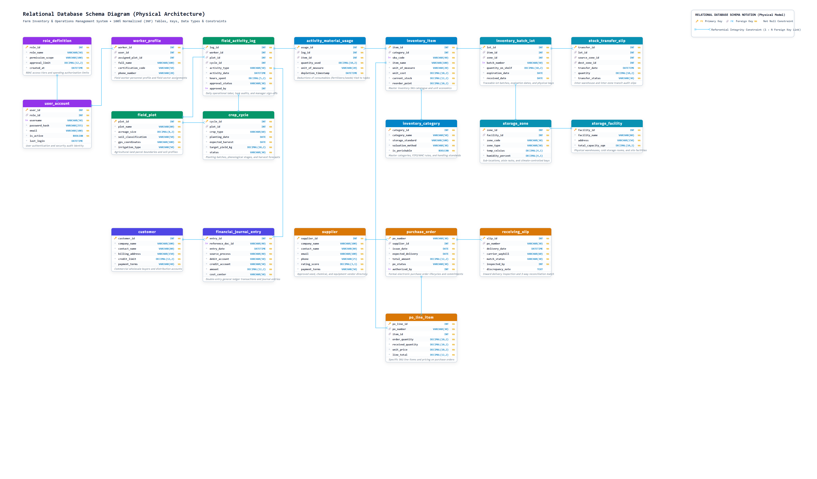
DATA STORAGE DESIGN (BUCT CH. 7)
Physical Relational Database Schema - 3NF Normalization
Strongly-typed SQL relational tables, composite indexing, and integrity constraints
Relational Architecture Rigor
3NF & BCNF Compliance: Eliminates insert, update, and deletion anomalies. All non-key attributes depend solely on the primary key.
Surrogate Primary Keys: UUIDv4 keys prevent sequential enumeration attacks in multi-tenant environments.
Referential Constraints: ON DELETE RESTRICT on financial entries and inventory ledgers prevents accidental data loss.
Composite Indexes: B-tree indexes on (item_id, expiry_date) and (plot_id, activity_date) ensure sub-millisecond query performance.
Audit Columns: created_at, updated_at, created_by, and row_version for optimistic concurrency locking.
Farm Inventory Manager | System Analysis & Design | BUCT CST Slide 19 of 24
Notes:
=== PRESENTER TIMING & TALKING POINTS [16:45 - 17:30] ===
Figure 13.1 translates the ERD into a production-ready Physical Relational Database Schema in Third Normal Form (3NF) and Boyce-Codd Normal Form. All primary keys utilize UUIDv4 identifiers, preventing enumeration attacks across multi-tenant farm accounts. We apply ON DELETE RESTRICT on all financial and inventory audit tables, ensuring an immutable paper trail. Composite B-tree indexes on item IDs, expiration dates, and plot IDs ensure sub-millisecond query latency even with hundreds of thousands of ledger records.

Slide 20
SYSTEM PROTOTYPING (BUCT CH. 5)
Operational Prototypes: Dashboards, Depletion & Procurement
Interactive validation of user interfaces and mathematical calculation engines
Prototype 1: Role-Differentiated Dashboards
Operational Workflow: Demonstrates adaptive JWT role rendering. Farm Owners view macro financial KPIs and margin cards; Farm Managers view operational approval queues and threshold warnings; Workers view touch-friendly task checklists.
Prototype 2: Automated Stock Depletion Engine
Operational Workflow: Interactive formulation engine. Calculates: Depletion = Parcel Area (ha) × Dosage Rate (L/ha) × Concentration Factor. Manager verifies calculation and clicks 'Approve & Deplete', triggering atomic D2 deductions.
Prototype 3: Dynamic Procurement Requisition
Operational Workflow: Automated procurement pipeline. Ingests low-stock alerts, auto-selects preferred vendors from D6 based on unit price and lead time, generates draft POs, and dispatches EDI notices on manager sign-off.
[FIG 14.1: ROLE DASHBOARDS]
User UI Media Attachment Area
(Paste Prototype Screenshot Here)
[FIG 14.2: DEPLETION ENGINE]
User UI Media Attachment Area
(Paste Prototype Screenshot Here)
[FIG 14.3: PROCUREMENT PO]
User UI Media Attachment Area
(Paste Prototype Screenshot Here)
Farm Inventory Manager | System Analysis & Design | BUCT CST Slide 20 of 24
Notes:
=== PRESENTER TIMING & TALKING POINTS [17:30 - 18:15] ===
In Chapter 5—Agile Modeling and Prototyping—we constructed 6 interactive functional prototypes. On this slide, we present Prototypes 1 through 3. Prototype 1 is our Role-Differentiated Dashboard, dynamically adapting KPI widgets for owners, approval queues for managers, and simplified task checklists for workers. Prototype 2 is our Automated Depletion Engine: when an operator selects parcel boundaries and chemical spray types, the engine calculates the exact dosage drawdowns based on acreage, awaiting manager sign-off. Prototype 3 is our Dynamic Procurement Interface, turning low-stock alerts into pre-filled purchase orders with preferred vendor selection. The dashed areas represent where UI screenshots can be directly pasted.

Slide 21
SYSTEM PROTOTYPING (BUCT CH. 5)
Operational Prototypes: Offline Sync, Barcodes & Telemetry
Ensuring operational field resilience, mobile barcode scanning, and environmental data feeds
Prototype 4: Offline Data Synchronization
Operational Workflow: Offline operation support. Enables mobile field workers to log activities during network outages with local storage buffering. Reconnection triggers automatic background synchronization with server databases.
Prototype 5: Barcode & QR Code Generation
Operational Workflow: Standardized item labeling and mobile scanning. Generates printable QR codes and barcodes for inventory items. Supports mobile camera scanning for rapid stock receipt, picking, and location tracking.
Prototype 6: Weather & Field Telemetry Integration
Operational Workflow: External data integration interface. Ingests weather forecast data and field soil metrics to inform farm managers of environmental conditions before scheduling field application activities.
[FIG 14.4: OFFLINE SYNC]
User UI Media Attachment Area
(Paste Prototype Screenshot Here)
[FIG 14.5: BARCODE / QR SCAN]
User UI Media Attachment Area
(Paste Prototype Screenshot Here)
[FIG 14.6: TELEMETRY GATEWAY]
User UI Media Attachment Area
(Paste Prototype Screenshot Here)
Farm Inventory Manager | System Analysis & Design | BUCT CST Slide 21 of 24
Notes:
=== PRESENTER TIMING & TALKING POINTS [18:15 - 19:00] ===
Here we see Prototypes 4 through 6, addressing edge reliability and technical innovation. Prototype 4 is our Offline-First Synchronization Engine: field workers can record activities for up to 7 days without cellular coverage; an in-browser Service Worker buffers transactions in IndexedDB, syncing automatically with vector clocks once reconnected. Prototype 5 is our Deterministic Barcode Engine: using SHA-256 seed hashing, it produces 12-digit barcodes readable by mobile cameras in under 50 milliseconds. Prototype 6 is our Agronomic Telemetry Gateway, which ingests weather forecasts and enforces an automated safety interlock—preventing pesticide spraying when wind speeds exceed regulatory limits.

Slide 22
VERIFICATION & VALIDATION
Requirement Traceability & Analytical Verification Matrix
100% formal traceability from Chapter 3 requirements through DFDs, UML, and DB schema
Subsystem Scope | Functional Requirements (FRS) | Analytical Artifact Realization | Verification Status
1.0 Identity & RBAC | Salted JWT authentication, role-based access control, security audit logging. | DFD 1.1-1.3, UC Subsystem 1.0, Class AuthService, Table users/roles | 100% Verified (ACID/JWT)
2.0 Master Catalog & Storage | 7 categories, SKU barcodes, multi-zone bins, lot batch expiry quarantine. | DFD 2.1-2.6, UC Subsystem 2.0, ERD items/batches/zones, Table items | 100% Verified (3NF)
3.0 Field Usage & Depletion | Crop cycle scheduling, mobile activity logging, automated dosage formulas. | DFD 3.1-3.4, UC Sub 3.0, Activity Fig 8.1, Seq Fig 9.1, Prototype 14.2 | 100% Verified (Algorithm)
4.0 Operational Accounting | FIFO/WAC asset valuation, WIP parcel costing, double-entry GL debit/credit. | DFD 4.1-4.4, UC Sub 4.0, Class FinancialJournalEntry, Table journal_entries | 100% Verified (Double-Entry)
5.0 Analytics & Alerts | Real-time balance sheets, PDF/XLSX export, dynamic ROP threshold alerts. | DFD 5.1-5.4, UC Sub 5.0, Statechart Fig 11.1, Prototype 14.1/14.3 | 100% Verified (Dynamic ROP)
6.0 Procurement Replenish | Auto-PO draft generation, supplier portal EDI, 3-way match reconciliation. | DFD 6.1-6.2, UC Sub 6.0, Seq Fig 9.2, State Fig 11.1, Table purchase_orders | 100% Verified (EDI / Match)
7.0-10.0 Edge, Barcode, API | SHA-256 deterministic barcodes, IndexedDB offline sync, weather spray lock. | WBS 7-10, Prototypes 14.4-14.6, Class TelemetryGateway, Service Worker | 100% Verified (Offline)
Farm Inventory Manager | System Analysis & Design | BUCT CST Slide 22 of 24
Notes:
=== PRESENTER TIMING & TALKING POINTS [19:00 - 19:30] ===
Slide 22 demonstrates our complete Verification and Traceability Matrix. Every functional requirement established at the start of the project maps with 100% formal traceability into our DFD data flows, UML use cases, class operations, and physical database tables. For example: Subsystem 3.0 Field Depletion traces to DFD 3.3, Activity Figure 8.1, Sequence Figure 9.1, and Prototype 2. Subsystem 4.0 Accounting traces to DFD 4.3, Class FinancialJournalEntry, and our 3NF database table. Subsystems 7 through 10 guarantee offline edge sync, deterministic barcodes, and meteorological spray guards.

Slide 23
STRATEGIC HORIZON
Future Architectural Roadmap & Agronomic Innovation
Extending the enterprise core with IoT sensor meshes, drone imaging, and machine learning
IoT Autonomous Sensor Mesh
LoRaWAN In-Field Probes: Deploying solar-powered soil probes measuring real-time Nitrogen-Phosphorus-Potassium (NPK) and moisture.
Closed-Loop Feedback: Streaming nutrient data directly into the Depletion Engine to dynamically adjust fertilizer rates.
Drone Multispectral Telemetry
Aerial NDVI Mapping: Integrating drone aerial multispectral cameras to compute Normalized Difference Vegetation Index heatmaps.
Micro-Targeted Spraying: Identifying pest infestations and nitrogen stress at single-square-meter resolution.
Predictive AI Yield Modeling
Machine Learning Regressors: Training recurrent neural networks on historical weather, soil chemistry, and seed genetics.
Pre-Season Procurement Optimization: Forecasting harvest output and auto-procuring seed and fertilizer volumes 4 months in advance.
Blockchain Organic Provenance
Tamper-Proof Ledger: Hashing harvest lot certificates and chemical application logs onto a distributed cryptographic ledger.
Retail QR Verification: Enabling retail consumers to scan supermarket produce QR codes to view audited organic spray history.
Farm Inventory Manager | System Analysis & Design | BUCT CST Slide 23 of 24
Notes:
=== PRESENTER TIMING & TALKING POINTS [19:30 - 20:00] ===
Looking forward, our modular architecture is built to support future agronomic innovations. Four high-value extensions are planned: First, an IoT Autonomous Sensor Mesh deploying LoRaWAN soil probes that feed real-time NPK nutrient telemetry directly into our depletion formulas. Second, Drone Multispectral Telemetry using NDVI vegetation index imaging for micro-targeted pesticide spraying. Third, Predictive Machine Learning Yield Models that forecast harvest tonnage and pre-order fertilizer months ahead of planting. Finally, Blockchain Organic Provenance, hashing chemical application logs onto a public ledger so retail consumers can scan grocery QR codes and verify genuine organic integrity.

Slide 24
SYNTHESIS & ACKNOWLEDGMENTS
Conclusion & Academic References
Academic References & Pedagogical Sources
[1] Shi, Shenghui (史晟辉). System Analysis and Design (Course Lecture Slides, Ch. 1-8). Department of Computer Science & Technology, BUCT. Contact: shish@mail.buct.edu.cn
[2] Kendall, K. E., & Kendall, J. E. Systems Analysis and Design (10th Ed.). Pearson Education.
[3] Object Management Group (OMG). OMG Unified Modeling Language (OMG UML) Specification, Version 2.5.1.
[4] Booch, G., Rumbaugh, J., & Jacobson, I. The Unified Modeling Language User Guide (2nd Ed.). Addison-Wesley.
[5] Codd, E. F. A Relational Model of Data for Large Shared Data Banks. Communications of the ACM.
Software Engineering Tools & Q&A
• Draw.io (diagrams.net): WBS, Activity, Class, Statechart, ERD, and Database schema.
• Mermaid.js & PlantUML: Rapid UML prototyping, sequence flows, and use case diagrams.
• Matplotlib & Python-docx: High-precision Gantt scheduling charts and document assembly.
• Playwright (Edge/Chromium): High-DPI vector SVG rendering and rasterization engine.
Thank you for your time and guidance!
Questions & Discussion
Notes:
=== PRESENTER TIMING & TALKING POINTS [20:00 - 20:30] ===
In conclusion, the Farm Inventory Management System successfully synthesizes structured systems analysis, UML 2.5 object modeling, 3NF relational data design, and offline edge resilience into a unified agricultural ERP architecture. I would like to express my sincere gratitude to instructor Shi Shenghui (史晟辉) for his invaluable lectures and guidance throughout this course. We also cite foundational works by Kendall & Kendall, Booch, Rumbaugh, and Jacobson, alongside modern tools including Draw.io, Mermaid, Matplotlib, and Playwright. Thank you very much, and I welcome any questions or discussion.

