Slide 1

Machine Learning Final Exam
Introduction to ML: Developing Notebook
By Fernando Reyes, Ali Shan, Edwin Marquez, Kendrick Robinson

Slide 2



What's This Notebook About?
Solving a Problem
Step-by-Step Guide
Real-World Skills
Using machine learning to predict customer churn (if a customer will leave).
Learn how to prepare data, train models, and check results.
Practice essential steps for building and evaluating ML solutions.

Slide 3
Our Practice Dataset
We're using a made-up dataset that looks like real customer information.
Mixed Data
Some Missing Info
Churn Prediction
Includes numbers (like age, income) and categories (like region, plan type).
Just like real data, some parts are missing, which we'll fix.
Each customer has a "target" label: whether they churned or not.

Slide 4
Key Step 1: Data Preparation
Before training, we clean and organize our data.
01
02
03
Split Data
Handle Missing Data
Transform Data
Divide into training (60%), validation (20%), and testing (20%) sets.
Fill in gaps using smart methods (like median for numbers, most common for categories).
Convert text categories into numbers and scale all numbers so they're comparable.

Slide 5
Key Step 2: Training Our Models
We use two different machine learning models to learn from the data.
Logistic Regression
Random Forest
A simpler model, good for understanding how different factors influence churn.
A more complex model that uses many "decision trees" to make predictions.
We "tune" these models to find the best settings for accuracy.

Slide 6

Results: Model Performance
After training, we check how well our models predict churn.
Best Model Settings
Logistic Regression: C=0.1 (AUC: 0.9676)
Random Forest: max_depth=10, n_estimators=200 (AUC: 0.9781)
The Random Forest model performed slightly better on our validation data.

Slide 7
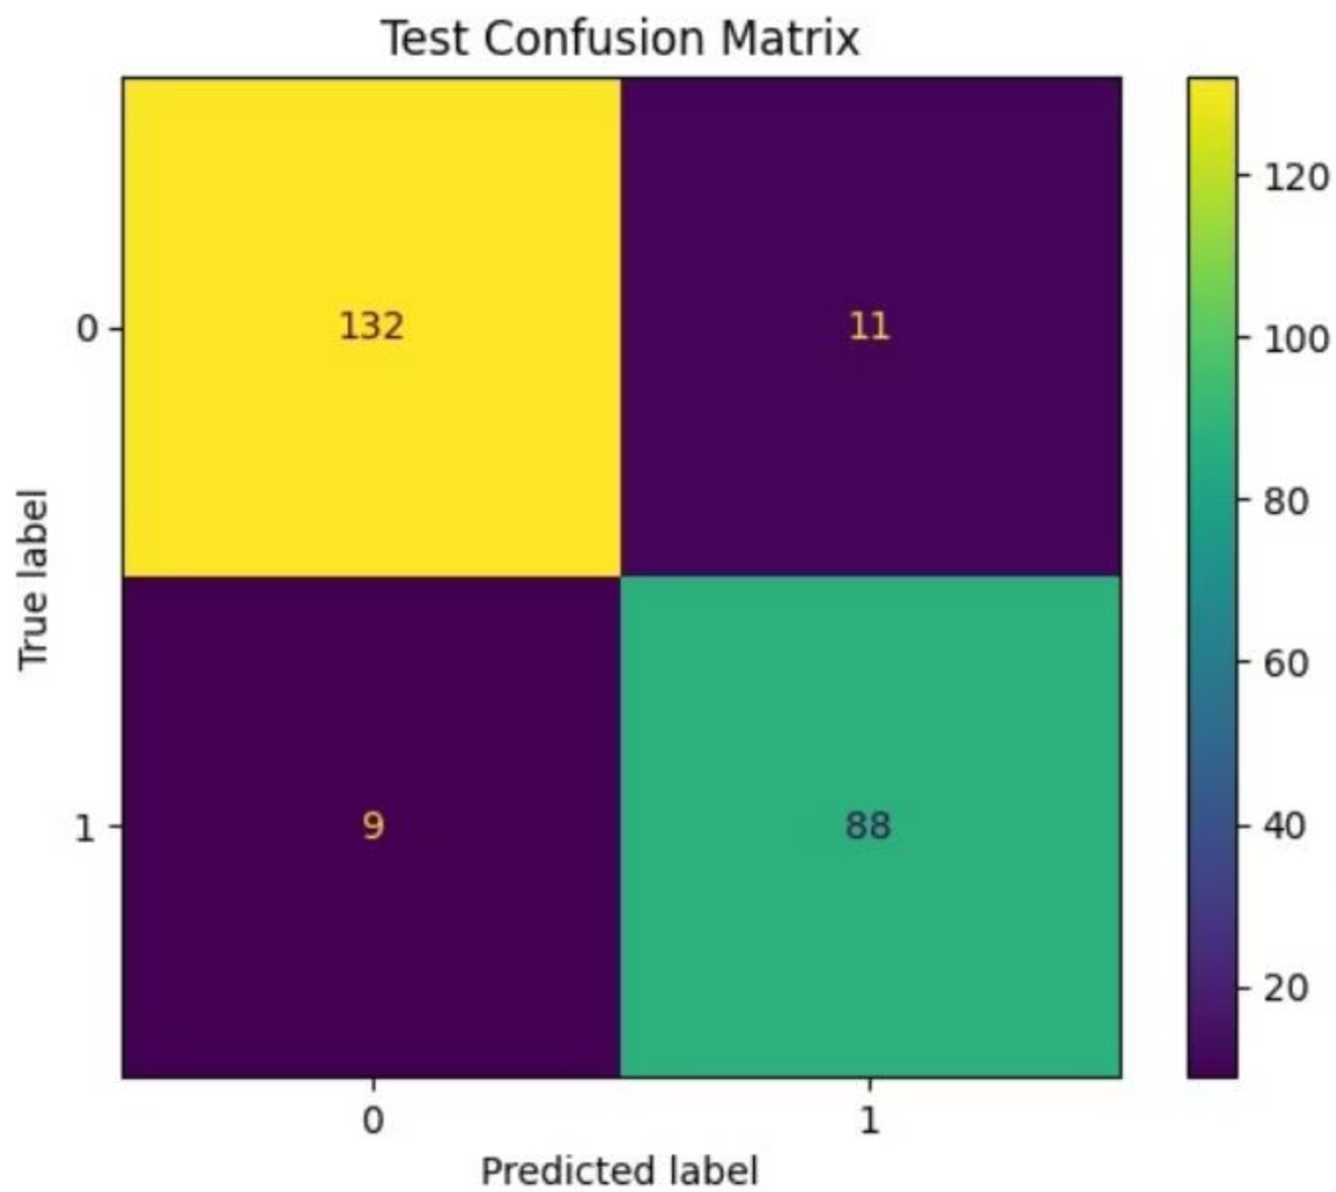
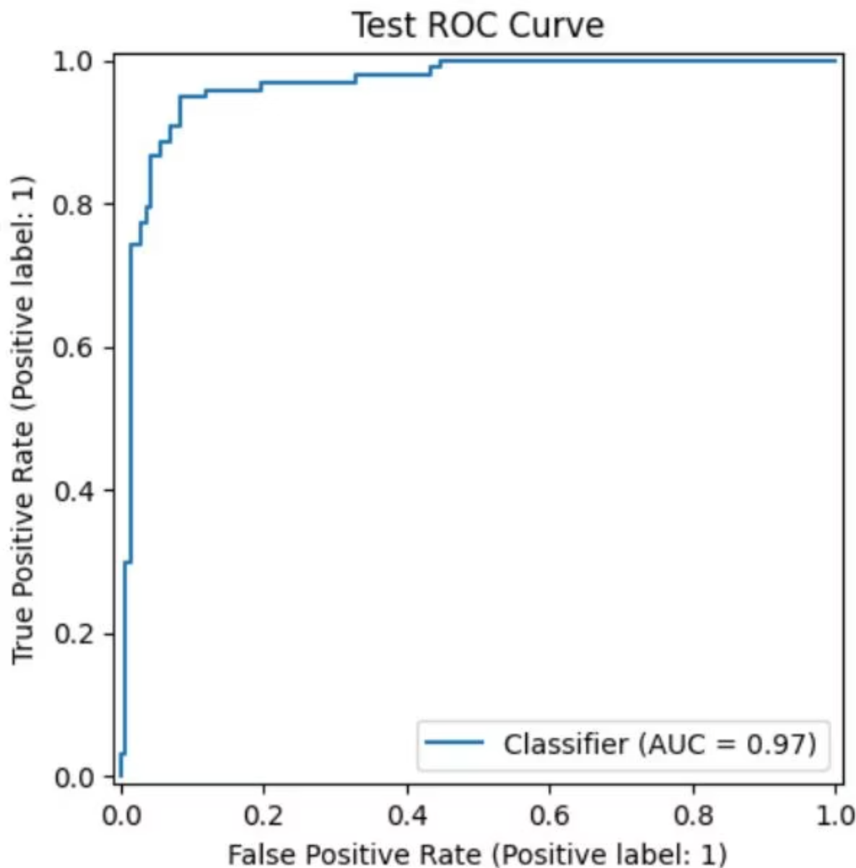
Results: Test Performance
We use the best model on completely new data (test set) to see its true performance.
Test ROC-AUC: 0.9655

Slide 8
What Do These Results Mean?
Class Imbalance
Random Forest Wins
ROC-AUC is Key
If churners are rare, we might need special techniques to make sure the model doesn't ignore them.
It was slightly better at predicting churn, likely because it can find more complex patterns.
This metric helps us see how well the model tells the difference between churners and non-churners, especially important when one group is smaller.

Slide 9







Key Learning Points from the ML Project
Our journey through this machine learning project provided valuable lessons about the entire ML process and its real-world complexities.
Data Preparation is Foundational
Choosing the Right Model
We learned that meticulous data cleaning, feature engineering, and understanding data distributions are crucial first steps. Ignoring these can lead to flawed models, regardless of algorithm choice.
The project highlighted that there's no one-size-fits-all model. Understanding the strengths and weaknesses of simpler versus complex algorithms, and when each is appropriate, is vital for effective problem-solving.
Beyond Accuracy: Proper Evaluation
Real-World ML Challenges
The project exposed us to practical challenges like class imbalance, data drift, and the trade-off between model performance and interpretability, emphasizing that ML is as much art as it is science.
Evaluating models goes beyond simple accuracy. We discovered the importance of metrics like ROC-AUC, precision, recall, and F1-score, especially with imbalanced datasets, to truly understand a model's performance in a real-world context.

