Slide 1
Energy-Aware Environment
Configuration in Simulation-Based
Testing of Autonomous Vehicles
Student: Rodrigo Friaes
Supervisors: Sandro Hernández Goicochea · Grégory Loubet-Bonino
Seminar in Software Engineering · Spring 2026

Slide 2
Agenda
01
Context & Motivation
02
Research question & Goal
03
Methodology
Why energy matters in AV simulation
Research questions & optimization objective
Study design and planned experimental setup
04
Implementation
05
Testing
06
Plan to Final
Survival test oracle & Measurement infra
Current status, findings, and open decisions
Milestones, configuration sweep, analysis

Slide 3
Context & Motivation
01
⚙
⚡
✓
?
CARLA Sim
AV validation at scale — 1000s of runs per campaign
High Energy Cost
GPU & CPU energy is a real and growing cost of simulation
Oracle Verdict
Pass / Fail based on safety metrics (collisions, lane, distance)
Hypothesis
Could config changes cut energy without changing the verdict?

Slide 4
Research Question & Project Goal
02
Research Question
Can simulation energy consumption be reduced by adjusting environment configurations while preserving the test verdict?
Project Goal
Optimization Objective
Find a configuration c* that minimizes energy
subject to: oracle verdict preserved

Slide 5



Methodology
03
The Test Tuple
Subject
Baseline configuration
Define:
Comparison and analysis
Driving Test Scenario
Oracle Metrics & Baseline
survival_test.py
Capture CPU/GPU Energy
Implement Measurement Scripts
measure_cpu/gpu_energy.py

Slide 6
Driving Test Scenario: Survival Test
04
Oracle Metrics
Why a Survival Test?
Collisions
The ego vehicle drives autonomously for a fixed time window. The oracle checks continuously for safety violations — not just whether a goal was reached. This allows energy to be measured over a reproducible, fixed-duration scenario.
Detected via collision sensor.
Lane Invasions
Each crossing is recorded with the marking type.
Test Execution Flow
Forward Clearance
Detected via Lidar sensor.
Spawn ego + 10 Vehicles
Enable autopilot
Run for 60 seconds
Metrics Results
Distance Traveled
Total ego displacement.

Slide 7
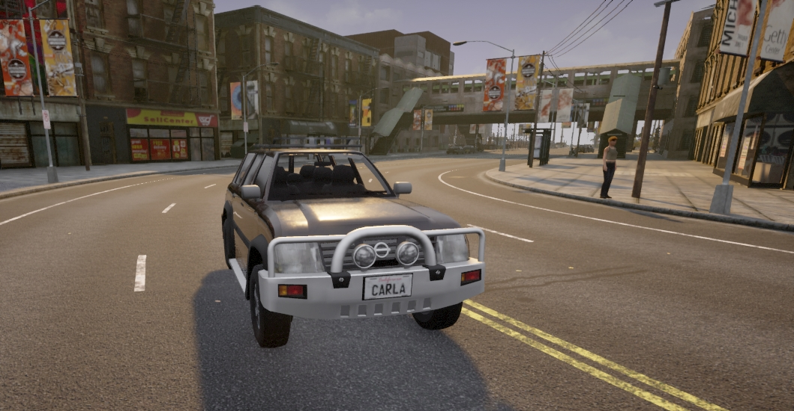
Baseline Configuration & Oracle Calibration
05
Baseline Configuration (c₀)
Oracle Observed Behaviour
Collisions: Always 0 across all runs
Lane invasions: Broken lane marks only (not a violation)
Distance traveled: Varies between x and y (m)
Min distance to NPC: Varies between a and b (m)
Map: Town10
Quality level: Epic
LiDAR points/s: 10k
Physics step: Default (0.05)
Weather: Default (clear noon)
NPC actors: 10
Execution: Synchronous mode
✓ PASS Oracle
✗ FAIL Oracle
Ands Collisions = 0
No invasion (except broken)
Distance traveled ≥ x
Min distance ≤ b
Ors Collisions > 0
Any non-broken lane invasion
Distance traveled > y
Min distance < a

Slide 8
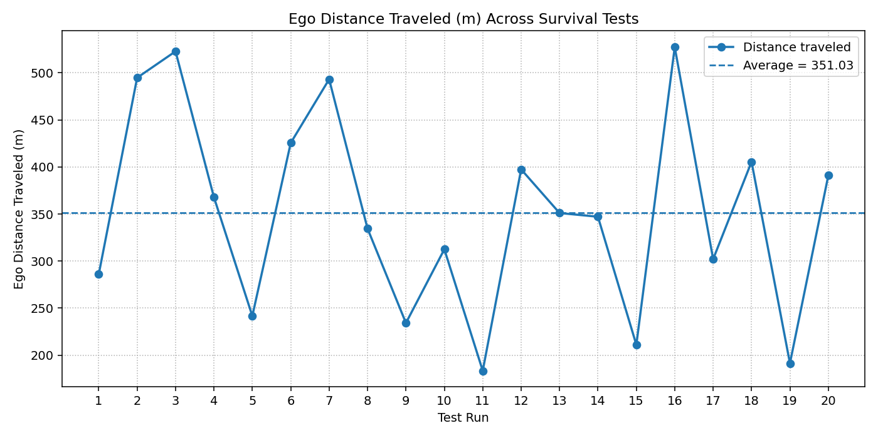
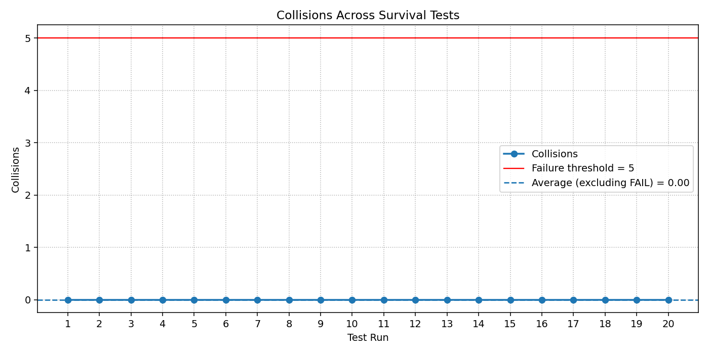
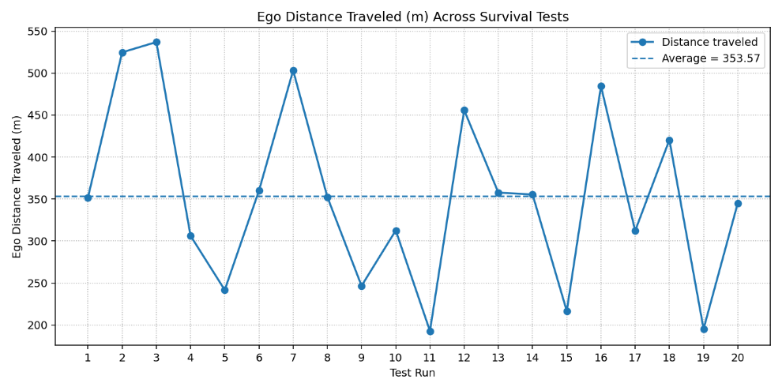
Batch Testing - Oracle Results
06
Collisions:
Distance Traveled:
Oracle Baseline:
Oracle Baseline:
Oracle PASS: Collisions = 0
Oracle PASS: Distance Traveled < 550
Oracle FAIL: Collisions > 0
Oracle FAIL: Distance Traveled < 150

Slide 9
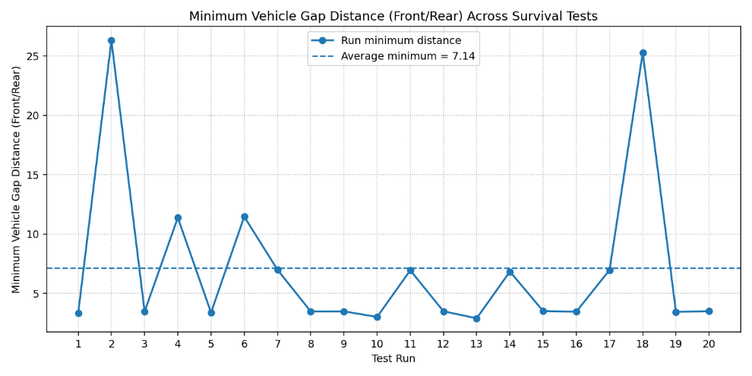
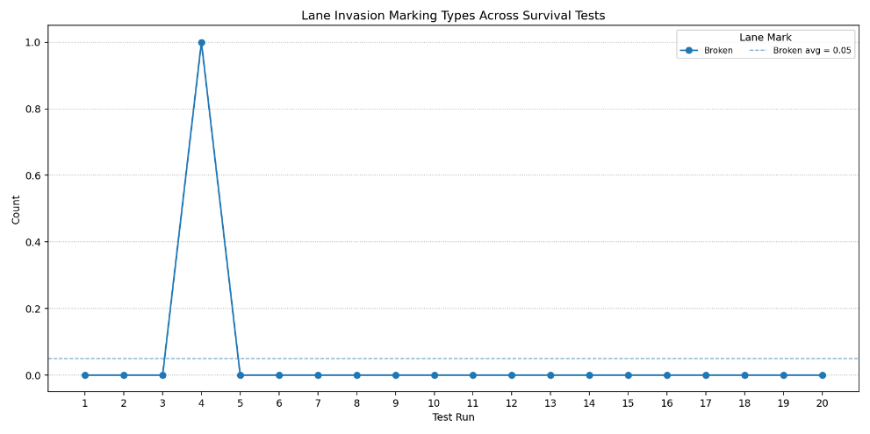
Batch Testing - Oracle Results
07
Lane Invasions:
Forward Clearance:
Oracle Baseline:
Oracle Baseline:
Oracle PASS: Solid Lane Mark = 0
Oracle PASS: Min Distance ≥ 3 m
Oracle FAIL: Solid Lane Mark > 0
Oracle FAIL: Min Distance < 3 m

Slide 10
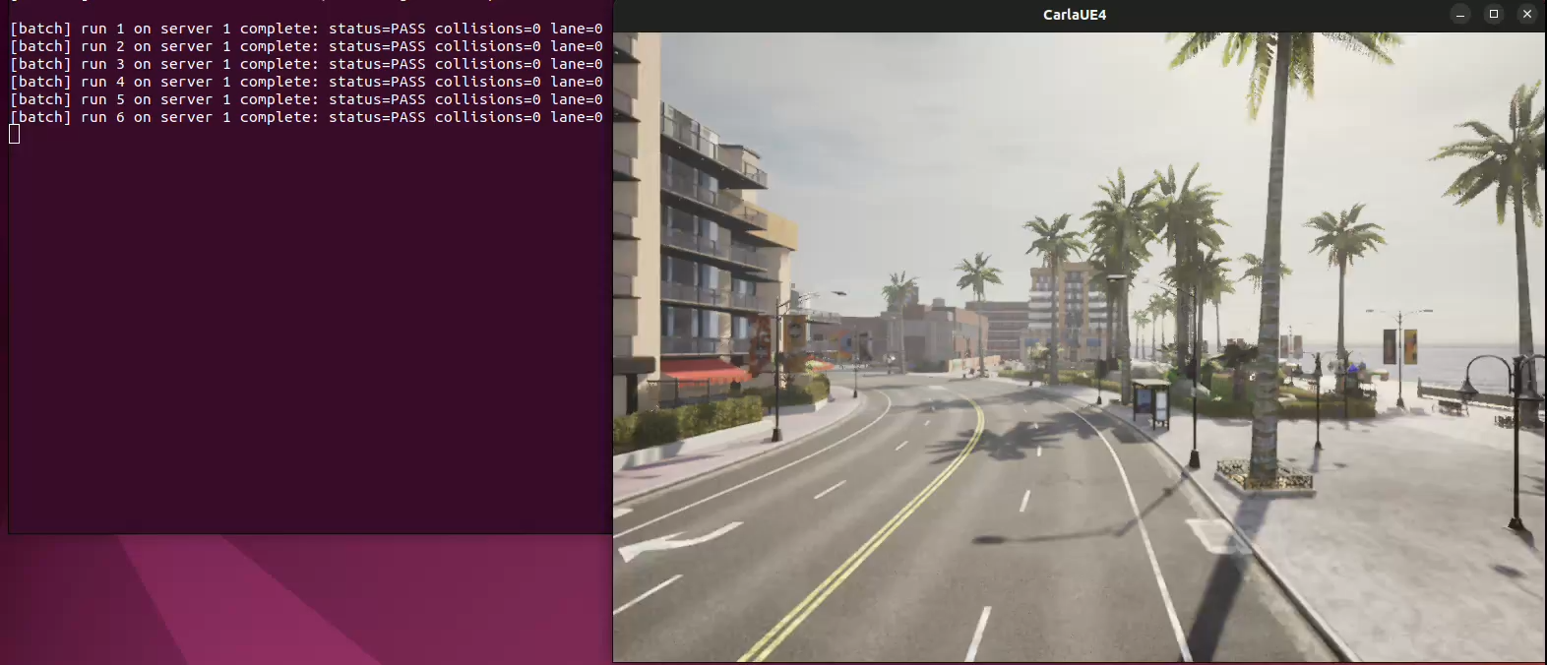
08

Slide 11
Measurement Infrastructure
09
CPU Energy — RAPL
run_survival_batch.py
Layered Process Wrapping
Running Average Power Limit (RAPL) provides hardware energy counters at the CPU package level.
N Tests
measure_cpu_energy.py
measure_gpu_energy.py
GPU Energy — nvidia-smi polling
measure_gpu_energy.py samples GPU power at a configurable interval (default 1 s).
survival_test.py

Slide 12
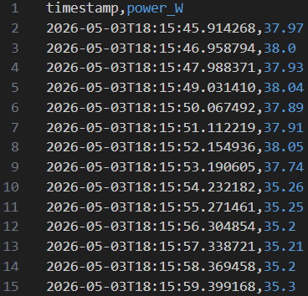
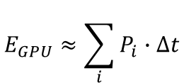
Measurement Infrastructure
10
CPU Energy Breakdown Table
Outputs per run:
Run | DeltaE (J) | E_start (uJ) | E_end (uJ) | Time (s) | P_avg (W)
1 | 1554.130 | 210,445,140,458 | 211,999,270,024 | 65.19 | 23.839
2 | 1563.608 | 212,000,327,080 | 213,563,925,442 | 65.27 | 23.955
3 | 1585.275 | 213,564,842,432 | 215,150,117,549 | 65.60 | 24.166
4 | 1549.489 | 215,151,274,101 | 216,700,762,688 | 65.54 | 23.641
5 | 1557.191 | 216,701,729,055 | 218,258,920,320 | 65.32 | 23.838
cpu_energy_table.md
gpu_energy_table.md
gpu_log_run_N.csv
gpu_log_run_1.csv
GPU Energy Breakdown Table
Run | Delta E(J) | Avg Power (W) | Samples | SampleInterval (s) | Time (s)
1 | 2413.597 | 37.062 | 63 | 1.0 | 65.19
2 | 2402.098 | 36.843 | 63 | 1.0 | 65.27
3 | 2428.818 | 37.067 | 63 | 1.0 | 65.60
4 | 2424.002 | 37.028 | 63 | 1.0 | 65.54
5 | 2419.484 | 37.080 | 63 | 1.0 | 65.32
$$E_{GPU}≈\sum_{i}{P_{i}∙Δt}$$

Slide 13
Environment Configuration Space
11
Execution-Level Parameters
Simulation-Dynamics Parameters
Affect how the simulation runs — not the scenario itself. Primary candidates for energy reduction without verdict impact.
May affect the behaviour of the simulation world itself. Trade-offs between realism and efficiency.
Rendering quality (low / epic)
Weather complexity
- Default & Hard Rain Sunset
Visualization resolution
Sensor update frequency
Headless vs graphical mode
Number of NPC actors
Logging level
Traffic density
Sensor recording
Physics step size
Oracle Impact Unlikely
Oracle Impact Possible

Slide 14
Configuration Oracle Results
Quality level x Weather — pass & fail oracle thresholds evaluated per cell
12
WEATHER
Default (Clear Noon)
HardRainSunset
Epic
PASS Oracle
FAIL Oracle
PASS Oracle
FAIL Oracle
Collisions | 20/20 | 0/20
Lane inv. | 20/20 | 0/20
Distance | 20/20 | 0/20
Forward Clear. | 20/20 | 0/20
 | 20/20 | 0/20
Collisions | 20/20 | 0/20
Lane inv. | 20/20 | 0/20
Distance | 20/20 | 1/20
Forward Clear. | 20/20 | 0/20
 | 20/20 | 1/20
★ Baseline Config (c₀)
QUALITY
Low
PASS Oracle
FAIL Oracle
PASS Oracle
FAIL Oracle
Collisions | 20/20 | 0/20
Lane inv. | 20/20 | 0/20
Distance | 20/20 | 5/20
Forward Clear. | 20/20 | 0/20
 | 20/20 | 5/20
Collisions | 20/20 | 0/20
Lane inv. | 20/20 | 0/20
Distance | 20/20 | 4/20
Forward Clear. | 20/20 | 0/20
 | 20/20 | 4/20

Slide 15












Configuration Oracle Results
Quality level x Weather — pass & fail oracle thresholds evaluated per cell
13
WEATHER
Default (Clear Noon)
HardRainSunset
Epic
PASS Oracle
FAIL Oracle
PASS Oracle
FAIL Oracle
20/20 | 0/20
20/20 | 1/20
$$E_{CPU}=1412J$$
-8.6%↓
$$E_{CPU}=1545J$$
$$E_{Total}=3957J$$
$$E_{GPU}=2412J$$
-1.3%↓
$$E_{Total}=3905J$$
$$E_{GPU}=2503J$$
+3.8%↑
★ Baseline Config (c₀)
QUALITY
Low
PASS Oracle
FAIL Oracle
PASS Oracle
FAIL Oracle
20/20 | 5/20
20/20 | 4/20
$$E_{CPU}=1491J$$
-3.5%↓
$$E_{CPU}=1469J$$
-4.9%↓
$$E_{Total}=3828J$$
-3.3%↓
$$E_{Total}=3910J$$
-1.2%↓
$$E_{GPU}=2337J$$
-3.1%↓
$$E_{GPU}=2441J$$
+1.2%↑

Slide 16
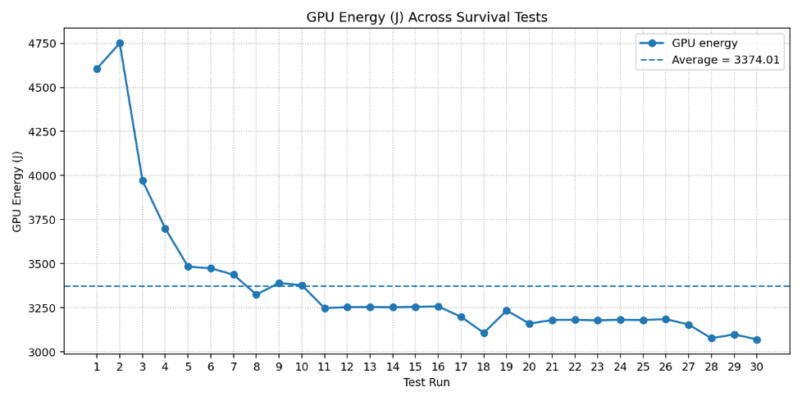
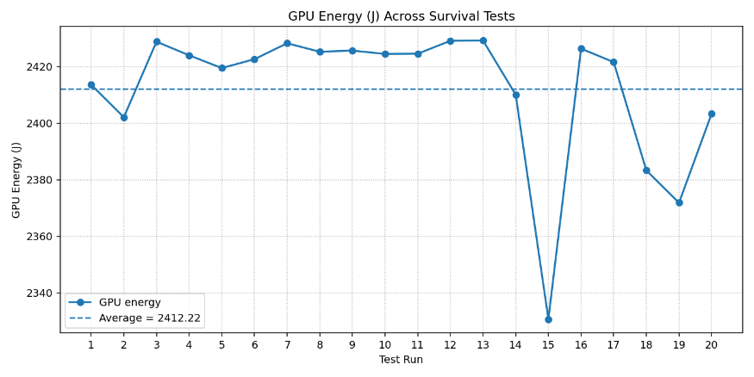
Configuration Sweep: Test Execution Design
14
The Problem: Thermal Bias
Running all tests of configuration A before configuration B means they execute at different GPU thermal states — the GPU heats up and throttles clock speed.
Group execution (naive):
A A A A A A A A A A → B B B B B B B B B B ...
A runs hot, B runs cool — results not comparable
A = {Quality = Epic; Weather = Default}
A fixed warmup period of ~2 hours was found necessary to stabilise GPU temperature - which is impractical as a methodology.
B = {Quality = Low; Weather = Default}

Slide 17
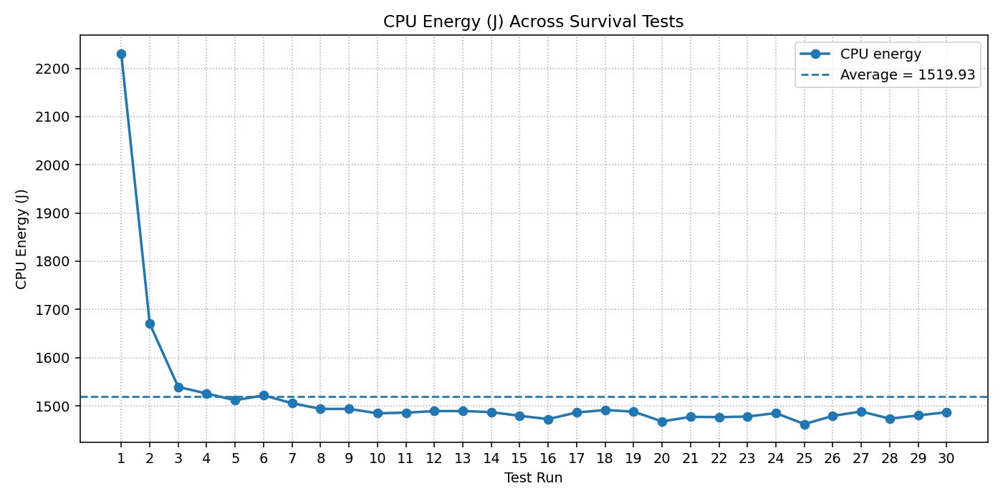
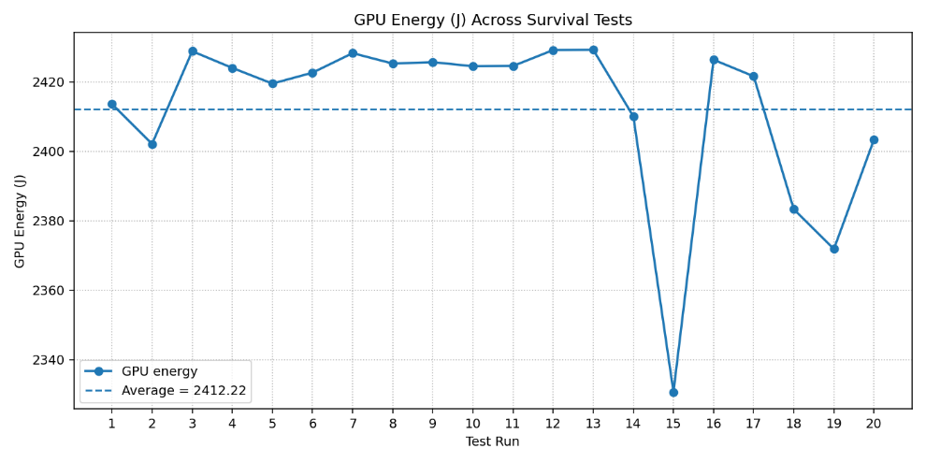
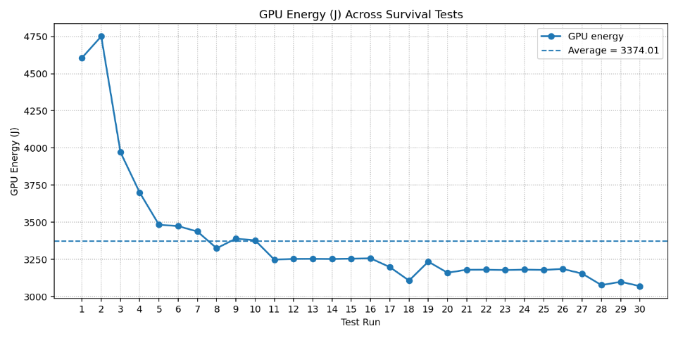
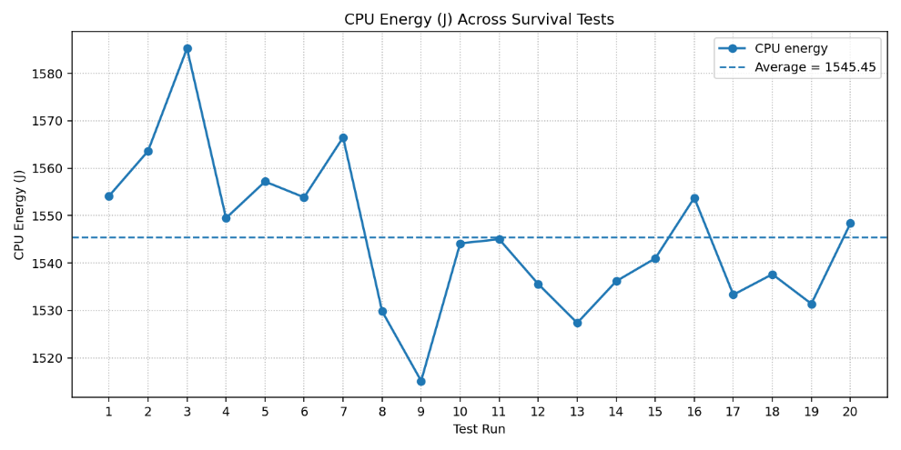
CPU Energy Results
15
First batch test:
2h warmup:

Slide 18
Configuration Sweep: Test Execution Design
16
The Solution: Randomised Block Design
Group execution:
A A A A A A A A A A ×10 Runs /config
↓ B B B B B B B B B B
↓ C C C C C C C C C C
↓ D D D D D D D D D
↓ … ×18 Configs
Block design:
Block 1: A → B → C → D → E → F ... R ×18 Configs
Block 2: A → B → C → D → E → F ... R
Block 3: A → B → C → D → E → F ... R
⋮ ×10 blocks
Final Design (Shuffle):
Block 1: C ↔ A ↔ F ↔ D ↔ B ↔ E ... Q ×18 Configs
Block 2: H ↔ B ↔ R ↔ A ↔ E ↔ C ... D
Block 3: E ↔ D ↔ A ↔ R ↔ C ↔ B ... F
⋮ ×10 blocks
Key properties:
✓ Every configuration appears exactly once per block
✘ The conditions order is still unfair
Key properties:
✓ Every configuration appears exactly once per block
✓ No condition is systematically first or last
✓ Standard design in empirical software testing

Slide 19
Block Structure: 18 Conditions × 10 Blocks
17
Factor Space — 3 × 3 × 2 = 18 conditions per block
NPC Count
Physics Step Δ
Lidar Points / sec
10
30
50
0.1 s
0.05 s
0.02 s
10 k
100 k
Session structure — 180 runs total (18 × 10 blocks)
18
combos / block
180
total runs
B1
×18
30
0.1 s
100 k
10
0.02 s
10 k
B2
… ×18
50
0.05 s
10 k
30
0.1 s
10 k
30
0.05 s
Order reshuffled each block.

Slide 20
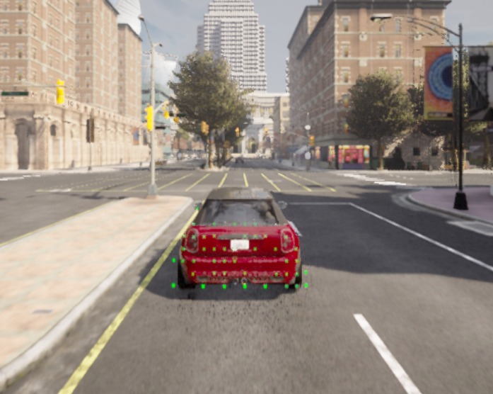
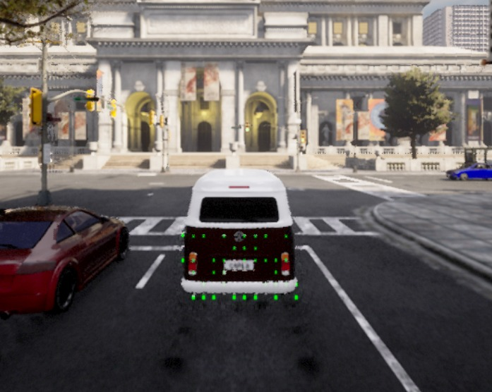
18

Slide 21
Oracle Results: Configuration Sweep
N/10 pass N/10 fail
rows = NPCs · cols = physics step Δ
19
Lidar 10,000 pts/sec
Lidar 100,000 pts/sec
NPCs ↓
0.10 s
0.05 s
0.02 s
NPCs ↓
0.10 s
0.05 s
0.02 s
10
10/10
pass
1/10
fail
★ baseline
9/10
pass
0/10
fail
10
10/10
pass
0/10
fail
10/10
pass
4/10
fail
10/10
pass
8/10
fail
10/10
pass
0/10
fail
30
10/10
pass
1/10
fail
10/10
pass
0/10
fail
9/10
pass
0/10
fail
30
10/10
pass
0/10
fail
8/10
pass
4/10
fail
9/10
pass
6/10
fail
50
10/10
pass
0/10
fail
10/10
pass
0/10
fail
8/10
pass
0/10
fail
50
10/10
pass
1/10
fail
10/10
pass
3/10
fail
10/10
pass
6/10
fail
Cell colour: green = low fail rate, orange = moderate, red = high fail rate. ★ baseline = 10 NPCs · 0.05 s · 10k pts/sec

Slide 22
Energy Results: Configuration Sweep
rows = NPCs · cols = physics step
20
Lidar 10,000 pts/sec
Lidar 100,000 pts/sec
NPCs↓
0.10 s
0.05 s
0.02 s
NPCs↓
0.10 s
0.05 s
0.02 s
10
3451 J
930 J
4381 J
★ baseline
3261 J
1172 J
4433 J
10
3330 J
971 J
4301 J
3314 J
1090 J
4404 J
3256 J
1306 J
4562 J
3405 J
967 J
4372 J
30
3318 J
1075 J
4393 J
3356 J
1102 J
4458 J
3245 J
1319 J
4564 J
30
3372 J
1090 J
4462 J
3266 J
1194 J
4460 J
3270 J
1338 J
4608 J
50
3306 J
1194 J
4500 J
3356 J
1218 J
4574 J
3250 J
1355 J
4605 J
50
3278 J
1195 J
4473 J
3246 J
1333 J
4579 J
3254 J
1396 J
4650 J

Slide 23
Configuration Total Energy / Oracle Results
21
Lowest Energy Configurations
These configurations combine:
Low NPC count
Larger physics step
Lower CPU cost
Config | Total Energy | Pass | Fail
10 NPC, 0.1Δ, 10k | 4381 J | 10/10 | 1/10
10 NPC, 0.1Δ, 100k | 4301 J | 10/10 | 0/10
10 NPC, 0.05Δ, 10k | 4372 J | 10/10 | 0/10
-1.83%↓ than baseline

Slide 24
Energy Reduction Without Oracle Change
22
14 /18
12 /18
349 J
configs with 10/10 pass
Pass oracle unchanged in 78% of configurations
configs with 0-1/10 fail
Fail oracle scarcely triggered in more than half of all configs
total energy range
4301 J – 4650 J across configs (best vs worst)
What this means
✓ Oracle verdicts are robust to some simulator config changes; the AV either passes or fails regardless of NPC count.
✓ The 10/0.10s/100k config achieves 4301 J total — 71 J below baseline — while maintaining 10/10 pass and 0/10 fail. A possible optimisation opportunity.
✓ The primary energy driver is CPU load, NPC count and physics step cause up to 44% CPU increase while GPU stays flat or decreases.
⚠ Configs with 100k lidar + 0.02s physics step show higher fail rates (up to 8/10), suggesting these push simulation beyond the oracle's calibrated envelope.

Slide 25
Future Work: Possible Extension
If results are promising, the project could be extended into any of these directions
1
▲
2
↺
3
◆
Energy-aware test prioritization
Run cheapest tests first to fail fast without wasting energy
Energy-constrained regression testing
Maintain safety coverage under an explicit energy budget
Learning-based energy prediction
Train a model to predict energy cost from config parameters
4
⬡
5
✔
Multi-objective optimization
Pareto trade-offs: safety vs energy vs simulation realism
Energy-aware oracle design
Design oracles that explicitly account for energy consumption

Slide 26
Configuration Oracle Results
19
Strongest Trend: LiDAR Density Increased Oracle Failures
Effect of NPC Count
Oracle Fail Summary:
This strongly suggests that increasing LiDAR density significantly stresses the perception or processing pipeline.
Increasing from 10 → 50 NPCs did not increase failures
LIDAR | Typical Fail Behaviour
10k | Mostly 0/10 failures
100k | Frequently 2–8/10 failures
Effect of Physics Step Size
Physics step Δ | Typical Fail Behaviour
0.02 | Worst Reliability 0-8/10
0.05 | Most Stable 0-4/10
0.1 | Best Reliability 0-2/10
*0.02Δ also caused no-Pass oracles

Slide 27
Configuration Energy Results
20
Strong Trend: Increased CPU Energy
Average CPU energy approximately behaved as:
100k LiDAR consistently increased CPU usage compared to 10k.
GPU Energy
Physics step Δ | NPCs | CPU
0.02 | 50 | Highest
0.05 | 30 | Medium
0.1 | 10 | Lowest
Physics step Δ | GPU
0.02 | -2.35% ~ -1.61%
0.1 | +0.21% ~ +3.82%
Weak Dependence on NPC Count and LiDAR Density

