Slide 1
Cooking for Two
An app to help you impress that special somebody, no matter their dietary requirements
Created by Ari Friedgut and Alex Baulderstone

Slide 2
Objectives
An app to help you choose the perfect meal
Inclusive of dietary choices or restrictions
Expandable for different meal types, diets, time restrictions etc

Slide 3
Overview
Cooking for two is a simple ruby app that runs in the terminal
User selects a meal type and is prompted about various dietary restrictions
Currently veganism and gluten free, but as the app uses a custom Cookbook class it’s easily expandable

Slide 4
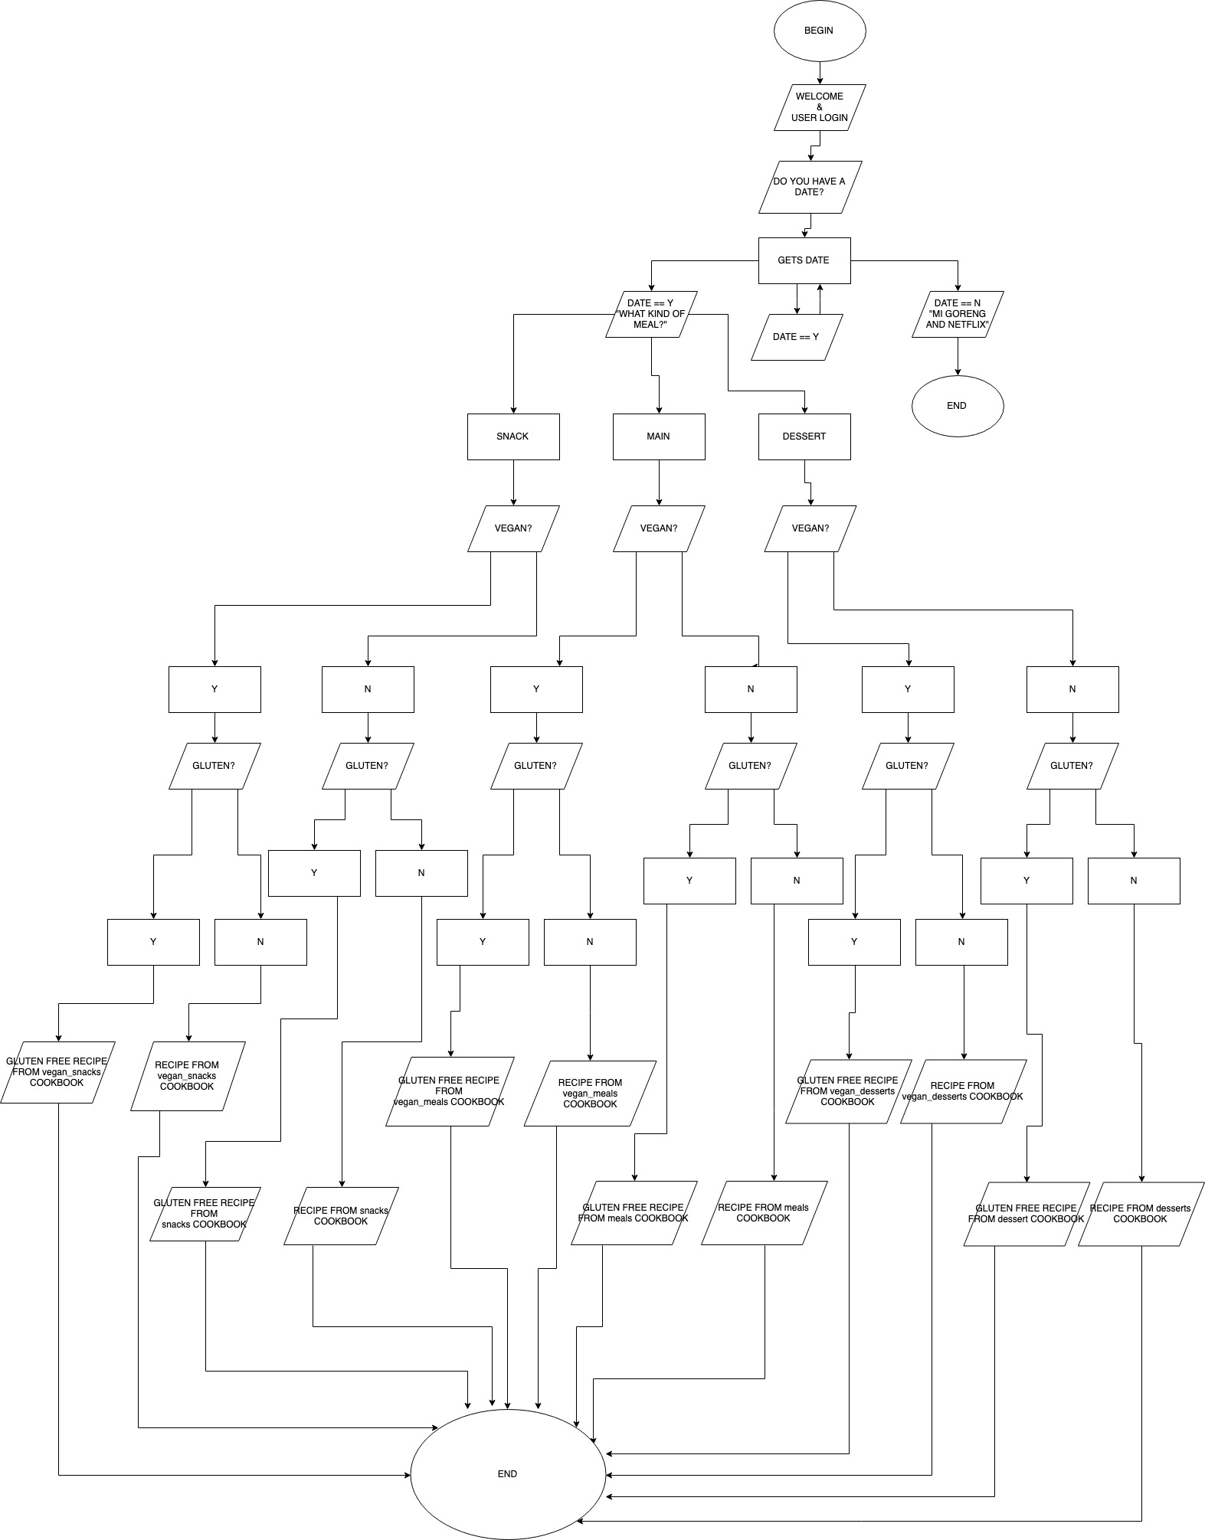

Slide 5
Strech Goals
If you don't like a recipe, let us know and we will never suggest it to you again!
If you LOVE a recipe, tell us and it will be added to your favourites!
We would like to implement a feature that writes the ingredients to a text file that can then be used as the user's shopping list.

Slide 6
Challenges
We probably didn’t spend enough time planning
Different coding styles, different ways of approaching problems
Github is a new platform that neither of us were well versed in
Formatting of the recipes
Objects can’t easily be referenced from another file

Slide 7
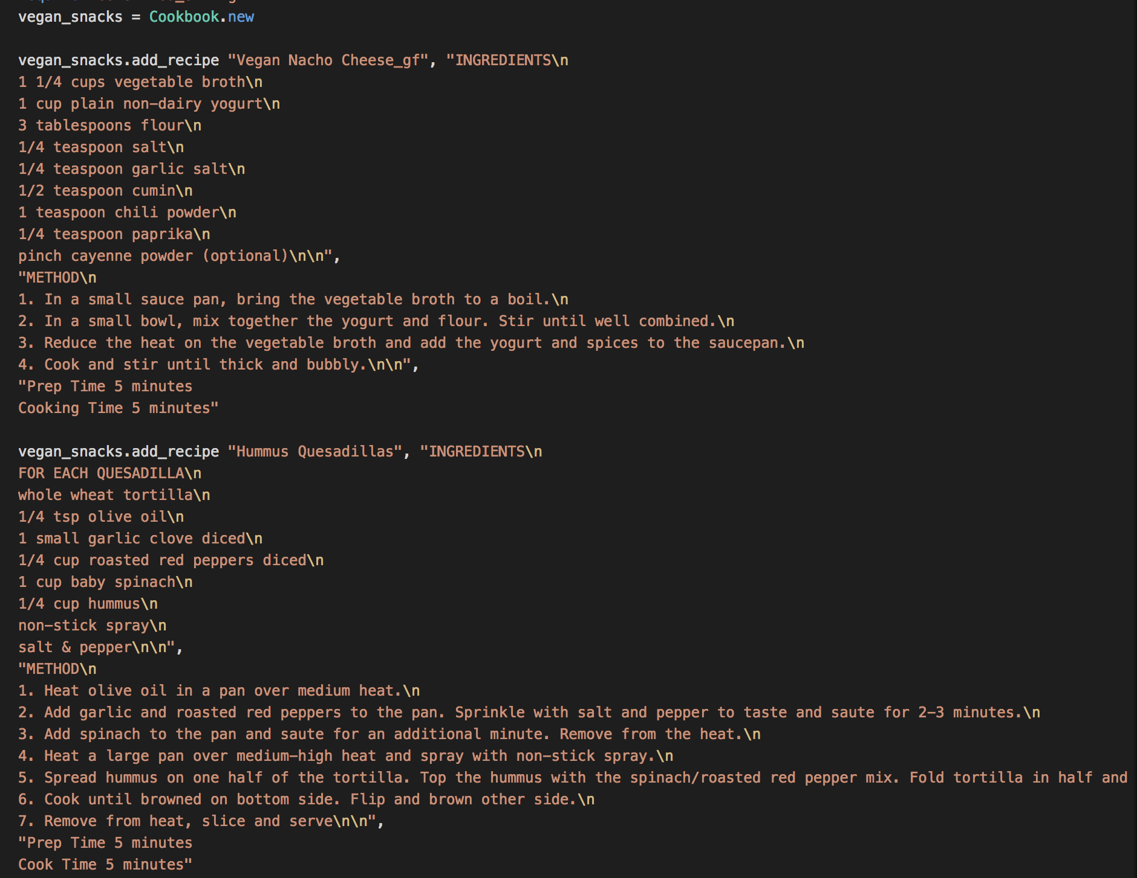
A big chunk of code that we’d like to keep out of the main file
File.Read?
Modules?
Including it in a class?

Slide 8
Moral or ethical issues
Isolating to single people
1
Potential for a non vegan recipe to be accidentally added to a vegan cookbook (open source)
2
At this stage of the build recipes don’t take into account the intricacies of cultural sensitivities or diets (kosher, halal, etc)
3

Slide 9
Questions?
This is the part where you ask us questions

