Slide 1
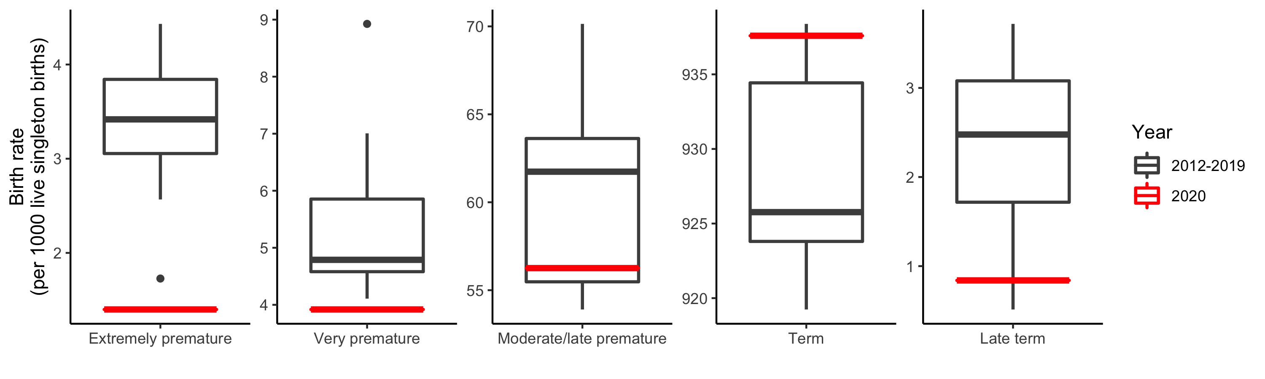
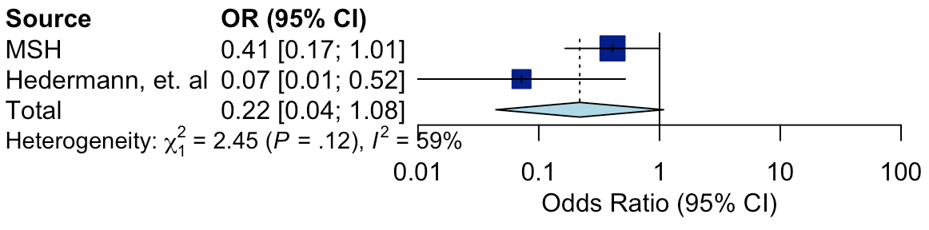
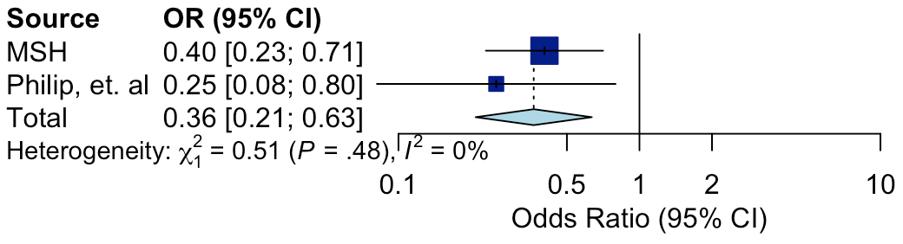
(a)
9/21
Change (%)
-59%
-18%
-8.9%
+1.3%
-66%
(b)
(c)
Figure 1. Rates of prematurity among Mount Sinai Hospital births during the COVID-19 pandemic period in New York City (3/16-8/31) compared to prior years (2012-2019). (a) There was a decrease in premature births during the lockdown in New York City, with larger decreases at more extreme gestational ages. However, none of these trends were statistically significant (all Fisher’s Exact Test P>0.08). Boxplots illustrate medians and interquartile ranges. (b) We observed a trending but not statistically significant association between lockdowns and decreases in extremely premature births in a meta-analysis with Hedermann, et. al (OR=0.22, P=0.06, 95% CI=0.004-1.08). (c) We observed a statistically significant association between the lockdown and decreases in very low birthweight infants in a meta-analysis with Philip, et. al (OR=0.38, P=0.0015, 95% CI=0.21-0.69). MSH=Mount Sinai Hospital

Slide 3
Line graph with N on graph
Percent of births from each borough
Figure 2. Total births and geographic trends. (a) We observed a drop in YYYY births at the Mount Sinai Hospital in NYC compared to 2019. (b) During the lockdown, there was a XXXX in proportion of births from Mothers residing in ZIP codes outside of New York City.

Slide 4
Line graph of % NICU admissions with N below graph
Line graph of % mortality with N below graph
Figure 3. NICU admissions and mortality during the COVID-19 pandemic. (a) We observed an increase in percent of births admitted to the NICU. (b) We observed XXXX in mortality. Given the stable absolute counts in both NICU admissions and mortality, these observations likely reflect the smaller denominator (i.e., fewer total births at MSH).

Slide 5
Born at Mount Sinai Hospital, 1/1/2012-8/31/2020
N=65,140
Singleton births
N=61,395
During NYC lockdown period, 3/16-8/31
N=29,427
Analysis
sample
sizes
Total births
N=29,427
Birthweight
N=29,401
Gestational age
N=27,718
Supplemental Figure 1. Flowchart illustrating patients included in this study. Due to different missingness for clinical features, separate analyses were conducted using birthweight and gestational age.

Slide 6
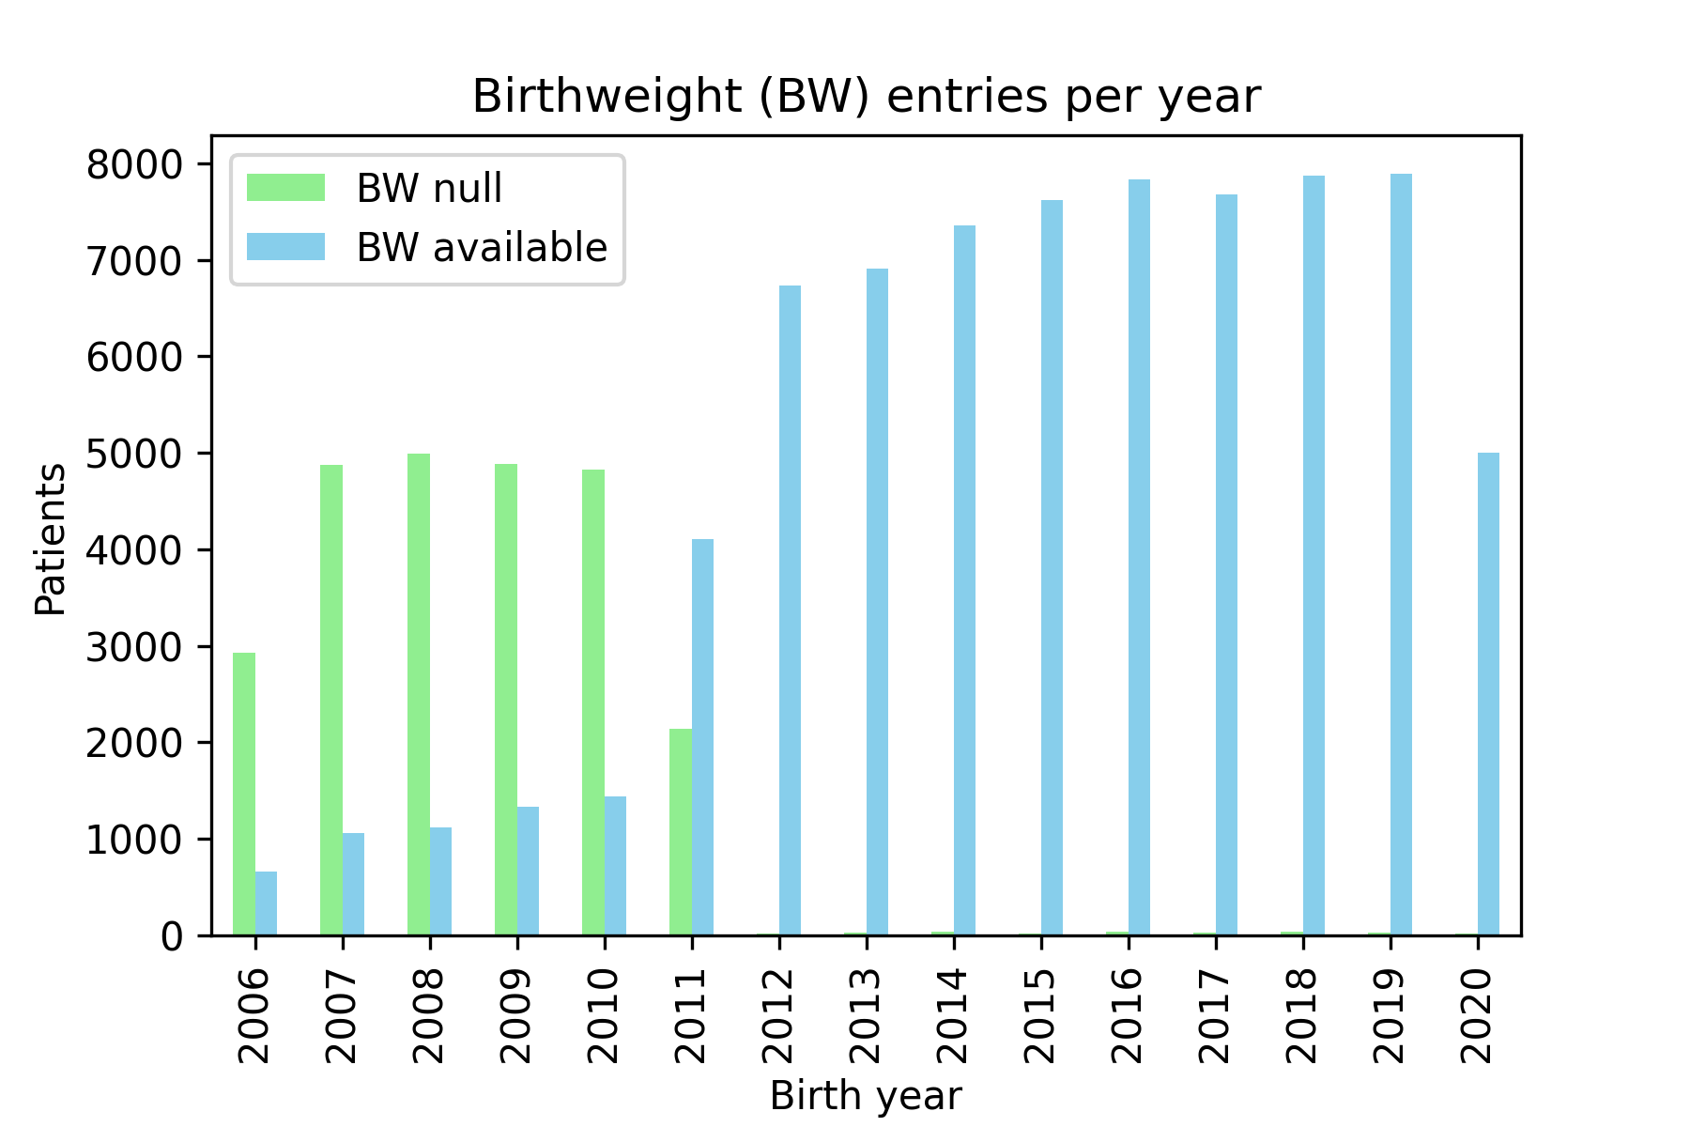
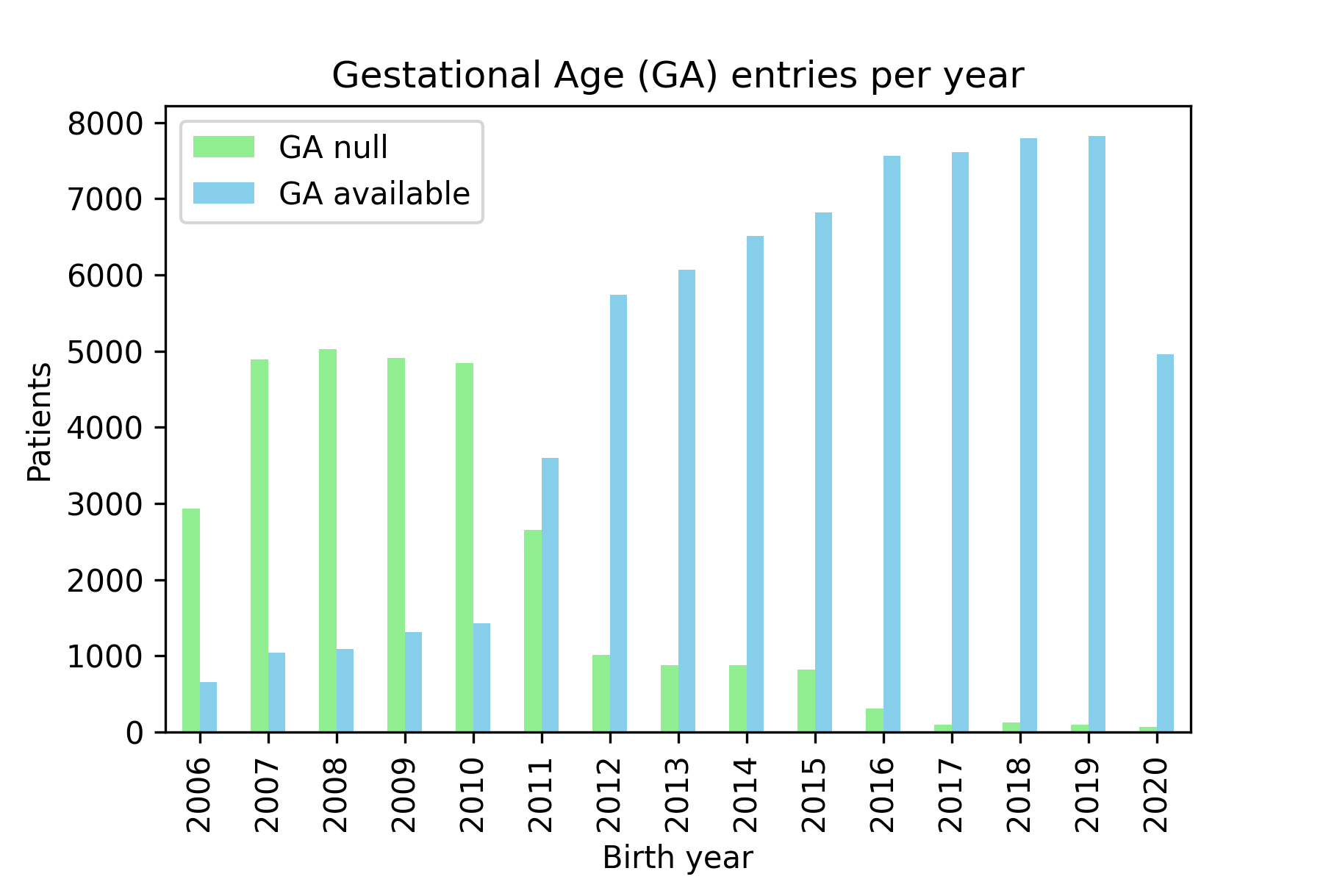
Supplemental Figure 2. Missing data for birthweight and gestational age. There was a sharp decrease in missing data in 2012, so only records since 2012 were used in subsequent analyses. Since 2012, 0.4% and 6.6% of births were missing birthweight and gestational age entries, respectively.

Slide 7
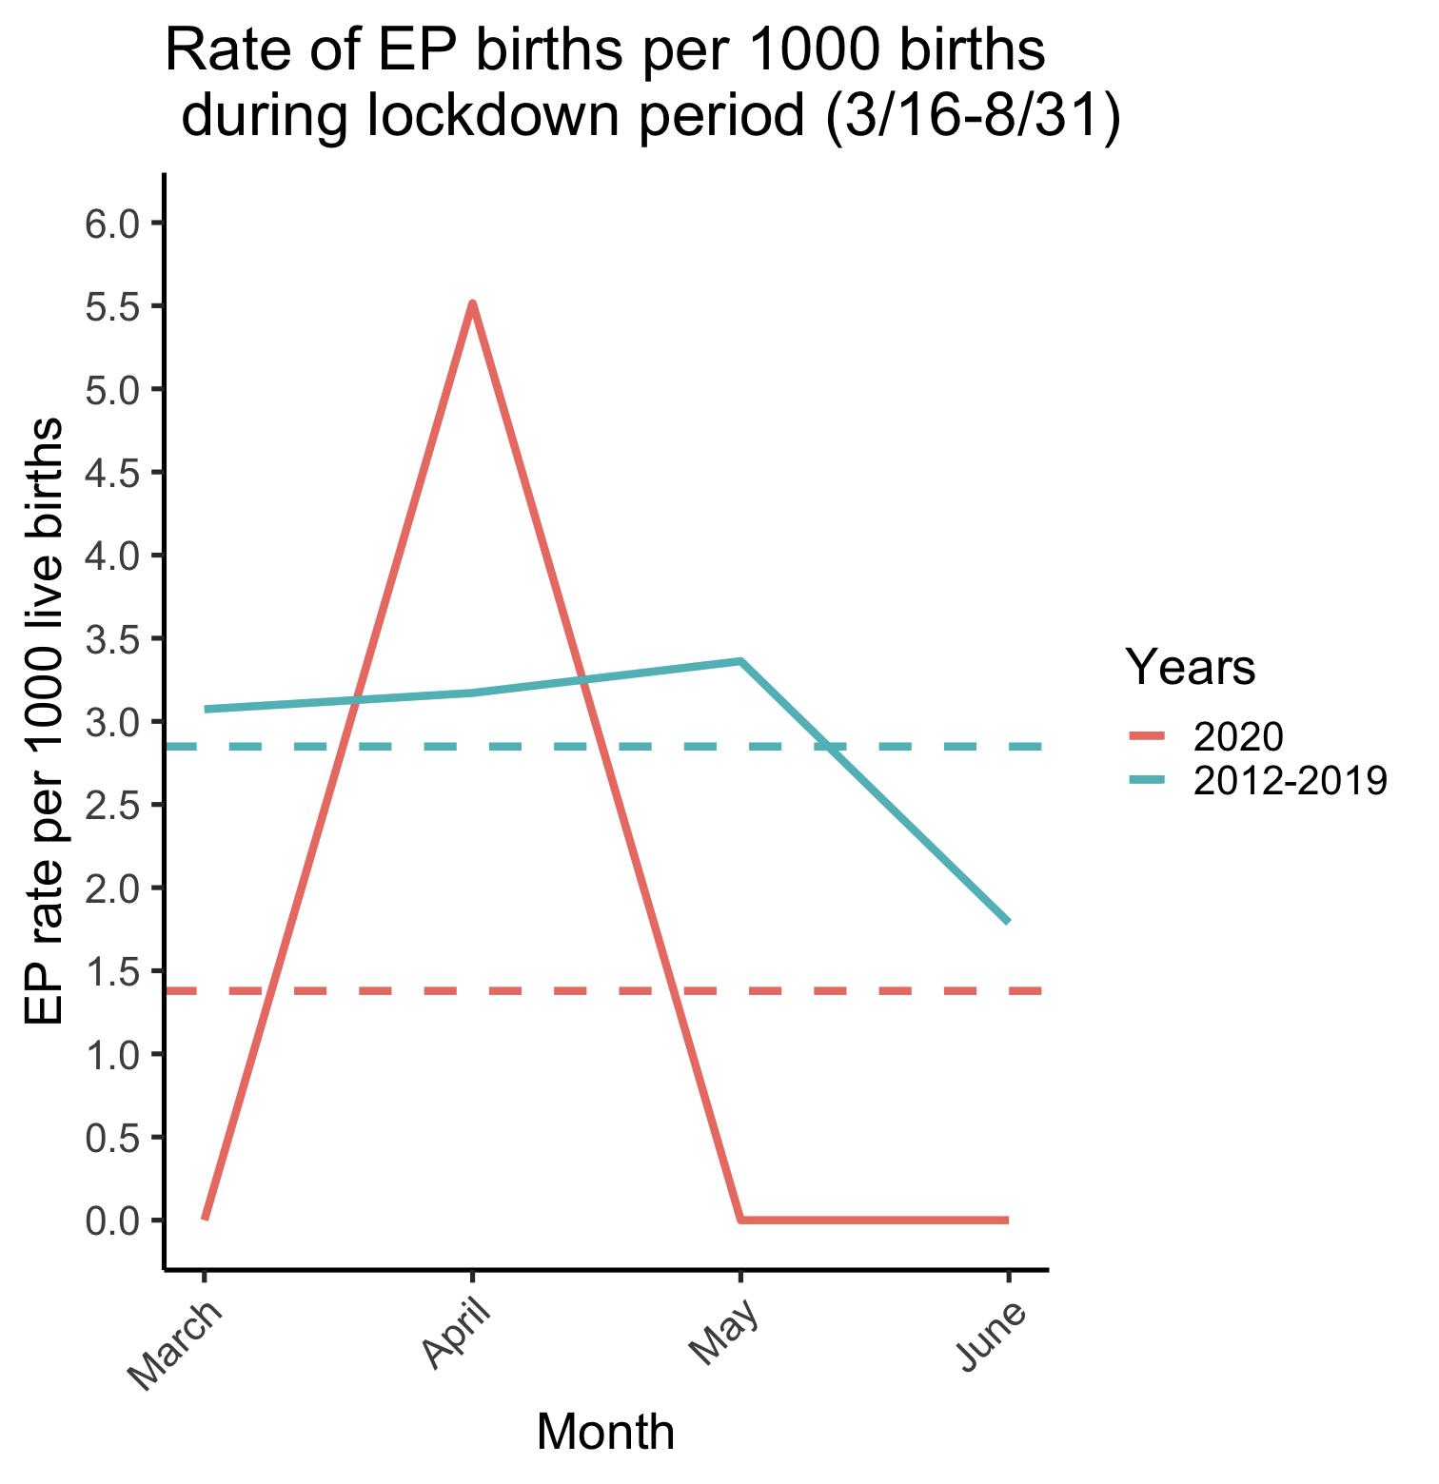
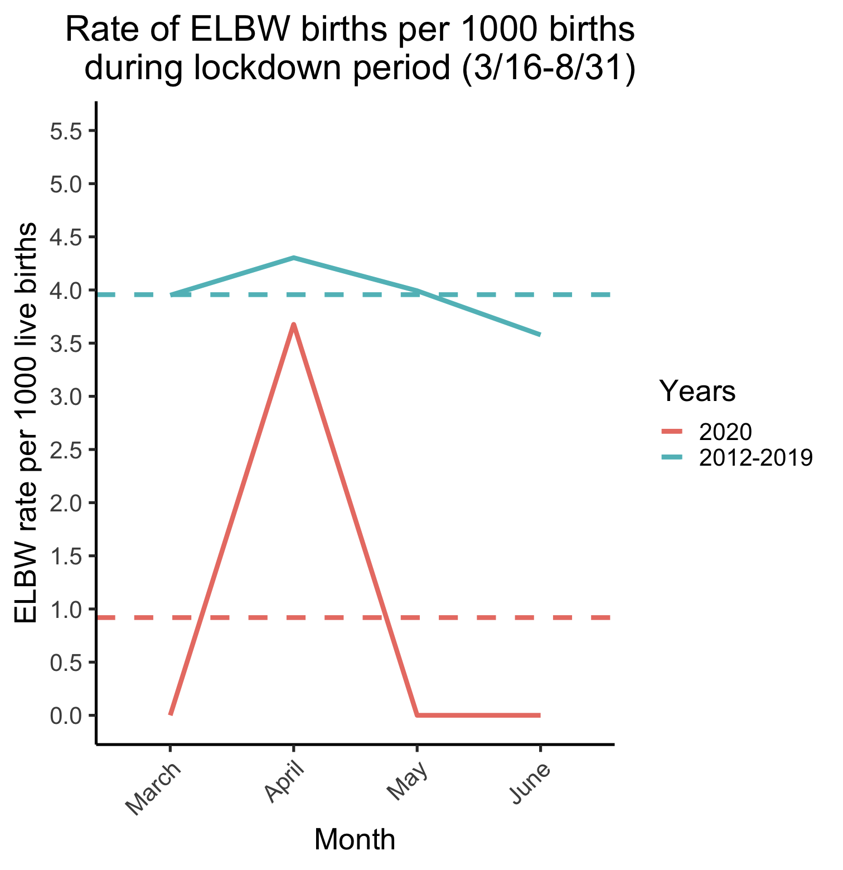
Possibly label key timepoints (School closing, Phase 1 reopening, Phase 2 reopening, etc)
Supplemental Figure 3. Month-by-month comparison of rates during the lockdown to prior years. (a) There was a spike in extremely premature (EP) births in April accounting for all EP births. (b) This trend was also observed when classifying patients based on extremely low birthweight.

Slide 8
Supplemental Figure 4. Month-by-month comparison of NICU admissions and mortality during the pandemic

Slide 9
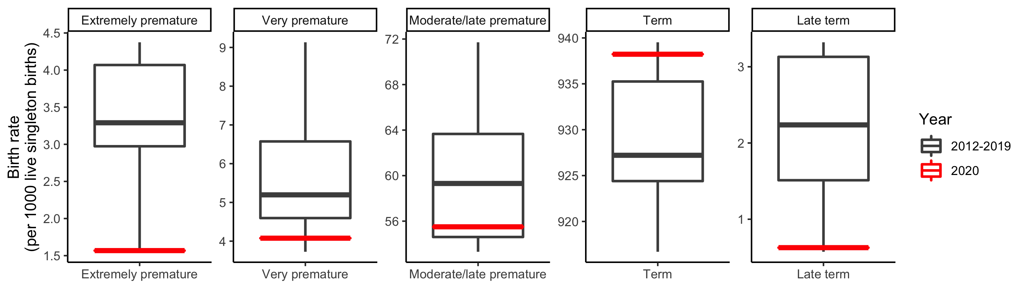
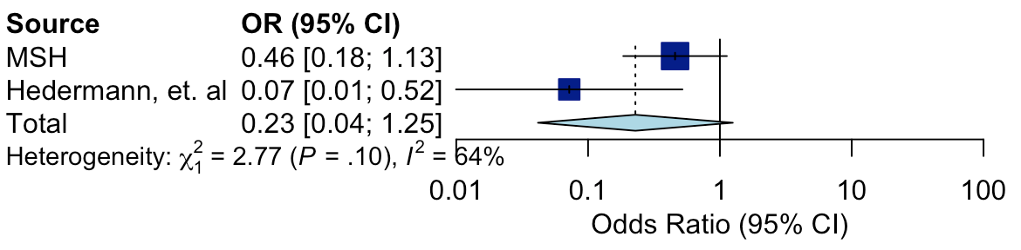
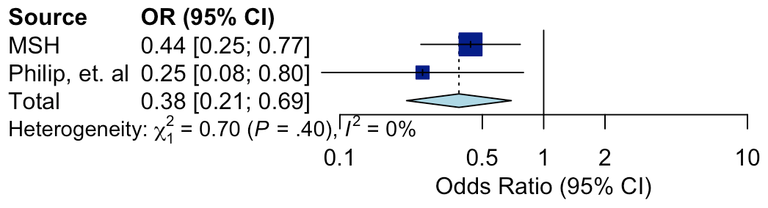
(a)
8/31
Change (%)
-52%
-22%
-6.4%
+1.2%
-72%
(b)
(c)
Figure 1. Rates of prematurity among Mount Sinai Hospital births during the COVID-19 pandemic period in New York City (3/16-8/31) compared to prior years (2012-2019). (a) There was a decrease in premature births during the lockdown in New York City, with larger decreases at more extreme gestational ages. However, none of these trends were statistically significant (all Fisher’s Exact Test P>0.08). Boxplots illustrate medians and interquartile ranges. (b) We observed a trending but not statistically significant association between lockdowns and decreases in extremely premature births in a meta-analysis with Hedermann, et. al (OR=0.23, P=0.09, 95% CI=0.042-1.25). (c) We observed a statistically significant association between the lockdown and decreases in very low birthweight infants in a meta-analysis with Philip, et. al (OR=0.38, P=0.0015, 95% CI=0.21-0.69). MSH=Mount Sinai Hospital

