Slide 1
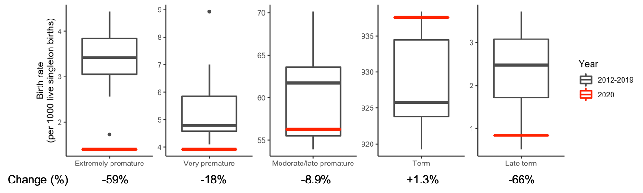
Figure 1. Rates of prematurity among Mount Sinai Hospital births during the COVID-19 pandemic period in New York City (3/16-9/21) compared to prior years (2012-2019). There was a decrease in premature births during the lockdown in New York City, with larger decreases at more extreme gestational age groups. However, these trends were not statistically significant (Chi-squared P=0.052). Categories are mutually exclusive; boxplots illustrate medians and interquartile ranges.

Slide 2
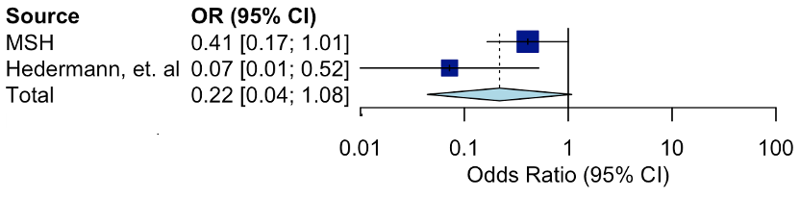
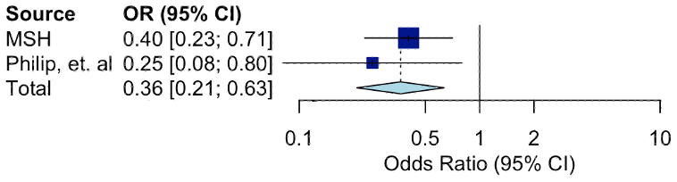
(a)
(b)
Figure 2. Meta-analyses of the impact of COVID-19 lockdown measures on rates of prematurity. (a) We observed a trending but not statistically significant association between lockdowns and decreases in extremely premature births in a meta-analysis with Hedermann, et. al (OR=0.22, P=0.06, 95% CI=0.042-1.08). (b) We observed a statistically significant association between the lockdown and decreases in very low birthweight infants in a meta-analysis with Philip, et. al (OR=0.36, P=3.6x10⁻⁴, 95% CI=0.21-0.63). MSH=Mount Sinai Hospital

Slide 3
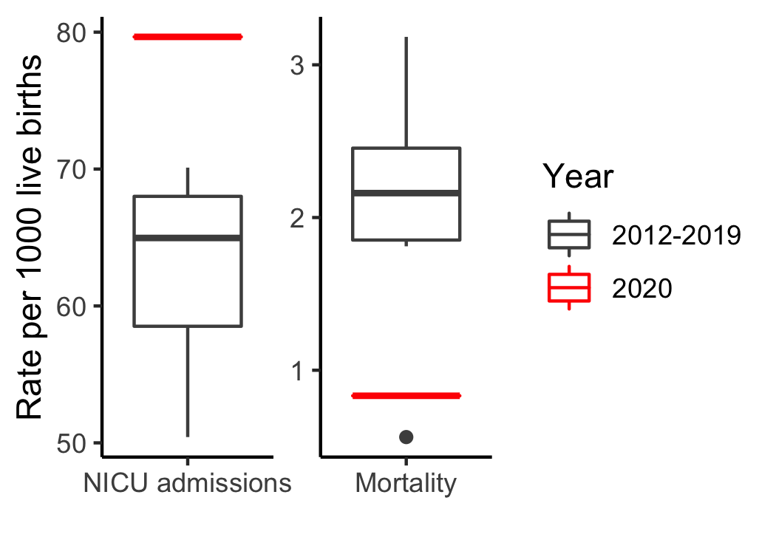
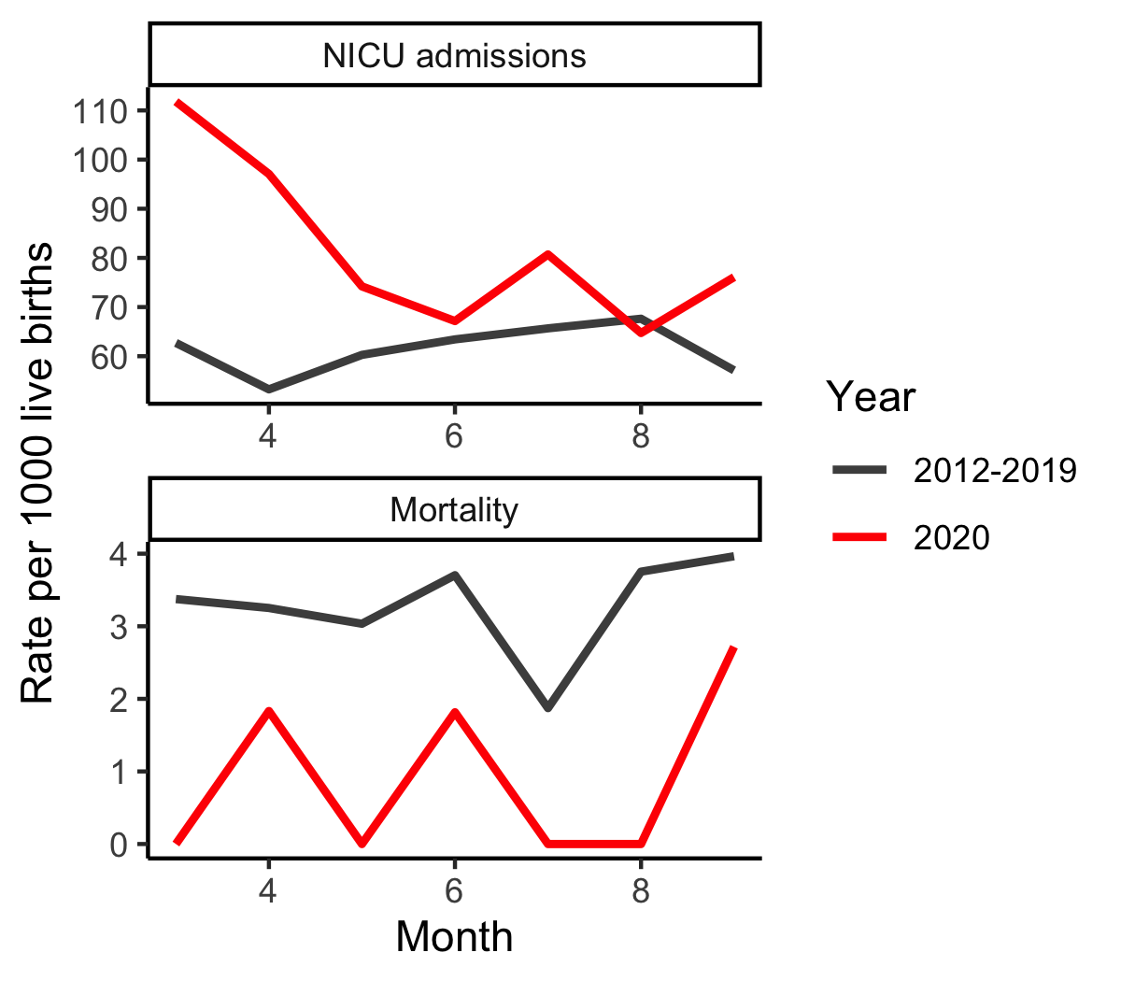
(a)
(b)
Figure 3. NICU admissions and mortality during the NYC lockdown. (a) We observed a higher proportion of births admitted to the NICU but a lower mortality during the lockdown (3/16-9/21) when compared to the same period in prior years (2012-2019). Boxplots illustrate medians and interquartile ranges. (b) Monthly NICU admissions revealed that the burden of NICU admissions was higher during the earlier phases of the pandemic compared to the median across years 2012-2019, while mortality has remained low throughout the pandemic and lockdown. March only includes births from 3/16-3/31, September only includes births from 9/1-9/21.

Slide 4
Born at Mount Sinai Hospital, 1/1/2012-9/21/2020
N=65,542
Singleton births
N=61,778
During NYC lockdown period, 3/16-9/21
N=29,427
Analysis
sample
sizes
Total births
N=29,810
Birthweight
N=29,784
Gestational age
N=28,101
Supplemental Figure 1. Flowchart illustrating patients included in this study. Due to different missingness for clinical features, separate analyses were conducted using birthweight and gestational age.

Slide 5
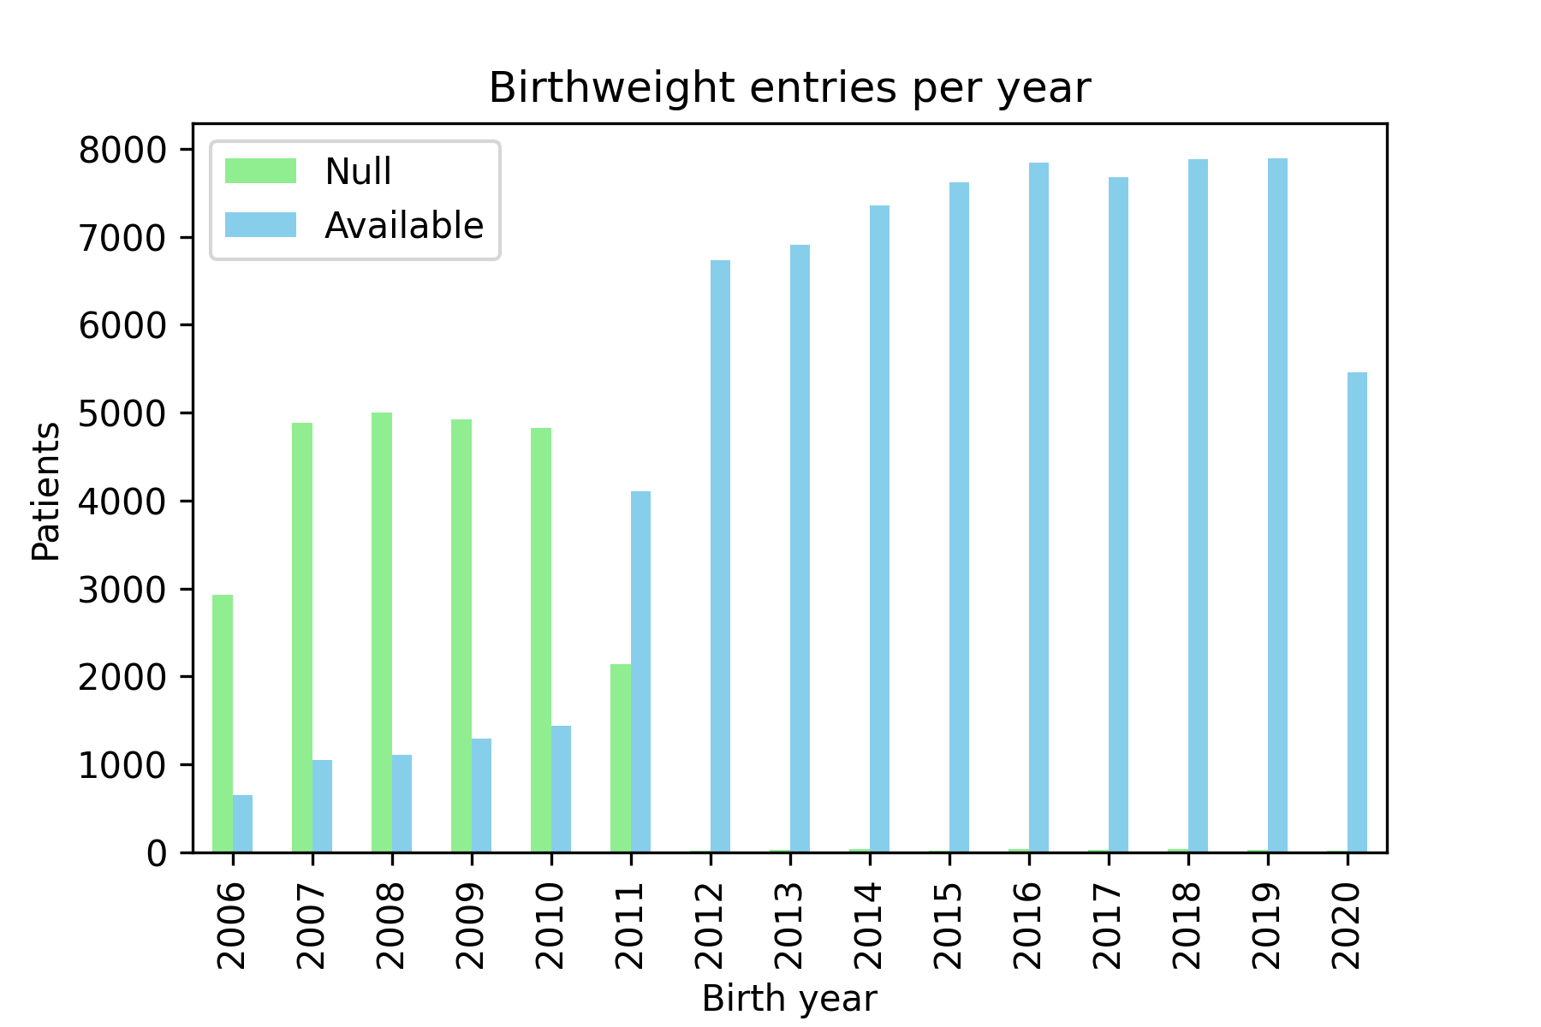
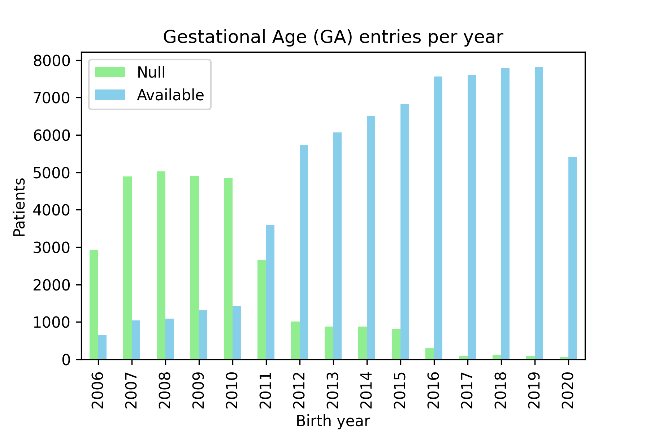
Supplemental Figure 2. Missing data for birthweight and gestational age. There was a sharp decrease in missing data in 2012, so only records since 2012 were used in subsequent analyses. Since 2012, 0.4% and 6.6% of births were missing birthweight and gestational age entries, respectively.

Slide 6
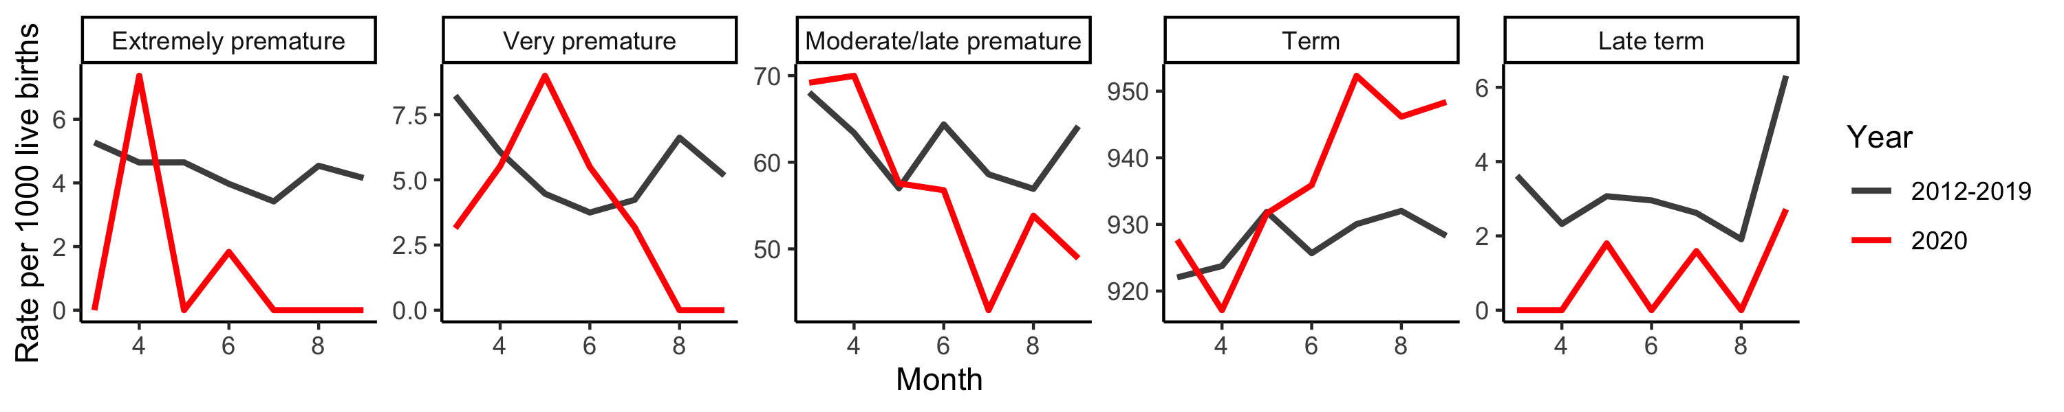
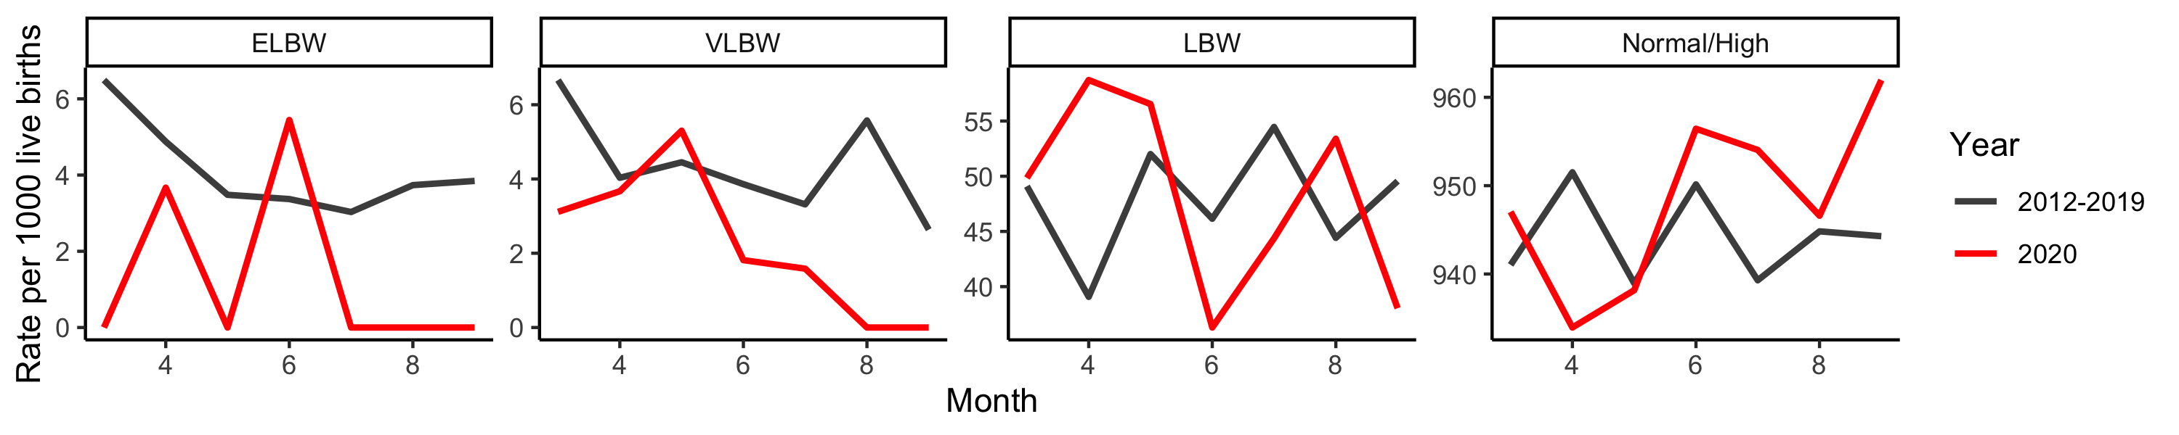
(a)
(b)
Supplemental Figure 3. Month-by-month comparison of prematurity rates during the lockdown period and the mean from prior years. (a) April and May had premature births rates consistent with prior years, relative to lower premature birth rates during the remainder of the lockdown period. (b) This trend was also observed when classifying patients based on birthweight.

Slide 7
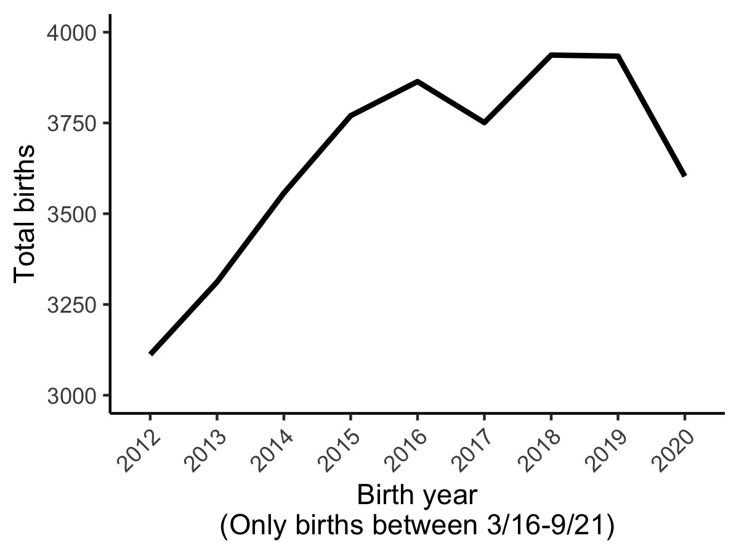
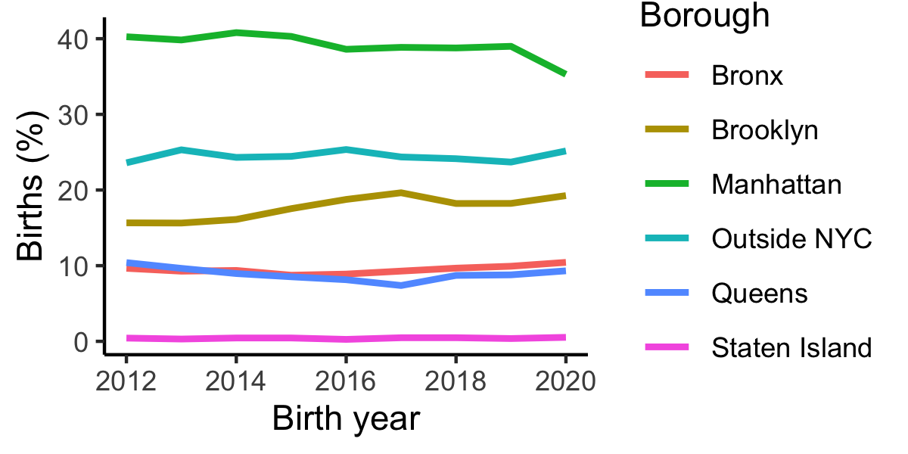
(a)
(b)
Supplemental Figure 4. Total births and geographic trends during the lockdown period (3/16-9/21). (a) We observed 331 (8.4%) fewer births at the Mount Sinai Hospital (MSH) in NYC compared to the same period in 2019; it was the lowest number of births at MSH since 2014. (b) During the lockdown, there was no change in the proportion of births from Mothers residing in each of the five Boroughs or outside NYC.

