Slide 1
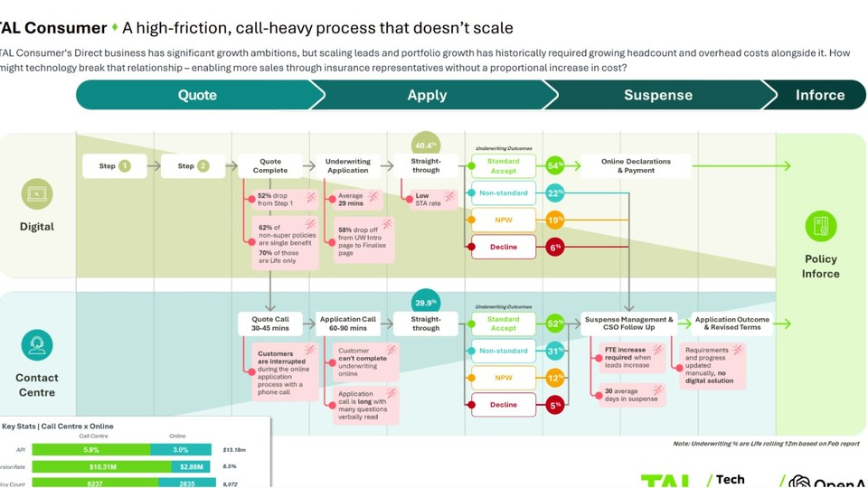
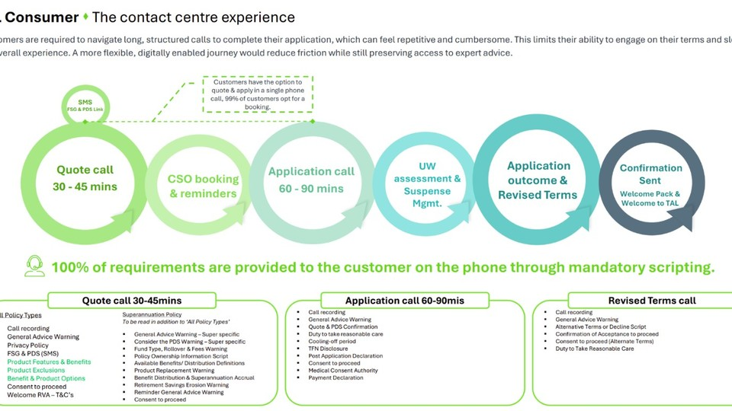
Coverbuilder Guided Apply
Hackathon concepts to increase digital completion while keeping representatives focused on high-value help
6-hour build lens: prove one working vertical slice

Slide 2
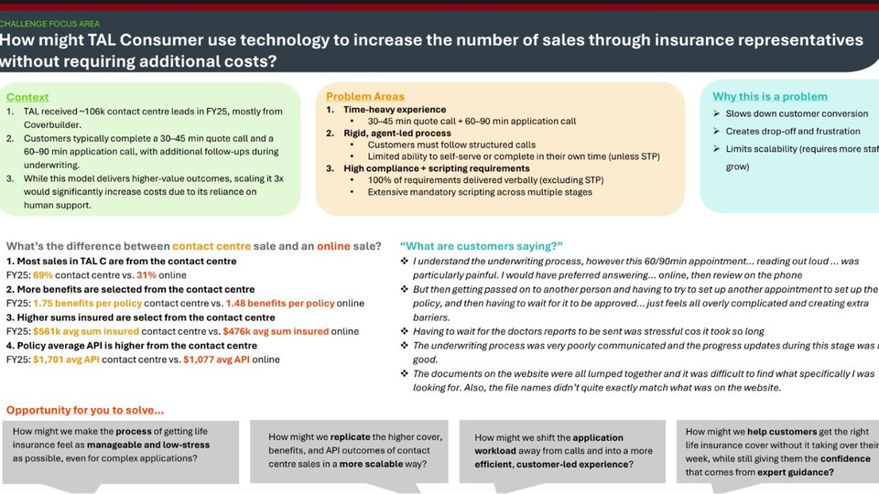
CURRENT PROCESS PAIN
The opportunity: digitally guided, representative-assisted sales
Problem
Idea / opportunity
High-friction, call-heavy journey
Shift work from calls to guided self-service
• Customers typically need a 30-45 minute quote call and a 60-90 minute application call.
• Mandatory scripting is delivered verbally across quote, application and revised terms stages.
• Scaling sales by simply increasing contact centre activity would increase cost and overhead.
• Use technology to make the digital journey clearer, more reassuring and easier to continue.
• Keep representatives available for targeted help, not full end-to-end verbal completion.
• Turn calls into short interventions, nudges, summaries and guided continuation links.
Make it manageable
Move workload online
Give confidence with expert guidance

Slide 3
HACKATHON OPPORTUNITY
Idea 1: Guided Digital Application Assistant
PROBLEM
IDEA / OPPORTUNITY
Pain point to solve
Hackathon idea
• Customers still need representatives because the website does not always explain questions, underwriting implications or next steps clearly enough.
• They may not know why medical, cover or declaration questions are being asked, so they call for reassurance.
• Long calls are then used to repeat guidance that could be surfaced inside the digital journey.
• Add an AI assistant beside the Coverbuilder journey that explains each step in plain English.
• Answer common questions such as “Why are you asking this?”, “How should I answer?” and “What happens next?”.
• Offer continue, save progress or request callback without forcing a full phone application.
6-hour prototype
Demo moment
• Mock three steps: Quote, Underwriting and Declaration.
• Add a side assistant with contextual help topics and scripted or AI-backed answers.
• Generate a handoff summary when the customer asks for expert help.
• Customer asks why medical history is needed.
• Assistant explains the purpose in compliant plain English and offers continue, save or callback.
• Representative receives a focused summary instead of starting from zero.
Reduce 90-min calls
Explain in the moment
Preserve expert fallback

Slide 4
HACKATHON OPPORTUNITY
Idea 2: Smart Call Deflection with Save and Continue Online
PROBLEM
IDEA / OPPORTUNITY
Pain point to solve
Hackathon idea
• Customers start digitally but end up in phone support when they are stuck, inactive or unsure.
• The representative often becomes the person completing the journey verbally.
• This does not scale because every extra lead can create more quote and application call workload.
• Give representatives a dashboard that identifies where the customer is stuck and sends a smart continuation link.
• The link returns the customer to the exact step with a short explanation and checklist.
• The representative becomes a guide and nudger, not a full application processor.
6-hour prototype
Demo moment
• Create a mock rep dashboard with customer status, stuck step and inactivity period.
• Add “Send guided continuation link” and “Generate customer message” actions.
• Create a customer continuation page that opens at the stuck step.
• Rep sees Jane stopped at Medical History and has been inactive for 3 days.
• Rep clicks “Send guided link”.
• Jane receives a message: “You are nearly finished. This step usually takes 8 minutes.”
Deflect full calls
Recover drop-offs
Use reps scalably

Slide 5
HACKATHON OPPORTUNITY
Idea 3: Application Progress Tracker
PROBLEM
IDEA / OPPORTUNITY
Pain point to solve
Hackathon idea
• Customers complain that underwriting progress is poorly communicated, especially doctor reports, suspense and revised terms.
• Waiting without visibility creates stress, repeated follow-up calls and potential drop-off.
• There is no clear digital solution showing requirements, ownership and expected next action.
• Create a customer-facing tracker like parcel delivery tracking for the insurance application.
• Show stages such as quote completed, application submitted, underwriting assessment, doctor report requested, outcome ready and policy issued.
• Explain what is happening, who owns the next action, expected timing and whether the customer needs to do anything.
6-hour prototype
Demo moment
• Build a status page with application stages and a current state.
• Add plain-English explanations and next-action buttons: upload, request update, check doctor details or book callback.
• Use mock data for customers waiting for underwriting outcome or doctor reports.
• Customer sees “Waiting for doctor report”.
• Tracker explains average timing and says no action is required today.
• Customer can request an update without making a long call.
Reduce anxiety
Cut follow-ups
Clarify next action

Slide 6
HACKATHON OPPORTUNITY
Idea 4: Website Document Finder and Explainer
PROBLEM
IDEA / OPPORTUNITY
Pain point to solve
Hackathon idea
• Customers find documents lumped together and hard to match to their specific need.
• Confusion around PDS, FSG, benefits, exclusions and forms can push customers to call.
• The digital journey loses momentum when the customer cannot quickly find the right document or section.
• Add a document assistant that finds relevant documents and explains them in plain English.
• Customers can ask: “Where is the PDS?”, “What applies to income protection?”, or “What does this exclusion mean?”.
• The assistant returns the exact document, relevant section, summary and link back to the application step.
6-hour prototype
Demo moment
• Use three to five sample or mock policy documents.
• Build a search box with simple retrieval and summarisation responses.
• Display relevant document, section, plain-English summary and next action.
• Customer asks “What documents explain waiting periods?”.
• Assistant returns Product Disclosure Statement, the relevant waiting-period section and a short summary.
• Customer continues instead of calling to find the document.
Find documents fast
Explain policy language
Keep journey moving

Slide 7
HACKATHON OPPORTUNITY
Idea 5: Before You Apply Readiness Check
PROBLEM
IDEA / OPPORTUNITY
Pain point to solve
Hackathon idea
• Customers may begin without knowing what information they need, how long it will take or whether they are ready.
• This uncertainty can cause abandonment, callbacks and incomplete applications.
• Customers need confidence before they commit time to the digital journey.
• Create a short readiness checklist before the customer starts.
• Ask about cover type, medical history, employment/income details, super-linked cover and preference for self-service or help.
• Return a readiness score, estimated time, checklist and recommended path.
6-hour prototype
Demo moment
• Build a five-question wizard with a readiness score.
• Show personalised checklist and recommendation: start online, assisted digital support or callback.
• Allow the customer to email or save the checklist before starting.
• Customer completes the readiness check.
• The app says “You are 80% ready. You can start online now. You may need medical history details later.”
• The customer starts with clearer expectations.
Set expectations
Reduce abandonment
Route support early

Slide 8
HACKATHON OPPORTUNITY
Idea 6: Representative Copilot for Faster Assisted Sales
PROBLEM
IDEA / OPPORTUNITY
Pain point to solve
Hackathon idea
• Some customers will still need help, but assisted calls are long because reps must follow scripts, capture notes and explain complex details.
• Mandatory scripting and compliance requirements add time and variability.
• Representatives need a way to shorten calls while maintaining quality and consistency.
• Build a rep-side copilot that provides script checklist, customer-friendly explanations, compliance reminders and next-best action.
• Generate call summary, missing items, completed disclosures and recommended digital continuation link.
• Help reps convert calls into short guided interventions.
6-hour prototype
Demo moment
• Create a simple rep console with customer context, current stage and script checklist.
• Paste a fake transcript and generate structured summary and next action.
• Show “send digital continuation link” as a recommended next step.
• Rep pastes a short transcript.
• Copilot extracts customer need, concerns, completed disclosures and missing items.
• Rep gets a concise handoff and next-best action.
Shorten calls
Improve consistency
Support compliance

Slide 9
HACKATHON OPPORTUNITY
Idea 7: Hybrid Journey, Online First and Expert When Needed
PROBLEM
IDEA / OPPORTUNITY
Pain point to solve
Hackathon idea
• The current choice can feel binary: customer completes digitally, or the contact centre takes over.
• That creates unnecessary calls for customers who only need a timely nudge or targeted explanation.
• Without friction detection, the business cannot prioritise rep effort where it matters most.
• Create a hybrid orchestration layer that detects friction signals and recommends the best intervention.
• Signals include help clicks, inactivity, stuck step, complex answers, document confusion or quote not converted to application.
• Actions include explain, continue self-service, send reminder, offer callback or route to representative.
6-hour prototype
Demo moment
• Build a simple rules engine using mock customer sessions.
• Show three customers with different friction patterns and recommended actions.
• Update the rep dashboard as customer behaviour changes.
• Customer A is stuck at underwriting, show explanation.
• Customer B is inactive for five days, send reminder link.
• Customer C is waiting for doctor report, show progress tracker.
Prioritise rep effort
Blend digital + human
Increase scalable sales

Slide 10
WHAT TO BUILD
Top 3 hackathon options
Best overall
Best business impact
Safest to finish
Guided Digital Application Assistant
Smart Call Deflection
Application Progress Tracker
Most visible customer impact. Helps customers complete digital steps with confidence and reduces call dependency.
Turns representative effort into targeted digital nudges, guided continuation links and short interventions.
Easiest 6-hour build. Reduces anxiety, suspense follow-ups and poor communication during underwriting.
1
2
3
Recommendation: combine option 1 and option 2 into a single Assisted Digital Journey prototype.

Slide 11
FINAL RECOMMENDATION
Recommended build: Assisted Digital Journey
Problem to prove
Idea / opportunity
• Customers do not always need a 90-minute application call.
• Many need timely guidance, confidence, progress visibility and a short expert handoff only when needed.
• The prototype should show how digital completion can increase without simply adding headcount.
• Build two linked screens: customer journey + representative dashboard.
• Customer gets contextual guidance inside Quote, Underwriting and Declaration steps.
• Representative sees friction signals and sends guided continuation or receives a handoff summary.
Customer step
AI guidance
Rep handoff
Customer screen
Friction scoring
Rep dashboard

Slide 12
BUILD PLAN
6-hour execution plan
1
Hour 1
Mock journey
Problem
Create Quote, Underwriting and Declaration steps with sample questions.
Idea / opportunity
• Hackathon time is short. Building too much would create an unfinished platform instead of a useful demo.
• The solution needs to prove value quickly with mocked data, reliable flows and a simple UI.
Hour 2
Assistant panel
• Build a narrow vertical slice that tells a complete story.
• Avoid auth, database, integrations, cloud deployment and full underwriting automation.
• Show the future state through working interactions, not architecture alone.
2
Add contextual help: why we ask, how to answer, what happens next.
3
Hour 3
Friction detection
Track help clicks, save/exit, incomplete answers and requested help.
4
Hour 4
Rep dashboard
Show customer cards, stage, friction score and recommended action.
5
Hour 5
Handoff summaries
Generate customer message and expert handoff summary.
6
Hour 6
Demo polish
Add mock customers, progress tracker, README and demo script.

Slide 13
HOW TO PRESENT IT
Demo script: prove the new operating model
Problem
Idea / opportunity
• Today, a customer who is stuck often becomes a long phone application.
• The business needs to know whether a customer can be guided back into digital completion without losing confidence or compliance.
• Demonstrate a flow where digital guidance handles common uncertainty and the representative receives only the right intervention point.
• Show upload-free, integration-free mocked interactions that still feel like the real customer journey.
Customer asks for help
Assistant explains
Friction score updates
Rep sends continuation link
Customer completes step
Success statement: “We did not automate the whole sale. We proved that many calls can become guided digital completion plus targeted human support.”

