Slide 1

INDUSTRY INTERNSHIP IN KRISTALBALL
CS400
Presented By:
AMAN KUMAR
BTECH/15023/21
COMPUTER SCIENCE ENGINEERING
UNDER THE GUIDANCE OF : DR AYAN DAS

Slide 2
ABOUT THE COMPANY
kristalball is a young startup dedicated to combining the power of artificial intelligence with the power of human intelligence to simplify transactions, improve business performance and elevate customer experience.
Our expertly curated SMART, easy-to-operate solutions are designed to solve day-to-day challenges while providing greater predictability about future trends.
Advocating the idea of “humane technology”, our technology is not an intrusion or obstruction to daily transactions. Instead, think of us as the missing piece in the puzzle which helps complete the whole picture - a seamless fit.
Aimed at connecting all hospitality industry stakeholders, our products offer a unique experience to bars, brands, and customers.

Slide 3
ABSTRACT
Bug Fixing & UI Improvements – Identified and resolved critical software issues to enhance system reliability and user experience.
Feature Development & Integration – Implemented new functionalities, ensuring seamless integration with existing components.
SQL Optimization & Performance Enhancement – Optimized database queries and structures to improve execution speed and overall system performance.
Frontend Refactoring : Migrated the codebase from JavaScript to TypeScript.

Slide 4




TECHSTACK

Slide 5
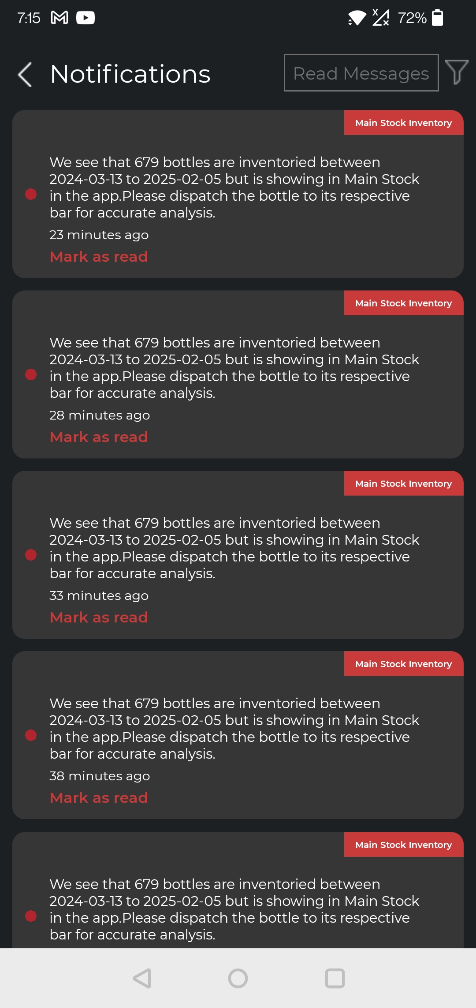
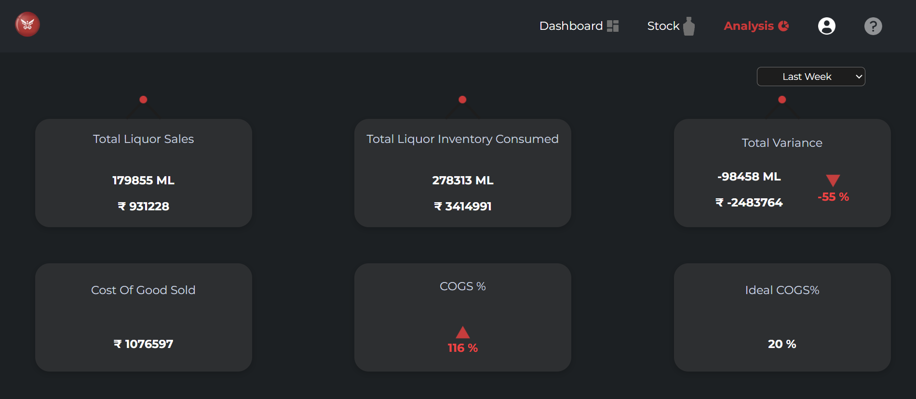
UI DESIGN

Slide 6
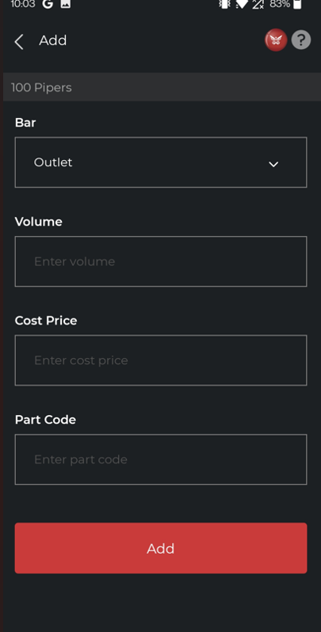
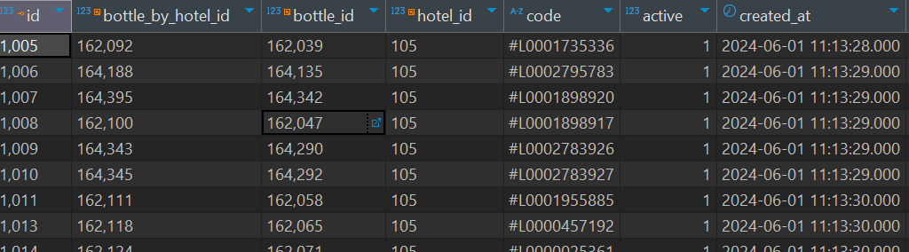
FEATURE ADDITION

Slide 7
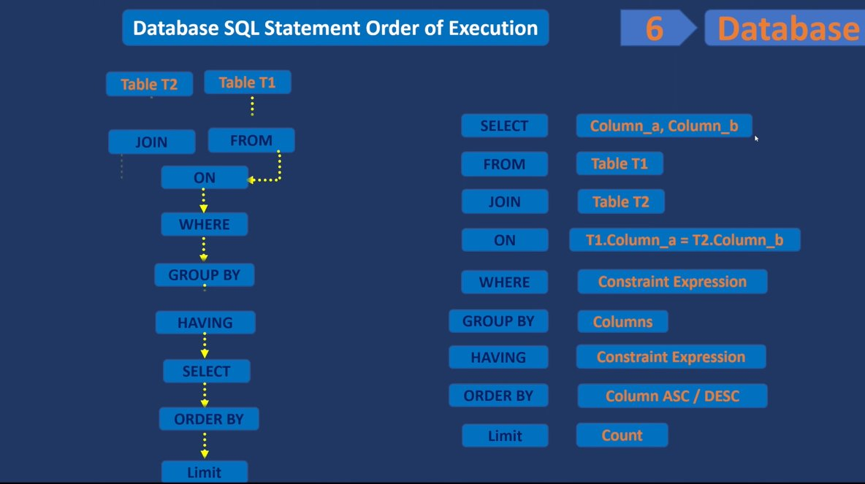
SQL OPTIMIZATION

Slide 8

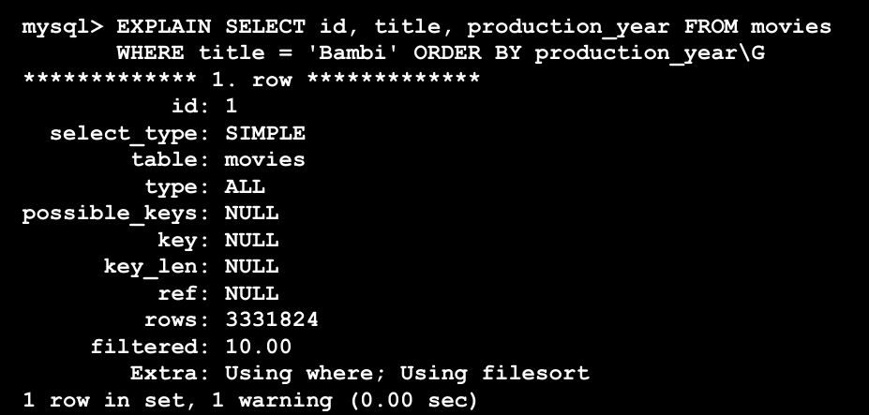
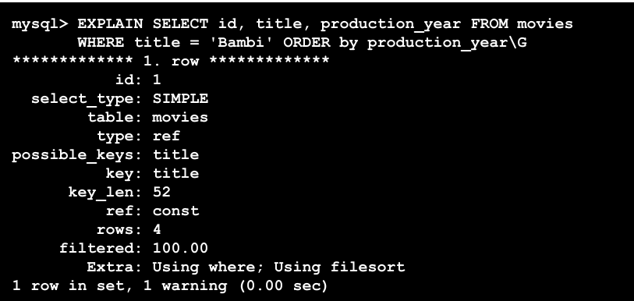
OPTIMIZATION TECHNIQUE:INDEXING

Slide 9
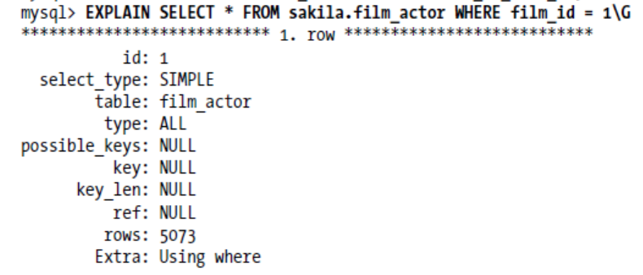
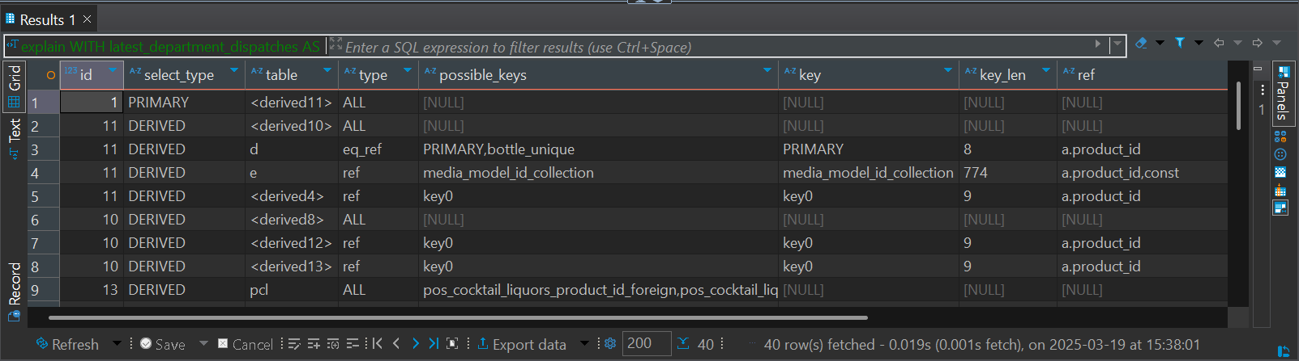
OPTIMIZATION TECHNIQUE:PROFILING

Slide 10
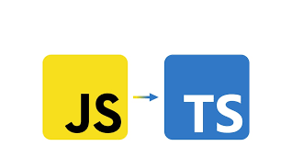
REFACTORING
Why? – TypeScript introduces type safety to the codebase which JavaScript lacks.
How? – Laying down the functionalities already present in JavaScript codebase and adding a layer of type safety by introducing Types

Slide 11
THANK YOU !!!!

