Slide 1

The fastest trading platform
Blockchain technology by LedgerSciences, powered by VIVA!

Slide 2
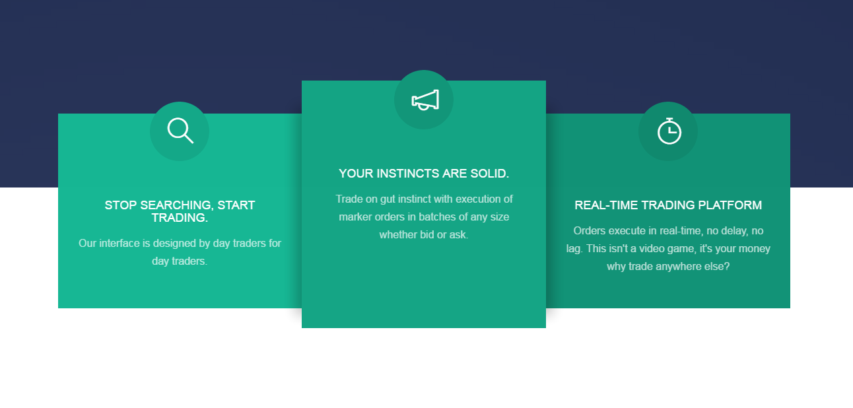
TRADEQWIK.COM

Slide 3
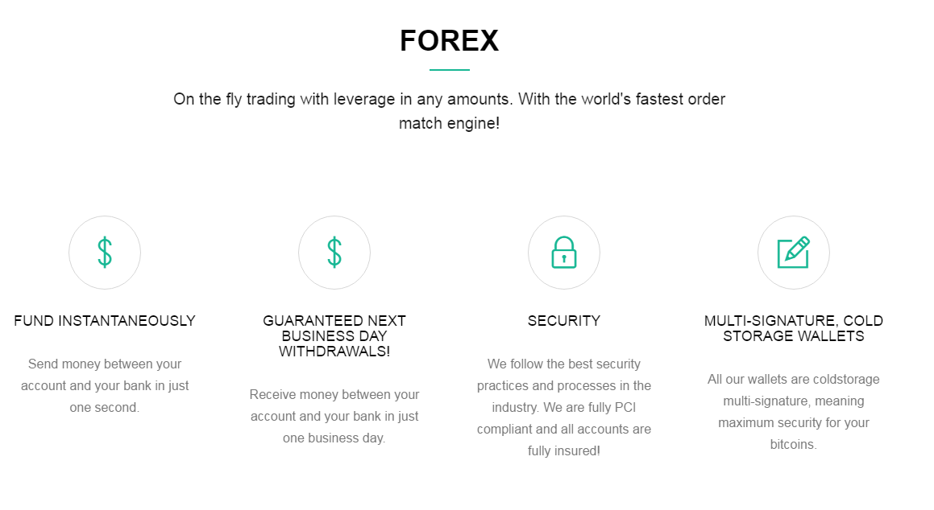
Highlights:

Slide 4
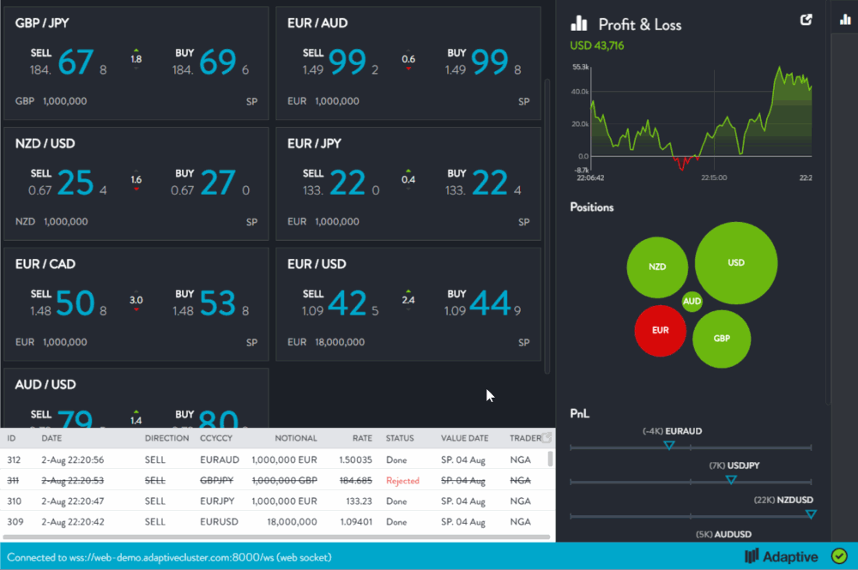
PREVIEW OF TRADEQWIK PLATFORM:

Slide 5
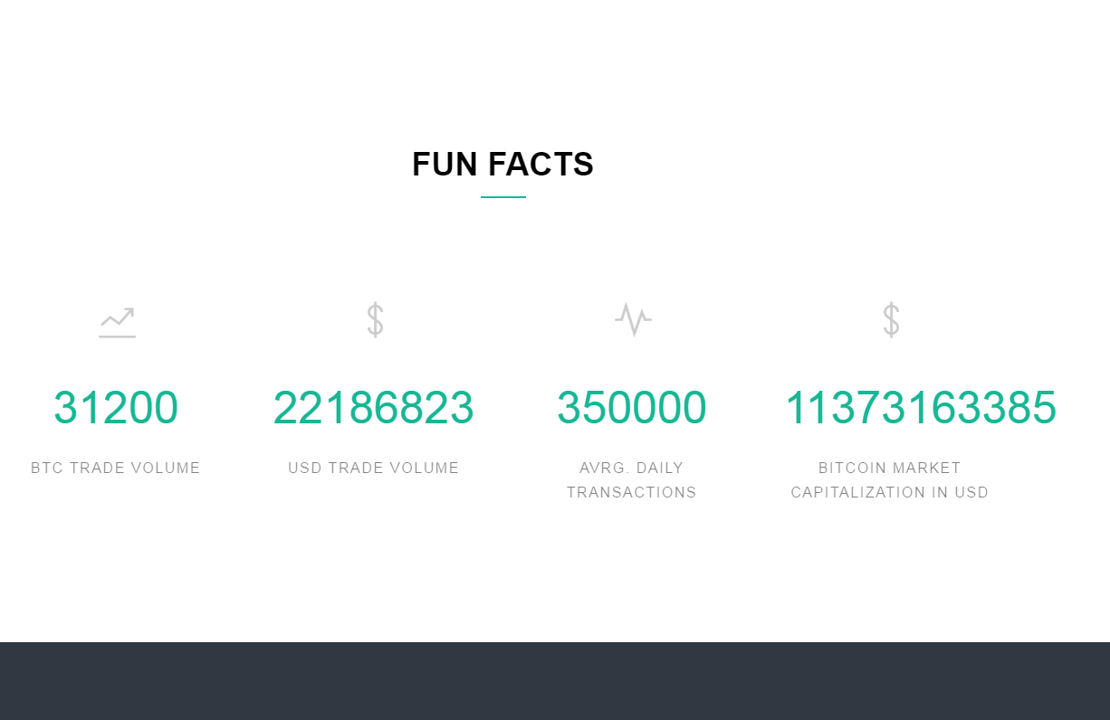
DAILY STATS:

Slide 6
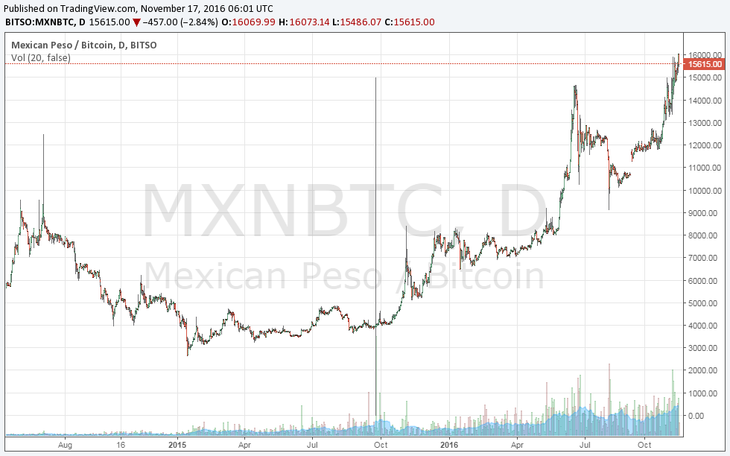
Bitso Market Data from 2014-Today:

Slide 7
PROBLEMS with Bitcoin exchanges & remittances:
Average Bitcoin exchange fee is 1% when entering the market and exiting the market, adding up to a total of 2%. Additionally market price feed vary a lot. For example: In November 2016 a Bitcoin did cost in the USA on average 700 USD, in Mexico the Bitcoin price was on average 720 USD. Making remittance not competitive to Wester Union and Co.
Bitcoin transactions are faster then international transactions, however, to cash them in and out can also take well over one day. The Bitcoin price fultuates on average between 1-5%. This is the volatility everybody is scared about, and stops people from using Bitcoin for remittances.
There are a lot of regulatory burdens, specially in the USA and Europe. Exchanges ask for an overwhelming amount of personal information from their customers. Many are uncomfortable to comply with this, or don’t get verified, because their documents are legit, but the standards of the AML/KYC are set too high by the exchange.
The onboarding of users is more complicated than it should be. (Party because of reasons above)
Exchanges misappropriate customer funds and sometimes those funds get stolen. Occasionally exchanges have been known to speculate with customer funds. This mismanagement of funds makes people not trust exchanges.

Slide 8
SOLUTION for remittance exchange:
Large unified international network with it’s own settlement mechanism – Having a thin spread, unified international network of that connects to low cost kiosks, and that uses it’s own, price stable settlement method makes remittances competitive with companies such as Western Union.
Own state of the art professional infrastructure – open source code base helps maintain lower development cost while increasing quality of the code.
Faster than Bitcoin and with price stability – allows us to beat competition and gives customers a peace of mind, that they get what they payed for.

Slide 9
THANK YOU!
Alec Hahn
www.alechahn.de
alec@bitcoin42.com
Links:
www.tradeqwik.com
www.bitcoin42.com
www.vivaco.in
http://goldcoinc.github.io

