Slide 1

The Fate of Stars at the sun’s location on m31’s disk
By Frida Jauregui

Slide 2
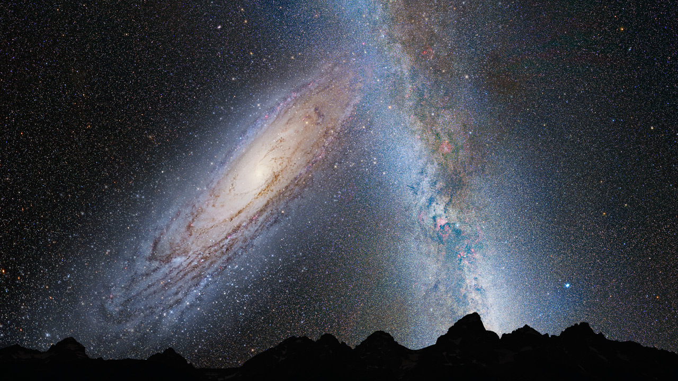
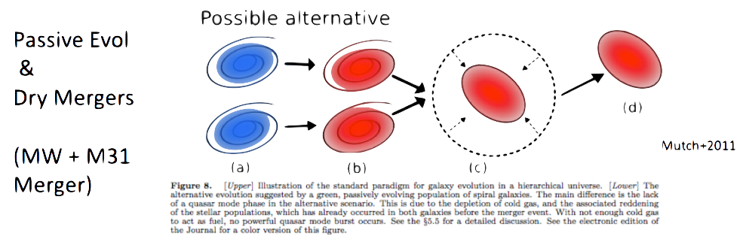
Background: Galaxies and Mergers
Milky Way (Sbc) vs Andromeda (Sb) = Milkomeda or Milkdromeda [Cox & Loeb]
6.2 Gyrs till collision!
M31 approaching the Milky Way at 110 km/s. [Cowen, 2012]
Major Merger: if two spiral galaxies that are ~ same size collide.
Andromeda Collides Milky Way (3.75 billion years), NASA
Lecture 13
Notes:
major merger: “takes place if two spiral galaxies that are approximately the same size collide at appropriate angles and speeds, they will likely merge in a fashion that drives away much of the dust and gas”
Dry merger : It takes place between gas-poor galaxies, or red galaxies. These mergers may not affect the star formation rate heavily but can play an important role in the stellar mass growth.

Slide 3
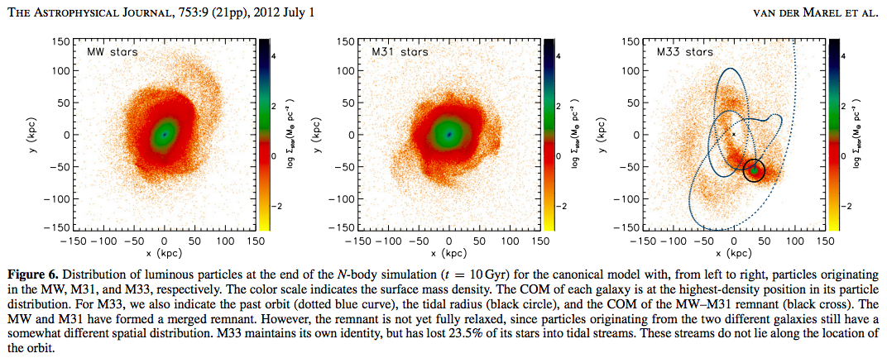
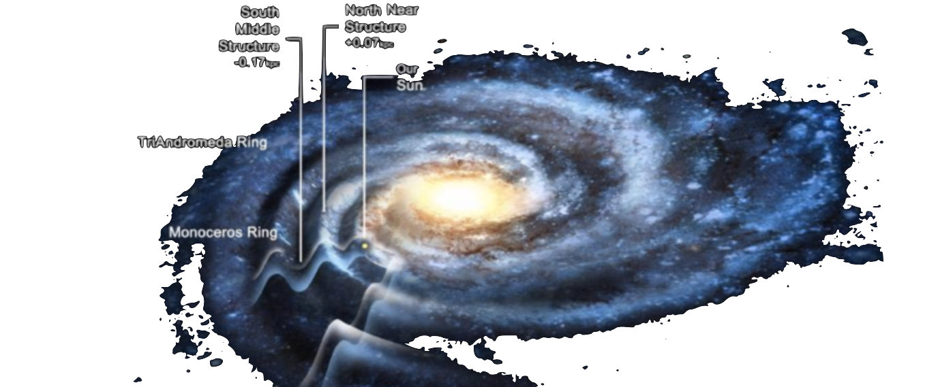
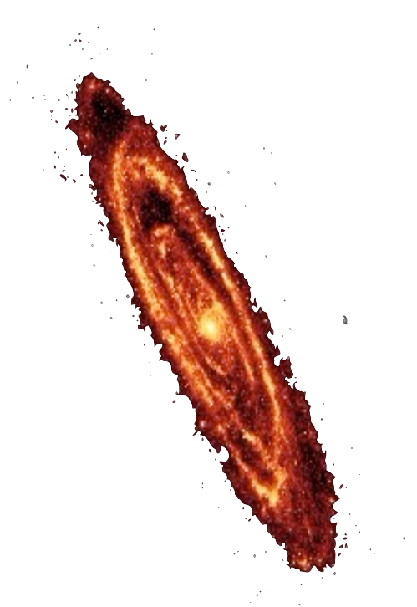
M31 & MW
MW: Monoceros rings 2-4kpc
M31: Rings 4-5 kpc
MW Disk Mass: 0.075*10¹² M☉
M31 Disk Mass: 0.12*10¹² M☉
Velocity vector of M31 is consistent with a head-on collision orbit toward the MW.
Transverse velocity was measured by using the orbiting satellites of M31. [J.-B. Salomon, R. A. Ibata, etc.]
Notes:
Now the properties of mw and m31
Monoceros rings: is a long, complex, ringlike filament of stars that wraps around the Milky Way three times
Transverse velocity of the Andromeda system is not measured with one observation

Slide 4
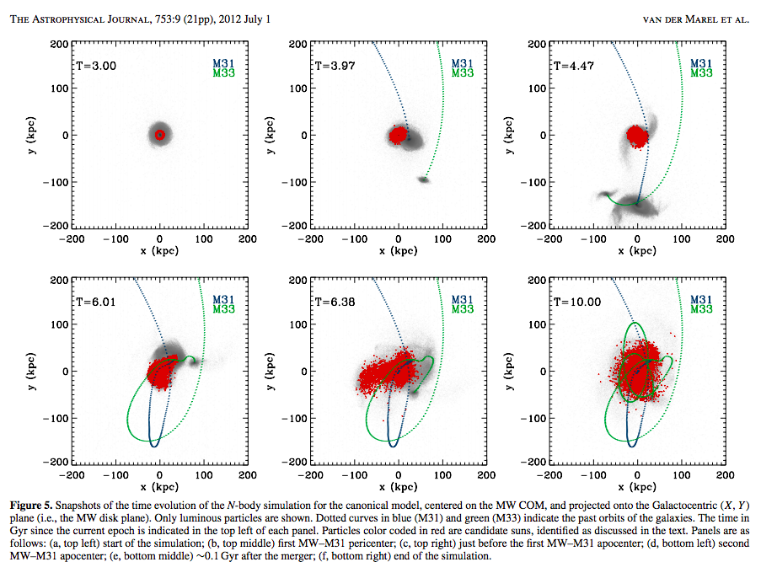
Fate of Our Sun
Our Sun is about at R☉= 8.20 kpc from the galactic center.
Initial conditions of the N-body simulations are the same initial conditions we derived in assignment 4.
Our Sun will have a 14.6% chance to reside r < R☉ a 85.4% chance to reside at r > R☉ and a 10.4% chance to reside at r > 50 kpc. [Van Der Marel, et al.]
Notes:
My assignment is fate of stars at the suns location, but on m31 disk
So likely it will be further out t the end of the merger
Assignment 4 COM

Slide 5
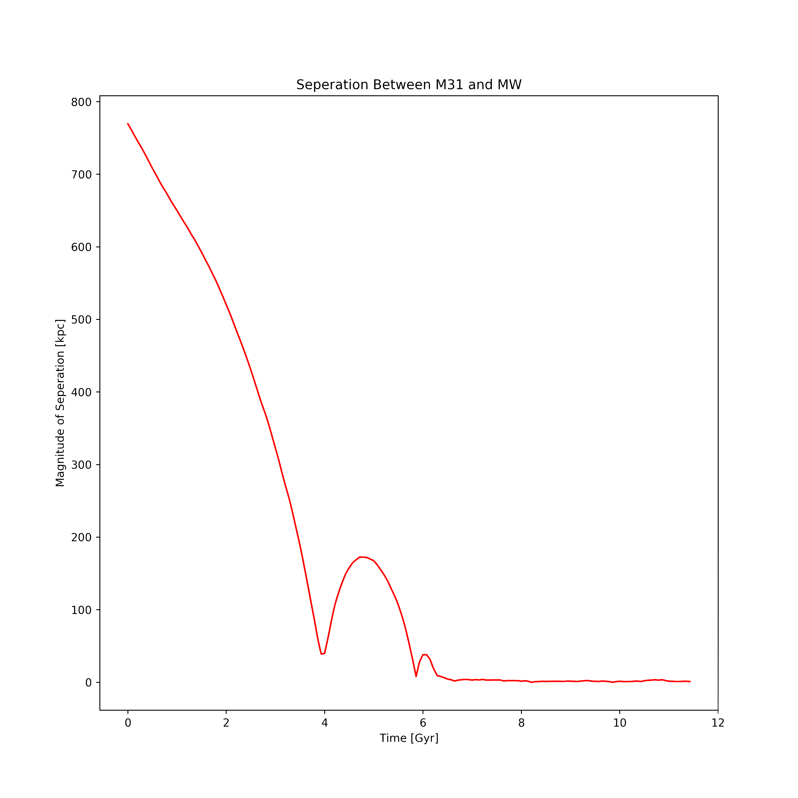
For This Project
Create a class to identify the disk particles I’m interested in.
Indexing my data from viewing and eventually plotting the stars over periods of time. (X² + Y²) within 7-9 kpc Z within -1 to +1
Taking the snapshots of interesting time: 0, 3.87, 5.87, 6.2, and 10.
Plotting edge on disk density for the merger.
Notes:
Index within radial position (x^2 + y^2) within 7-9 kpc from m31 COM and z within -1 +1 close to plane
Lab 7

Slide 6
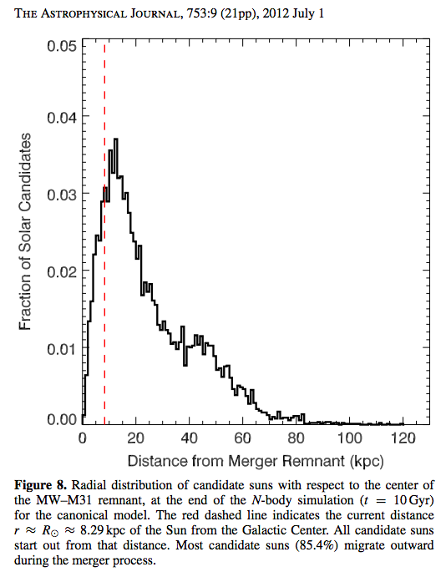
Importance and Rising questions
Likely outcome Elliptical Galaxy
Less stellar density in the center of the merger than present-day ellipticals. [Naab & Ostriker]
Fate of our Solar System (our Sun) is still unknown!
Could help us understand the evolution of our own galaxy and other disk-like galaxies.
Will stars, like our Sun end up further beyond 8.29 kpc after the merger on M31?
I believe that stars will go further beyond.
What is the circular velocity of the merger at 8.29 kpc and at radial distances beyond that, is there a possibility that the Stars will be ejected out of M31 and to what fraction?
Notes:
Diffused merger
M31 has more disk mass
Circular velocity MW Md to produce a circular velocity of Vc ≈ 239 km s−1
M31 Vc ≈ 250 km s−1
“These comparisons gives credence to the claim that present–day ellipticals can not have formed from the merger of present day spirals (Naab & Ostriker 2007).”
“The unknown magnitude of Andromeda’s transverse velocity adds uncertainty into the present day orbital parameters and therefore the past and future evolution of the Local Group”
-mass
-constraints

Slide 7
Questions?

