Slide 1

The Fate of Stars at the sun’s location on m31’s disk
By Frida Jauregui

Slide 2
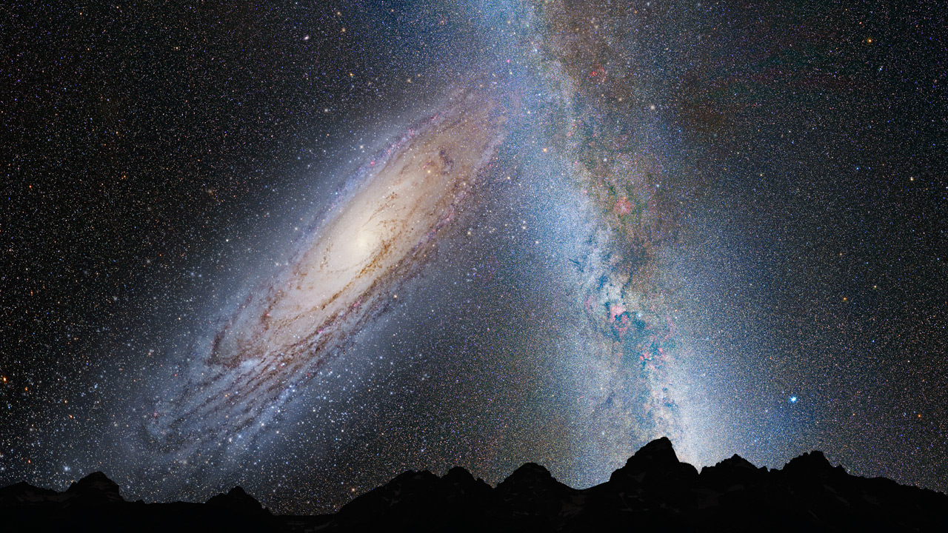
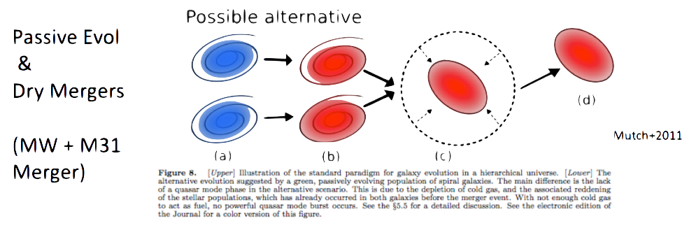
Background: Galaxies and Mergers
Milky Way (Sbc) vs Andromeda (Sb) = Milkomeda or Milkdromeda [Cox & Loeb]
6.2 Gyrs till collision!
M31 approaching the Milky Way at 110 km/s. [Cowen, 2012]
Major Merger: if two spiral galaxies that are ~ same size collide.
Andromeda Collides Milky Way (3.75 billion years), NASA
Lecture 13
Notes:
major merger: “takes place if two spiral galaxies that are approximately the same size collide at appropriate angles and speeds, they will likely merge in a fashion that drives away much of the dust and gas”
Dry merger : It takes place between gas-poor galaxies, or red galaxies. These mergers may not affect the star formation rate heavily but can play an important role in the stellar mass growth.

Slide 3
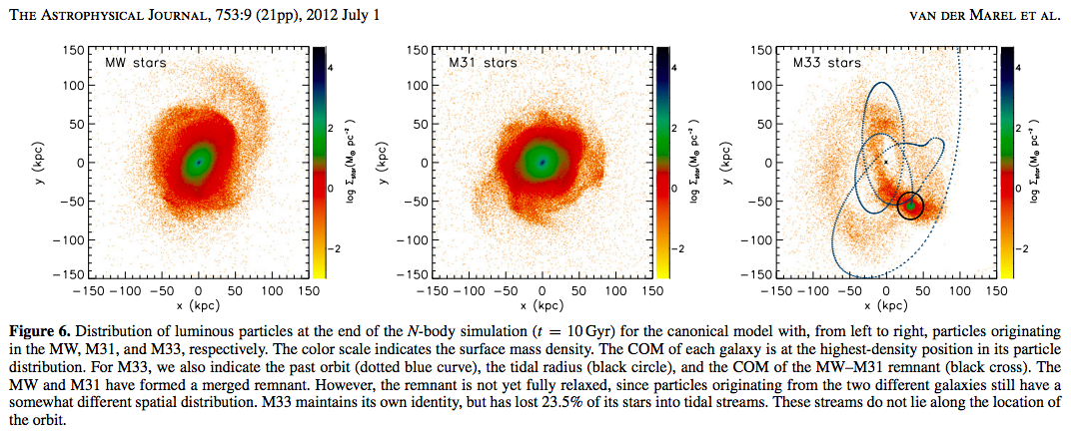
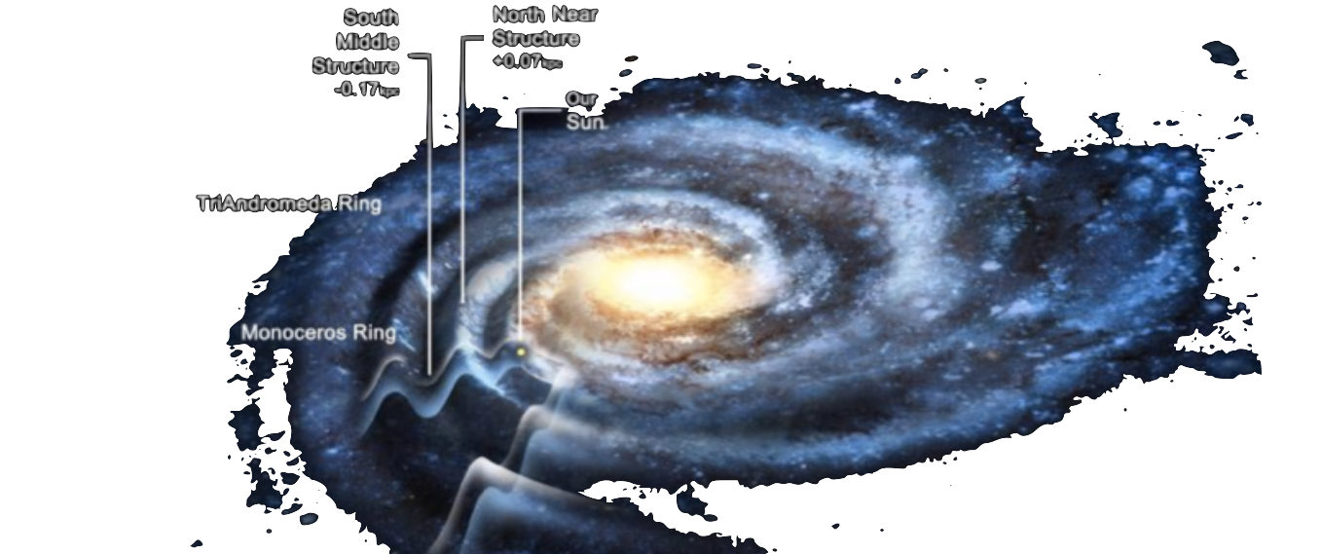
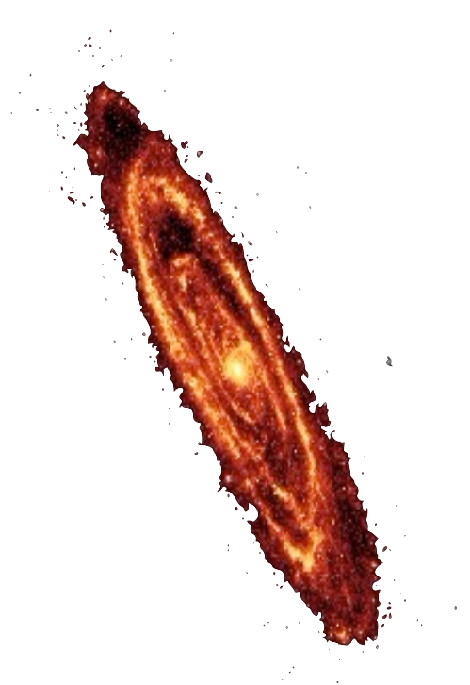
M31 & MW
MW: Monoceros rings 2-4kpc
M31: Rings 4-5 kpc
MW Disk Mass: 0.075*10¹² M☉
M31 Disk Mass: 0.12*10¹² M☉
Velocity vector of M31 is consistent with a head-on collision orbit toward the MW.
Transverse velocity was measured by using the orbiting satellites of M31. [J.-B. Salomon, R. A. Ibata, etc.]
Notes:
Now the properties of mw and m31
Monoceros rings: is a long, complex, ringlike filament of stars that wraps around the Milky Way three times
Transverse velocity of the Andromeda system is not measured with one observation

Slide 4
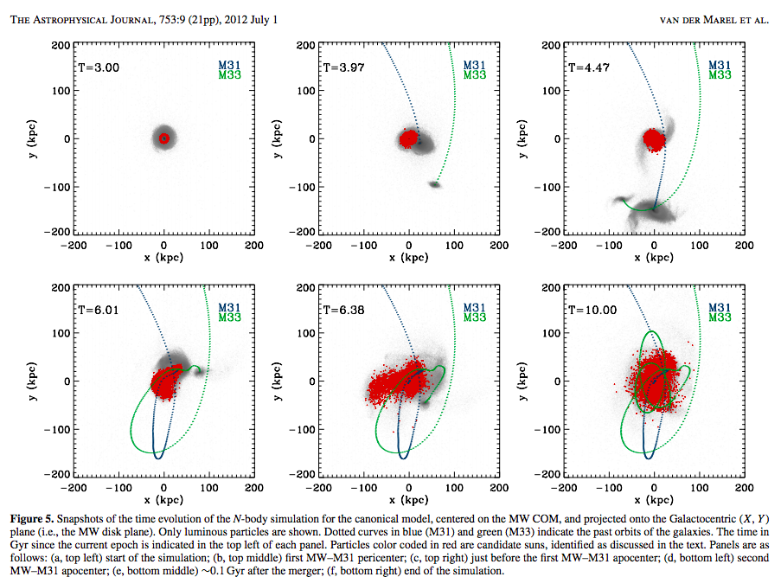
Fate of Our Sun
Our Sun is about at R☉= 8.20 kpc from the galactic center.
Initial conditions of the N-body simulations are the same initial conditions we derived in assignment 4.
Our Sun will have a 14.6% chance to reside r < R☉ a 85.4% chance to reside at r > R☉ and a 10.4% chance to reside at r > 50 kpc. [Van Der Marel, et al.]
Notes:
My assignment is fate of stars at the suns location, but on m31 disk
So likely it will be further out t the end of the merger
Assignment 4 COM

Slide 5
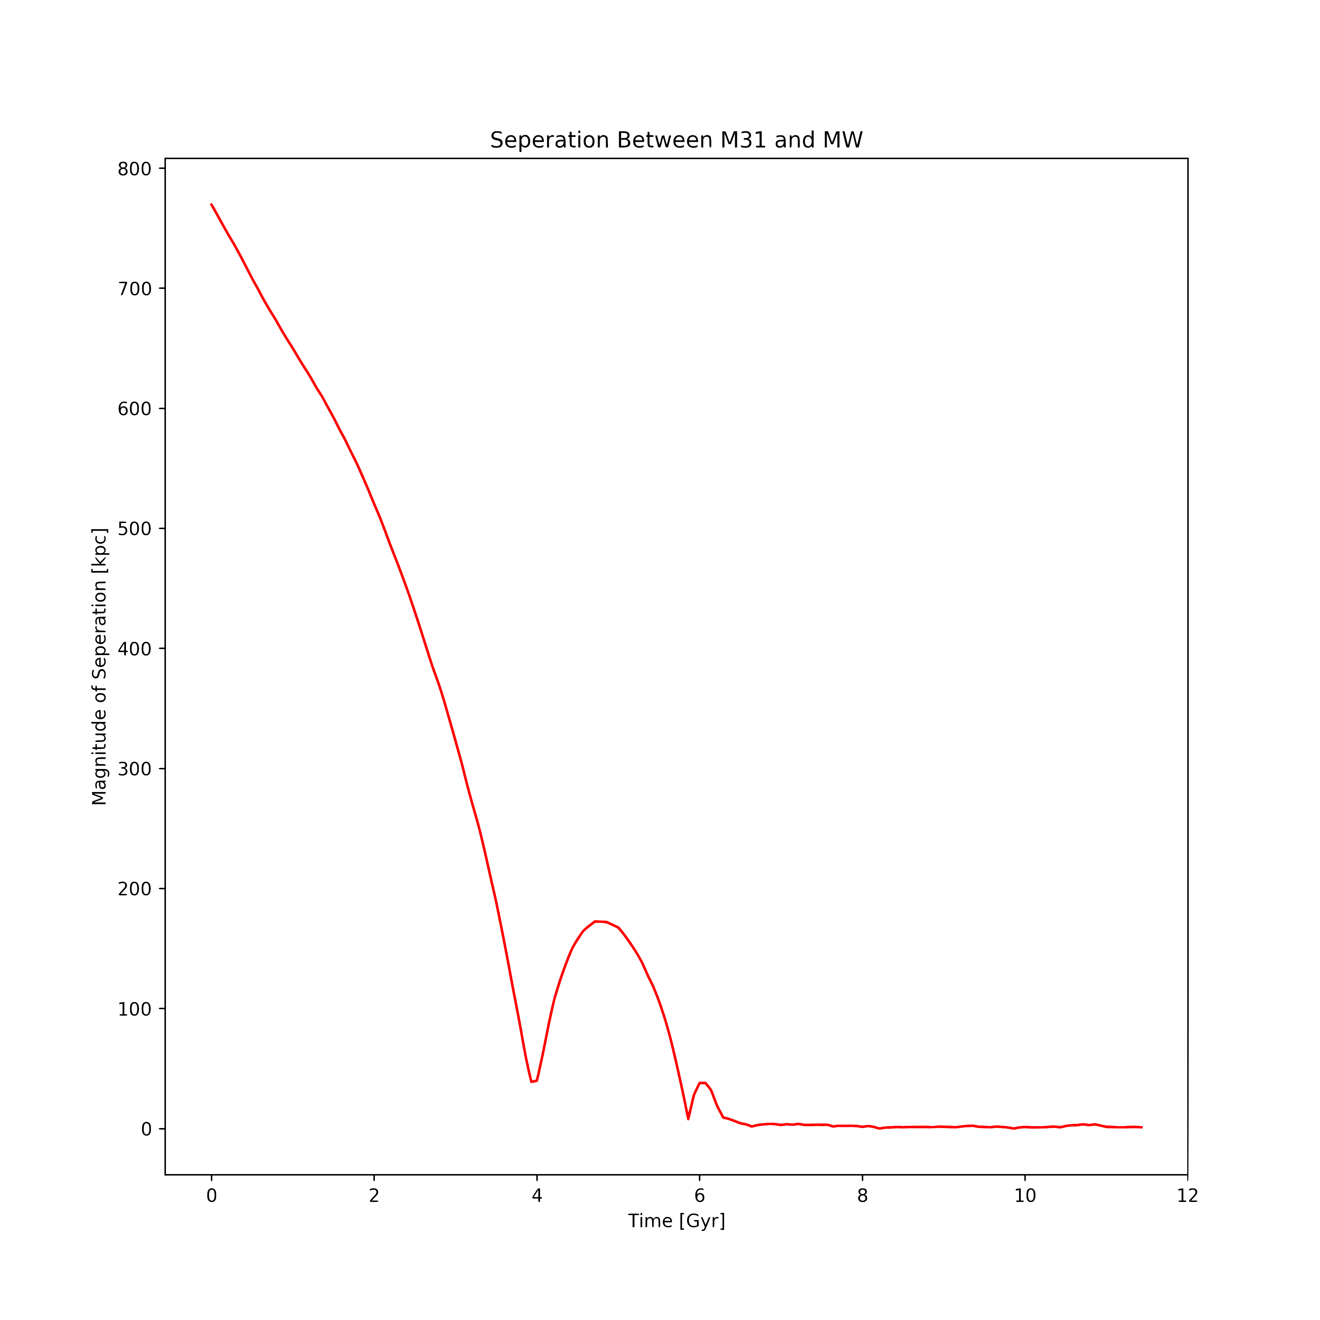
For This Project
Create a class to identify the disk particles I’m interested in.
Indexing my data from viewing and eventually plotting the stars over periods of time. (X² + Y²) within 7-9 kpc Z within -1 to +1
Taking the snapshots of interesting time: 0, 3.87, 5.87, 6.2, and 10.
Plotting edge on disk density for the merger.
Notes:
Index within radial position (x^2 + y^2) within 7-9 kpc from m31 COM and z within -1 +1 close to plane
Lab 7

Slide 6
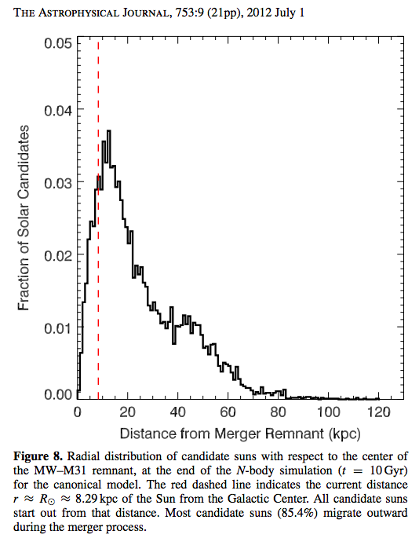
Importance and Rising questions
Likely outcome Elliptical Galaxy
Less stellar density in the center of the merger than present-day ellipticals. [Naab & Ostriker]
Fate of our Solar System (our Sun) is still unknown!
Could help us understand the evolution of our own galaxy and other disk-like galaxies.
Will stars, like our Sun end up further beyond 8.29 kpc after the merger on M31?
What is the circular velocity of the merger at 8.29 kpc and at radial distances beyond that, is there a possibility that the Stars will be ejected out of M31?
Notes:
Diffused merger
M31 has more disk mass
Circular velocity MW Md to produce a circular velocity of Vc ≈ 239 km s−1
M31 Vc ≈ 250 km s−1
“These comparisons gives credence to the claim that present–day ellipticals can not have formed from the merger of present day spirals (Naab & Ostriker 2007).”
“The unknown magnitude of Andromeda’s transverse velocity adds uncertainty into the present day orbital parameters and therefore the past and future evolution of the Local Group”
-mass
-constraints

Slide 7
Questions?

