Slide 1
Analyze NYSE Data
Project 2
Business Analyst Nanodegree
2 year forecast model
Using NYSE Dataset & Dynamic dashboards
To create forecast models for
IBM and Amazon
1
Notes:
NYSE_forecast

Slide 2
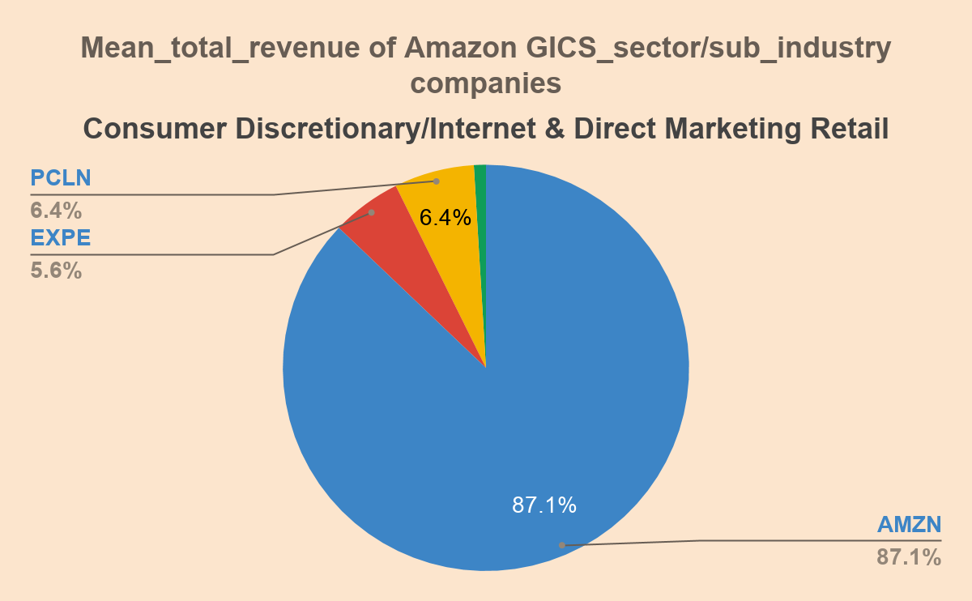
2
Notes:
NYSE_forecast

Slide 3
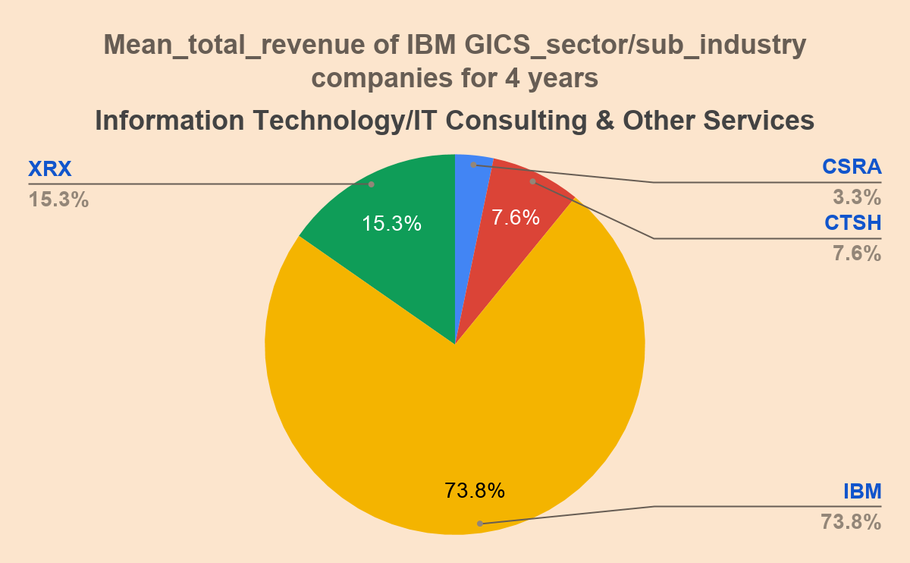
3
Notes:
NYSE_forecast

Slide 4
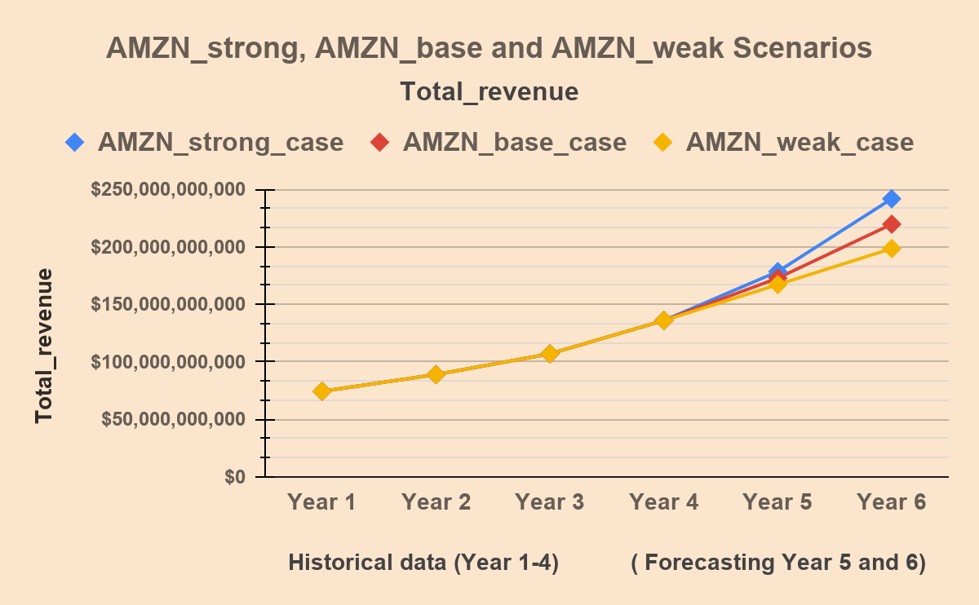
Standard Deviation
$62,932,426,046
$55,023,967,755
$47,726,977,384
Range
$167,269,508,968
$145,170,038,811
$124,017,031,455
4
Notes:
NYSE_forecast

Slide 5
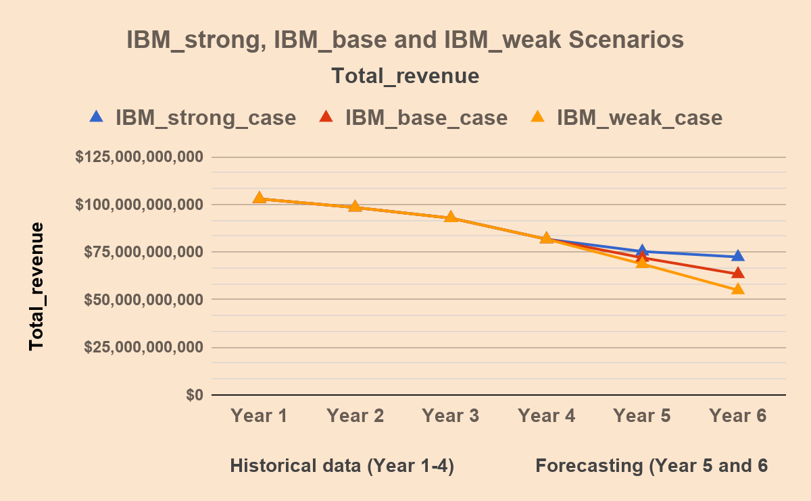
Standard Deviation
$12,588,207,038
$15,514,021,278
$18,529,332,458
Range
$30,479,373,359
$39,444,774,574
$47,879,795,182
5
Notes:
NYSE_forecast

Slide 6
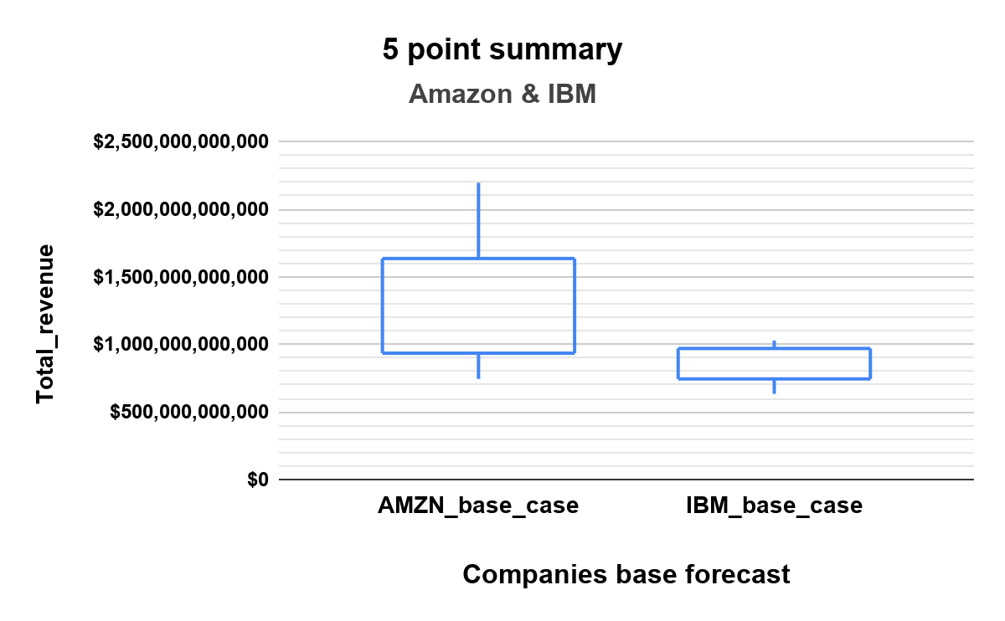
AMZN_stdev
$55,023,967,755
IBM_stdev
$15,514,021,278
AMZN_mean
$133,145,352,678
IBM_mean
$85,201,593,459
AMZN_median
$121,496,500,000
IBM_median
$87,267,000,000
6
Notes:
NYSE_forecast

Slide 7
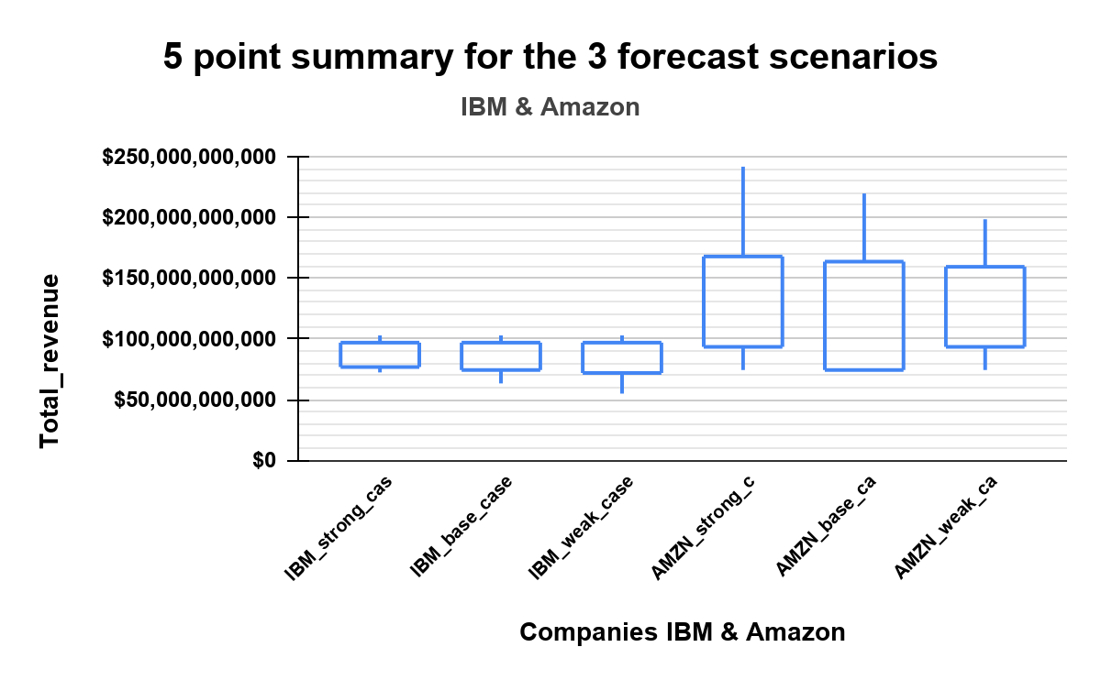
AMZN_Stdev
$62,932,426,046 Strong
$55,023,967,755 Base
$47,726,977,384 Weak
AMZN_median
$121,496,500,000
IBM_Stdev
$12,588,207,038 Strong
$15,514,021,278 Base
$18,529,332,458 Weak
IBM_median
$87,267,000,000
Ranges
$167,269,508,968 $145,170,038,811 $124,017,031,455
Ranges
$30,479,373,359 $39,444,774,574 $47,879,795,182
7
Notes:
NYSE_forecast

Slide 8
Conclusions:
Slides 2 & 3: Pie Charts Both IBM and Amazon have the largest share of their GICS_sector and GICS_sub-industry market categories. IBM 75% of Information Technology/IT Consulting & Other Services. Amazon 87.1% of Consumer Discretionary/Internet & Direct Marketing Retail.
I used the base scenario historical data to calculate the standard deviation for the Revenue_growth, Gross_margin and Operating_margin for the two companies. Then added one standard deviation to the base scenario for the strong_case and subtracting one standard deviation for the weak_case scenarios. Repeated for the next year.
Slides 4 & 5: Line Charts The data analysis from the NYSE dataset shows a general downward trend in IBM for all 3 scenarios. It also shows an upward trend for Amazon in all 3 scenarios. The forecast for Amazon tends to show the same doubling of revenue trend every 2 years. While a halving of revenue for IBM over 6 years.
Slides 6 & 7: Candlestick Charts Slide 6, shows that Amazon has much higher Standard deviation ($55,023,967,755) than IBM ($15,514,021,278). This could indicate higher investment risk while IBM may be more stable. Amazon’s total_revenue_mean is greater than its median indicating Right skewness. IBM’s mean is less than its median indicating Left skewness.
Slide 7, all 3 scenarios shows AMZN growing & IBM total revenue declining over 6 years. The forecast trend shows increase spread, Standard deviation, for Amazon from weak to strong scenario. IBM shows decrease spread, Standard deviation, from weak to strong scenario. The total Range for each scenario shows Amazon strong case having the greatest range at $167,269,508,968 of total_revenue as it increases from a weak case range of $124,017,031,455. While IBM has the lowest range of total revenue for the strong case $30,479,373,359 case increasing to $47,879,795,182 for the the weak case.
Overall Amazon is a higher risk investment but it has potential for huge returns. IBM is more stable for long term.
8
Notes:
NYSE_forecast

