Slide 1
20190524
Xingrong.Wu

Slide 2
Contents
Learning Coding in Unity 0510
No PointerUp on iPhoneX 0516
Start to Develop iOS APP 0516
Roll-a-ball Tutorial 0517

Slide 3
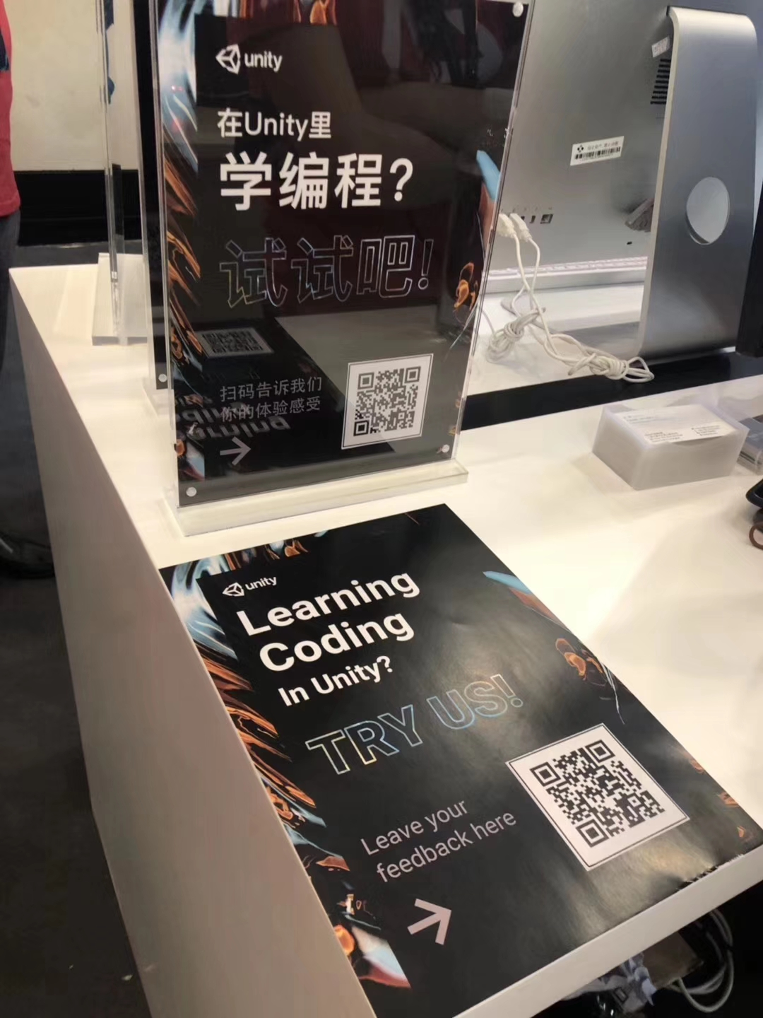
Learning Coding in Unity 0510
IDE Feature: Customer editor window, Keyboard short cut, Highlight, Auto-Complete, Error Message, ’Single step through’(doesn’t stop, not single line of code actually, not the same code as user coded)
@Stone

Slide 4

No PointerUp on iPhoneX 0516

Slide 5
No PointerUp on iPhoneX 0516

Slide 6
No PointerUp on iPhoneX 0516
Event Trigger in Canvas:
No canvas renderer in the area
UGUI block:
Transition->Pointer
ScrollView Content->Drag

Slide 7







Start to Develop iOS APP 0516
Unity Group
Apple ID
Registered iOS
iOS SDK
Provisioning Profile
Xcode
Signing
macOS

Slide 8
Start to Develop iOS APP 0516
Apple Developer account:
https://confluence.hq.unity3d.com/display/QA/Building+iOS+Application
macOS, Xcode and iOS SDK:
Xcode 10.1: highest for macOS 10.13.x
https://download.developer.apple.com/Developer_Tools/Xcode_10.1/Xcode_10.1.xip
iOS SDK: copy from higher versions of Xcode

Slide 9
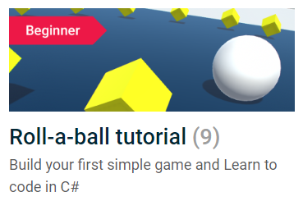
Roll-a-ball Tutorial 0517
Principle:
Test early and test often.
Use contrast color and motion to attract the player.
API:
gameObject.CompareTag(tag) is more efficient than gameObject.tag == tag.
Tag is case-sensitive.

Slide 10
Roll-a-ball Tutorial 0517
API:
*Time.deltaTime: smooth and frame rate independent.
LateUpdate() runs every frame after all the Update()s, used for follow cameras, procedural animation and gathering last known states.
@Update Order Unity Manual
Notes:
2018.4 LTS
Update Order
When you’re keeping track of game logic and interactions, animations, camera positions, etc., there are a few different events you can use. The common pattern is to perform most tasks inside the Update function, but there are also other functions you can use.
FixedUpdate: FixedUpdate is often called more frequently than Update. It can be called multiple times per frame, if the frame rate is low and it may not be called between frames at all if the frame rate is high. All physics calculations and updates occur immediately after FixedUpdate. When applying movement calculations inside FixedUpdate, you do not need to multiply your values by Time.deltaTime. This is because FixedUpdate is called on a reliable timer, independent of the frame rate.
Update: Update is called once per frame. It is the main workhorse function for frame updates.
LateUpdate: LateUpdate is called once per frame, after Update has finished. Any calculations that are performed in Update will have completed when LateUpdate begins. A common use for LateUpdate would be a following third-person camera. If you make your character move and turn inside Update, you can perform all camera movement and rotation calculations in LateUpdate. This will ensure that the character has moved completely before the camera tracks its position.

Slide 11
Roll-a-ball Tutorial 0517
Static Collider | Dynamic Collider
Collider only | Collider and Rigidbody
shouldn’t move | can move
like walls and floors | like the player
Static Collider cache is recalculated every time the Transform of any of them is changed.
Performance matters!

Slide 12
Roll-a-ball Tutorial 0517
Standard Rigidbody | Kinematic Rigidbody
is moved using physics forces | will not react to any physics forces
shouldn’t be animated and moved by its Transform | can be animated and moved by its Transform only
 | like elevators, moving platforms and objects with triggers
Performance matters!

Slide 13
Roll-a-ball Tutorial 0517
Dynamic Collider
Standard Rigidbody
Y
Y
Move?
Physics?
N
N
Static Collider
Kinematic Rigidbody
Best Practice!

