Slide 1
20190531
Xingrong.WU

Slide 2
Contents
Git Workflow 0524
Circuit Simulation Engine 0526
Using the Unity Interface Tutorial 0529
Beginner Gameplay Scripting 0529
UGUI Mask Material 0530

Slide 3
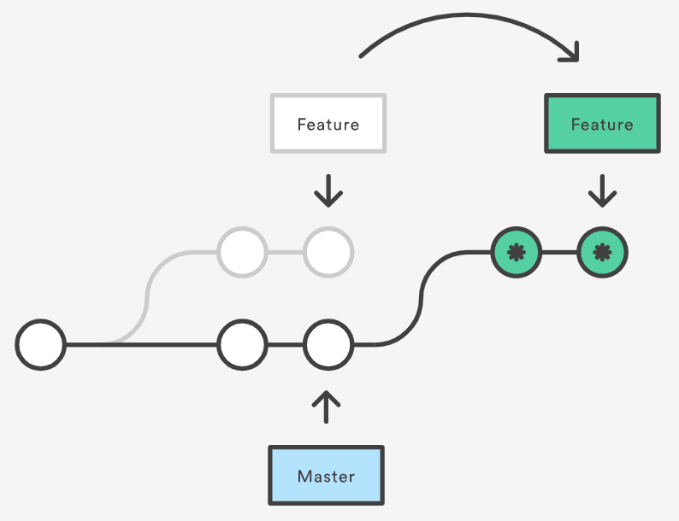
Git Workflow 0524
abort changes:
git checkout — file_name
delete all the untracked files:
git clean -d -fx
rebase:
git rebase branch_name

Slide 4
Circuit Simulation Engine 0526
ElectronicComponent
Node
Node
Pin
Pin
ElectronicComponent
Node
Pin
Pin

Slide 5
Circuit Simulation Engine 0526
Maintain Connection Graph
Add/Delete
Link/Unlink
Calculate Contribution of each EC
KCL formula
Solve the Matrix
LU decomposition
$$v=U^{−1}∙L^{−1}∙i$$
𝑣=𝑈^(−1)∙L^(−1)∙𝑖
$$v=G^{−1}∙i$$
𝑣=𝐺^(−1)∙𝑖

Slide 6
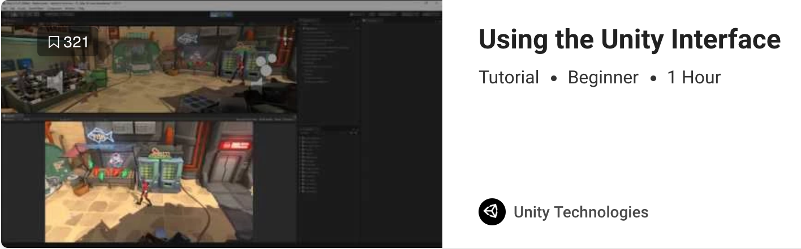
Using the Unity Interface Tutorial 0529
Scene View：
Tool change: QWERT
Hand tool: (Alt + Ctrl/Command) + Drag
Fly-through mode: (Right Mouse Button) + WASD(move)/QE(change height): (holding: continue to accelerate)
when transform tool selected:
Rotate: (Alt) + (Left Mouse Button)Drag
Zooms: (Alt) + (Right Mouse Button)Drag

Slide 7
Using the Unity Interface Tutorial 0529
Focus on the frame selected: selected + F
Inspector View: Debug Mode
Searching for type(tag/Component): “t:” + …

Slide 8
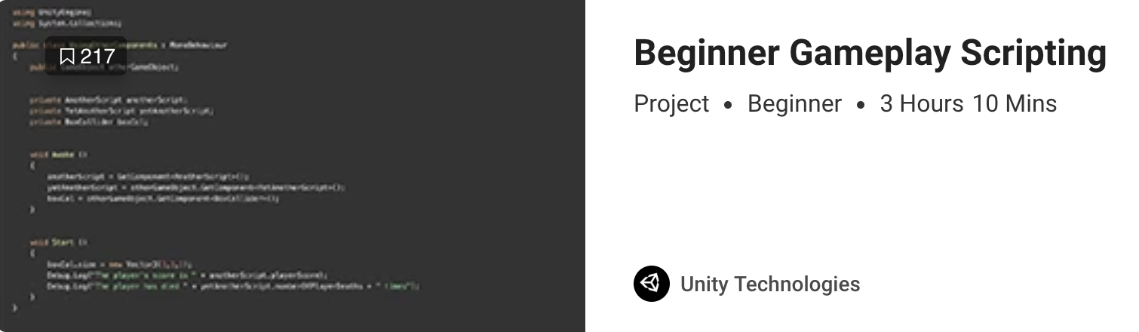
Beginner Gameplay Scripting 0529
Update(): Called every frame; Used for moving non-physics objects, simple timers, receiving input; update interval times vary
FixedUpdate(): Called every physics step; Fixed update intervals are consistent; used for adjusting physics(Rigidbody) objects
gameObject.activeSelf/activeInHierarchy: is (not) related to the activeness of the ancestor
Mathf/Vector3/Color.Lerp(from, to, percentage)
SmoothDamp: used to smooth a value over time

Slide 9
Beginner Gameplay Scripting 0529
transform.Translate/Rotate: should be used for static collider/dynamic collider with kinematic rigidbody
Vector3.forward/up: is local
transform.LookAt(transform): changes local forward direction
GetButtion>GetKey
GetAxis: (sensitivity + gravity)/GetAxisRaw(1/0, not smooth), snap(up + down = 0)

Slide 10
Beginner Gameplay Scripting 0529
GetComponent is expensive: don’t use it in update()
Invoke(string functionName, float delay) & InvokeRepeating(string functionName, float delay, float interval): function should return void and has no parameters
CancelInvoke(optional string functionName): cancel all the invokes if no parameter
enum: change type by : type, ended by ;

