Slide 1
DATA STRUCURES AND ALGORITHM

Slide 2
What are Data Structures?
Data structure is a storage that is used to store and organize data. It is a way of arranging data on a computer so that it can be accessed and updated efficiently.
Depending on your requirement and project, it is important to choose the right data structure for your project. For example, if you want to store data sequentially in the memory, then you can go for the Array data structure.

Slide 3
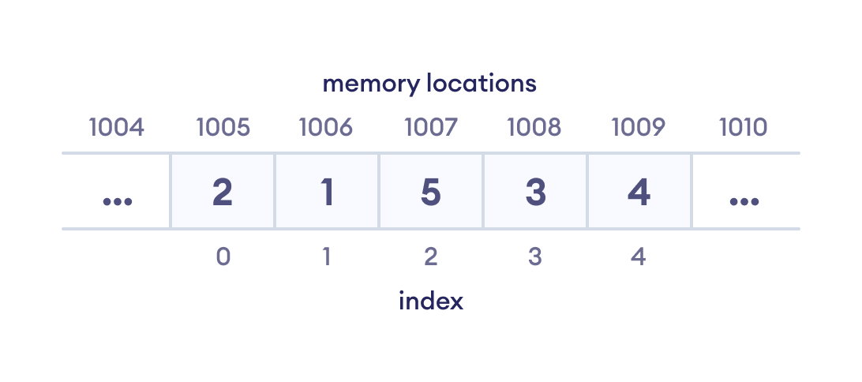
ARRAY

Slide 4
Types of Data Structure
Linear data structure
Non-linear data structure

Slide 5
Linear data structures
In linear data structures, the elements are arranged in sequence one after the other. Since elements are arranged in particular order, they are easy to implement.
However, when the complexity of the program increases, the linear data structures might not be the best choice because of operational complexities.
ARRAY
LINKED LIST
STACK
QUEUE

Slide 6
DIFFERENCE B/W LINEAR – NON LINEAR
Linear Data Structures | Non Linear Data Structures
The data items are arranged in sequential order, one after the other. | The data items are arranged in non-sequential order (hierarchical manner).
All the items are present on the single layer. | The data items are present at different layers.
The memory utilization is not efficient. | Different structures utilize memory in different efficient ways depending on the need.
The time complexity increase with the data size. | Time complexity remains the same.
Example: Arrays, Stack, Queue | Example: Tree, Graph, Map

Slide 7
Application of data structures
Databases: Databases use data structures such as trees, heaps, and hash tables to store and retrieve data efficiently.
Operating systems: Operating systems use data structures such as lists, queues, and stacks to manage tasks, processes, and memory.
Web search engines: Web search engines use data structures such as inverted indexes and tries to index and search the web efficiently.
Computer graphics: Computer graphics use data structures such as binary trees, octrees, and meshes to represent and manipulate 3D objects.

Slide 8
Application of data structures
Computer networks:
.Video games:
Financial systems:

Slide 9
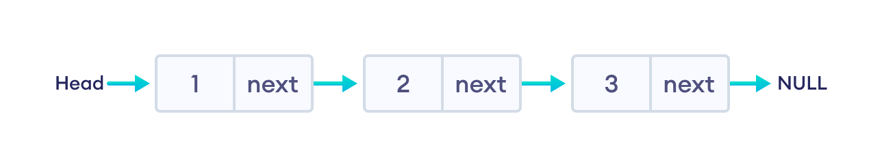
Linked List Data Structure
In linked list data structure, data elements are connected through a series of nodes. And, each node contains the data items and address to the next node.

Slide 10
Non-Contiguous Memory Allocation (Linked List)
In a linked list, nodes are not stored in adjacent memory locations. Each node is allocated separately and contains a pointer to the next node.
(Node 1: 10, Address: 500) --> (Node 2: 20, Address: 1200) --> (Node 3: 30, Address: 800)

Slide 11
Instead, the JVM ensures that Java code runs consistently on Windows, macOS, Linux, etc., without worrying about memory allocation.
portable language
does not use pointers for security reasons

Slide 12
.
There are four key types of linked lists:
Singly linked lists.
Doubly linked lists.
Circular linked lists.
Circular doubly linked lists.

Slide 13
Advantages of Linked Lists
Dynamic Size: Can grow or shrink as needed without reallocating memory.
Efficient Insertions/Deletions: Adding or removing elements (especially at the beginning or middle) is faster than arrays because there is no need for shifting elements.

Slide 14
Disadvantages of Linked Lists
Extra Memory Overhead: Each node requires additional memory for storing pointers.
Slower Access Time: Unlike arrays, where elements can be accessed in constant time O(1), linked lists require traversal (O(n)) to access an element.

Slide 16
Singly linked lists.

Slide 17
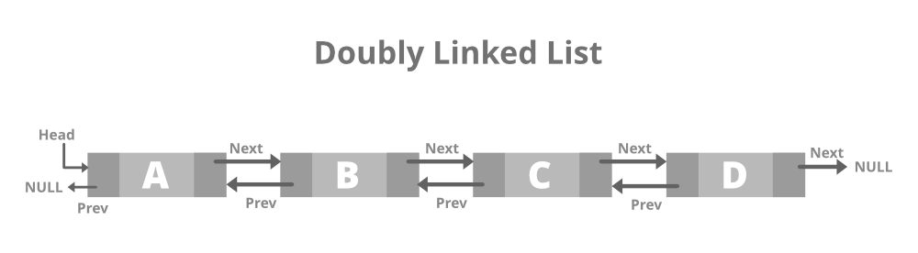
.

Slide 18
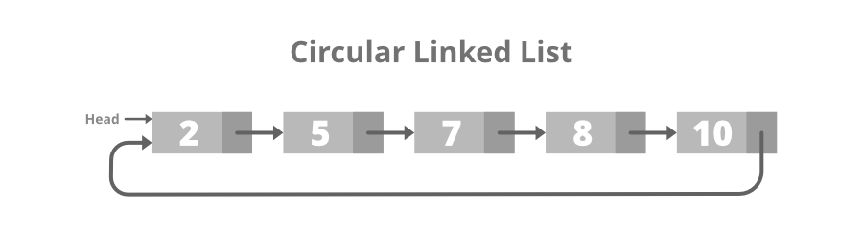
.

Slide 19
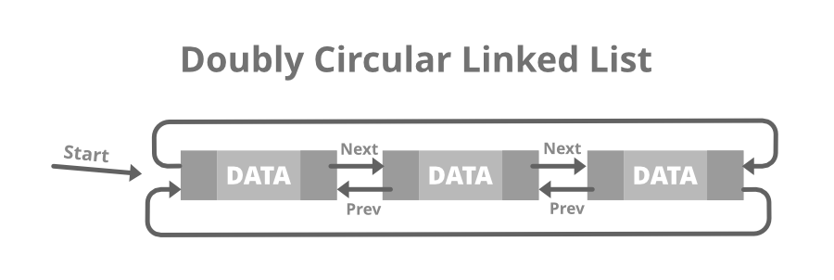
.

Slide 20
Application of Linked List
To perform undo operation.
Back button.[LIFO]
History of visited pages.

Slide 21
STACK
A Stack is a linear data structure that follows a particular order in which the operations are performed.
The order may be LIFO(Last In First Out) or FILO(First In Last Out).
LIFO implies that the element that is inserted last, comes out first and FILO implies that the element that is inserted first, comes out last.

Slide 22
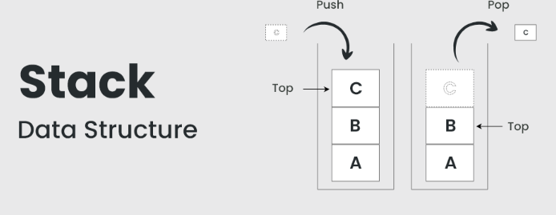

Slide 23
QUEUE
A Queue Data Structure is a fundamental concept in computer science used for storing and managing data in a specific order. It follows the principle of “First in, First out” (FIFO), where the first element added to the queue is the first one to be removed

Slide 24
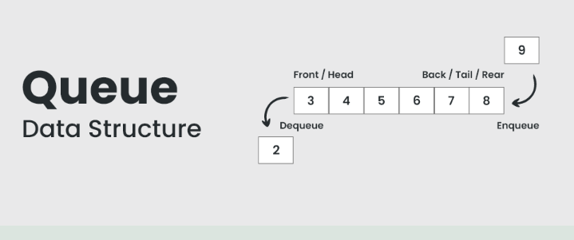

Slide 25
INTERFACE
Comparator, Collection, and Iterator are interfaces in Java, but they serve different purposes

Slide 26
Comparator Interface
Purpose: Used to define custom sorting logic for objects.
Located in: java.util package.
Key Method: compare(T o1, T o2)
Usage: When you need to sort objects in a non-natural order (i.e., different from the Comparable interface).

Slide 27
Collection Interface
Purpose: Root interface of Java's collection framework. Defines operations like adding, removing, and checking elements.
Located in: java.util package.
Common Subinterfaces:
List (ArrayList, LinkedList)
Set (HashSet, TreeSet)
Queue (PriorityQueue, LinkedList)

Slide 28
. Iterator Interface
Purpose: Used to traverse elements of a collection one by one.
Located in: java.util package.
Key Methods:
hasNext()
next()
remove()

Slide 29
TREE-Non Linear datastructure
Tree data structure is a hierarchical structure that is used to represent and organize data in the form of parent child relationship. The following are some real world situations which are naturally a tree.

Slide 30
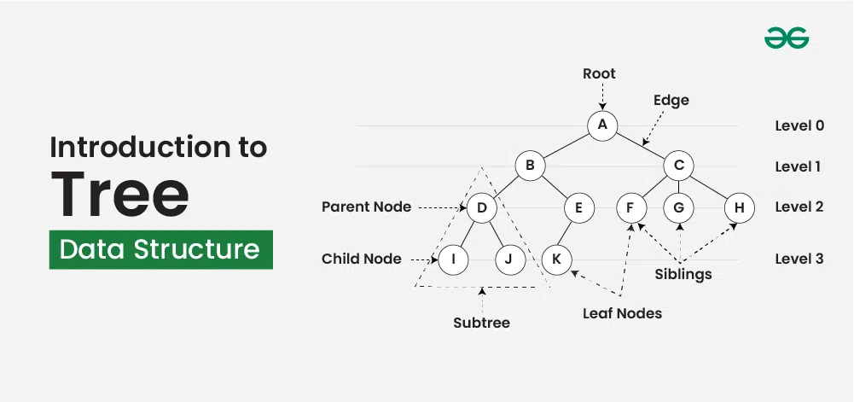

Slide 31
Properties of Tree Data Structure:
Number of edges: An edge can be defined as the connection between two nodes. If a tree has N nodes then it will have (N-1) edges. There is only one path from each node to any other node of the tree.
Depth of a node: The depth of a node is defined as the length of the path from the root to that node. Each edge adds 1 unit of length to the path. So, it can also be defined as the number of edges in the path from the root of the tree to the node.

Slide 32
Height of a node: The height of a node can be defined as the length of the longest path from the node to a leaf node of the tree.
Height of the Tree: The height of a tree is the length of the longest path from the root of the tree to a leaf node of the tree.
Degree of a Node: The total count of subtrees attached to that node is called the degree of the node. The degree of a leaf node must be 0. The degree of a tree is the maximum degree of a node among all the nodes in the tree.

Slide 33
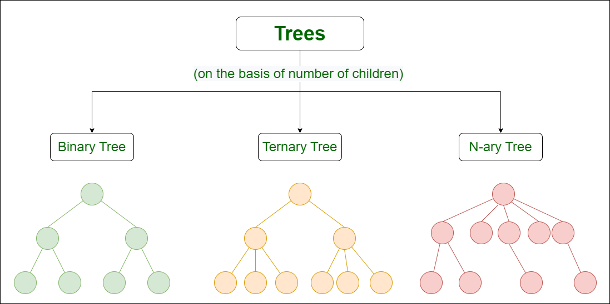

Slide 34
Classification of trees based on Node values
Binary Search Tree
AVL Tree
Red-Black Tree
B-Tree

Slide 35
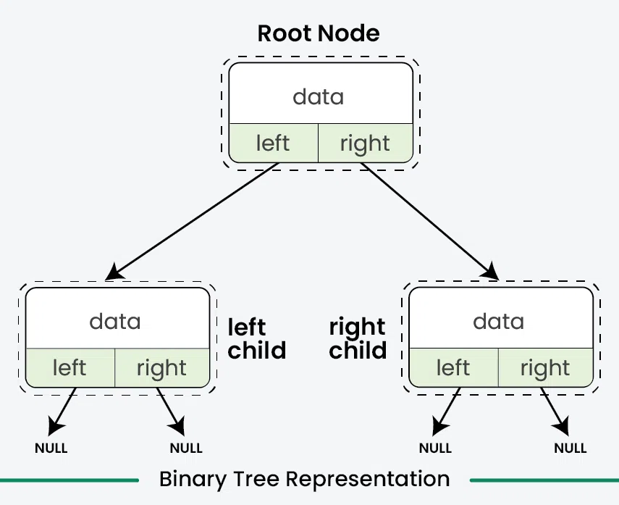

Slide 36
An AVL Tree
An AVL Tree is a self-balancing Binary Search Tree (BST) where:
The height difference between left and right subtrees (balance factor) is at most 1.
If the tree becomes unbalanced after insertion, rotations are applied to restore balance.

Slide 37
Why?
BST operations (Insert, Delete, Search) can degrade to O(n) in an unbalanced tree.
AVL Trees ensure O(log n) time complexity for all operations.
Used in database indexing, memory allocation, and file system implementations.

Slide 38
Balance Factor Calculation
Balance Factor = Height of Left Subtree - Height of Right Subtree
If the Balance Factor is not in the range [-1, 0, 1], the tree is unbalanced.

Slide 39
example
Example:
50
/ \
30 70
/ \
20 40
Balance Factors:
50 -> 1 (Balanced)
30 -> 1 (Balanced)
70 -> 0 (Balanced)
20, 40 -> 0 (Balanced)

Slide 40
Single Rotations- Right Rotation
(2).
Right Rotate the unbalanced node.
Node rightRotate(Node y) {
Node x = y.left;
Node T2 = x.right;
x.right = y;
y.left = T2;
return x;
}

Slide 41
Single Rotations-Left Rotation
(-2)
Left Rotate the unbalanced node.
Node leftRotate(Node x)
{
Node y = x.right;
Node T2 = y.left;
y.left = x;
x.right = T2;
return y;
}

Slide 42
Double Rotations- Left-Right Rotation (LR Rotation)
Used when insertion happens in the right subtree of the left child.
First, Left Rotate the left child, then Right Rotate the unbalanced node.
Node leftRightRotate(Node z)
{
z.left = leftRotate(z.left);
return rightRotate(z);
}

Slide 43
Double Rotations-Right-Left Rotation (RL Rotation)
Used when insertion happens in the left subtree of the right child.
First, Right Rotate the right child, then Left Rotate the unbalanced node.
Node rightLeftRotate(Node z)
{
z.right = rightRotate(z.right);
return leftRotate(z);
}

Slide 44
Any difference in traversal bw BST & AVL???
????

Slide 45
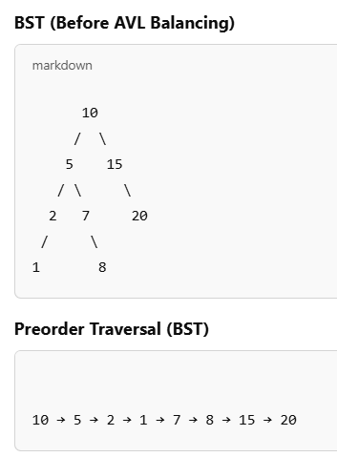

Slide 46
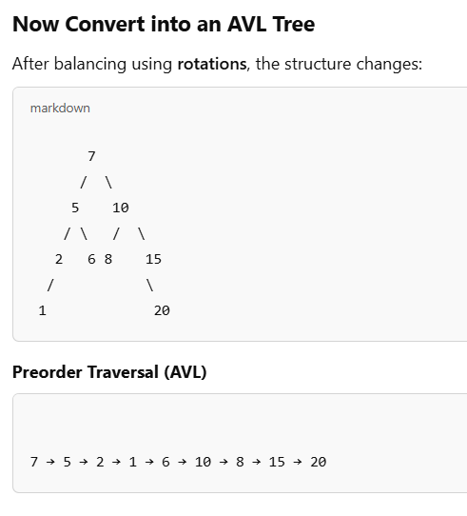

Slide 47
IT DIFFERES
PRE, POST AMND INODER ARE DIFFERENT BETWEEN BST & AVL

Slide 48
ADVANTAGES & REAL TIME EXAMPLES
They are ideal when you frequently insert and delete elements but still require fast lookups.
Ensures that search, insert, delete operations take O(log n) time, preventing performance degradation.

Slide 49
Database Indexing (e.g., MySQL, PostgreSQL)
When searching for records in a large dataset, an AVL tree helps in faster retrieval.

Slide 50
Red Black Tree:
Red Black Trees are a type of balanced binary search tree that use a set of rules to maintain balance, ensuring logarithmic time complexity for operations
Red Black Trees are self-balancing, using a simple color-coding scheme to adjust the tree after each modification.

Slide 51
Red-Black Tree
A Red-Black Tree is a self-balancing binary search tree where each node has an additional attribute: a color, which can be either red or black.
The primary objective of these trees is to maintain balance during insertions and deletions, ensuring efficient data retrieval and manipulation.

Slide 52
A Red-Black Tree have the following properties:
Node Color: Each node is either red or black.
Root Property: The root of the tree is always black.
Red Property: Red nodes cannot have red children (no two consecutive red nodes on any path).
Black Property: Every path from a node to its descendant null nodes (leaves) has the same number of black nodes.
Leaf Property: All leaves (NIL nodes) are black.

Slide 53
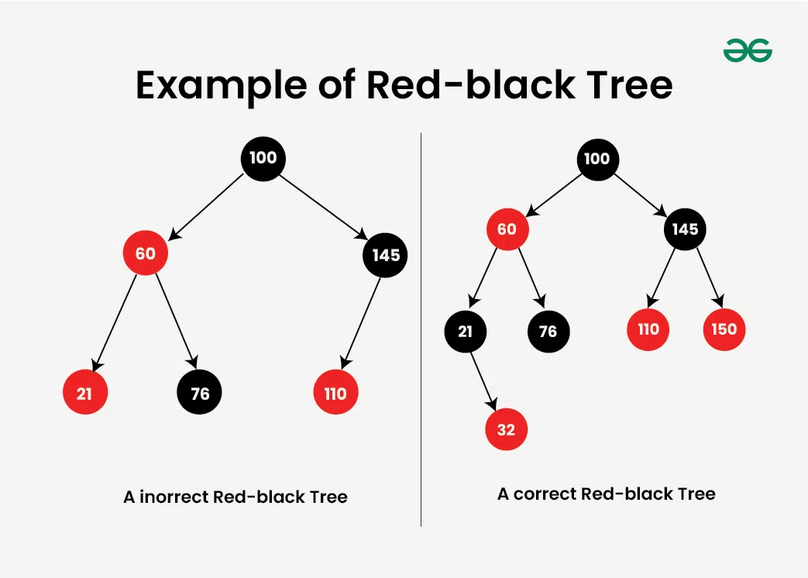

Slide 54
AVL vs RED BLACK
So if your application involves frequent insertions and deletions, then Red-Black trees should be preferred
And if the insertions and deletions are less frequent and search is a more frequent operation, then AVL tree should be preferred over the Red-Black Tree.

Slide 55
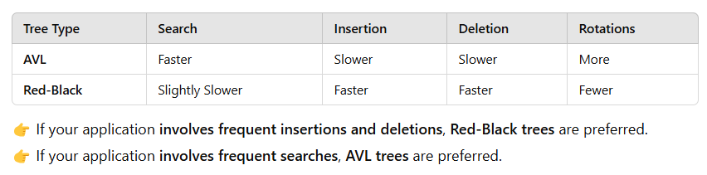

Slide 56
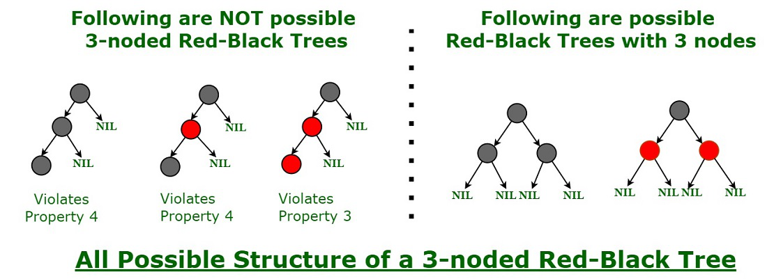

Slide 57
Insertion
Inserting a new node in a Red-Black Tree involves a two-step process: performing a standard binary search tree (BST) insertion, followed by fixing any violations of Red-Black properties.
Insertion Steps
BST Insert: Insert the new node like in a standard BST.
Fix Violations:
If the parent of the new node is black, no properties are violated.
If the parent is red, the tree might violate the Red Property, requiring fixes.

Slide 58
What is a Heap?
A heap is a complete binary tree where each node follows a specific order:
Min-Heap: Parent is less than or equal to its children.
Max-Heap: Parent is greater than or equal to its children.
Heaps are implemented using arrays.
Index Relations in array representation:
Left Child: 2*i + 1
Right Child: 2*i + 2
Parent: (i - 1) / 2

Slide 59
Properties of a Complete Binary Tree
Every level (except the last) is completely filled.
The last level is filled from left to right without skipping any node.
It is always as compact as possible (i.e., no gaps between nodes).

Slide 60
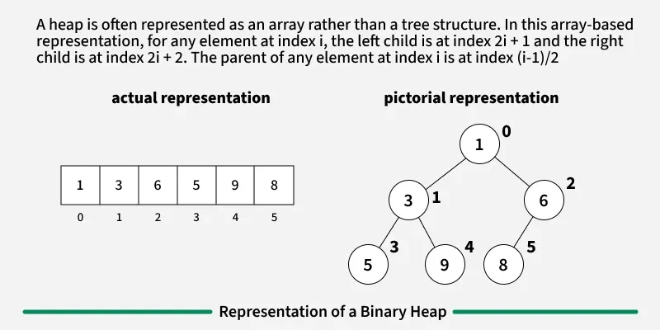

Slide 61
1.Tree is __________?
2. Binary Tree - ______________?
3. Binary Search Tree - _____________?
4. AVL tree is ______________?
5. Red Black Tree is ___________?
6.Complete tree - _____________?
7.Heap is _______________?

Slide 62
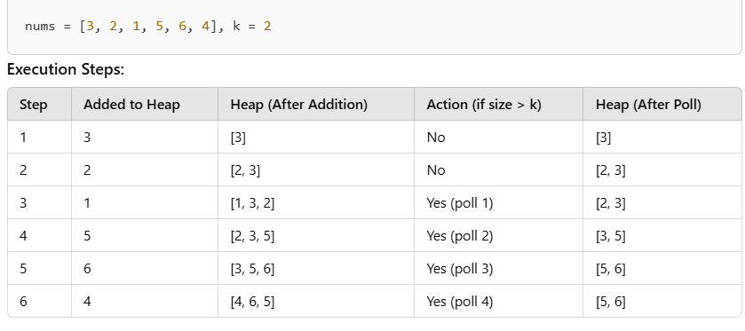
LEETCODE 215

Slide 63
HashMap
A HashMap in Java is a part of the java.util package and is used to store key-value pairs. It is an implementation of the Map interface that provides constant-time performance (O(1)) for basic operations like put, get, and remove, assuming a good hash function is used.

Slide 64
LEETCODE 621
Using Hashmap
Using List
Using Priority Queue

Slide 65
HASHING:
Hashing is a technique used in data structures that efficiently stores and retrieves data in a way that allows for quick access.
Hashing involves mapping data to a specific index in a hash table (an array of items) using a hash function. It enables fast retrieval of information based on its key.
The great thing about hashing is, we can achieve all three operations (search, insert and delete) in O(1) time on average.

Slide 66
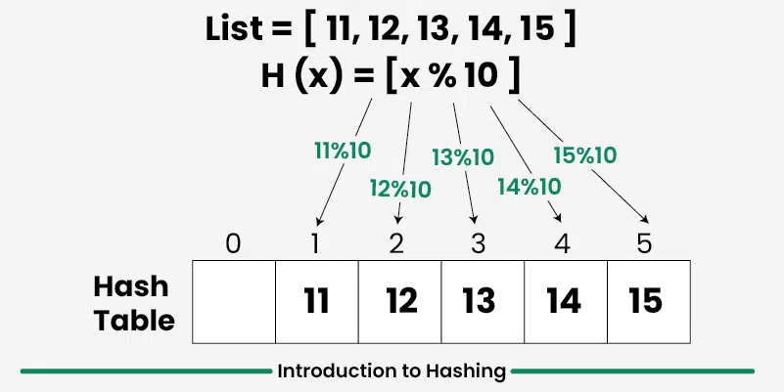
Hash Table.
Hashing uses mathematical formulas known as hash functions to do the transformation. This technique determines an index or location for the storage of an item in a data structure called Hash Table.

Slide 67
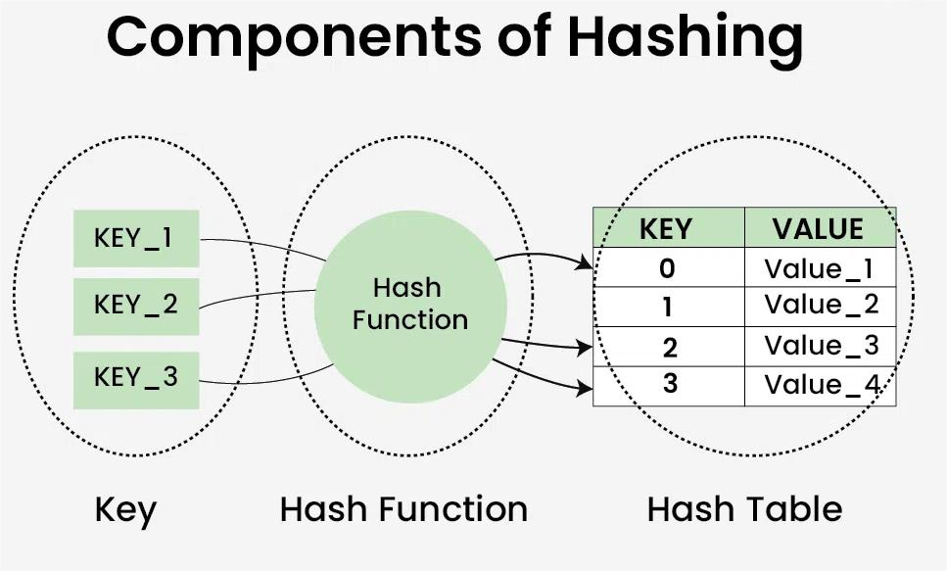

Slide 68
Purpose of Hashing
Fast data lookup (e.g., in hash tables or dictionaries)
Data integrity check (e.g., checksums)
Password storage (store hashed version, not plain text)
Cryptography (e.g., digital signatures)

Slide 69
Graph Data Structure
Graph Data Structure is a non-linear data structure consisting of vertices and edges. It is useful in fields such as social network analysis, recommendation systems, and computer networks.

Slide 70
TYPES
1.Directed
2.Undirected
3.Weighted
4.Complete

Slide 71
Representation of Graph Data Structure:
There are multiple ways to store a graph: The following are the most common representations.
Adjacency Matrix
Adjacency List

Slide 72
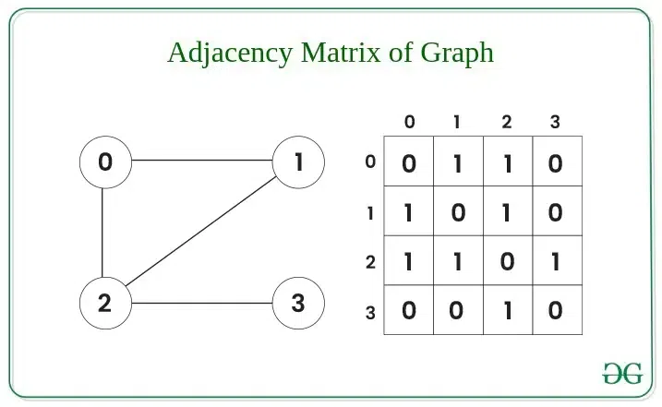

Slide 73
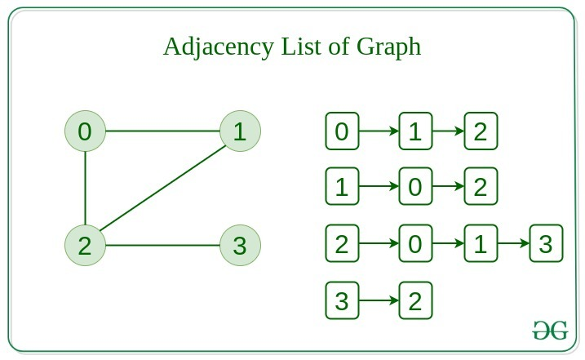

Slide 74
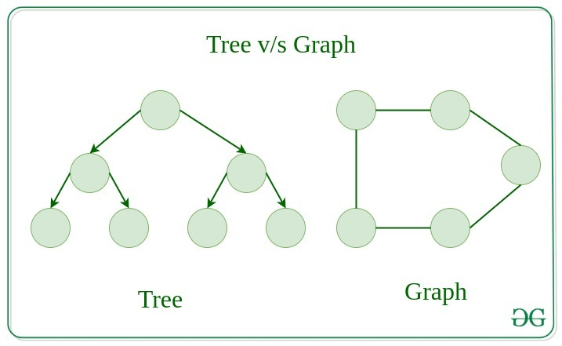
Difference between Tree and Graph:
Tree is a restricted type of Graph Data Structure, just with some more rules. Every tree will always be a graph but not all graphs will be trees.

Slide 75
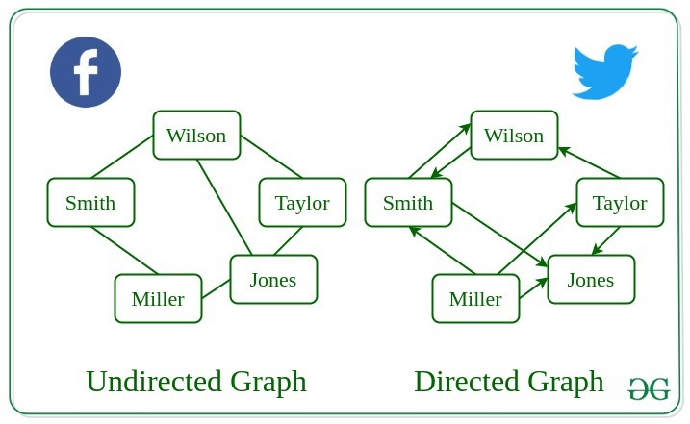
Real time application

