Slide 1
Examining Cryptocurrency Correlations with Heatmaps using Windowed Look Backs
Sameeullah Babar

Slide 2
Introduction
In the last decade, cryptocurrency has become a juggernaut of non-traditional assets
Widely accessible and not as daunting as the stock market
Heavy media attention both online and on television

Slide 3
What makes Cryptocurrency special?
Cryptocurrencies use a decentralized platform to conduct peer to peer transactions
Known as the Blockchain
Allows for more secure and traceable transactions
Removes intermediaries from exchange processes
Unregulated as a result
No regulatory bodies mean there is no one to keep volatility or prices from getting out of control

Slide 4
Big players in Cryptocurrency
Bitcoin:
Considered the market leader in cryptocurrency
Market cap of over 1 trillion dollars
Ethereum
Uses “smart contracts” to verify and record transactions on the blockchain
Allows for bits of code to be executed on the blockchain
Popular for creating NFTs
Both Bitcoin and Ethereum are strongly correlated to traditional markets

Slide 5
Advantages of cryptocurrency:
Multiple Redundancies:
Blockchain technology allows for trades to be secured and recorded even if one or more servers fail
Global transactions:
Can conduct international transactions instantaneously without having to wait for banks and currency conversion

Slide 6
Disadvantages of cryptocurrency
Volatility
Cryptocurrencies, even strong ones like Bitcoin and Ethereum, are susceptible to high volatility
Cryptocurrency prices are determined more by "sentiment-driven investor reasoning” than empirical data(James 2022)
Many cryptocurrencies have rabid communities that inflate the value of a coin
“Herding Behavior” exhibited by these investors cause prices to fluctuate based on the emotional reactions of the community(Cary 2021)
Exacerbated as a result of Social Media

Slide 7
Social Media and Cryptocurrency
Many cryptocurrency companies and communities utilise Social Media platforms to push their coin and acquire new investors
Some Social Media Influencers have become “crypto-tastemakers” who can sway the public opinion of a coin(Cary 2021)
Often results in steep drops or price hikes
Even popular celebrities such as Elon Musk have become “crypto-tastemakers” and have heavily influenced the value of coins

Slide 8
Elon Musk and Dogecoin
In the first half of 2021, tech mogul Elon Musk began using Twitter to hype up Dogecoin, a Memecoin frequently bought because investors think it’s funny, not hoping to see any real return
These tweets caused the price of Dogecoin to soar, going from a price of 3 cents to 73 cents, an almost 2500% increase
Price sunk in May of 2021 when Musk gave a horrid performance on Saturday Night Live
Musk’s antics still have influence over Doge despite a lack of attention from Musk
Dogecoin went up by 25 percent after Elon Musk purchased Twitter(Macheel 2022)

Slide 9

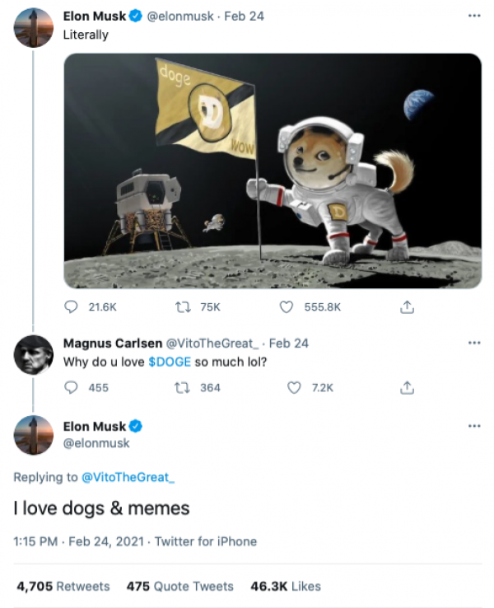

Slide 10
How to account for volatility in Crypto
Comparing newer coins to traditional markets will result in inconsistent estimates.
Using cross-correlations to compare coins to markets using Bitcoin and Ethereum as a proxy can yield better results
Utilize heatmaps with windowed look backs to account for variations as a result of time, negating inconsistencies resulting from temporary booms

Slide 11
Data and Methodology
Sourced from Kaggle
Contains time series data on various coins from 12/31/2020 to 03/06/2022
Cardano(ADA), Binance Coin(BNB), Bitcoin(BTC), Cronos(CRO), Dai(DAI), Dogecoin(Doge), Ether(ETH), Litecoin(LTC), Terra(LUNA), Solana(SOL), TRON(TRX), and Ripple(XRP) were used for analysis
Pearson correlation used to provide global synchrony across time series
Heatmaps generated using Seaborn

Slide 12
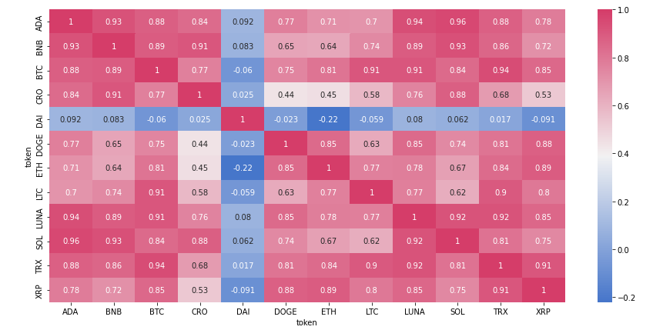

Slide 13
356 day lookback
Height of cryptocurrency boom
Heatmap almost entirely red
All coins strongly correlated with each other
Exception is DAI
a stable coin which strives to maintain a price of 1 USD per coin
generally uncorrelated with other non-stable coins.
Unlikely to find meaningful conclusions

Slide 14
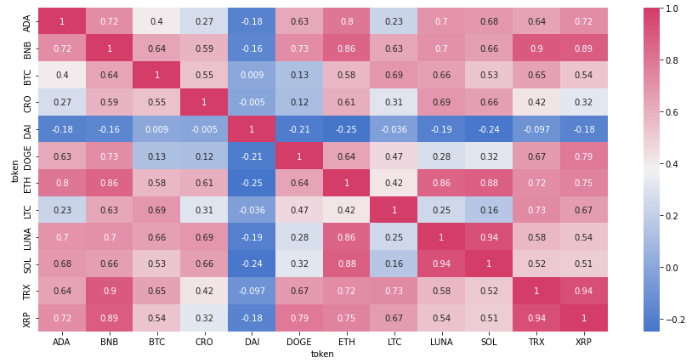

Slide 15
90-day lookback
Ethereum strongly correlated with most coins
Has stronger correlations with all coins but Litecoin(LTC)
Bitcoin has no strong correlation with other coins
Highest is 0.64 with Binance Coin(BNB)
Binance coin a strong performer
Strongly correlated with Ethereum
Strongly correlated with smaller coins

Slide 16
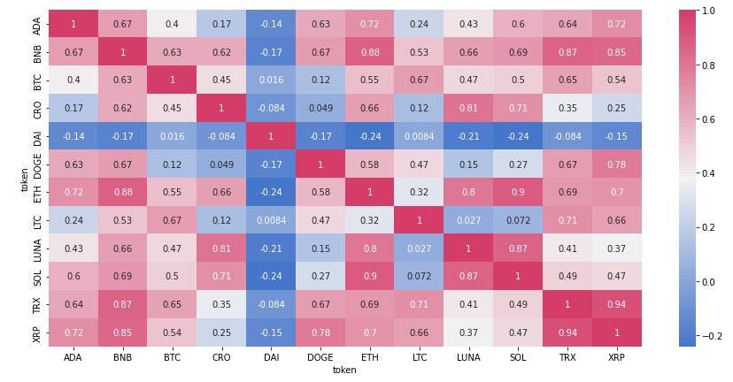

Slide 17
60-day lookback
Cryptocurrency market beginning to shift towards Ethereum as the preferred market standard
Binance Coin still going strong
Correlations amongst other small coins mostly dying down

Slide 18
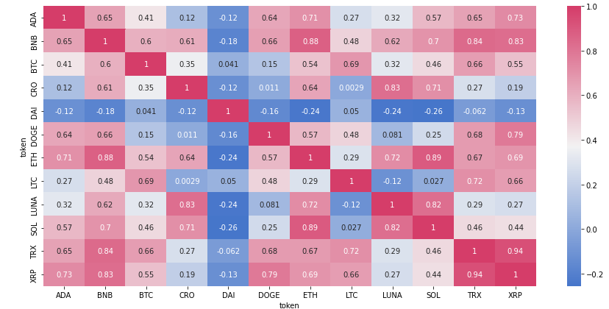

Slide 19
30-day lookback
most of the correlations to Ethereum exceed that of Bitcoin by 0.3 to 0.4
Cryptomarket demonstrating a clear shift towards Ethereum and Binance Coin
Binance Coin is also poised to overtake Bitcoin’s market position.

Slide 20
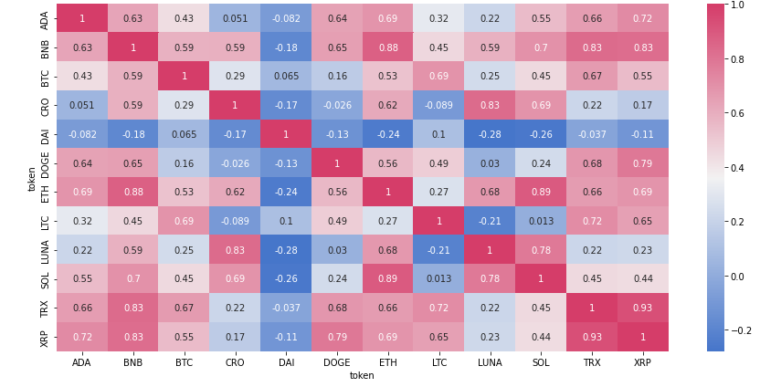

Slide 21
Whole dataset
Ethereum and Binance coin have middling to strong correlations with almost all the other coins.
Both strong with regards to smaller coins
Bitcoin has only one strong correlation
0.69 with Litecoin(LTC)
It has become evident that Bitcoin has been eclipsed as the market leader in cryptocurrency twice over

Slide 22
Conclusion
Bitcoin is no longer the market leader in cryptocurrency
Ethereum and Binance coin are the new market leaders
As Ethereum is correlated to traditional markets, coins with strong correlations with Ethereum are cross-correlated with said markets
Especially true for Binance Coin
Investors should put their money into Ethereum and Binance coin to minimize volatility based risks
Investors in small coins should look at correlations with Binance, as smaller coins show stronger correlation with Binance than Ethereum

Slide 23
Sources:
Macheel, Tanya. “Dogecoin Jumps More than 20% after Twitter Agrees to Elon Musk's Buyout Deal.” CNBC, CNBC, 25 Apr. 2022, https://www.cnbc.com/2022/04/25/dogecoin-jumps-more-than-20percent-after-twitter-agrees-to-elon-musks-buyout-deal.html.
James, Nick. “Evolutionary Correlation, Regime Switching, Spectral Dynamics and Optimal Trading Strategies for Cryptocurrencies and Equities.” Physica. D 434 (2022): n. pag. Web
Cary, Michael. “Down with the #Dogefather: Evidence of a Cryptocurrency Responding in Real Time to a Crypto-Tastemaker.” Journal of theoretical and applied electronic commerce research 16.6 (2021): 2230–2240. Web.

