Slide 1
DATABASE
Principles, Programming, and Performance
Patrick O’Neil and Elizabeth O’Neil
Lectured by Dr. Lican Huang
Email: licanhuang@zist.edu.cn
huang_lican@yahoo.co.uk
http://virgo.sourceforge.net/licanhuang.html

Slide 2
6 Database Design
Q: how do we analyze an enterprise and list the data items for a database, then decide how to place these data items columns in relational tables.
put them all in the same table? NO
redundency
CAPORDERS := C X A X P X O where C.cid = O.cid and A.aid = O.aid and P.pid = O.pid
Update
Insert new
There are two approaches about separating tables for a database:
Entity-Relationship modeling
Normalization

Slide 3
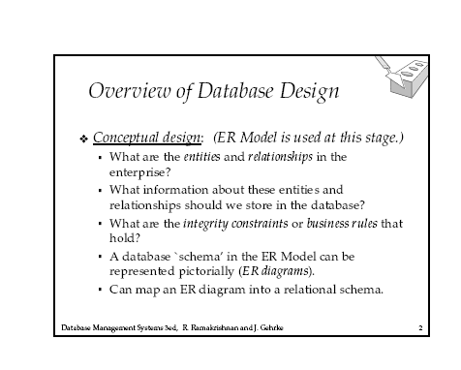
6 Database Design

Slide 4
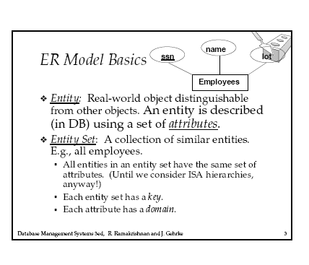
6. Database Design

Slide 5
6. Database Design
Definition 6.1.1 Entity pp332
Definition 6.1.2 Attribute pp332
Figure 6.2 pp333

Slide 6
6. Database Design
Transformation rule 1 pp334
Example 6.1.1
Transformation rule 2 pp334
example 6.1.2

Slide 7
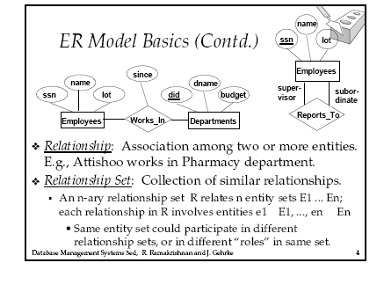
6. Database Design

Slide 8
6. Database Design
Definition 6.1.3 Relationship pp335
Figure 6.3 pp336
Figure 6.5 pp338

Slide 9
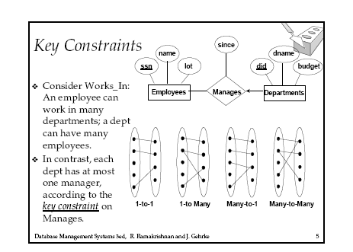
6. Database Design

Slide 10
6. Database Design
Cardinality of Entity participation in a Relationship
Figure 6.6 pp339
Figure 6.7 pp341

Slide 11
6. Database Design
Transformation Rule 3. N-N Relationships pp 343
Figure 6.8 pp344
Transformation rule 4 N-1
Figure 6.9 pp345
Transformation rule 5 1-1, optional
Transformation rule 6 1-1, mandatory

Slide 12
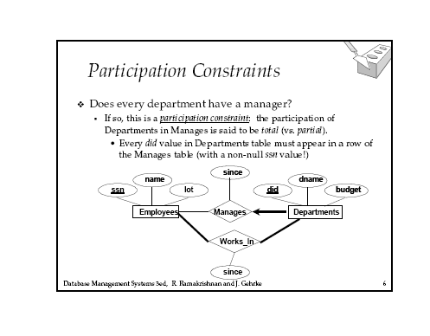
6. Database Design

Slide 13
6. Database Design
Cardinality of Attributes
Figure 6.10 pp 347

Slide 14
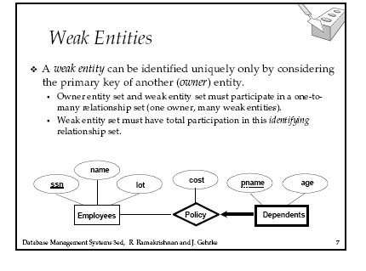
6. Database Design
See also Figure 6.11

Slide 15
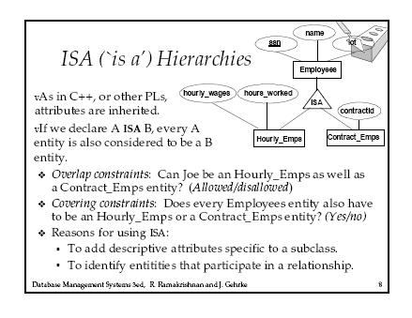
6. Database Design
See also figure 6.12

Slide 16
6. Database Design--Case Study
Entity Flights, primary identifier flightno, descriptive attribute depart_time (e.g., Nov 19, 9:32 PM).
Entity Passengers, primary identifier ticketno.
Entity Seats, identified by seatno,
Entity Gates, with primary identifier gateno.

Slide 17
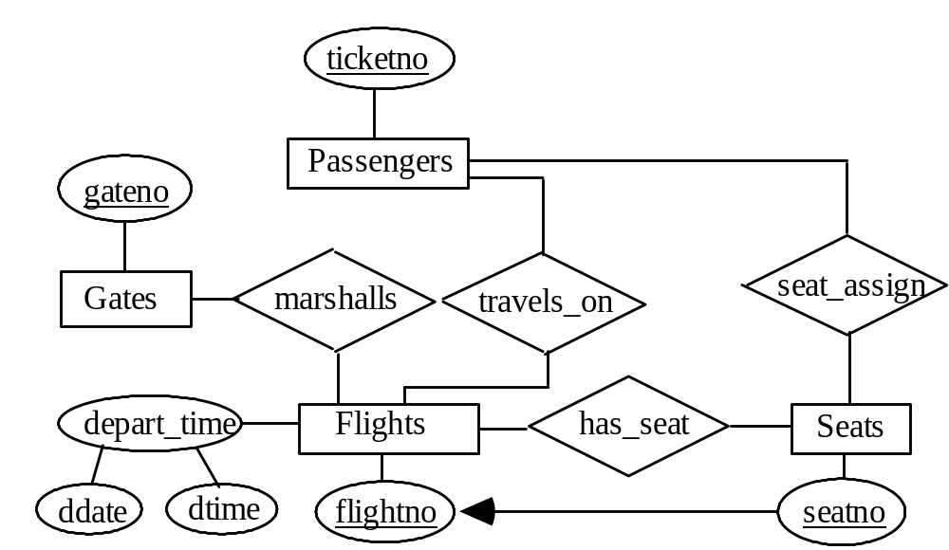
6. Database Design--Case Study

