Slide 1
DATABASE principles, Programming, and Performance
Patrick O’Neil and Elizabeth O’Neil
Lectured by Dr. Lican Huang
Email: licanhuang@zist.edu.cn
huang_lican@yahoo.co.uk
http://virgo.sourceforge.net/licanhuang.html

Slide 2
Chapter 1 Introduction
1.1 Fundamental Database Concepts
1.2 Database Users
1.3 Overview of Relational and Object–Relational DBMS

Slide 3
1.1 Fundamental Database Concepts
Database management system (
Database system or DBMS) is a program product for keeping computerized records about an enterprise.
wholesale business—sales data
university ---student records
library --- book information
The collection of records kept for a common purpose ( store and retrieve , etc. ) is known as a Database.

Slide 4
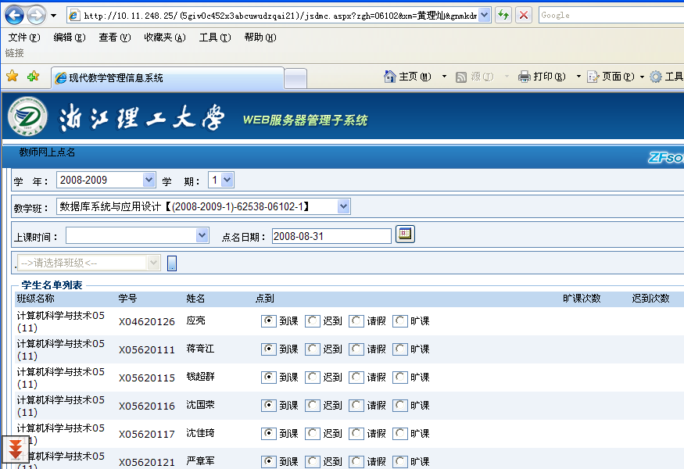
Chapter 1 Introduction

Slide 5
History of Database Systems
IBM’s IMS(information management System), 1968, Hierarchical data Model, where different kinds of records relate to one another in a hierarchical form

Slide 6
Hierarchical data Model
根节点
系
系编号
系名
办公地点
兄弟节点(Sibling)
教研室
学生
教研室编号
教研室名
学号
姓名
成绩
叶节点
教员
职工号
姓名
研究方向
叶节点

Slide 7
Network data model
Cullinet Software’s IDMS, early 1970s, from 1971 CODASYL report of an industry database task group.
Network data model , a generation of the hierarchical model (1) more than one node have no parents.(2) one node has more than one parent.

Slide 8
Legacy systems
The main drawback of products with hierarchical data model or network data model was that queries against the data were difficult to pose and execute, normally requiring a program written by an expert programmer who understand what could be a complex navigational structure of the data.

Slide 9
The Relational and Object-Relational Models
Relational model provides a flexible capability to allow non-programmers to pose general queries quickly and easily.
A DBMS that utilizes the relational model is known as a relational DBMS, or RDBMS.
A DBMS that utilizes the object-relational model is referred to as an ORDBMS product. ORDBMS is an evolutionary extension of RDBMS, so it is also written as RDBMS/ORDBMS.

Slide 10
The commercial database systems
ORACLE
DB2 Universal Database DB2 UDB
INFORMAX
DB2
SQL Server
Mysql

Slide 11
A Relational Database Example
Student enrollment records in a university
Page 4 Figure 1.1a

Slide 12
A Object-Relational Database Example
Student enrollment records in a university
Page 5 Figure 1.1b

Slide 13
Database Users
End users—Interactive users
casual users—Users accessing the DBMS with SQL queries
Naive users –Users accessing the DBMS through menus

Slide 14
Database Users
Application programmers
writes the menu applications used by naïve users
Database administrators (DBA)
A DBA is a computer professional responsible for the design and maintenance of the database.

Slide 15
1.3 Overview of Relational and Object-Relational DBMS
Chapter 2 The Relational Model
Relational rules
RULES of Relational Model. Tables have followed rules so all commercial prod­ucts are the same, like typewriter keyboards.
For years these rules were as in Sect. 2.3. E.g., no column of a table should have a complex column value (a record), only a simple type (an integer). Similarly, can't have multiple values for a column of a row.
But there is coming to be a new model, known as the Object-Relational model, that does allow complex column values (and collection types as well: Can have a Set, Multiset, or List of values in a single row column).

Slide 16
1.3 Overview of Relational and Object-Relational DBMS
Chapter 2 The Relational Model
Relational Algebra. A non-machine query language that gives a good idea of power of query languages: make new tables out of old tables by simple operations. E.g., List cno, cname for courses meeting MW2. Rel. Alg. (AGENTS where city = 'New York) [aid, aname, percent]
Gives us simplest possible approach understanding what SQL is aiming at.

Slide 17
1.3 Overview of Relational and Object-Relational DBMS
Chapter 3 Basic SQL Query language
SQL queries, already seen. Turns out to have more power than Rel. Alg. Also covers how to Insert new row in table, Delete old rows from table, Update column values of existing rows in table.
SQL is also in the midst of change, changing from Relational model (SQL-92, Oracle R7) to Object-Relational model (SQL-3, DB2 V2, Oracle R8).

Slide 18
1.3 Overview of Relational and Object-Relational DBMS
Chapter 4 The Object-Relational Model
Object-Relational SQL (Informix, Oracle). Now we CAN per­form the query just named, by creating a table with one column (abstract_word) permitting MULTIPLE values.

Slide 19
1.3 Overview of Relational and Object-Relational DBMS
Chapter 5 Programs to Access a Database
C programs with embedded SQL statements: Embedded SQL. Idea is to present a Menu to naive users so they never have to understand SQL.
Reason: complex job to write SQL, bank tellers and airline reservation clerks don't want to have to do complex stuff like this. DANGEROUS to let people in a hurry try to update data using SQL.

Slide 20
1.3 Overview of Relational and Object-Relational DBMS
Chapter 6. Some of what DBAs do. Design database. Lots of complex commands to construct a database. Begin with Logical Design.
Logical design: break down all the data into tables so tables have good properties. E.g., how handle employee with unknown number of depen­dents? Can get EXTREMELY complicated.
E.g., relatively simple school application: Departments contain teachers and are responsible for offering subjects, made up of multiple classes.
The subjects have prerequisites. The classes are offered in given periods in specific rooms. Students have schedules (each term), drop and add classes, get grades, have library records, tuition payments, health insur­ance, etc. How break all these up?
One basic idea is that entities (real world objects: students, rooms, even class-periods) each deserve their own table. They have attributes (student name and id, room number and floor, period length and how grouped: 3/week, 2/week).
There are relationships between entities: above, enrollment is a rela­tionship between student and course. But in a more complex scheme, need to relate teachers with periods, rooms, and subjects to form a class of­fering, then the class offering and student are related in a student sched­ule and a distinct class schedule.

Slide 21
1.3 Overview of Relational and Object-Relational DBMS
Chapter 7. Commands for creating databases, creating and loading ta­bles, (performance related issues, such as indexes, come later).
Integrity. Set up rules for how data can change. Rules keep errors from occurring because of inexperienced application writers. Rules can be treated as data, so high level designers know what is happening, not buried in millions of lines of applications.
Creating Views. Views are virtual tables, pretend tables created out of real base tables. DBA creates these so specific application programmers have an easier time (fewer fields to learn), easy to change DB without breaking old applications.
Security. What users can look at/change salary values for employees. Tax accountants can look at, can't change. Programmers have very low data security.

Slide 22
1.3 Overview of Relational and Object-Relational DBMS
Chapter 10. Update Transactions.
When updates are performed on a database, we need some way to guarantee that a set of updates will succeed all at once or not at all—it is unacceptable, for example, that a transfer of money from one account to another should succeed in taking money out of the first account, but then, perhaps because of a system crash, fail in adding the transferred quality into the second account.

Slide 23
Chapter 2 The Relational Model
..\王姗\database1.pdf

Slide 24
Chapter 2 The Relational Model
The CAP Database ( Customers, Agents. And Products)
Figure 2.1 page 27
Figure 2.2 page 28

Slide 25
2.2 Naming the parts of a database
Database is defined to be a set of named tables, or relations.
CAP = { CUSTERS, AGENTS, PRODUCTS,ORDERS}
Heading of a table– relational schema
Head(CUSTOMERS) = {cid, cname,city,discnt}
Head(CUSTOMERS) = cid cname city discnt

Slide 26
2.2 Naming the Parts of a Database
The set of rows, or tuples, in a table is referred to as the content of the table, and the number of such rows is sometimes referred as the cardinality of the table.

