Slide 1
DATABASE
Principles, Programming, and Performance
Patrick O’Neil and Elizabeth O’Neil
Lectured by Dr. Lican Huang
Email: licanhuang@zist.edu.cn
huang_lican@yahoo.co.uk
http://virgo.sourceforge.net/licanhuang.html

Slide 2
3 Basic SQL Query Language
3.1 Introduction
ANSI SQL-92
ANSI SQL-99 release in 1999

Slide 3
3 Basic SQL Query Language
3.1 Introduction
SQL (Structured Query Language)
􀂄 1974 Boyce and Chamberlin
􀂄 1975—1979,IBM implemented it in System R􀂄
IBM developed SQL, and it became standard. Most queries (including updates, in­serts, deletes) are very standard across relational products.

Slide 4
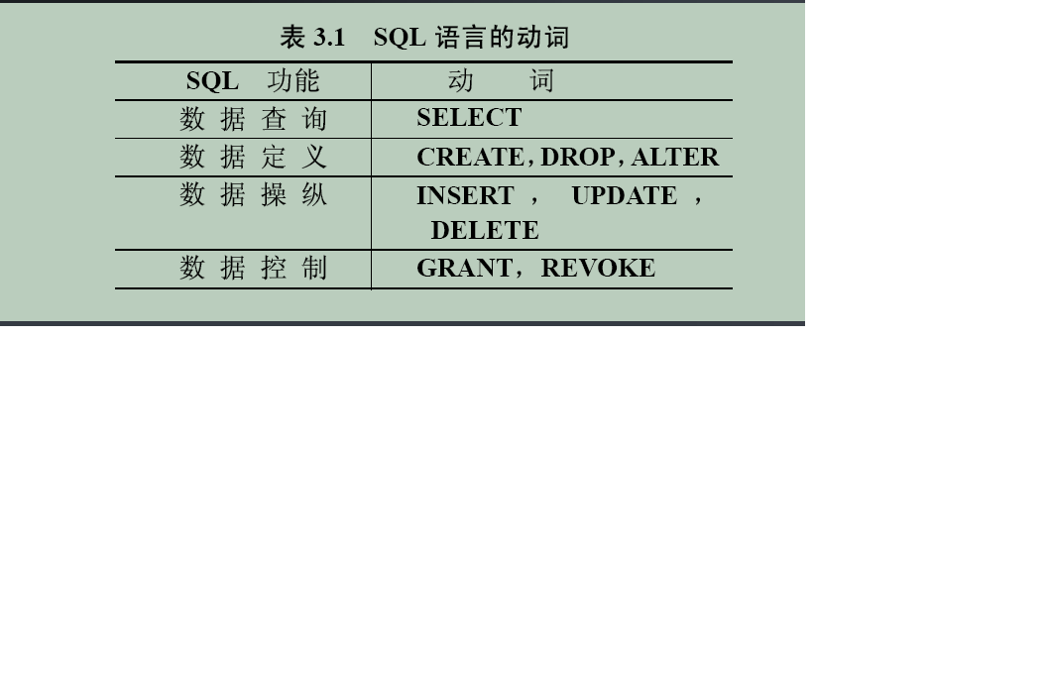
3. Basic SQL Query Language

Slide 5
3 Basic SQL Query Language
3.3 Simple Select Statements
Example 3.3.1
(AGENTS where city =“New York”)[aid, aname]
Select aid, aname from agents where city = “New York”;

Slide 6
3 Basic SQL Query Language
3.3 Simple Select Statements
Example 3.3.2
Select * from customers;
Retrieve all fields ( all columns)

Slide 7
3 Basic SQL Query Language
3.3 Simple Select Statements
Example 3.3.3
Select pid from orders;
Duplicate rows;
select all|distinct from …
Optinal all

Slide 8
3 Basic SQL Query Language
3.3 Simple Select Statements
Example 3.3.4
((CUSTOMERS[cid,cname] ∞ ORDERS
) ∞AGENTS)[cname,aname]
(((CUSTOMERS X ORDERS)XAGENTS) where CUSTOMERS.cid = ORDERS.cid and ORDERS.aid = AGENTS.aid)[cname, aname]
Select distinct customers.cname, agents.aname from customers, orders, agents where customers.cid= orders.cid and orders.aid=agents.aid;

Slide 9
3 Basic SQL Query Language
3.3 Simple Select Statements
Example 3.3.5
Select ordno,x.cid,x.aid,x.pid, .40*(x.qty*p.price)-0.1*(c.discnt + a.percent)*(x.qty*p.price) from orders as x, customers as c, agents as a, products as p where c.cid = x.cid and a.aid = x.aid and p.pid =x.pid;
As alias
profit

Slide 10
3 Basic SQL Query Language
3.3 Simple Select Statements
Example 3.3.6
Select c.cid, c2.cid from customers c1, customers c2 where c1.city = c2.city and c1.cid < c2.cid;

Slide 11
3 Basic SQL Query Language
3.3 Simple Select Statements
Example 3.3.7
Select distinct x1.pid from orders x1, orders x2 where x1.pid = x2.pid and x1.cid < x2.cid;

Slide 12
3 Basic SQL Query Language
3.3 Simple Select Statements
Example 3.3.8
Select distinct y.cid from orders x, orders y where y.pid = x.pid and x.aid = “a06”;

Slide 13
3 Basic SQL Query Language
3.2 Setting Up the Database
Create Table customers (cid char(4) NOT NULL, cname varchar(13), city varchar(20),discnt real, primary key(cid));

Slide 14
3 Basic SQL Query Language
3.2 Setting Up the Database
Create Table tablename (colname datatype [NOT NULL] {, colname datatype[not null]….} [, primary key (colname{,colname …})]);

Slide 15
3 Basic SQL Query Language
3.2 Setting Up the Database
A.3 datatypes (page 733)
Char(n)
Varchar(n)
Smallint
Integer
Real
float
page 733

Slide 16
3 Basic SQL Query Language
3.10 Insert
Example 3.10.1
Insert into orders (ordno, month, cid,aid,pid) values(1107,’aug’,’c006’,’a04’,’p01’);

Slide 17
3 Basic SQL Query Language
3.10 Update Statement
Example 3.10.3
Update agents set percent = 1.1*percent where city = ‘New York’;

Slide 18
3 Basic SQL Query Language
3.10 Delete Statement
Delete from agents where city = ‘New York’

Slide 19
3 Basic SQL Query Language
3.10 drop
drop table tablename;

Slide 20
3 Basic SQL Query Language
3.10 Alter Table
Page 745
Alter Table tablename ADD ( columnname datatype. ..)
Alter Table tablename drop( columnname datatype. ..)
Alter Table tablename modify( columnname datatype, columnname datatype)
ORACLE

Slide 21
3 Basic SQL Query Language
3.4 Subqueries
The IN Predicate
Example 3.4.1
Select distince cid from orders where aid in (select aid from agents where city =“Duluth” or city = “ Dallas”);

Slide 22
3 Basic SQL Query Language
3.4 Subqueries
The IN Predicate
Example 3.4.2
select * from agents where city in(“Duluth”,”Dallas”);

Slide 23
3 Basic SQL Query Language
3.4 Subqueries
The IN Predicate
Example 3.4.3
Select cname, discnt from customers where cid in(select cid from orders where aid in (select aid from agents where city in (“Duluth”,”Dallas”)));

Slide 24
3 Basic SQL Query Language
3.4 Subqueries
The IN Predicate
Example 3.4.4
Select distinct cname from customers where ‘p05’ in (select pid from orders where cid = customers.cid);

Slide 25
3 Basic SQL Query Language
3.4 Subqueries
The IN Predicate
Example 3.4.6
Select ordno from orders where(cid,aid) in (select cid, aid from customers c, agents a where c.city = “Duluth” and a.city =“New York”);

Slide 26
3 Basic SQL Query Language
3.4 Subqueries
The IN Predicate
expr NOT IN(Subquery)
Expr[NOT] IN (Subquery)| expr[NOT] IN (val {,val….})

Slide 27
3 Basic SQL Query Language
3.4 Subqueries
The Quantified Comparison Predicate
Expr theta {SOME|ANY|ALL}(Subquery)
Theta <,<=, =, <>,>,>=
SOME ANY are same.

Slide 28
3 Basic SQL Query Language
3.4 Subqueries
Example 3.4.7
Select aid from agents where percent <=all (select percent from agents);

Slide 29
3 Basic SQL Query Language
3.4 Subqueries
Example 3.4.8
select cid, cname from customers where discnt = some(select discnt from customers where city = “Dallas” or city = “Boston”);

Slide 30
3 Basic SQL Query Language
3.4 Subqueries
Example 3.4.9
select cid from customers where discnt < all (select discnt from customers where city = “Duluth”);

Slide 31
3 Basic SQL Query Language
3.4 The EXISTS Predicate
[NOT] EXISTS (Subquery)
Example 3.4.10
select distinct c.aname from customers c where exists (select * from orders x where c.cid = x.cid and x.aid = “a05”);

Slide 32
3 Basic SQL Query Language
3.4 The EXISTS Predicate
[NOT] EXISTS (Subquery)
Example 3.4.11
select distinct cid from orders x where pid =“p01” and exists (select * from orders where cid = x.cid and pid =‘p07’);

Slide 33
3 Basic SQL Query Language
3.4 The EXISTS Predicate
[NOT] EXISTS (Subquery)
Example 3.4.12
select distinct c.cname from customers c where not exists(select * from orders x where c.cid = x.cid and x.aid = ‘a05’);

Slide 34
3 Basic SQL Query Language
3.4 The EXISTS Predicate
[NOT] EXISTS (Subquery)
Example 3.4.13
page 105

Slide 35
3 Basic SQL Query Language
3.4 The EXISTS Predicate
[NOT] EXISTS (Subquery)
Example 3.4.14
select distinct cid from orders x where no exists (select * from orders where cid = x.cid and aid = ‘a03’);

