Slide 1
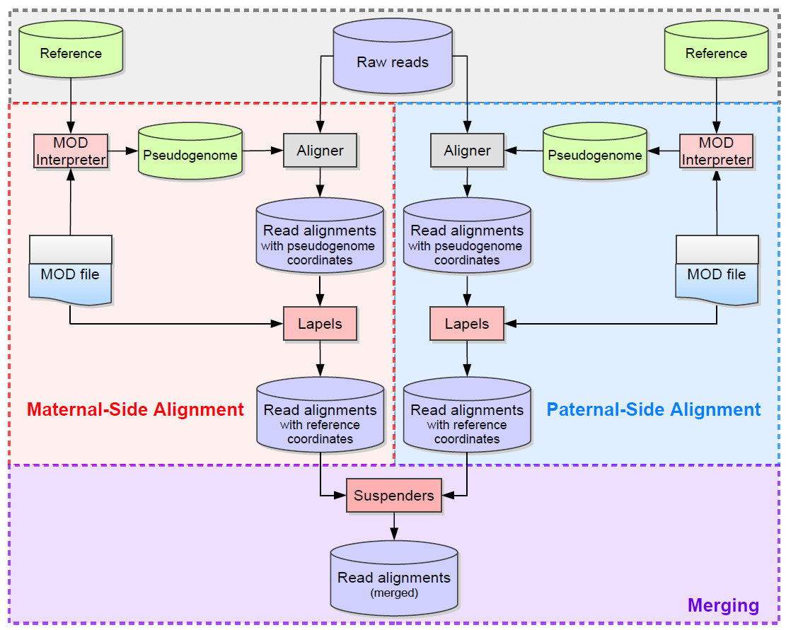
Part II:
mapping to pseudogenomes (bowtie2/Tophat)
mapping back to reference genome (lapels)
identifying optimal alignment (suspenders)
Part I:
MOD file preparation
pseudogenome generation
remove unmapped reads
Part III:
counting maternal/paternal reads
Notes:
pipelineOverview.png
Holt, J., Huang, S., McMillan, L., & Wang, W. (2013). Read Annotation Pipeline for High-Throughput Sequencing Data. In J. Gao (Ed.), ACM Conference on Bioinformatics, Computational Biology and Biomedical Informatics. Washington, DC, USA.

Slide 2
Part III:
counting maternal/paternal reads
filters:
multiple alignments (XS flag, NH flag)
mapping quality
duplicates
suspenders
mark duplicates
allelic filter.py on mark duplicates output
featureCounts on allelically filtered files (ignore Duplicates, set mapping quality)
DESeq
sorting/indexing?
variant overlaps:
-

Slide 3
Task | Tool | What it does | Advantages | Disadvantages
Counting reads | featureCounts | Per genes, per exons SAF/GTF file + any number of BAM files | Can count fragments Mapping quality filter Efficient Count table output Good documentation | Erratic behavior with single bp BED files? → can be controlled using the –O option which will count reads that overlap with more than one feature
 | coverageBed | Per variants 1 BAM + 1 BED | Straight-forward, can be piped with samtools | Slow No fragment counting
ASE | DESeq |  | Straight-forward usage Established method | Do the assumptions hold for the comparison between two alleles?
 | Chi-square test
 | Bayesian classifier |  |  | Needs DNA sample

