Slide 1
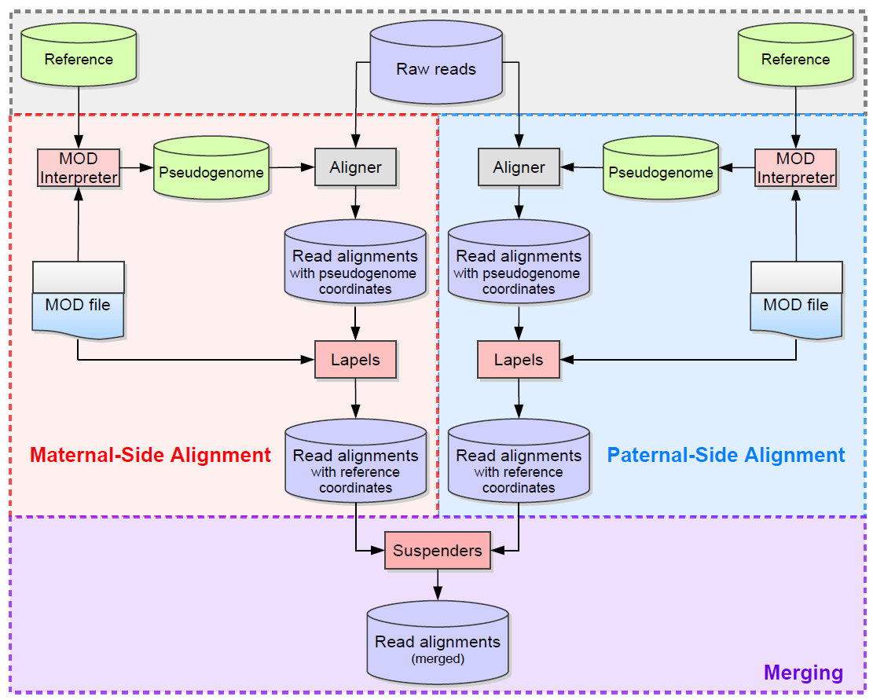
Part II:
mapping to pseudogenomes (bowtie2/Tophat)
mapping back to reference genome (lapels)
identifying optimal alignment (suspenders)
Part I:
MOD file preparation
pseudogenome generation
Part III:
counting maternal/paternal reads
Notes:
pipelineOverview.png
Holt, J., Huang, S., McMillan, L., & Wang, W. (2013). Read Annotation Pipeline for High-Throughput Sequencing Data. In J. Gao (Ed.), ACM Conference on Bioinformatics, Computational Biology and Biomedical Informatics. Washington, DC, USA.

