Slide 1

Code: Class 3
Datatypes, Variables, and Basic Math

Slide 3
What is a Datatype?
Why Do We Need it?
Notes:
DATATYPES
- Dataype: the classification of a piece of information
- Reason: As in real life, the computer has to know what something is before it can store it, or perform actions or it, or whatever.

Slide 4
Datatypes
Name | Use | Code | Real life
Integer | Whole numbers | int | I have 5 dogs.
Float | Numbers with a decimal | float | I’m 24.5 years old.
String | Words or letters | String | “Get off my lawn!”
Character | A single letter | char | ‘A’
Boolean | True or false | boolean | It’s true that I want coffee.

Slide 5

How would you classify these things?
Choose: integer, float, string, boolean, char
Datatypes
The number of kids you have
Your name
Your middle initial
Your apartment number
Whether you ate breakfast or not
The street you live on
The temperature outside
Whether the lights are on or not

Slide 6
What is a Variable?
Why Do We Need it?
Notes:
VARIABLES
- Variable: A container that holds a piece of information (integer, float, string, boolean, etc.) that can change its value.
- Reason: If you can’t change the value of something, it stays static. Forever. Not very interactive, huh?

Slide 7
Variables
Datatype
Name
Value
What kind of thing are we dealing with here? Can we add it or subtract it? Is it text? Or is it a true or false condition?
What are we calling this thing? We need a way to refer to it within our code.
What number, text, or condition is this variable representing?
Syntax:
datatype name = value;
Notes:
CONCEPTS:
- Requirements for computer to hold anything in its memory:
- What kind of thing are we dealing with here?
- What are we going to call it?
- What is its value?

Slide 8
How would you create a variable that represents this condition?
Variables
The number of years Jane has left in her program is 1.

Slide 9
Variables
The number of years Jane has left in her program is 1.
Requirements | Definition | Here
Datatype | The category of data | A whole number (integer, or int)
Name | A name for the thing we’re referring to | Something relating to the value (like years)
Value | What amount, condition, or text the variable actually contains | The years left (1)
Syntax:
datatype name = value;

Slide 10
Variables
The number of years Jane has left in her program is 1.
Real Life:
Code:
datatype name = value;
int years = 1;
The number of years Jane has left in her program is 1.

Slide 11
Variable Notes
Name your variables something that makes sense
  Good: playerHealth
  Bad: herpDerp
Use underscores or alternating caps to make things readable
  Good: userAge, player_speed
  Bad: timeelapsedsincethegamestarted

Slide 12
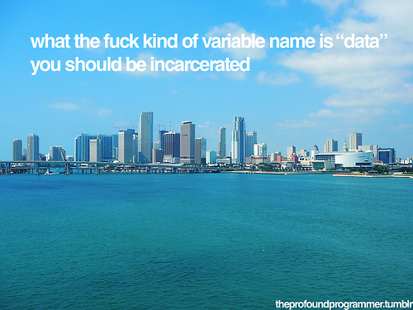

Slide 13
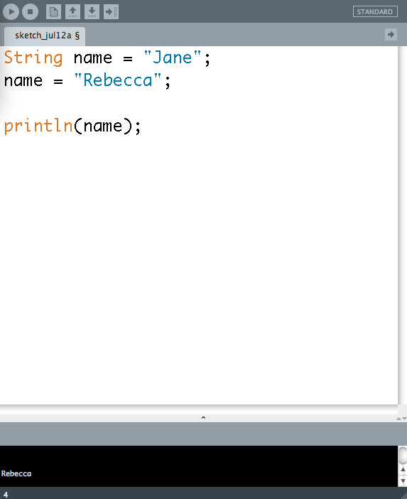
Changing values
Use a single-equals (=) to make the thing on the left equal the thing on the right.
name initially equals “Jane”
We change name’s value to “Rebecca”
We print the value to see if it worked...
... and it did!

Slide 14
What is Concatenation?
Why Do We Need It?
Notes:
CONCATENATION:
- Concatenation: Basically, gluing two pieces of info end-to-end.
- Reason: It lets you label the things you print out, so you don’t have an unintelligible string of letters and numbers.

Slide 15
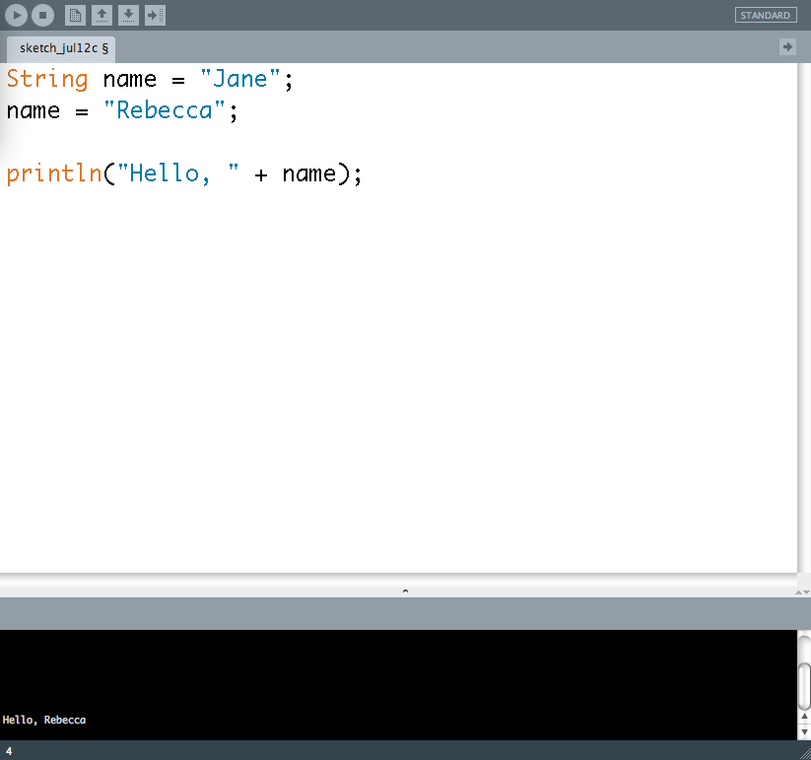
Concatenation
name initially equals “Jane”
We change name’s value to “Rebecca”
We print the value to see if it worked, but glue “Hello, ” in front of it...
... and it did!

Slide 16
Math
(We need some way to manipulate numbers, right?)
Operator | Code
Addition | +
Subtraction | -
Division | /
Multiplication | *
We’ll talk about another operator, modulo (%), soon.

Slide 17
Try using println and the math symbols to print the result of the following equations.
Datatypes
Five plus 3
Five minus 3
Five times 3
Five divided by three
Five-point-zero divided by three-point-zero

Slide 18
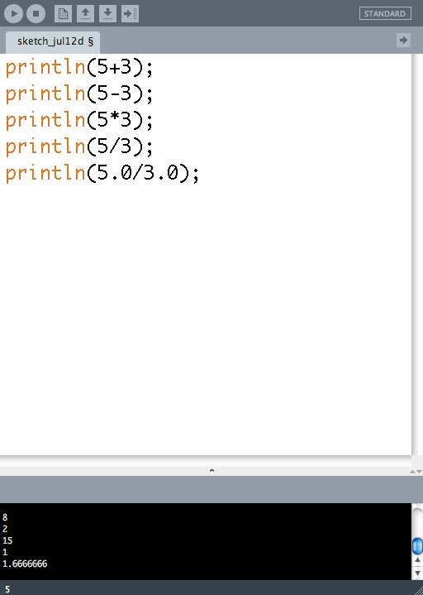
Notice something weird?
Notes:
To a computer, 5/3 is not the same as 5.0/3.0!
It goes back to datatypes. The computer sees whole numbers, so it assumes everything is an integer, and spits out a whole number--even when that’s not really correct.

Slide 19
Try defining an integer variable called xPos, and make it equal 5.
Define another integer variable called yPos, and make it equal 7.
Draw a circle at xPos and yPos.
Draw another circle at xPos + 10 and yPos.
Draw another circle at xPos + 40 and yPos.
(They should have a width and height of 9.)
Putting It All Together

Slide 20
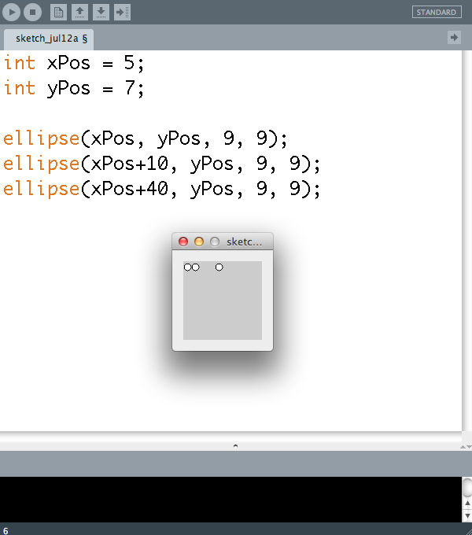
Putting it All together

