Slide 1
The Melbourne deconstruction
A Springboard’s Introduction to Data Science Capstone Project

Slide 2
Introducing the problem
At my local coffee shop, are sales of drinks influenced by weather?
But, how to define drinks?
If it’s a latte, do we code “1” for “latte” and 0 for other variables?
If it’s an americano, do we code “1” for “americano”?..
What’s the use in knowing if high pressure is associated with more americanos sold?
There must be a more useful approach…

Slide 3
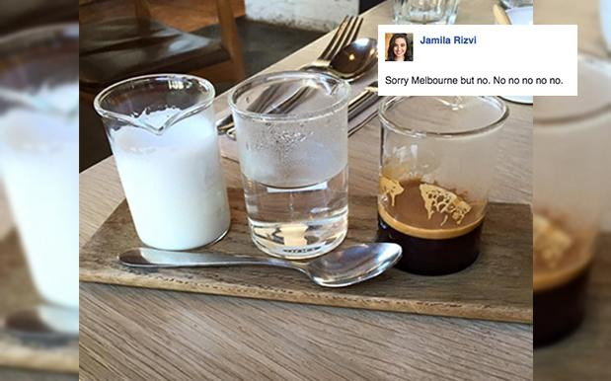
The Melbourne Deconstruction
A couple of years ago, Melbourne baristas decided to serve a long macchiato like this:

Slide 4
The Melbourne Deconstruction
It’s no way to serve a drink…
but it’s definitely useful for data science.
Coding drinks according to their ingredients and traits (not their actual names) is more representative of…
A café’s day-to-day logistics
The highly customizable nature of the product

Slide 5






Data wrangling
data frame with
counts of drinks sold,
by feature
TYPOS AND PROMOS
NO WAY TO DISCERN BETWEEN MENU ITEM AND OPTIONS
data frame of drinks sold
(coded on every ingredient and trait)
DOUBLE-BOOKED
ID NUMBERS
Coding book
Final dataset
Proprietary data from
a local coffee shop
448 *.csv files
daily sales reports
generated by a cloud-based
cash register system
Weather data from
Climate Canada
1 *.csv file
hourly data
downloaded from
the government website
Reference table coding menu items and options manually
data frame of orders made at the café
data frame of
drinks sold
(data in string form)

Slide 6
Variables in the dataset
Dependent | Independent
Content (ingredients): Espresso Tea Regular milk Specialty milk Chocolate Water Seasonal ingredients Juice Traits: Cold Froth High in sugar High in caffeine | Temperature Dew Point temperature Relative humidity Wind speed Pressure Atmospheric phenomena and sky conditions: Rain Snow Clear sky Fog

Slide 7
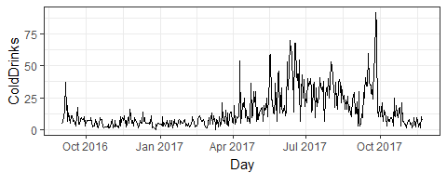
Statistical analysis: sales of cold drinks
Hypothesis: higher numbers of cold drinks sold coincide with higher temperatures, better visibility (manifested by clear skies and lack of fog), and lack of precipitation.

Slide 8
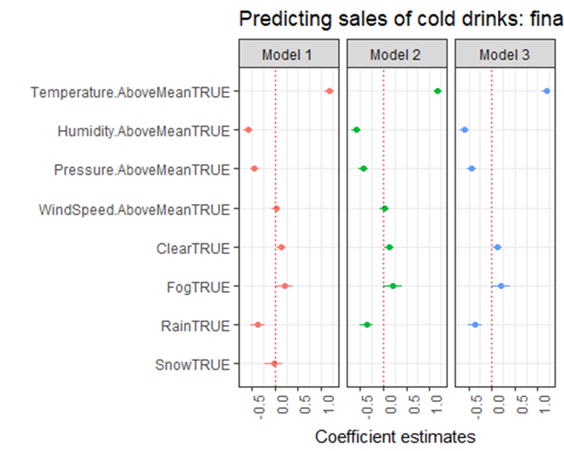
Multiple linear regression

Slide 9
Results
Higher numbers of cold drinks sold coincide with above-average temperatures.
However, above-average pressure and humidity are both associated with lower numbers of cold drinks sold.
Finally, visibility, measured by the presence of clear sky or fog, does not appear to be a factor in sales of cold drinks.

Slide 10
Recommendations
Create a weather trigger-based marketing strategy for cold drinks. The trigger should include above-average temperature, humidity and pressure—the latter coincide with lower sales of cold drinks.
Use in-store displays to emphasize that cold drink options are available both “to go” and “for here.” Do not assume that cold drinks are only suited for weather that lends itself nicely to walking around with an iced latte in hand.

