Slide 1



Data Storytelling
The Language of Graphs
Laura Bandi
February 15, 2024
Dr. Michael Friendly
PSYC6135

Slide 2
What is Data Storytelling?
Crafting a narrative to communicate insights from your data to inform, influence, and enlighten your audience
Transforming complex information into something more accessible and engaging

Slide 3
What is the difference between data stories and data visualizations?
Data visualizations are just one piece in crafting a data story
The goal of a visualization is to simply represent your data in an effective way visually
Data stories also present data visually, but do so using a clear narrative structure
Placing data and data visualizations in context that connects with the audience

Slide 4
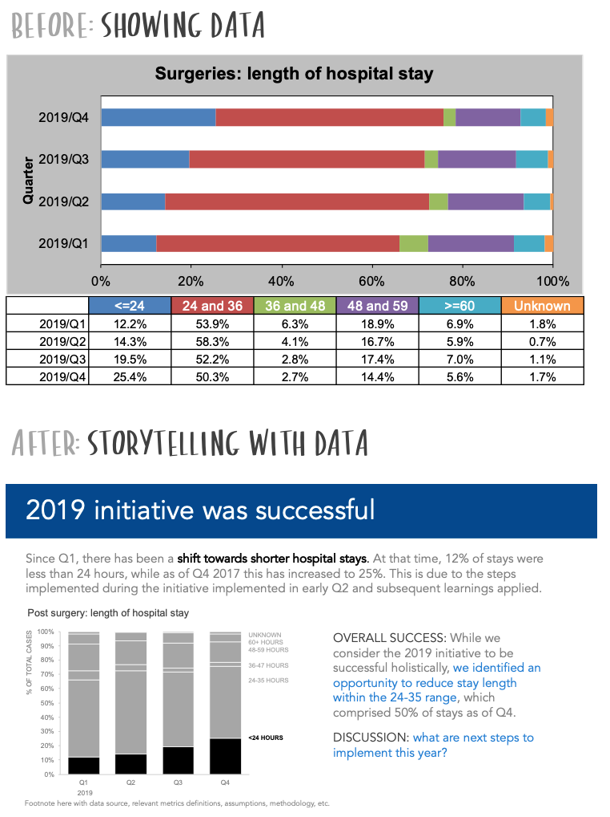

Slide 6
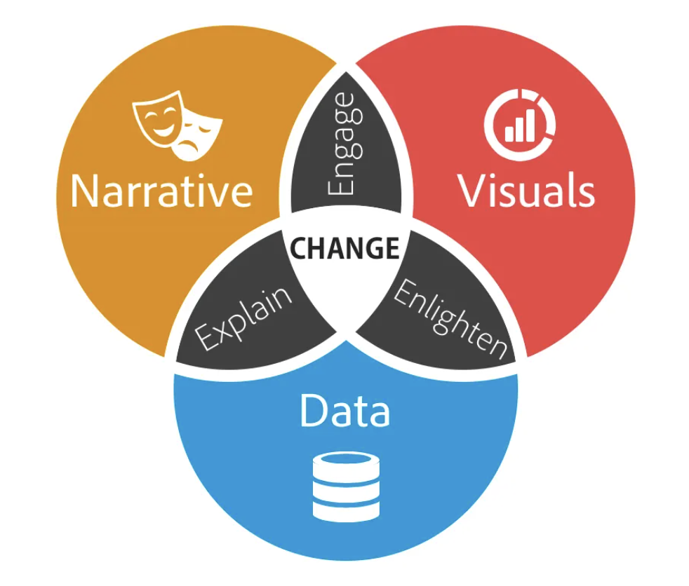
Elements of Data Storytelling
Data (of course)
Narrative structure
Use of visualizations
Audience-centred
Emphasis on context and insights
Emotion

Slide 7
Why tell a story with your data?
The human brain reacts better to stories, than it does to the presentation of rote data/statistics
Stories are:
More memorable
More engaging
More persuasive

Slide 8
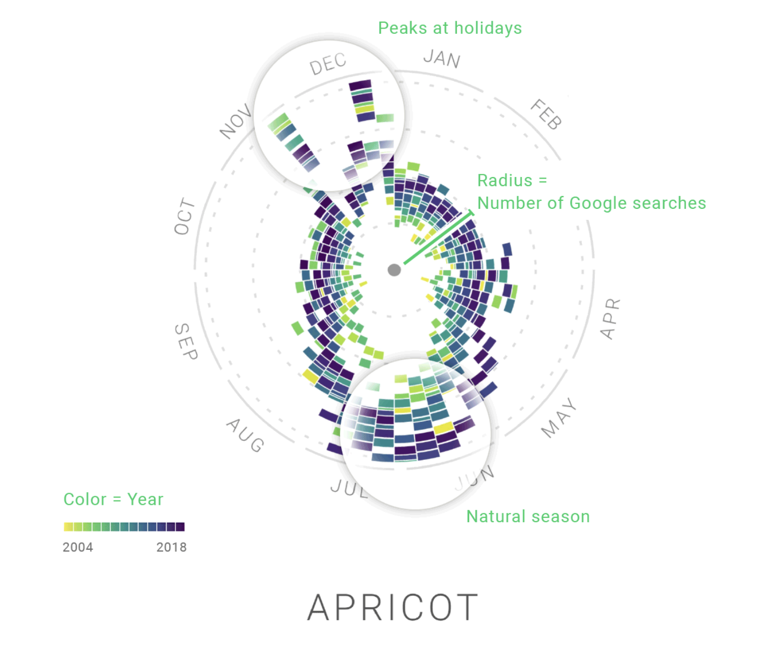
Data Storytelling Example - The Rhythm of Food
Other cool examples HERE

Slide 9
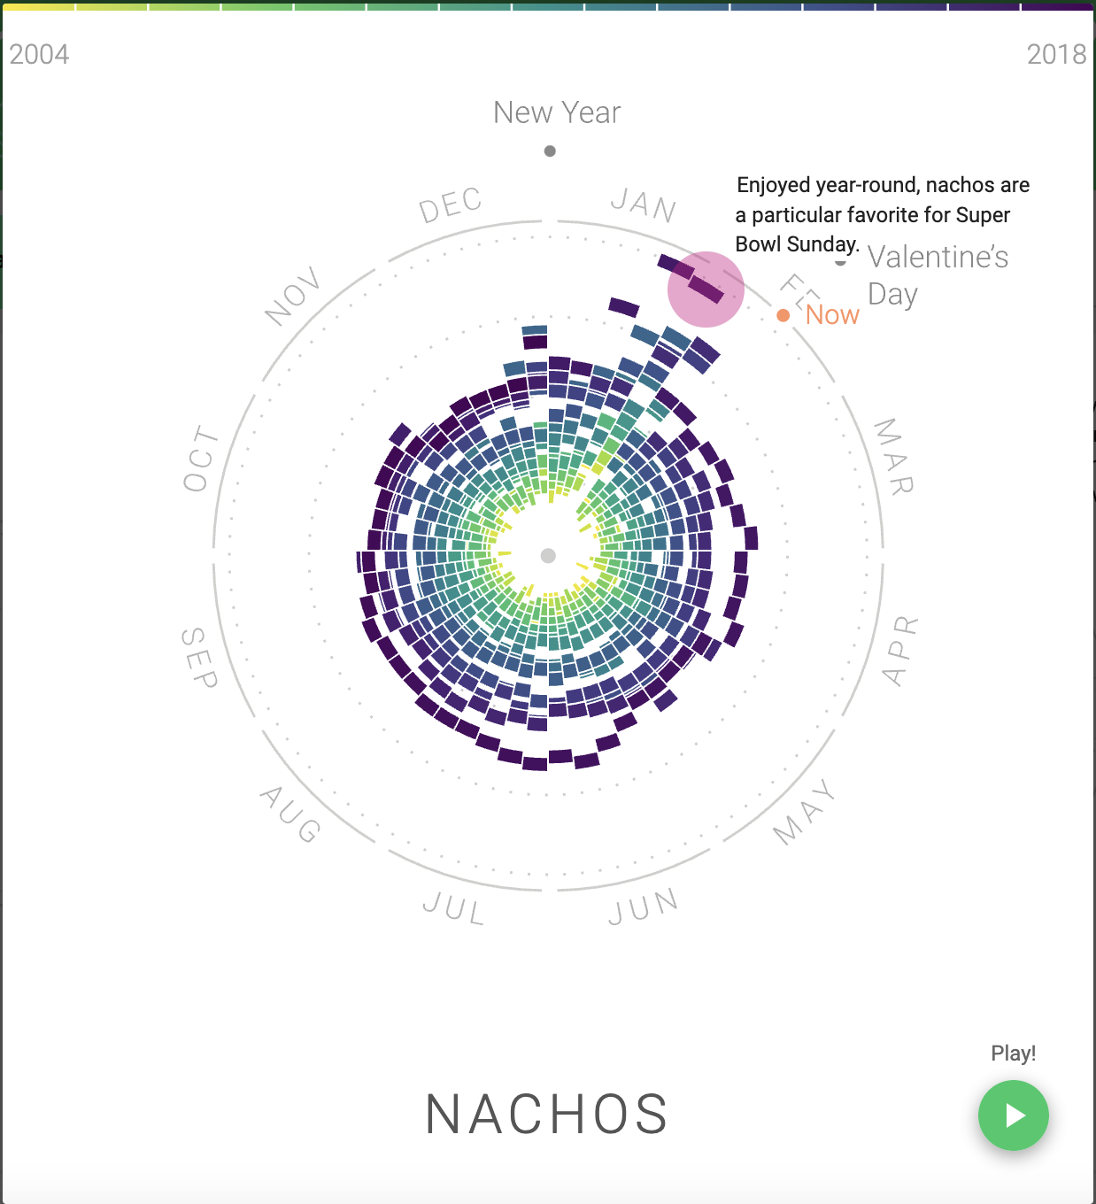

Slide 10
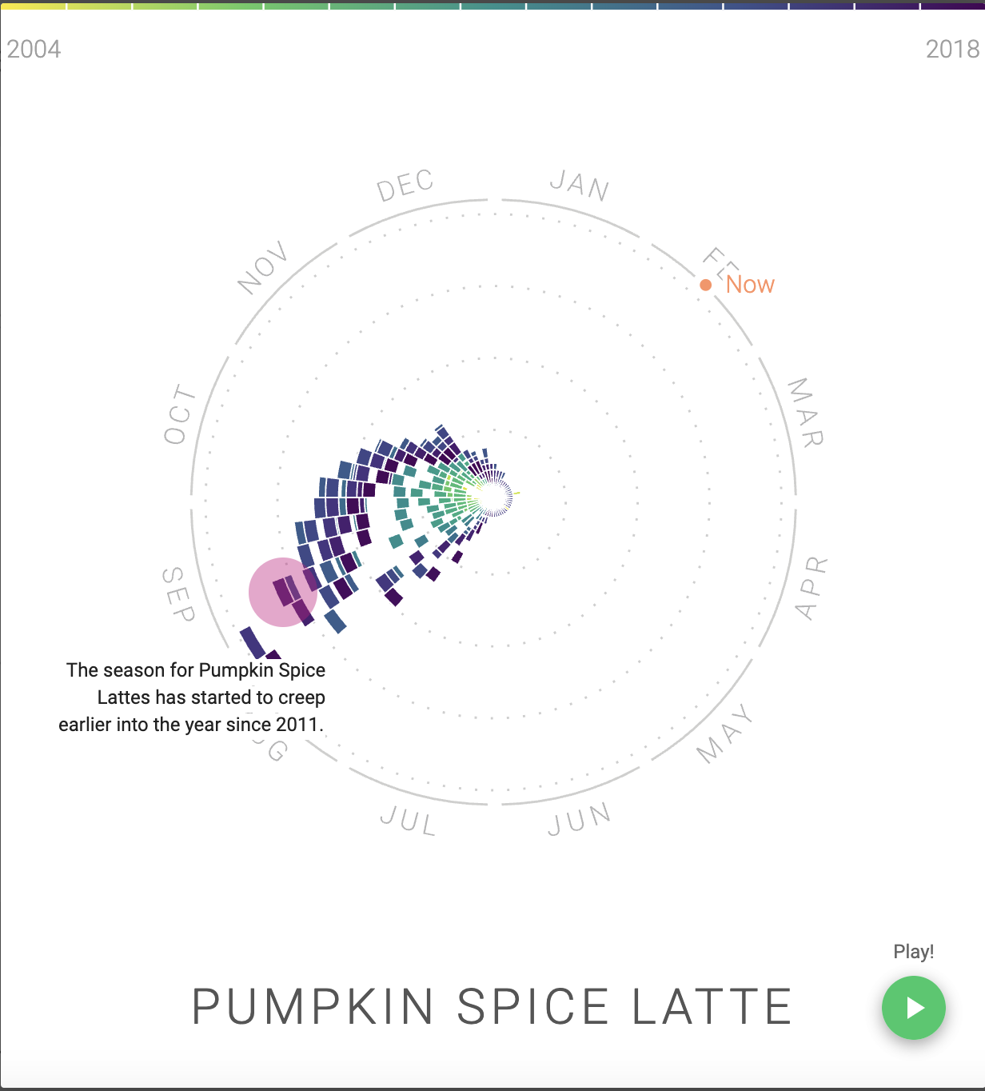

Slide 11
Any thoughts, comments, questions?

