Slide 1
Individual Differences in Graphical Perception
Spencer Arshinoff
February 8th, 2024
PSYC6135 – Psychology of Data Visualization

Slide 2
Individual Differences in Graphical Perception
In psychology, we can find general principles and laws to describe the human mind
But we shouldn’t forget that there is always variation in minds
The psychology of graphical perception is no exception!

Slide 3
Cognitive Traits
Liu et al. (2020) reviewed 29 studies
Found “evidence that nearly every cognitive trait[…]can impact visualization use” (p.703)
Includes personality differences (e.g., extraversion, openness) and cognitive abilities (e.g., memory)

Slide 4
Locus of Control
Internal vs. external locus of control: are you in control of events in your life, or are they in control of you?
Does this affect how well you can use a tree diagram? (Ziemkiewicz et al., 2013)

Slide 5
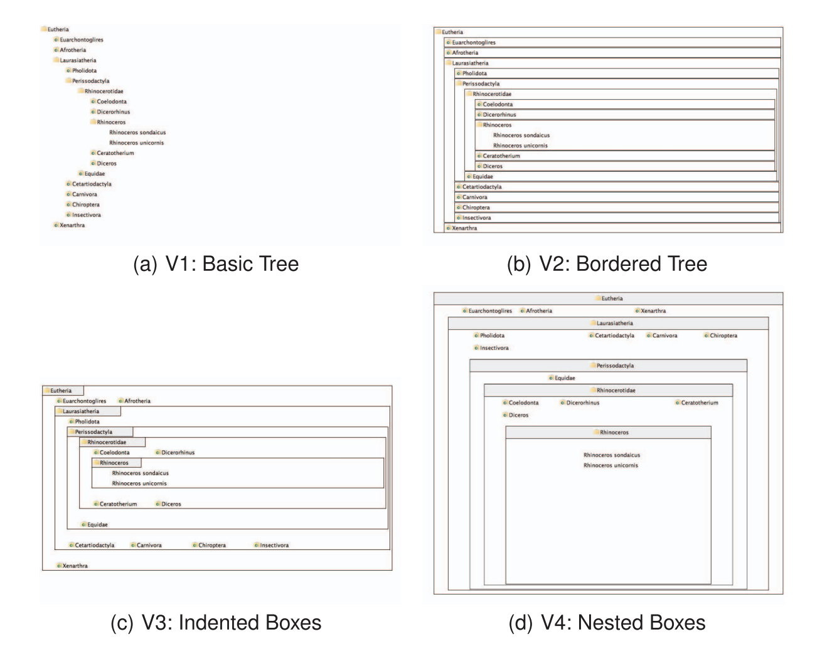
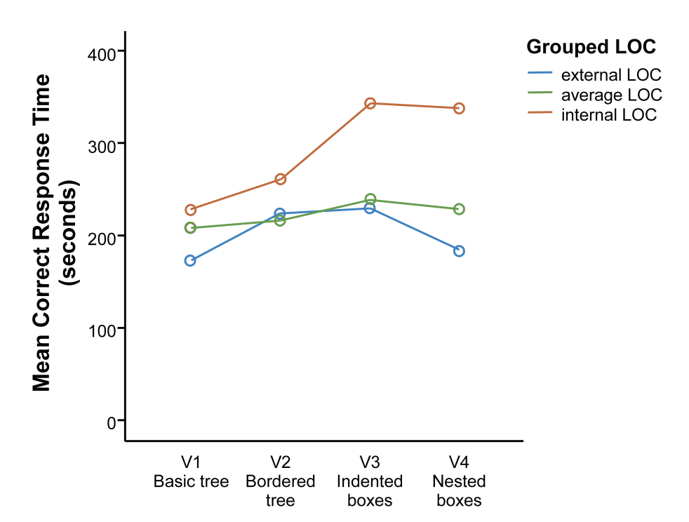

Slide 6
What’s wrong with this diagram?

Slide 7
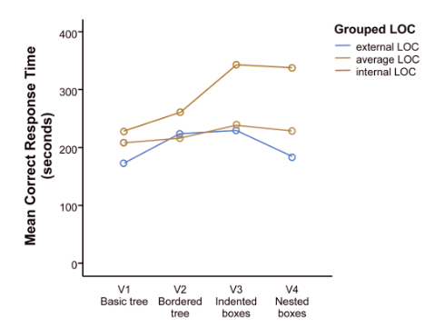
It is not colourblind accessible!
Also uses a line graph despite there being no inherent order to the IVs, which is confusing

Slide 8
Colour Blindness
There are those among us who literally perceive the world differently

Slide 9
Colour Blindness
Some colour palettes are designed for accessibility
Colour should never be the only visual cue

Slide 10
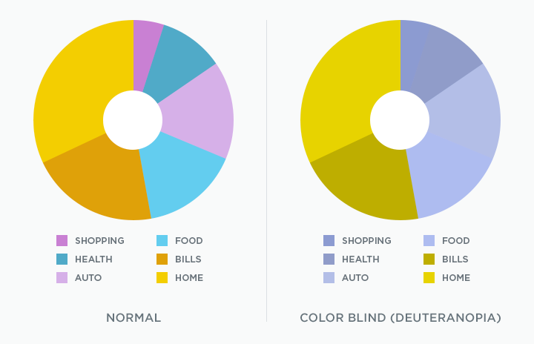
Source: https://cruxcollaborative.com/insights/understanding-color-blindness-guide-to-accessible-design

Slide 11
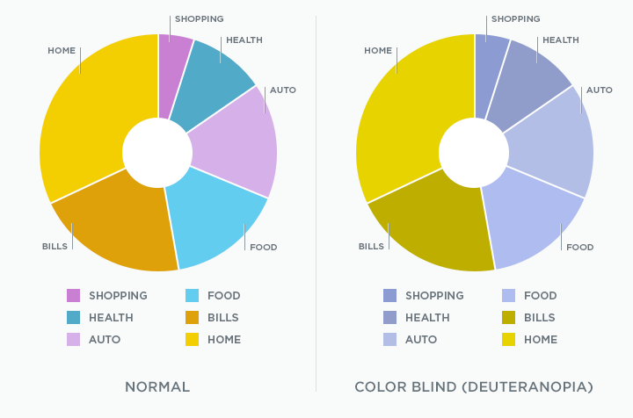
Source: https://cruxcollaborative.com/insights/understanding-color-blindness-guide-to-accessible-design

Slide 12
Accessibility Concerns
Conditions such as colour-blindness may interfere with graphical perception
The World Wide Web Consortium (W3C) has a set of accessibility guidelines

Slide 13
Accessibility Concerns
Relevant guidelines include:
Colour contrast ratio ≥4.5:1
Letter spacing ≥12% of font size
Word spacing ≥16% of font size

Slide 14
Accessibility Concerns
Relevant guidelines include:
Colour contrast ratio ≥4.5:1
Letter spacing ≥12% of font size
Word spacing ≥16% of font size

Slide 15
Accessibility Concerns
Relevant guidelines include:
Colour contrast ratio ≥4.5:1
Letter spacing ≥12% of font size
Word spacing ≥16% of font size
Source: (World Wide Web Consortium, 2023)

Slide 16
Linguistic Relativity
Does the language we speak affect how we think?
In some ways, yes

Slide 17
Linguistic Relativity
English speakers think of time as moving left to right
Is it because that’s how we write?
Speakers of Arabic, a right-to-left language, think of time as moving right to left (Park et al., 2024)

Slide 18
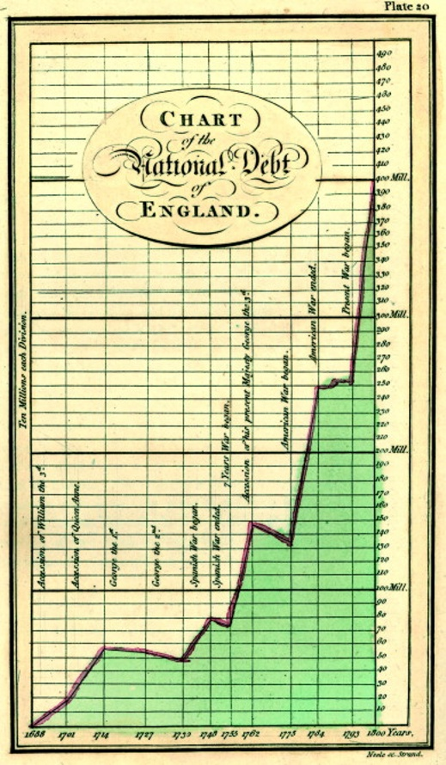

Slide 19
Linguistic Relativity
Even showing time as horizontal is arbitrary
Chinese (Mandarin) speakers think of it as up to down (Boroditzky, 2001)

Slide 21
Colour Perception
Colour is a continuous variable, but we perceive it categorically (Liu & Heer, 2018)

Slide 22
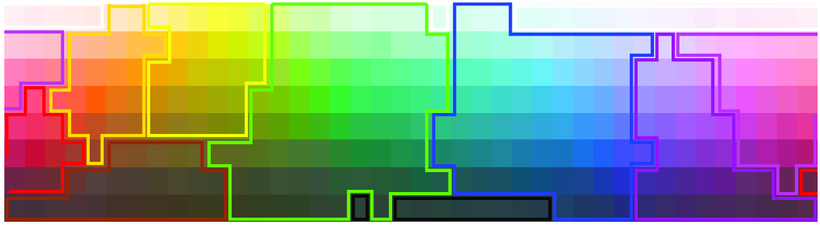
Image source: doi.org/10.1109/TIP.2009.2019809

Slide 23
Colour Perception
People typically fare better on graphical perception tasks when the colours fall into more than one linguistic category (Liu & Heer, 2018)

Slide 24
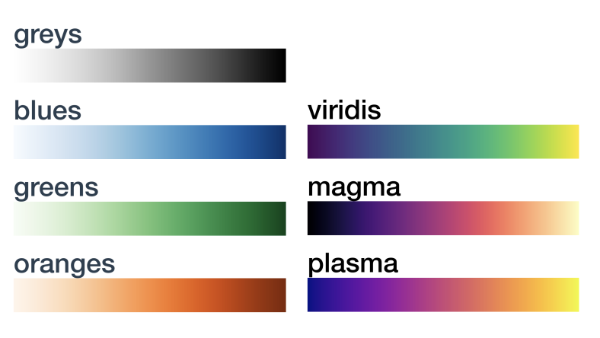
Which of these should you use?
Source: Liu & Heer (2018)

Slide 25
Colour Perception & Language
However, not every language divides colours the same way
Greek speakers have separate words for dark and light blue, which affects performance on some visual tasks (Thierry et al., 2018)

Slide 26

Greek:
English:
Γαλάζιο
Blue
Μπλε
Blue

Slide 27
Colour Perception & Language
How does this affect graphs?
We don’t know!

Slide 28
Works Cited
Boroditsky, L. (2001). Does Language Shape Thought?: Mandarin and English Speakers’ Conceptions of Time. Cognitive Psychology, 43(1), 1–22. https://doi.org/10.1006/cogp.2001.0748
Liu, Y., & Heer, J. (2018). Somewhere Over the Rainbow: An Empirical Assessment of Quantitative Colormaps. Proceedings of the 2018 CHI Conference on Human Factors in Computing Systems, 1–12. https://doi.org/10.1145/3173574.3174172
Liu, Z., Crouser, R. J., & Ottley, A. (2020). Survey on Individual Differences in Visualization. Computer Graphics Forum, 39(3), 693–712. https://doi.org/10.1111/cgf.14033
Park, J., Gagné, C. L., & Spalding, T. L. (2024). Writing direction and language activation affect how Arabic-English bilingual speakers map time onto space. Frontiers in Psychology, 14, 1356039. https://doi.org/10.3389/fpsyg.2023.1356039
Thierry, G., Athanasopoulos, P., Wiggett, A., Dering, B., & Kuipers, J.-R. (2009). Unconscious effects of language-specific terminology on preattentive color perception. Proceedings of the National Academy of Sciences, 106(11), 4567–4570. https://doi.org/10.1073/pnas.0811155106
World Wide Web Consortium. (2023, September 21). Web Content Accessibility Guidelines (WCAG) 2.1. W3C. https://www.w3.org/TR/WCAG21/
Ziemkiewicz, C., Ottley, A., Crouser, R. J., Yauilla, A. R., Su, S. L., Ribarsky, W., & Chang, R. (2013). How visualization layout relates to locus of control and other personality factors. IEEE Transactions on Visualization and Computer Graphics, 19(7), 1109–1121. https://doi.org/10.1109/TVCG.2012.18

