Slide 1
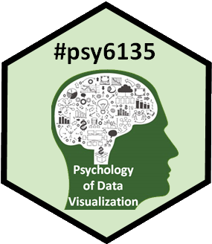
Chart junk:
Trash and Treasure
Marcus Meng

Slide 2
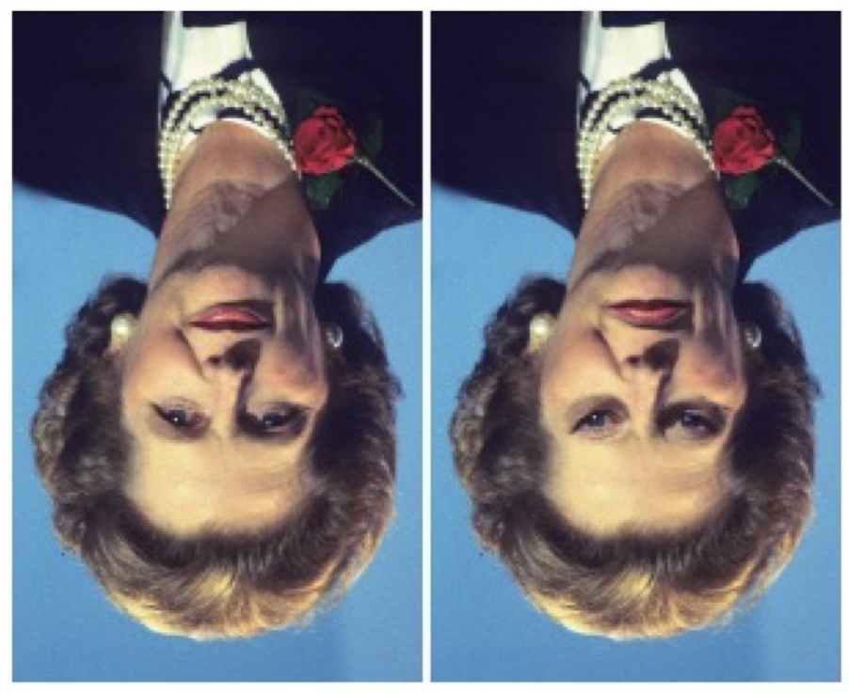
What is special about these faces?
The whole is more important than its sum of parts!

Slide 3
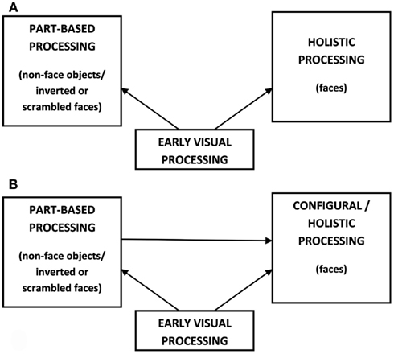
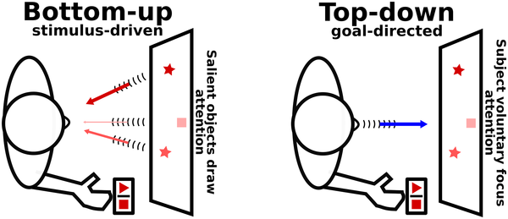
Vision Processing
Local vs Holistic processing
Bottom-up processing
(Belkaid et al., 2017)
(Piepers & Robbins, 2012)

Slide 4
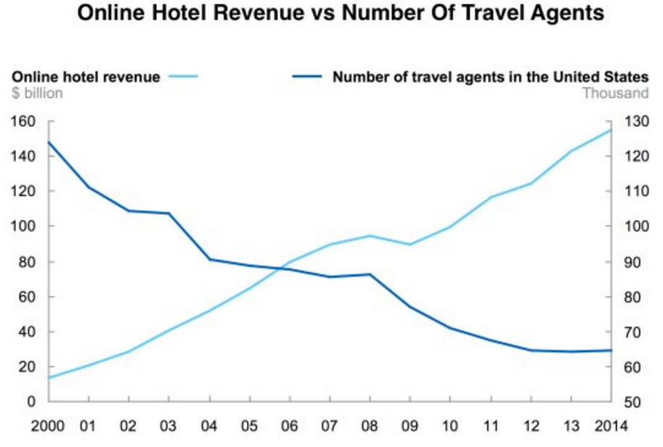
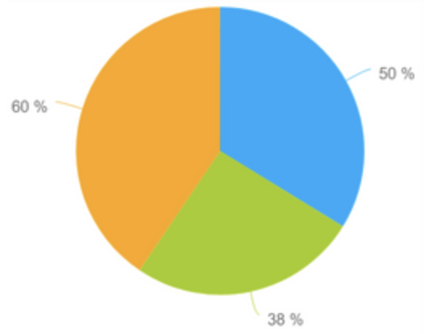


Types of Chart Junks
Pride
and
Prejudice
Wrongful representation
Inapporatiate chart type
Inaccurate information
Intentional “mistakes”
Accurate information
Misleading interpretation

Slide 5
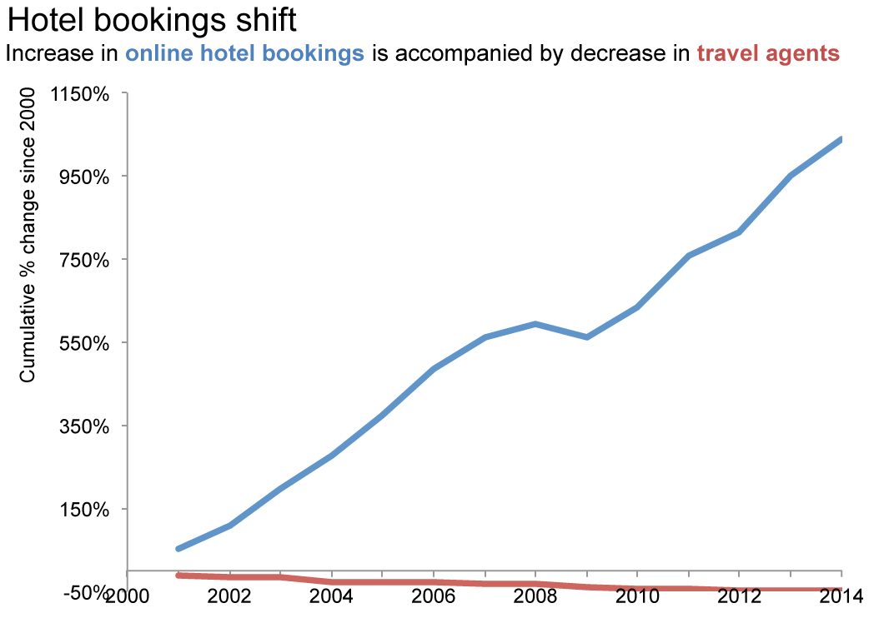
Why these chart junks can be effective
Attention devoted to pictures, less to words
Top-down processing makes things worse

Slide 6
Discussion: Goal-directed chart junk
Chart junk goals: lure the reader into a mindset they won’t have with good charts
All the data is accurate
What graphical features leads to misinterpretation?
Ethical concerns?

