Slide 1
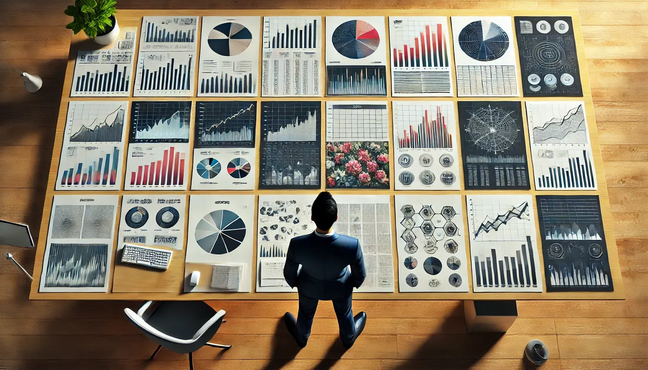
title
The 6135 Vizzies
March 2025
Michael Friendly
Psych 6135
http://friendly.github.io/6135

Slide 2
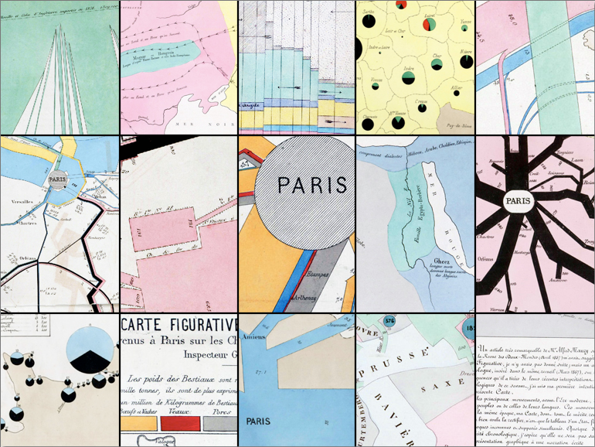


Celebrating
Minard’s Birthday,
March 27, 1781

Slide 3
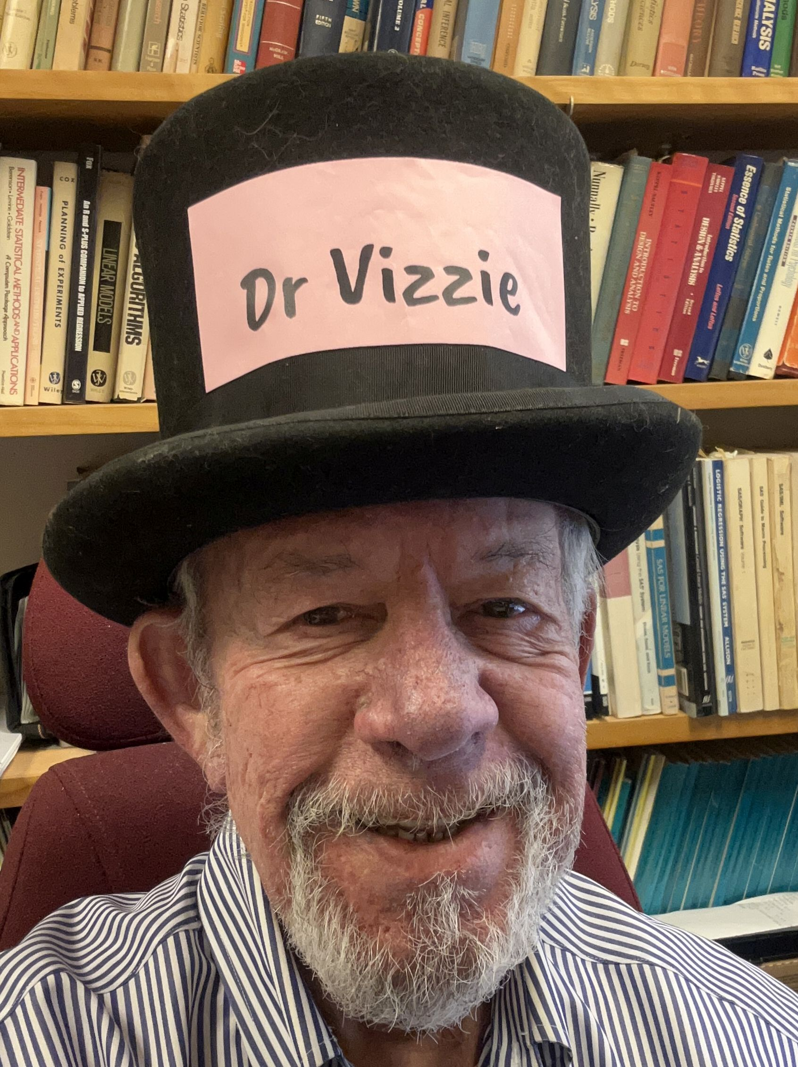
Conference Chair
The One and Only Friendly
Dr Vizzie

Slide 4
Distinguished Presenters
Danika Danylchuk-Wagner: Visualizing Preferences: History, Method, and Importance
Iroshini Gunasekera: Data Visualization for Public Health
Audrey Li-Chay-Chung: Increasing Data Accessibility for Visually Impaired
Talia Tissera: Data Sonification
Camille Prozanski: Data Visualization in Augmented and Virtual Reality
BREAK
Vanessa Basurto: Rethinking Data: Creative Applications of Data Visualization
Mina Aryaie: The Role of Data Visualization in Crime Prevention and Public Safety
Courtney Chan: Data Visualization Methods in Social Cognition

Slide 5
Vizzies, Session 2
Jessica Newman & Ashley Siegel: Data Visualization for Therapeutic Process and Outcomes
Victoria Cello: Shiny Applications for Teaching Statistics
Hannah Tran: The Quantified Self & Media Consumption Data Tracking
BREAK
Sophie Li: Data Visualization in Basketball
William Fisher: Visualizing Narratives & Cognitive Trajectories in Semantic Space
Sami Harb: Visualization for Qualitative Data
Nisha Vashi: Data Visualization in Education & Teaching
WRAP UP
Dr. Vizzie: Your Turn: Feedback on #psy6135

