Slide 1

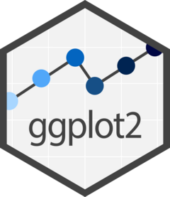
ggplot2 and efficiently generating several plots
William Fisher
PSYC6135
Notes:
I am going to try to avoid getting lost in the weeds of code as I know we haven’t dug into ggplot yet

Slide 2
ggplot2 and faceting
library(ggplot2)
ggplot(data = data.long, aes(x = Measure, y = Value)) +
geom_violin(aes(fill = Measure)) +
geom_boxplot(width = 0.1, alpha = 0.5) +
scale_fill_manual(values=c("#66c2a5","#fc8d62")) +
labs(y = "Score", x = "Measures") +
facet_grid(~Group, scales = "fixed")
ID | Group | Measure | Value
1001 | Group 1 | Measure 1 | 0.178
1001 | Group 1 | Measure 2 | 0.662
1002 | Group 1 | Measure 1 | 0.092
… | … | … | …
5040 | Group 5 | Measure 2 | 0.036
Notes:
Ggplot and the grammar of graphics
First → data
Second → aesthetic
Third → geometrics
Then, we add layers

Slide 3
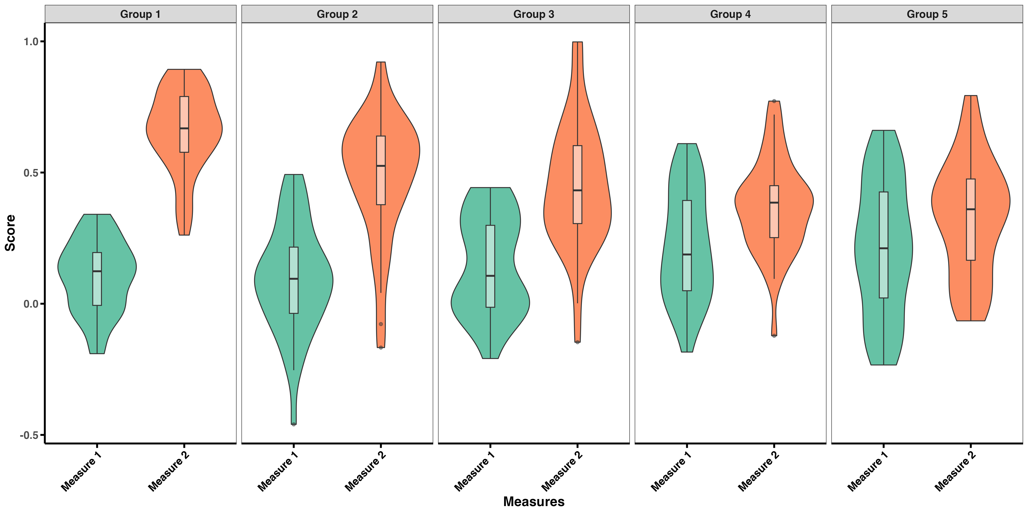
What if I want to save a separate plot for each group?

Slide 4
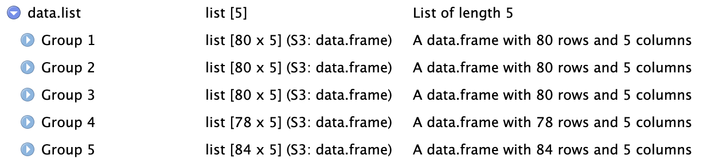
What if I want to save a separate plot for each group?
I could plot each group one by one and then save these plots
I could plot each group one by one and then save these plots – or I can do this in one chunk by:
Method 1: define a function and loop through a list (my preferred method)
First step is to split the long dataframe into several smaller dataframes and store them in a list
data.list <- split(data.long, data.long$Group)
Then, we define a function to create and save our plots and then run it through our list

Slide 5
plot.fun <- function(df){
title = unique(df$Group)
ggplot(data = df, aes(x = Measure, y = Value)) +
geom_violin(aes(fill = Measure)) +
geom_boxplot(width = 0.1, alpha = 0.5) +
scale_y_continuous(limits = c(-.5,1), breaks = seq(-.5, 1, .5)) +
scale_fill_manual(values=c("#66c2a5", "#fc8d62")) +
labs(y = "Score", x = "Measures", title = title)
ggsave(paste0("PSYC6135/MiniPresentation/Plots/", title,".png"), width = 8, height = 8, dpi = 300)
}
for(i in names(data.list)){
plot.fun(data.list[[i]])
}
Notes:
The ggplot object in the function is nearly identical to the one I created when I made the faceted plot. However, the first difference is that I first create an object called ‘title’ that will serve as the main title for our plot and will also serve in the naming of my file. A second difference is that I add a layer that specifies a common y-axis for all the plots – since this was done in the facet layer that doesn’t exist here, I need to do it separately. The third difference is that I save the file

Slide 6
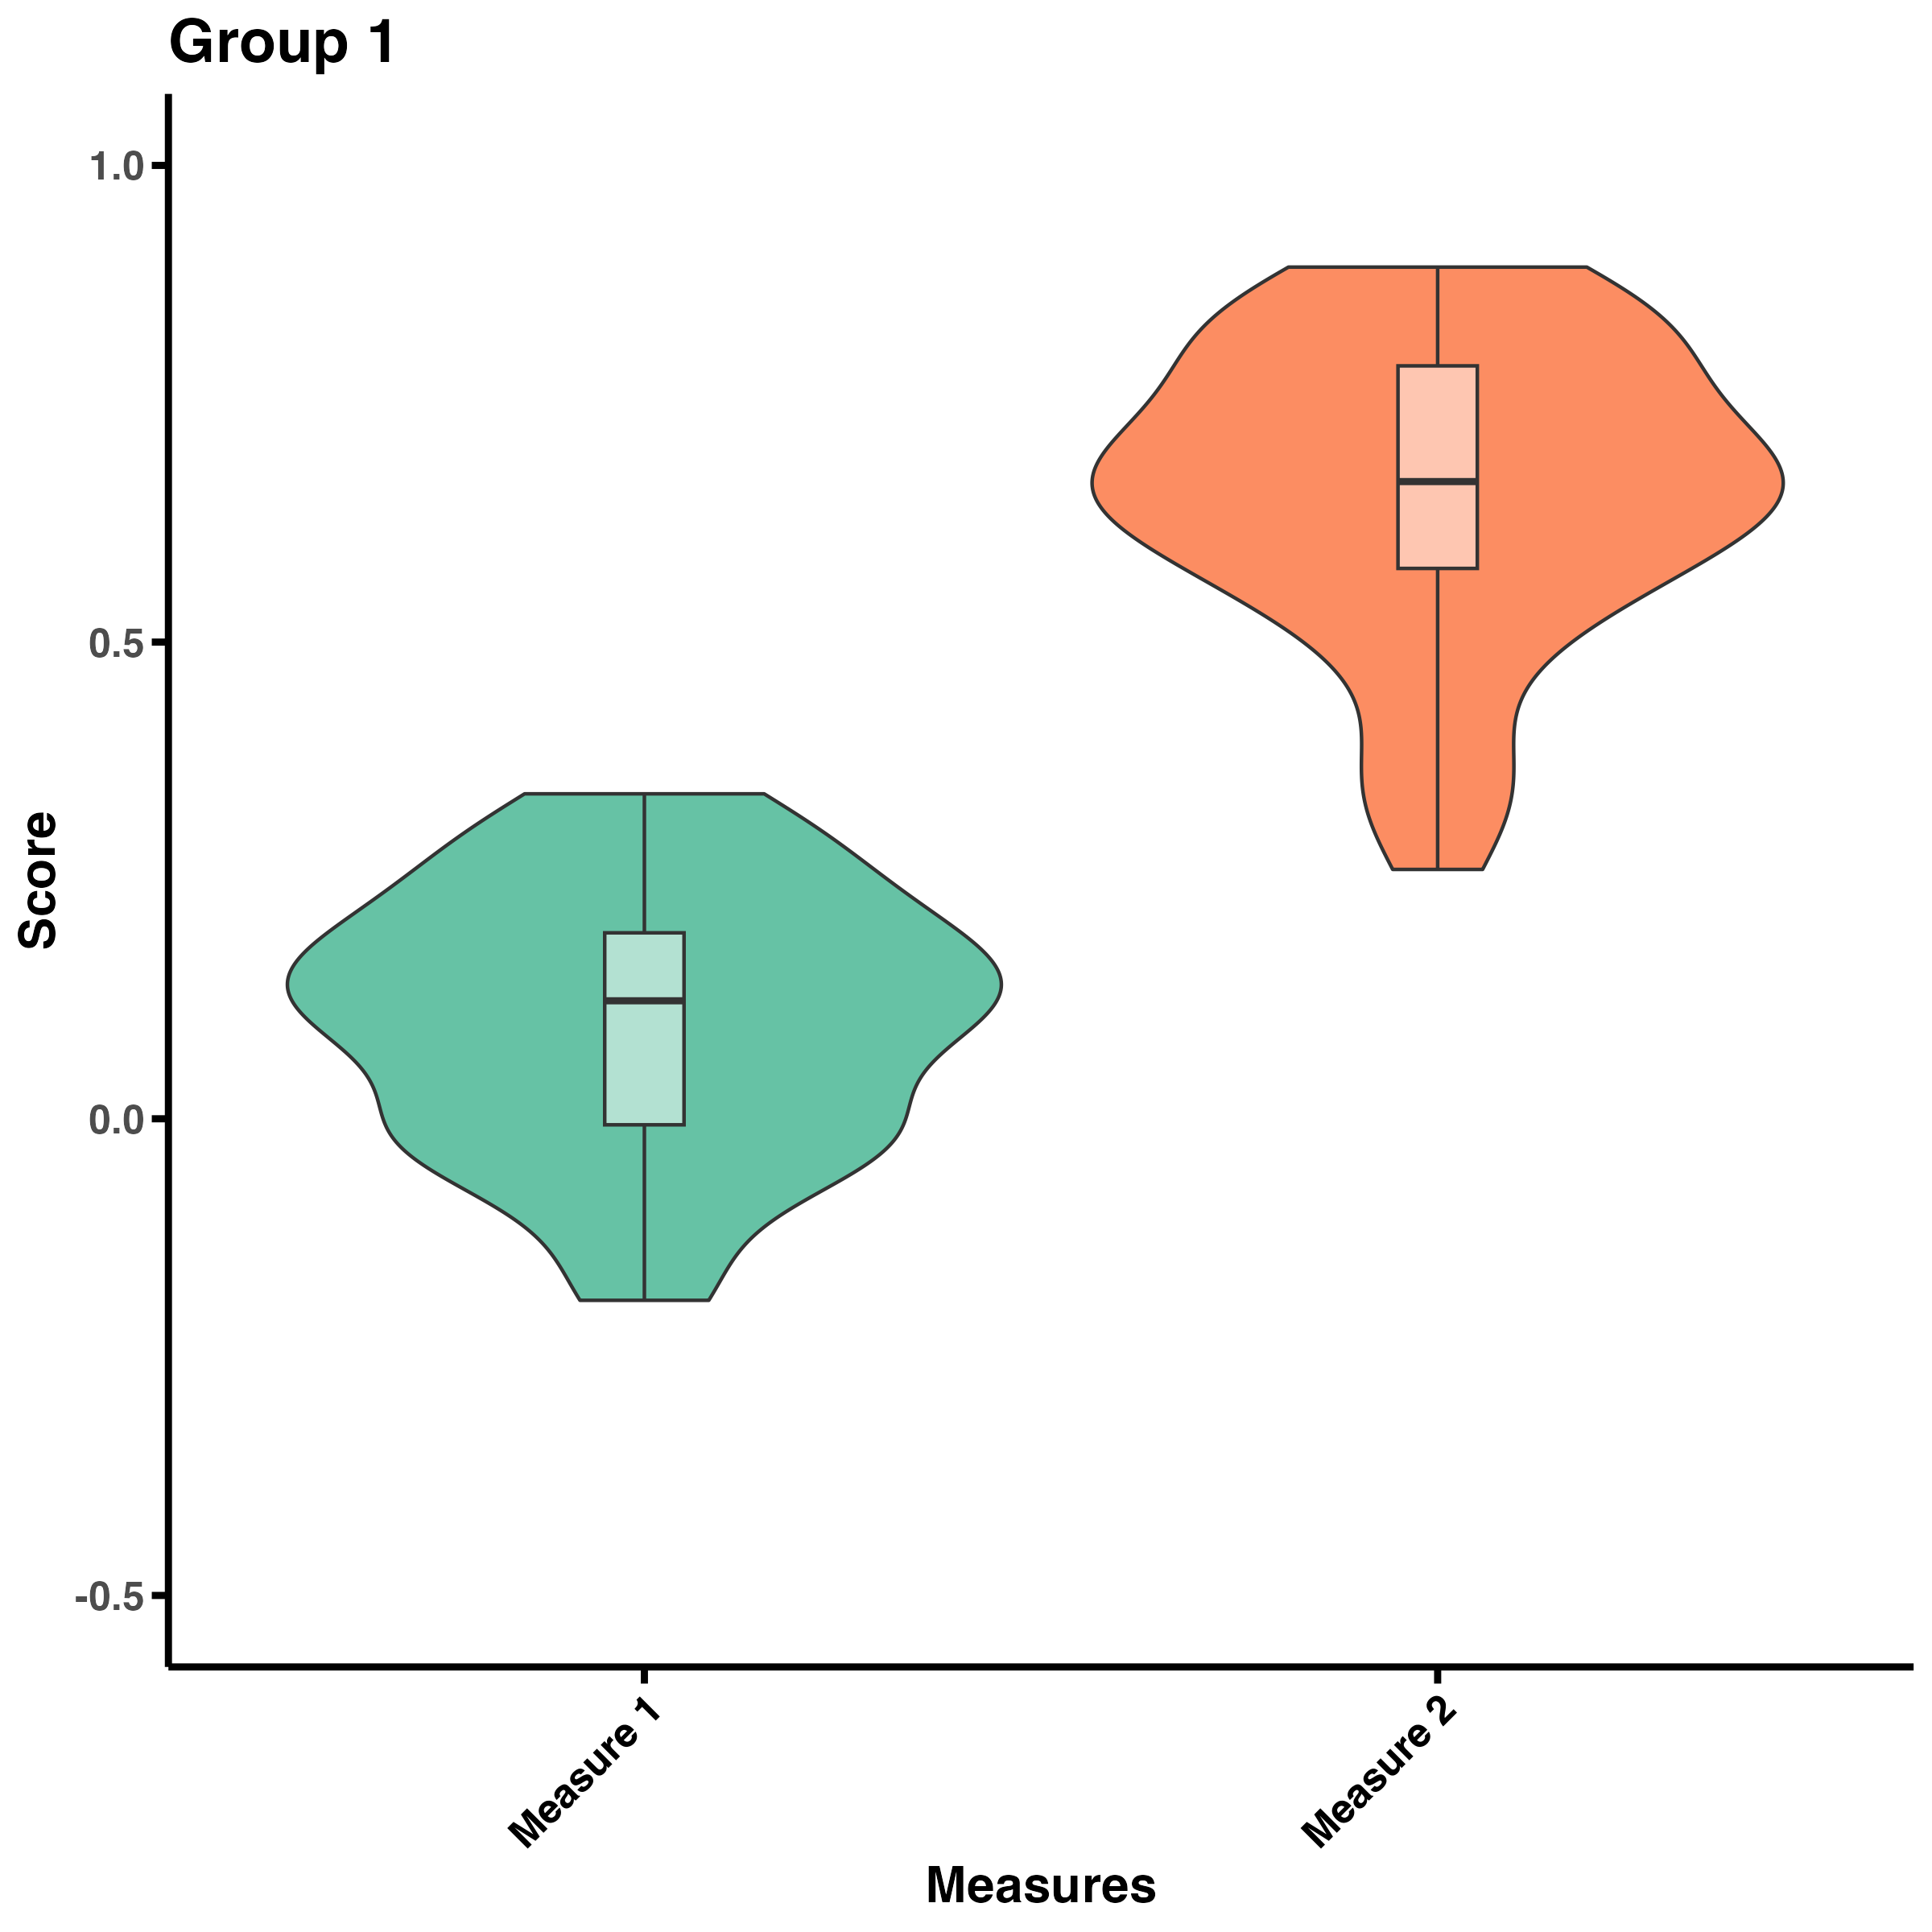
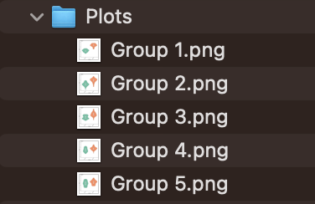
Notes:
I like this function and for-loop method because it’s very adjustable when there are differences in your data. The same way I define an object to be my title that differs across dataframes, I could define axis limits that differ across dfs, axis labels that differ, and so on.

Slide 7

Method 2: Using the iwalk() function from the purrr package
library(purr)
iwalk(data.list, ~ {
p <- ggplot(data = .x, aes(x = Measure, y = Value)) +
geom_violin(aes(fill = Measure)) +
geom_boxplot(width = 0.1, alpha = 0.5) +
scale_y_continuous(limits = c(-.5, 1), breaks = seq(-.5, 1, .5)) +
scale_fill_manual(values = c("#66c2a5", "#fc8d62")) +
labs(y = "Score", x = "Measures", title = unique(.x$Group))
ggsave(paste0("PSYC6135/MiniPresentation/Plots/", .y, "_walk.png"),
plot = p, width = 8, height = 8, dpi = 300)
})
*.x is each dataframe as it ‘walks’ through the list, and .y is each dataframe’s name*

Slide 8
Thanks for listening!
References
H. Wickham. ggplot2: Elegant Graphics for Data Analysis. Springer-Verlag New York, 2016.
Wickham H, Henry L (2025). purrr: Functional Programming Tools. R package version 1.0.4,
https://github.com/tidyverse/purrr, https://purrr.tidyverse.org/.

