Slide 1

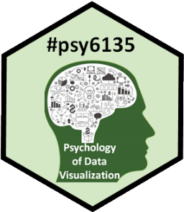
Your Turn: Feedback?
Michael Friendly
Psych 6135
https://friendly.github.io/6135/

Slide 2
What did you like best about 6135?
What topics were the most interesting?
What did you learn most from?
How does this relate to your own work?

Slide 3
What could have been done better or differently?
More of X?
Less of Y?
Hands on stuff?

Slide 4
Future of data visualization?
What do you think are important or hot topics for the future?
Areas of application?
New methods?

