Slide 1

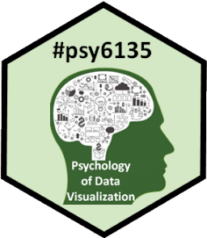
Your Turn: Feedback on #psy6135
Michael Friendly
Psych 6135
https://friendly.github.io/6135/

Slide 2
Overall impression of 6135?
What topics were the most/least interesting?
What course aspects did you learn most/least from?
Lectures / readings / prep for presentations / …
How did you use the course materials on the web?
Lecture notes?
Readings?
Resources?
How does this relate to your own work?

Slide 3
What could have been done differently?
Topics:
More of X?
Less of Y?
Hands on stuff?
More time showing coding in R/Rstudio?
More exercises/examples/mini-assignments?
More ‘active learning’ components?
Class demos, participation activities?
Graph critiques? Could this be a class activity?
Evaluation:
Something other than mini-pres / presentation / paper?
Re-weight components?

Slide 4
Future of data visualization?
What do you think are important or hot topics for the future?
Areas of application?
New methods?
What would be good topics for next 6135?
What excites you?

