Slide 1

Hans Rosling: Revolutionizing Global Understanding
A Journey Through Data, Perception and Progress
Kathryn Pierce – Jan 18/23 – Data Visualization Discussion

Slide 2

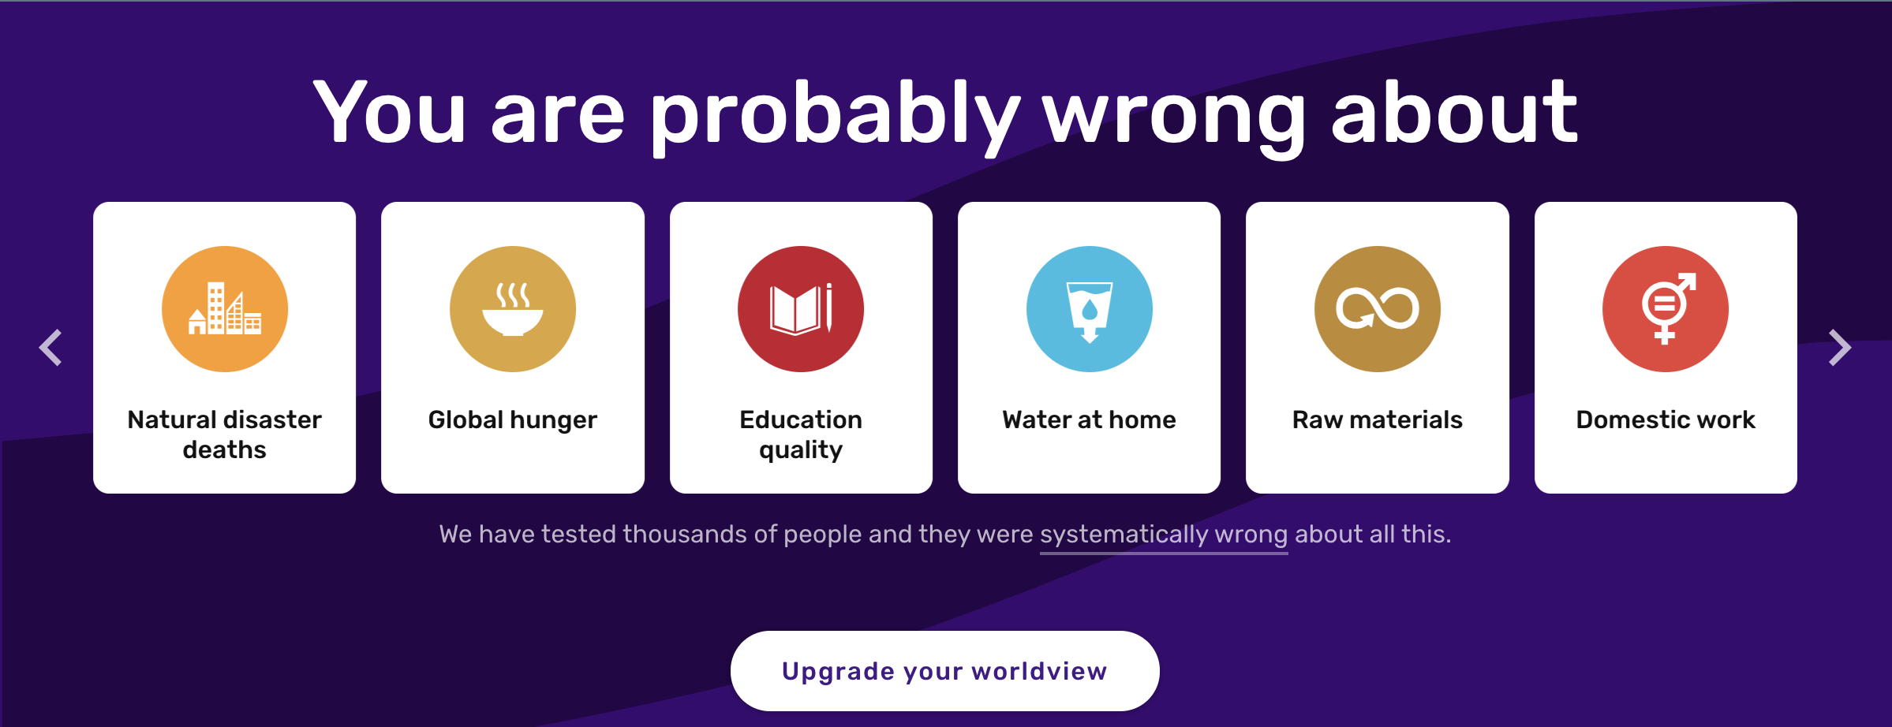
Introduction
Hans Rosling – Swedish physician, academic and public speaker
Co-founded the Gapminder Foundation, a non-profit organization that aims to promote a fact-based world view by making data on global development accessible and understandable.

Slide 3
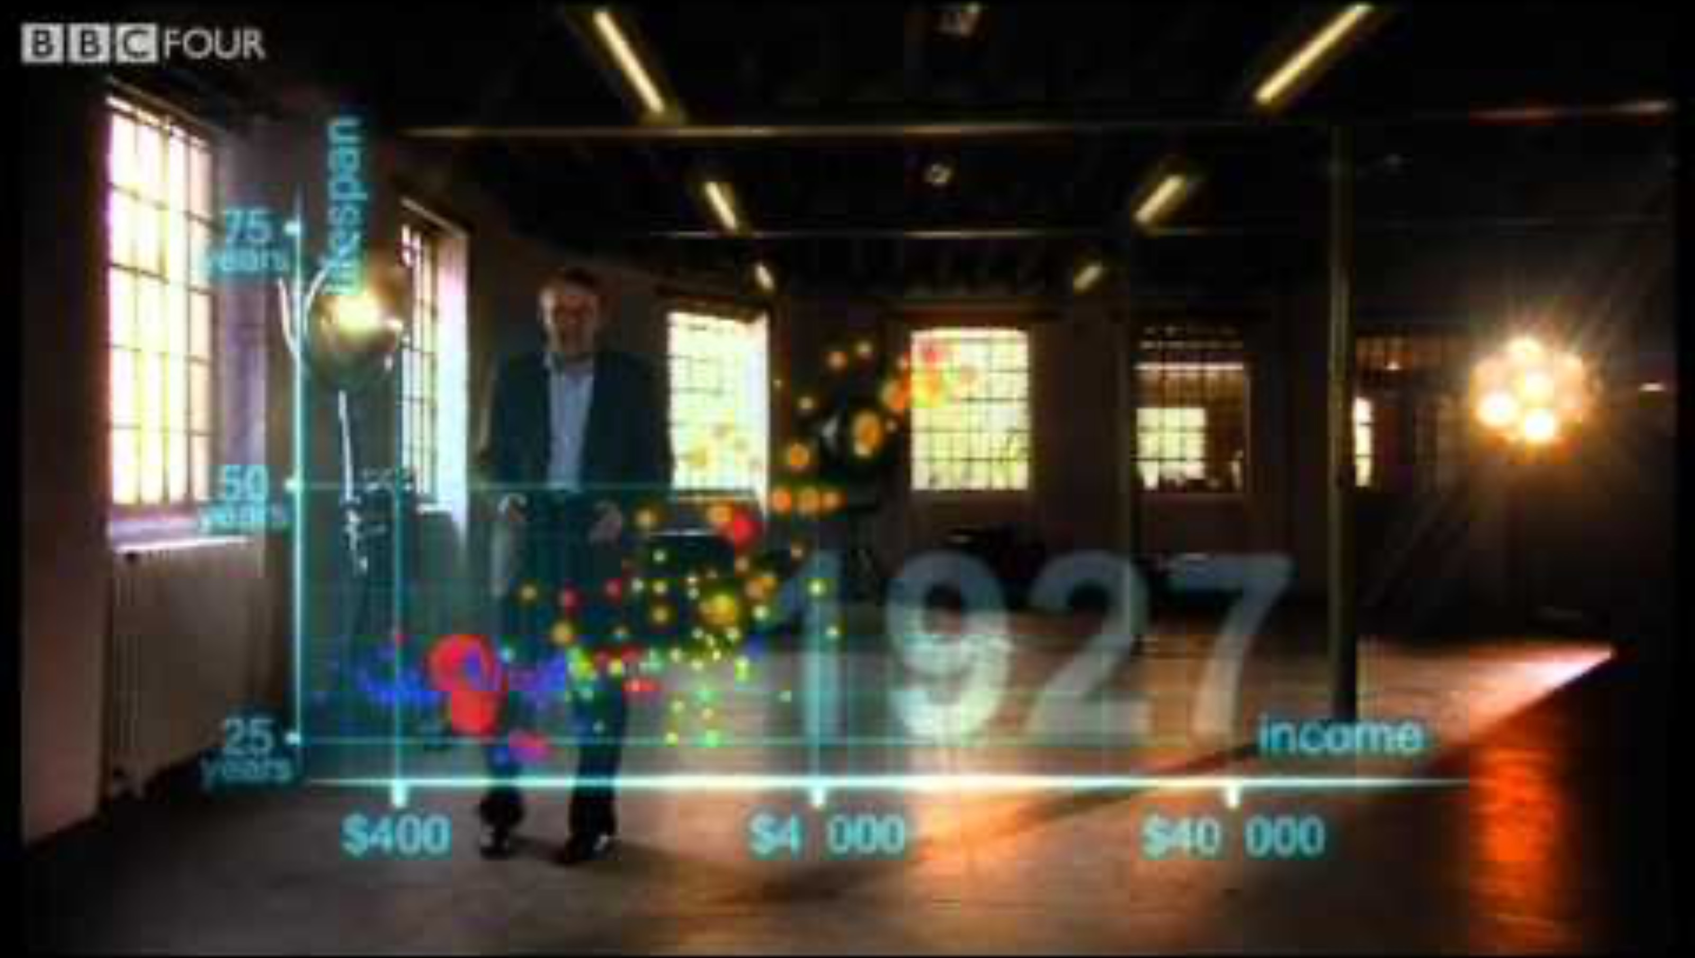
200 Countries, 200 Years, 4 Minutes: The Joy of Stats

Slide 4

Strengths
Highly memorable
Good use of colour and motion
Tells a clear story about a large and complex dataset
Encourages critical thinking
Accessible

Slide 5

Potential Pitfalls
Potential for misinterpretation, especially with logarithmic scale
Assumption of global linear progression
Focus on aggregate data – though China is broken down into sub-regions, it is only one country

Slide 6

Other Thoughts?

