Slide 1
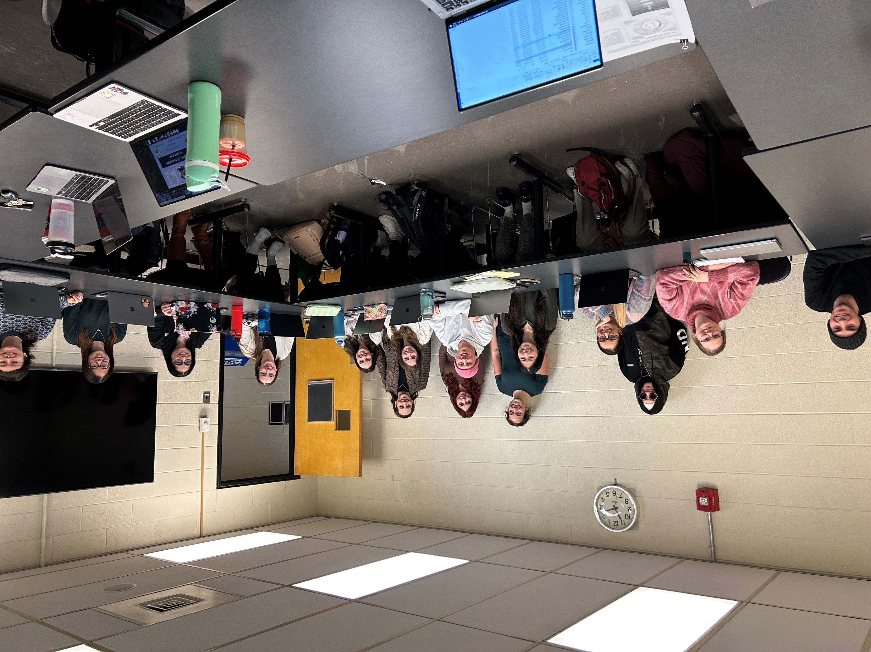


Team 6135: Winter, 2025
Victoria
Vanessa
Marlee
Ashley
Danika
Mina
Yara
Will
Audrey
Jessica
Sami
Camile
Nisha
Hannah
Courtney

