Slide 1
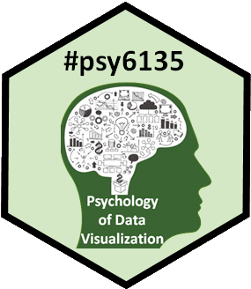
AI & Dataviz
Michael Friendly
Psych 6135
http://friendly.github.io/6135

Slide 2
How can AI help in datavis?
Graph description: generate ALT text for visually impaired
Graph construction: co-pilots for data analysis
What else?

Slide 3
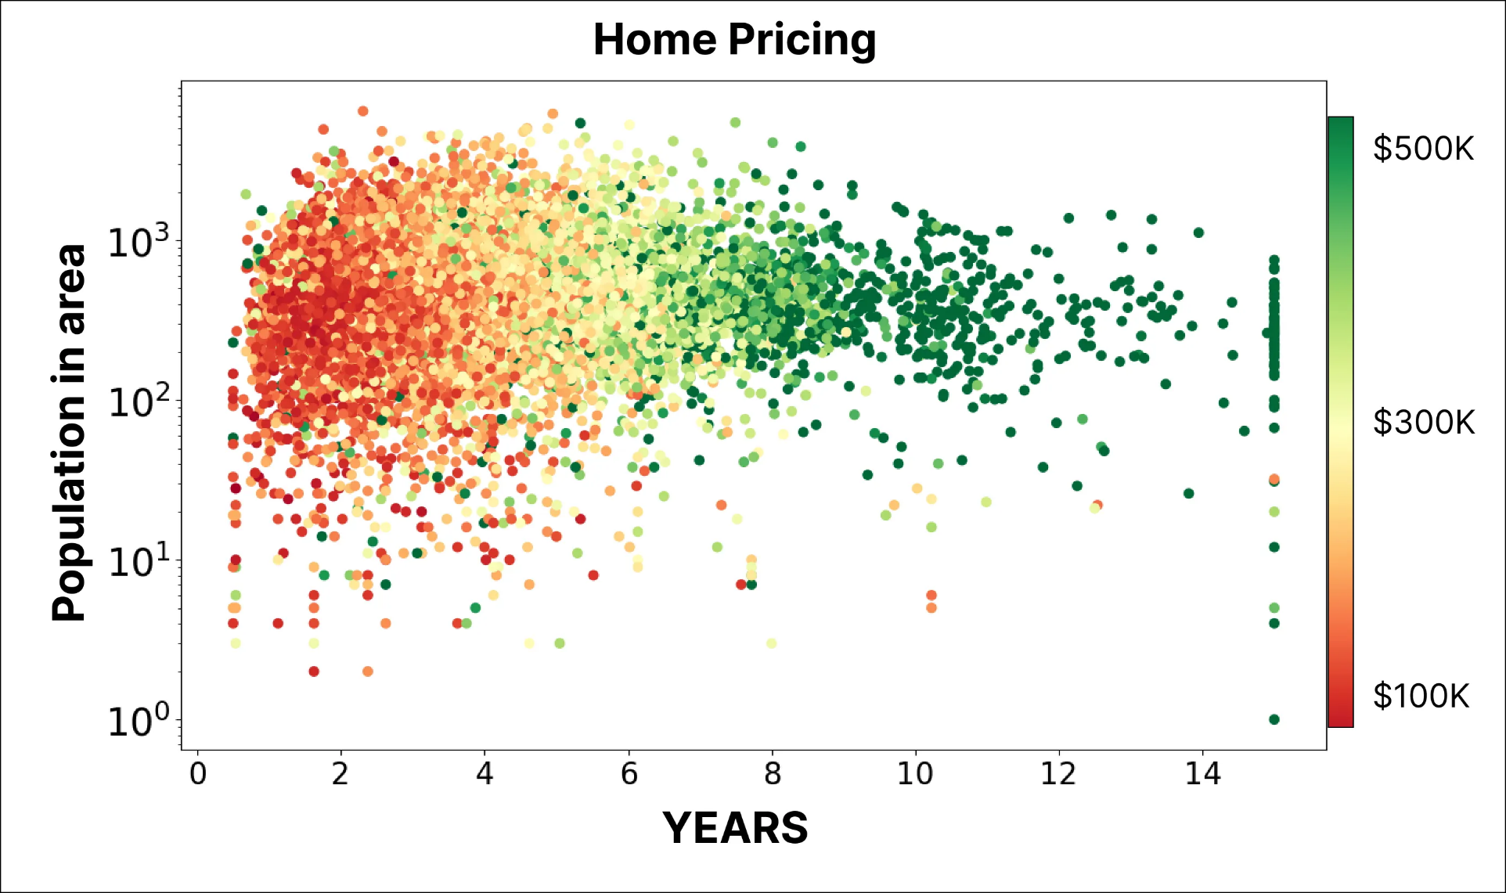
What is this graph?

Slide 4
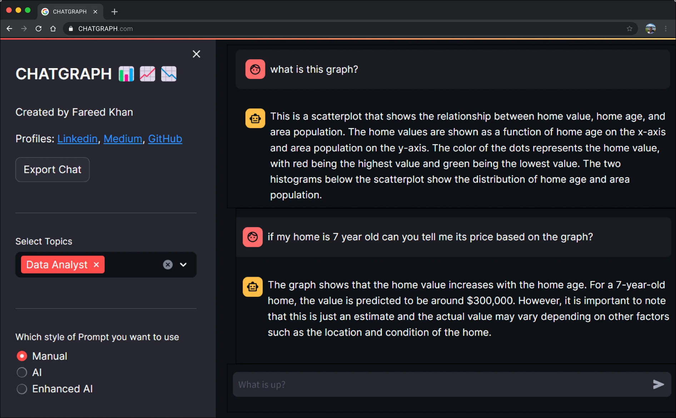
ChatGraph
App: https://chat-with-graph.streamlit.app/
See: https://levelup.gitconnected.com/chat-with-graphs-intelligently-969af38516b2

Slide 5
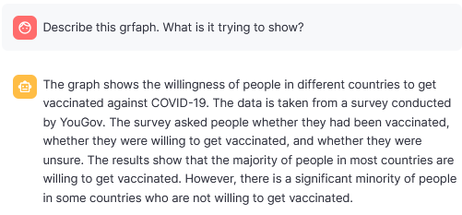
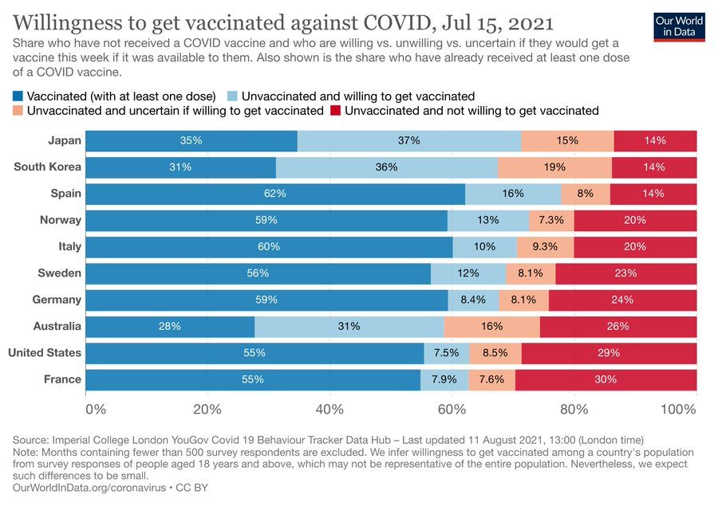
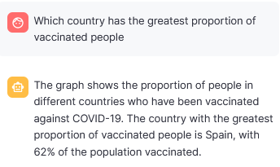
Complicated bar chart

Slide 6
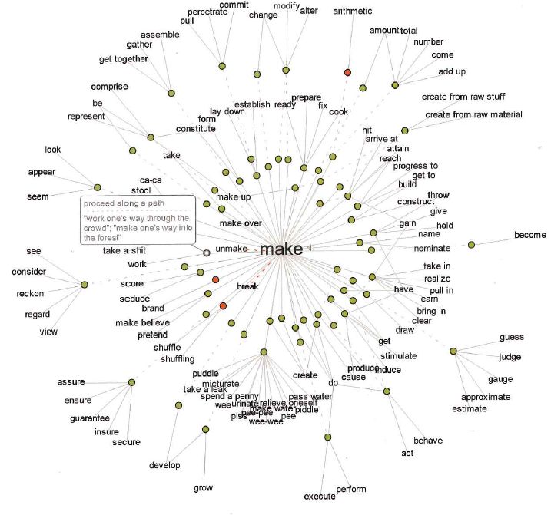
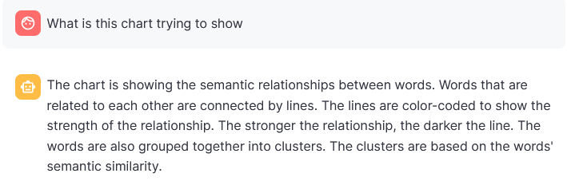
Radial network diagram

