Slide 1
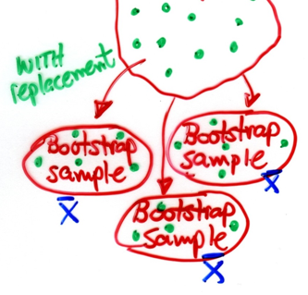
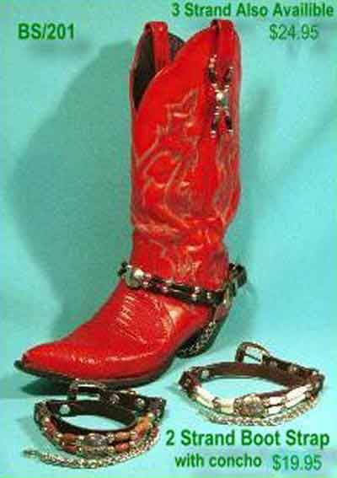

Bootstrapping
Michael Friendly
Psych 6135
https://friendly.github.io/6135/

Slide 2
Bootstrapping
Classical statistical inference relies on
Distributional assumptions, e.g., ε ∼ N(0, σ²)
Asymptotic results, e.g., in SEM: F_{ML} ~ χ2 as n → ∞
Bootstrapping is a non-parametric approach to inference that substitutes computation for assumptions
Functional bootstraps: help to pull you up from where you are (data), to where you want to be (reasonable conclusions)
bootstrap (v): help oneself, often through improvised means
Decorative bootstraps: we don’t need these

Slide 3
Bootstrapping
Can provide more accurate inferences when data is badly behaved or n is small
linear models, SEM, …
Can be applied when no sampling theory is available
Tests of equality of ratios: (y₁/x₁) =? (y₂/x₂)
fMRI studies: differences among patterns of brain activation
Shoeless Joe Jackson: how did he hit in clutch situations?
Can be applied to complex data-collection plans (stratified/clustered samples)

Slide 4
More general ideas: Resampling
The bootstrap is an example of the general idea of resampling from an original data set for statistical inference
Other examples:
Jackknife: leave-one-out analysis
Cross-validation: choosing optimal model fitting parameters
Permutation tests: totally non-parametric
Uses:
Std errors, CIs with small samples
Subset selection in linear models
Dealing with missing data
Complex algorithms: ML neural networks

Slide 5
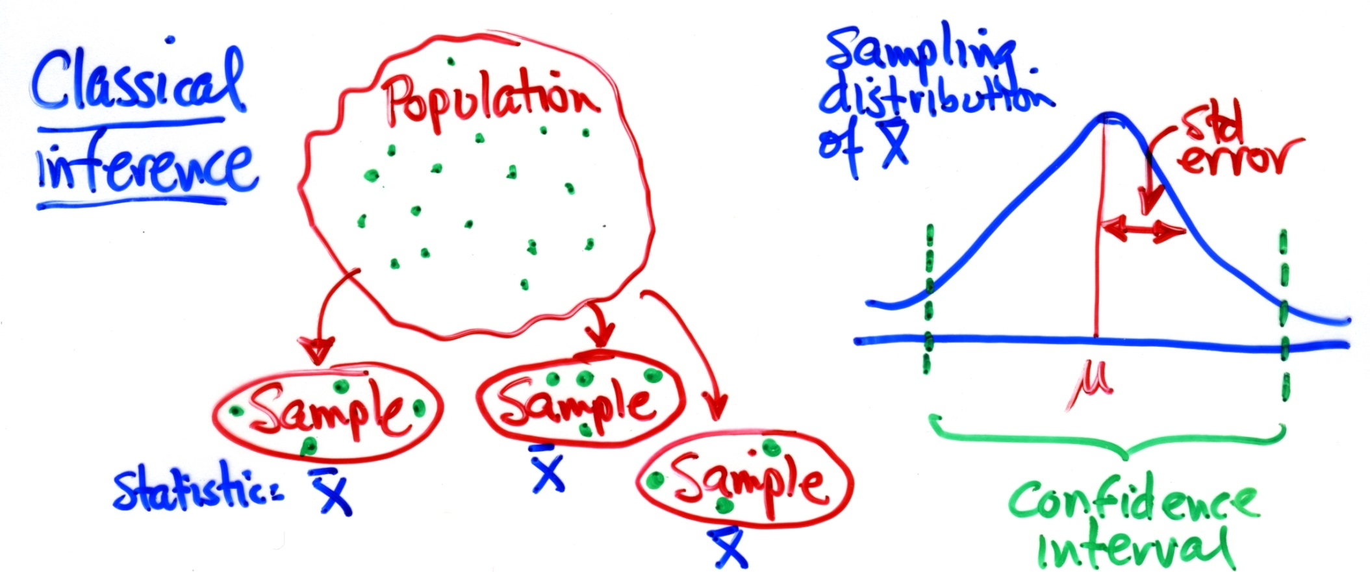

Classical statistical inference
Here, we rely on statistical theory (CLT) & assumptions (independence, normality, constant variance) to take us to the sampling distribution of the statistic of interest.

Slide 6
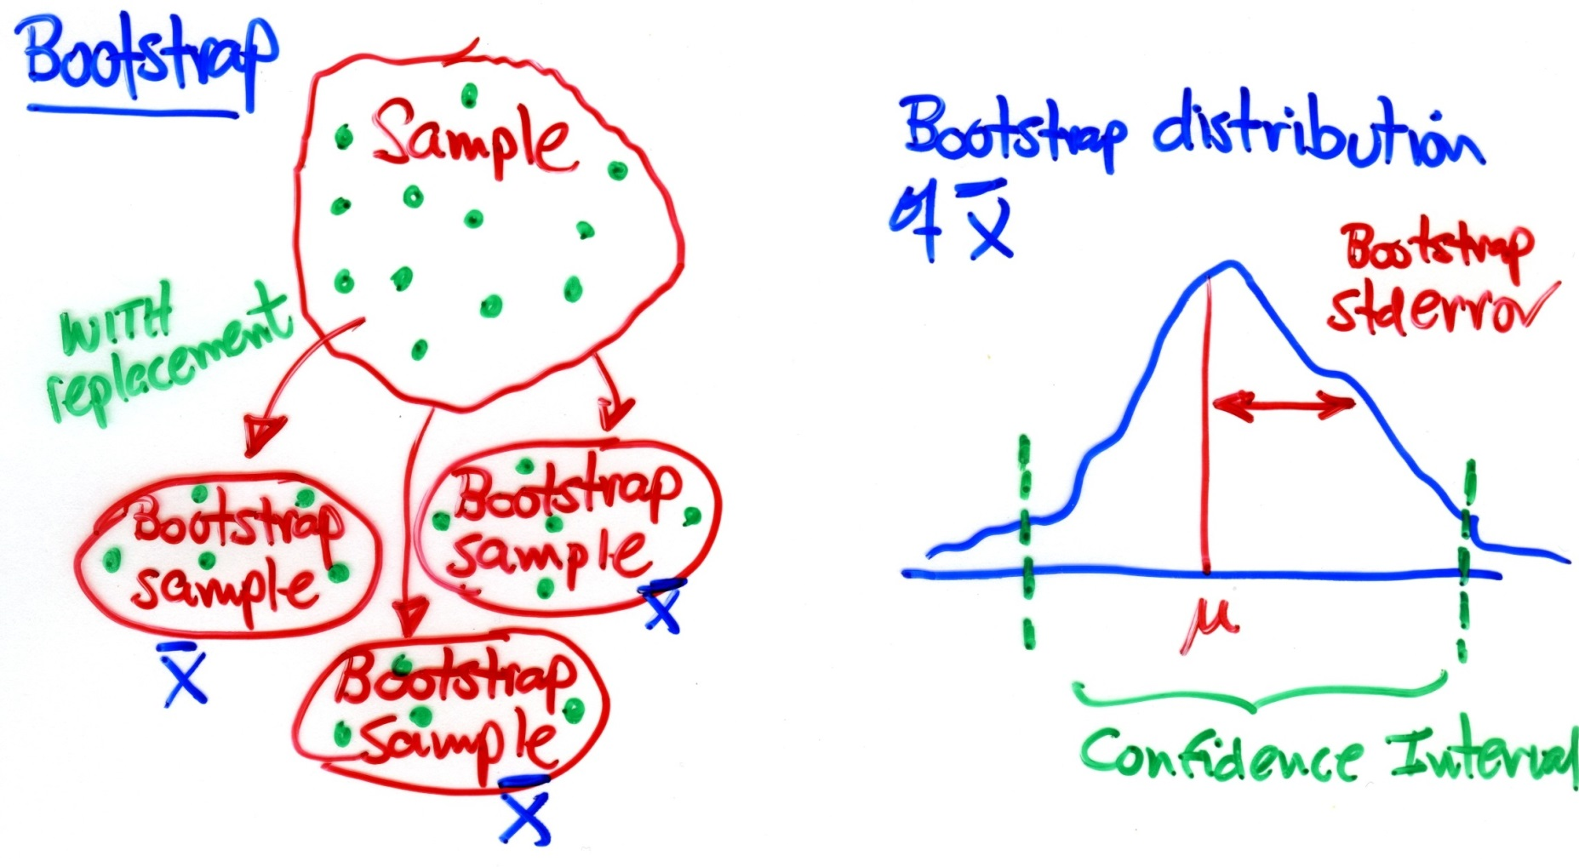

Bootstrap
Key idea:
Population is to the sample
Population is to the sample
Sample is to the bootstrap sample
AS
Sample is to the bootstrap sample
AS

Slide 7
R Packages
ungevis Tools for visualizing uncertainty with ggplot2
rsample Tidy resampling methods
bootstrapper()
stat_smooth_draws()
Animations over bootstrap samples
Random, stratified, grouped resampling
Cross validation (train, test)
Bootstrapping
bootstraps()
purr::map() over samples
CI methods
plots

Slide 8
Bootstrap resampling demo
# devtools::install_github("wilkelab/ungeviz")
library(ungeviz)
bs <- bootstrapper(3) # create 3 draws
(draws <- bs(data.frame(letter = LETTERS[1:4])))
The bootstrapper function creates a function to create bootstrap samples
-- here 3 draws of 4 letters
# A tibble: 12 x 6
# Groups: .draw [3]
.draw .id .original_id letter .copies .row
<int> <int> <int> <chr> <dbl> <int>
1 1 1 1 A 1 1
2 1 2 4 D 2 2
3 1 3 4 D 2 3
4 1 4 3 C 1 4
5 2 1 4 D 1 5
6 2 2 1 A 2 6
7 2 3 1 A 2 7
8 2 4 2 B 1 8
9 3 1 1 A 1 9
10 3 2 2 B 1 10
11 3 3 3 C 2 11
12 3 4 3 C 2 12
letter is the data value.
Other variables identify all aspects of the bootstrap
Code: https://raw.githubusercontent.com/friendly/6135/refs/heads/master/R/bootstrap-demo.R

Slide 9
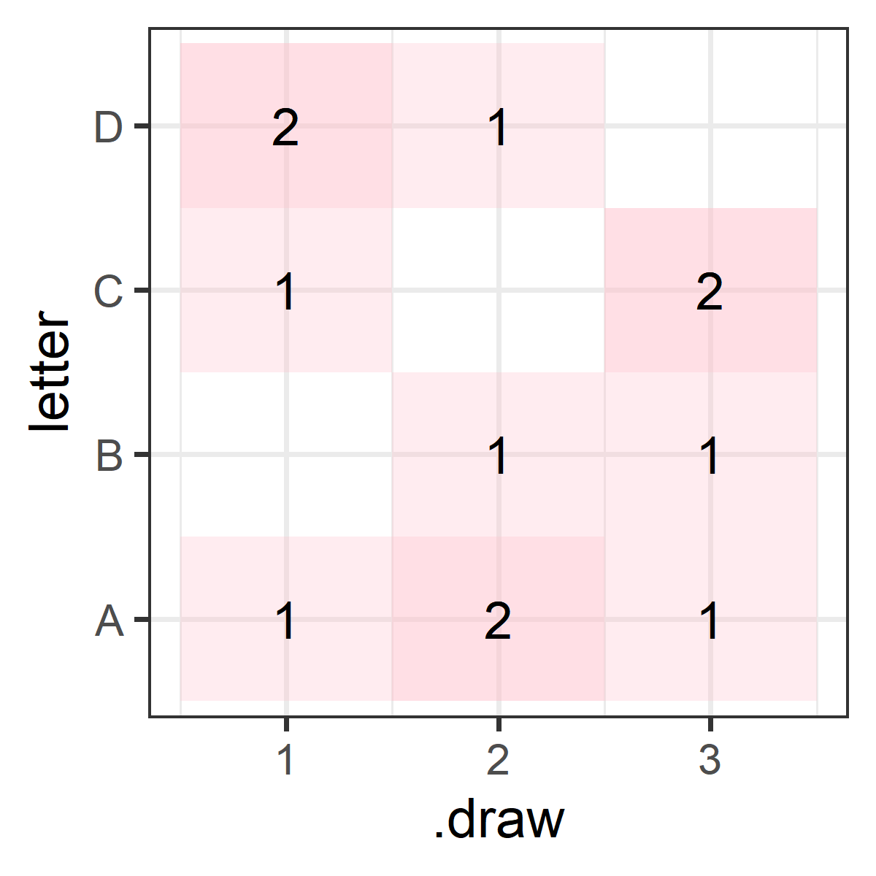
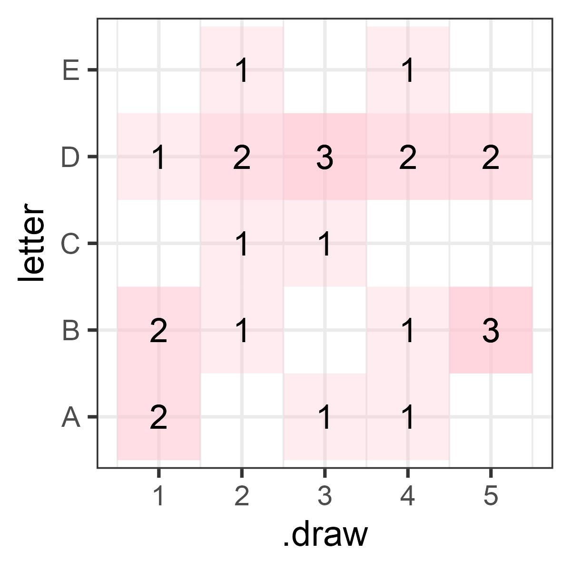
Bootstrap resampling demo
ggplot(draws, aes(x=.draw, y=letter)) +
geom_tile(fill="pink", alpha=0.3) +
geom_text(aes(label=.copies), size=6)
The same for 5 draws of LETTERS[1:5]
Each tile shows the number of times that letter was picked in a given .draw
bs2 <- bootstrapper(5)
draws2 <- bs2(data.frame(letter = LETTERS[1:5]))

Slide 10
Regression illustration
# randomly generate dataset
set.seed(12345)
x <- rnorm(15)
df <- data.frame(x,
y = x + 0.5*rnorm(15))
# bootstrapper object
bsr <- bootstrapper(10)
Animated plot, by .draw:
ggplot(df, aes(x,y) +
geom_point(data=bsr, aes(group= .row) +
geom_text(data = bsr, aes(label = .copies) +
geom_smooth(data = bsr, aes(group = .draw),
method = "lm“) +
# animation
transition_states(.draw, 1, 2) +
enter_fade() + exit_fade()

Slide 11
Bootstrapped confidence bands
The same method can be used to illustrate the uncertainty around the regression line, as reflected in the confidence band
However, the std conf. band is calculated using classical normal theory
The bootstrapped fits trace out an empirical confidence band.

Slide 12
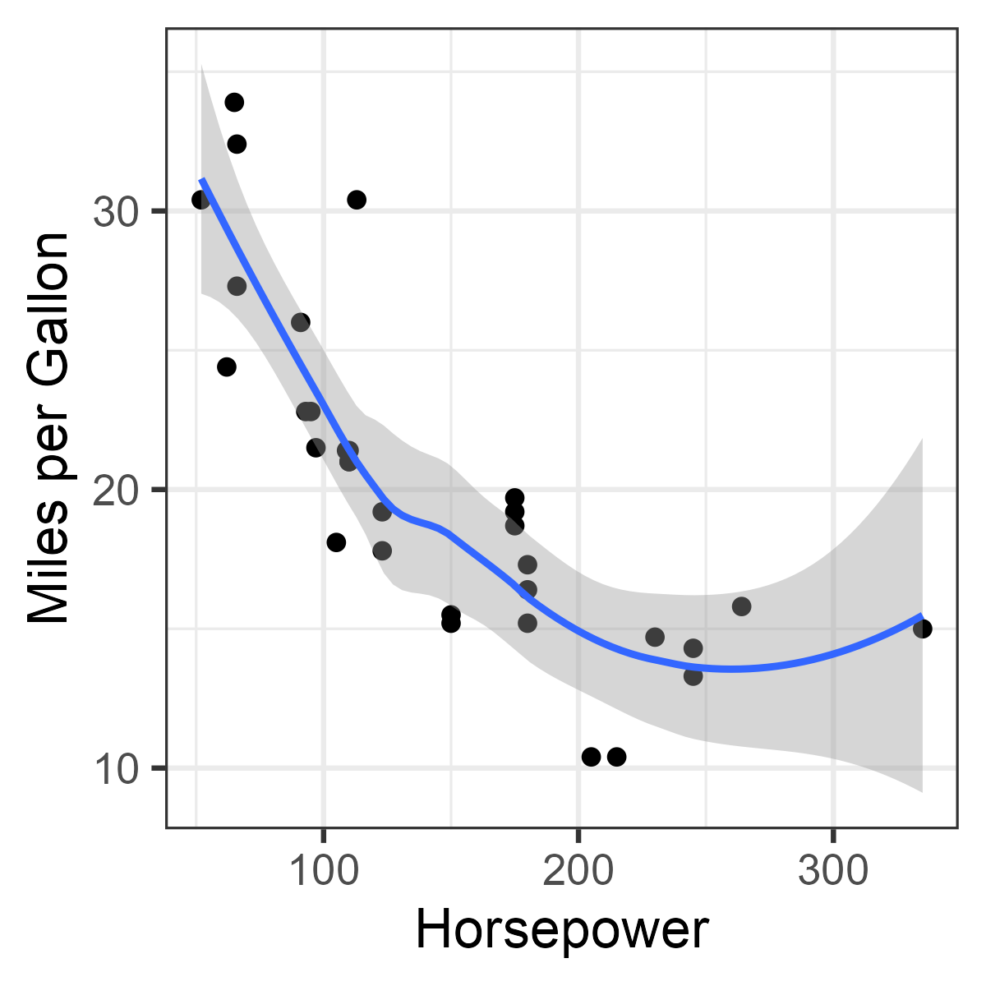
Non-linear relations: smoothing
We know how to use loess to estimate a non-parametric smoothed curve
There is also theory that allows calculation of a (approx.) confidence envelope
ggplot(mtcars, aes(hp, mpg)) +
geom_point(size = 2) +
geom_smooth(method = "loess") +
labs(x = "Horsepower",
y = "Miles per Gallon")

Slide 13
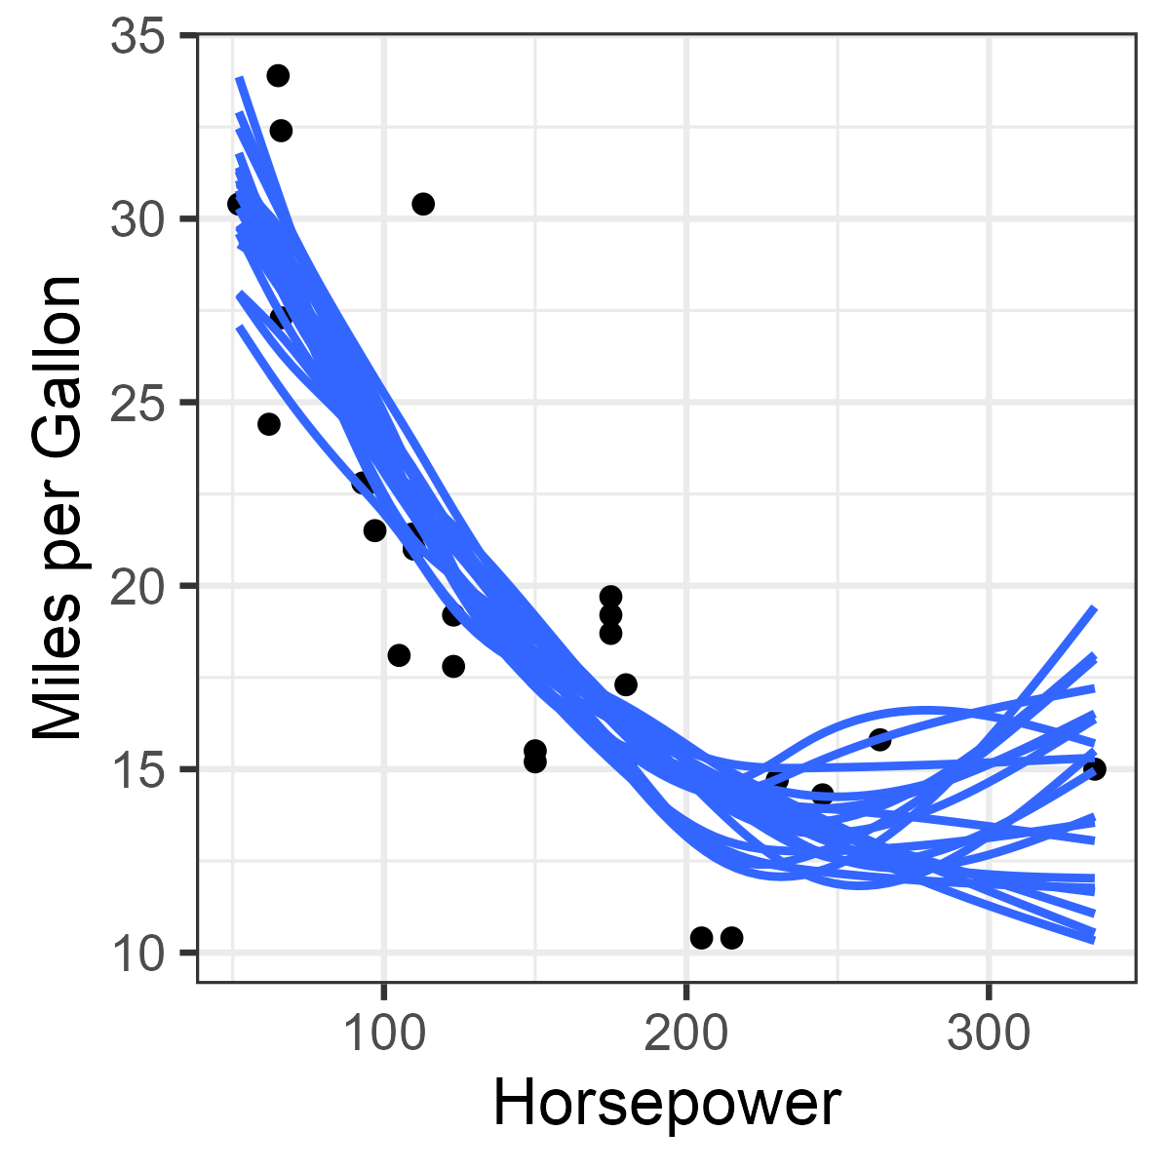
Resampling: smooth draws
Instead, resampling methods generate outcome draws from a smooth fit using mgcv::gam(). The collection of draws provide an empirical confidence envelope
plt <-
ggplot(mtcars, aes(hp, mpg)) +
geom_point(size = 2) +
stat_smooth_draws(times = 20,
aes(group = stat(.draw) ))
plt

Slide 14
Resampling: smooth draws
Animation shows how the collection of sampled smooths develop over time
The animation transitions over draws (.draw)
shadow_trail() keeps the previous curves
plt +
transition_states(stat(.draw)) +
enter_fade() +
exit_fade(alpha=0.8) +
shadow_trail()

Slide 15
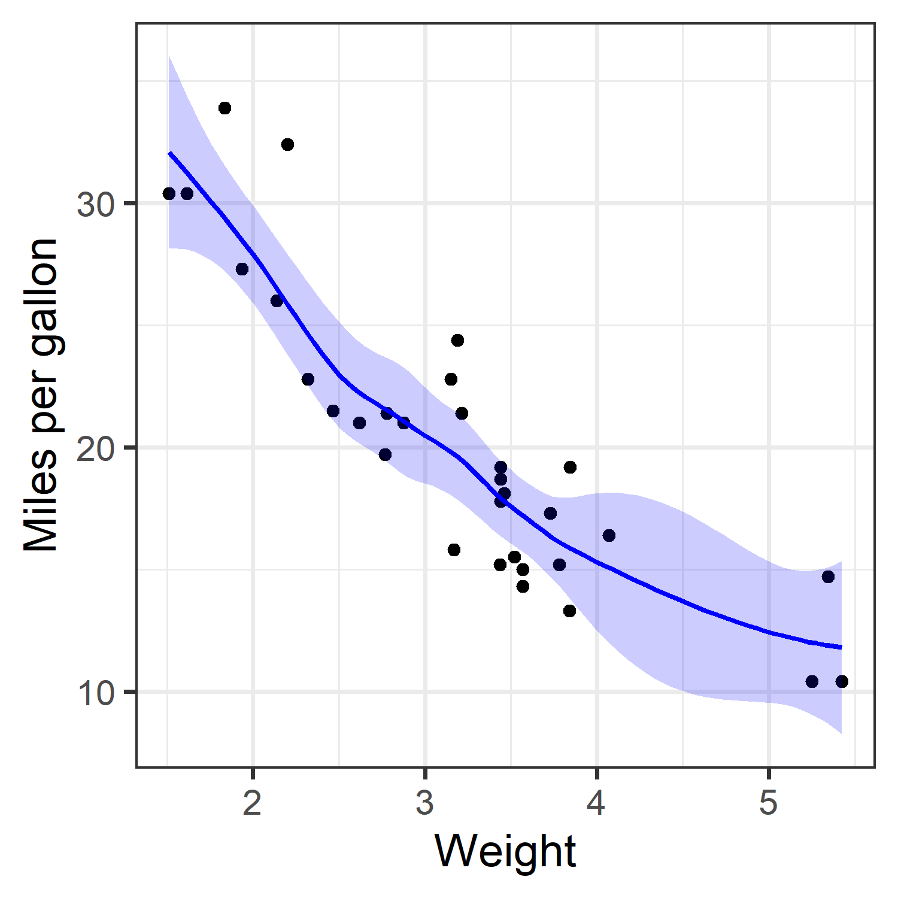
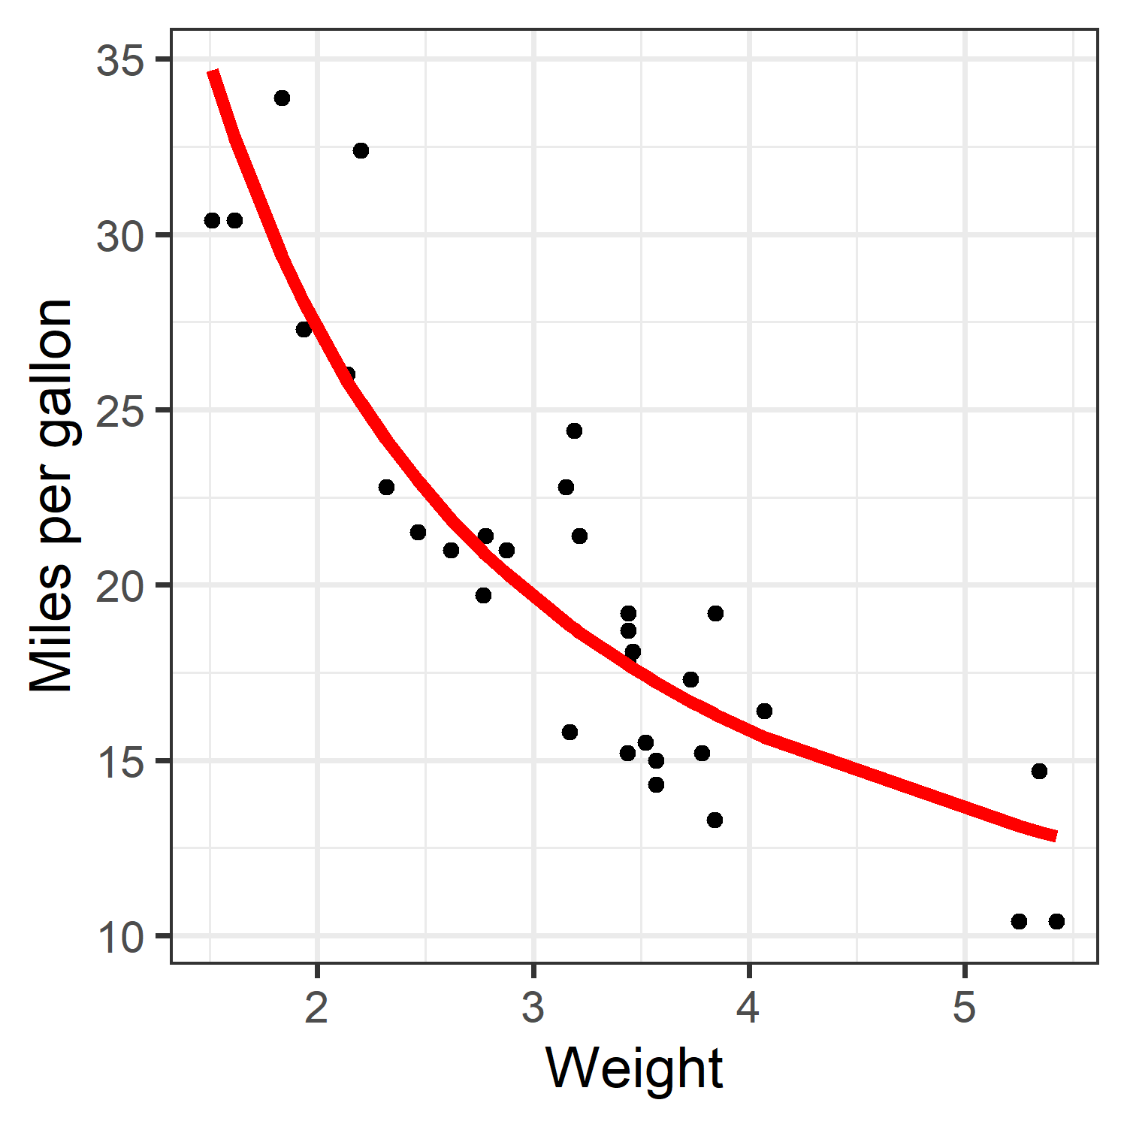

Bootstrapping models
Rather than fitting a nonparametric smoothed curve, we might want to fit a parametric but nonlinear model, perhaps for substantive interpretation
loess: nonparametric
An inverse relation:
$$y=\frac{k}{x}+b$$

Slide 16
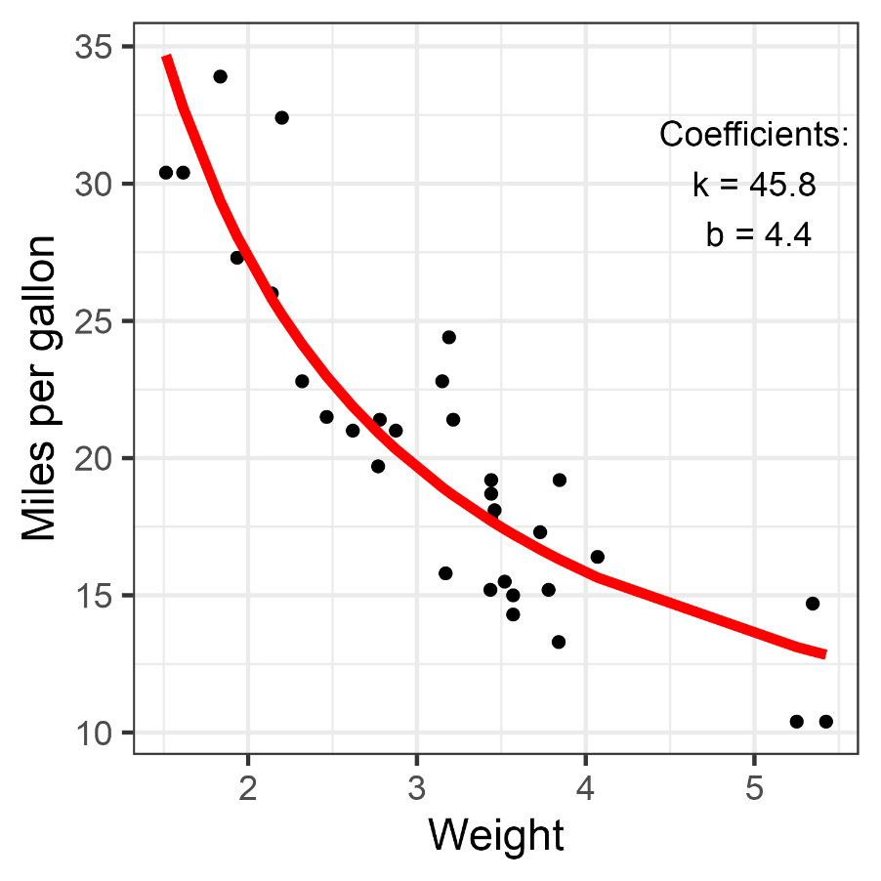
Nonlinear model: nls()
nlsfit <- nls(mpg ~ k / wt + b, mtcars,
start = list(k = 1, b = 0))
summary(nlsfit)
Formula: mpg ~ k/wt + b
Parameters:
Estimate Std. Error t value Pr(>|t|)
k 45.829 4.249 10.786 7.64e-12 ***
b 4.386 1.536 2.855 0.00774 **
This uses stats::nls() to fit nonlinear models
There is also a {nlstools} package (that does bootstrapping)

Slide 17
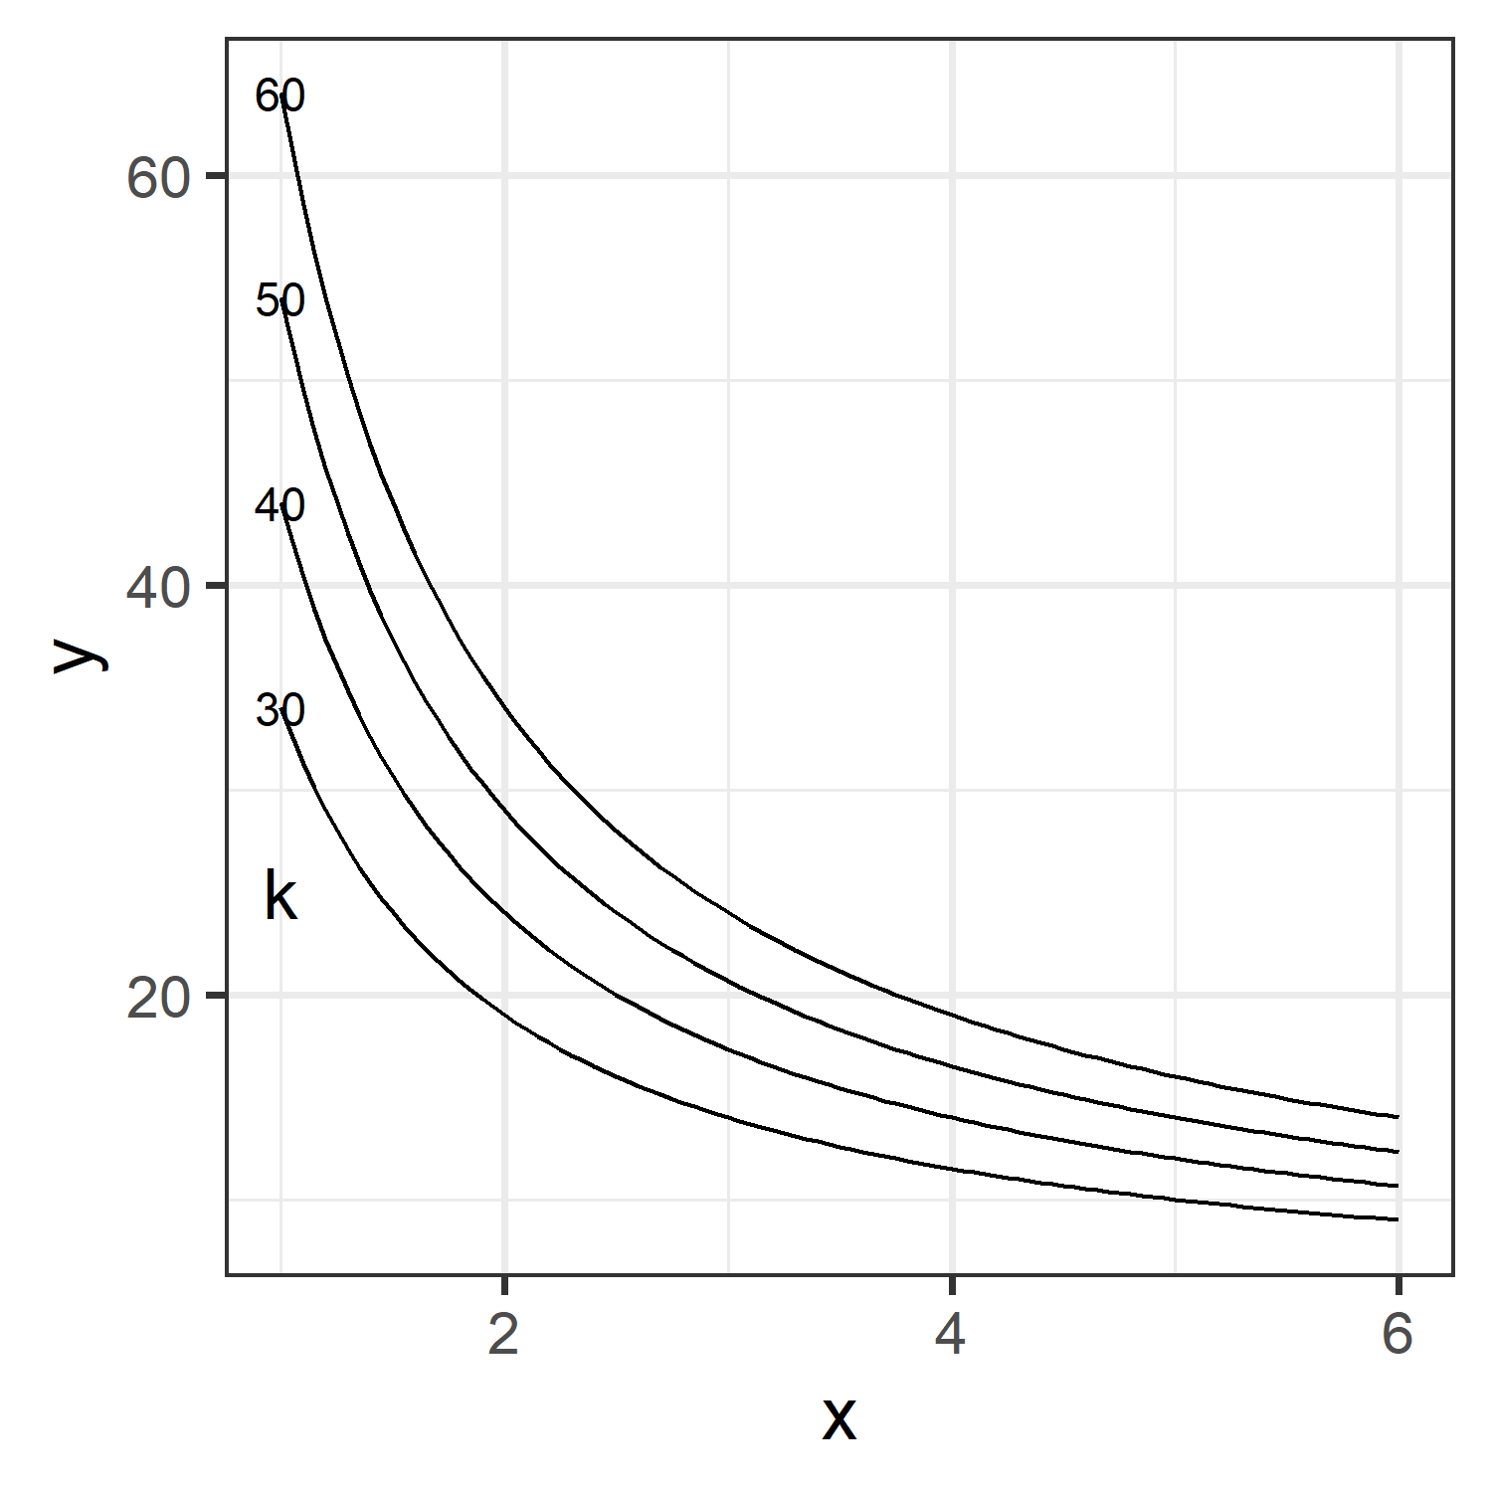
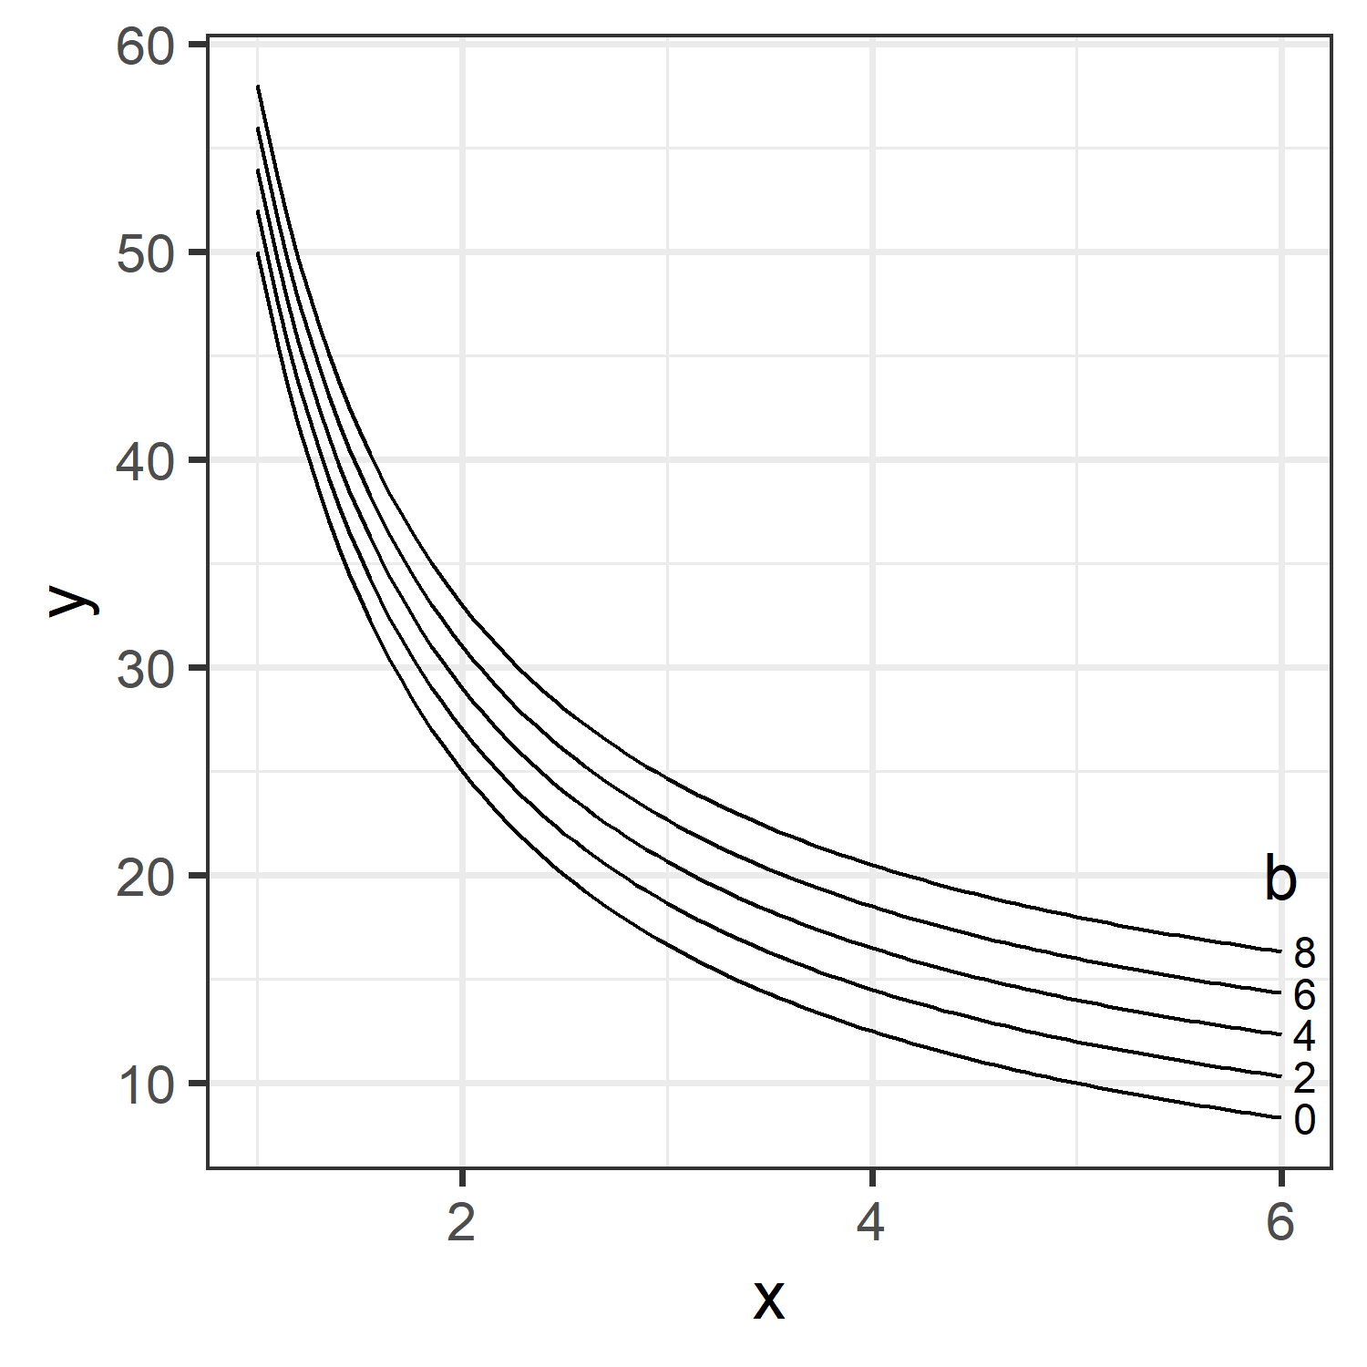
Inverse model
What are the parameters in this model?
k: starting value
b: asymptote

Slide 18

rsample package
Schema for bootstrapping using the rsample package
set.seed(42)
boots <- bootstraps(data, times = 2000)
# specify the model
mod <- as.formula(y ~ x1 + x2 + x3)
# function to fit for one <split>
fit <- function(split, …) {
glm(mod, data = analysis(split))
}
# run the bootstrap
boot_models <- boots |>
mutate(model = map(splits, fit),
coefs = map(model, tidy))
# Confidence intervals
int_pctl(boot_models, coefs)
int_bca(boot_models, coefs)
int_t(boot_models, coefs)
Generate ‘times’ bootstrapped samples, indexed by splits
Scheme to fit the model for one bootstrap sample.
analysis() extracts the data.
Generates a nested data structure containing <model>, <coefs> for each split
Functions to calculate confidence intervals from the bootstrapped models

Slide 19
rsample package
set.seed(27)
boots <- bootstraps(mtcars, times = 500)
boots
# Bootstrap sampling
# A tibble: 500 x 2
splits id
<list> <chr>
1 <split [32/10]> Bootstrap001
2 <split [32/12]> Bootstrap002
3 <split [32/10]> Bootstrap003
4 <split [32/10]> Bootstrap004
5 <split [32/11]> Bootstrap005
6 <split [32/14]> Bootstrap006
7 <split [32/11]> Bootstrap007
8 <split [32/8]> Bootstrap008
9 <split [32/11]> Bootstrap009
10 <split [32/13]> Bootstrap010
# ... with 490 more rows
Generate ‘times’ bootstrapped samples
{rsample} provides a more general approach, allowing cross-validation
For bootstrapping, each split[n/m] contains:
[n] sample with replacement
[/m] items not selected in that sample

Slide 20
Running the bootstrap
fit_nls<- function(split) {
nls(mpg ~ k / wt + b,
data= analysis(split),
start = list(k = 1, b = 0))
}
Create a helper function to fit an nls() model on each bootstrap sample.
rsample::analysis() extracts that sample.
Use purrr::map() to apply this function to all the bootstrap samples at once.
Similarly, create a column of tidy coefficients
boot_models <- boots |>
mutate(model = map(splits, fit_nls),
coef_info = map(model, tidy))
boot_coefs <-
boot_models |>
unnest(coef_info)
Extract the coefficients for all models

Slide 21
Bootstrapped coefficients
The result is a nested data frame of coefficient statistics for each bootstrap sample
> boot_coefs
# A tibble: 1,000 x 8
splits id model term estimate std.error statistic p.value
<list> <chr> <list> <chr> <dbl> <dbl> <dbl> <dbl>
1 <split [32/10]> Bootstrap001 <nls> k 47.1 3.49 13.5 2.74e-14
2 <split [32/10]> Bootstrap001 <nls> b 3.60 1.23 2.92 6.62e- 3
3 <split [32/12]> Bootstrap002 <nls> k 50.0 5.64 8.87 6.95e-10
4 <split [32/12]> Bootstrap002 <nls> b 3.29 2.09 1.57 1.26e- 1
5 <split [32/10]> Bootstrap003 <nls> k 42.0 4.38 9.59 1.20e-10
6 <split [32/10]> Bootstrap003 <nls> b 5.89 1.51 3.89 5.20e- 4
7 <split [32/10]> Bootstrap004 <nls> k 56.7 5.01 11.3 2.36e-12
8 <split [32/10]> Bootstrap004 <nls> b 1.49 1.75 0.852 4.01e- 1
9 <split [32/11]> Bootstrap005 <nls> k 48.6 3.22 15.1 1.48e-15
10 <split [32/11]> Bootstrap005 <nls> b 3.01 1.22 2.46 1.98e- 2
# ... with 990 more rows
From this we can find confidence intervals (& test hypotheses)
> int_pctl(boot_models, coef_info)
# A tibble: 2 x 6
term .lower .estimate .upper .alpha .method
<chr> <dbl> <dbl> <dbl> <dbl> <chr>
1 b 0.312 4.20 7.04 0.05 percentile
2 k 38.0 46.4 59.0 0.05 percentile
Percentile intervals use the (.025, .975) quantiles, but require >1000 samples

Slide 22
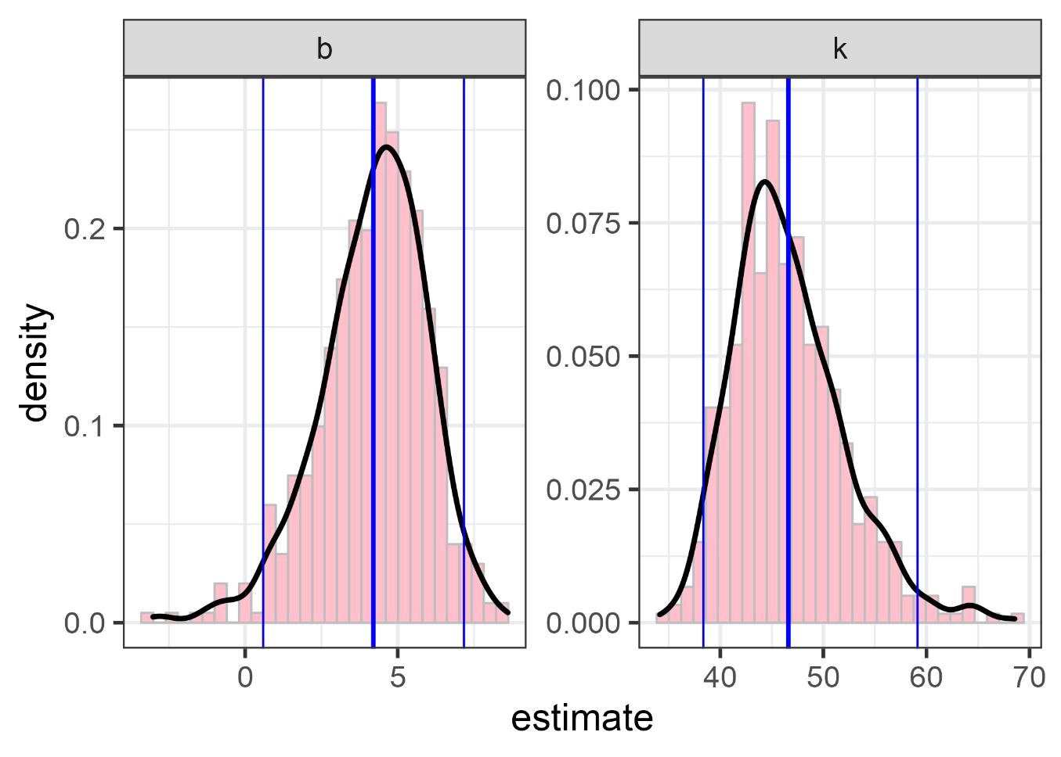
Bootstrapped distributions
ggplot(boot_coefs, aes(estimate)) +
geom_histogram(aes(y = ..density..),
bins = 30, fill="pink", color="gray") +
geom_density(size = 1.2) +
facet_wrap( ~ term, scales = "free") + …
Plots of bootstrapped coefficients show their shape
-- not quite normal as assumed by std theory

Slide 23
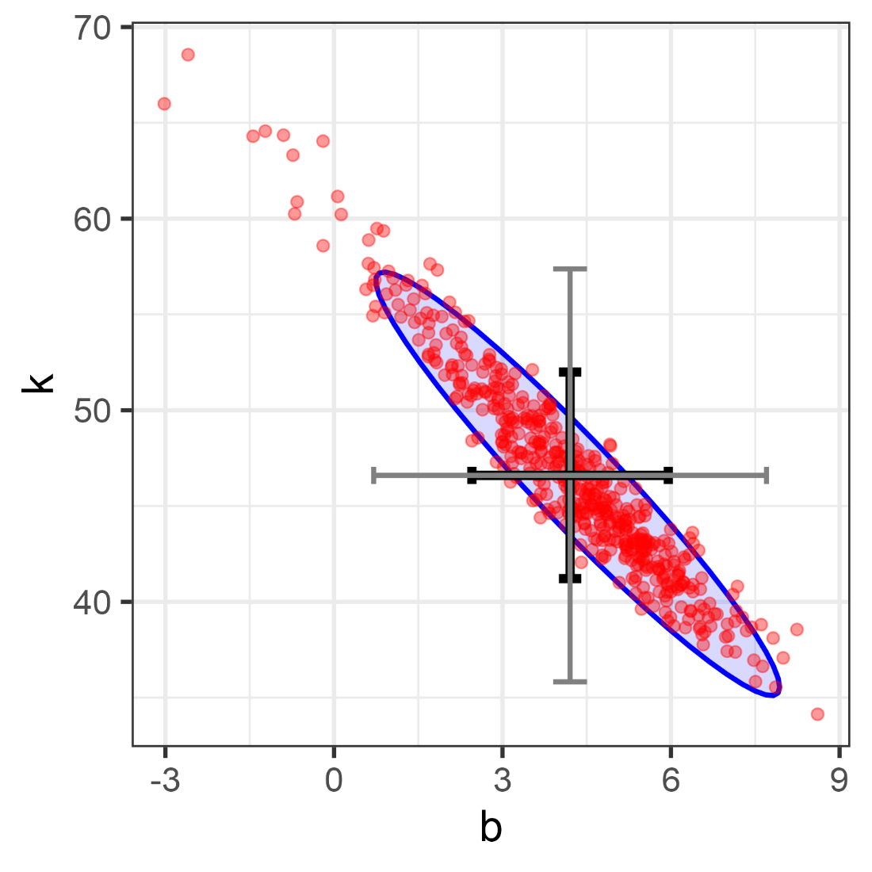
Scatterplot of coefficients
Finally, a fancy scatterplot of the joint distribution of the (b, k) estimates
How did I do this?
Processing:
spread coefs -> wide to plot k ~ b
find means , se of b & k
Plotting:
ellipse: stat_ellipse()
geom_point() – after ellipse!
geom_errorbar(): se * (1, 2)

Slide 24
# 1. pivot wider
boot_coefs_wide <- boot_coefs %>%
select(id, term, estimate) %>%
tidyr::pivot_wider(
names_from = term,
values_from = estimate)
> boot_coefs_wide
# A tibble: 500 x 3
id k b
<chr> <dbl> <dbl>
1 Bootstrap001 47.1 3.60
2 Bootstrap002 50.0 3.29
3 Bootstrap003 42.0 5.89
4 Bootstrap004 56.7 1.49
5 Bootstrap005 48.6 3.01
6 Bootstrap006 42.7 4.46
7 Bootstrap007 49.1 3.56
8 Bootstrap008 49.6 3.19
9 Bootstrap009 51.8 2.66
10 Bootstrap010 54.0 1.94
# ... with 490 more rows
# 2. find means , se of b & k
mean_se <- boot_coefs_wide %>%
summarise(
sk = sd(k), sb = sd(b),
k = mean(k), b = mean(b))
> mean_se, digits=4
sk sb k b
1 5.511 1.737 46.37 4.204

Slide 25
boot_coefs_wide %>%
ggplot(aes(b, k)) +
stat_ellipse(level = .95,
geom = "polygon", alpha = 0.15,
fill = "blue", color = "blue") +
geom_point(color = "red", size=2, alpha=0.4) +
◆
❖
Error bars
geom_errorbar(data = mean_se,
aes(ymin = k - sk,
ymax = k + sk, x = b), size=2) +
geom_errorbarh(data = mean_se,
aes(xmin = b - sb,
xmax = b + sb, y = k), size=2) +
⬥
Redraw error bars at m ± 2 sd, but thinner


Slide 26
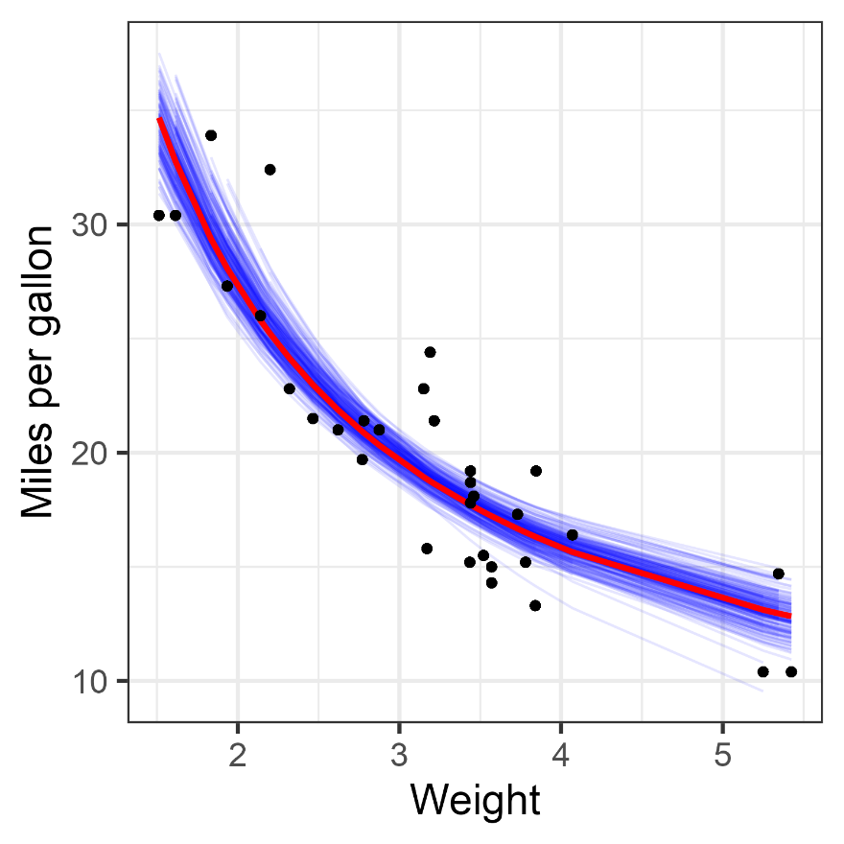
Visualize the fitted curves
boot_aug <-
boot_models %>%
sample_n(200) %>%
mutate(augmented =
map(model, augment)) %>%
unnest(augmented)
Use augment() to visualize the uncertainty in the fitted curve
Use sample_n() to plot only 200
ggplot(boot_aug, aes(wt, mpg)) +
geom_line(aes(y = .fitted, group = id),
alpha = 0.1) +
geom_line(data=mtcars,
aes(x = wt, y = predict(nlsfit)), color=“red”) +
geom_point() +
labs(x = "Weight", y = "Miles per gallon")

