Slide 1
ggplot2: the untold story
Jessica Newman and Danika Wagner

Slide 2
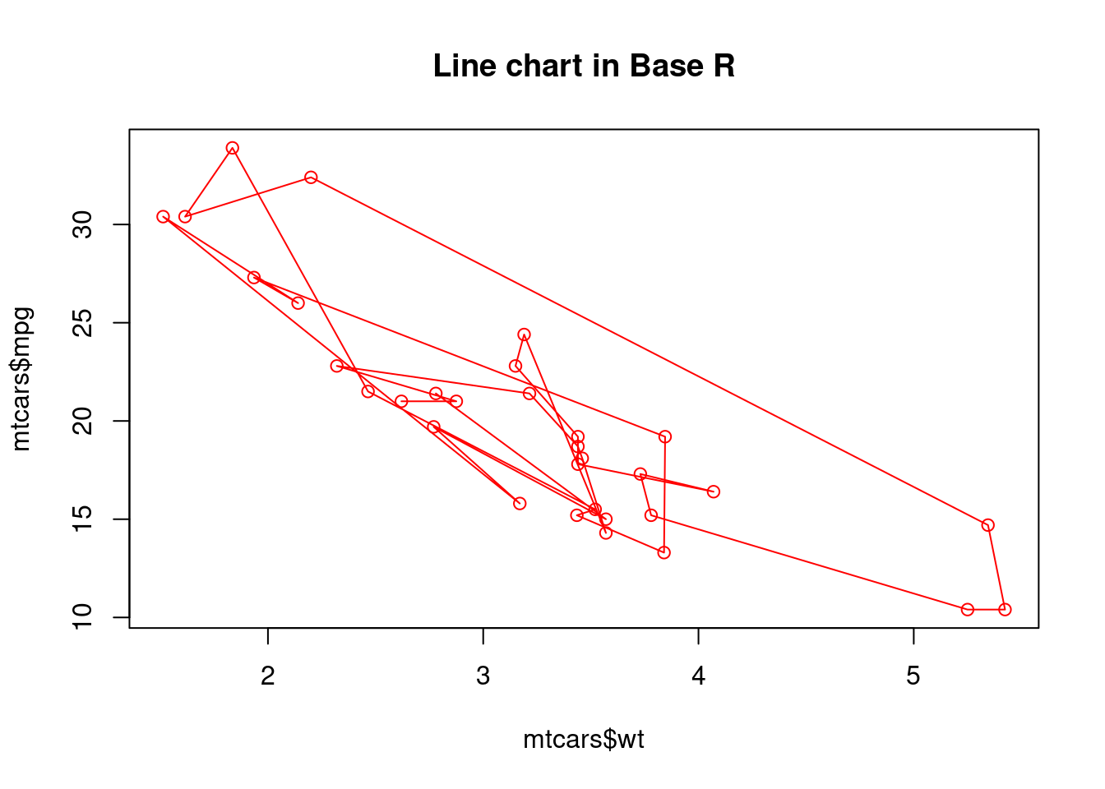
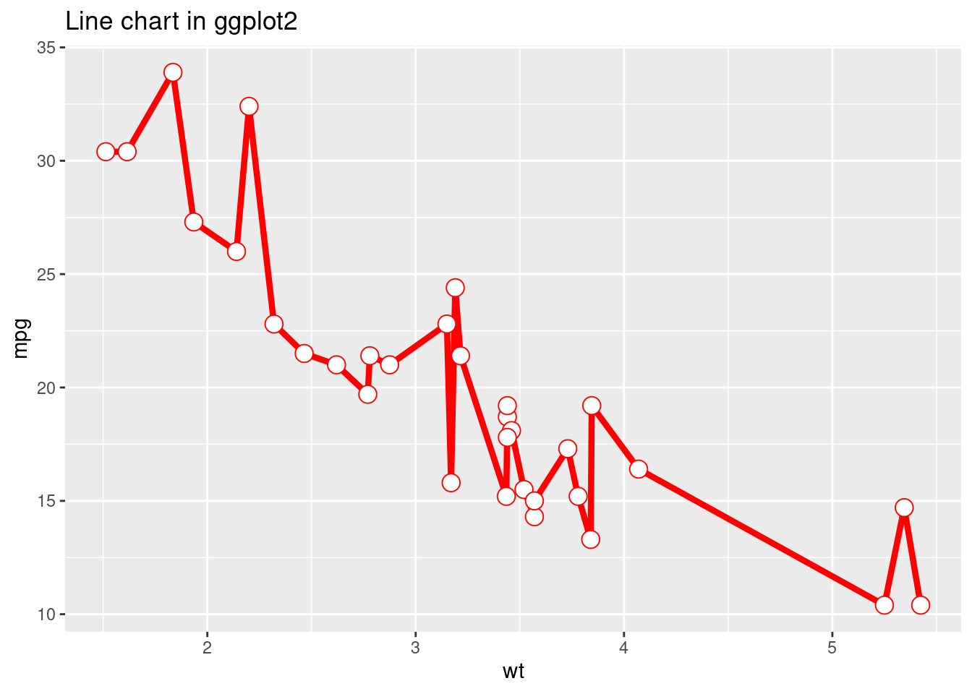
Base R plot vs ggplot2 plot
Li & Fa, n.d.

Slide 3
Strengths and Limitations
Must superimpose graphs to add new visuals
Grids
Code
Li & Fa, n.d.

Slide 4
Who is Hadley Wickham?
Born in New Zealand
Family interest in statistics
Father and sister have doctorates in statistics (Pricenomics, 2015)
Father inspired interest in databases (Wickham, 2023)
First job at 15
Developing Microsoft Access Databases
Undergraduate at University of Auckland
Birthplace of R
PhD in statistics from Iowa State University (2004-2008)
Began developing R packages there
Priceonomics, 2015; Wickham, 2022, 2023

Slide 5
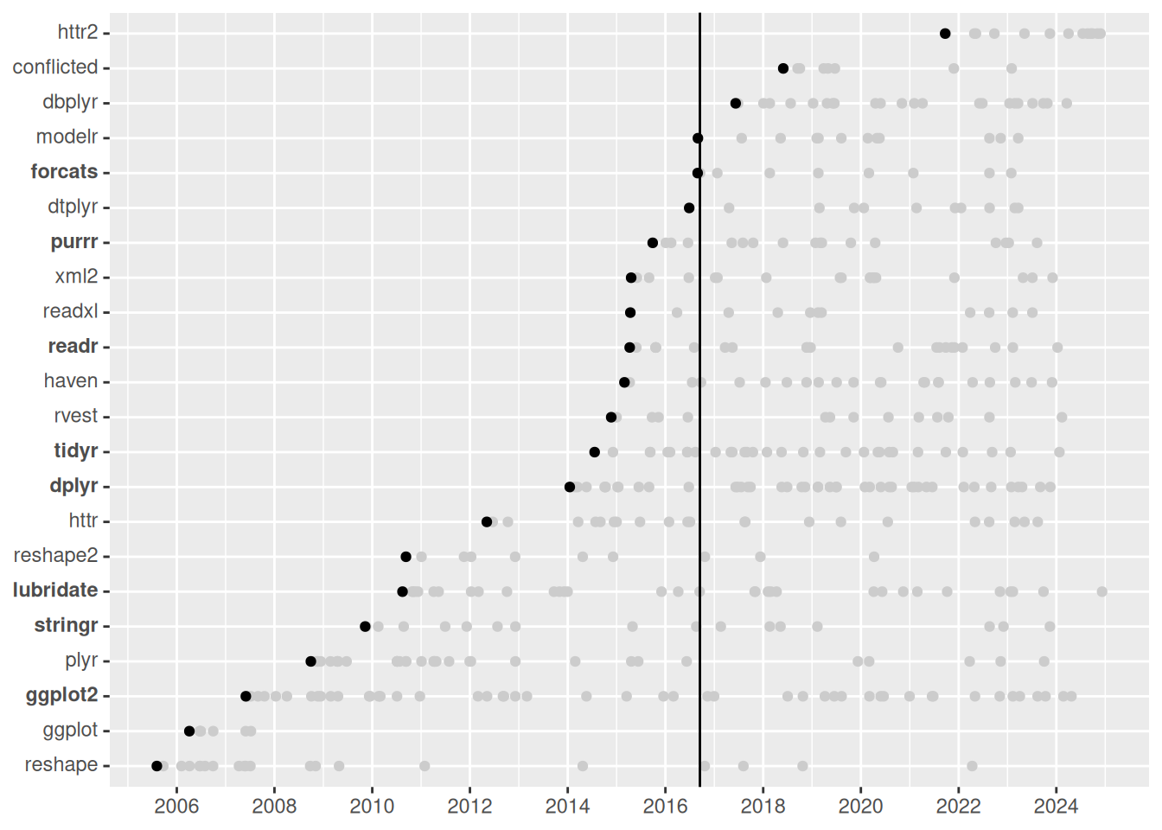
Packages Created by Wickham
Wickham, 2022

Slide 6
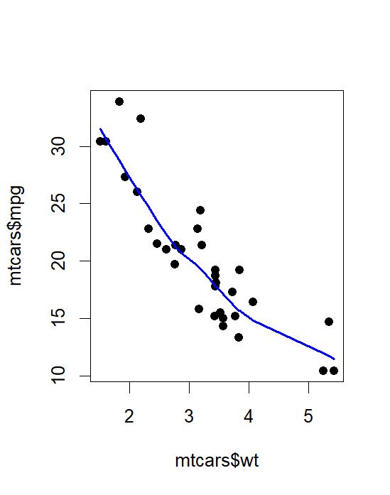
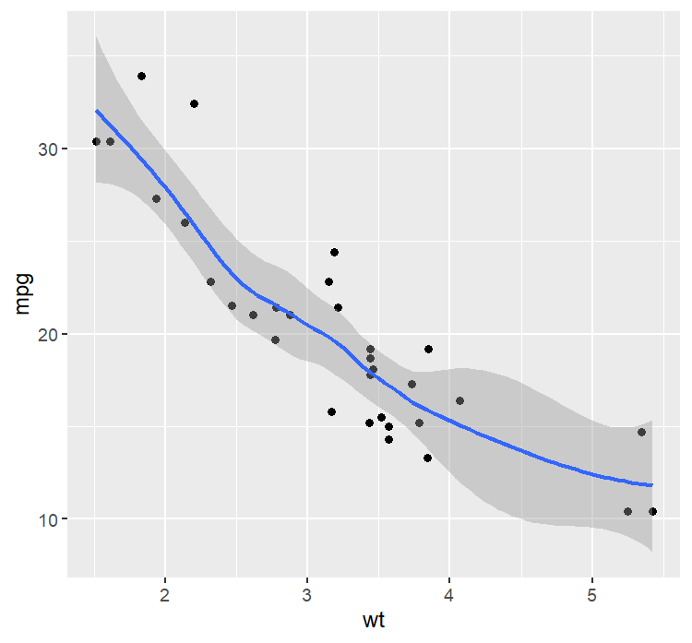
Base R and ggplot Code
Base R:
plot(mtcars$wt, mtcars$mpg, pch=19)
lines(lowess(mtcars$wt, mtcars$mpg), col="blue", lwd=2)
ggplot:
geom_smooth(geom_point(ggplot(mtcars, aes(wt, mpg))))
Li & Fa, n.d.

Slide 7
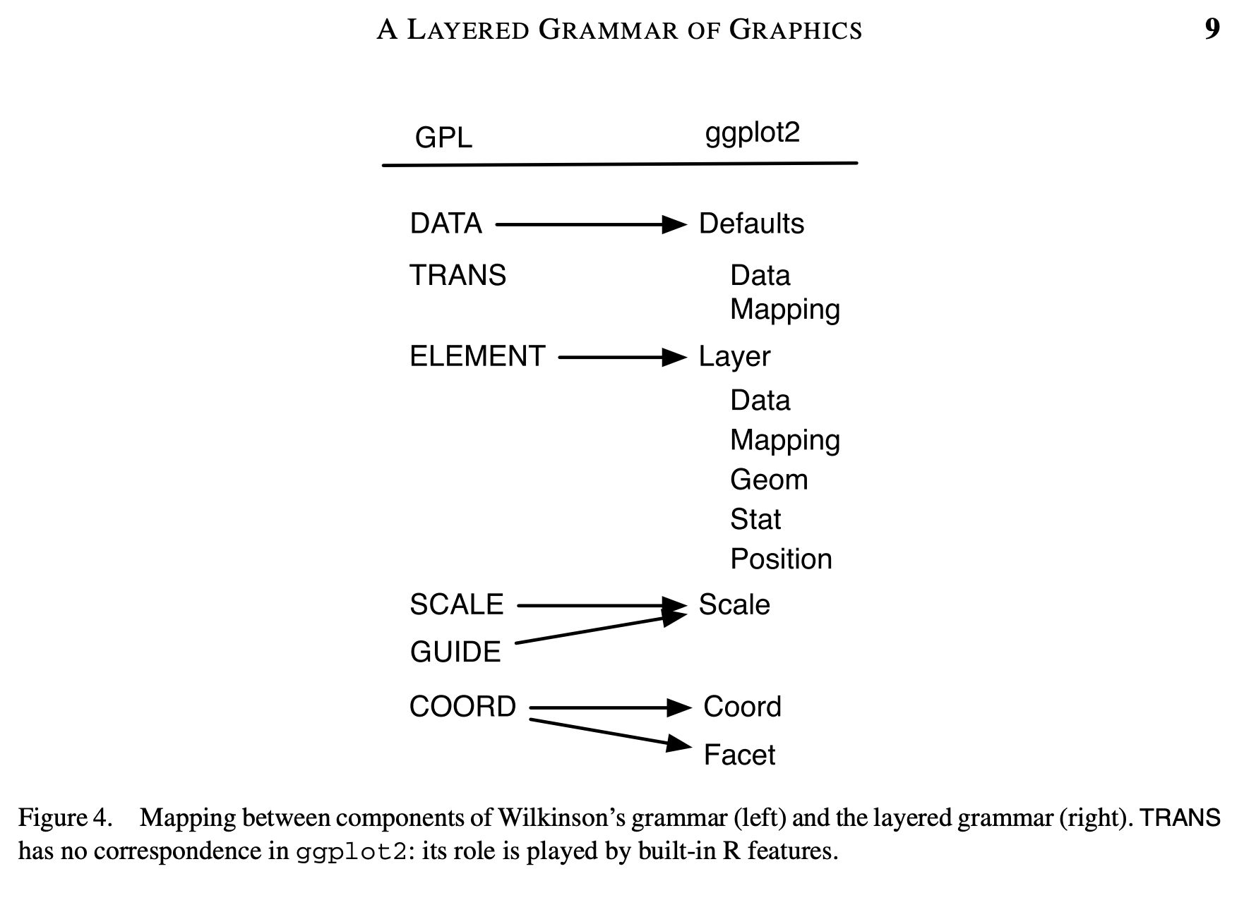
Developing ggplot
Wickham based ggplot on Wilkinson’s Grammar of Graphics (GoG)
This breaks down components that make up a plot
Wickham, 2010, 2022

Slide 8
Base R and ggplot Code
Base R:
plot(mtcars$wt, mtcars$mpg, pch=19)
lines(lowess(mtcars$wt, mtcars$mpg), col="blue", lwd=2)
ggplot:
geom_smooth(geom_point(ggplot(mtcars, aes(wt, mpg))))
Li & Fa, n.d.

Slide 9
Developing ggplot2
Wickham based ggplot2 on Grammar of Graphics (GoG) and was inspired by fluent interface
Fluent interface = application programming interface that relies extensively on method chaining to increase code legibility
Wickham, 2022

Slide 10
Base R and ggplot Code VS ggplot2 Code
Base R:
plot(mtcars$wt, mtcars$mpg, pch=19)
lines(lowess(mtcars$wt, mtcars$mpg), col="blue", lwd=2)
ggplot:
geom_smooth(geom_point(ggplot(mtcars, aes(wt, mpg))))
ggplot2: ggplot(mtcars, aes(wt, mpg)) + geom_point() + geom_smooth()
Li & Fa, n.d.

Slide 11
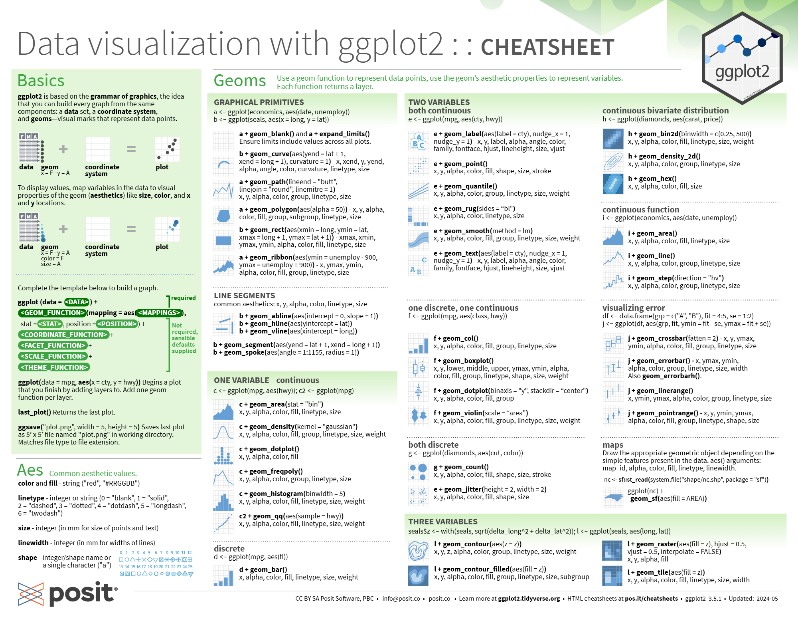
ggplot2 Basics Cheat Sheet
RStudio. (n.d.)

Slide 12
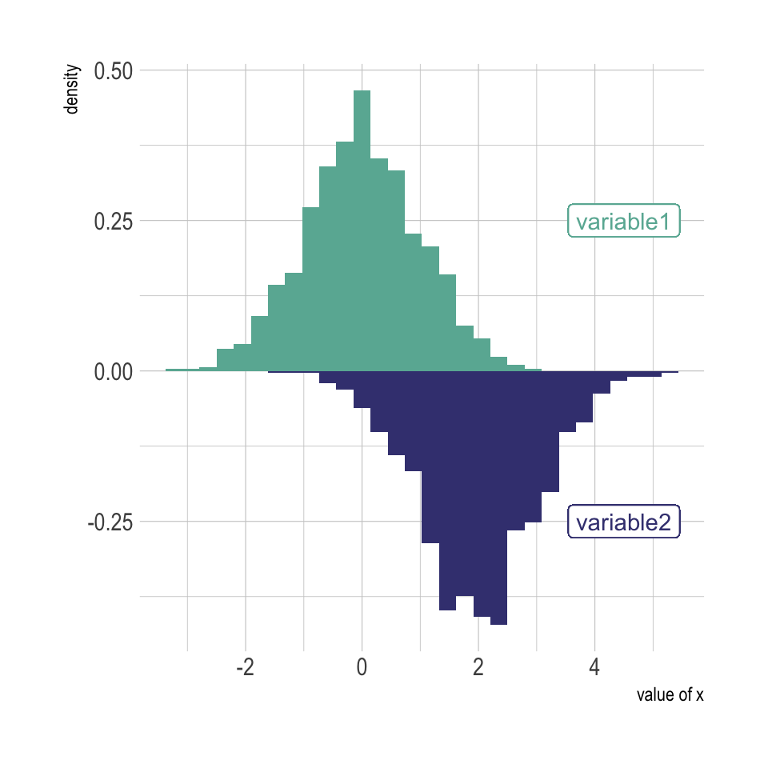
ggplot2 Basics Cheat Sheet

Slide 13
RStudio. (n.d.)

Slide 14
ggplot2 Code:
ggplot(data, aes(x=x) )
RStudio. (n.d.)

Slide 15
RStudio. (n.d.)

Slide 16
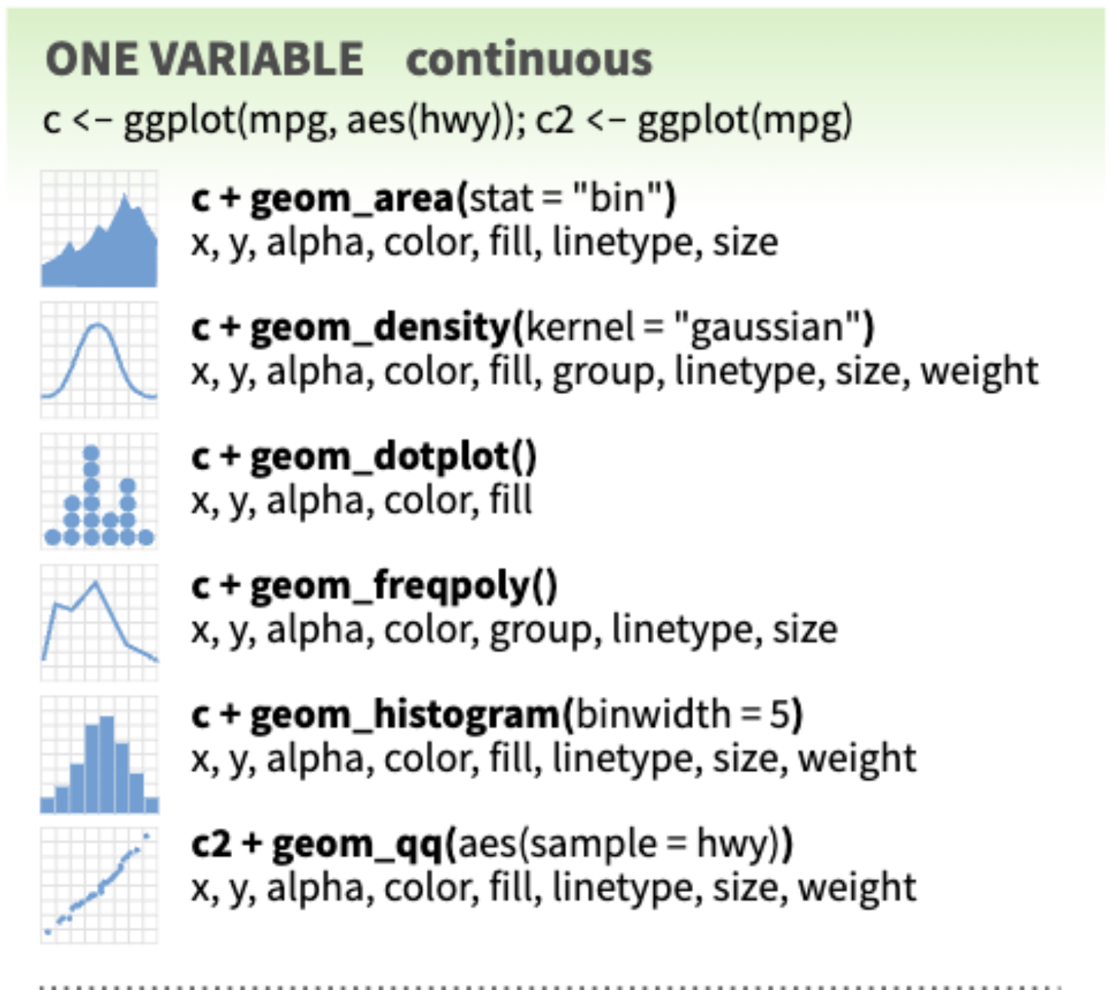
ggplot2 Code:
ggplot(data, aes(x=x) ) + geom_histogram( )
RStudio. (n.d.)

Slide 17
RStudio. (n.d.)

Slide 18
ggplot2 Code:
ggplot(data, aes(x=x) ) + geom_histogram( aes(x = var1, y = ..density..), fill="#69b3a2")+
RStudio. (n.d.)

Slide 19
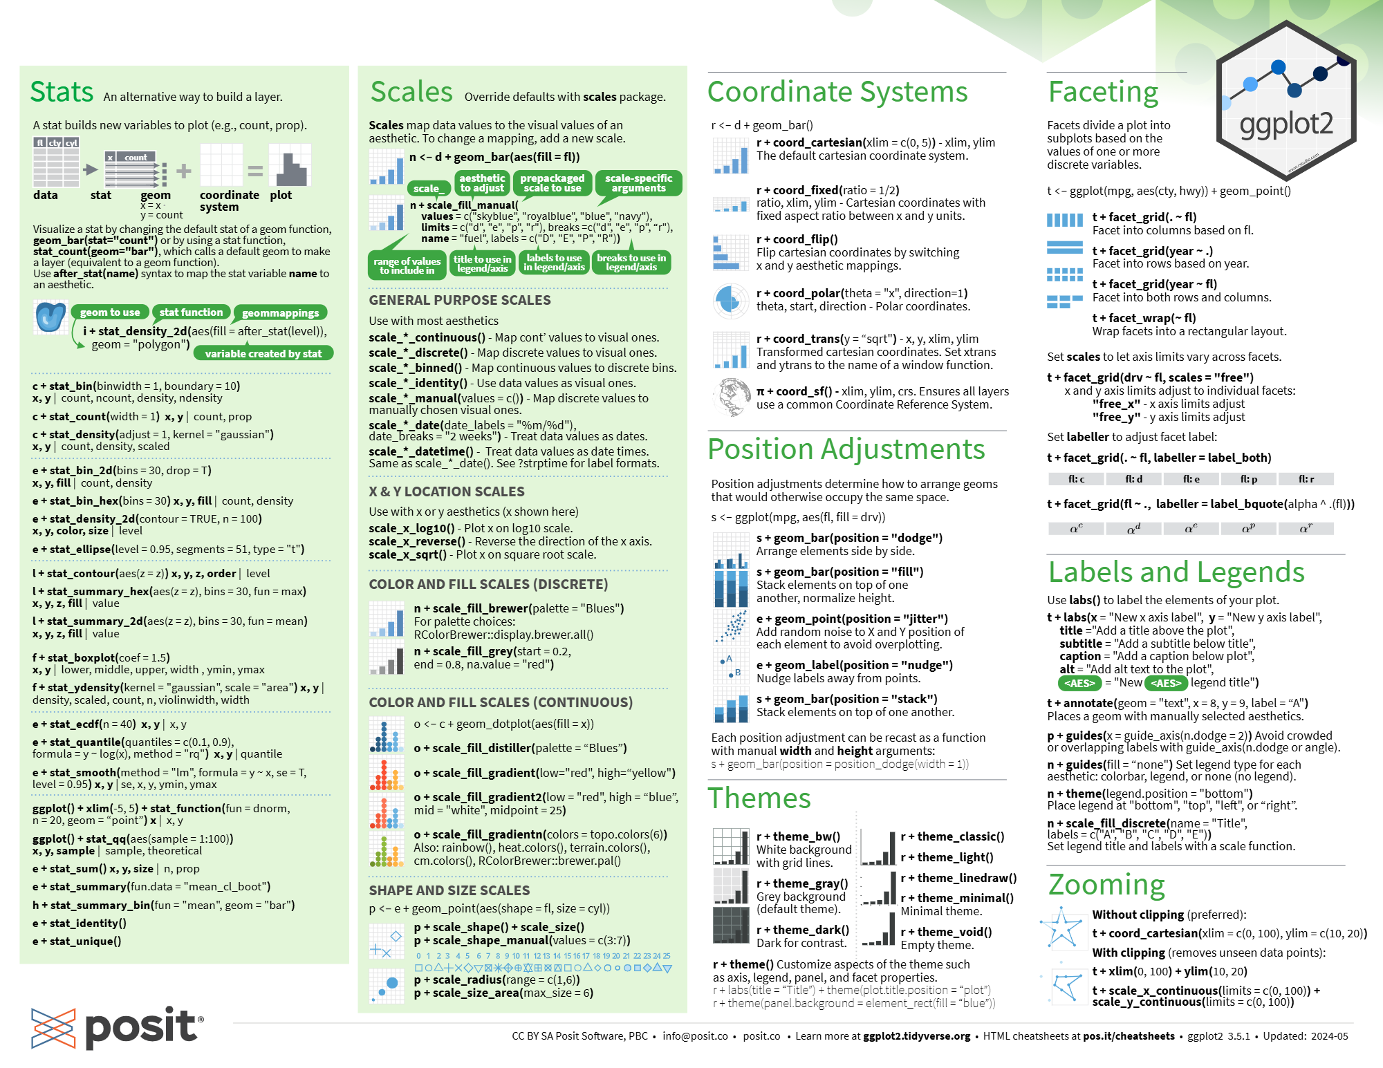
RStudio. (n.d.)

Slide 20
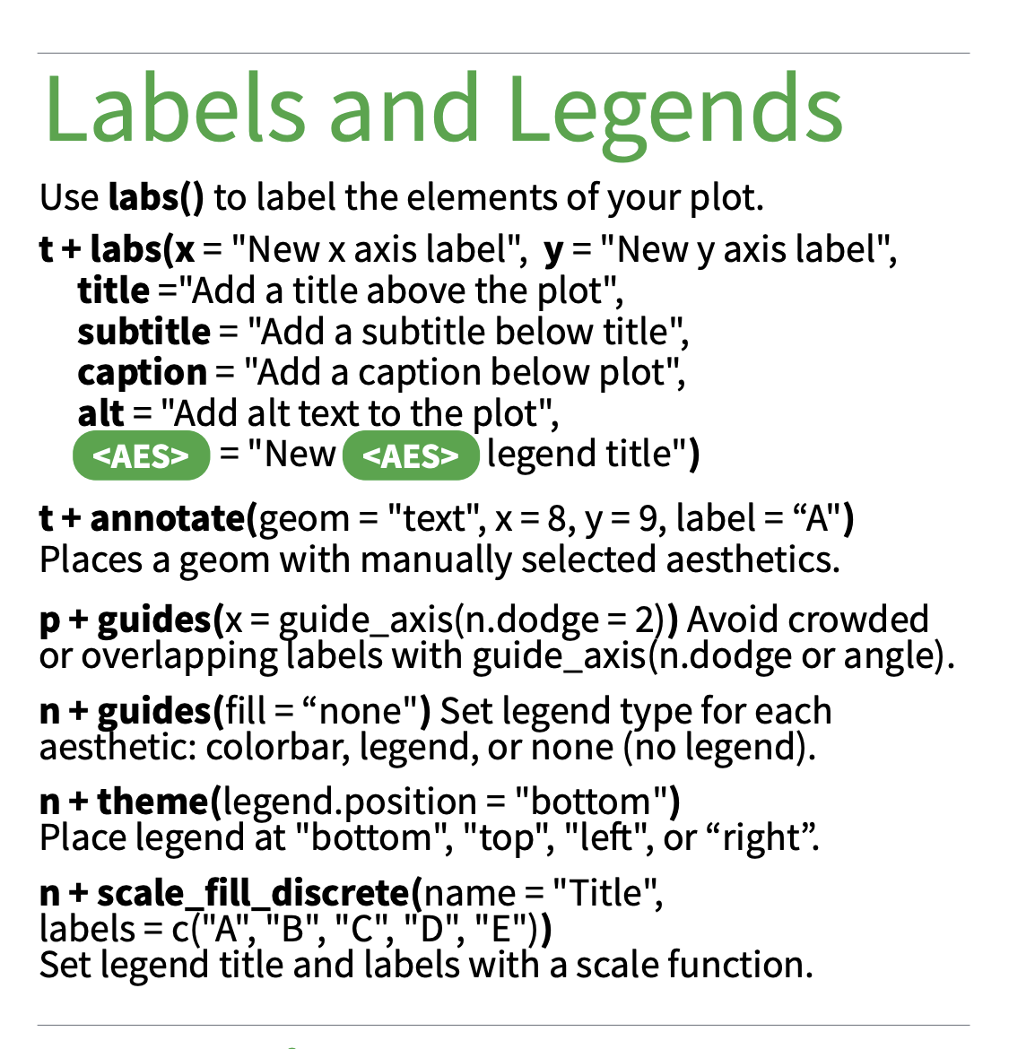
ggplot2 Code:
ggplot(data, aes(x=x) ) + geom_histogram( aes(x = var1, y = ..density..), fill="#69b3a2")+ geom_label( aes(x=4.5,y=0.25, label="variable1"), color="#69b3a2") + xlab("value of x")
RStudio. (n.d.)

Slide 21
RStudio. (n.d.)

Slide 22
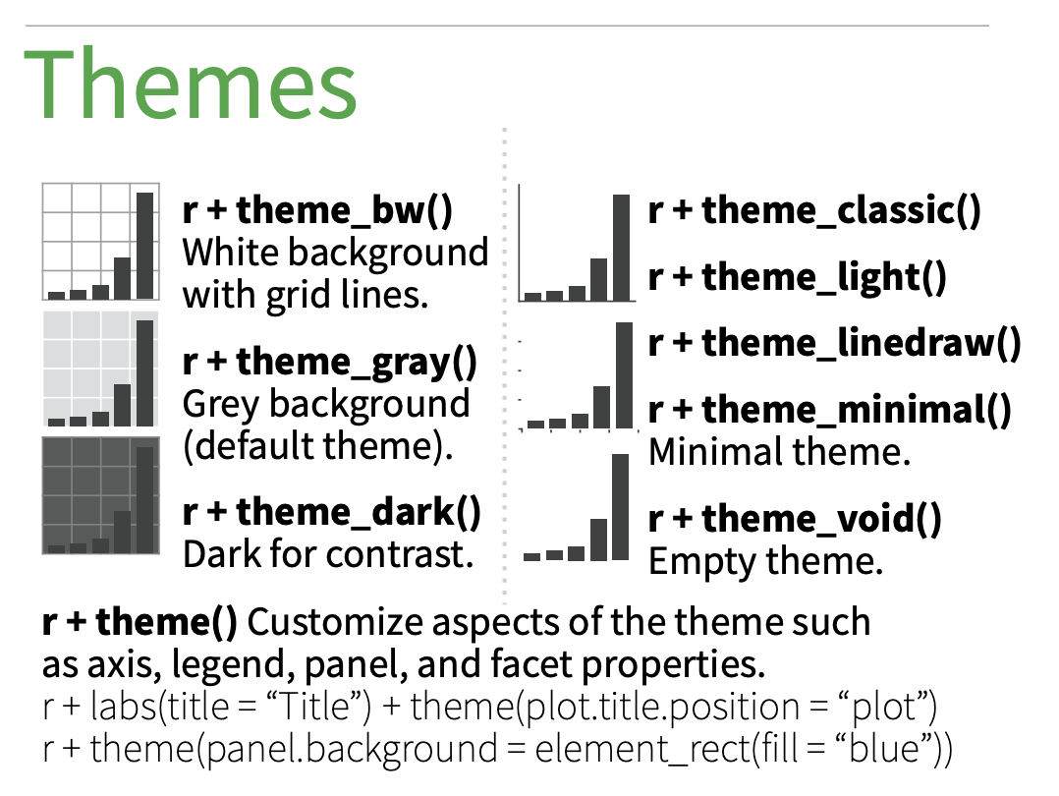
ggplot2 Code:
ggplot(data, aes(x=x) ) + geom_histogram( aes(x = var1, y = ..density..), fill="#69b3a2")+ geom_label( aes(x=4.5,y=0.25, label="variable1"), color="#69b3a2") + geom_histogram( aes(x = var2, y = -..density..), fill= "#404080") + geom_label( aes(x=4.5, y=-0.25, label="variable2"), color="#404080") + theme_ipsum() + xlab("value of x")
RStudio. (n.d.)

Slide 23
ggplot2 Plots
ggplot2 Code:
ggplot(data, aes(x=x) ) + geom_histogram( aes(x = var1, y = ..density..), fill="#69b3a2")+ geom_label( aes(x=4.5,y=0.25, label="variable1"), color="#69b3a2") + geom_histogram( aes(x = var2, y = -..density..), fill= "#404080") + geom_label( aes(x=4.5, y=-0.25, label="variable2"), color="#404080") + theme_ipsum() + xlab("value of x")
Holtz, Y. (n.d.).

Slide 24
Thank you for listening!
“Fundamentally learning about the world through data is really, really cool.”
~ Hadley Wickham, prolific R developer

Slide 25
References
Douglas, A., Roos, D., Mancini, F., Couto, A., & Lusseau, D. (2014). An Introduction to R. https://intro2r.com/Rbook.pdf
Holtz, Y. (n.d.). Mirrored histogram in base R. – the R Graph Gallery. https://r-graph-gallery.com/190-mirrored-histogram.html
Holtz, Y. (n.d.). Mirrored density chart with ggplot2. – the R Graph Gallery. https://r-graph-gallery.com/density_mirror_ggplot2.html
Li, Y., & Fan, Z. (n.d.) 107 Base r vs. ggplot2 visualization. https://jtr13.github.io/cc21fall2/base-r-vs.-ggplot2-visualization.html#:~:text=The%20looking%20of%20the%20graphs,the%20scale%20more%20straight%2Dforward.
Priceonomics. (2015, July 24). Hadley Wickham, the Man Who Revolutionized R. https://priceonomics.com/hadley-wickham-the-man-who-revolutionized-r/
RStudio. (n.d.). Data visualization with ggplot2 [PDF]. RStudio. https://github.com/rstudio/cheatsheets/blob/main/data-visualization.pdf
Wickham, H. (2010). A Layered Grammar of Graphics. Journal of Computational and Graphical Statistics, 19(1), 3-28. https://doi.org/10.1198/jcgs.2009.07098
Wickham, H. (2022, May 2). A brief history of the tidyverse. Hadley Wickham. https://hadley.github.io/25-tidyverse-history/#whats-next Wickham, H. (2023, September 29). My dad, Brian Wickham. Tidy Design. https://tidydesign.substack.com/p/my-dad-brian-wickham

