Slide 1

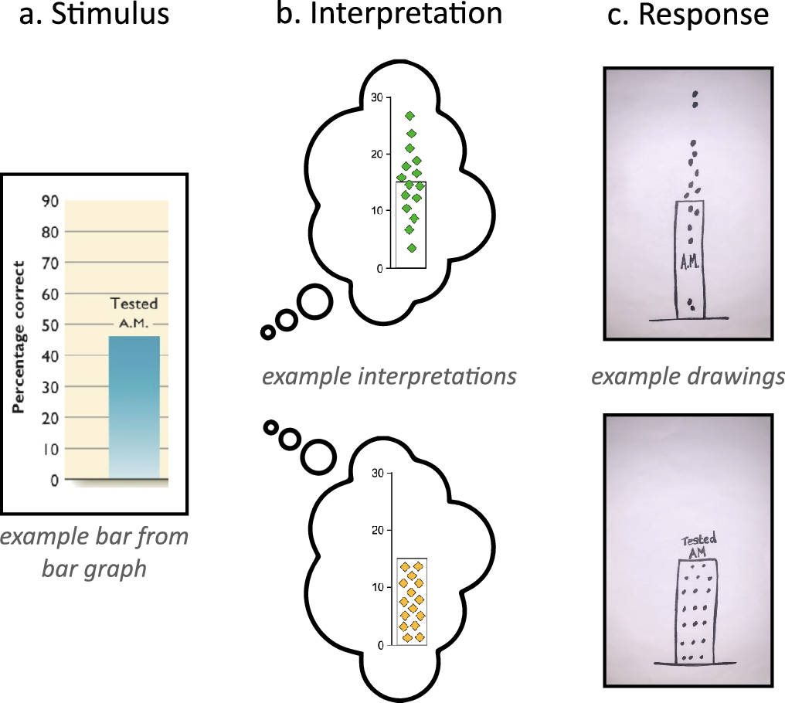
From: Two graphs walk into a bar: Readout-based measurement reveals the Bar-Tip Limit error, a common, categorical misinterpretation of mean bar graphs
Journal of Vision. 2021;21(12):17. doi:10.1167/jov.21.12.17
Figure Legend:
The Draw Datapoints on Graph (DDoG) measure maintains the graph as a consistent reference frame across its three stages. (a) Participants are presented with a graph stimulus that (b) produces a mental representation of the data; (c) this interpretation is recorded by sketching a version of the graph along with hypothesized locations of individual data values. Drawings are representative examples of the two common responses seen in pilot data collection: the correct Bar-Tip Mean response (top), and the incorrect Bar-Tip Limit (BTL) response (bottom).
Date of download: 12/2/2021
The Association for Research in Vision and Ophthalmology Copyright © 2021. All rights reserved.

