Slide 1

telling a story with data:
effective visualizations for business cases.
Jean-Marc Moke
Notes:
Hi guys,
I want to talk very generally about how one can tell a story with visuals in a business context.

Slide 2
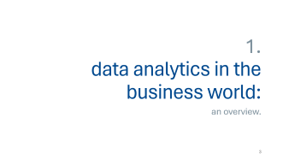




Outline:
Notes:
I’ll start with a general overview about what it means to do analysis for corporate institutions,
then go into how consultants tell good stories with visuals that inform decision-making.
I then want to emphasize the importance of the context as a preface to choosing effective visuals.
From there I will synthesize some recommendations that management researchers have given for choosing the most effective visuals
and then summarize the 6 basic rules at the end.

Slide 3
1. data analytics in the business world:
an overview.
Notes:
So, what does it mean to do analytics for business clients?

Slide 4
what are business analytics?
Businesses collect data for insights.
Techniques reveal trends and metrics.
Promise to increase system efficiency.
Example:
Manufacturing companies record runtime, downtime, and work queues,
analyze data to improve peak capacity of machines.
Notes:
Businesses collect all kinds of information that is then subjected
to data analytics techniques to get insight that can be used to improve things.
Data analytics techniques can reveal trends and metrics that would otherwise be lost in the mass of information.
This information can then be used to optimize processes to increase the overall efficiency of a business or system.
For example, manufacturing companies often record the runtime, downtime, and work queue for various machines
and then analyze the data to better plan workloads so the machines operate closer to peak capacity.

Slide 5
what are business analytics?
Analytics do more than improve bottlenecks
Businesses hire consultants to synthesize collected data.
In-house or from graduate programs.
In sum:
Data-driven approaches inform business decisions.
Good analysts ensure their story aligns with client needs.
Notes:
Data analytics can do much more than point out bottlenecks in production.
Gaming companies use data analytics to set reward schedules for players that keep the majority of players active in the game.
Content companies use many of the same data analytics to keep you clicking, watching, or re-organizing content to get another view or another click.
Every business hires consultants that can take care of the process of analytics and present them in ways that they can understand.
Sometimes these consultants are in-house analysts, sometimes they come to Schulich to ask a person like me to help them find ways to improve their company diversity programs.
So in essence, businesses use data-driven approaches to inform company programs and management practices,
ensuring that their products stay attractive and that they retain the best talent for their business purposes.
So if you want to be a good business analyst and keep getting paid for your consultation services,
you have to make sure that your message tells a story that aligns with what your client of choice actually needs

Slide 6
2. showing vs. story-telling:
telling business stories with visuals.
Notes:
But how do we tell a good story about the data we’ve collected with visuals?

Slide 7
Analysts were asked to answer the prompt:
“When I’m asked to show the data, I feel…”
“Frustrated because I don’t think I’ll be able to tell the whole story.”
“Inadequate. Boss: Can you drill down into that? Give me the split by x, y, and z.”
We aren’t naturally good at telling stories with data…
(Knaflic, 2015)
Notes:
To start with a situating example:
A researcher conducted a LinkedIn poll asking business analysts what they feel when their boss asks them
to show them the data they collected about whatever it is they were hired to find out:
Some of the responses were definitely interesting. Here we can see that one of the respondents answered:
"Frustrated because I don’t think I’ll be able to tell the whole story.
"Inadequate. Boss: Can you drill down into that? Give me the split by x, y, and z."
(Nussbaumer Knaflic, 2015)
Being able to tell a story with data is a very important skill in all contexts,
but in the business world, you live and die by the story you can tell with the data you have.
As academics, we are well-versed in quantitative techniques such as finding the data, pulling it together, analyzing it, building models.
But we're not always so good at telling effective stories with the data we have.
This can become very problematic, especially when this is usually the most important part in your
communications with any company that wants to hire you to show them what to do next.
They don't usually care about how well you ran your analysis,
or how significant the difference for one group was compared to another.

Slide 8
Showing vs. Story-telling
6 keys for visual storytelling in business:
Understand the context.
Choose an appropriate visual display.
Eliminate clutter.
Focus attention on the important.
Think like a designer.
Tell the story!
Notes:
So how do we tell a story to decision makers?
There are 6 basic rules-of-thumb that are generally recommended when you want to create a visual report for a business case:
Understand the context: you need to know who your audience is and what they need you to do then you can
Choose an appropriate visual: that can help you communicate your message in a business setting.
It is important to eliminate clutter: as this can increase the cognitive load of your clients.
Business decision-makers lose interest in visuals that are too busy.
You don’t want your clients to lose interest in your message.
Another way to sell the importance of your story is to Focus their attention on the important:
as this can help drive the message home before you even speak on your core idea
Thinking like a designer: really just emphasizes the idea that form follows function.
When it comes to the form and function of our data visualizations,
we first want to think about what it is we want our audience to be able to do with the data (function)
and create a visualization (form) that will allow for this with ease.
In all of this, remember to Tell a story.
To tell a clear story, your visuals have to fit into the message you are trying to sell.
In a few slides I'll try to show you how you can synthesize these elements in the visuals you choose to tell your story.

Slide 9
3. the importance of context:
who, what, and how.
Notes:
Before I go into the visuals though, I want to emphasize the importance of context.
We've had many conversations in class about the difference between an academic and the lay audience. I know I've mentioned a few times that sometimes flashy is good, but there are caveats to that idea.
Before you go ahead making a flashy graph for your business clients, you need to have answered the who what and how question.

Slide 10
the who, what, and how
Consider this example:
Who:
The budget committee that can approve funding for continuation of the summer learning program.
What:
The summer learning program on science was a success; please approve budget of $X to continue.
How:
Illustrate success with data collected through the survey conducted before and after the pilot program.
Notes:
You want to start with the who by identifying your audience and
imagining how the story you want to tell can change
depending on who can make what decision.
After addressing the who,
the what becomes easier to identify and articulate
because now you know what your potential audience
might want to hear.
After identifying who our audience is and what they want to know,
you can start to think about the data you have
that will act as evidence of the story you want to tell.
Consider this example:
if our who is a budget committee that can approve funding for a summer program
what we want to show them is that the program was a success
so that they can approve your required budget
finally, we want to know how we can show the success of the program
with data we collected before and after a pilot for example
Now that you've identified the who what and how
you want to choose a visual that can help you tell that story,
but there are a few extra questions you want to answer
before you know which visual to choose...

Slide 11
the who, what, and how
Questions that need answers:
What background information is relevant or essential?
Who is the decision maker?
What bias do they have?
What data would strengthen our case?
Where are the risks factors?
What would a successful outcome look like?
If you only had limited time, what would you say?
Notes:
You want to ask:
What background information is relevant or essential for you to tell your story?
Who is the decision-maker and what do we know about them?
What biases do they have that might make them supportive of or resistant to our message?
What data can we use to strengthen our case? And is our audience familiar with this data, or is it new?
Where are the risks: what factors could weaken our case, and do we need to proactively address them?
What would a successful outcome look like?
Finally, you want to ask:
If you only had a limited amount of time or a single sentence to tell your audience what they need to know, what would you say?

Slide 12
4. choosing effective visuals
general recommendations for visual storytelling.
Notes:
Once you’ve answered these questions for yourself,
you can now go ahead and decide which visual you want to use
to help you tell a good story

Slide 13
outline
Recommended Visuals:
Simple Text
Scatterplots
Line Graphs
Bar Graphs
Graphs you avoid at all costs.
Notes:
Management researchers recommend using
simple text
scatterplots
line charts
and bar charts
there are also some recommendations about which graphs not to use,
but I just want to touch on two of the most popular ones for our purposes.

Slide 14
Simple Text
Job Satisfaction in the U.S.
% of American employees who reported satisfaction across 26 job components.
Figure 1
Job Satisfaction original graph
62%
43%
Note. The 26 components were separated into compensation and non-compensation factors.
Source: Job Satisfaction 2023, THE CONFERENCE BOARD Consumer Confidence Survey, Nov. 2022
Notes:
When you want to tell a story about a simple comparison,
simply using text can be a very effective technique.
As an illustration,
this graph is adapted from data that was published by The Conference Board dot Org
in 2023 showing how job satisfaction has changed since the 2008 recession:
Here you can see that more employees were satisfied with their jobs in 2022 than in 2010,
but this graph requires your audience to do a lot of reading that is frankly unnecessary.
Just because you have numbers to show,
does not mean that you need to draw a graph to present that information.
So how can we fix this visual?

Slide 15
Simple Text
62%
of American employees
feel satisfied with their job
in 2022, compared to 43% in 2010
Figure 2
Job Satisfaction simple text makeover
Notes:
Using simple text, you can focus attention on the most important point of the story we want to tell about job satisfaction.
That is, that more 62% of employees in the US feel more satisfied with their jobs in 2022 compared to in 2010 right after the recession.
As you can see, this is a much easier easier way to pull your audiences attention towards the difference
Using large test and bold contrasts makes your story easier to tell.
An important point to note is that this type of information can be presented in many different ways,
so be careful not to mislead your audience with your visual.
With all that said, if you do have more data to show, a graph would generally be more appropriate.

Slide 16
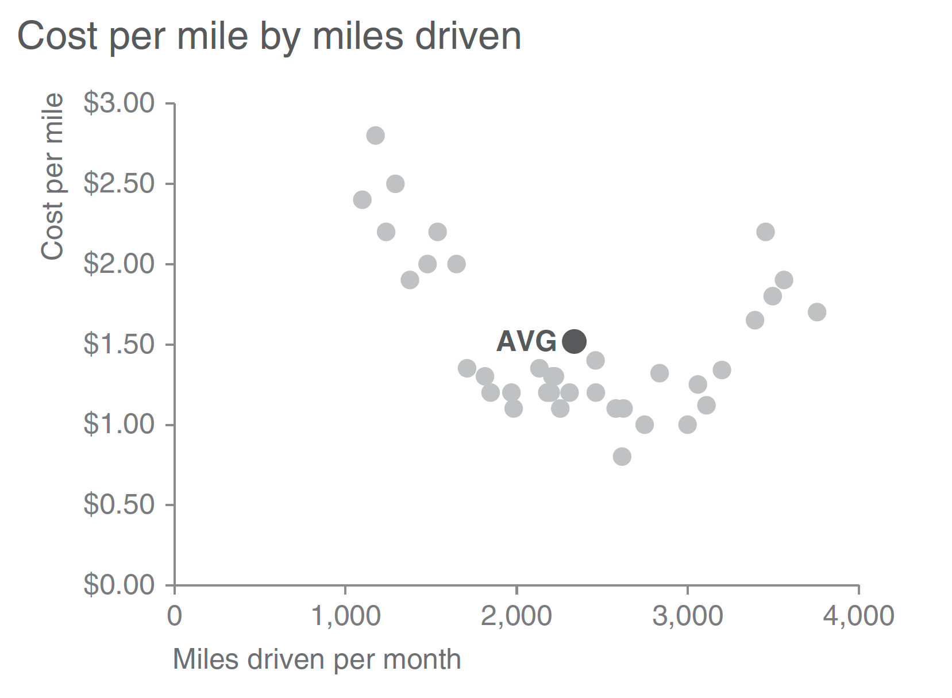
Scatterplots
Figure 3
Scatterplot: Basic
Notes:
You could use a scatter plot:
As we know, scatterplots can be useful for showing relationships between two things,
because they allow you to encode data at the same time on a horizontal x‐axis and vertical y‐axis to see if and what relationships exists.
Because they tend to be used more in scientific fields, they are often seen as more complicated.
That said, there are good use cases for scatterplots in the business world too.
For example, let’s say that we manage a bus fleet and want to understand the relationship between miles driven and cost per mile.
The scatterplot may look something like this:
But remember, you want to tell a story and pull your audience's attention
So you can use a color scheme to focus on those cases where cost per mile is above average,

Slide 17
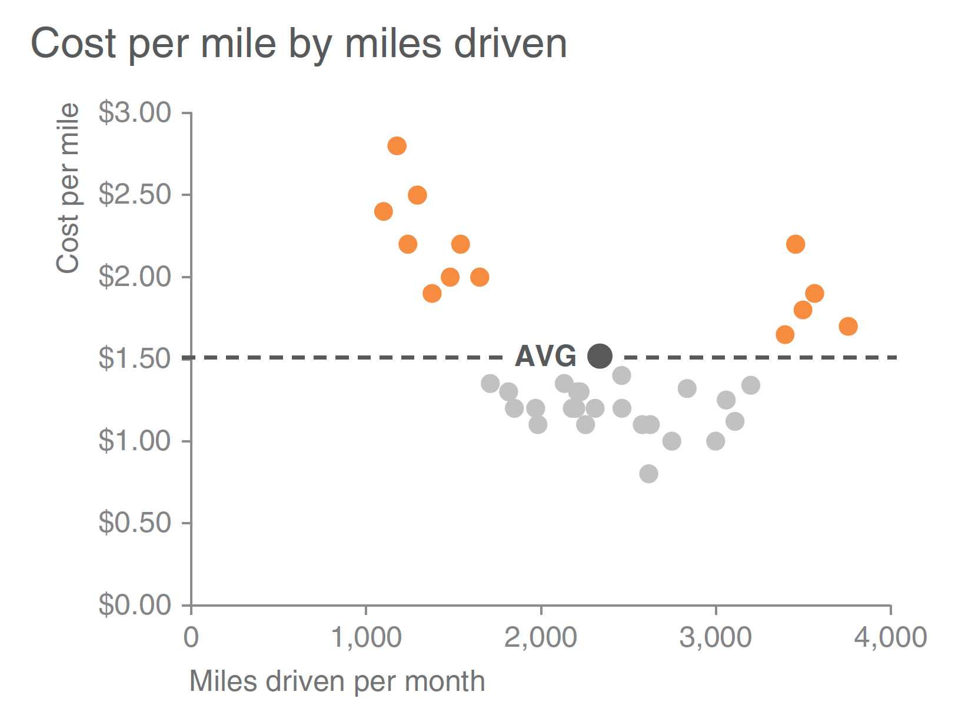
Scatterplots
Figure 4
Scatterplot: Focused
Notes:
a slightly modified scatterplot designed to draw the eye to that story quicker might look something like this:
Remember to declutter your scatterplot.
You don't want too much information such as texts on your dots or grid lines in the background.
Another thing is that your choice of colors and point types also plays an important role in the story you want to tell,
so make sure to choose these elements with those key insights in mind.

Slide 18
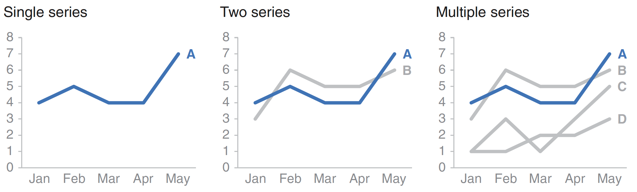
Line Graphs
Figure 5
Time Series Examples
Notes:
Line graphs are also a good option.
There are two types of line graphs you can use: time series or slope graphs.
Time series lines graphs can show either one series or multiple series for comparison.
(graph)
The important point to remember with line graphs is that you need to keep the intervals between your x-axis units consistent.
Removing the consistency alerts your audience that you are trying to be misleading,
and we don't want the client company walking away from whatever we are trying to propose because they didn't trust the data in our graphs.

Slide 19
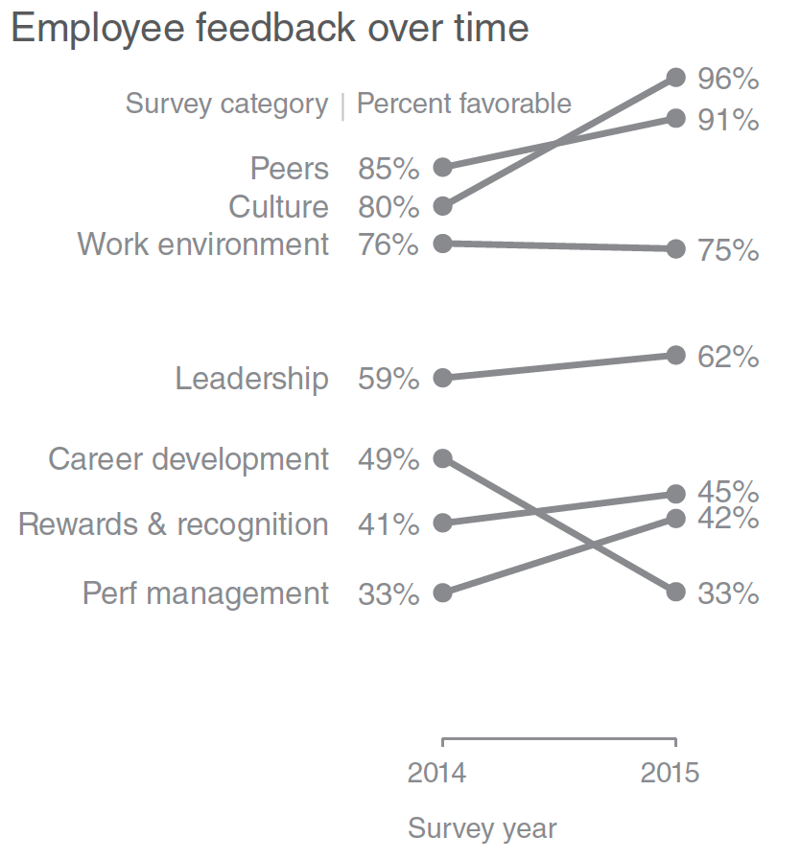
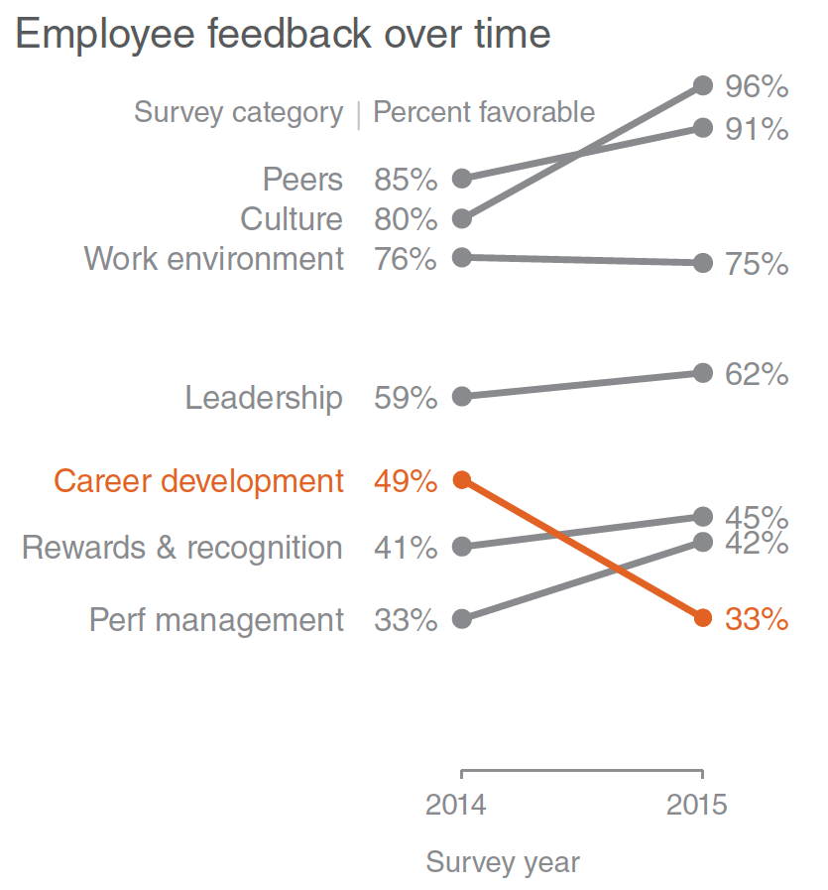
Line Graphs
Figure 5
Left: Simple Slope graph
Right: Focused Slope graph
2022
2023
2022
2023
Notes:
Slope graphs can be useful when you have two or more time points of comparisons
and you want to quickly show relative increases and decreases
or differences across various categories between the two data points.
Imagine that you are analyzing and communicating data from a recent employee feedback survey.
To show the relative change in survey categories from 2022 to 2023,
your slope graph might look something like this:
Slope graphs give a lot of information in that they show increase and decrease by
connecting two values with different lines showing the direction of the change.
Depending on the context, a slope graph may not always be the best option,
but in some cases, you may want to use them
to emphasize an important aspect of the changes.
For example, we can draw attention to the change in career development satisfaction
in the employee feedback survey.
As you can see in the focused graph,
your attention is drawn immediately to the decrease in
“Career development,”
while the rest of the data is preserved for context without competing for attention.

Slide 20
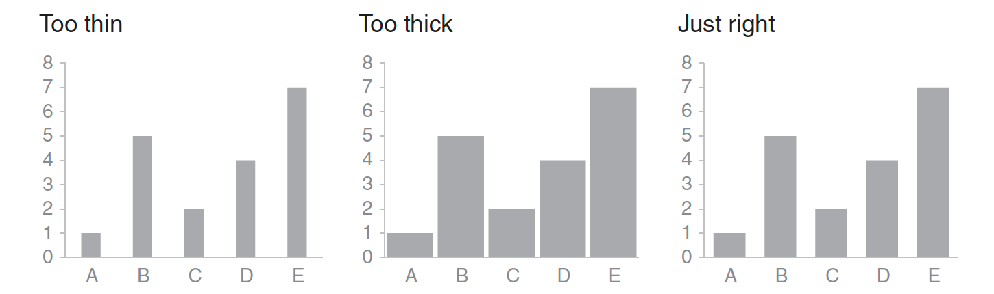
Bar Graphs
Figure 6
Basic
Bar Graph
Recommendations
Too thin
Too thick
Just right
Notes:
We can also use bar graphs
These charts tend to be the go-to visual for consultants who want to show differences between categories.
They also tend to be avoided because they're so common.
Instead, I believe bar charts should be used more because they are so common
because then they're easier to do since we already know how to create them.
The same rules apply here as they do for the previous graphs.
You want to make sure your audience can see your story
so you need to make sure your colors and choice of bar size height width and spacing tell that story.
Another point to consider is to make sure the relative order of your categories are crystal clear.
If your bar chart has too many bars or too many points are clustered together,
it becomes more difficult to focus on one at a time and pull out insight,
so use multiple series bar charts with caution.
I could spend forever and a day talking about the things to avoid when drawing up a bar chart for the business case,
but the important takeaway I want to leave you with here is that
simple but impactful is always better than complex and too complicated.

Slide 21
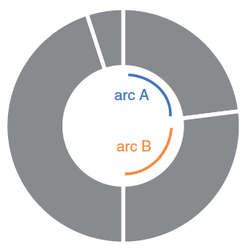
Graphs to avoid
Figures 7 & 8
Pie and Donut charts
The donut chart
Notes:
So what visuals should we avoid?
There are a few graphs that analysts recommend not to use when you’re trying to tell a visual story in business contexts.
I want to touch on three of them here, but these are by no means an exhaustive list of all the graphs to leave out:
Starting with the Pie Chart:
The type of graph is misleading for the simple fact that it is usually hard to tell the
proportions of the different categories you are trying to compare.
A simple solution for this would be to plot your information on an ordered bar chart,
as this approach conveys a much easier message when presenting comparisons.
In a similar vein, the donut chart is generally not recommended as it forces your audience
to have to guess the size of the angles.
As you can see here, it is very difficult to tell which arc is bigger between arc A and B.
Similar to the pie chart, a bar graph would be better at displaying information that would typically appear on this visual.
More recommendations exist out there that business clients generally do not want to see,
like the 3-d chart which Michael has mentioned many times,
but the general idea here is to show your clients visuals that they can easily understand without getting pulled out of your story.

Slide 22
5. summary
6 things to remember.
Notes:
So, to summarise…

Slide 23
6 things to remember:
Always know your audience.
Choose a visual display they will understand.
Clutter is your enemy.
Focus attention on the important.
Form follows function.
KEY: Remember your story!
Notes:
The 6 things to remember include knowing your audience and what they want to hear.
Choosing a visual that will speak to them, but making sure to declutter your graphs
(like avoiding animations as most business clients tend to hate them).
You also want to make sure that your visual pulls your audiences attention to the most important features,
which you can accomplish by thinking like a designer rather than a data scientist
The moral of the story I want to leave you with is to remember to tell a story.
As much as we are taught as graduate students to show our findings,
if you ever end up presenting data to institutional clients,
it is much better to tell a story rather than to show them the fanciest graph you can come up with.

Slide 24
thank you.
Jean-Marc Moke
PSYC6135: The Psychology of Data Visualization
Dr. Michael Friendly
April 11, 2024

Slide 25
References
Berinato, S. (2016, June). Analytics and data science: Visualizations the really work. Harvard Business Review, 92-100. https://hbr.org/2016/06/visualizations-that-really-work
Knaflic, C. N. (2015). Storytelling with data: A data visualization guide for business professionals. Wiley.
Lavelle, A., Maté, A., Trujillo, J., & Rizzi, S. (2024). Visualization requirements for business intelligence analytics: A goal-based, iterative framework. 2019 IEEE 27th International Requirements Engineering Conference (RE), pp. 109-119. https://ieeexplore.ieee.org/document/10428306.
The Conference Board. (2023, May). Job Satisfaction 2023: US Worker Satisfaction Continues to Increase. https://www.conference-board.org/pdfdownload.cfm?masterProductID=46114.
Zheng, J. G. (2017). Data Visualization in Business Intelligence. In J. M. Munoz (Eds.), Global business intelligence (pg. 67-81). Routledge.

