Slide 1
Biases in Data Visualization
Hannah Tran and Courtney Chan

Slide 2
Creating Graphs

Slide 3
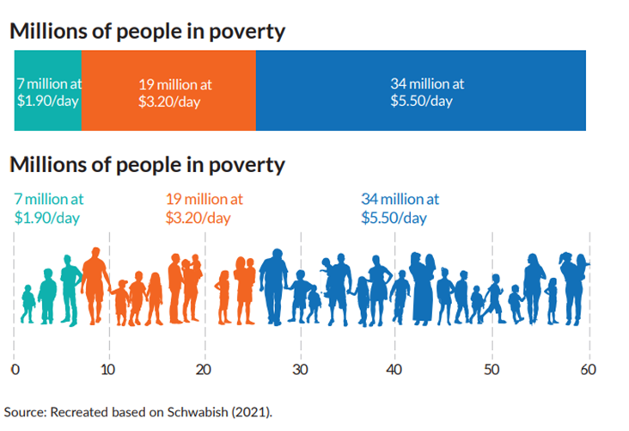
Anthropomorphizing Data Points

Slide 4
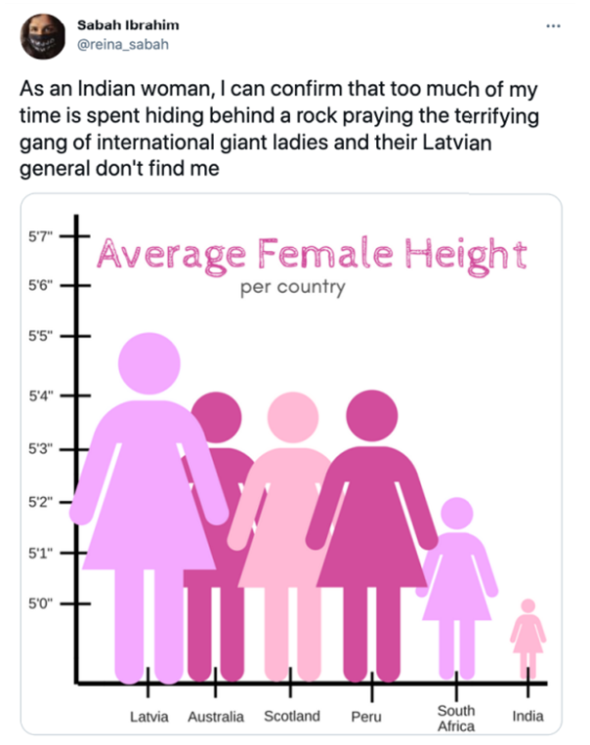
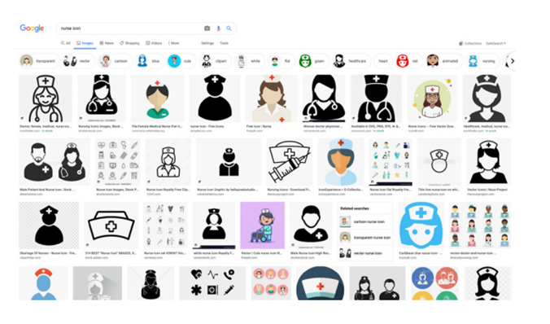
Anthropomorphizing Data Points Gone Wrong!

Slide 5
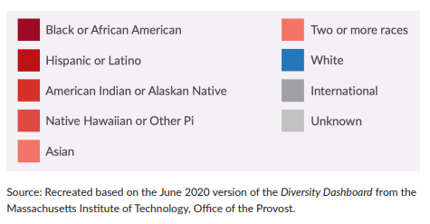
Be Considerate of Color Choices

Slide 7
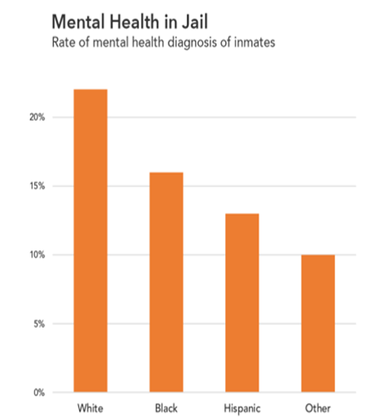
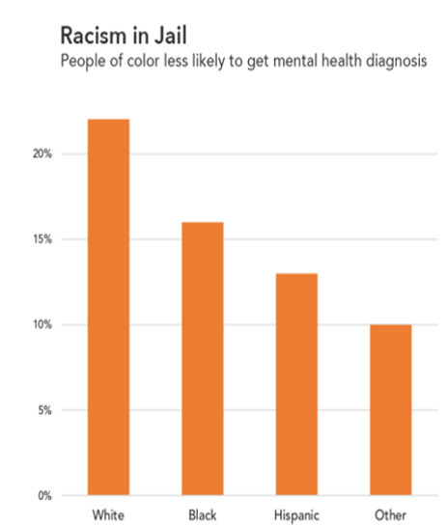
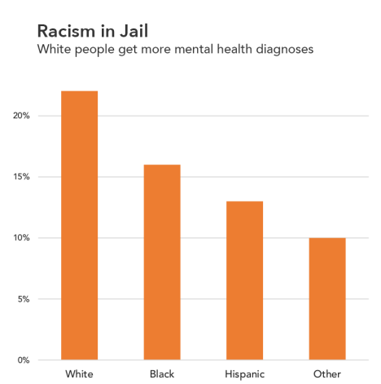
Framing Your Graphs

Slide 8
Demographics/Legends
White/European
Black/African
Latin American
East Asian
South Asian
Indigenous
Black/African
East Asian
Indigenous
Latin American
South Asian
White/European
East Asian (50%)
Black/African (20%)
White/European (11%)
Latin American (9%)
Indigenous (6%)
South Asian (4%)
Latin American (focus of research)
East Asian
Indigenous
Black/African
South Asian
White/European
Racial hierarchy
Highlights focus group
Alphabetical
Proportional

Slide 9
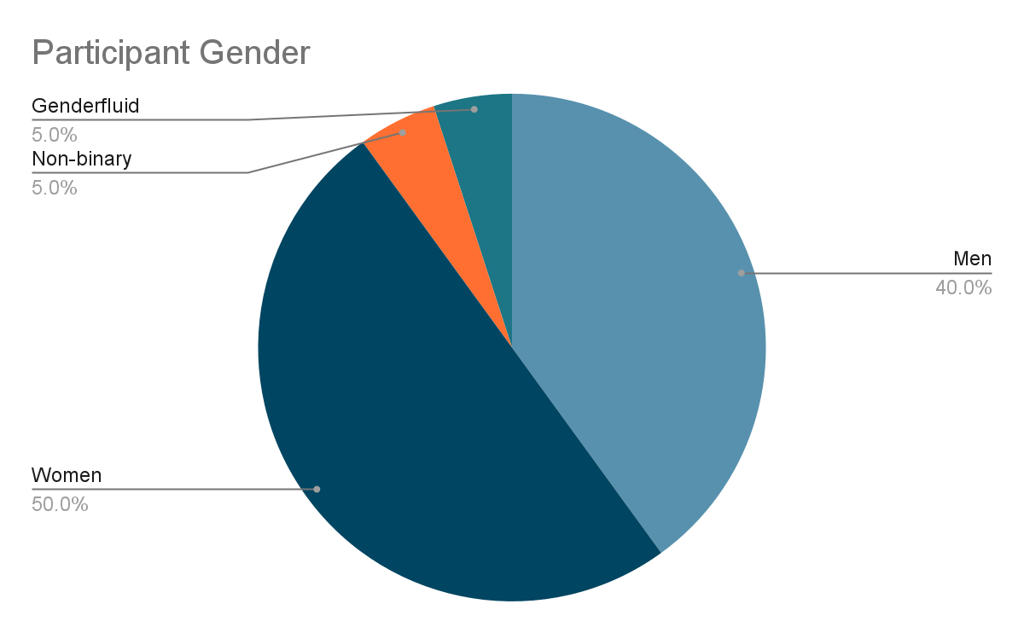
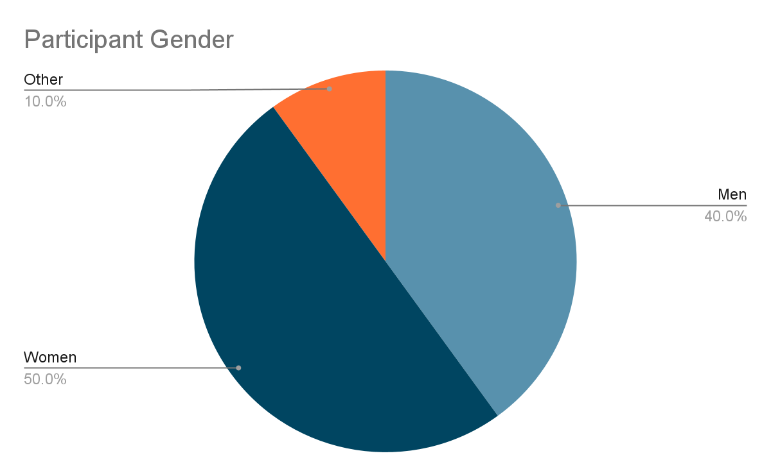
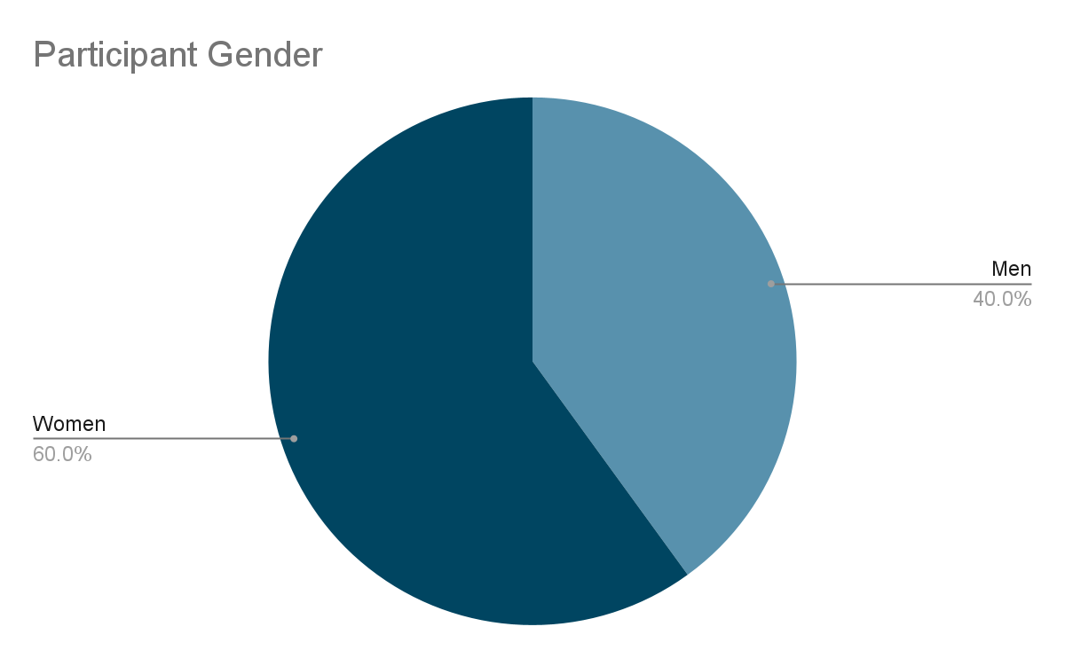
Demographics and Legends
*Nonbinary response options not available in original dataset

Slide 10
Reading Graphs

Slide 11
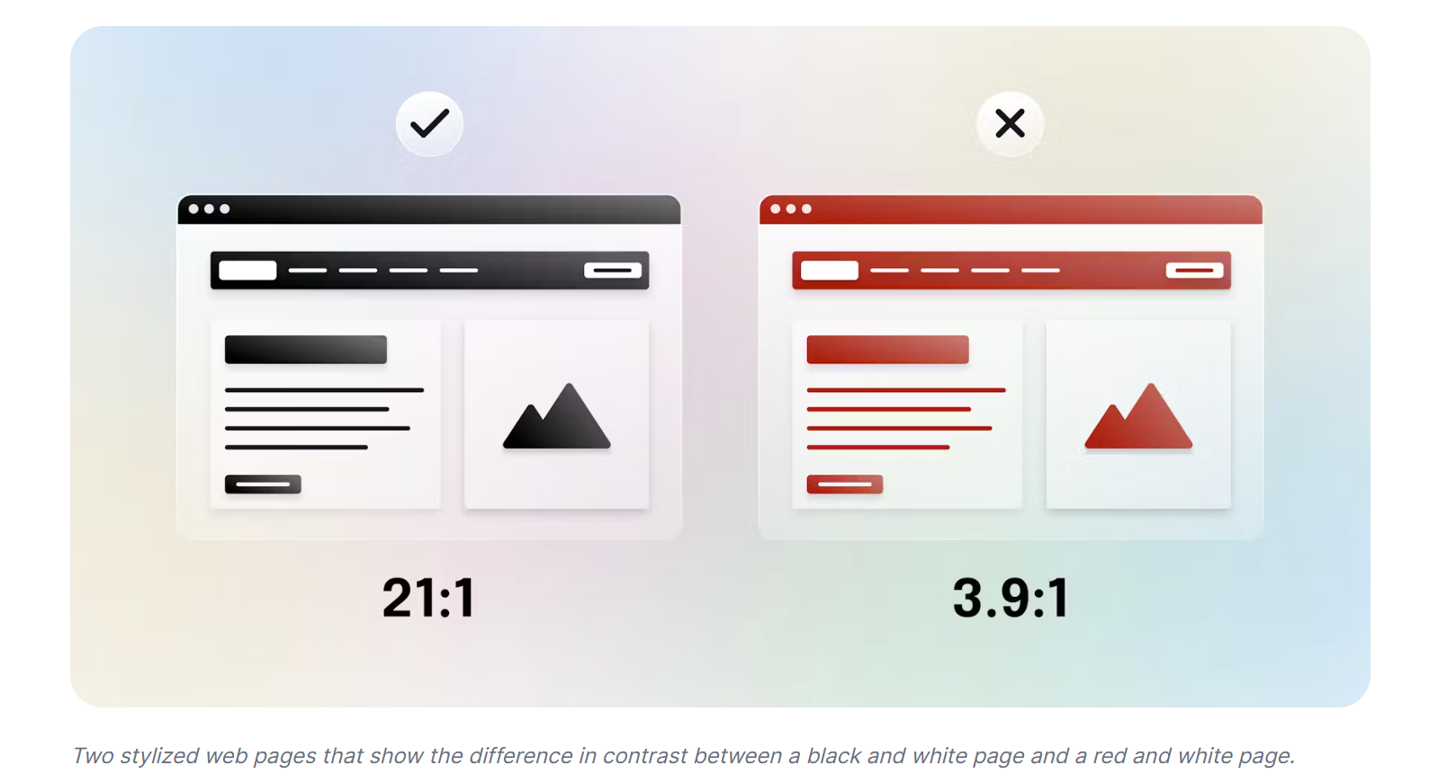
Visual Accessibility: Color Contrast
https://www.audioeye.com/color-contrast-checker/

Slide 12
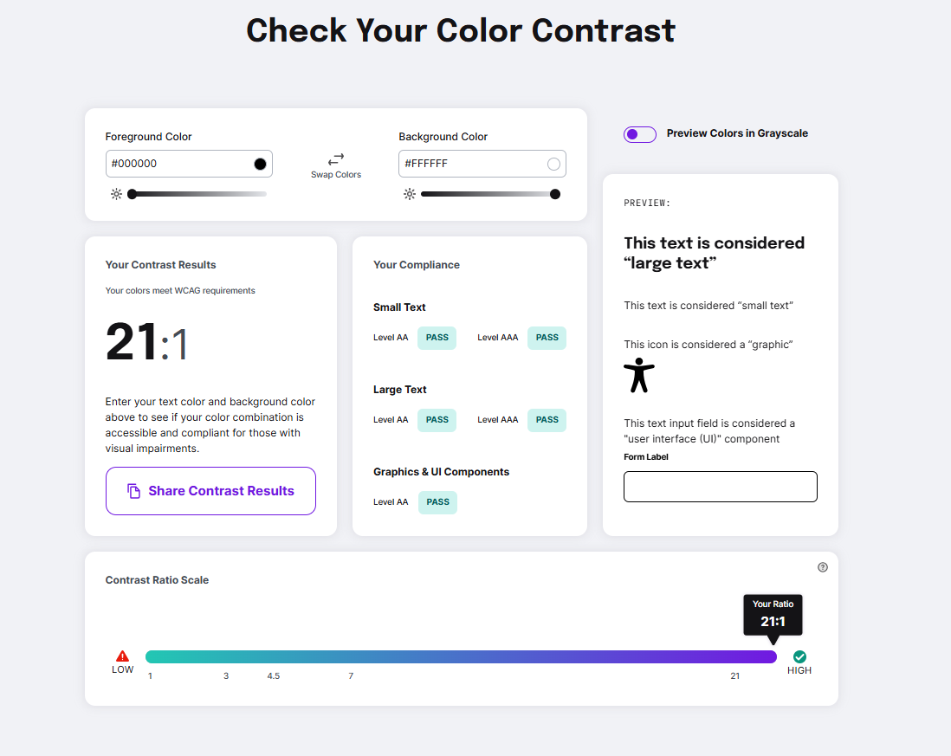

Slide 13
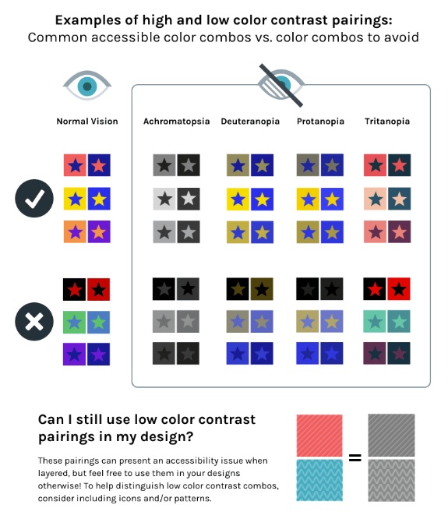
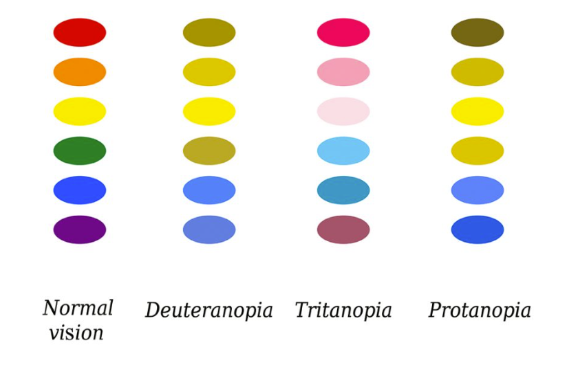
Types of Color Blindness
https://www.whocanuse.com/

Slide 14

Accessible Fonts

Slide 15
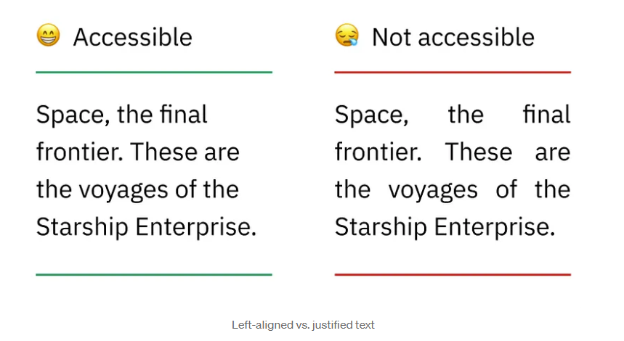
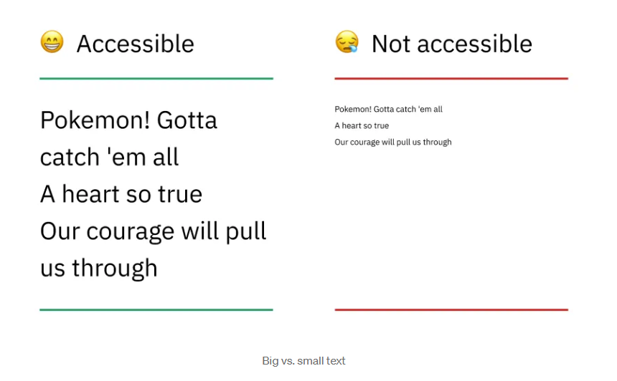
Accessible Type

Slide 16
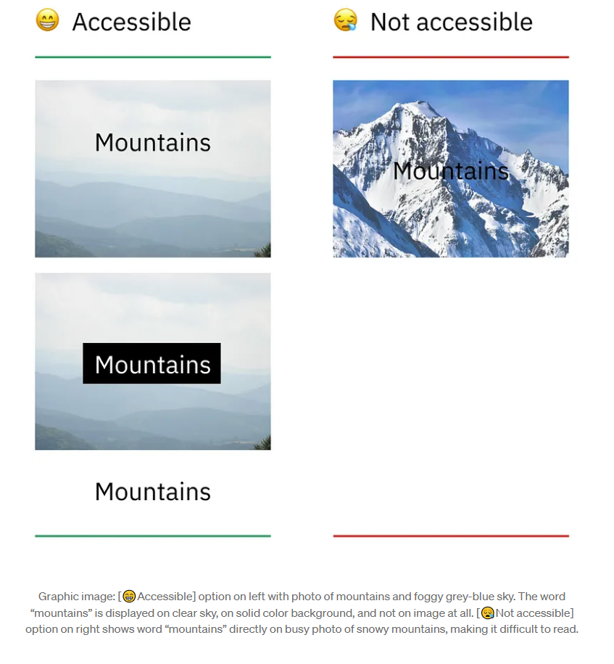
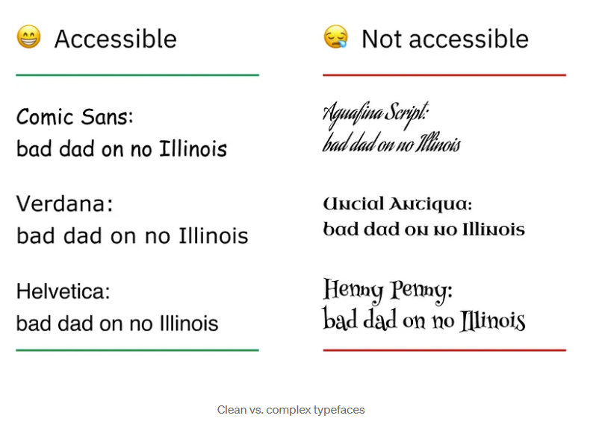
Accessible Type

Slide 17
Thank you!

