Slide 1



Encoding & decoding
When we construct a graph, we encode a numerical or categorical variable as a graphical attribute
When we view a graph, the goal is to decode the graphical attributes and extract information about the data that was encoded
→ Encoding should rely on features that can easily be decoded
→ Designing effective graphs depends on understanding these ideas!
encode
view
decode

Slide 2





encode
view
decode

Slide 3

Orienting questions
How did we get from early ideas of graph types (line, bar, pie charts, scatterplots, …) to expressing those in modern software?
data
idea
code
graph
What new thinking was required?
How to formalize different kinds of graphs and their attributes?
How to make the language of a graph express what we want to see?
How to do that most simply, elegantly, or generalizable?

Slide 4

data
idea
code
graph
graph
Claude
code
decode

Slide 5
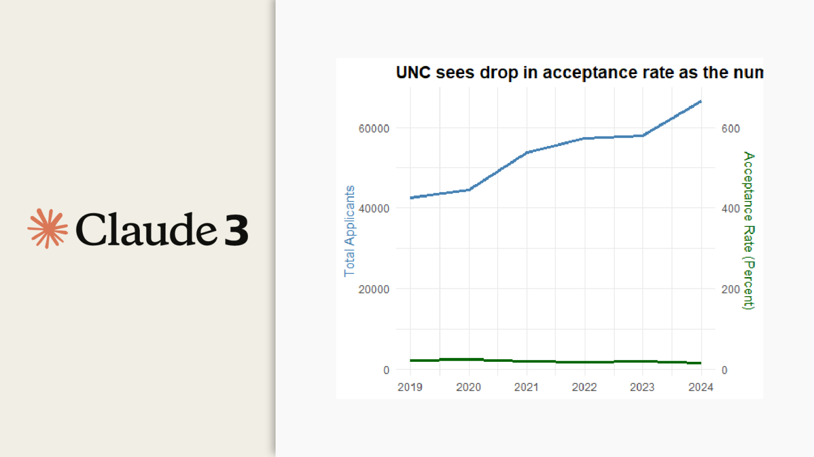
graph
Claude
code

