Slide 1


© Copyrighted image
© Copyrighted image

Slide 2
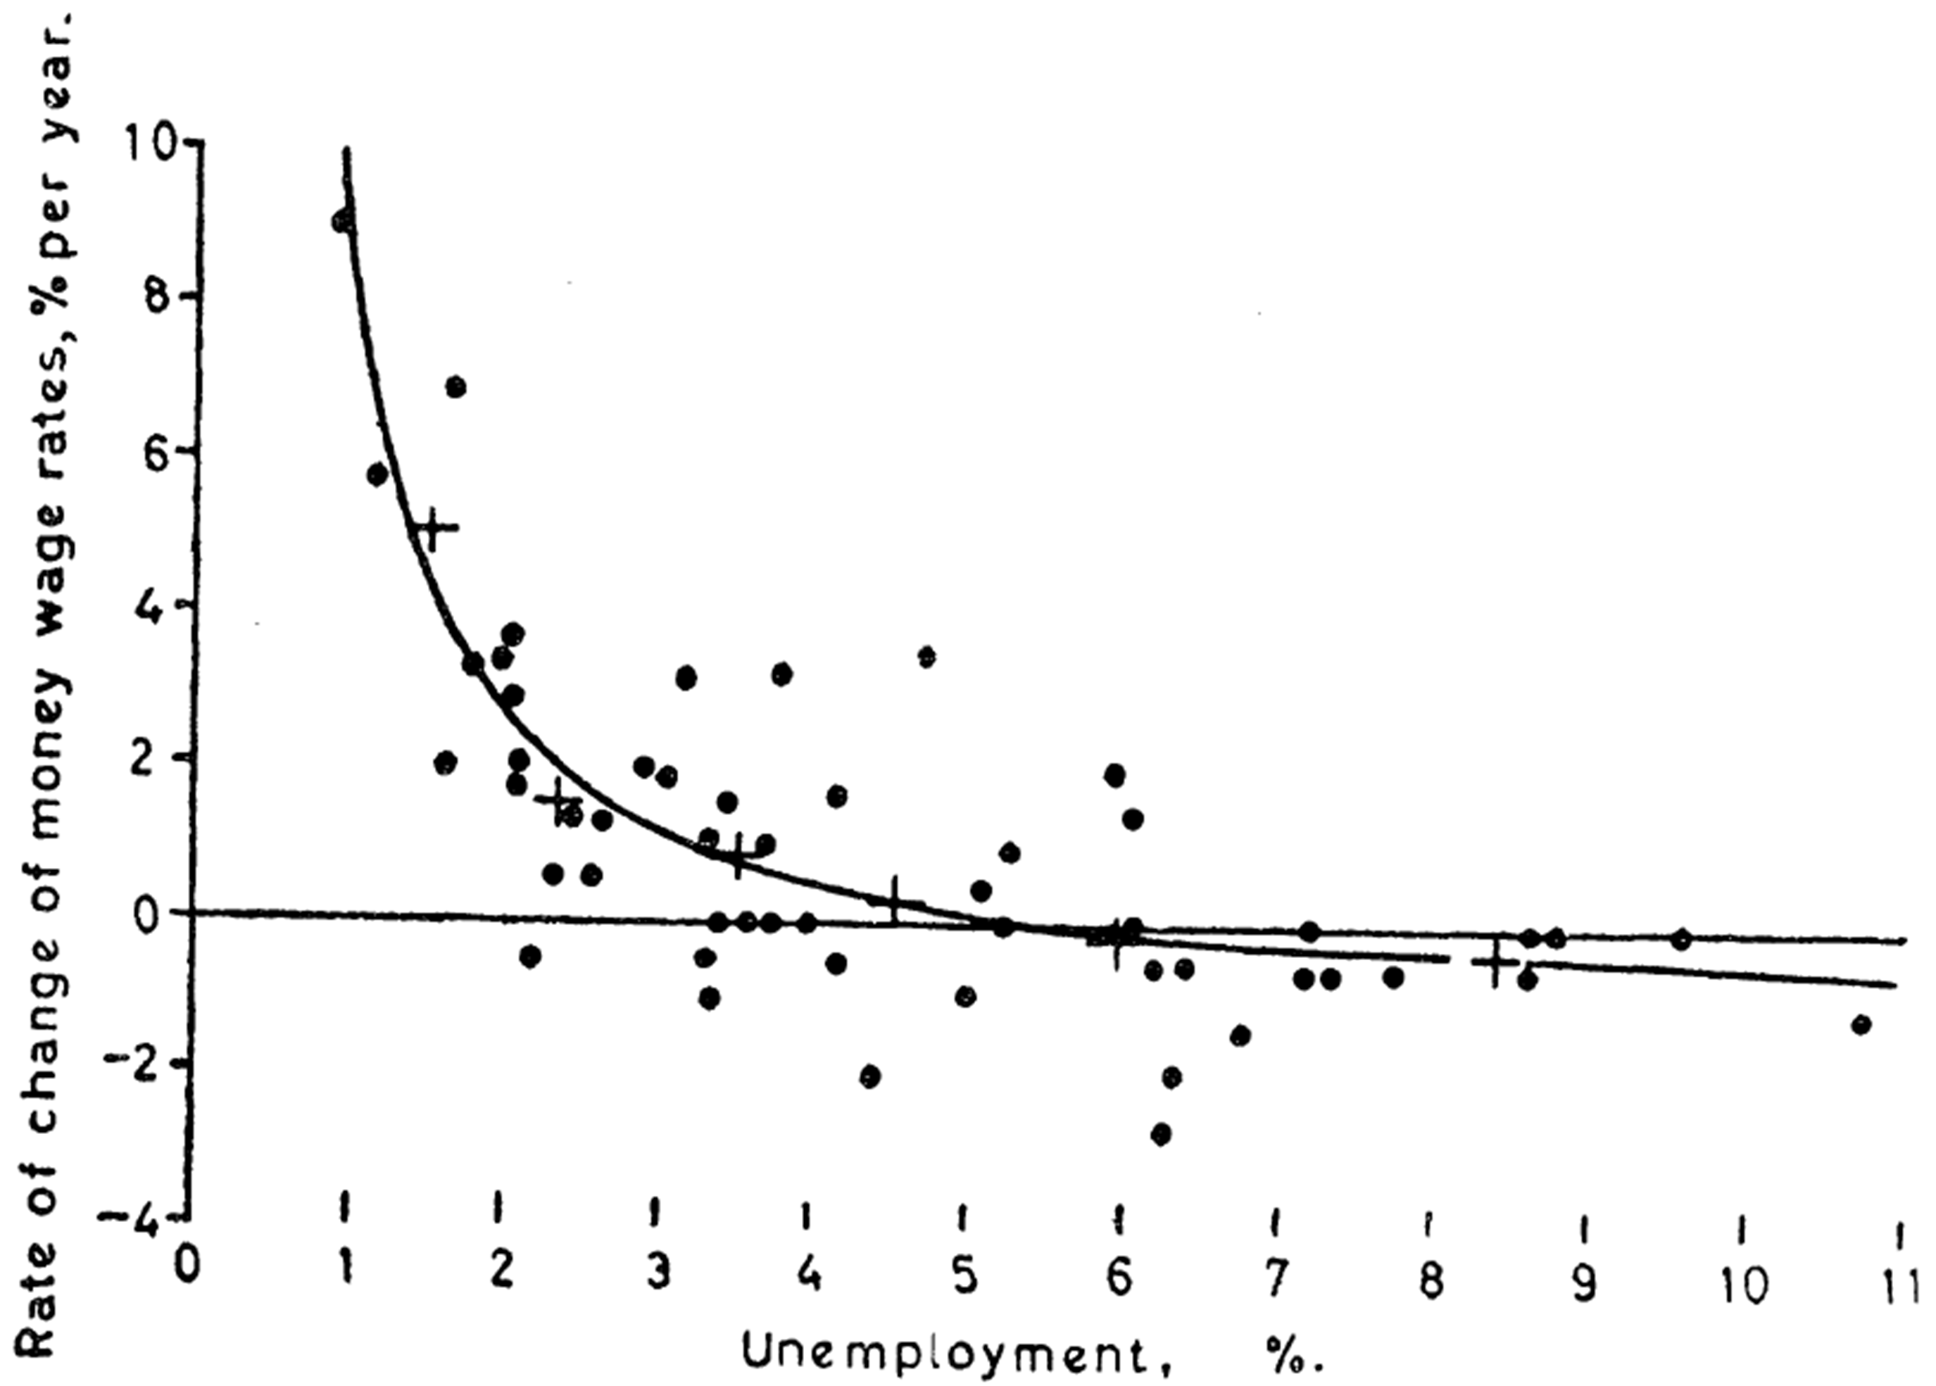
© Copyrighted image

Slide 3
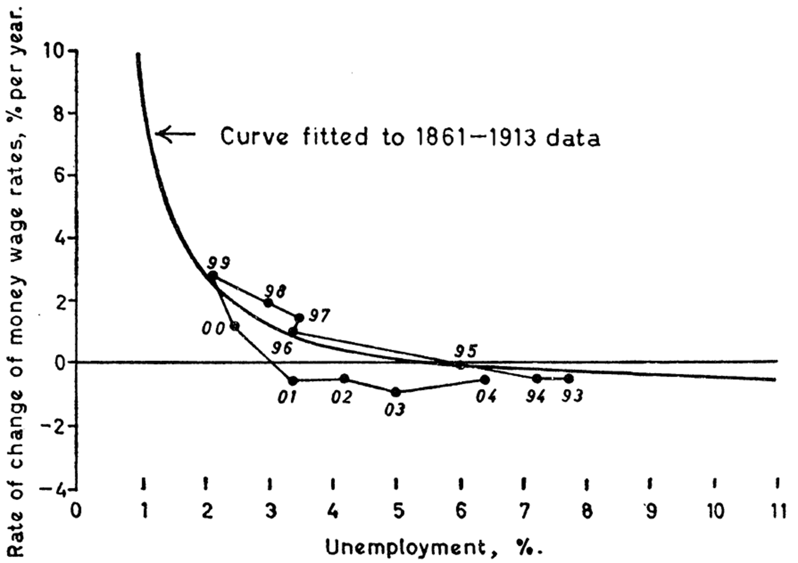
© Copyrighted image

