Slide 1
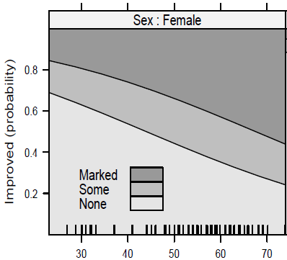
glm()
polr()
multinom()
plot(mod)
plot(f(mod))
input data.frame
model object

