Slide 1
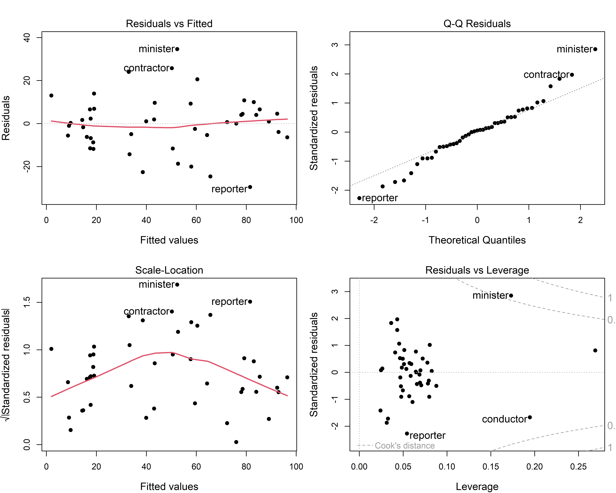
The regression quartet
Residuals vs. fitted: nonlinearity
Normal QQ: distribution of residuals
Scale-location: non-constant variance
Residuals vs. leverage: influential cases
Figure 7.2
Notes:
The four standard diagnostic plots, here for Duncan's data on the prestige of occupations predicted from income and education.

Slide 2
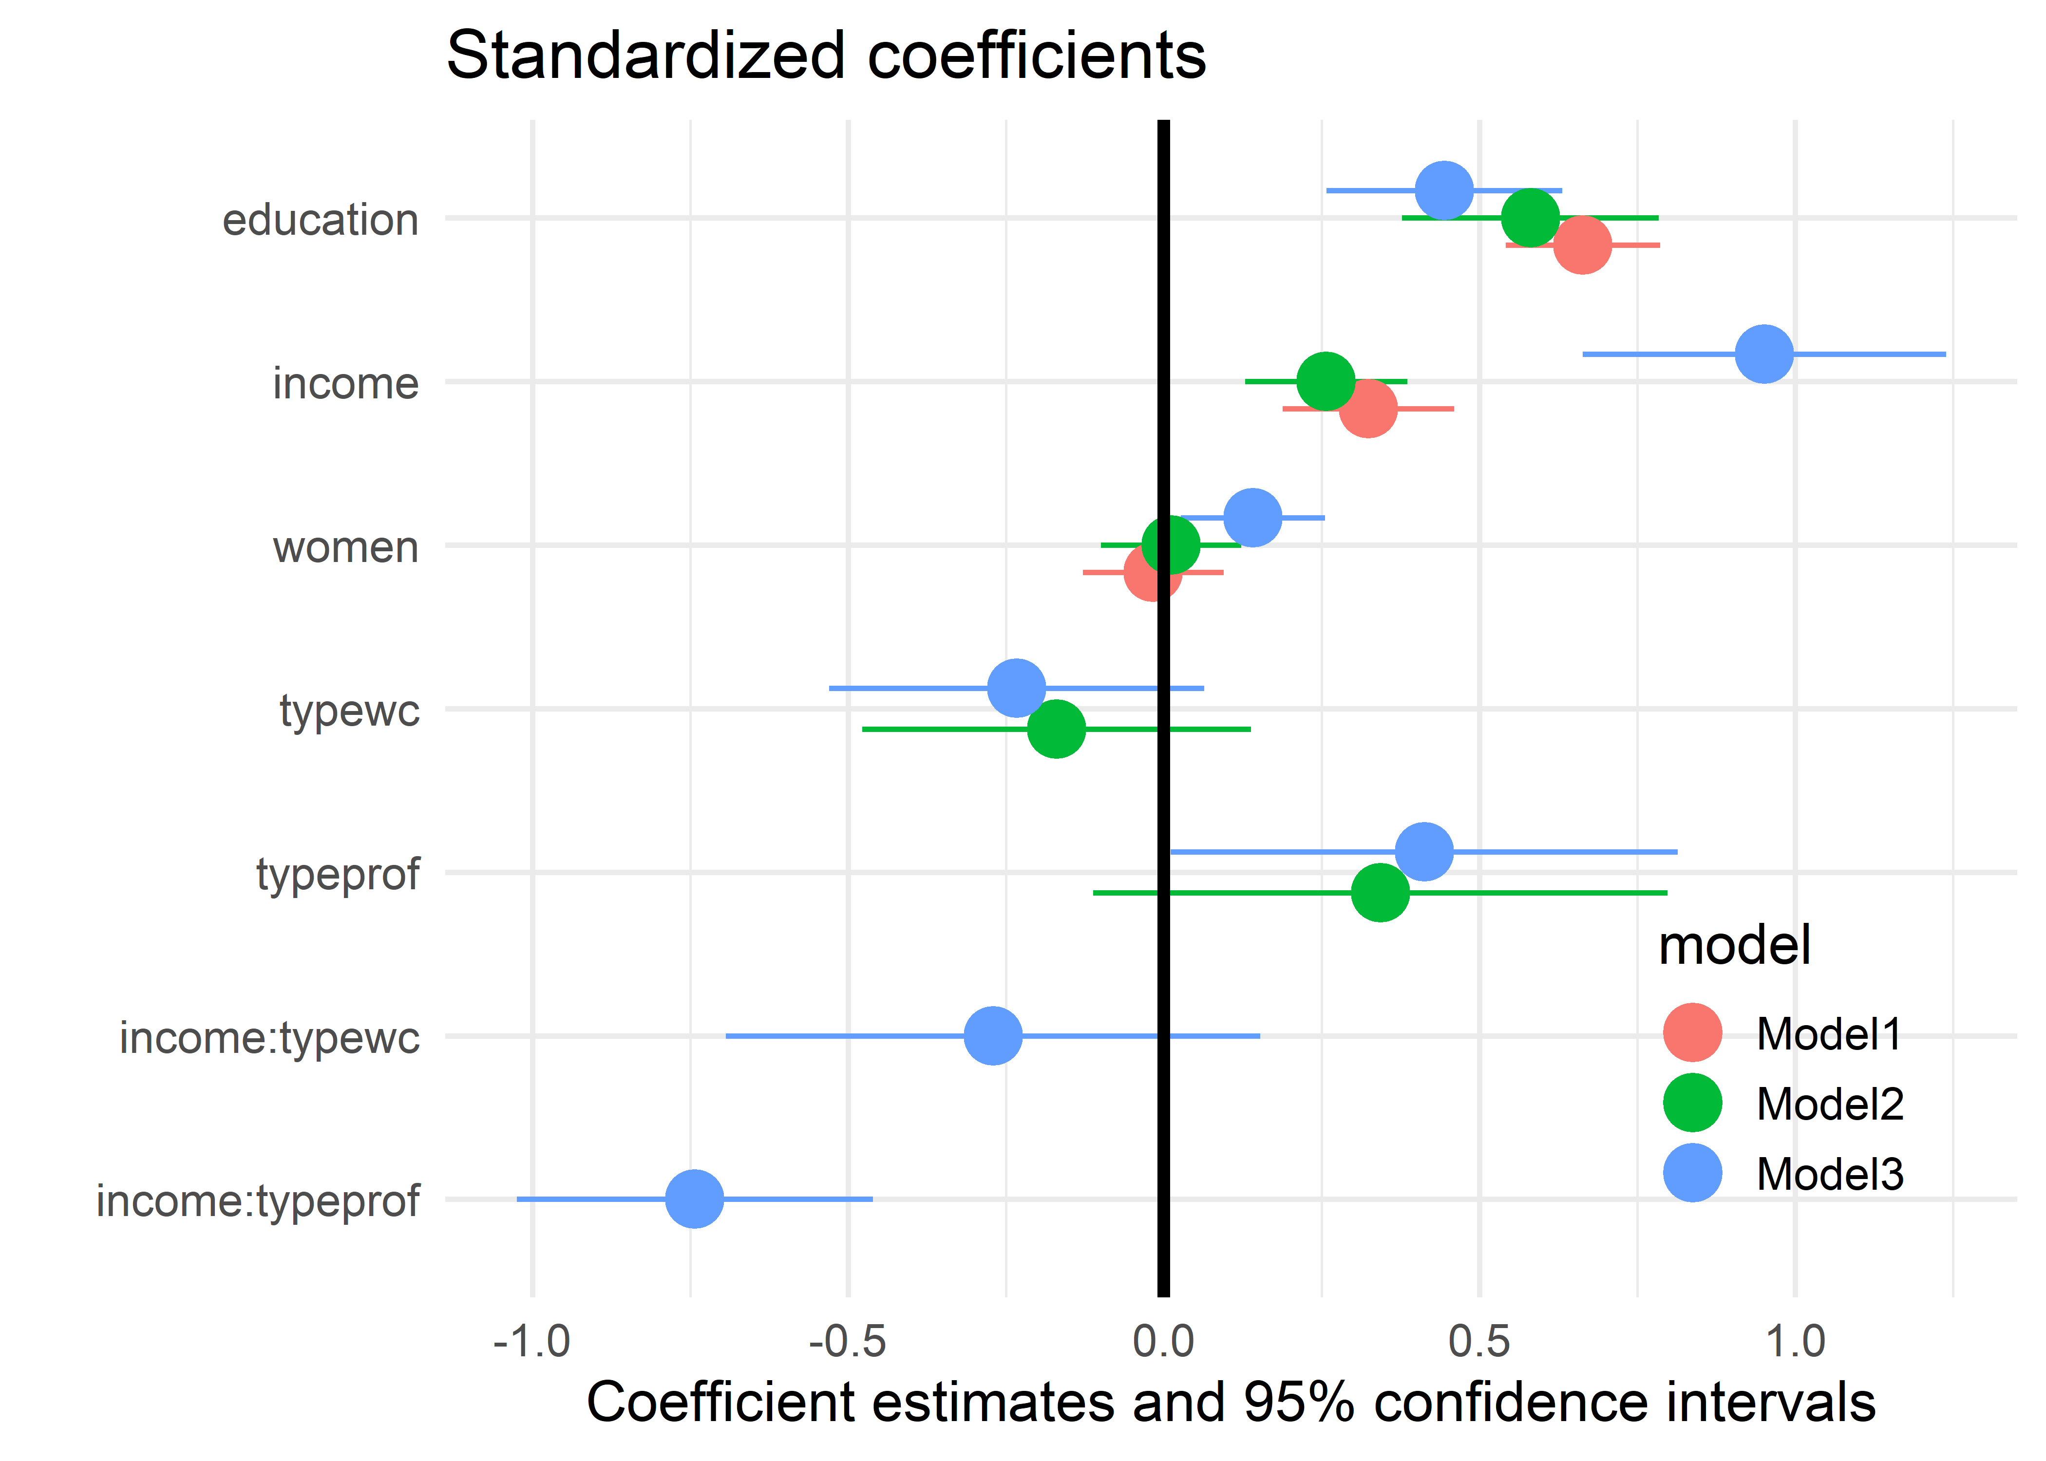
Coefficient plots: show the estimates, not a table
Estimates with confidence intervals
Standardize, or the scales of the predictors dominate the picture
Easy to compare several models
Figure 7.7
Notes:
Plot of standardized coefficients and their confidence intervals.

Slide 3
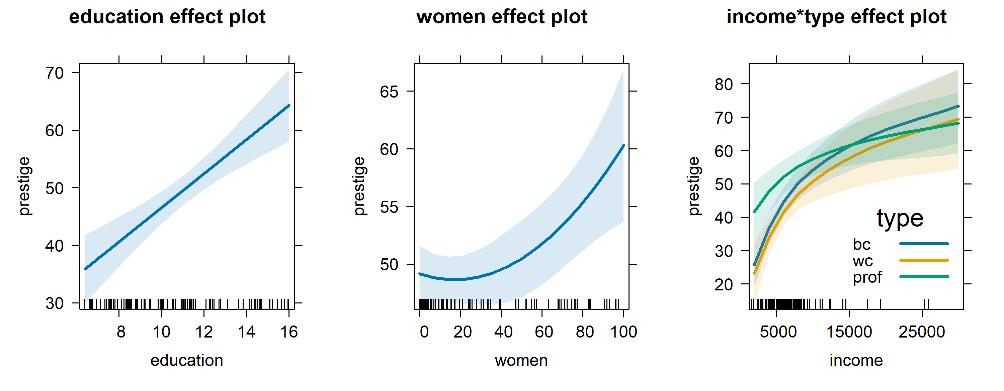
Effect displays: what the model predicts
Fitted values for each predictor, averaging over the others.
Figure 7.17
Notes:
[OPTIONAL for a 45-minute talk] Predictor effect plots for all terms in the model for the Prestige data.

Slide 4
Collinearity and ridge regression
Seeing the problem, and seeing the remedy
Notes:
Other problems in fitting & understanding linear models are also made simpler with visual, geometric and dimension reduction ideas

Slide 5
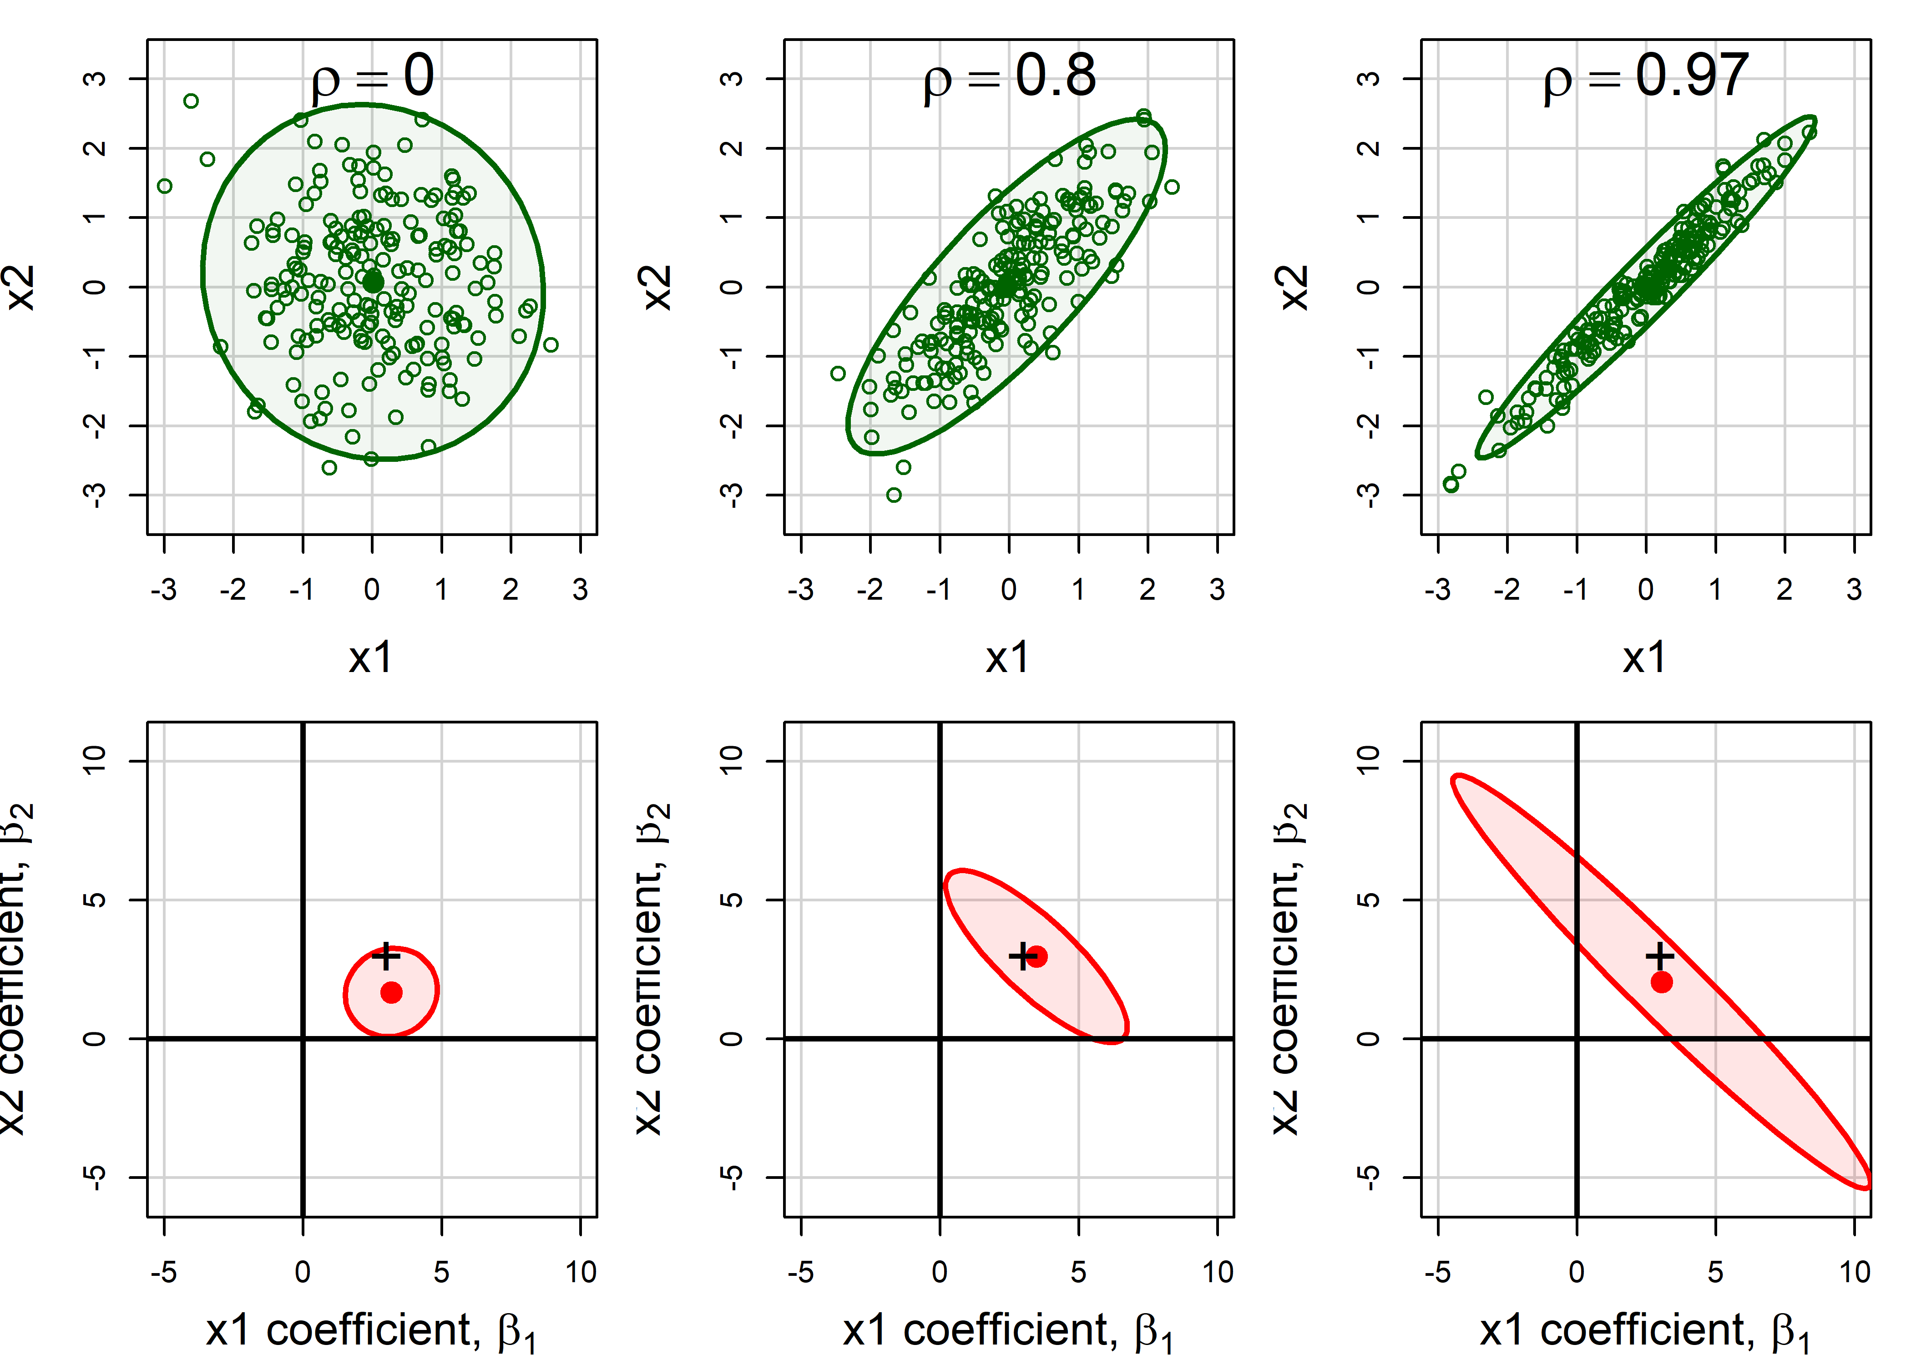
Collinearity: narrow data → increased uncertainty
As the predictors become more correlated,
data ellipse narrows
confidence ellipse balloons.
Data space
β space
Figure 9.4
Notes:
[OPTIONAL for a 45-minute talk] 95% data ellipses for x1, x2 and the corresponding confidence ellipses for their coefficients, for increasing correlation.

Slide 6
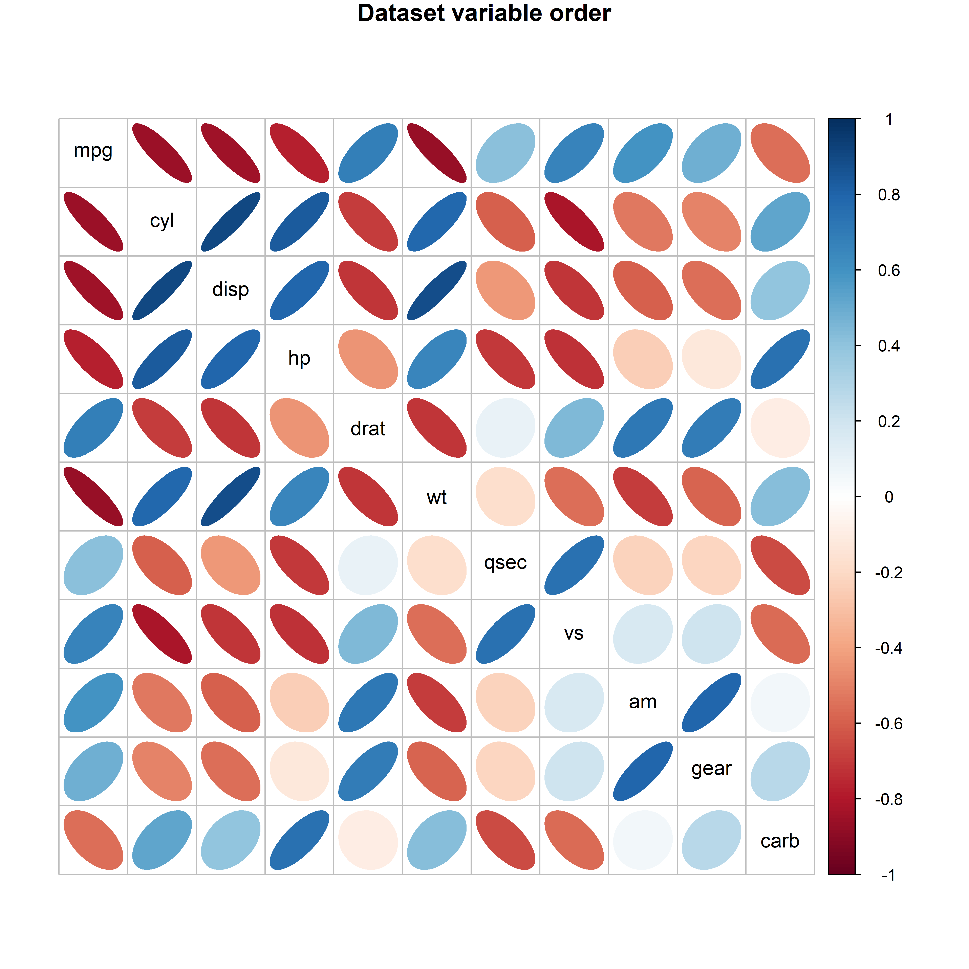
Application: effect ordering variables in displays
The same correlations of the mtcars data: in dataset order (left) and in PCA order (right).
Figure 5.27, 5.29
Notes:
[OPTIONAL for a 45-minute talk] Ordering variables by their angles in the biplot puts similar variables together and makes the pattern visible.

Slide 7
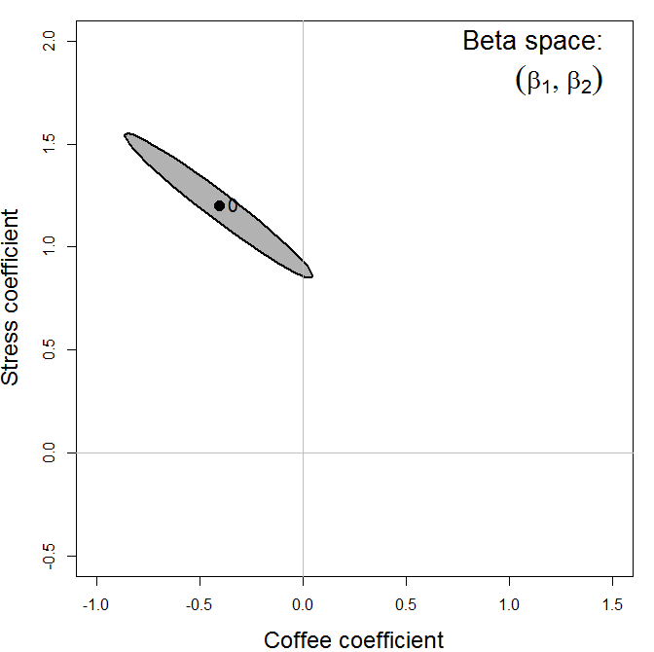
Measurement error for β₁ also biases β₂
As error in Stress increases, β_{Stress} → 0 .
  OK, understand that now.
But, at the same time, the effect of coffee, β_{Coffee} seems to become larger!
Elliptical insight:
  Increasing error in x₂ drives coefficient for x₁ toward the marginal model, ignoring x₂
  You can also see that the std. errors of β_{Coffee} decrease with error in Stress!

Slide 8
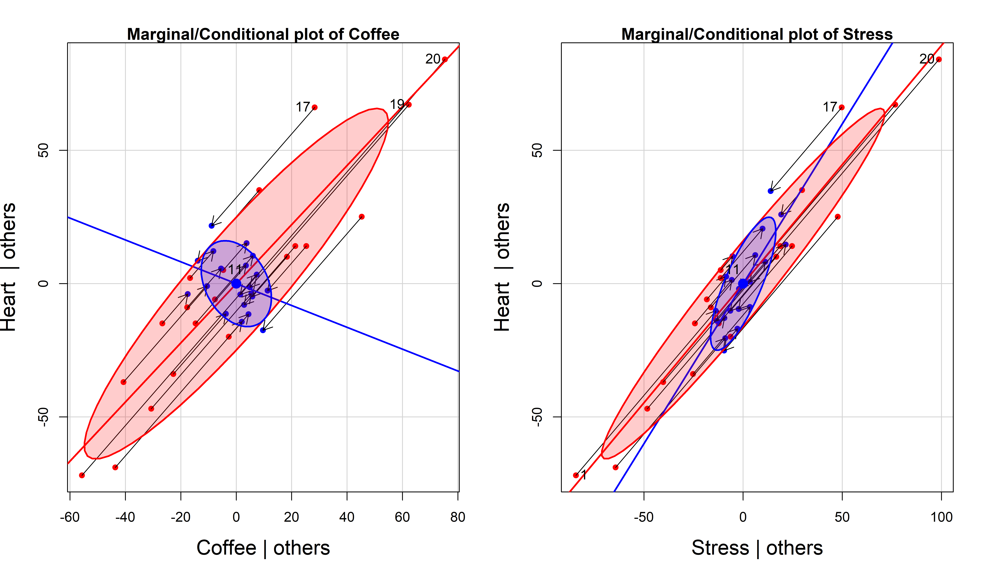
Added-variable plots show partial relationships
Control/adjust for all others to see the net relationship between Y and X_{i}
Coffee, stress and heart damage:
Marginal & partial slopes for coffee have opposite signs.
Coffee is good, controlling for stress
Slopes are similar for stress, but steeper when controlled for coffee
→ Practice yoga at Starbucks?
Figure 7.12
Notes:
Marginal + conditional (added-variable) plots for the coffee data. Each added-variable plot shows the relation of y to one predictor with the others partialled out; the slope is the coefficient in the full model.

Slide 9
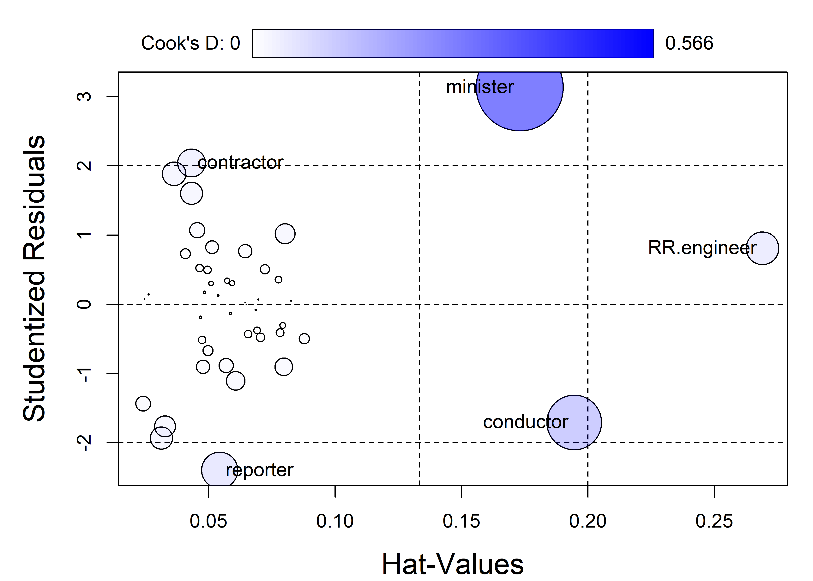
Leverage and influence: car::influencePlot(model)
carData::Duncan
Leverage: unusual in the predictors (hat values)
Outlier: a large residual
Influence = leverage x residual
→ Bubble size: Cook's distance (Δβ_{(-i)})
But this doesn’t tell us why or how
Figure 7.26
Notes:
Influence plot for the Duncan model. Minister and conductor stand out.

Slide 10
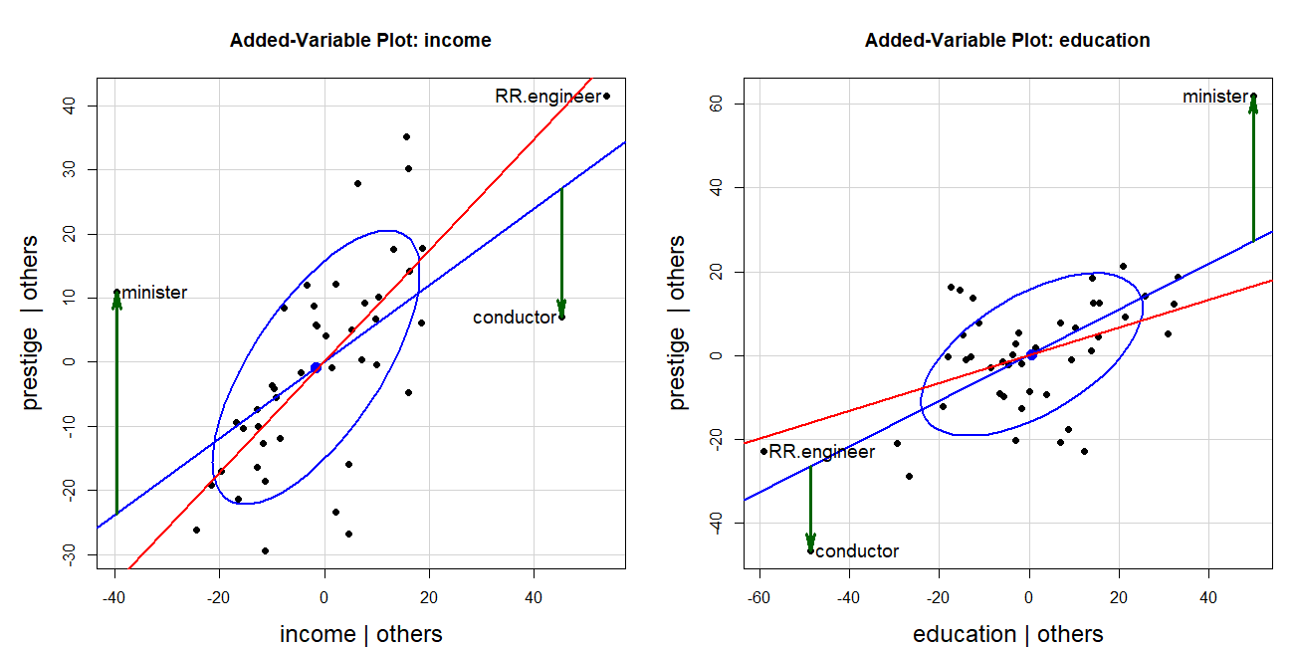
Which observations drive the fit?
Added-variable plots can show precisely the impact on regression slopes
Fitted line with all cases
Fitted line w/out 2 cases
Residuals for those cases
.
Figure 7.27
Notes:
One of the figures the organizer singled out. The two occupations pull the income and education slopes in opposite directions.

Slide 11
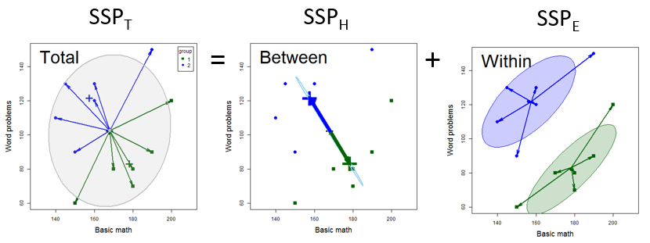
MANOVA: the same sums of squares, now as matrices
Total = Hypothesis + Error. Each is a matrix, so each can be drawn as an ellipse.
Figure 11.2
Notes:
Breakdown of the total SSP matrix into H and E. The Wilks, Pillai, Hotelling-Lawley and Roy tests are all functions of the eigenvalues of H relative to E.

Slide 12
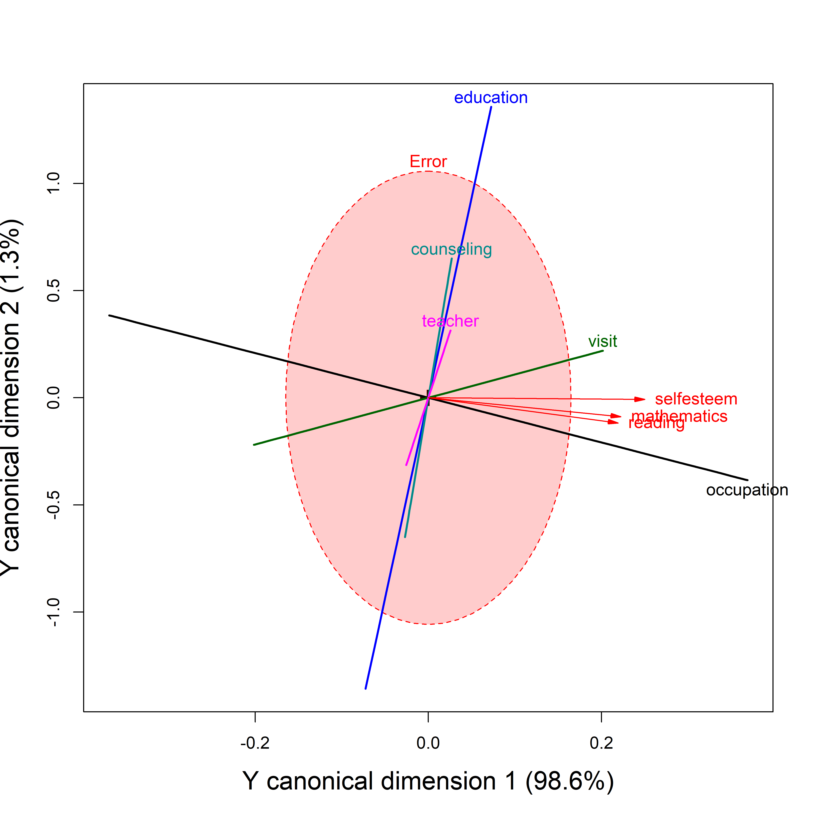
Canonical correlation in an HE plot
Canonical correlation: the weighted sums of the Y and X variables that correlate most highly
Shown as an HE plot in the canonical space, with vectors for X & Y variables
Figure 12.22
Notes:
[OPTIONAL for a 45-minute talk] HE plot for the canonical correlation analysis of the school data.

Slide 13
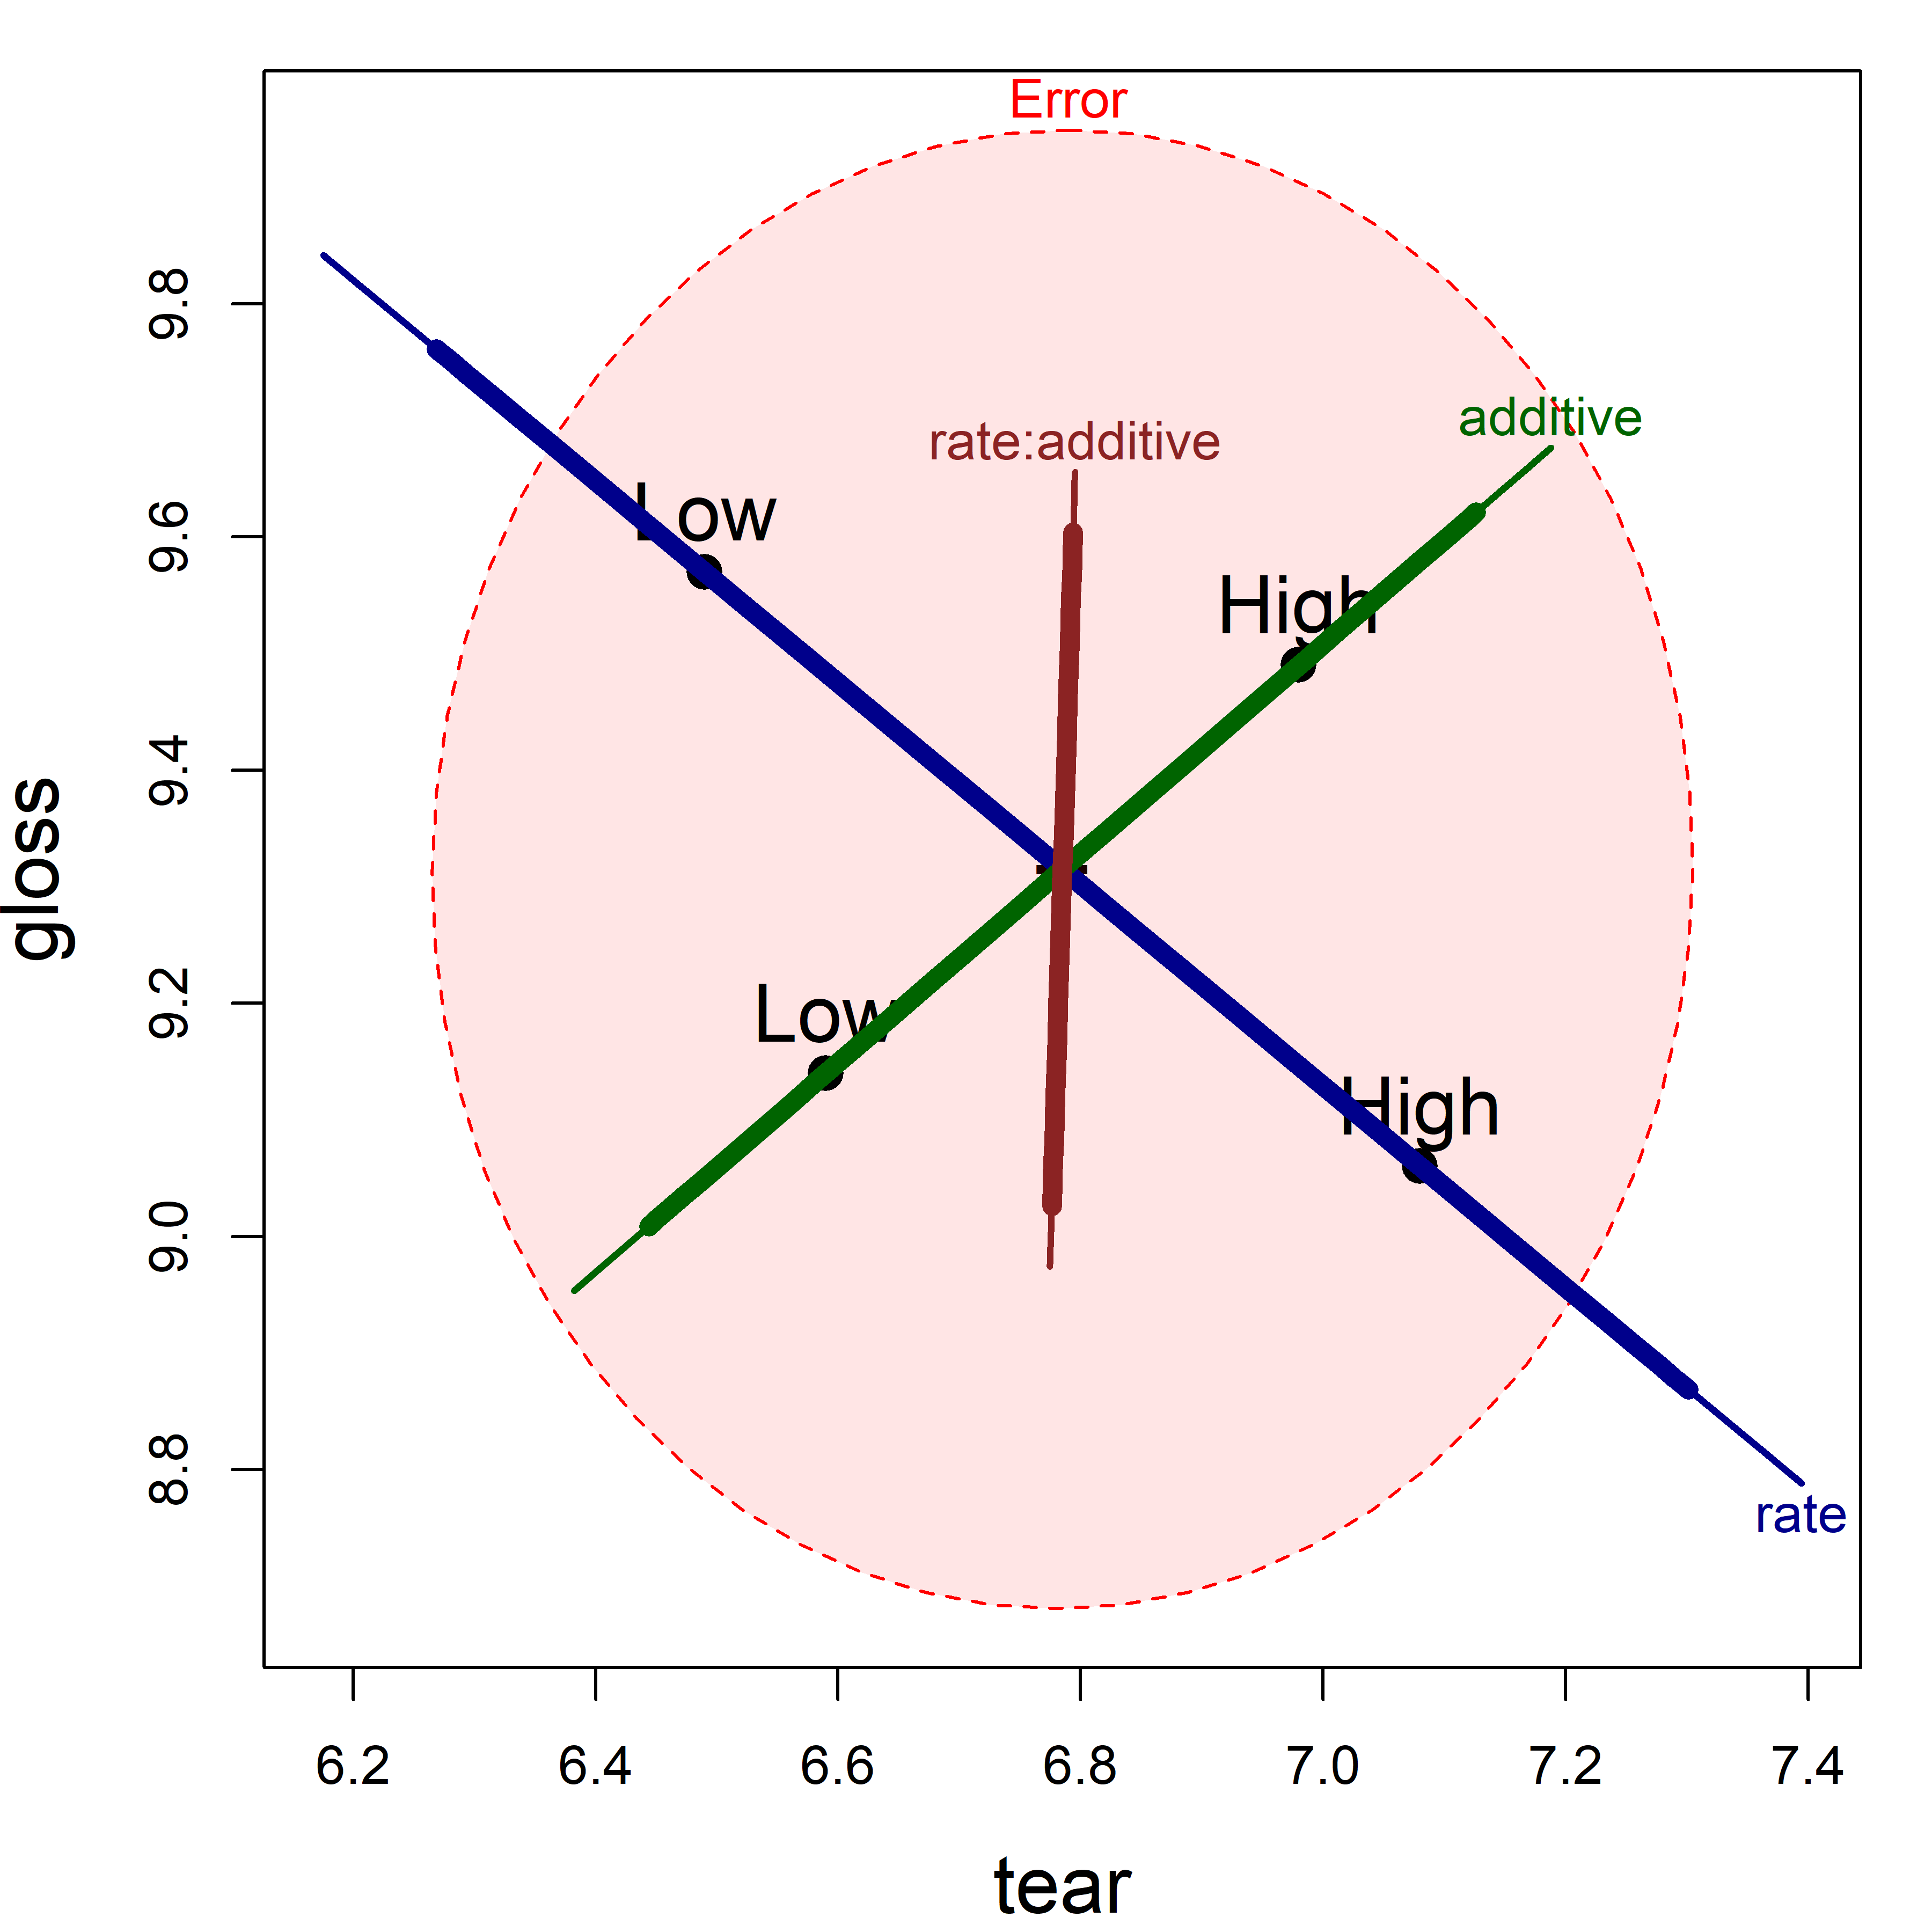
Factorial designs: main effects and interactions
Plastic film data: tear and gloss by rate of extrusion and amount of additive
One H ellipse for each term in the model
Figure 12.11
Notes:
[OPTIONAL for a 45-minute talk] HE plot for the two-way MANOVA of the plastic film data.

Slide 14
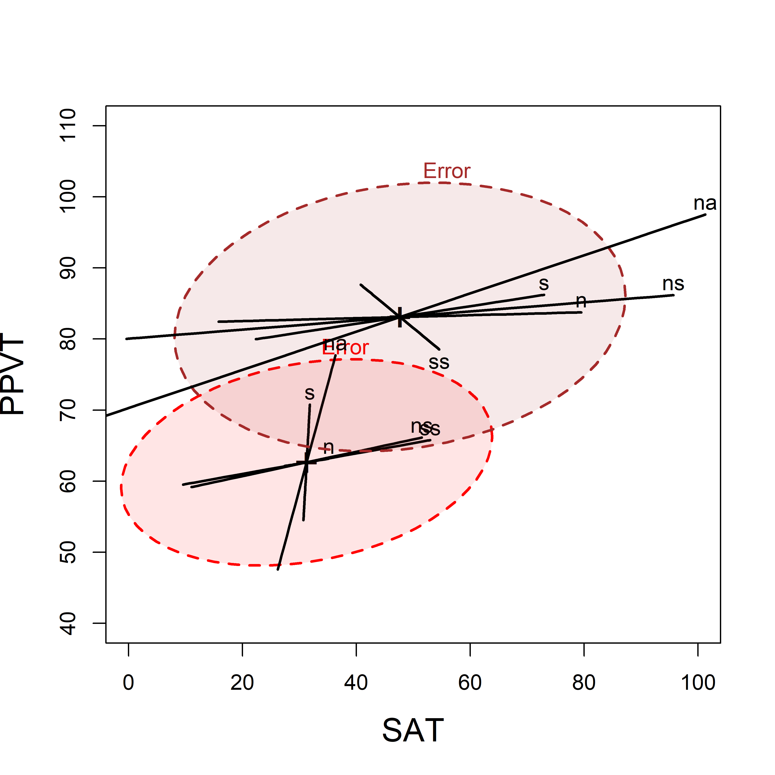
MANCOVA: are the regressions the same across groups?
Rohwer data: aptitude and achievement predicted from paired-associate tasks
Overlaid HE plots for the low and high SES groups
Figure 12.25
Notes:
[OPTIONAL for a 45-minute talk] Overlaid HE plots for SAT and PPVT for the two SES groups.

Slide 15
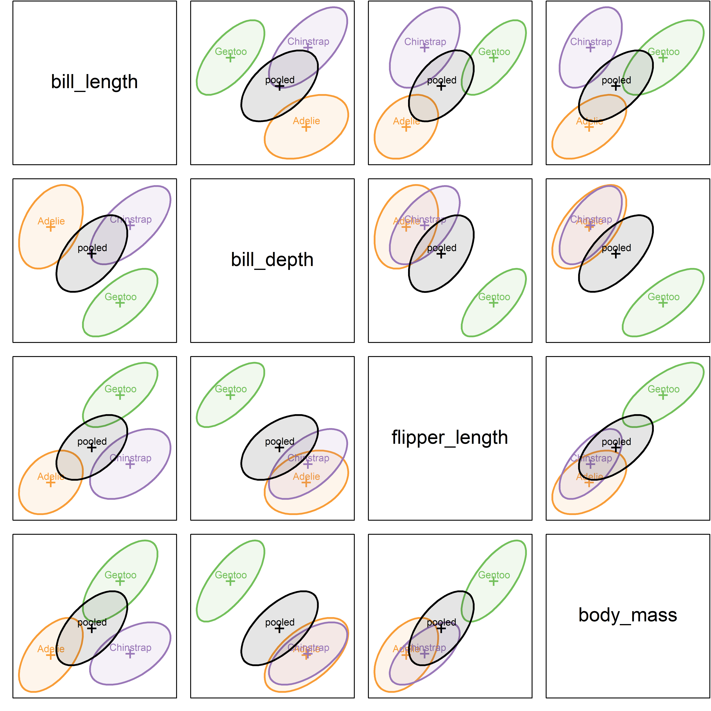
Are the covariance matrices equal?
MANOVA assumes equal within-group covariance matrices
Compare the data ellipse of each group with the pooled one
Look for differences in size and shape
Figure 13.4
Notes:
[OPTIONAL for a 45-minute talk] All pairwise covariance ellipses for the penguin data.

Slide 16
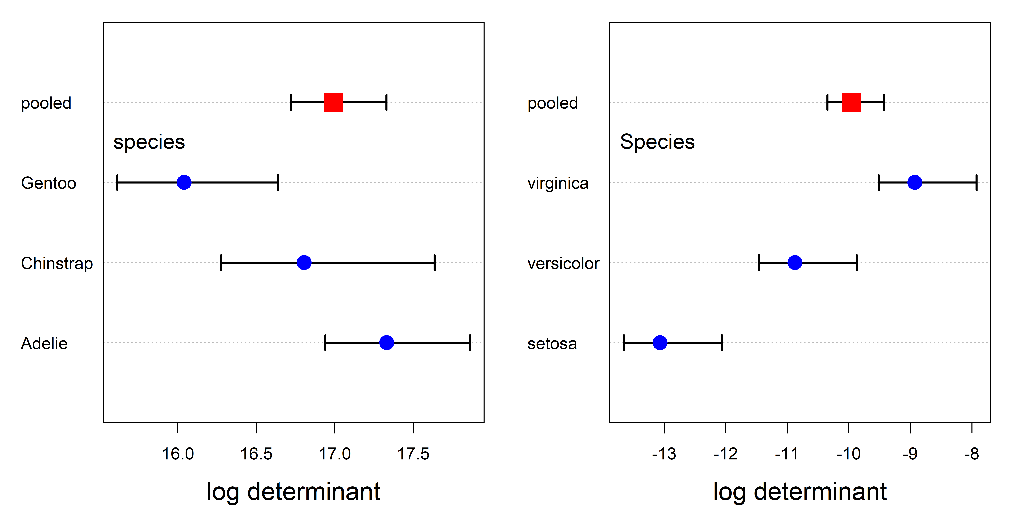
Visualizing Box's M test
Box's M compares the log determinants of the group covariance matrices with that of the pooled matrix.
Figure 13.6
Notes:
[OPTIONAL for a 45-minute talk] Plots of the contributions to Box's M for the penguin and iris data.

Slide 17
Quadratic discriminant analysis
With a separate covariance matrix for each group, the boundaries become curved.
Notes:
[OPTIONAL for a 45-minute talk] Quadratic discriminant prediction regions for the penguin data.

Slide 18

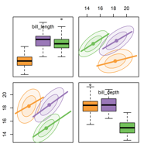
Seeing multivariate data
Data ellipses, penguins, and looking at many variables at once
Notes:
The first act in understanding multivariate data is to be able to “see” it

