Slide 1
X
X
Y
X
x₁
x₂
x₃
x₄
y
~
y₁
y₂
~
x₁
x₂
x₃
x₁
x₂
x₃
max R²
v₁
v₂

Slide 2
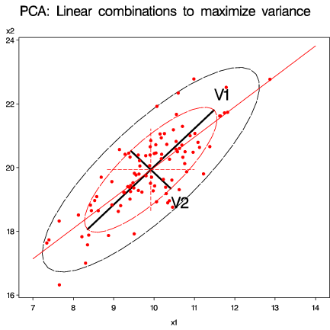
PCA
X
x₁
x₂
x₃
x₄
v₁
v₂

Slide 3
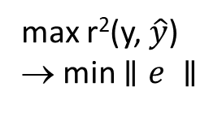
X
y
x₂
e
y
~
x₁
x₂
x₃
max r²(y, $\hat{y}$)
→ min $∥e ∥$
x₁
max R²

Slide 4
Y
X
Y
X
y₁
y₂
~
x₁
x₂
x₃
y₁
y₂
~
x₁
x₂
x₃
max R²
v₁
w₁
v₂
w₂

Slide 5
Response variables: Y = (y₁, … y_{q})
 | Quantitative |  | Discrete
 | q=1 | q>1 | q=1 | q>1
p=1 | Simple regression | Multivariate regression | Simple logistic regression
p>1 | Multiple regression | Multivariate regression Canonical corr. Partial corr. | Mult. logistic regression Discriminant analysis | Multivariate logistic regression
p=1 | t-test 1-way ANOVA | Hotelling T² 1-way MANOVA | Simple χ² | Loglinear models
p>1 | Factorial ANOVA | Factorial MANOVA | Logit models Loglinear models
Quantitative
Predictor variables: X =(x₁, … x_{p})
Discrete
Loglinear models

Slide 6
 | Regression | ANOVA
Dependent (response) | Quantitative | Quantitative
Independent (predictors) | Quantitative | Discrete factors
Concepts, statistics | Terms: X₁, X₂ Interactions: X₁ * X₂ Linear hypotheses R², coefficients | Main effects: A, B Interactions: A*B Contrasts F stats, factor effects

Slide 7
 | Dependent variables
Independent variables | 1 Quantitative y = X β | 2+ Quantitative Y = X B
Quantitative | Regression | Multivariate regression
Categorical | ANOVA | MANOVA
Both | Reg. w/ dummy vars ANCOVA Homogeneity of regression | General MLM Homogeneity of regression MANCOVA

Slide 8
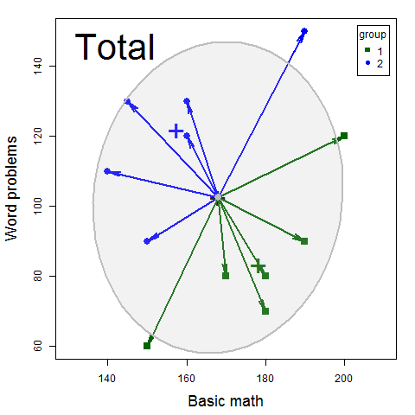
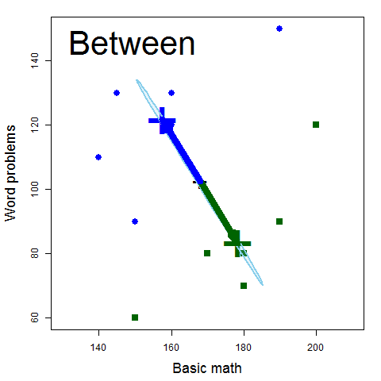
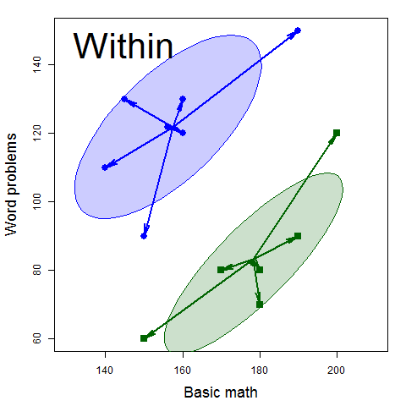
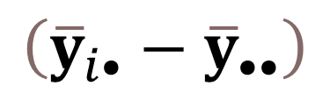
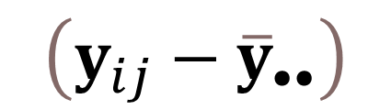
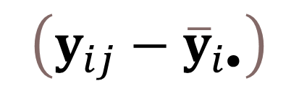
$$\left(y_{ij}−{\overline{y}}_{••}\right)$$
=
$$\left({\overline{y}}_{i•}−{\overline{y}}_{••}\right)$$
+
$$\left(y_{ij}−{\overline{y}}_{i•}\right)$$
=
+

