Slide 1
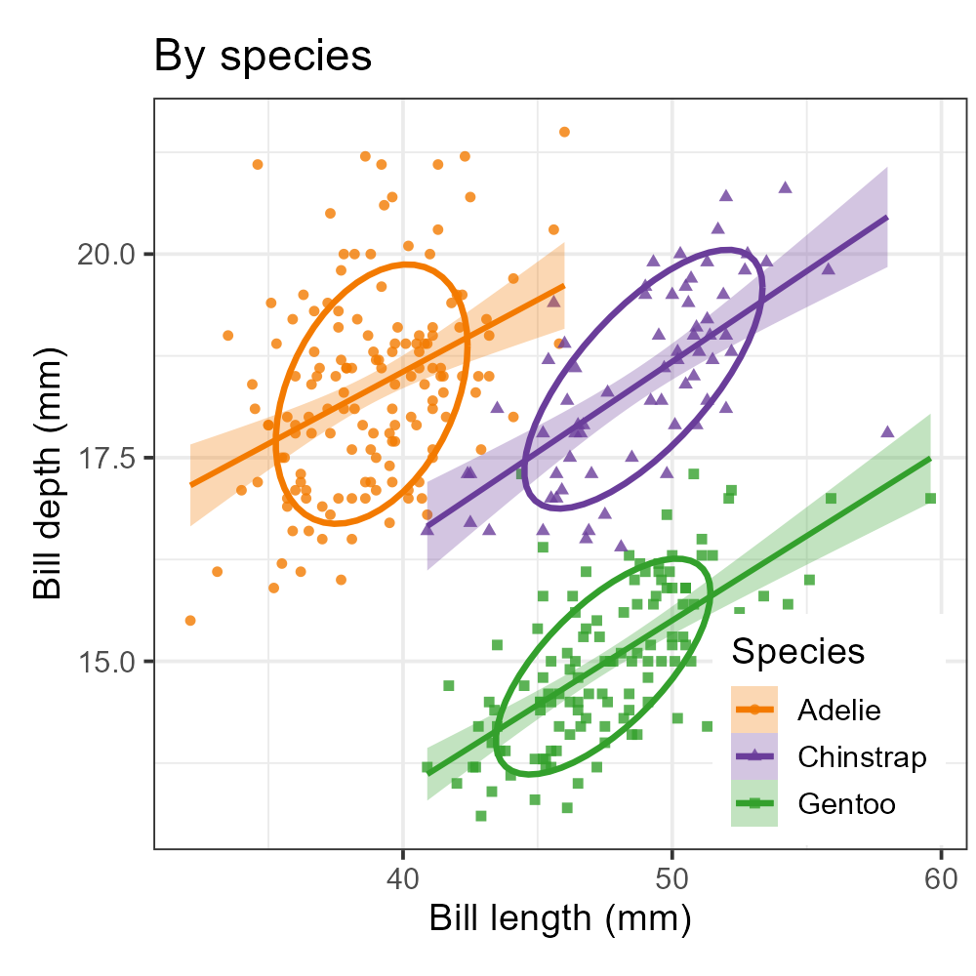
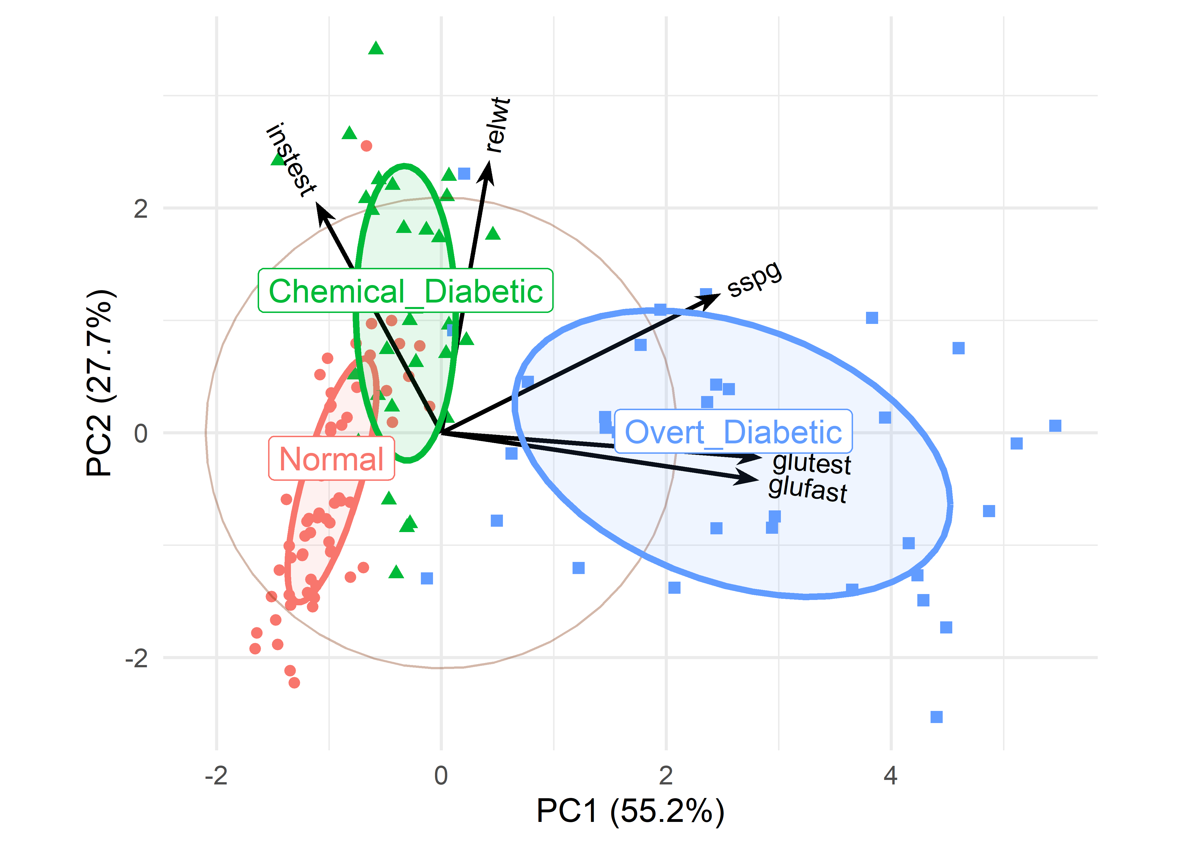
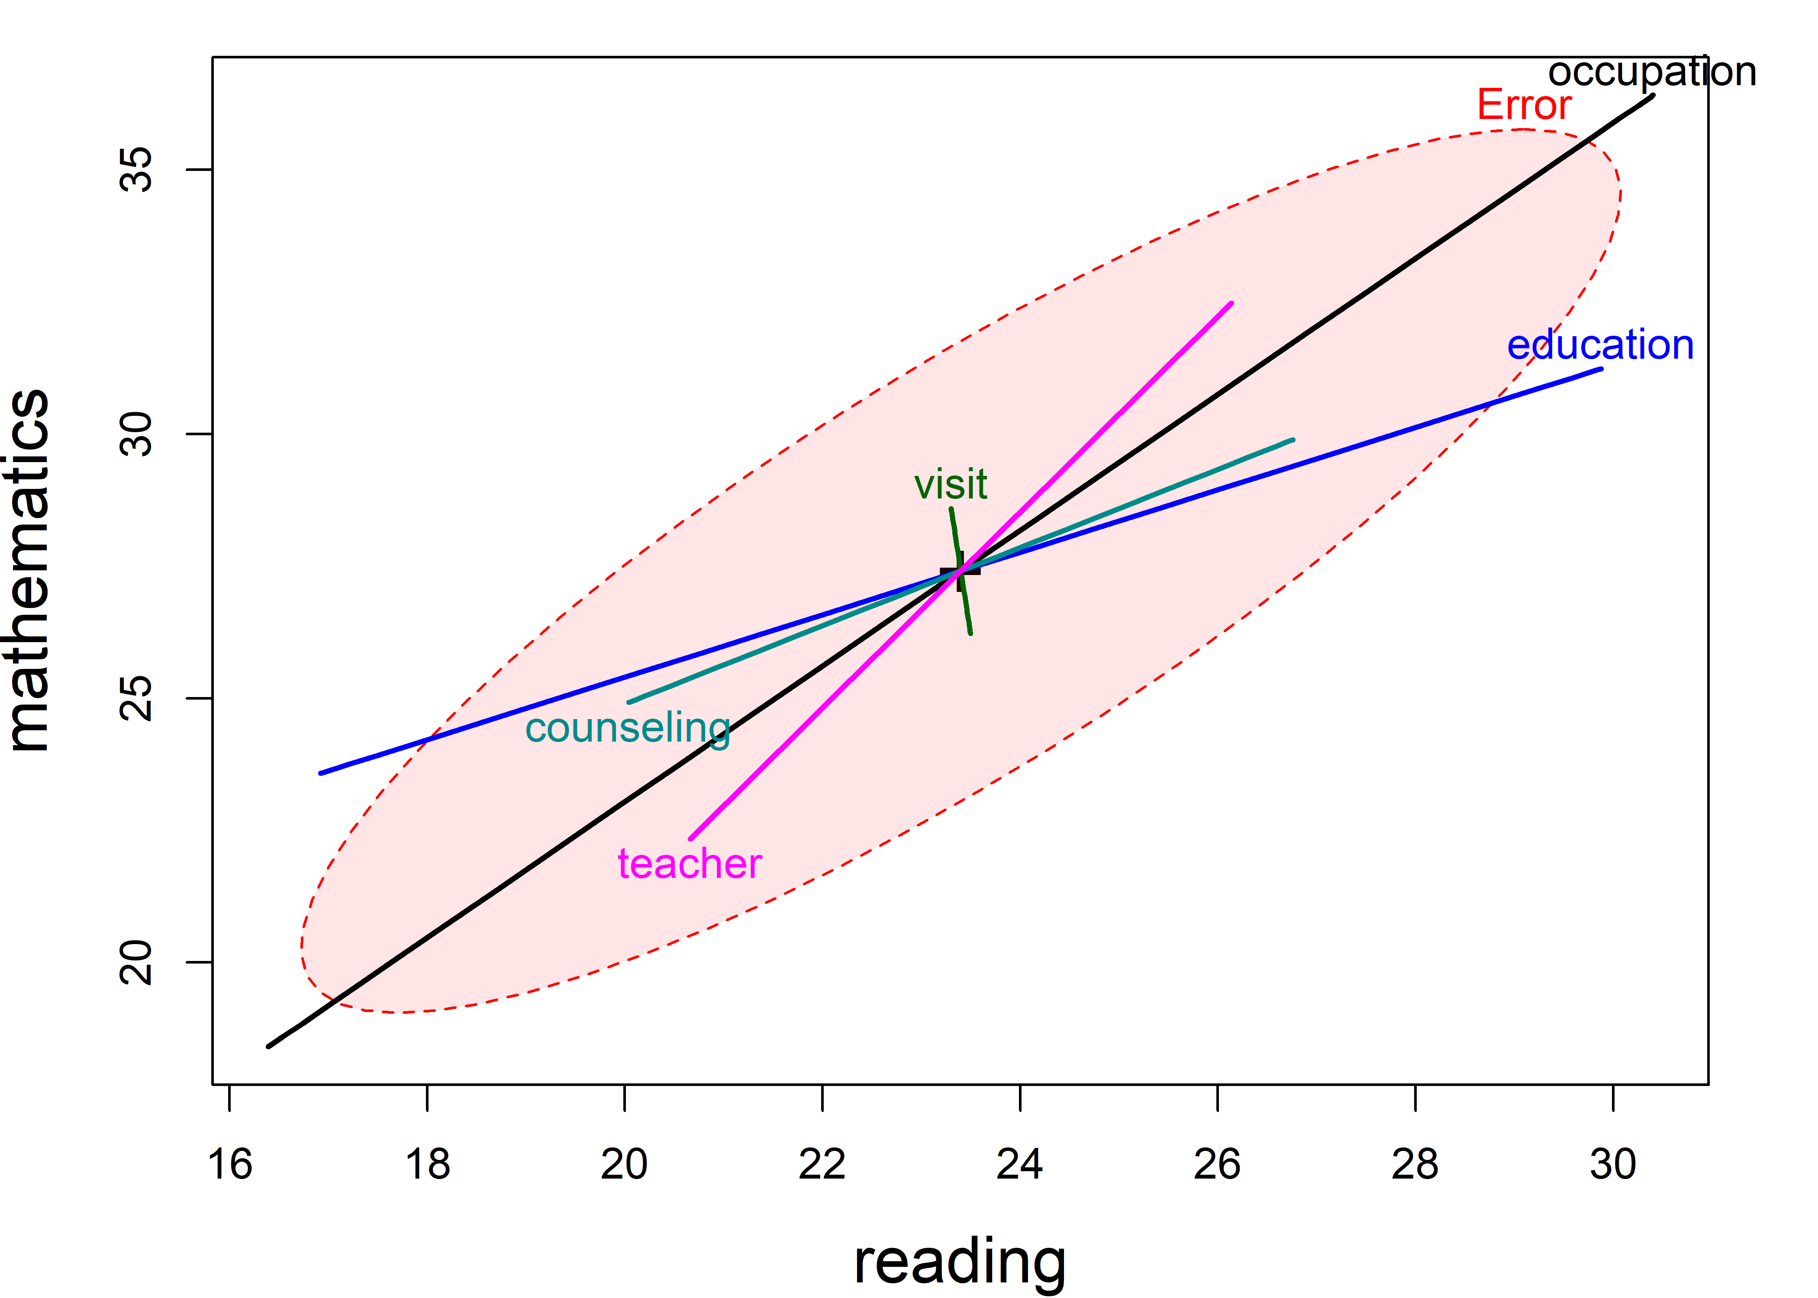

Visualizing Multivariate Data and Models in R
A Romance in Many Dimensions
Methodology & Statistics Group, Utrecht, Nov. 2026
Michael Friendly, York University, friendly.github.io | datavis.ca
Notes:
I’m so glad to be with you here today.
I just returned from Leuven, where I was on the jury for the Rousseeuw Prize in Statistics, which was happily awarded to The R Project in Statistical Computing & Graphics
As a bonus, daughter’s family lives in Utrecht, so I was happy to see them all.
And now, I’ll give the first public talk about my current book.

Slide 2
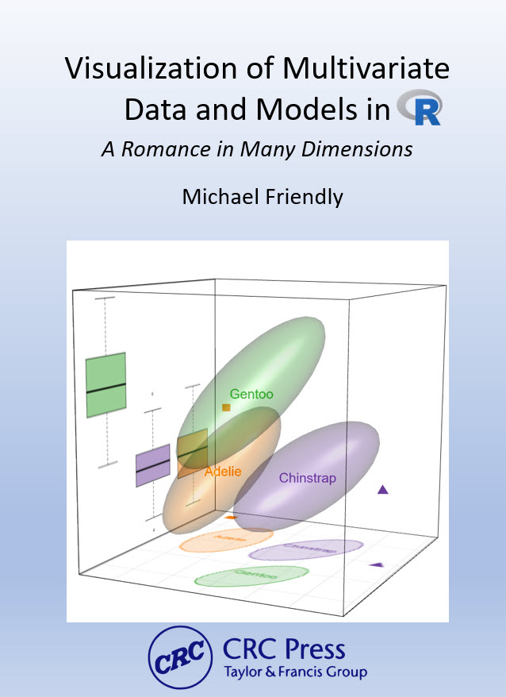
The book
Graphical methods for multivariate data and for multivariate linear models
15 chapters in four parts, from exploratory plots to MANOVA and discriminant analysis
To appear CRC Press / Chapman & Hall, 2027
Online version: friendly.github.io/Vis-MLM-book
Notes:
This book is the outcome of what, in one way or another, I’ve been working on for nearly my entire career. I’m happy to be able to share it with you today
It started in my first grad course, Multivariate Data Analysis when I arrived at York in 1971
How to teach the essential ideas of multivariate analysis?
– Notation: Matrix algebra?
- Visual understanding: Geometry
How to make it easier for researchers to use these methods to answer multivariate questions?
The print copy is in the hand of Copy Editing Surgeons at CRC press.
But I’m allowed to share an online version that also has animations I could not do in print and put all the R code online.

Slide 3
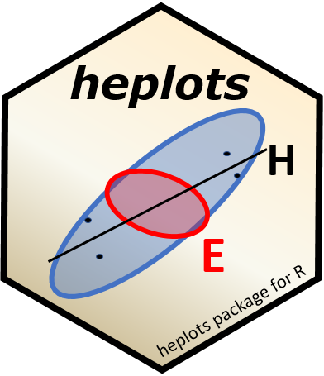
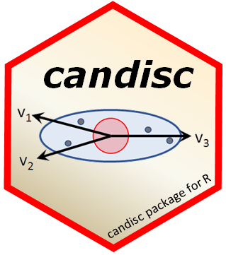

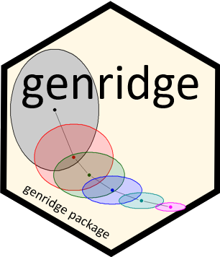
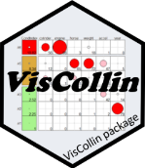
R packages
Theory → Practice: Making tools accessible
heplots
Visualizing hypothesis tests in multivariate linear models: HE plots, covariance ellipses, robust MLMs
candisc
Canonical discriminant and canonical correlation analysis: low-dimensional views of multivariate effects
mvinfluence
Influence measures and diagnostic plots for multivariate linear models
genridge
Generalized ridge trace plots: bias and precision in ridge regression
VisCollin
Understanding problems of collinearity thru visualization and reduced-rank views
Notes:
Theory to practice: the methods in the book are only useful if people can apply them. These four packages implement most of what follows: heplots (HE plots and related methods), candisc (canonical views), mvinfluence (multivariate influence), genridge (ridge trace plots).

Slide 4
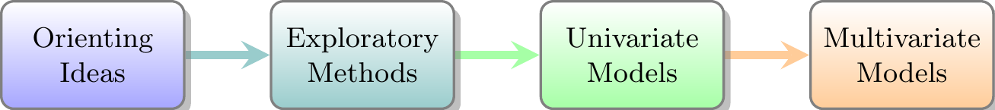
Ideas I’ll talk about today (thematic)
Why a romance in many dimensions?
Seeing multivariate data: ellipses everywhere
Multivariate juicers: low-D views, and Waldo space
Elliptical insights: models with one response
The HE plot framework for multivariate models
Checking multivariate models
Road map of the book (linear)
Notes:
Roadmap: The book follows a linear path: plots of data, then models with one response, then models with many responses.
Today, I want to talk about the main themes of the book.
Themes:
The ellipse is the recurring visual device I use to understand multivariate phenomena.
I’ll try to show how a wide variety of multivariate problems can be understood with insightful visual tools.

Slide 5
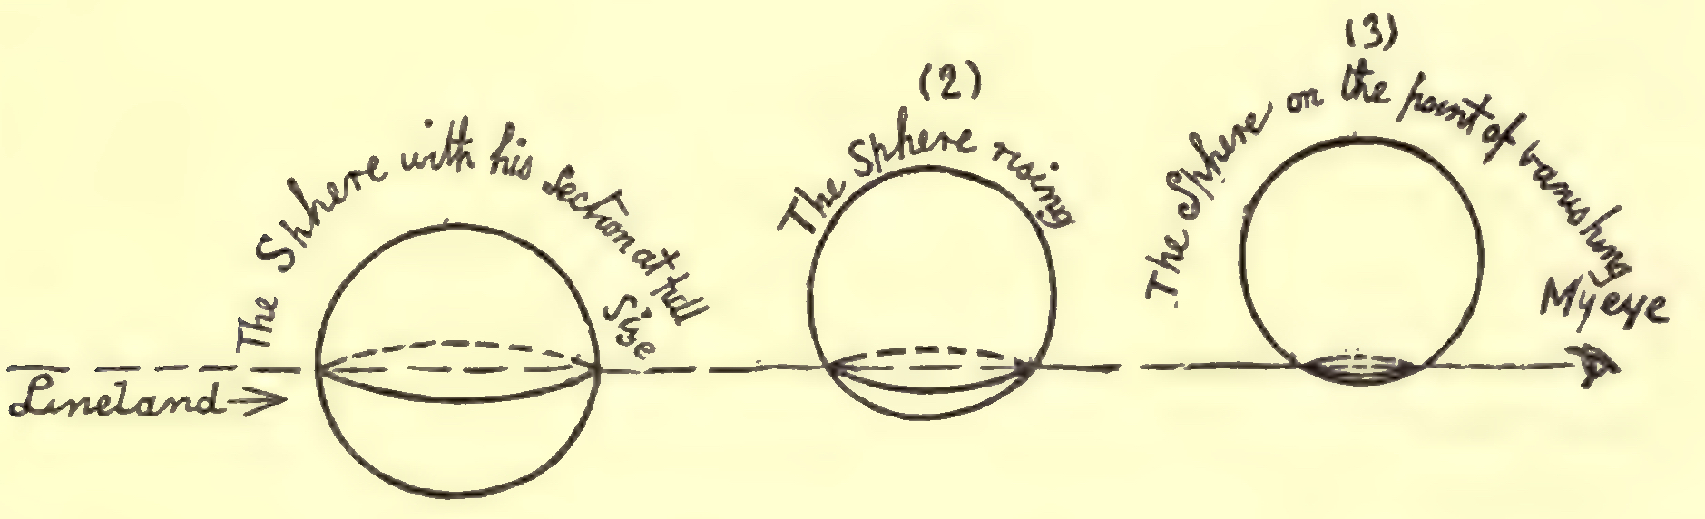
Why a romance in many dimensions?
How can we understand important scientific phenomena?
Our data live in Spaceland, sometimes high-D, but we plot in Planeland
Notes:
I chose this subtitle to reflect the love I’ve always had about understanding high-D phenonema data through the visual and analysis tools we have at our disposal
Our goal in data analysis & visualization should be to help understand scientific phenomena
Yet our data ofen live in Spaceland, sometimes high-D.
But, we are forced to plot them in 2D space.

Slide 6
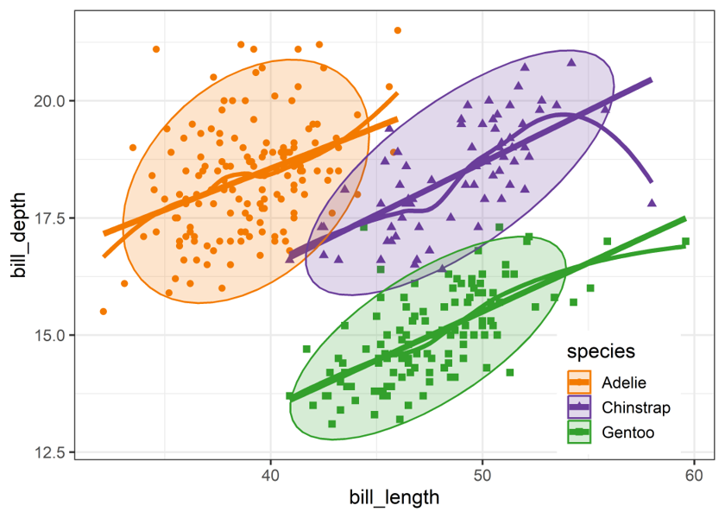
Planeland: we only ever see 2D projections
Abbott's Flatland (1884): a sphere passing through a 2D world is seen as a circle that grows and shrinks
Our 2D plots are Flatland views of data that live in many dimensions
Multivariate visualization is the art of choosing good views
#dataviz is the art of making plots informative (& pretty!)
Truth & Beauty: That’s the Romance!
Figure 1.1
Notes:
The book's subtitle is a nod to Abbott's 'Flatland: A Romance of Many Dimensions'. The Flatlander sees only a slice of the sphere. We are in the same position with p > 2 variables.

Slide 7
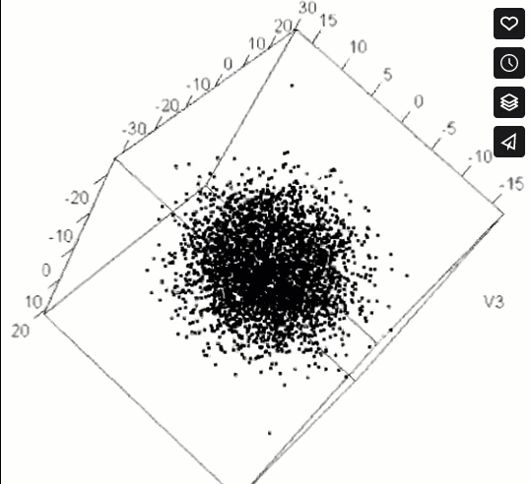
EUREKA! Structure can hide in many dimensions
HistData::Pollen, 5D, from the 1986 JSM Data Exposition: “Find something interesting here”
Zooming in on the right view reveals what no summary statistic could ever do
History of science gives many Eureka Moments revealed by graphs
Figure 1.5
Notes:
Animation (plays in slide show mode).
The Pollen dataset contains 5 variables measured on grains of pollen. It was created for the 1986 JSM Data Exposition:
The invitation was “Show your stuff!”, “Find something interesting here”.
It was a challenge, because, to most graphic methods of the day, it looks like a featureless cloud of points.
The secret hidden there was only revealed from one orientation in 5D space when you zoom in on the dense center, where the points spell out a word.

Slide 8
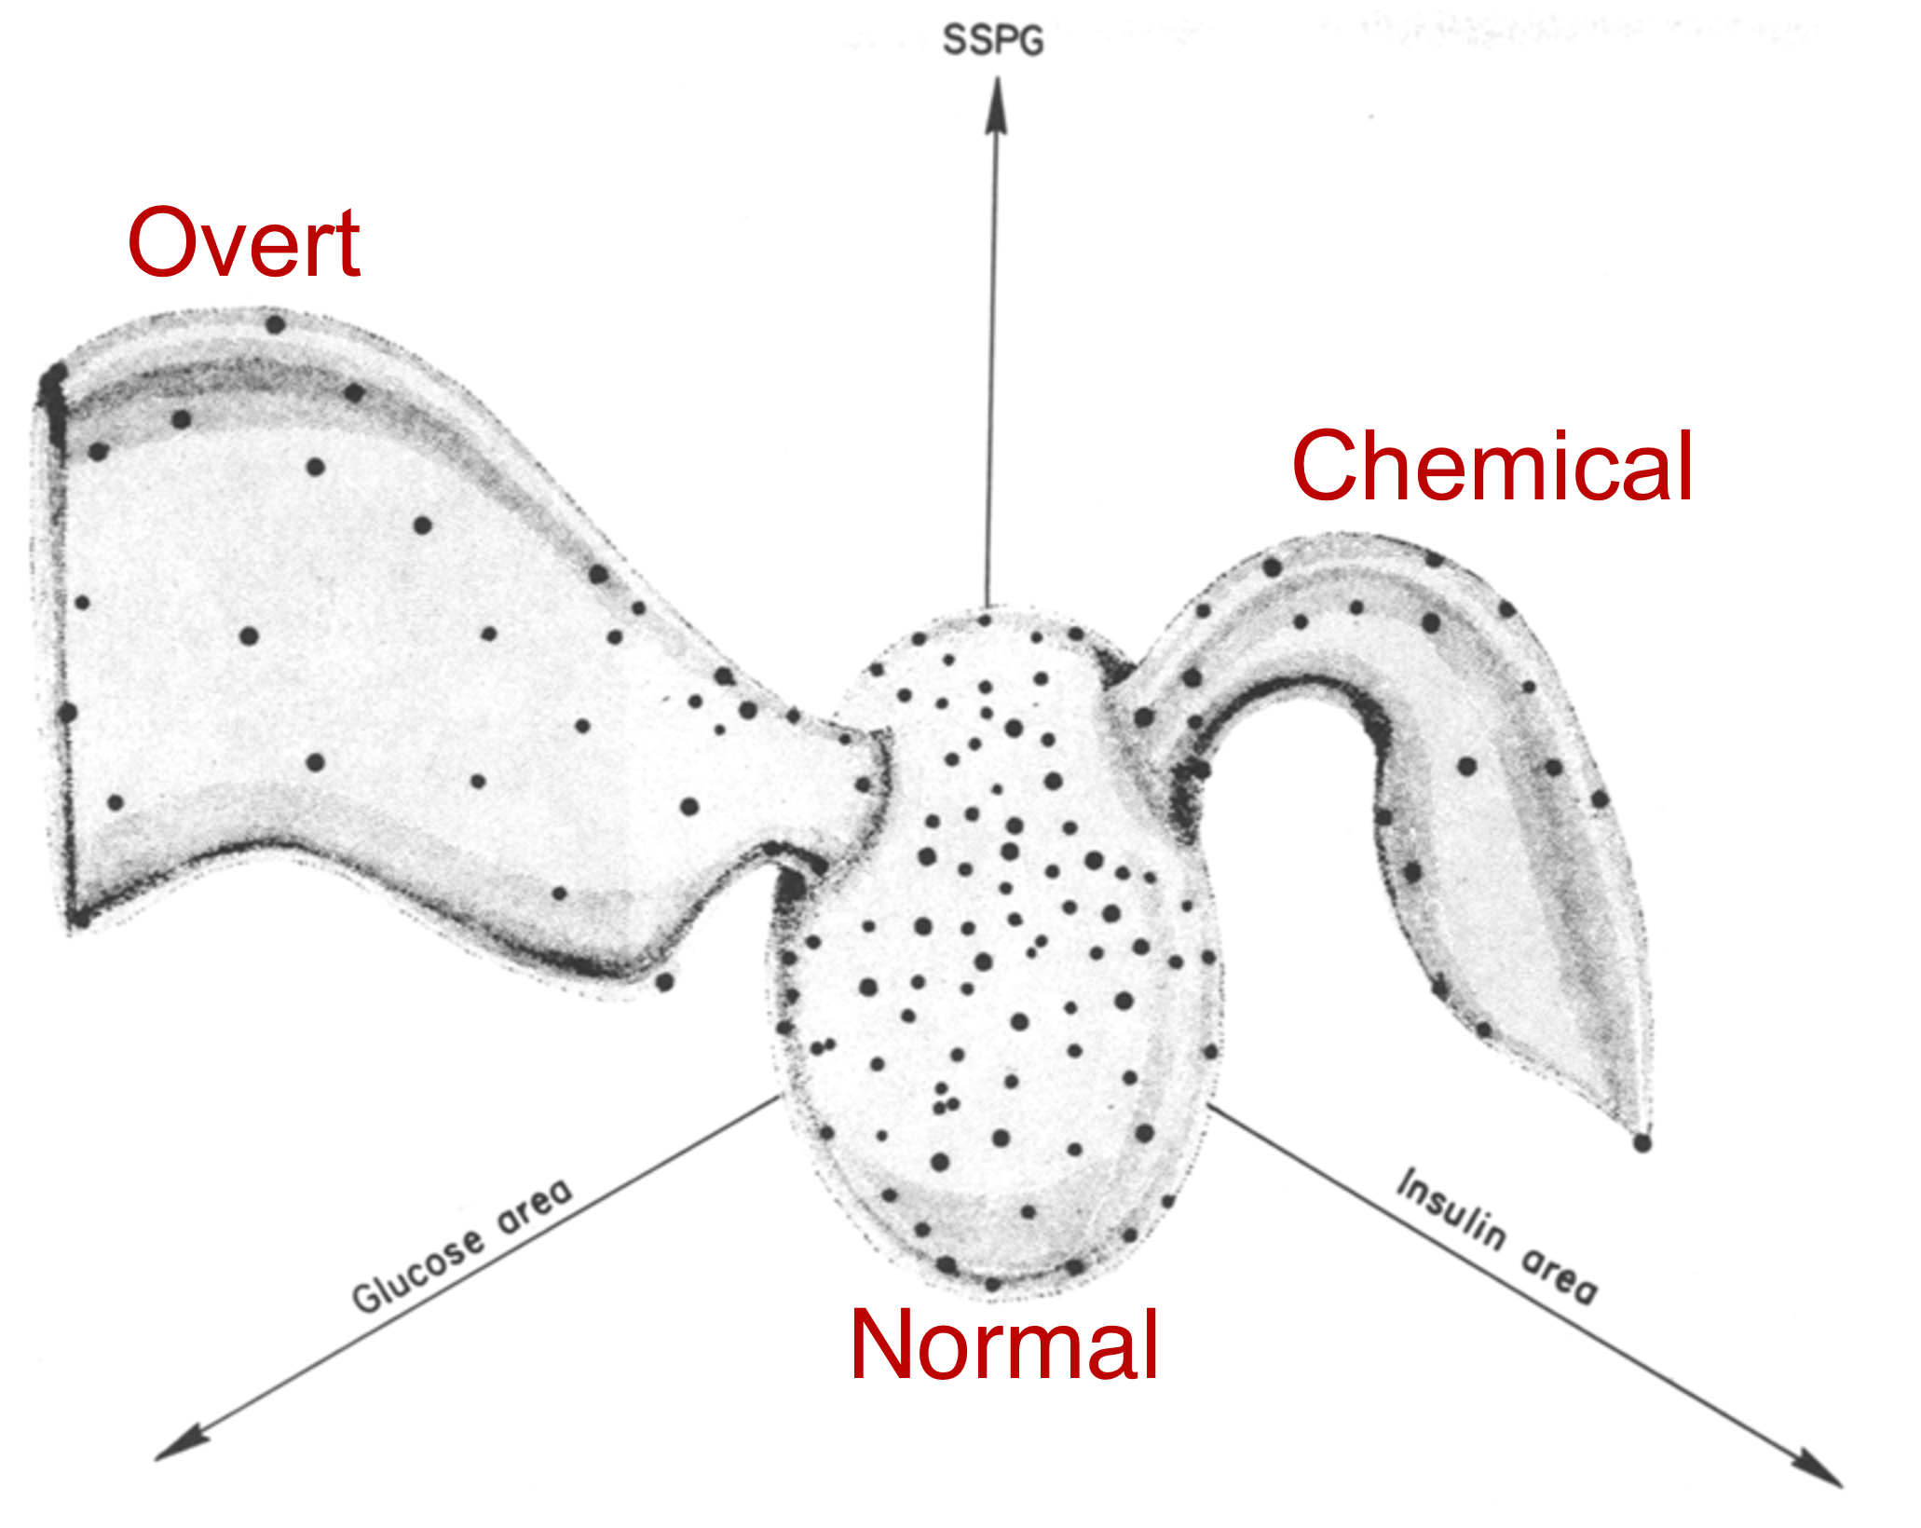
Multivariate discovery: kinds of diabetes
Reaven & Miller (1979) viewed glucose and insulin measures in 3D with PRIM-9
Earlier 1968 study: murky in 2D
The 3D view showed distinct groups that 2D plots had obscured
The picture changed how the disease was classified
Figure 1.7
Notes:
An example of a scientific discovery that came from looking at data in more than two dimensions. The Diabetes data come back later in the dimension reduction section.

Slide 9
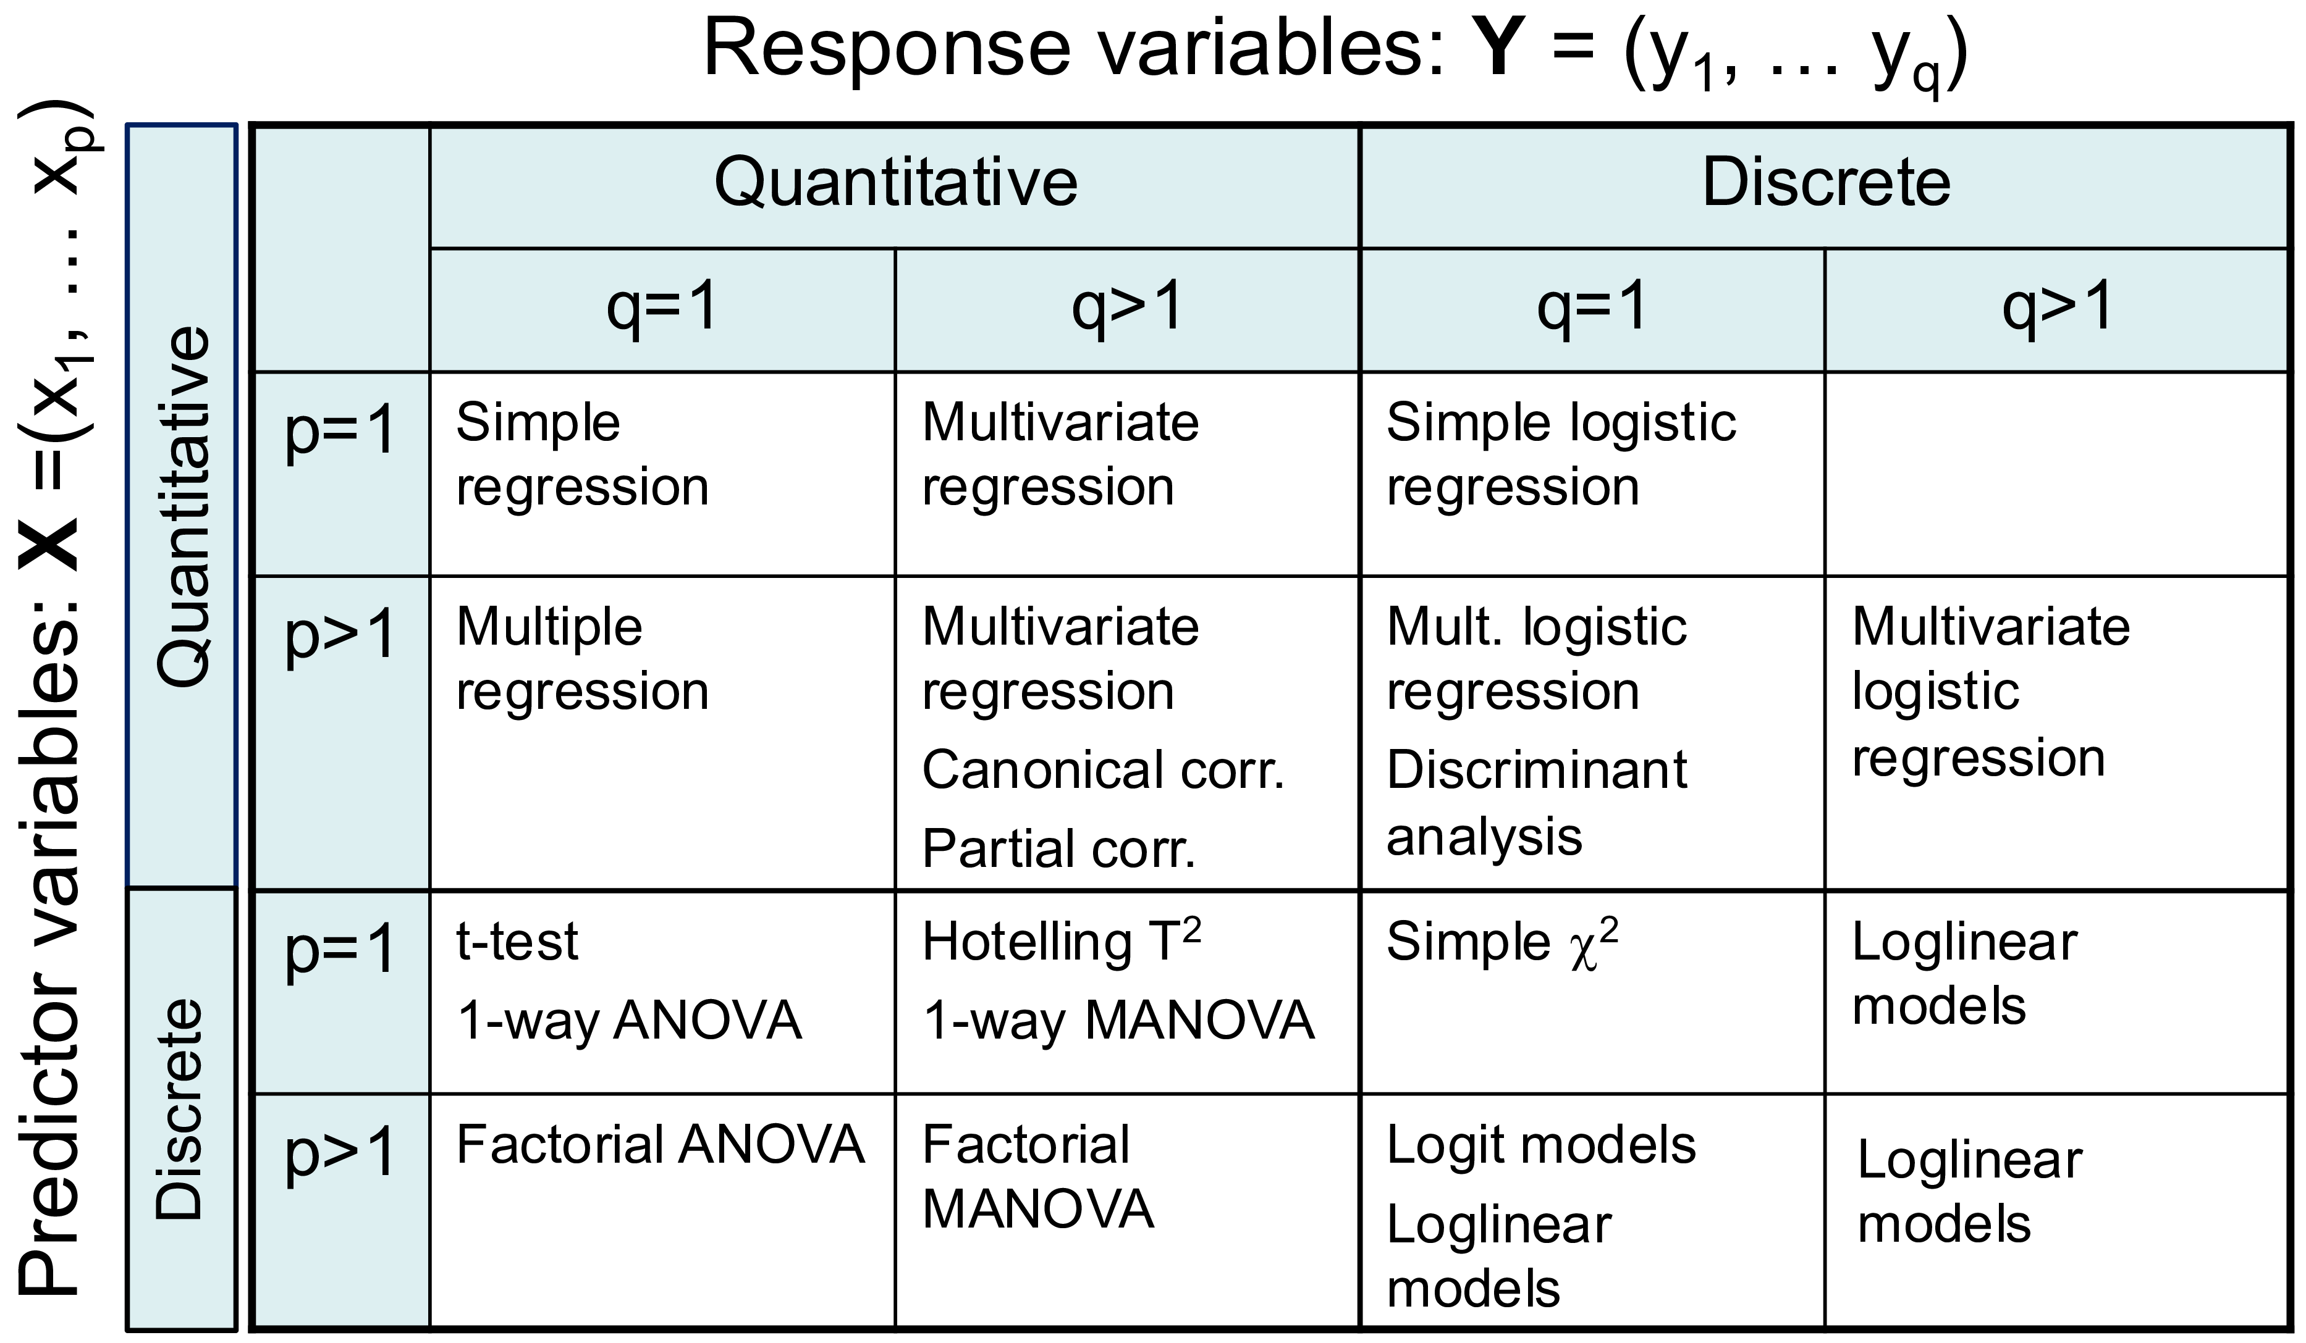
MLM problem: easy to fit, hard to see
With one response, we have a rich toolkit of plots for linear models
With several responses, lm(cbind(y1, y2, y3) ~ ...) is just as easy to fit
Math is beautiful & easy too: y ⤳ Y
But the results arrive as tables of multivariate tests
Goal: plots that show what those tests mean, visual inference?
Figure 6.1
Notes:
The table classifies linear model techniques by the number and type of responses and predictors. The right-hand column, multivariate responses, is where graphical methods have been thin.

Slide 10


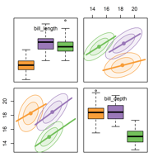
Seeing multivariate data
Data ellipses, penguins, and looking at many variables at once
Notes:
The first act in understanding multivariate data is to be able to “see” it

Slide 11
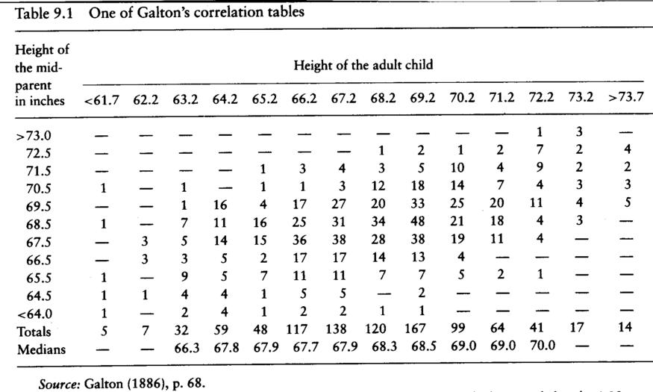
Galton’s visual discovery:
Bivariate normal correlation surface (1886)
Notes:
My path to multivariate visualization begins with Galton’s remarkable visual insight from a table of heights of parents and their offspring, that later gave rise to the theory of correlation and regression.

Slide 12
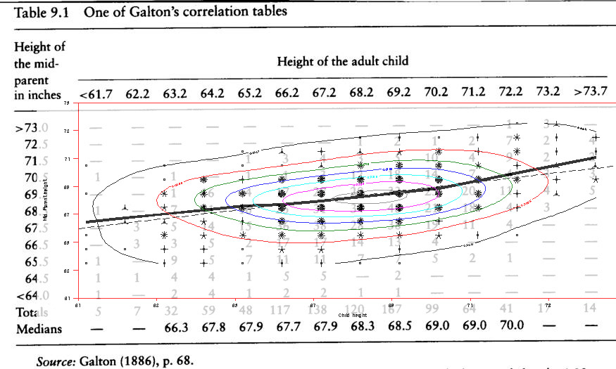
Visual smoothing → Insight
Notes:
It is really more a semi-graphic table, recording frequency in this bivariate distribution.
Galton drew smoothed curves- by eye and brain- of equal frequency
He noticed that these formed “concentric and similar ellipses,” and
that the lines of means of x|y and y|x were the loci of conjugate tangents of the ellipses.

Slide 13
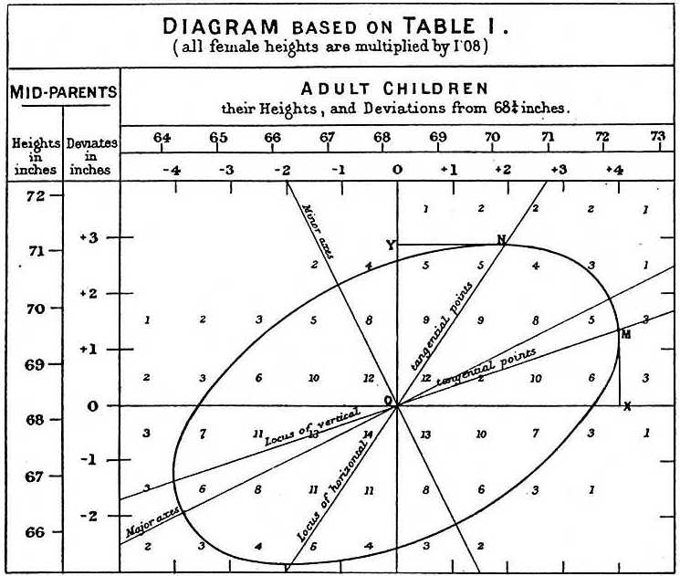
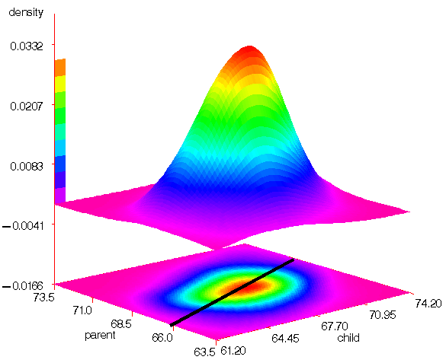
Visual insight → Theory (the OMG! moment)
3D Level curves are ellipses
Regression lines are loci of conjugate tangents
PCA dims are major / minor axes
… that Galton should have evolved all this … is to my mind one of the most note-worthy scientific discoveries arising from analysis of pure observation (Pearson 1920, p37)
Galton (1886, Pl X): Smoothed contours of heights of parents and children
Notes:
From this, evolved the famous Galton diagram of correlation and regression shown at the right, where:
level curves of equal frequency are concentric ellipses and
the two regression lines, x|y and y|x are the loci of conjugate tangents.
Equally remarkable, he shows the major and minor axes of the ellipse, which would later be shown to be the principal component directions in a bivariate distribution.

Slide 14
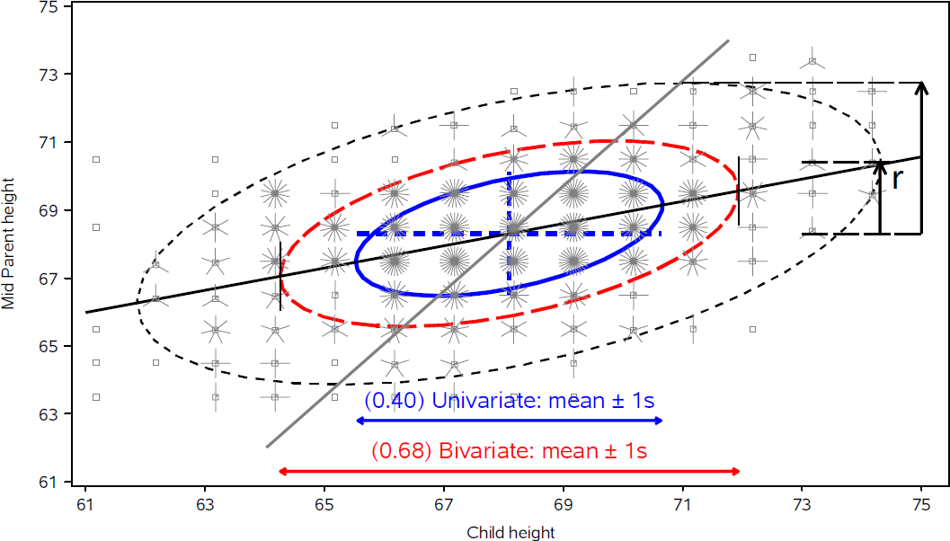
The data ellipse summarizes means, spread & correlation – a sufficient visual summary for N(µ, Σ)
Ellipsoid boundary: Mahalanobis D_{M}² (y_{i}) ~ χ_{p}²
  p=2: shadows generalize univariate confidence intervals
  eccentricity: precision; visual estimate of correlation
95%
68%
40%
r ≈ 0.5 here
Notes:
Galton's data on the heights of parents and children. Data ellipses of 50%, 68% and 95% coverage. The ellipse is the workhorse of the book: the same idea returns as confidence ellipses for coefficients and as H and E ellipses for multivariate tests.

Slide 15
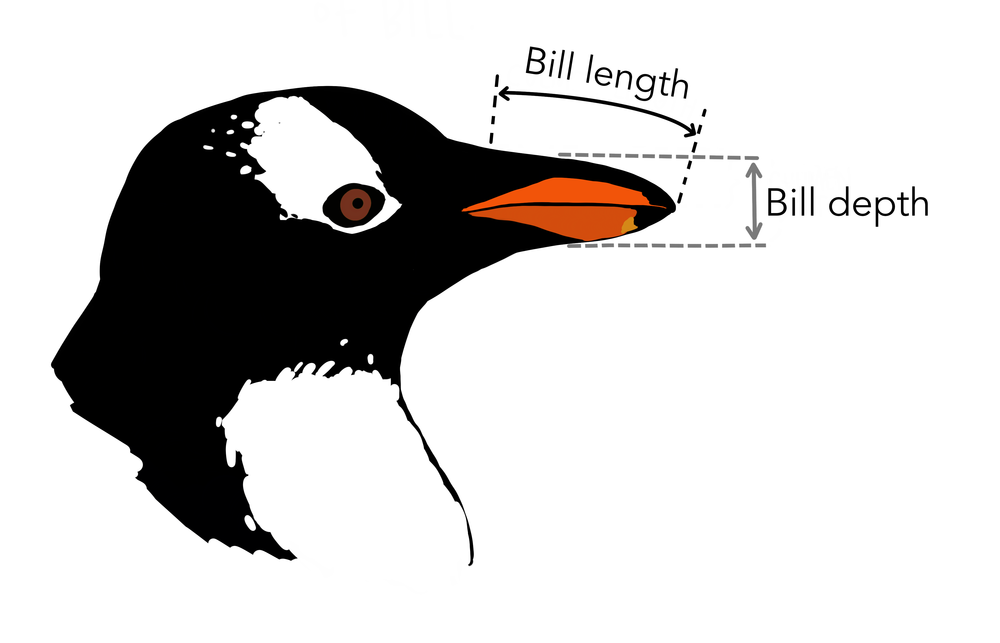
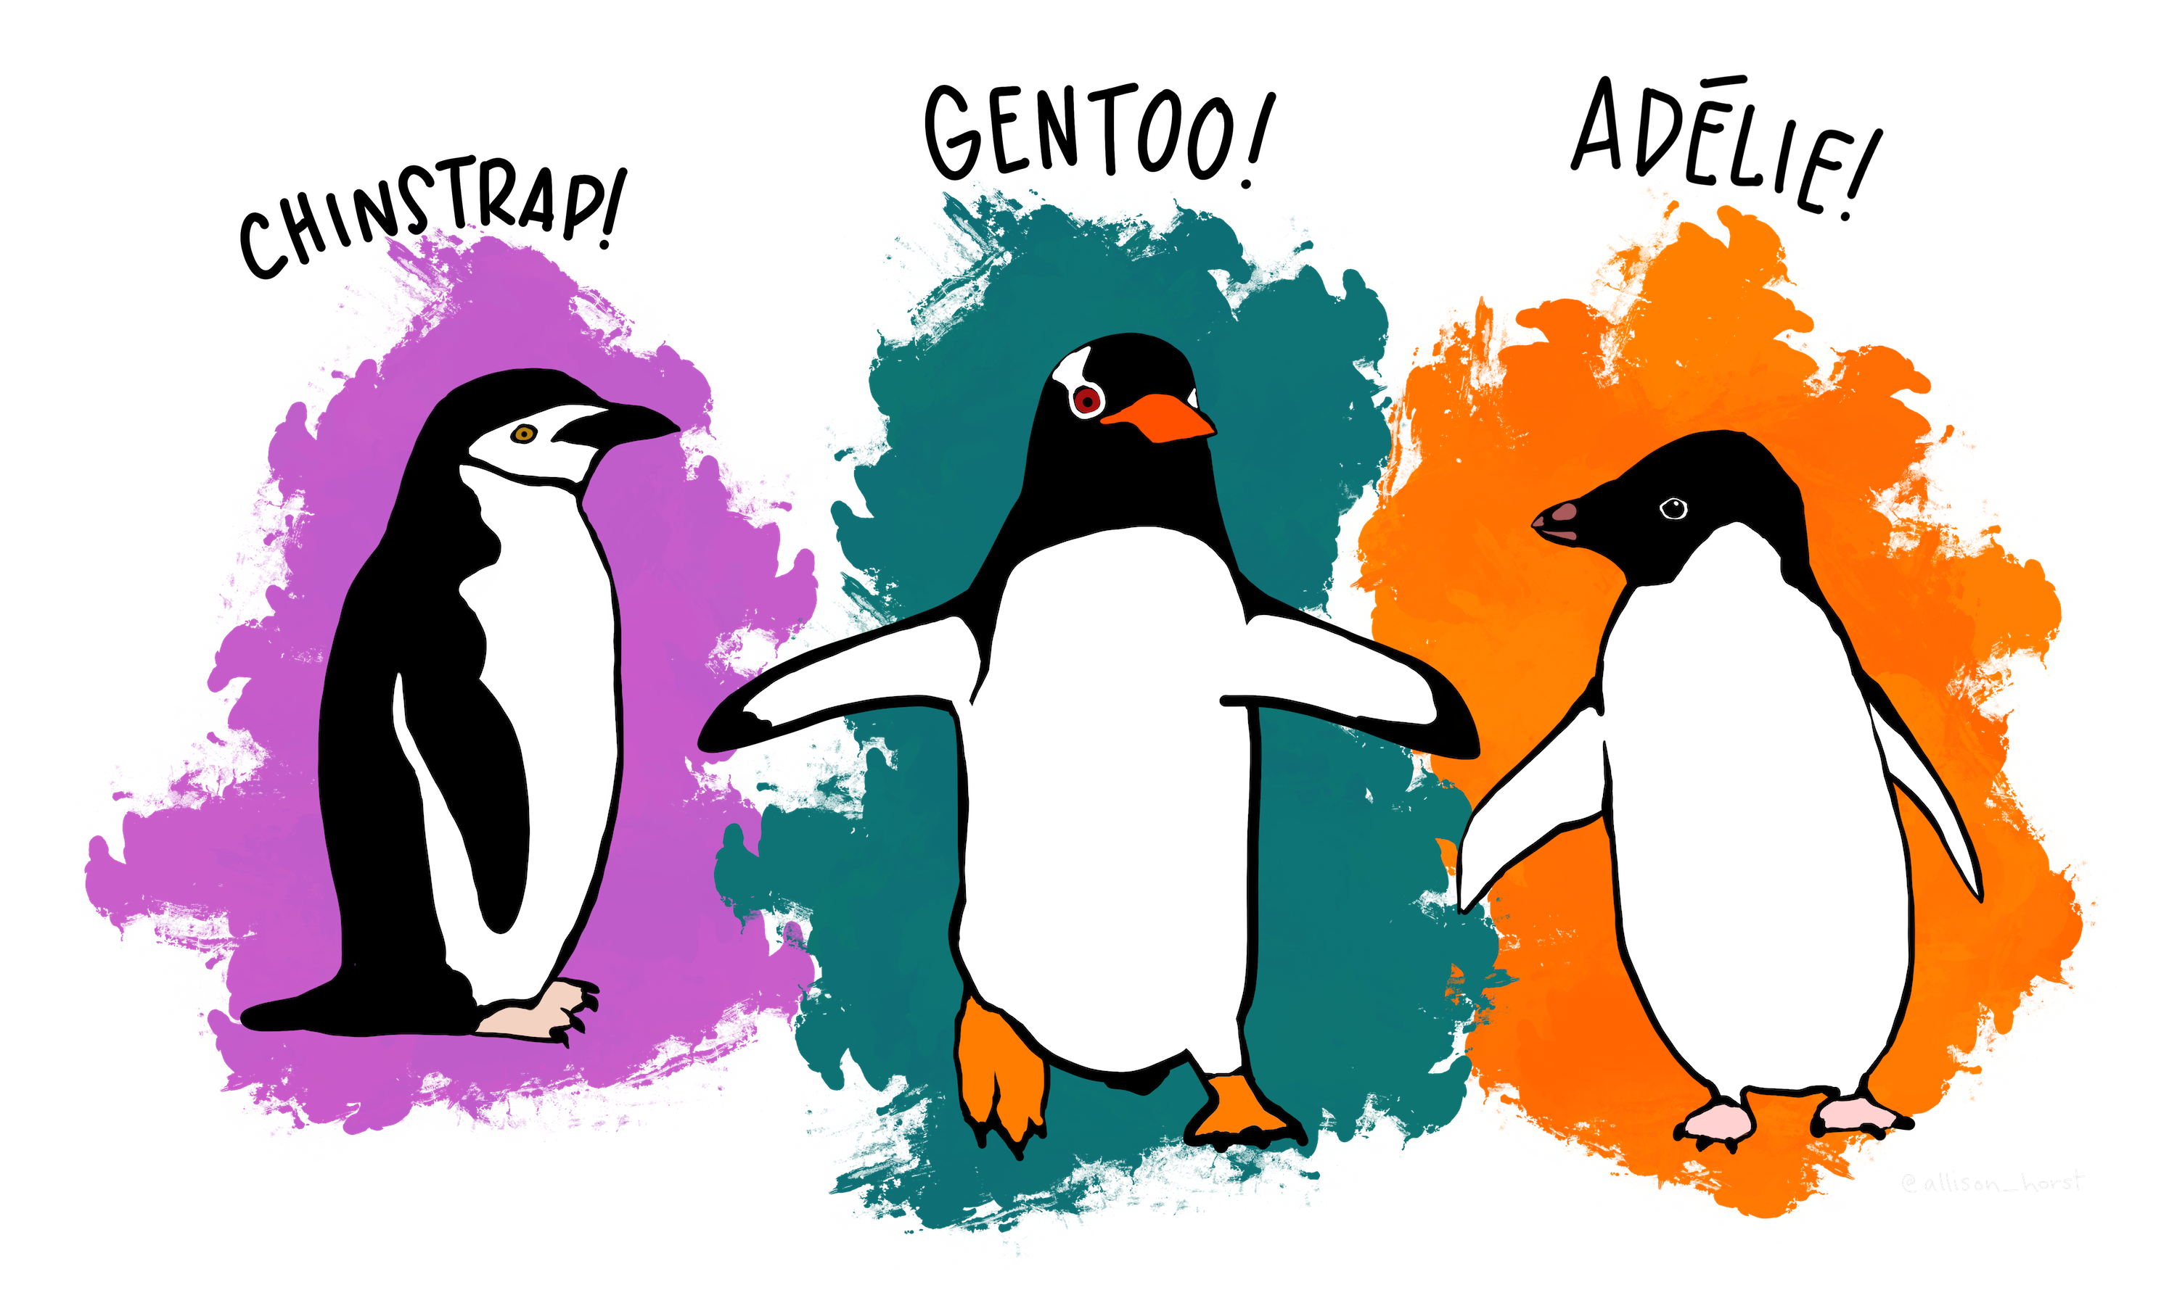
Meet the penguins
Three species, four size measures: bill length, bill depth, flipper length, body mass. Artwork: Allison Horst.
Figure 4.17, 4.19
Notes:
The Palmer penguins data is a main running example in the book
(The classic iris data seems to have been eclipsed b/c of Fisher’s association with the eugenics movement because often called “Fisher’s Iris data” even though it came from Edgar Anderson.
Here: bill length and bill depth with data ellipses and regression lines for each species.

Slide 16
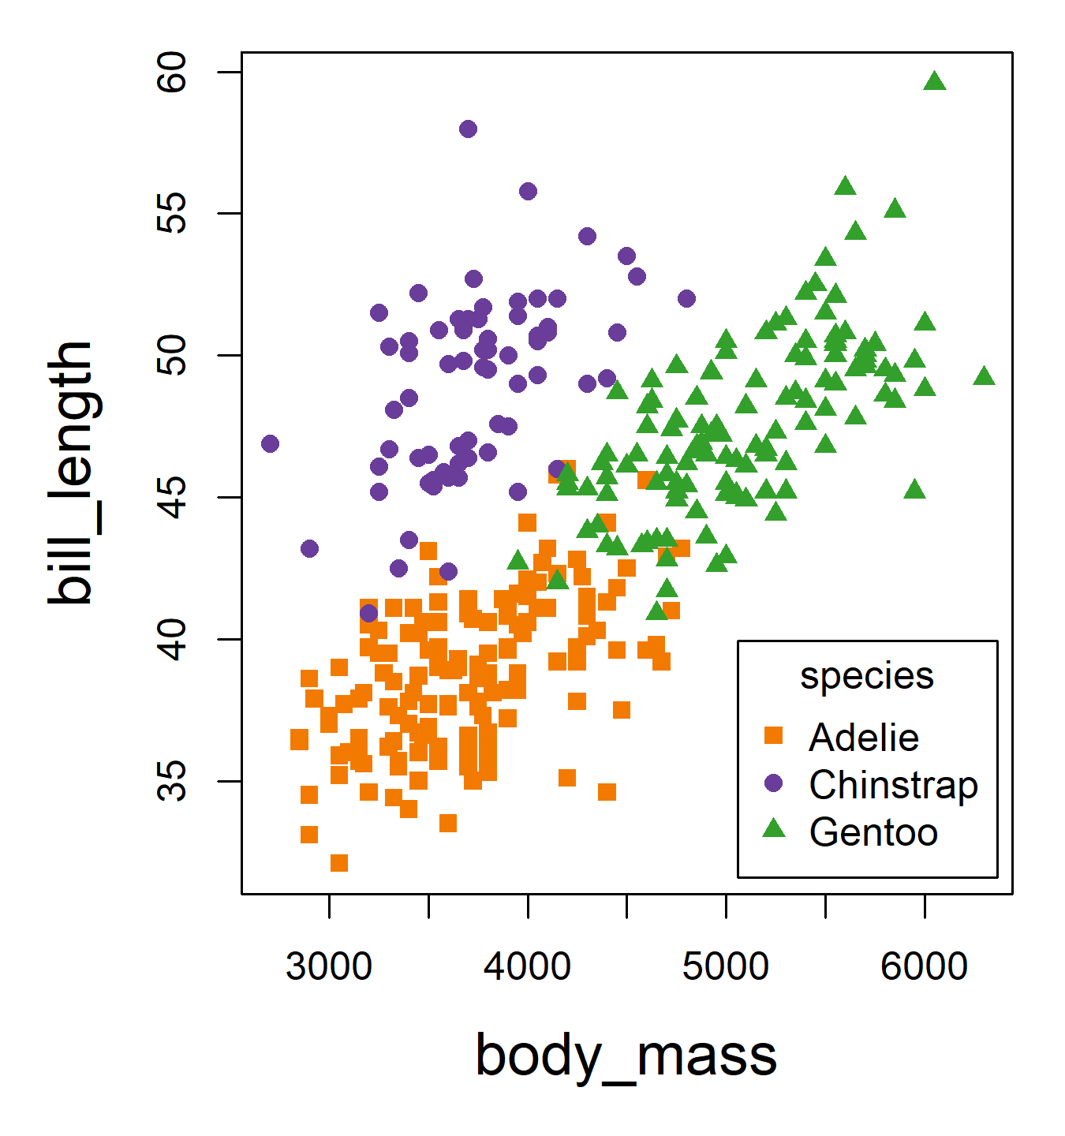
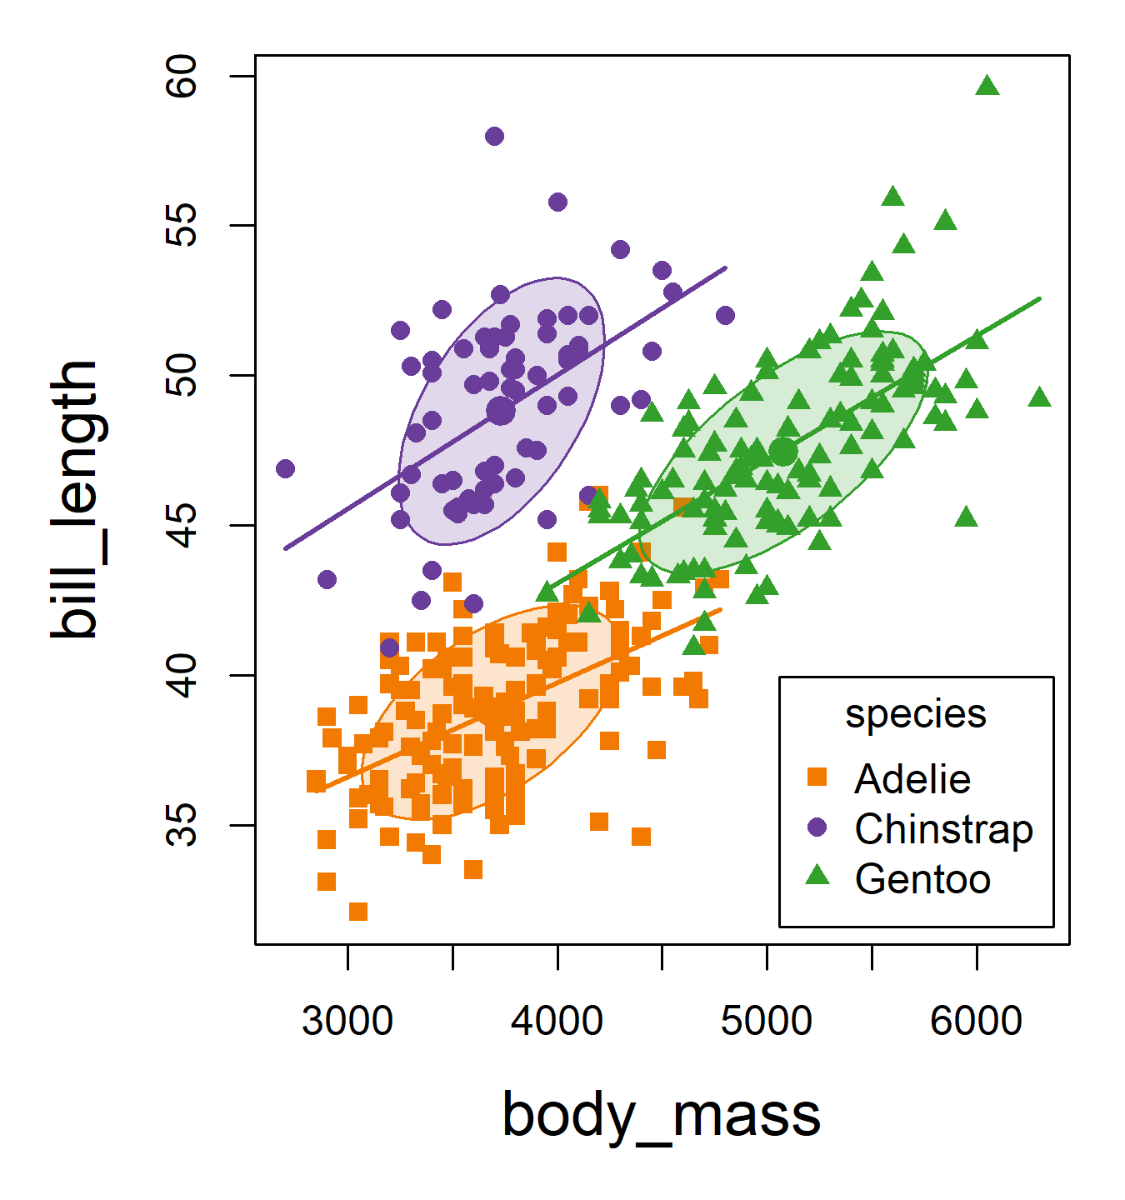
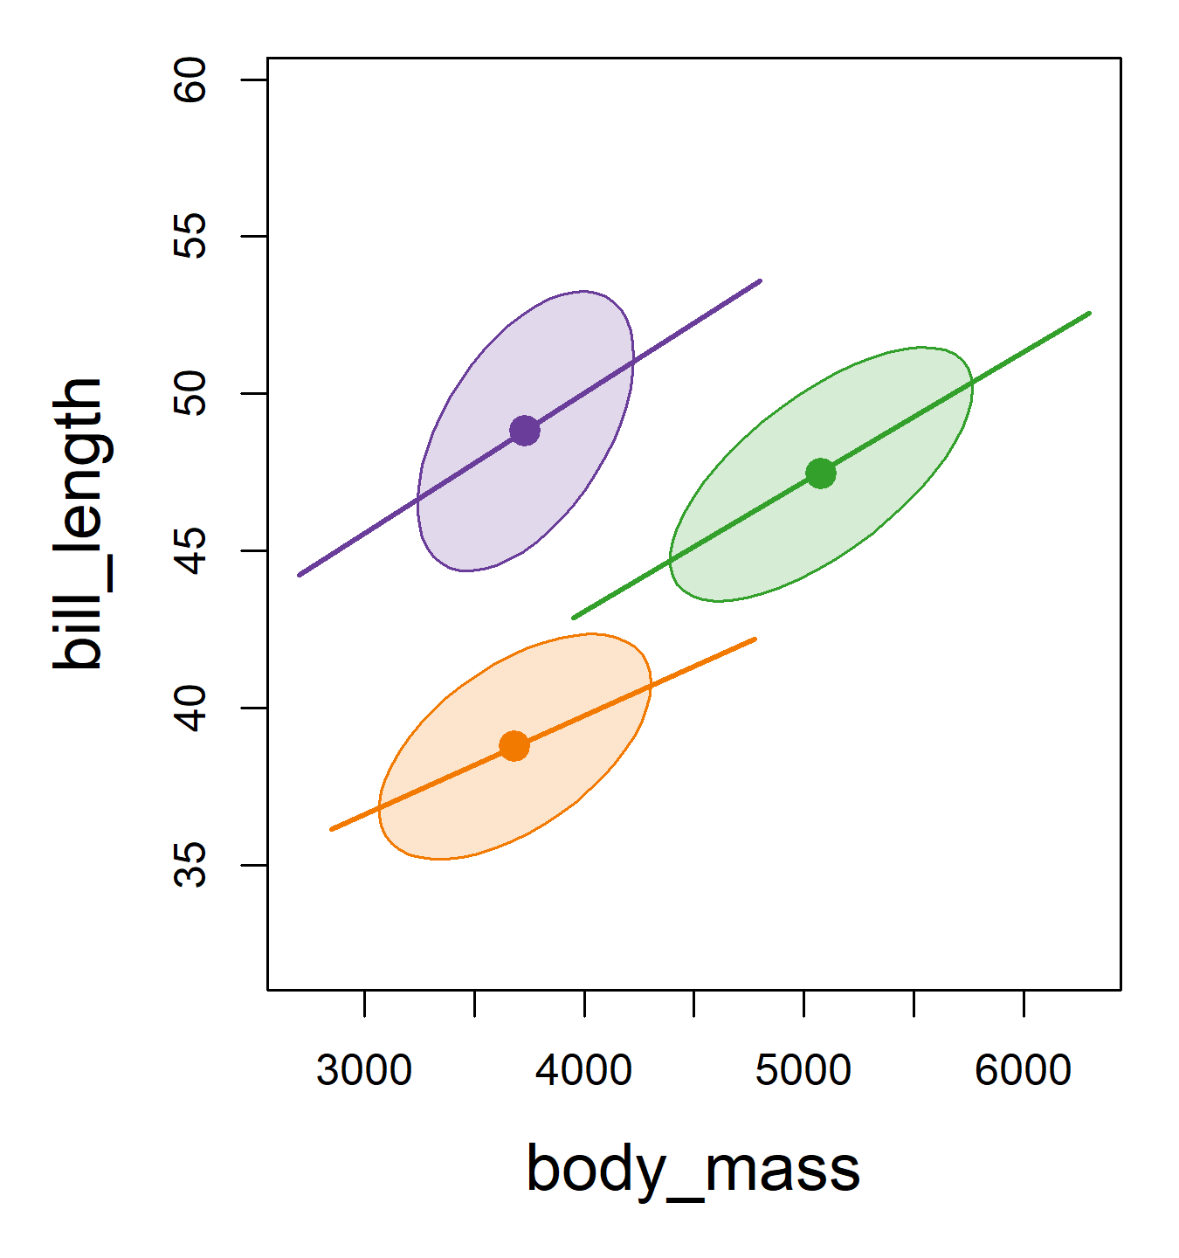
Data ellipses: Sufficient visual summary
Plot annotations are visual summaries (ellipse, regression line, conf. band)
Add data ellipses to show w/in group means & scatter (sufficient for N(µ, Σ))
Remove the points to show the overall patterns: means, shape, corr., precision
What remains is all that linear models care about (ellipses can be made robust!)
Standard scatterplot
Add data ellipses
Remove points
Notes:
To illustrate what I mean when I say “sufficient visual summary”– let’s start with an ordinary scatterplot…

Slide 17
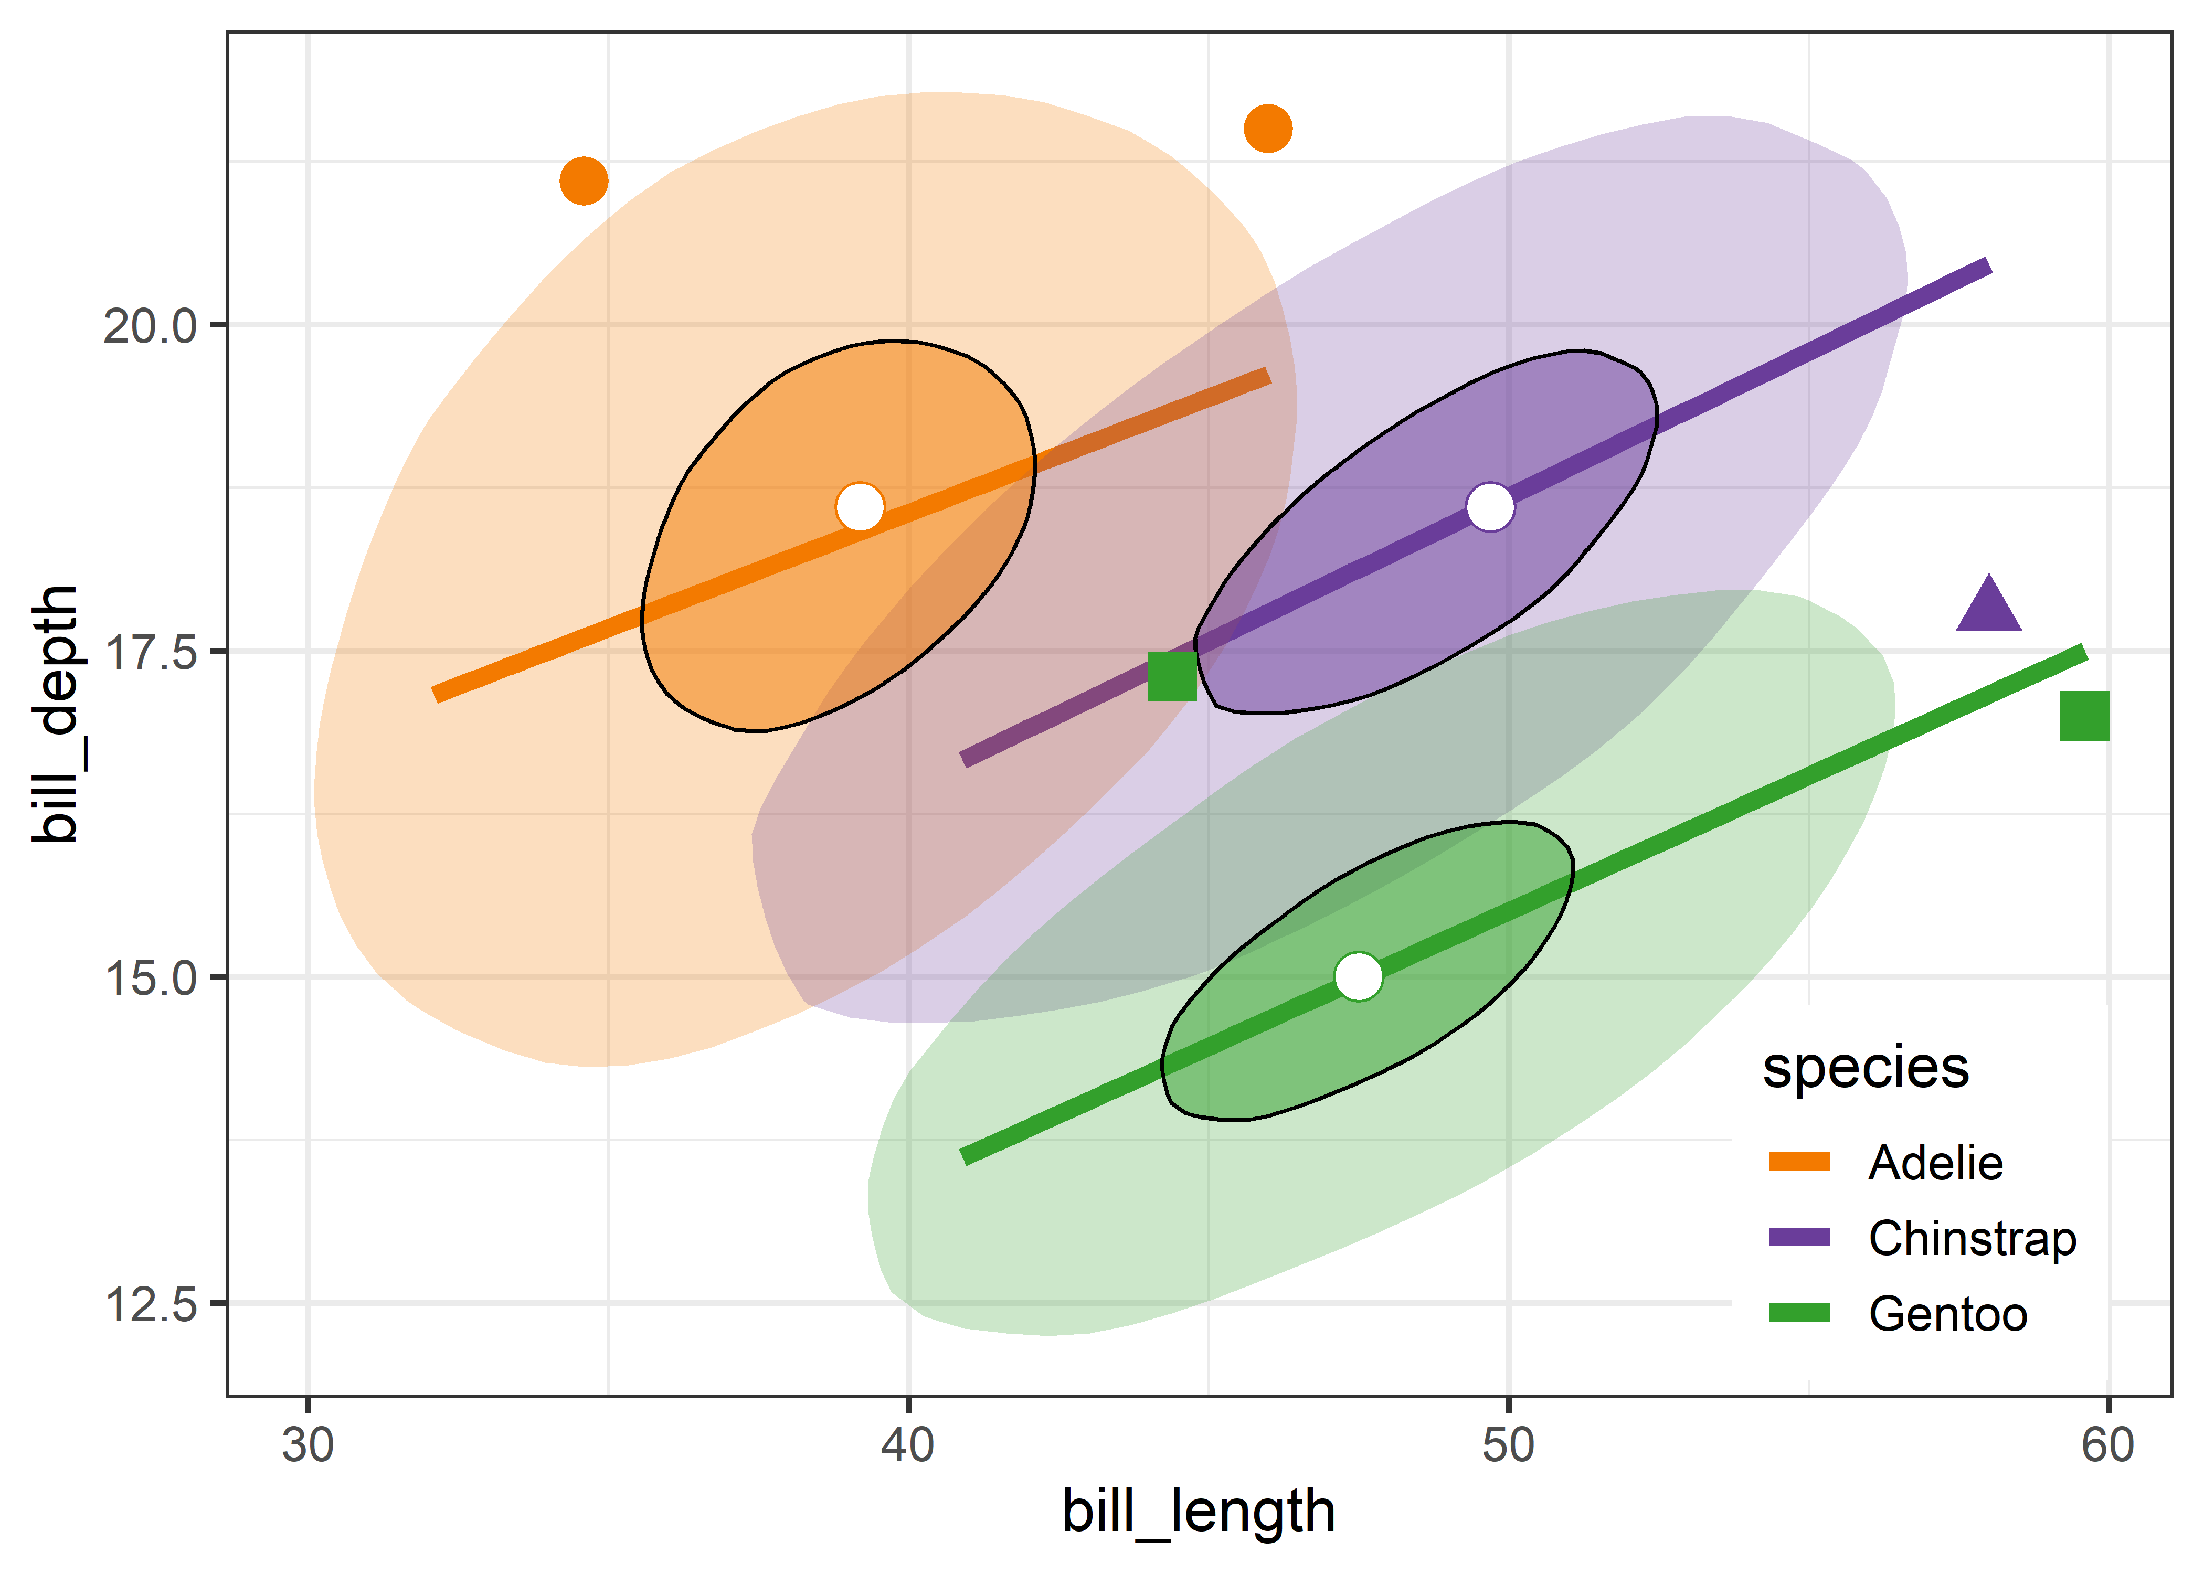
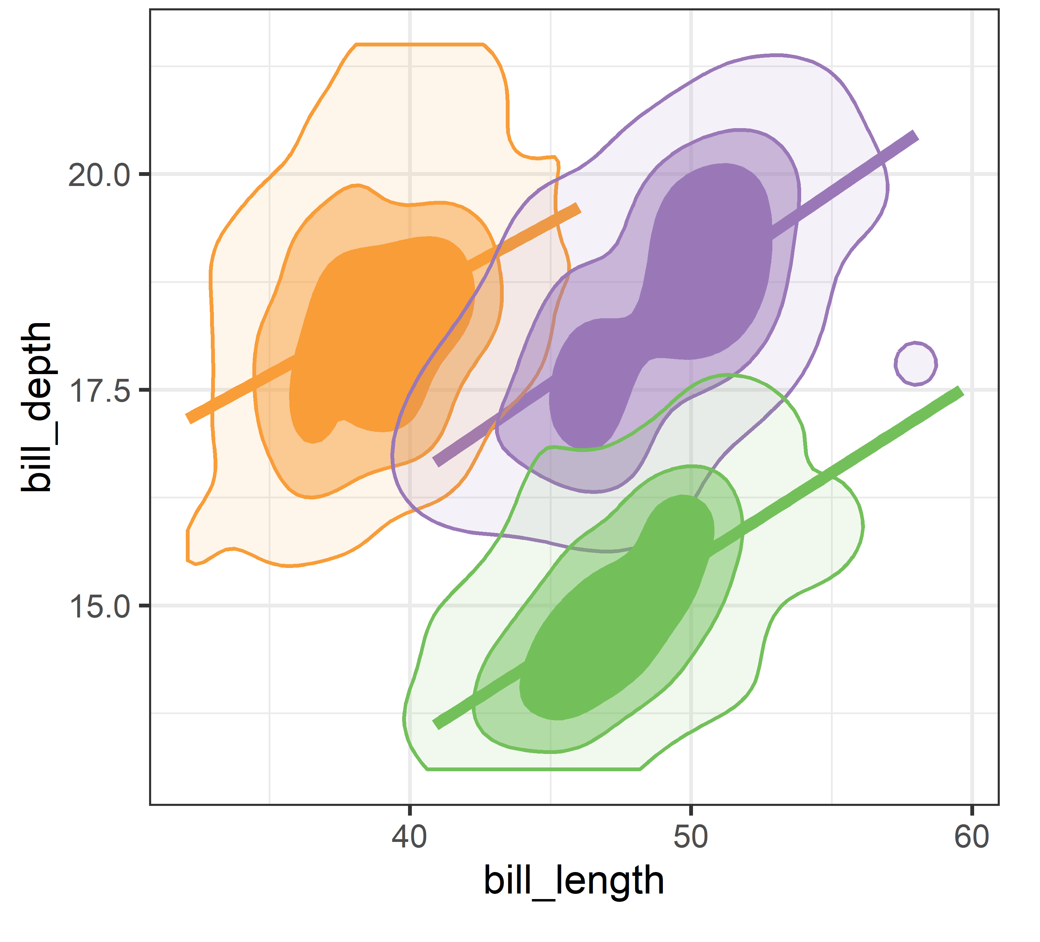
What if I'm not Normal?
Don’t worry: there are non-parametric alternatives
gggda::geom_bagplot()
ggdensity::geom_hdr()
Bags and high-density regions don't assume normality, yet for the penguins they come out nearly elliptical
Figure 4.21, 4.22
Notes:
If you’re worried about the assumption of bivariate normality in these plots, there are several non-parametric alternatives, just for the asking.

Slide 18
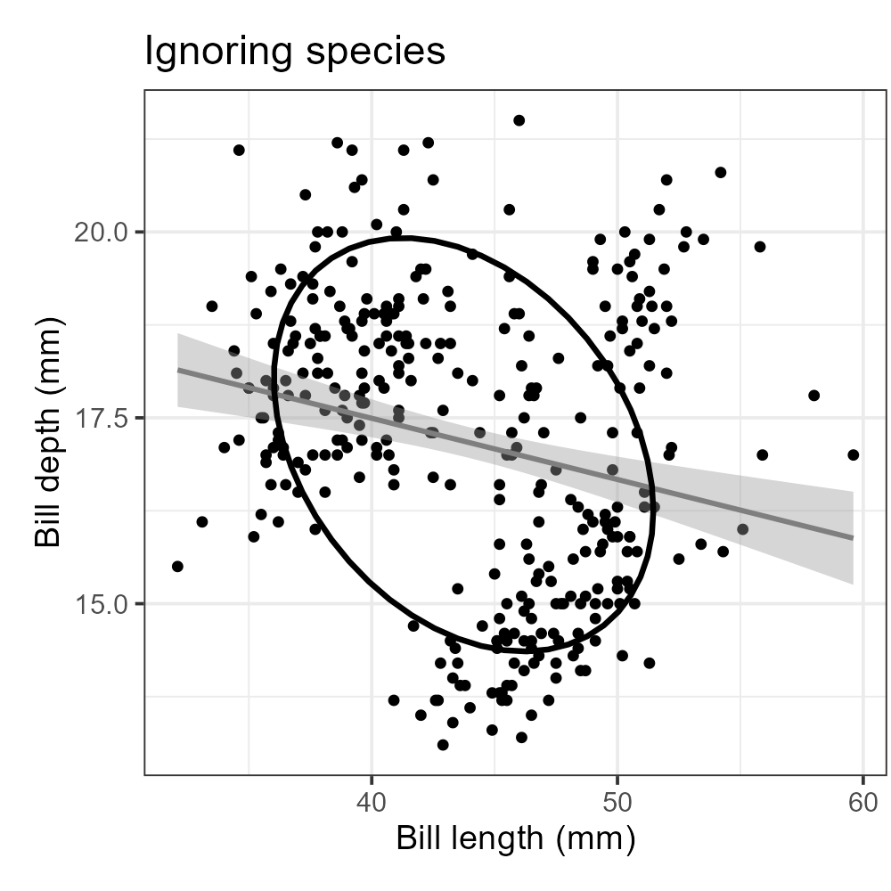
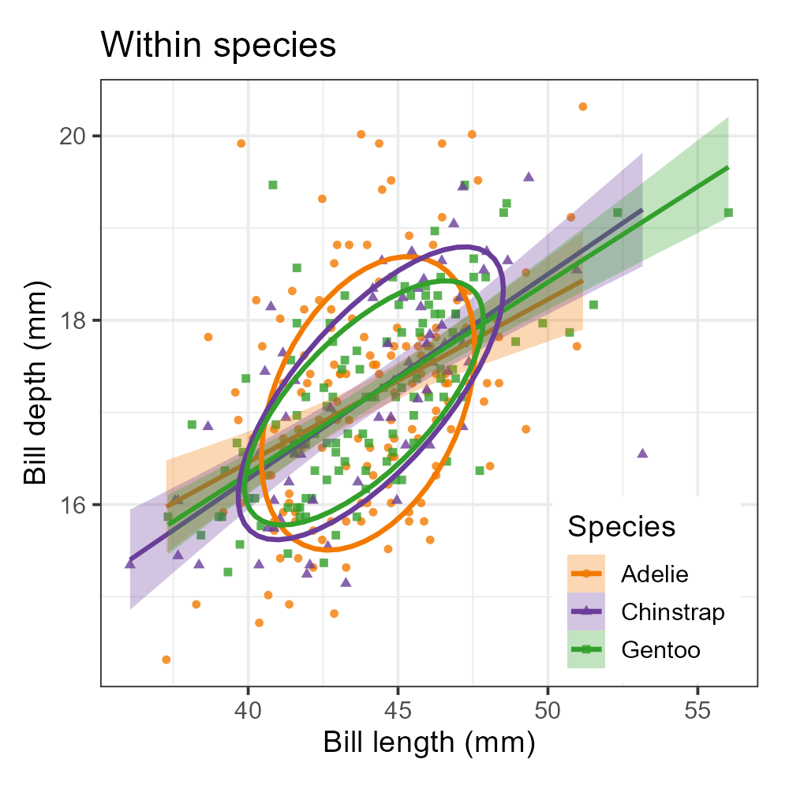
Simpson's paradox: marginal & conditional relations
Ignoring species, longer bills are shallower
By species, relation is positive for each
Within species shows diffs in slopes & covariances
Figure 4.23
Notes:
Panels: (a) ignoring species, (b) by species, (c) pooled within species. The data ellipses make the reversal immediate.

Slide 19
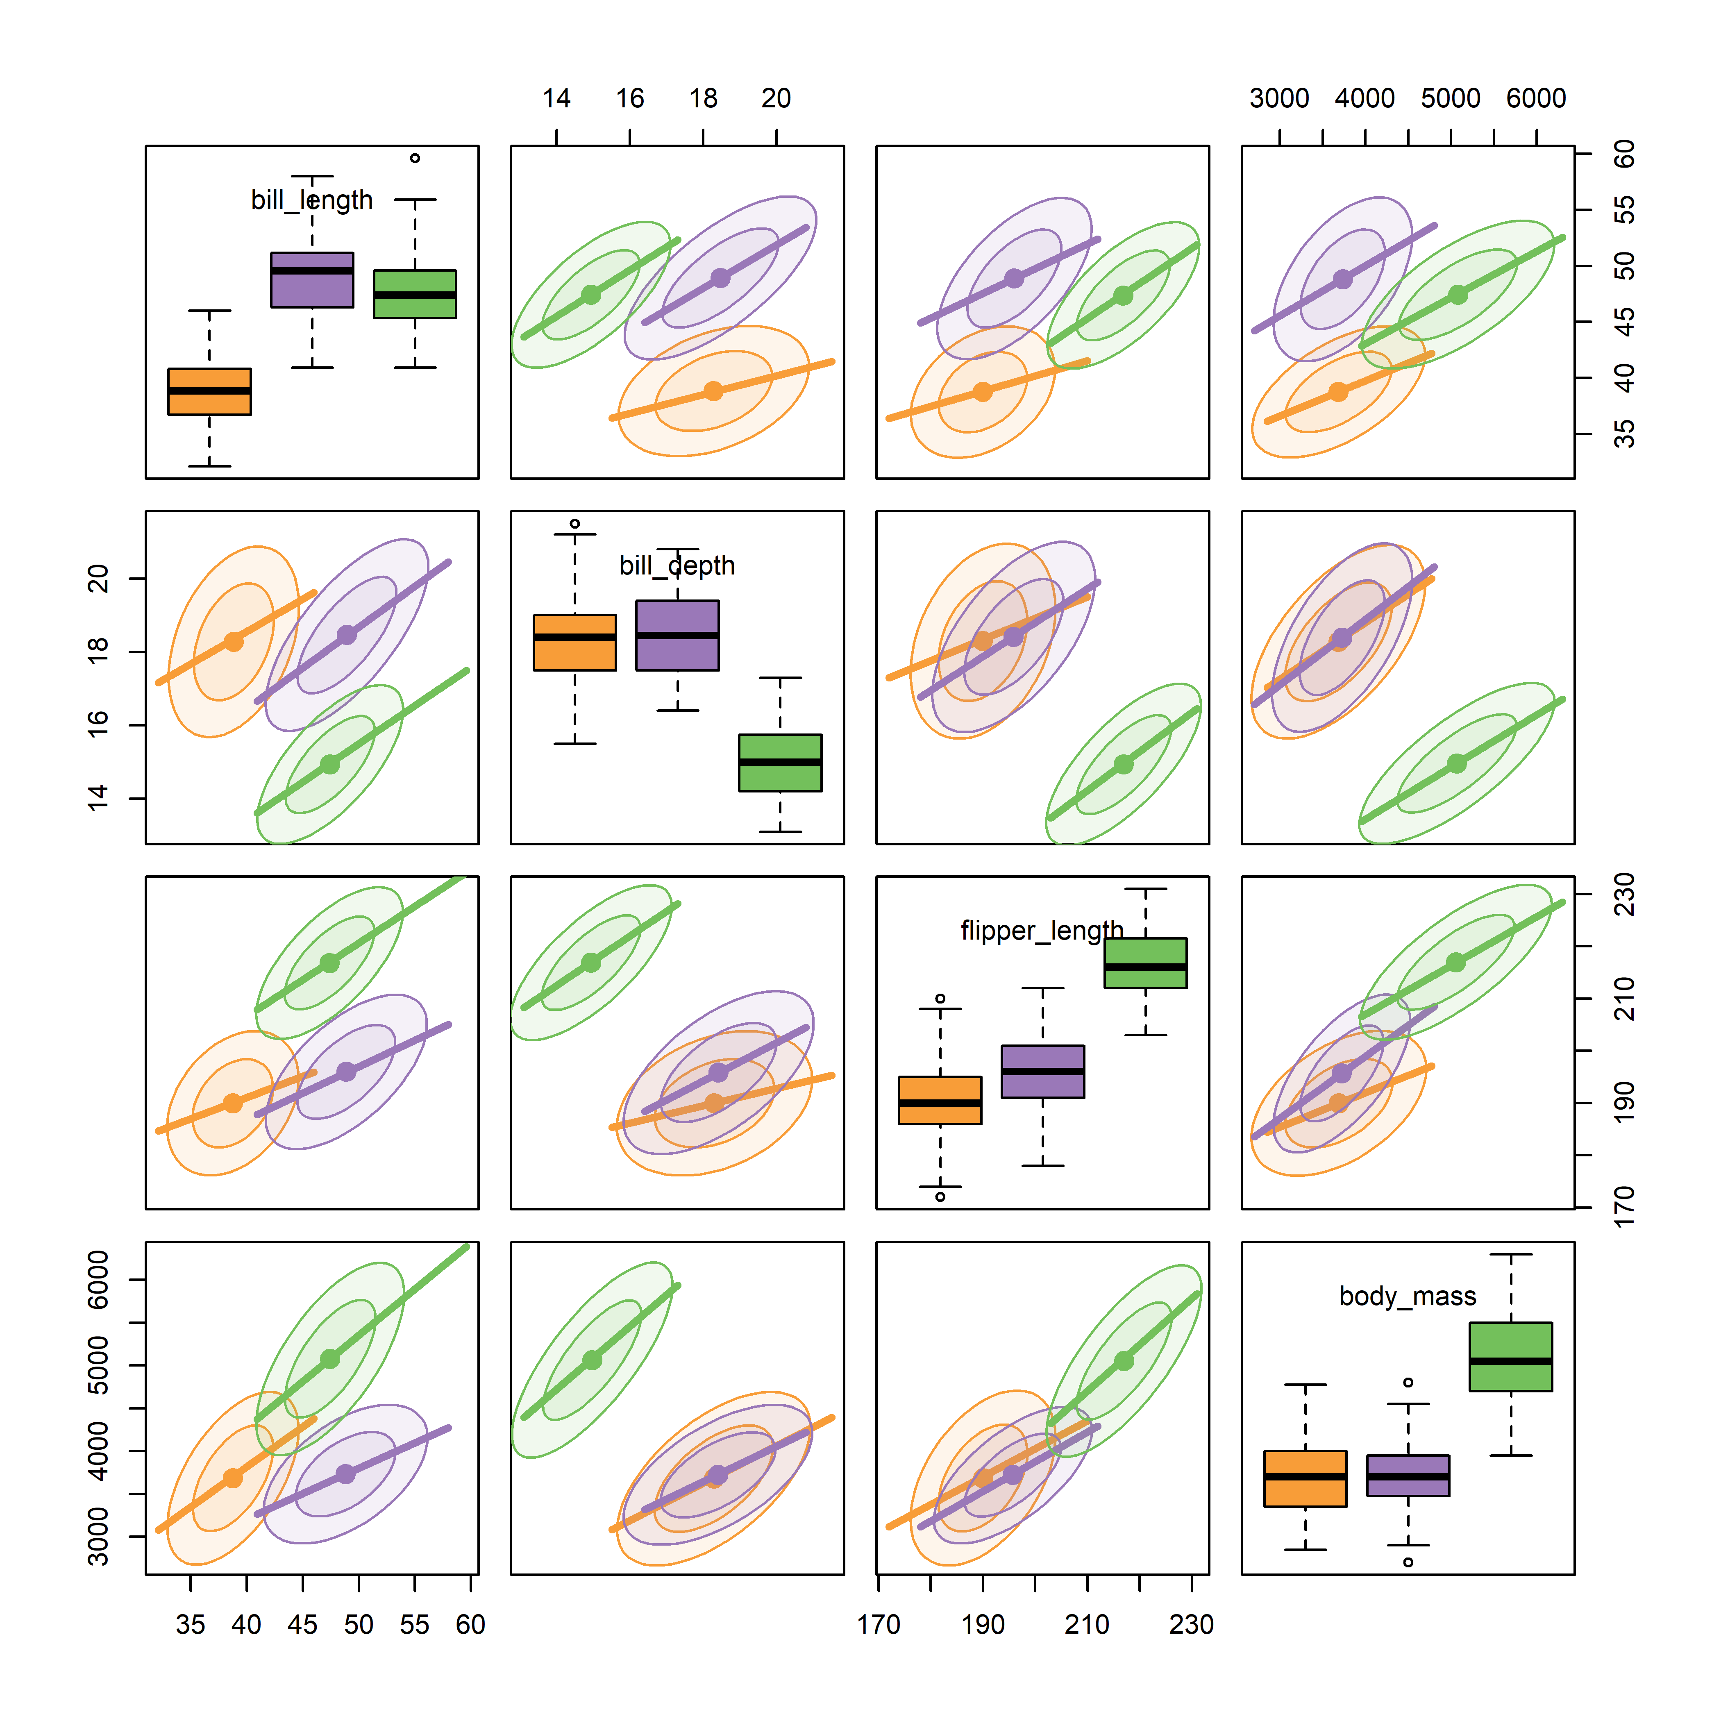
How to visualize p > 2 variables in Planeland?
Scatterplot matrices: all pairs at once
Every pairwise view in one display
Data ellipses & regression lines by species
Works well up to a moderate number of variables
Visual thinning: data → ellipses + regression lines
Figure 4.31
Notes:
Scatterplot matrix of the quantitative penguin variables.

Slide 20
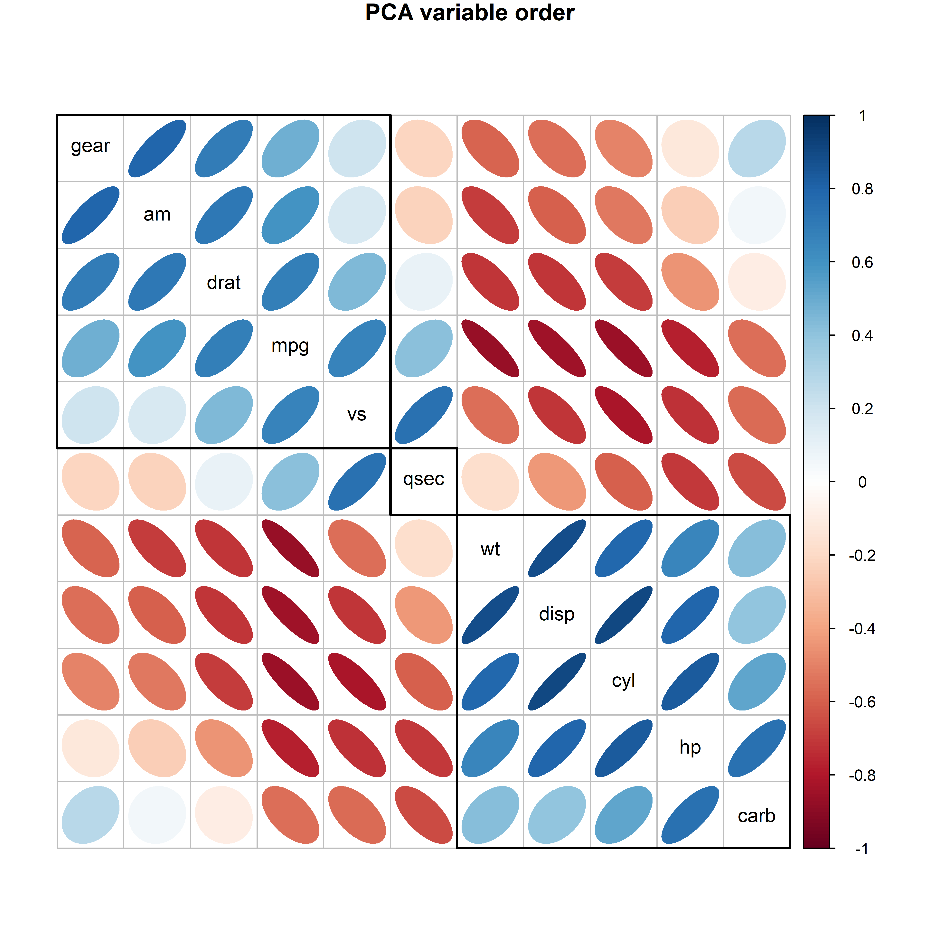
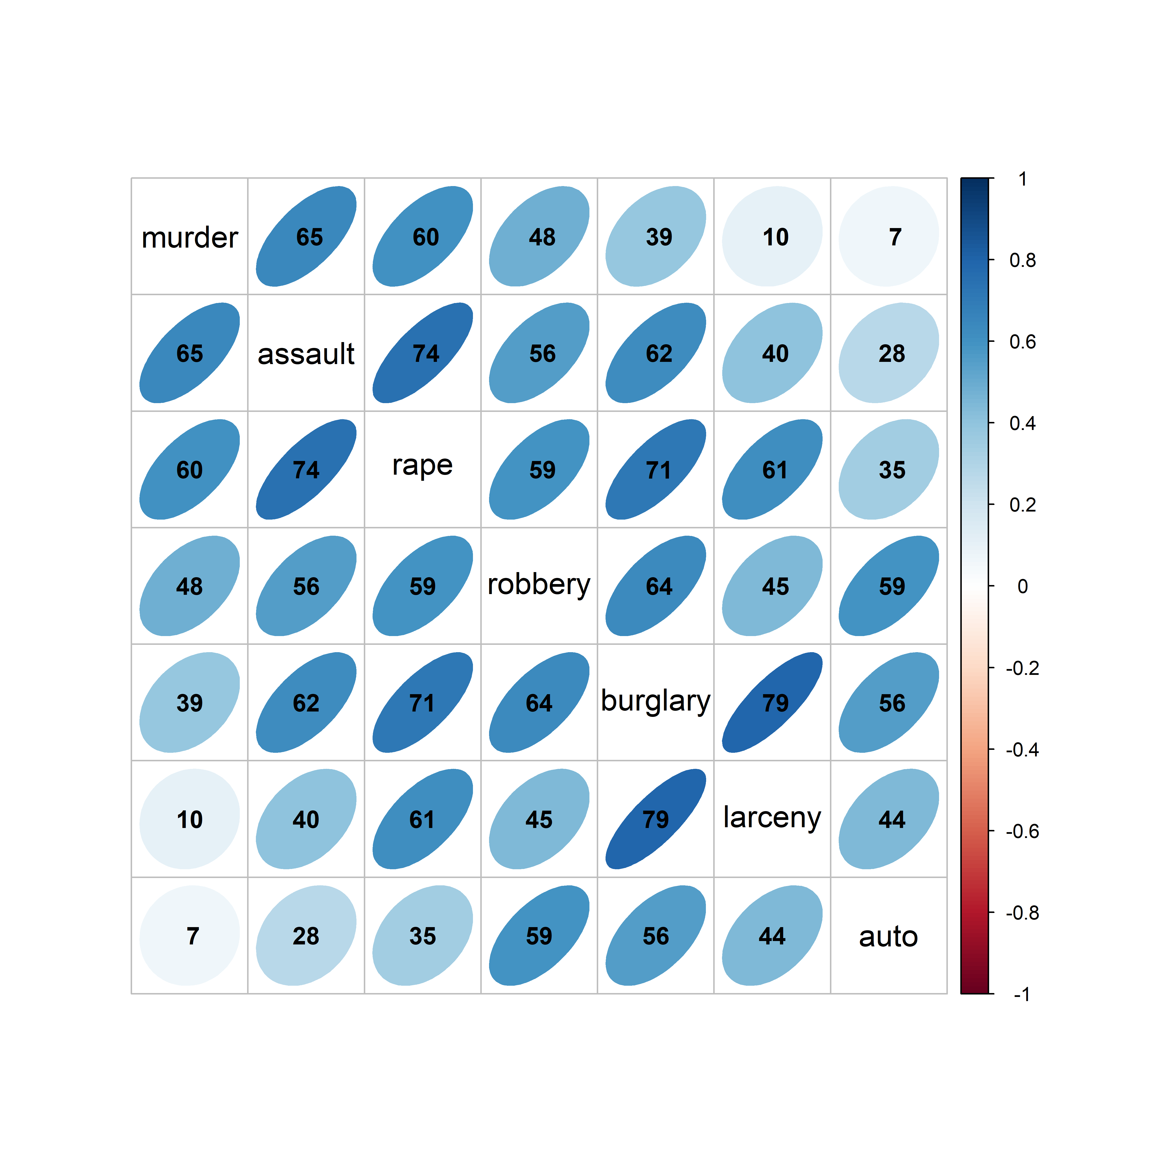
Visual thinning: show less to see more
Effect order: order variables to see what you want to show
corrplot(): With many variables, replace the points by a rendering of each correlation
Order the variables so that similar ones are adjacent
Here: ordered by the angles of the variable vectors from a PCA
Notes:
Corrplot of the crime data, with variables reordered. The ordering idea is taken up again under PCA.

Slide 21
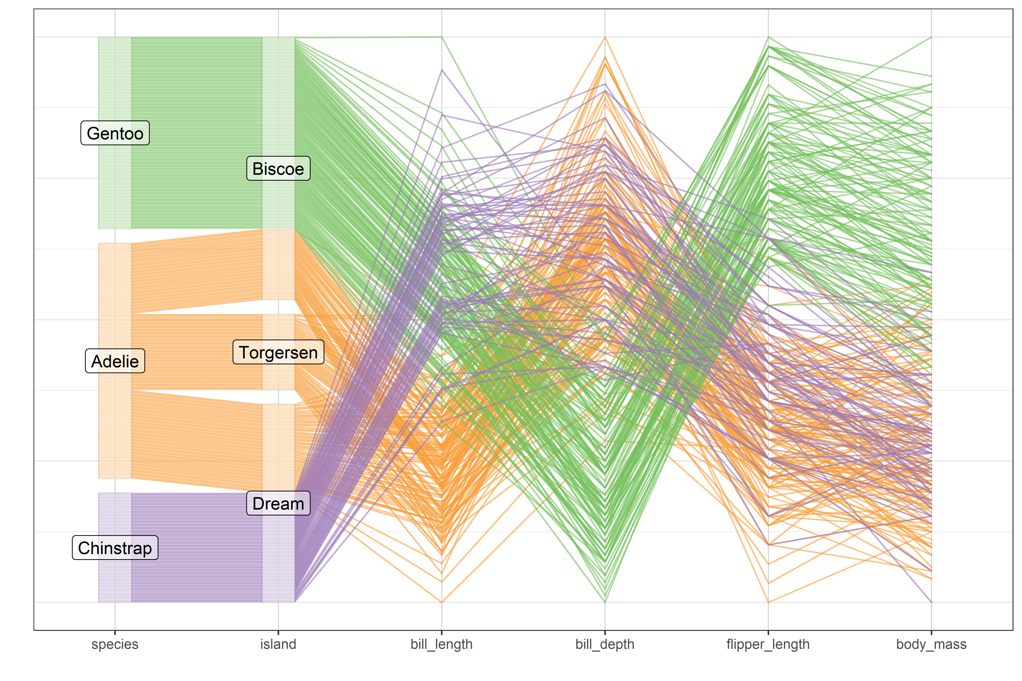
Parallel coordinates: one line per penguin
Each observation is a line across the variable axes
Groups appear as bundles
Easy to extend to more variables
Variable ordering is important here
Using this interactively could make a tool for understanding
Figure 4.40
Notes:
[Do this quick] Parallel coordinates plot of the penguin size variables, colored by species.

Slide 22
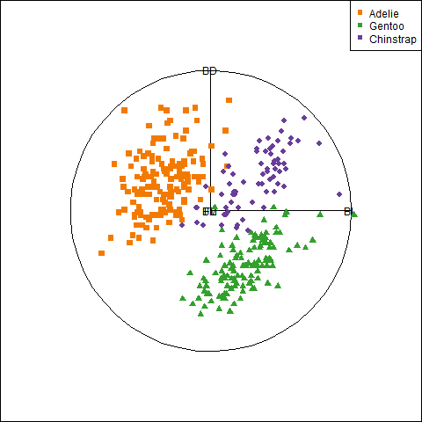
Animated tours: flying through projections (tourr pkg)
Animation adds one more dimension to what we can see from 2D projections
A grand tour shows a smooth sequence of 2D projections
Variable vectors show where you are in n-D space (as in biplot)
A guided tour steers toward interesting ones.
Optimize an index: separation of groups, anomalies (outliers)
Notes:
Yet another idea is to animate a sequence of 2D projections, on a travel through nD space
Animation (plays in slide show mode): grand tour of the penguin data. Guided tours optimize an index, e.g. separation of groups or the presence of anomalies.

Slide 23
Flatland and Spaceland: dimension reduction
PCA, biplots, and nonlinear methods

Slide 24

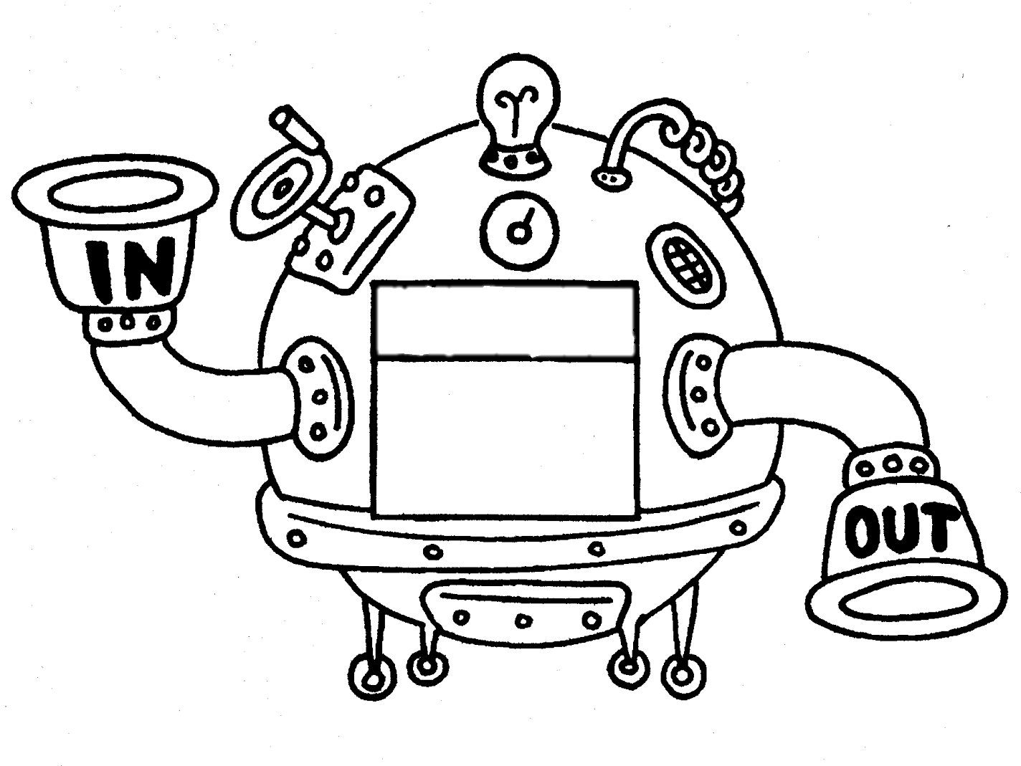
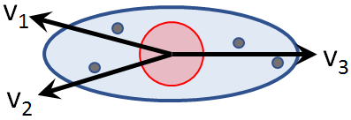

Multivariate Juicers
Squeeze the most flavor from your data in low-D space
data
insight
Biplot: The data juicer
CDA plots: The MANOVA juicer
Notes:
With more than a few variables, you can gain greater understanding with a multivariate juicer.
I know this is SO cheesy! But I find this a nice analogy to explain what we do with low-D methods

Slide 25
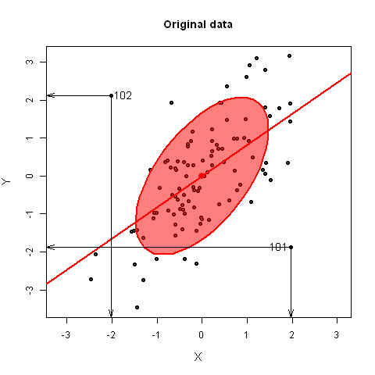
PCA: rotate to the views that show the most variance
PCA is a rotation of the axes: PC1 lies along the direction of greatest variance, PC2 is orthogonal to it.
Outliers typically appear on the smallest dimensions (“Waldo space”)
Figure 5.35
Notes:
Animation (plays in slide show mode): rotation from data space to PCA space, with two added points (101, 102). They are not extreme on either original variable, but stand out on the smallest principal component. Geometry of PCA as a rotation. Tie back to the data ellipse: its major and minor axes are PC1 and PC2.

Slide 26
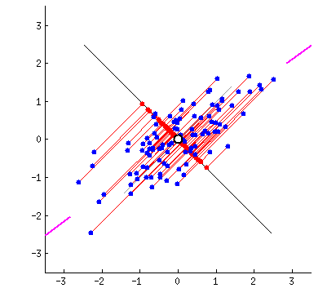
PCA fitted by springs: Physical analog
Least squares ↔ observations connected by springs
For PCA, connect a rigid line to the points by springs
Springs pull the line in proportion to squared distance
It settles on the first principal component
Figure 5.5
Notes:
Animation (plays in slide show mode). The blue points are connected to their projections on the red line by springs perpendicular to that line. A physical intuition for least squares. One of the figures the organizer singled out.

Slide 27
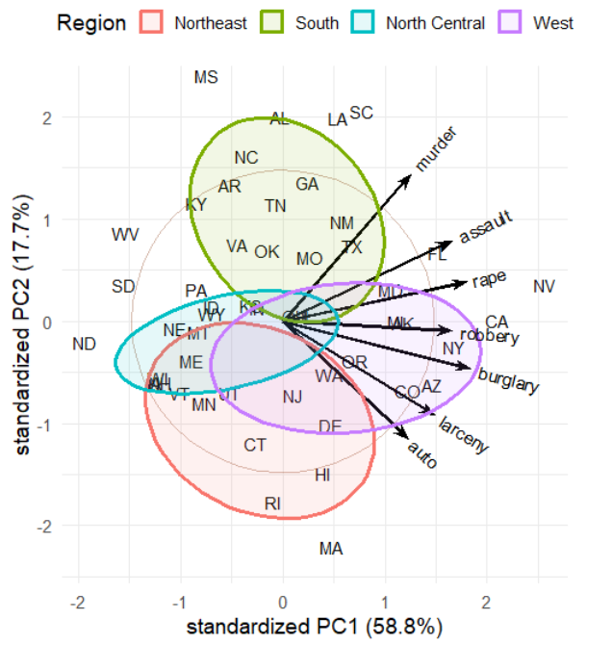
Biplots: observations and variables in one view
Points: observations (US states) in the PC1-PC2 plane
Vectors: variables (crime rates)
  Angles between vectors approximate correlations
  Projecting a point on a vector approximates its value on that variable
Interpretation:
  PC1: Overall crime rate
  PC2: Personal vs. property crime
  Region: summarizes diffs
Figure 5.14
Notes:
Basic biplot of the crime data. The biplot is the low-D view used again and again: for collinearity, for canonical discriminant analysis, and for ridge regression.

Slide 28

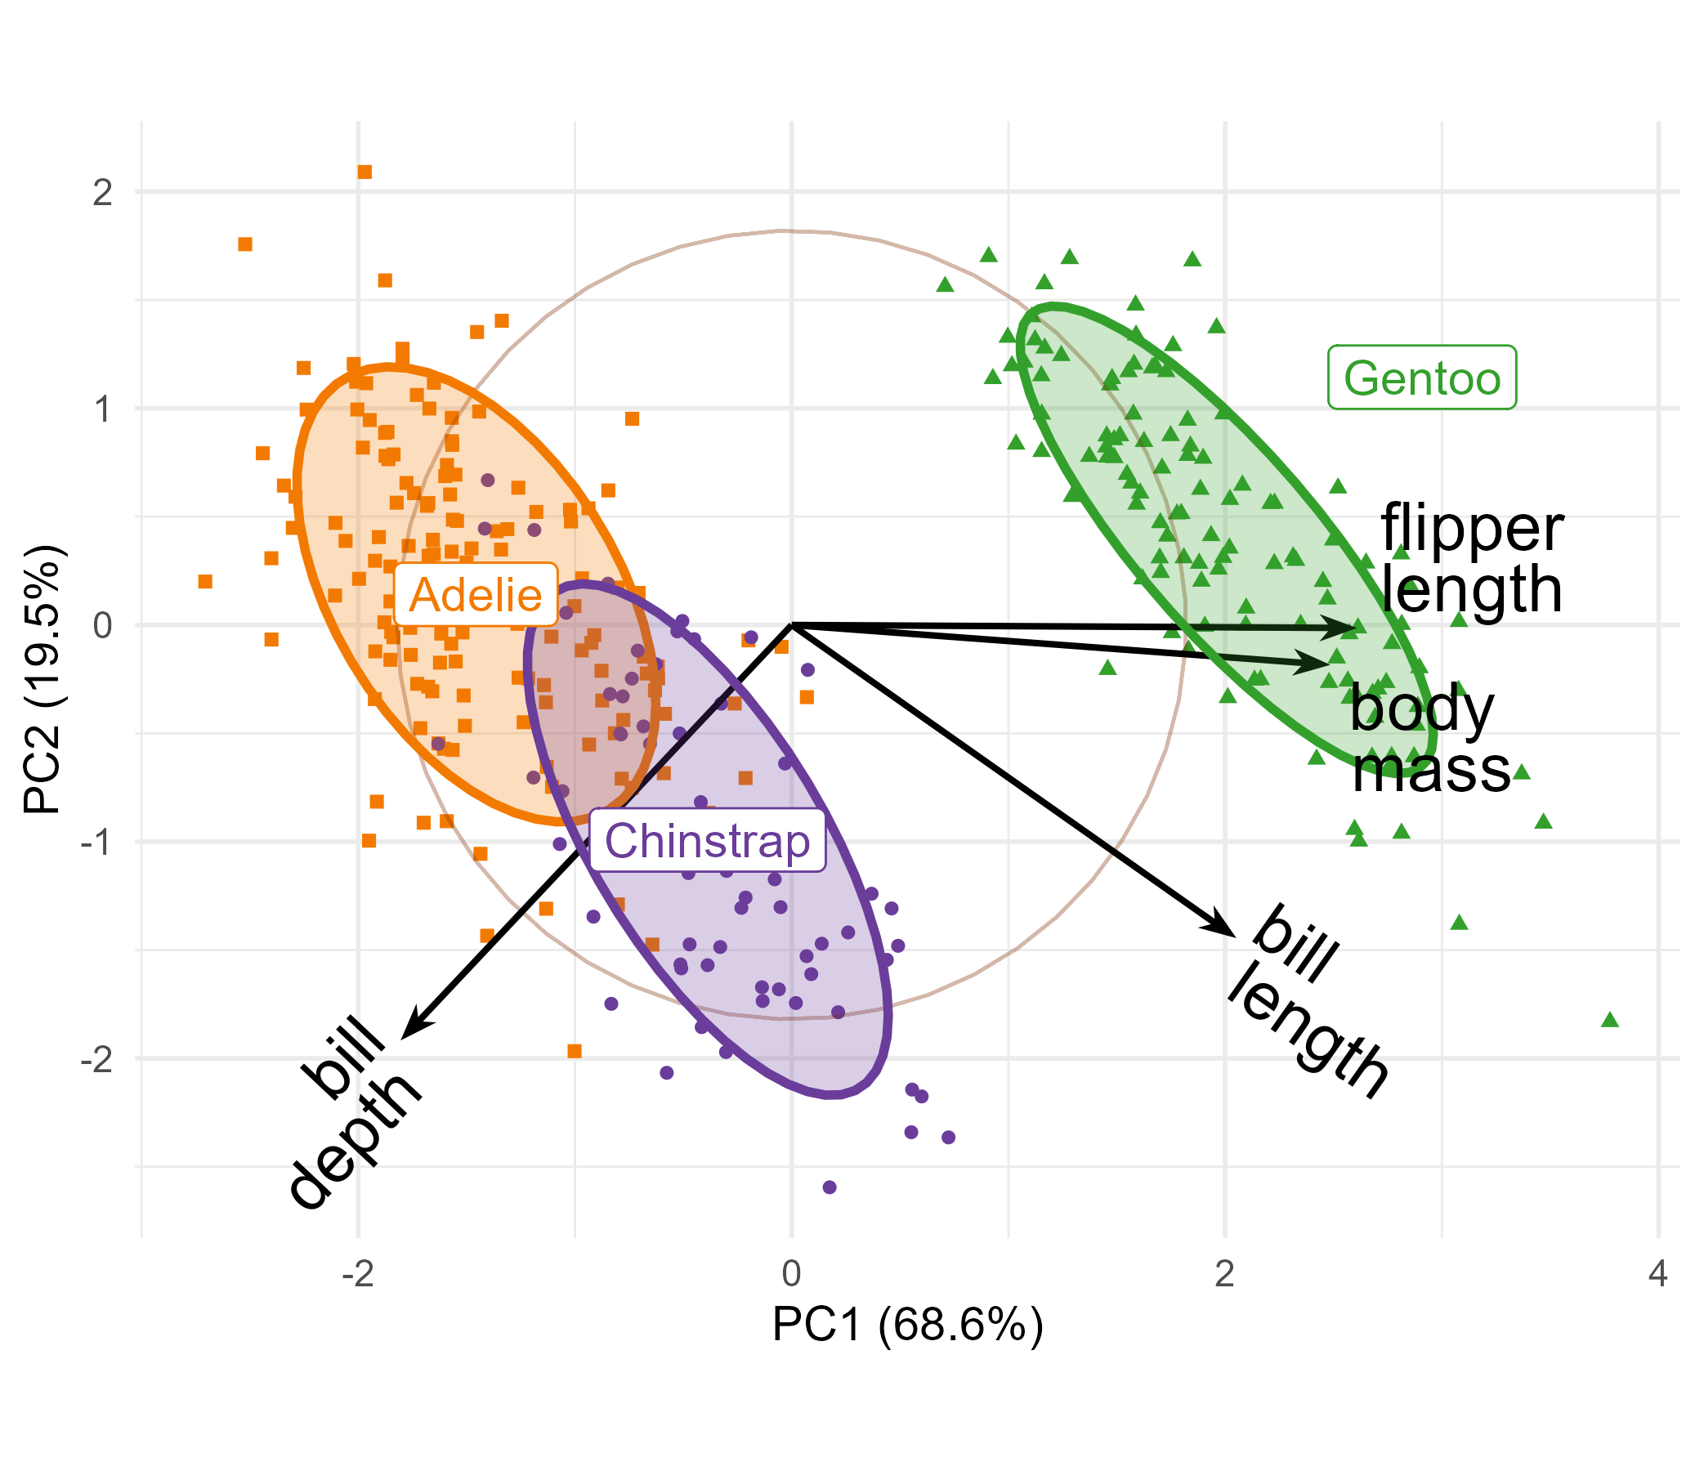
Biplot: The data juicer
peng.pca <- prcomp (~ bill_length + bill_depth + flipper_length + body_mass)
library(ggbiplot)
ggbiplot(peng.pca, obs.scale = 1, var.scale = 1,
groups = peng$species, ellipse = TRUE)
PC1, PC2 ~ 88.1% of variance
PC1: largely flipper length & body mass: “penguin size”
PC2: relates to “bill shape”
Easy to characterize the species in terms of these variables
See: https://rpubs.com/friendly/penguin-biplots

Slide 29
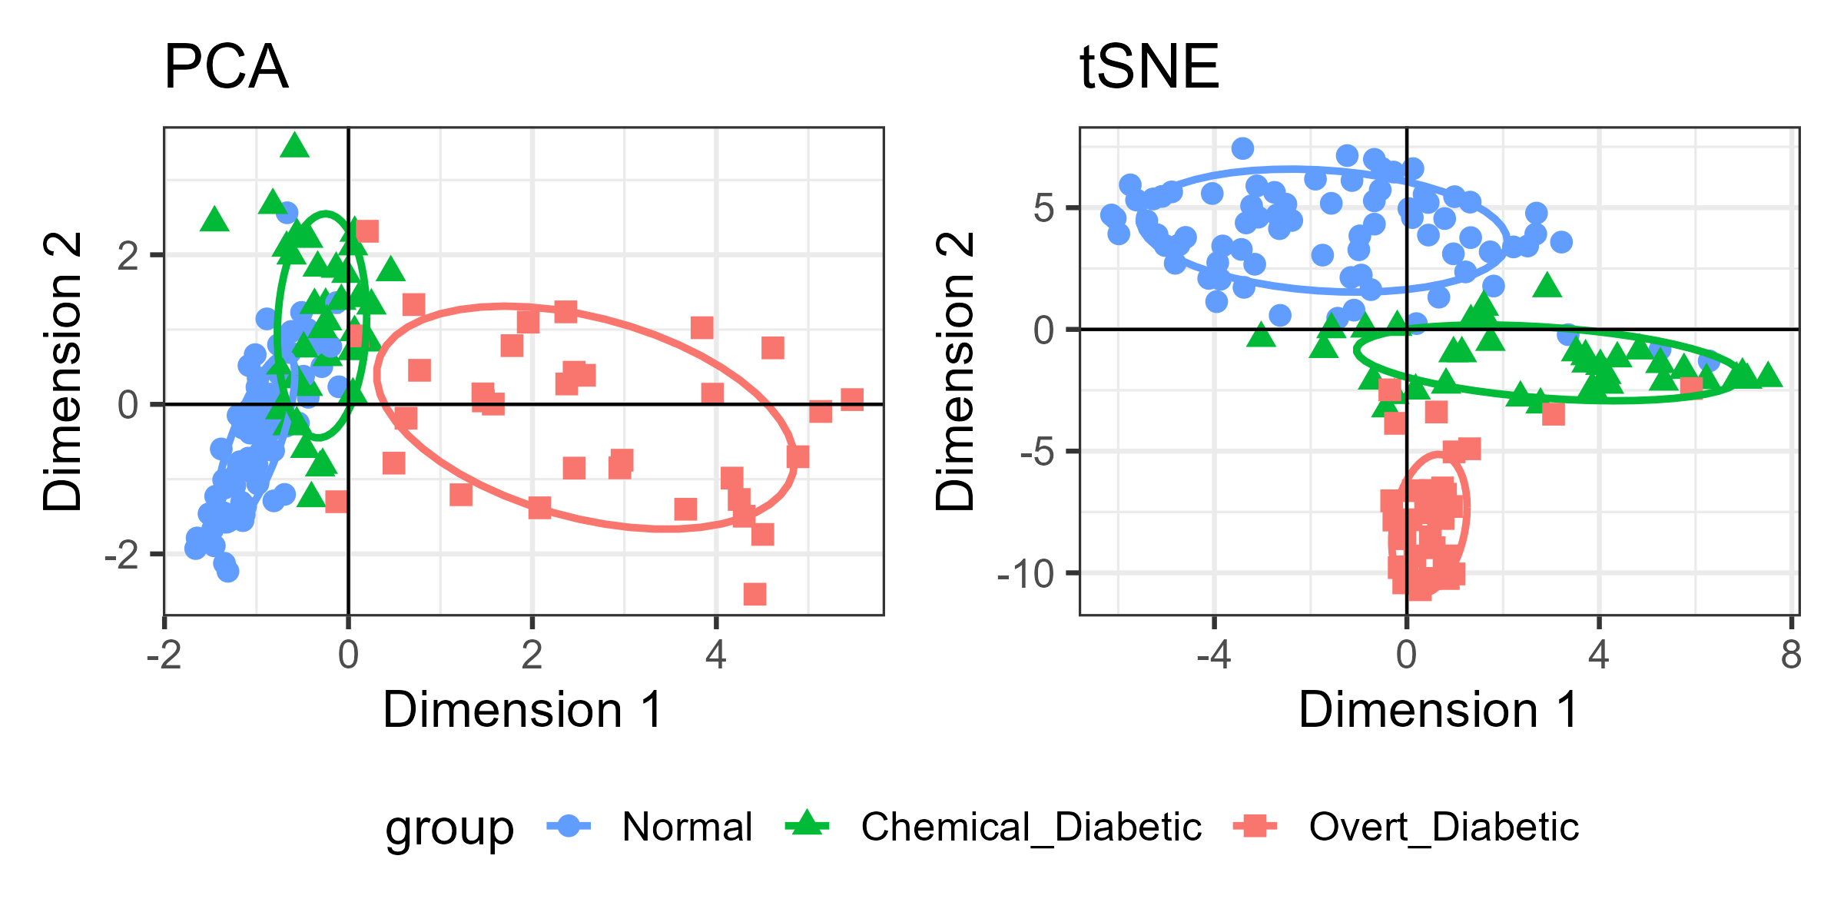
When a linear view is not enough: PCA vs t-SNE
t-SNE separates the Diabetes groups more cleanly, but distances & axes no longer have a direct meaning.
Figure 5.25
Notes:
Comparison of the PCA and t-SNE 2D representations of the Diabetes data. Nonlinear methods preserve local neighborhoods at the cost of global geometry.

Slide 30
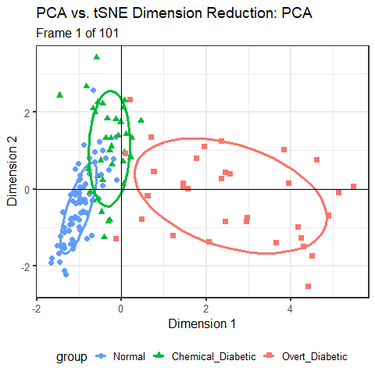
From PCA to t-SNE, animated
We can better understand algorithms visually by animating a smooth interpolation from one to another
Here, the PCA configuration morphs into the t-SNE one largely by a rotation.
But t-SNE achieves wider separation among groups
The data ellipses here carry the visual message.
Figure 5.26
Notes:
Animation (plays in slide show mode): interpolating between the PCA and t-SNE solutions for the Diabetes data.

Slide 31
Elliptical Insights
Visual understanding of problems in statistics that only confound us in tables & formulas
Outlier detection
Measurement error
Understanding collinearity
Ridge regression

Slide 32

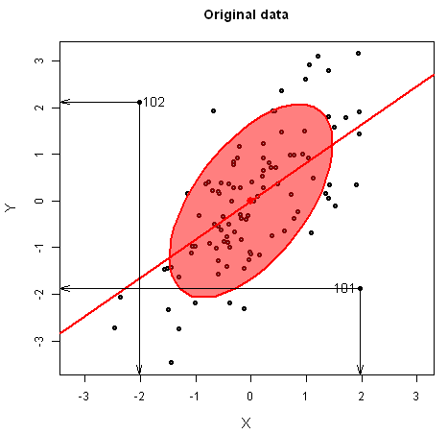
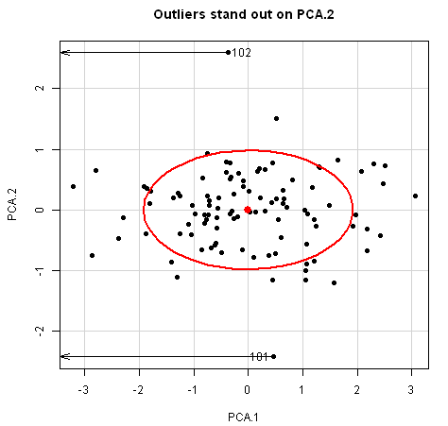
Outlier detection: Waar is Wally?
Multivariate outliers might be invisible in univariate views, but become readily apparent on the smallest principal component
  100 observations on two correlated normal variables with two bivariate outliers near (2,2), (-2, -2)
Data space
Waldo space
Animation: http://www.datavis.ca/gallery/animation/outlier-demo/
Notes:
Like Galton, I’ve been impressed with the insights that can be had from elliptical thinking.
Just a simple demonstration of how outliers become apparent when viewed in the space of small principal components.
I call this Waldo space, by analogy with Martin Hansford’s popular books, Where’s Waldo? (Waar is Wally? in Dutch)

Slide 33
Multivariate outliers: which penguins are unusual?
Hook Nose
Cyrano
Mahalanobis D² distances against χ² quantiles shows which ones are unusual
We can try to understand why they are unusual in data space of some variables
Figure 4.26, 4.27
Notes:
Standard method: Chi-square QQ plot for the penguin data,
We can look at these in 2D plots -- the unusual birds identified in the bill length-bill depth plot.
Two of them, nicknamed
Cyrano – really long billed Chinstrap
Hook Nose – largest curvature
Bird 35 doesn’t seem at all unusual for an Adelie
I’ll follow these birds in the influence and robust sections.

Slide 34
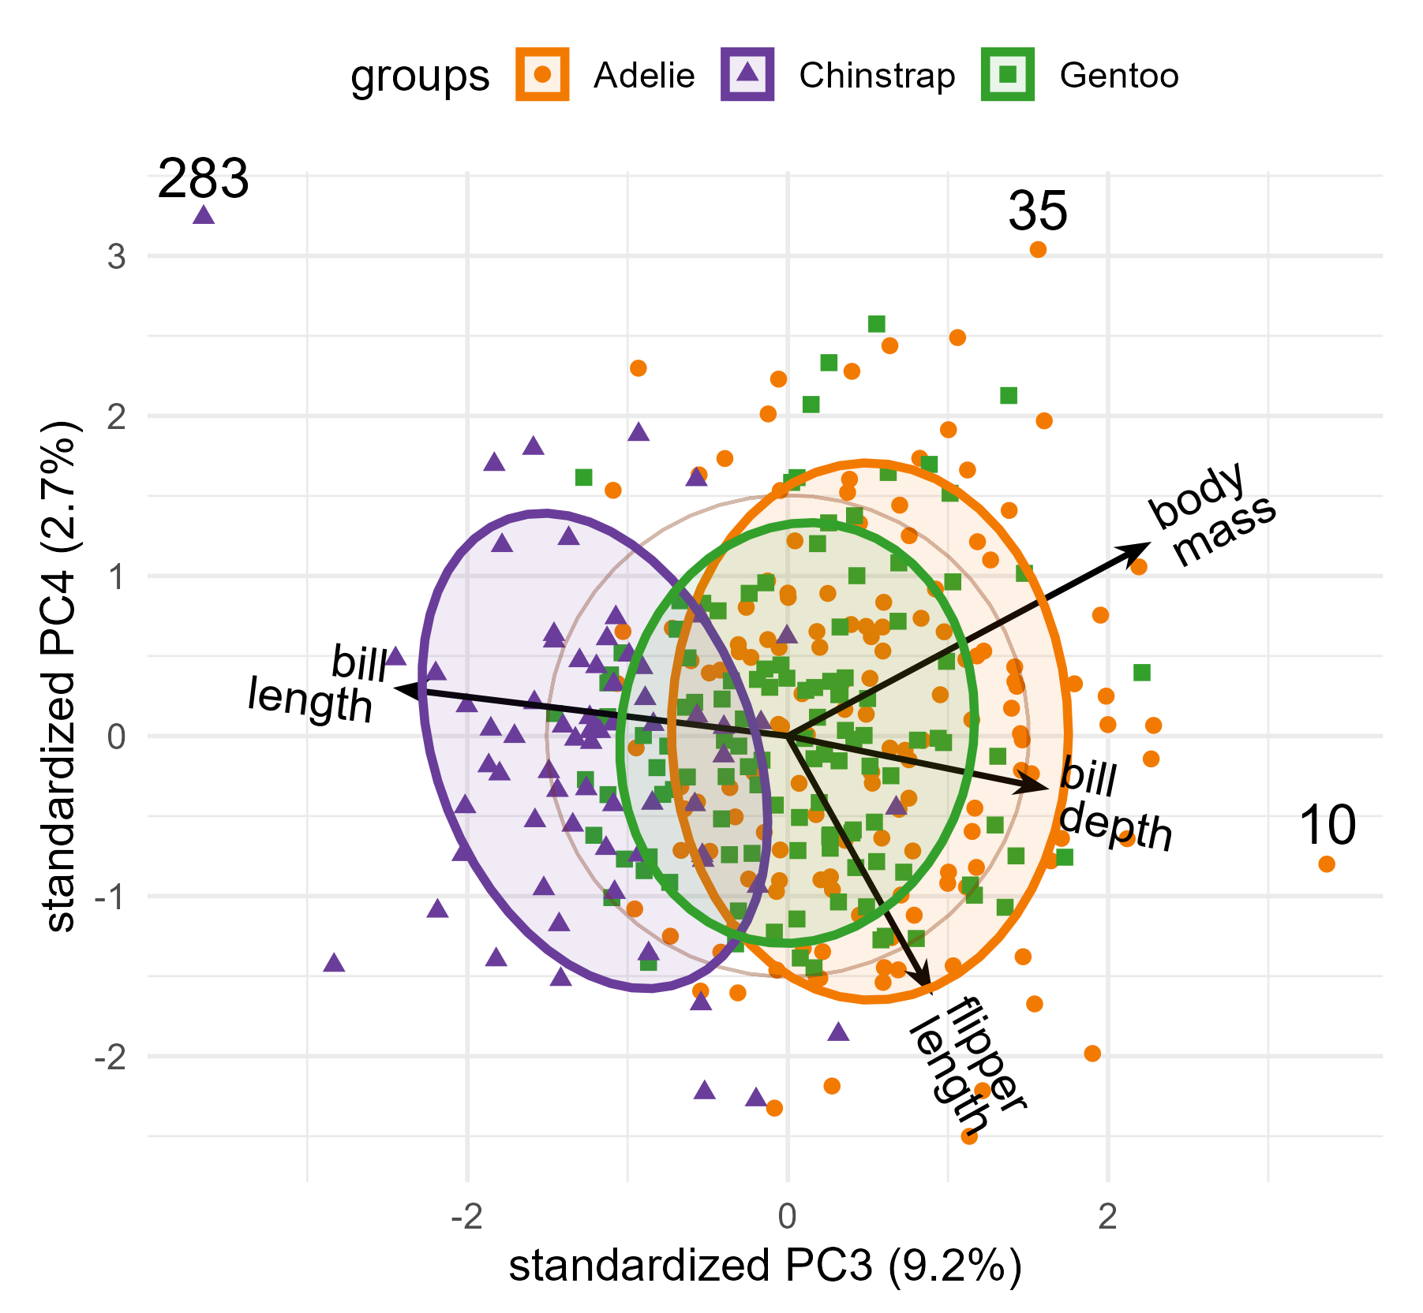
Outliers hide in the smallest dimensions
The first two dimensions show the typical penguins
The last dimensions show what does not fit that pattern
Biplot of dimensions 3-4 of the penguin data
  Variable vectors show relations to dimensions
  Ellipses show diffs among groups
Outliers are often extremes in Waldo space
  → why they’re weird
Cyrano
Hook Nose
Figure 5.37
Notes:
[OPTIONAL for a 45-minute talk] An 'elliptical insight': multivariate outliers often show up in the dimensions with the least variance.

Slide 35
Elliptical insights: Measurement error
In classical linear models, predictors (X) are usually assumed to be fixed (non-random), or measured w/o error
  Rarely true in social science, medicine, …
  (Structural equation models often used to account for this)
  What effects do errors in predictors have on typical regression models?
Main ideas:
  Ellipses in data space show effects on bias and precision
  The same effects can be seen in parameter (β) space
Friendly, Monette & Fox (2013). Elliptical Insights: Understanding Statistical Methods Through Elliptical Geometry. Statistical Science, 28, 1–39. https://www.datavis.ca/papers/ellipses-STS402.pdf
Notes:
Another insight comes from considering the effect of measure error in predictors in linear models.
In data space, we can see these effects on bias and precision of coefficients.
But there is also a dual space of the parameters – beta space.

Slide 36
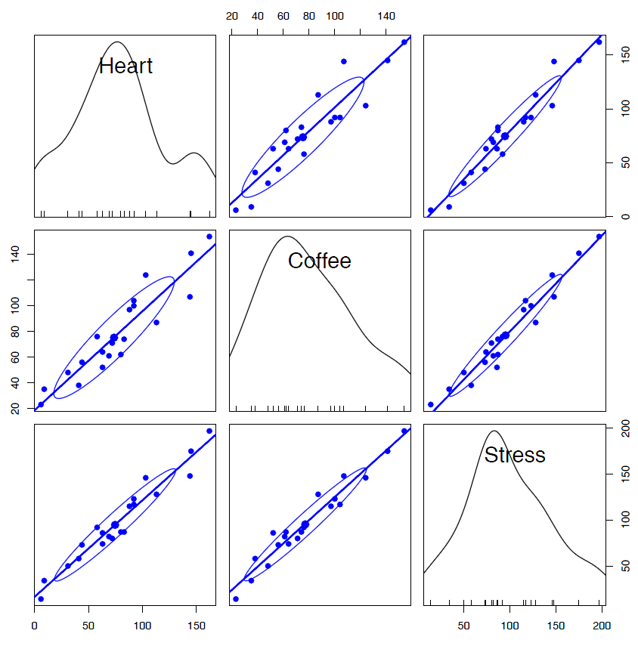
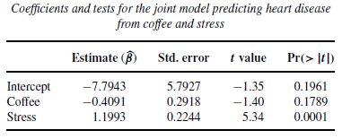
Coffee, stress and heart disease
Imagine a small study investigating the relation between a measure of heart disease (y), and coffee consumption (x₁) and stress (x₂)
Results: lm(Heart ~ Coffee + Stress)
✗
✓
Wow! That means I can drink all the coffee I want as long as I avoid stress.
But what happens if there is measurement error in y or x₁ , x₂ ?

Slide 37
Data space and beta space are dual
The data ellipse for the predictors (X’X) is the inverse of the confidence ellipse for the coefficients, (X’X)⁻¹
Figure 8.3
Notes:
[OPTIONAL for a 45-minute talk] Data space and beta space for the coffee data. Where the predictors have a wide spread, the coefficients are estimated precisely, and vice versa. This sets up collinearity.

Slide 38
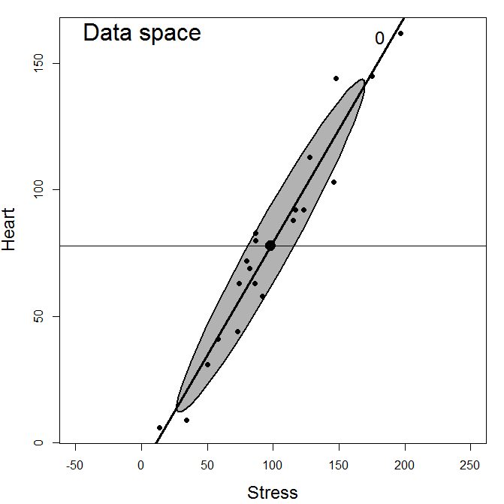
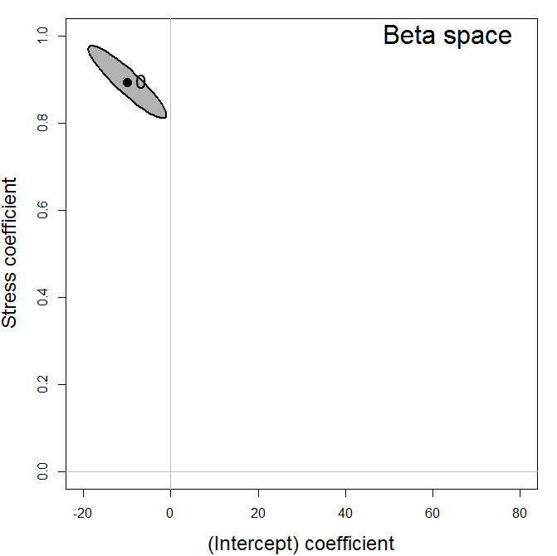
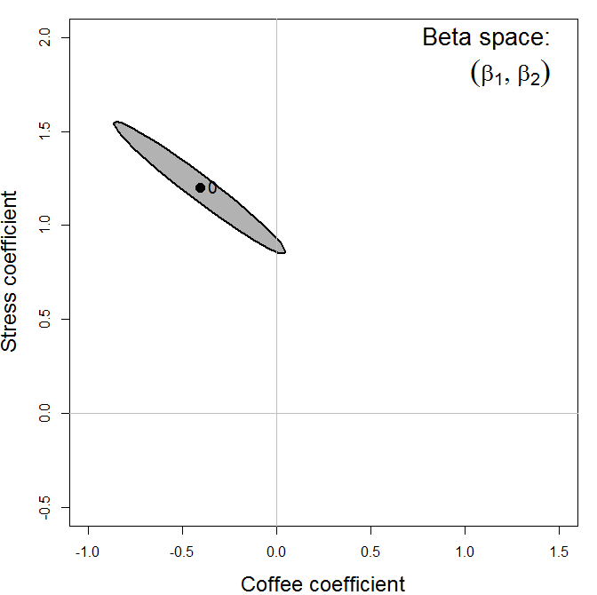
Adding measurement error
Measurement error in Heart (y) decreases precision ( ↑ std. errors)
Measurement error in Stress (x₂) biases its effect β_{Stress} → 0
With Coffee in the model, it also drives β_{Coffee} toward its marginal value (right)
Notes:
Animations (play in slide show mode), with increasing measurement error added to Stress.
Left, data space: the data ellipse for Heart and Stress gets wider, and the slope flattens.
Middle, beta space for the simple regression: the coefficient for Stress is attenuated toward 0.
OK, we understand that now. But, at the same time, in the model with both predictors (right), the effect of coffee becomes larger: it moves toward its marginal value, the slope you get ignoring Stress.
Elliptical insight: increasing error in x2 drives the coefficient for x1 toward the marginal model. You can also see that the standard error of the Coffee coefficient decreases as error in Stress increases.

Slide 39
Understanding collinearity
Visualizing VIFs, condition indices, variance %
Collinearity problems live in Waldo space
Figure 9.6, 9.7
Notes:
A visual approach also helps to understand problems of collinearity--- high correlations among predictors--- in linear models
The standard collinearity diagnostics table hides the important information.
A tableplot makes what you should attend to stand out– ordered by condition indices
A collinearity biplot shows which variables are involved and possible outliers appear in Waldo space

Slide 40
Ridge regression: shrink to gain precision
Constrain the size of the coefficients
The estimate moves from the OLS solution toward the origin
A little bias buys a lot of precision
Figure 9.9
Notes:
[OPTIONAL for a 45-minute talk] Geometric interpretation of ridge regression.

Slide 41
The usual ridge trace shows only the estimates
Longley data: six highly collinear economic predictors
Coefficients plotted against the shrinkage constant
Shows the bias, but nothing about precision
Figure 9.10
Notes:
[OPTIONAL for a 45-minute talk] Univariate ridge trace plot for the Longley data.

Slide 42


Generalized ridge trace plots
Notes:
Instead of plotting point estimates, we can see effects of ridge shrinkage by plotting bivariate ellipsoids for pairs of parameters

Slide 43
A low-rank view of ridge regression
Transform to the principal component space of the predictors
Shrinkage happens mostly in the smallest dimensions
A biplot shows how the variables relate to them
Figure 9.18
Notes:
Transforming the predictors to PCA space makes them uncorrelated.
Biplot view of the ridge trace plot for the smallest dimensions.

Slide 44
The HE plot framework
Seeing multivariate tests as ellipses

Slide 45

HE plots: Visual overview
Data ellipses
HE plot
Canonical space
Discrim axes
Notes:
The HE plot framework starts with data ellipses for the groups in a multivariate linear model
An “HE plot” summarizes the evidence for differences among groups in a MANOVA design
Equally, this can be cast as a discriminant analysis problem
A simple description can be seen in an HE plot in canonical space

Slide 46
Data → Data ellipses → HE plot
Differences between group means are shown by the H ellipsoid– data ellipsoid of the fitted values (w/ 1 df, degenerates to a line)
  Direction shows relation of groups to response variables
  Size shows “how big is H relative to E”
Variation within groups is reflected in the E ellipsoid-- data ellipsoid of the residuals
  Direction: residual (partial) correlation between BM & WP
  Size/shape: residual variance
Notes:
Mathscore data: two groups, basic math (BM) and word problems (WP). From the data to data ellipses to the HE plot. From the short course, lecture 2.

Slide 47

The H ellipse
Jittered fitted values
(gp means)
The H ellipse is the data ellipse of the fitted values (group means, here)
  The H matrix is the sum of squares and crossproducts of the fitted values, corrected for the grand mean
Notes:
The H ellipse is the data ellipse of the fitted values; with 1 df it collapses to a line. From the short course, lecture 2.

Slide 48
The E ellipse
The E ellipse is the data ellipse of the residuals
  What you get when you subtract the group means from all observations, shifting them to the grand means.
  E matrix called the “within-group pooled covariance matrix”
Notes:
The E ellipse is the data ellipse of the residuals: the pooled within-group covariance. From the short course, lecture 2.

Slide 49
HE plots: Effect scaling vs. Significance scaling
Effect scaling: Plot ellipses for H & E directly
Significance scaling: Scale H so an H ellipse that projects outside E signals a significant effect (Roy's test).
Direction of H vs. E shows how groups differ in a data-space view
cf. Figure 12.5
Notes:
HE plots for bill depth vs bill length in the penguin data, with effect scaling (left) and significance scaling (right).
E: within-group variation. H: variation of the group means.
The orientation of H shows how the groups differ. The species effect is so strong that, with significance scaling, H dwarfs E.

Slide 50
Contrasts & linear hypotheses: What diff^{ces} make H big?
Any linear hypothesis has its own H
A 1 df hypothesis is a line
Orthogonal contrasts decompose the overall effect: H = H₁ + H₂
  H₁: (Adelie, Chinstrap) vs Gentoo
  H₂: Adelie vs Chinstrap
These are conjugate axes of H
Each “pushes” the H ellipse out in the direction of mean differences.
cf. Figure 12.7
Notes:
[OPTIONAL for a 45-minute talk]
HE plots also allow us to decompose an overall effect of group differences into effects related to contrasts among the factor levels
For bill length and depth in the penguin data, showing two orthogonal contrasts: Adelie vs Chinstrap (A:C), and those two vs Gentoo (AC:G).
Each is a line; together they are conjugate axes of the H ellipse.

Slide 51
HE pairs() plots
The pairs() method for mlm objects gives all pairwise HE plots in a scatterplot matrix format in data space.
pairs(peng.mod0, size="effect", …)
Something new here:
avg. bill depth is negatively correlated with “size” variables – larger penguin species have smaller bill depths (curvature?)
correlation of avg. bill depth with body mass nearly -1

Slide 52
Quantitative predictors: each effect is a line
School data: 70 US schools in a program for disadvantaged students
  Outcomes: reading, mathematics, self-esteem
  Predictors: parents’ education & occupation, school visits, counseling, number of teachers
Length: the strength of the relationship
Direction: how the predictor relates to the two responses
The overall test is the ellipse for all predictors jointly
Figure 12.17
Notes:
One of the figures the organizer singled out. HE plot for the multivariate regression model for the school data. Each predictor has 1 df, so its H 'ellipse' collapses to a line.

Slide 53
Canonical discriminant plots: The MANOVA juicer
As with biplot, we can visualize MLM for all responses by projecting H and E into low-rank space
  Canonical projection: $Y→Z=YE^{−1/2}V$ where V = eigenvectors of HE⁻¹
This is the view that maximally discriminates among groups
CD HE plot: vectors show structure coefs (correlations) of variables w/ CD dimensions
Biplot of canonical scores
HE plot of canonical scores

Slide 54
Linear discriminant analysis: main ideas
Find the directions that best separate the groups, then classify by distance to the group means.
Notes:
[OPTIONAL for a 45-minute talk] Illustration of the main ideas of linear discriminant analysis.

Slide 55
Prediction regions in data space
Classify every point in a grid of values: the LDA boundaries are linear.
Notes:
[OPTIONAL for a 45-minute talk] Linear discriminant prediction regions for the penguin data.

Slide 56
Prediction regions in discriminant space
With three species, two discriminant dimensions show everything
Variable vectors show which measures separate the species
Notes:
[OPTIONAL for a 45-minute talk] The penguin data in discriminant space, with variable vectors.

Slide 57
Checking multivariate models
Outliers, influence and robust estimation

Slide 58
Unusual is not the same as influential
Distance plot: where is it unusual?
Influence plot: does it matter?
School data: 70 schools, 3 outcomes, 5 predictors
Distance plot: predictor distance (leverage) vs. residual distance (outliers)
Lines: cutoffs for “large”
Influence plot: bubble size ~ multivariate Cook’s D
44, 59: high leverage and influential
35: an outlier, but little influence
66: high leverage, but harmless
Refit without 44 and 59: the same three predictors stay significant, but the reading and mathematics coefficients change by 77–104% for visit and over 300% for counseling.
Figure 11.18, 11.19
Notes:
The distance plot is one of the figures the organizer singled out. School data model: reading, mathematics and self-esteem on five predictors, 70 schools. Distance plot (heplots::distancePlot) and influence plot (mvinfluence::influencePlot), re-drawn as a matched pair with the same cases in the same colors (talks/R/school-diagnostics.R).
Click 1: influence plot. Click 2: sensitivity analysis. Cook's D: 59 = 2.99, 44 = 1.60, 33 = 0.71, 35 = 0.30, 66 = 0.07. Without 44 and 59, education, occupation and visit remain significant; relative change in coefficients: visit 104% (reading), 77% (math); counseling 332%, 305%.

Slide 59
Who are the influential penguins?
Multivariate influence plot
The most influential case is our Chinstrap friend 'Cyrano'
'Hook Nose', an Adélie, is among the others
One factor as predictor: hat values depend only on group size, so three columns
Figure 14.8
Notes:
Influence plot for the penguin MANOVA model.

Slide 60
Robust MLMs: down-weight what does not fit
robmlm(): iteratively reweighted least squares for a multivariate model
Index plot of the final observation weights
Cyrano gets weight 0; Hook Nose gets 0.13
Figure 14.10
Notes:
heplots::robmlm() applied to the penguin model. Most coefficients change little; the largest changes are for Chinstrap, reflecting the removal of Cyrano.

Slide 61
Summary: A few ideas go a long way
Ellipses: for data, for coefficients, and for hypotheses and error
Projections: every plot is a view; choose the views that answer the question
Geometry: provides the connective tissue to understand relations in different, equivalent spaces.
Low-D views: biplots and canonical plots show many variables in the space that matters
Visual thinning: summarize, so the message can be seen
Multivariate models deserve graphs as good as those for a single response
Notes:
Summary of the themes that recur through the book.

Slide 62
Book, code and packages
Online version: friendly.github.io/Vis-MLM-book
Source and R code: github.com/friendly/vis-MLM-book
R packages: heplots, candisc, mvinfluence, genridge, VisCollin
To appear with CRC Press / Chapman & Hall, 2027
Notes:
Where to find the book and the software.

Slide 63
Questions?
Discussion?

Slide 64
The regression quartet
Residuals vs. fitted: nonlinearity
Normal QQ: distribution of residuals
Scale-location: non-constant variance
Residuals vs. leverage: influential cases
Figure 7.2
Notes:
The four standard diagnostic plots, here for Duncan's data on the prestige of occupations predicted from income and education.

Slide 65
Coefficient plots: show the estimates, not a table
Estimates with confidence intervals
Standardize, or the scales of the predictors dominate the picture
Easy to compare several models
Figure 7.7
Notes:
Plot of standardized coefficients and their confidence intervals.

Slide 66

Effect displays: what the model predicts
Fitted values for each predictor, averaging over the others.
Figure 7.17
Notes:
[OPTIONAL for a 45-minute talk] Predictor effect plots for all terms in the model for the Prestige data.

Slide 67
Collinearity and ridge regression
Seeing the problem, and seeing the remedy
Notes:
Other problems in fitting & understanding linear models are also made simpler with visual, geometric and dimension reduction ideas

Slide 68
Collinearity: narrow data → increased uncertainty
As the predictors become more correlated,
data ellipse narrows
confidence ellipse balloons.
Data space
β space
Figure 9.4
Notes:
[OPTIONAL for a 45-minute talk] 95% data ellipses for x1, x2 and the corresponding confidence ellipses for their coefficients, for increasing correlation.

Slide 69
Application: effect ordering variables in displays
The same correlations of the mtcars data: in dataset order (left) and in PCA order (right).
Figure 5.27, 5.29
Notes:
[OPTIONAL for a 45-minute talk] Ordering variables by their angles in the biplot puts similar variables together and makes the pattern visible.

Slide 70
Measurement error for β₁ also biases β₂
As error in Stress increases, β_{Stress} → 0 .
  OK, understand that now.
But, at the same time, the effect of coffee, β_{Coffee} seems to become larger!
Elliptical insight:
  Increasing error in x₂ drives coefficient for x₁ toward the marginal model, ignoring x₂
  You can also see that the std. errors of β_{Coffee} decrease with error in Stress!

Slide 71
Added-variable plots show partial relationships
Control/adjust for all others to see the net relationship between Y and X_{i}
Coffee, stress and heart damage:
Marginal & partial slopes for coffee have opposite signs.
Coffee is good, controlling for stress
Slopes are similar for stress, but steeper when controlled for coffee
→ Practice yoga at Starbucks?
Figure 7.12
Notes:
Marginal + conditional (added-variable) plots for the coffee data. Each added-variable plot shows the relation of y to one predictor with the others partialled out; the slope is the coefficient in the full model.

Slide 72
Leverage and influence: car::influencePlot(model)
carData::Duncan
Leverage: unusual in the predictors (hat values)
Outlier: a large residual
Influence = leverage x residual
→ Bubble size: Cook's distance (Δβ_{(-i)})
But this doesn’t tell us why or how
Figure 7.26
Notes:
Influence plot for the Duncan model. Minister and conductor stand out.

Slide 73
Which observations drive the fit?
Added-variable plots can show precisely the impact on regression slopes
Fitted line with all cases
Fitted line w/out 2 cases
Residuals for those cases
.
Figure 7.27
Notes:
One of the figures the organizer singled out. The two occupations pull the income and education slopes in opposite directions.

Slide 74
Bias vs. Precision tradeoff
Particularly important when the goal is predictive accuracy
  Complex models, many predictors, e.g., demand for medical care
  In-sample prediction error decreases with model complexity
But, in new samples prediction error suffers from high variance of complex models
How to visualize the tradeoff in data?
+1 if you guessed an ellipse !

Slide 75
From the t-test to Hotelling's T²
Two groups, several responses
T² is the largest squared t over all linear combinations of the responses
That best combination is the discriminant axis
Figure 10.1
Notes:
Hotelling's T-squared as a generalized t-test.

Slide 76
The Hypothesis-Error plot framework
Data ellipses → E ellipse
Group means → H
Projection → discriminant view.
Notes:
One of the figures the organizer singled out. Above: data ellipses summarized in an HE plot showing the pooled within-group error ellipse (E) and the H 'ellipse' for the group means. Below: observations projected on the line joining the means.

Slide 77
MANOVA: the same sums of squares, now as matrices
Total = Hypothesis + Error. Each is a matrix, so each can be drawn as an ellipse.
Figure 11.2
Notes:
Breakdown of the total SSP matrix into H and E. The Wilks, Pillai, Hotelling-Lawley and Roy tests are all functions of the eigenvalues of H relative to E.

Slide 78
Canonical correlation in an HE plot
Canonical correlation: the weighted sums of the Y and X variables that correlate most highly
Shown as an HE plot in the canonical space, with vectors for X & Y variables
Figure 12.22
Notes:
[OPTIONAL for a 45-minute talk] HE plot for the canonical correlation analysis of the school data.

Slide 79

Factorial designs: main effects and interactions
Plastic film data: tear and gloss by rate of extrusion and amount of additive
One H ellipse for each term in the model
Figure 12.11
Notes:
[OPTIONAL for a 45-minute talk] HE plot for the two-way MANOVA of the plastic film data.

Slide 80
MANCOVA: are the regressions the same across groups?
Rohwer data: aptitude and achievement predicted from paired-associate tasks
Overlaid HE plots for the low and high SES groups
Figure 12.25
Notes:
[OPTIONAL for a 45-minute talk] Overlaid HE plots for SAT and PPVT for the two SES groups.

Slide 81
Are the covariance matrices equal?
MANOVA assumes equal within-group covariance matrices
Compare the data ellipse of each group with the pooled one
Look for differences in size and shape
Figure 13.4
Notes:
[OPTIONAL for a 45-minute talk] All pairwise covariance ellipses for the penguin data.

Slide 82
Visualizing Box's M test
Box's M compares the log determinants of the group covariance matrices with that of the pooled matrix.
Figure 13.6
Notes:
[OPTIONAL for a 45-minute talk] Plots of the contributions to Box's M for the penguin and iris data.

Slide 83
Discriminant analysis
MANOVA turned around: predicting the group

Slide 84
Quadratic discriminant analysis
With a separate covariance matrix for each group, the boundaries become curved.
Notes:
[OPTIONAL for a 45-minute talk] Quadratic discriminant prediction regions for the penguin data.

